Slide 1
Selection Statement
Chul Min Yeum
Assistant Professor
Civil and Environmental Engineering
University of Waterloo, Canada
AE121: Computational Method
Last updated: 2019-05-03

Slide 2
Recall Relational Expressions
The relational operators in MATLAB are:
> greater than
< less than
>= greater than or equals
<= less than or equals
== equality
~= inequality
The resulting type is logical 1 for true or 0 for false
The logical operators are:
|| or for scalars (and)
&& and for scalars (or)
~ not
Also, xor function which returns logical true if only one of the arguments is true

Slide 3
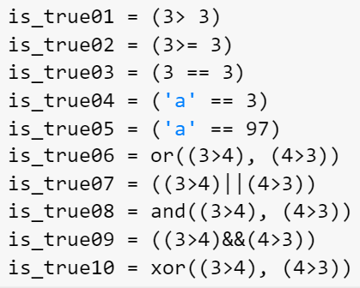
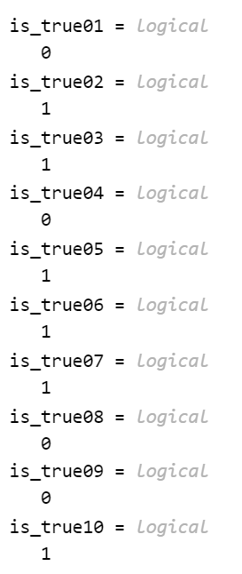
Example: Relational Expressions

Slide 4
The “is” Functions
There are many “is” functions in MATLAB that essentially ask a true/false question, and return logical 1 for true or 0 for false
isscalar returns logical 1 (true) if size(A) returns [1 1], and logical 0 (false) otherwise.
isvector returns logical 1 (true) if size(A) returns [1 n] or [n 1] with a nonnegative integer value n, and logical 0 (false) otherwise.
ismatrix returns logical 1 (true) if size(V) returns [m n] with nonnegative integer values m and n, and logical 0 (false) otherwise.
isrow returns logical 1 (true) if size(V) returns [1 n] with a nonnegative integer value n, and logical 0 (false) otherwise.
iscolumn returns logical 1 (true) if size(V) returns [n 1] with a nonnegative integer value n, and logical 0 (false) otherwise.

Slide 5
The “is” Functions (Continue)
isempty returns 1 if the variable argument is empty, or 0 if not.
ischar returns logical 1 (true) if A is a character array and logical 0 (false) otherwise.
isspace returns a logical array TF. If A is a character array or string scalar, then the elements of TF are logical 1 (true) where corresponding characters in A are space characters, and logical 0 (false) elsewhere. isspace recognizes all Unicode® whitespace characters.
isletter returns 1 or 0 for every character in a string – whether it is a letter of the alphabet or not.

Slide 6
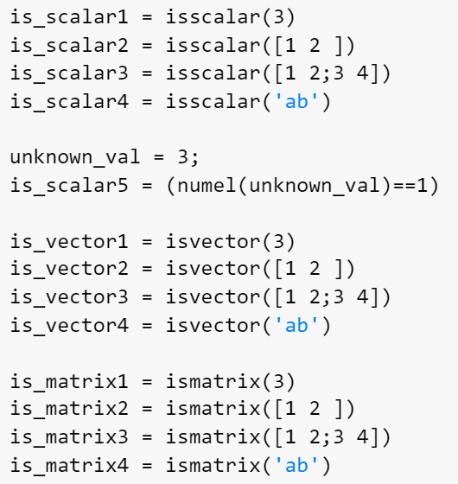
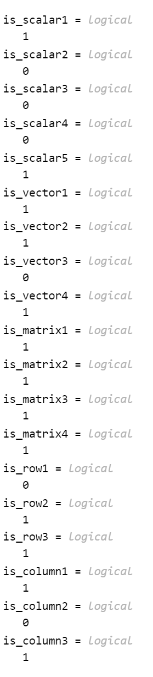
Example: isscalar, isvector, and ismatrix
A scalar is considered to be a 1 x 1 vector or 1 x 1 matrix.
A n x 1 vector is considered to be a n x 1 matrix.

Slide 7
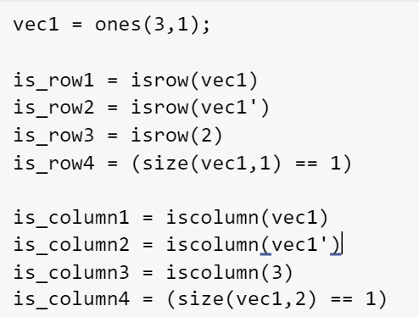
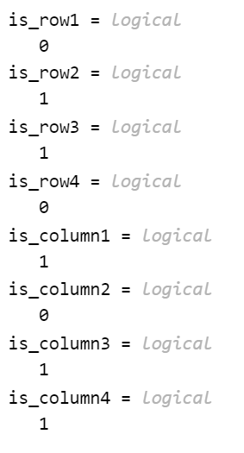
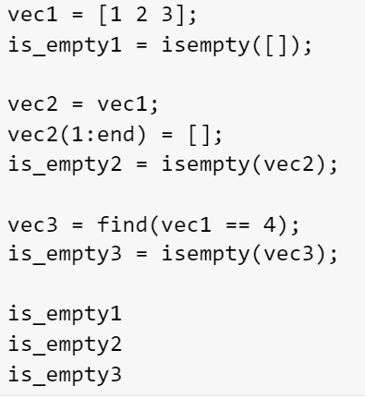
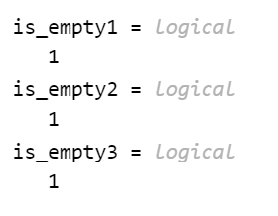
Example: isrow, iscolumn, isempty

Slide 8
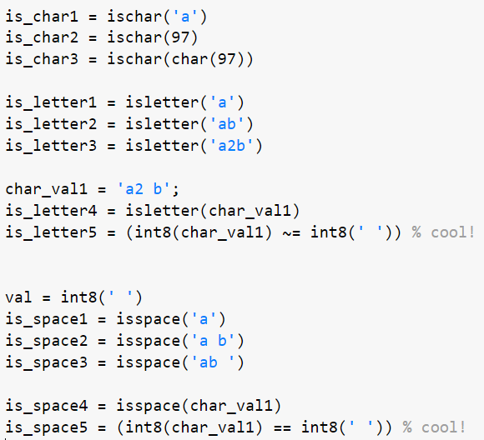
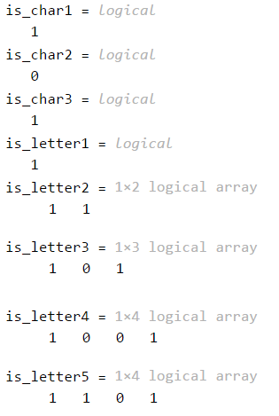
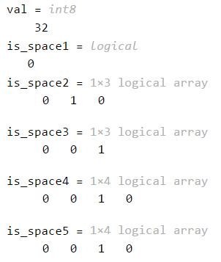
Example: ischar, isletter, and isspace

Slide 9
If Statement
The if statement is used to determine whether or not a statement or group of statements is to be executed
General form:
if condition
action
end
the condition is any relational expression
the action is any number of valid statements (including, possibly, just one)
if the condition is true, the action is executed – otherwise, it is skipped entirely

Slide 10
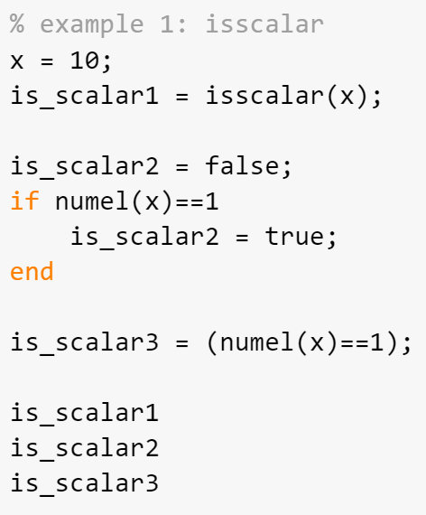
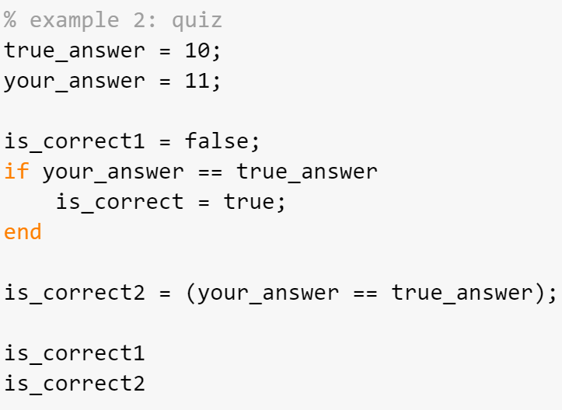
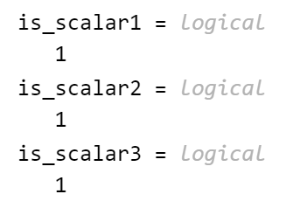
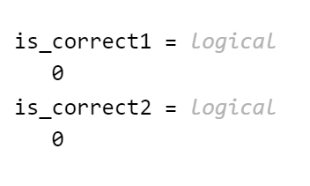
Example: Simple Examples

Slide 11
Representing True/False Concepts
Note: to represent the concept of false, 0 is used. To represent the concept of true, any nonzero value can be used – so expressions like 5 or ‘x’ result in logical true
This can lead to some common logical errors
For example, the following expressions are always true (because the “relational expressions” on the right, 6 and ‘N’, are nonzero so they are true; therefore, it does not matter what the results of the others are):
(number < 5) || 6
(letter == ‘n’) || ‘N’
You always check your answers.

Slide 12
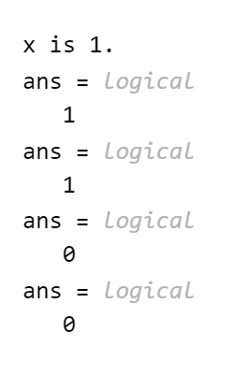
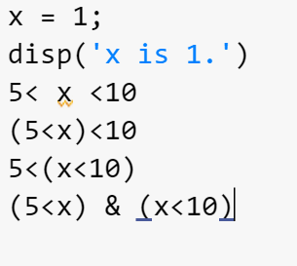
Revisit: Operator Precedence
How to make an expression of ? in other words, how to write a code to check if x lies in between 5 and 10. If yes, 1 and otherwise 0.

Slide 13
If-else Statements
The if-else statement chooses between two actions
General form:
if condition
action1
else
action2
end
One and only one action is executed; which one depends on the value of the condition (action1 if it is logical true or action2 if it is false)

Slide 14
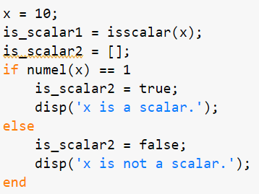
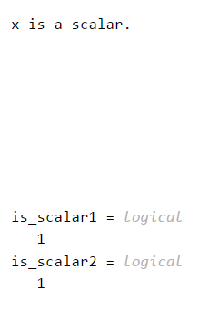
Revisit: Simple Example

Slide 15
If-else Statements are not Always Necessary!
Simplify this statement:
if num < 0
num = 0;
else
num = num;
end
Answer:
if num < 0
num = 0;
end
The point is that the else clause does not accomplish anything, so it is not necessary … sometimes just an if statement is all you need!

Slide 16
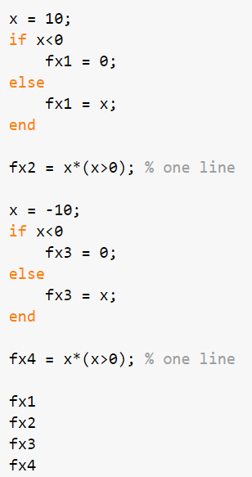
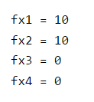
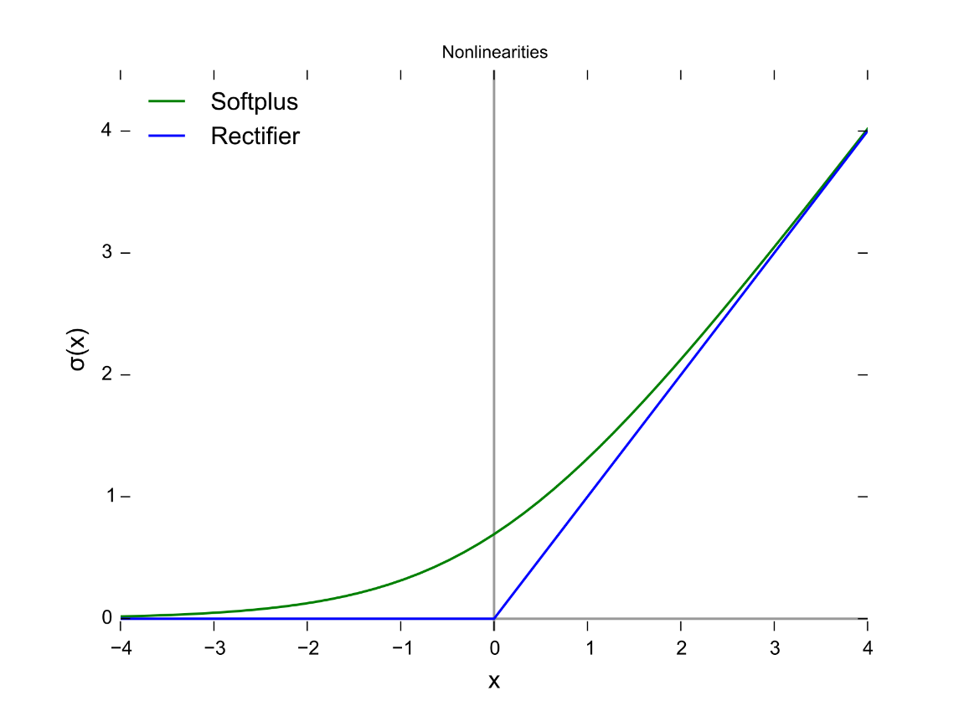

Example: Rectifier
$$f\left(x\right)=max⁡(0, x)$$
https://en.wikipedia.org/wiki/Rectifier_(neural_networks)

Slide 17
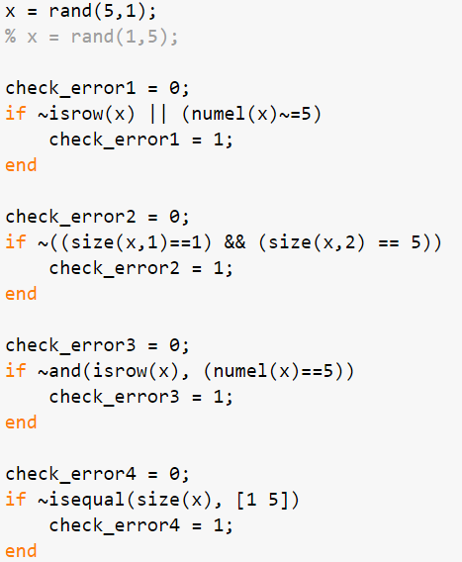
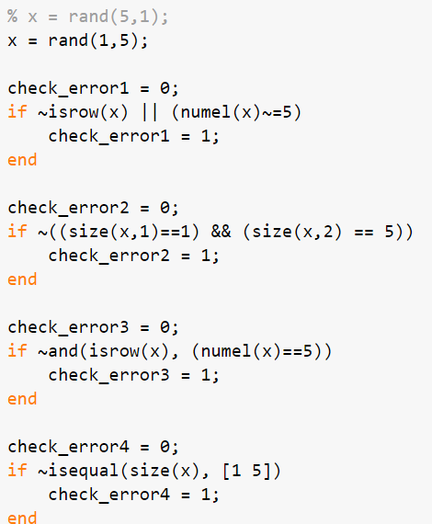
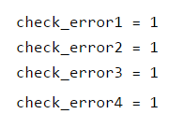
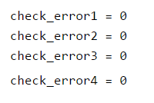
Example: Check a Dimension of Your Input Vector

Slide 18
Throwing an Error
MATLAB has an error function that can be used to display an error message in red, similar to the error messages generated by MATLAB
if radius <= 0
error('Sorry; %.2f is not a valid radius\n', radius)
else
% carry on
end
When an error is thrown in a script, the script stops executing

Slide 19
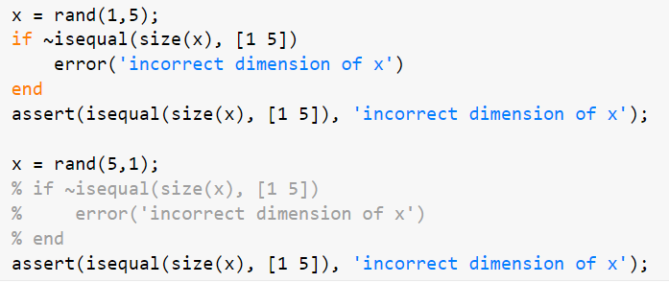
Example: Throwing an Error

Slide 20
Nested if-else Statements
To choose from more than two actions, nested if-else statements can be used (an if or if-else statement as the action of another)
General form:
if condition1
action1
else
if condition2
action2
else
if condition3
action3
% etc: there can be many of these
else
actionn % the nth action
end
end
end

Slide 21
The elseif Clause
MATLAB also has an elseif clause which shortens the code (and cuts down on the number of ends)
General form:
if condition1
action1
elseif condition2
action2
elseif condition3
action3
% etc: there can be many of these
else
actionn % the nth action
end

Slide 22
The elseif Clause is Not Always Necessary!
Simplify this statement:
if val >= 4
disp('ok')
elseif val < 4
disp('smaller')
end
Answer:
if val >= 4
disp('ok')
else
disp('smaller')
end
The point is that if you get to the else clause, you know that the expression val >= 4 is false – so, val must be less than 4 so there is no need to check that.

Slide 23
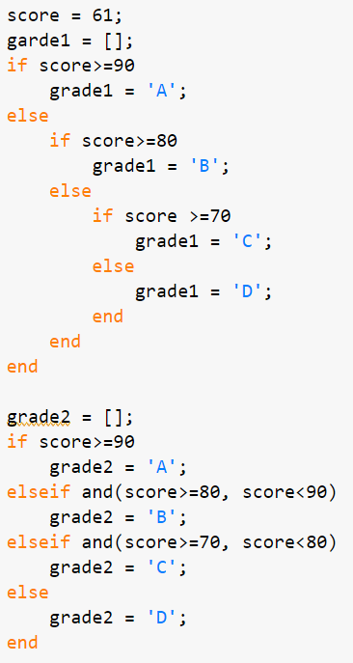

Example: Grading
Write a program that gives a grade based on a score. A: >=90, B: 80~90, C:70~80, D: <70

Slide 24
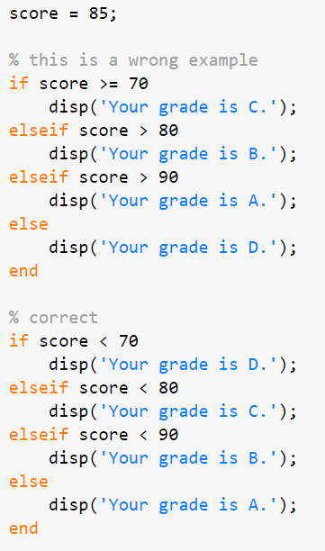


Example: Correct Use of elseif Statement

Slide 25
The Switch Statement
The switch statement can frequently be used in place of a nested if-else statement
General form:
switch switch_expression
case caseexp1
action1
case caseexp2
action2
case caseexp3
action3
% etc: there can be many of these
otherwise
actionn
end
this can be used when comparing the switch_expression to see if it is equal to the values on the case labels (the otherwise clause handles all other possible values)

Slide 26
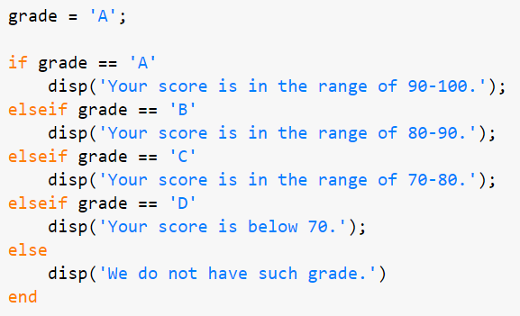
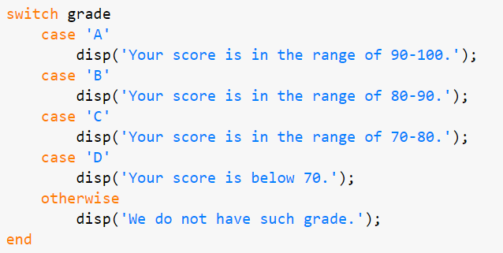
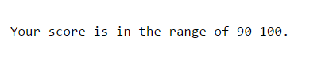
Example: Switch Statement
Let's write a code for conducting an opposite action. A program tells you the score range when you type your grade.

Slide 27
Common Pitfalls
Some common pitfalls have been pointed out already; others include:
Using = instead of == for equality in conditions
Putting a space in the keyword elseif
Not using quotes when comparing a string variable to a string, such as
letter == y
instead of
letter == 'y'
Writing conditions that are more complicated than necessary, such as
if (x < 5) == 1 instead of just if (x < 5)

Slide 28
Programming Style Guidelines
Use indentation to show the structure of a script or function. In particular, the actions in an if statement should be indented.
When the else clause isn’t needed, use an if statement rather than an if-else statement
CTRL + I : Smart Indent

Slide 29
Slide Credits and References
Stormy Attaway, 2018, Matlab: A Practical Introduction to Programming and Problem Solving, 5th edition
Lecture slides for “Matlab: A Practical Introduction to Programming and Problem Solving”
Holly Moore, 2018, MATLAB for Engineers, 5th edition

