Slide 1
Built-in Functions
Chul Min Yeum
Assistant Professor
Civil and Environmental Engineering
University of Waterloo, Canada
AE121: Computational Method
Last updated: 2019-04-30

Slide 2
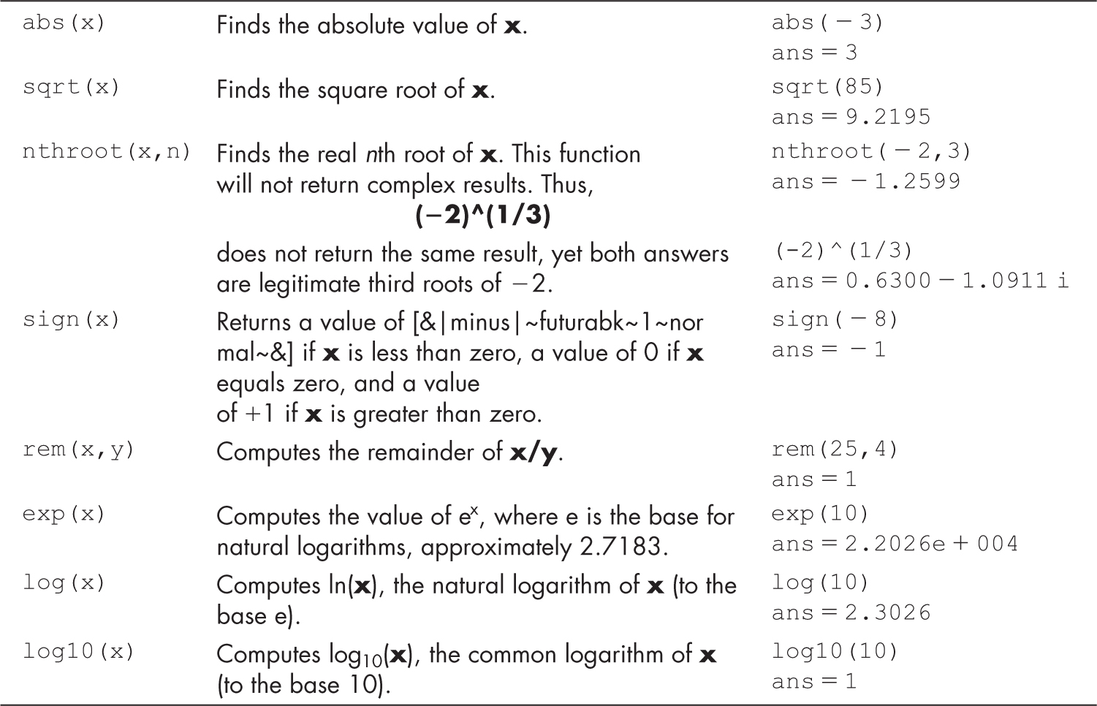
Common Math Functions
Return – is x is less than zero, a value of 0 if x equals zero, and a value of +1 if x is greater than zero

Slide 3
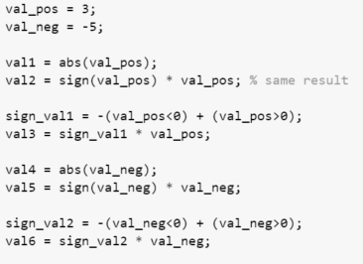




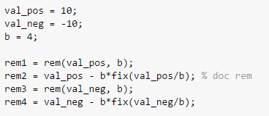
Example: Common Math Functions

Slide 4
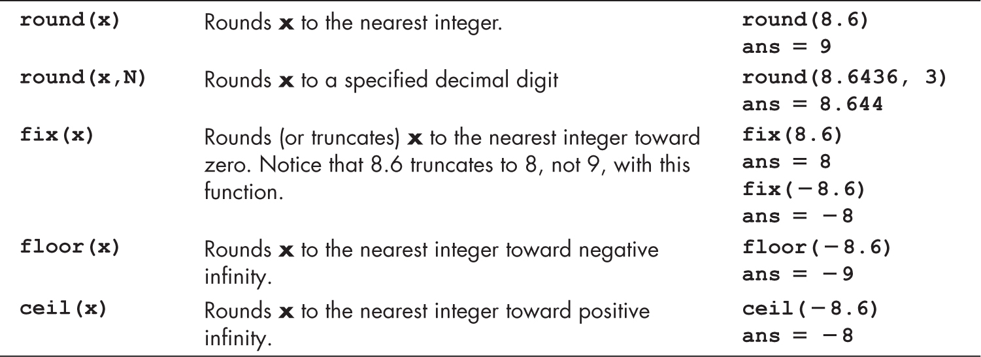
Rounding Functions
Truncates

Slide 5
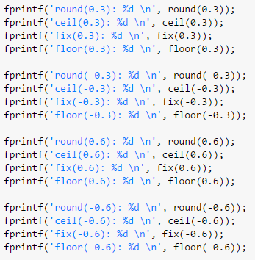
Example: Rounding Functions
 | round | ceil | fix | floor
0.3 | 0 | 1 | 0 | 0
-0.3 | 0 | 0 | 0 | -1
0.6 | 1 | 1 | 0 | 0
-0.6 | -1 | 0 | 0 | -1

Slide 6
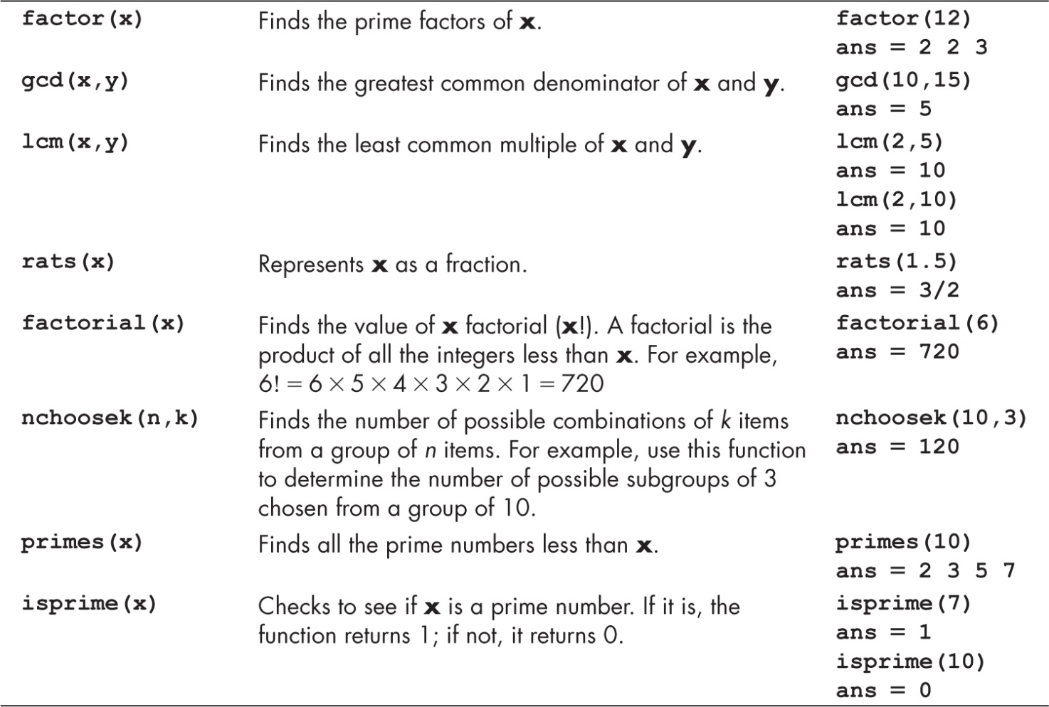
Function Used in Discrete Mathematics

Slide 7
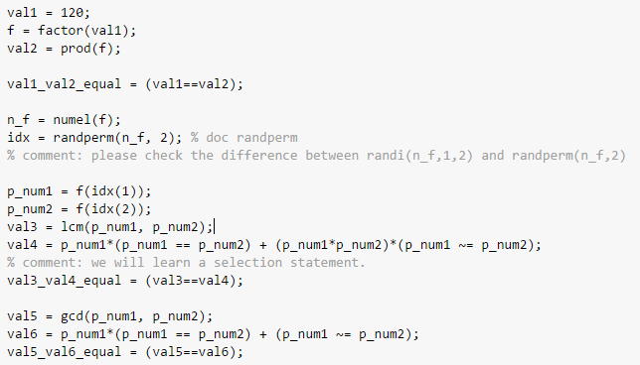
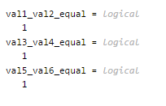
Example: factor(x), gcd(x,y), and lcm(x,y)

Slide 8
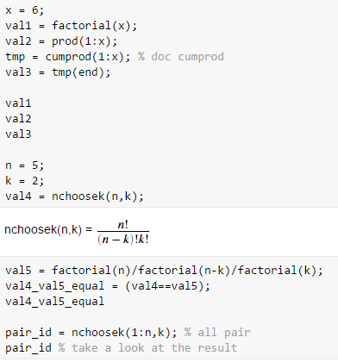
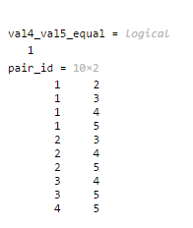

Example: factorial(x) and nchoosek(n,k)

Slide 9
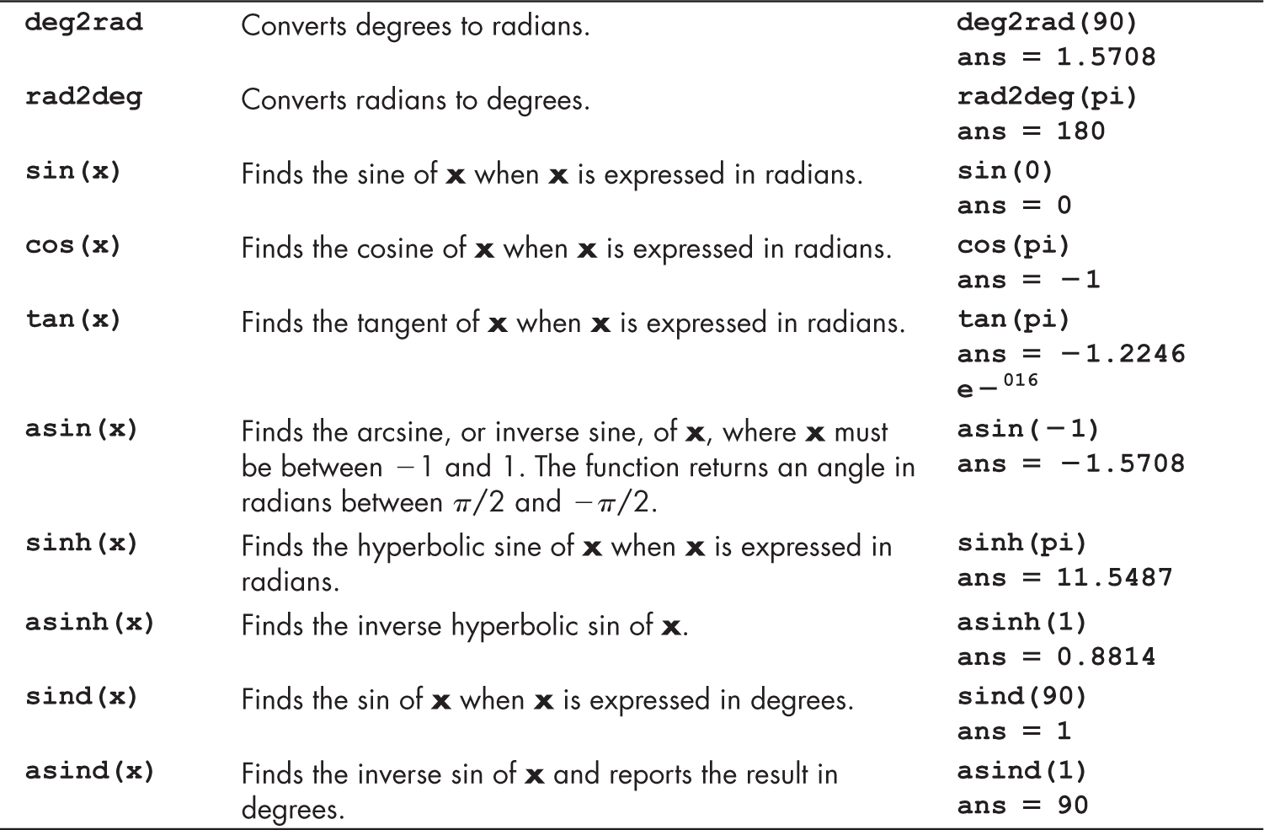
Some of the Available Trigonometric Functions

Slide 10
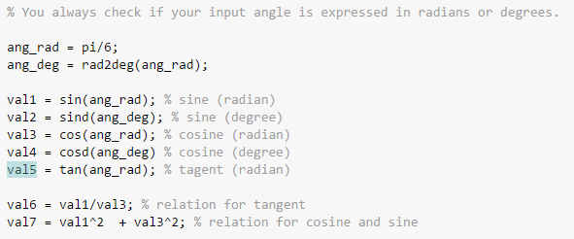
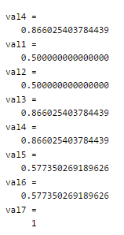
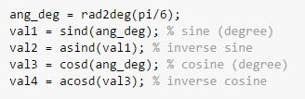
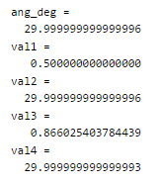
Example: Trigonometric Functions
Why isn’t 30 degrees?

Slide 11
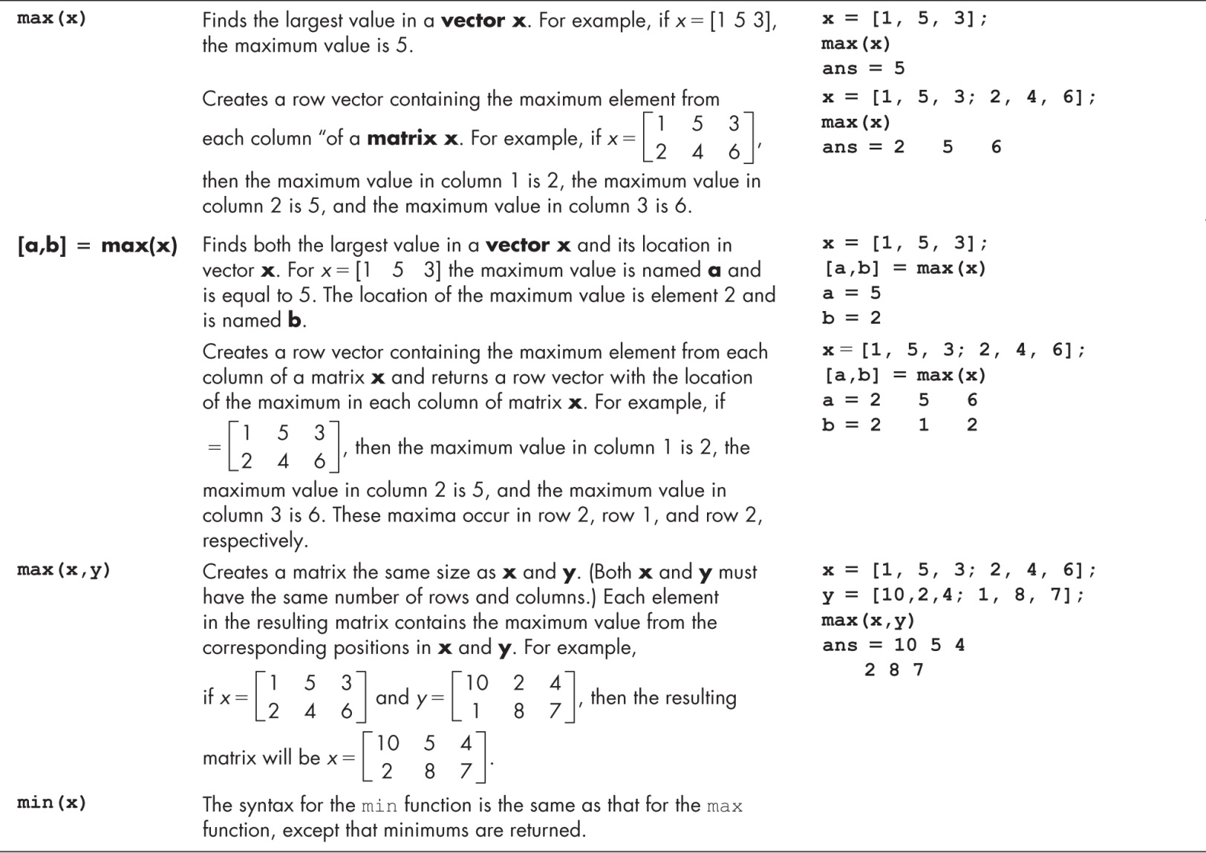
Maxima and Minima

Slide 12
Maxima and Minima (Continue)

Slide 13
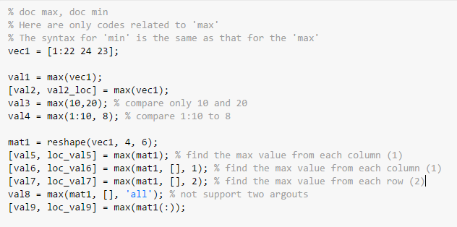
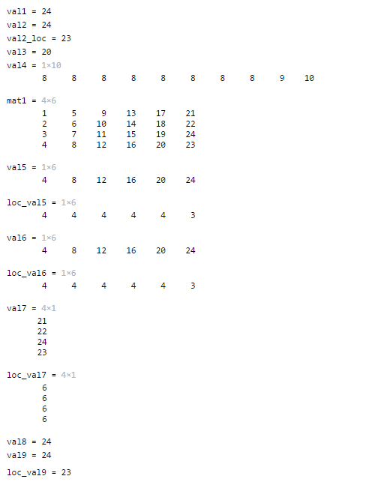
Example: Maxima and Minima

Slide 14
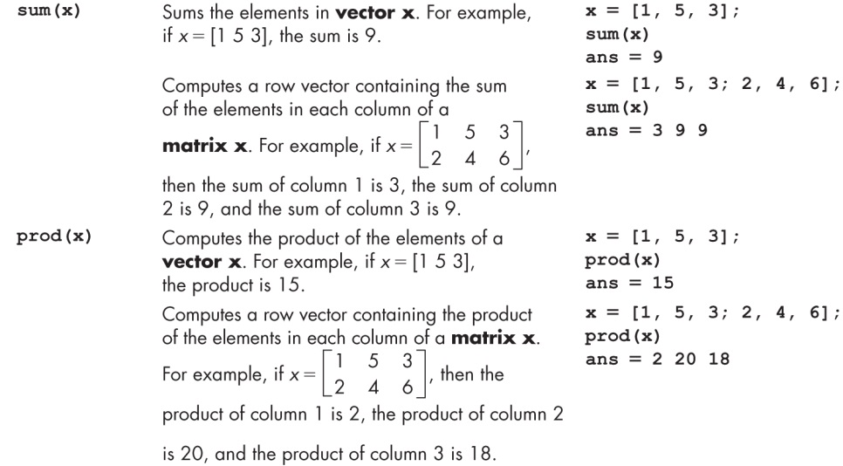
Sums and Products

Slide 15
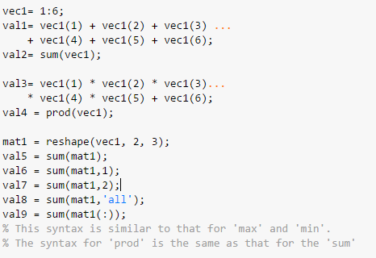
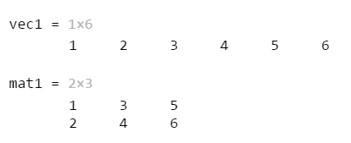
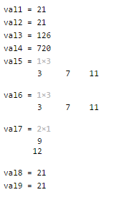
Example: Sum and Product

Slide 16
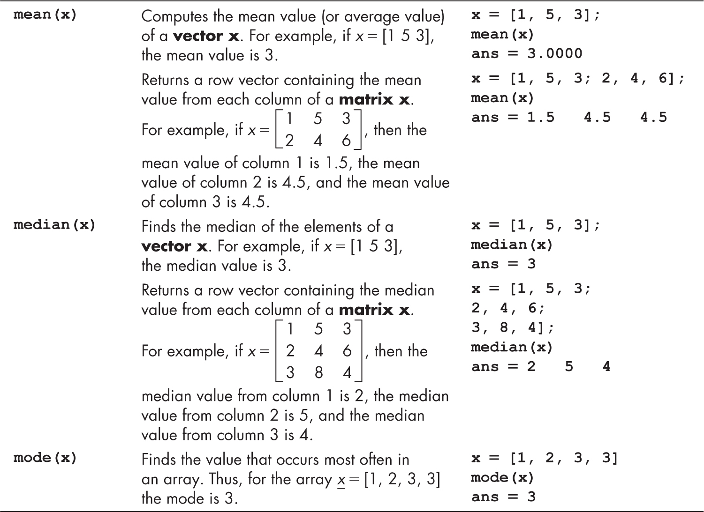
Averages

Slide 17
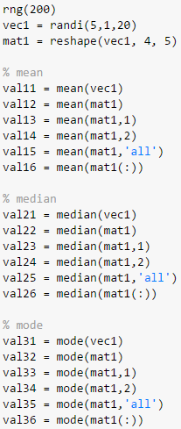
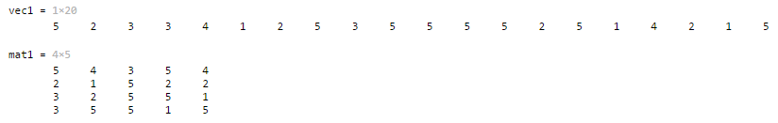
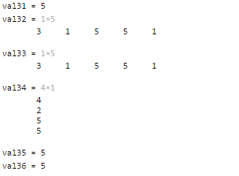
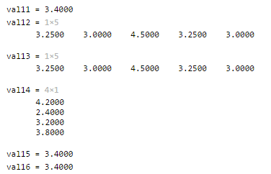
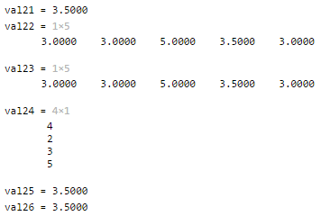
Example: Averages
similar structure

Slide 18
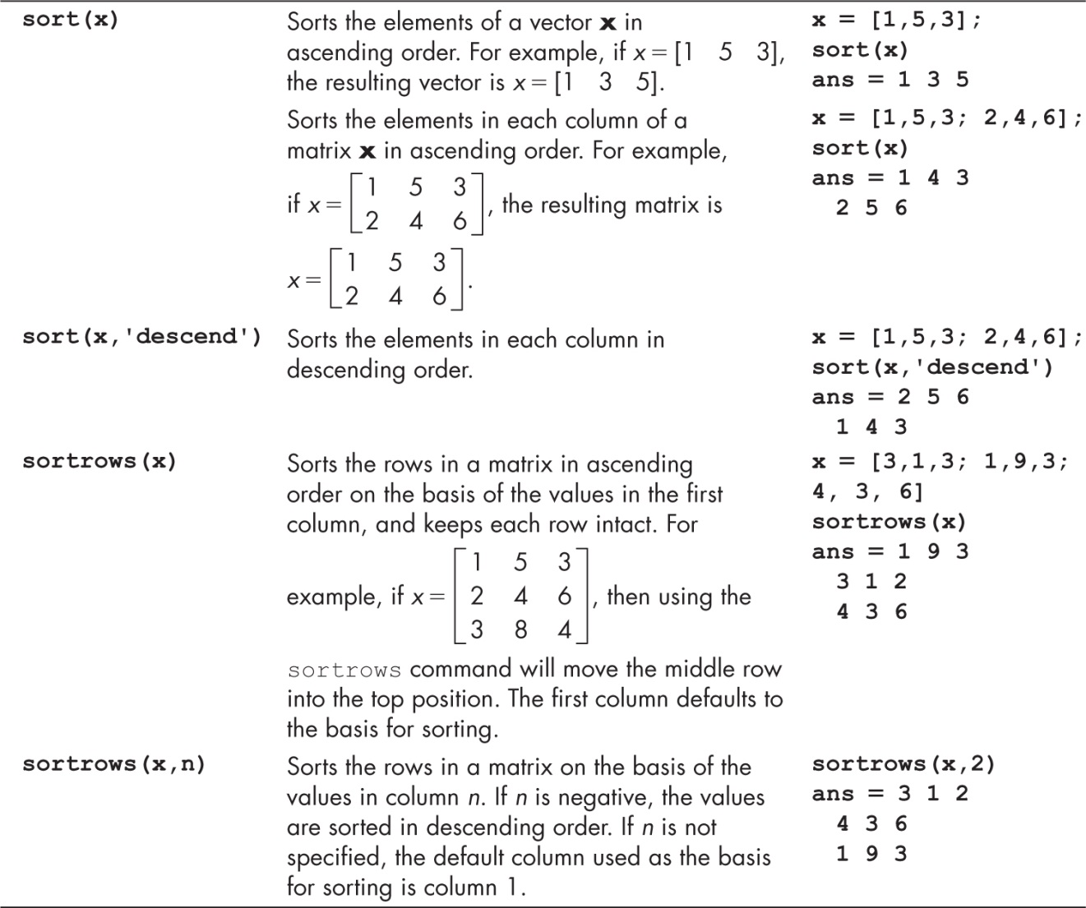

Sorting Functions
$$x=\left[\begin{matrix}1 & 4 & 3 \\ 2 & 5 & 6\end{matrix}\right]$$

Slide 19
Sorting Functions (Continue)

Slide 20
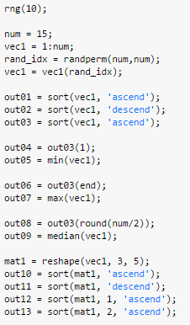
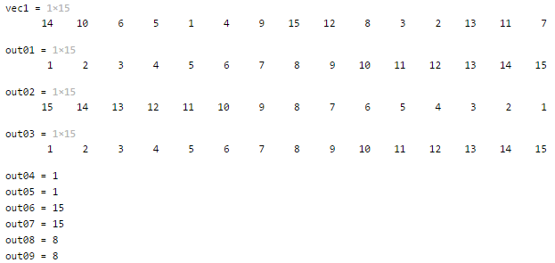
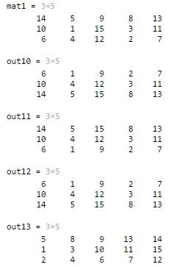
Example: Sort

Slide 21
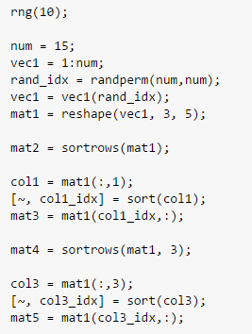
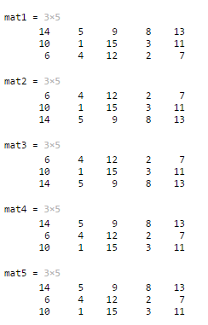
Example: sortrows

Slide 22
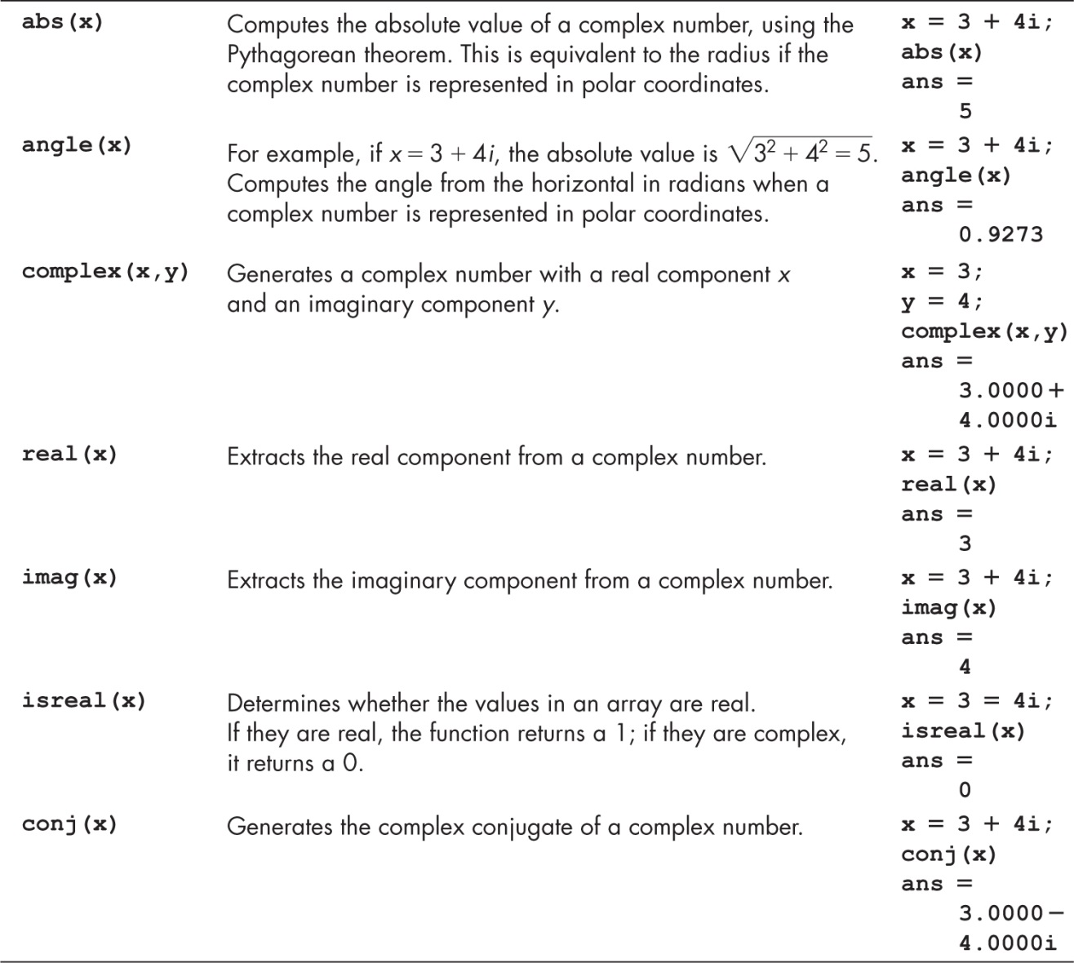
Functions Used with Complex Numbers

Slide 23
Functions Used with Complex Numbers (Continue)

Slide 24
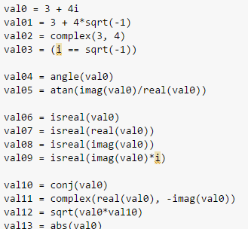
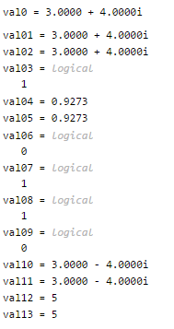
Example: Complex Numbers

Slide 25
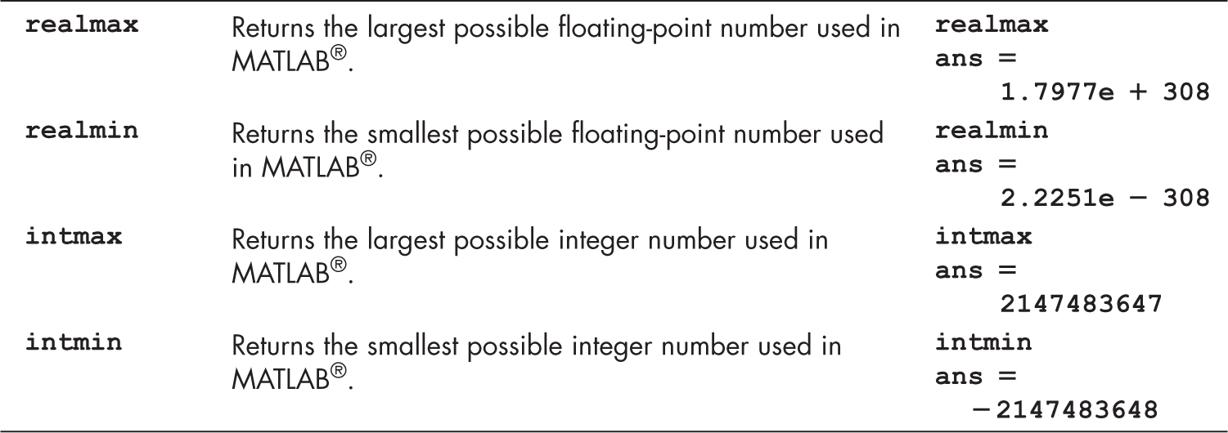
Computational Limits
eps : Floating-point relative accuracy
https://www.mathworks.com/matlabcentral/answers/57444-faq-why-is-0-3-0-2-0-1-not-equal-to-zero

Slide 26
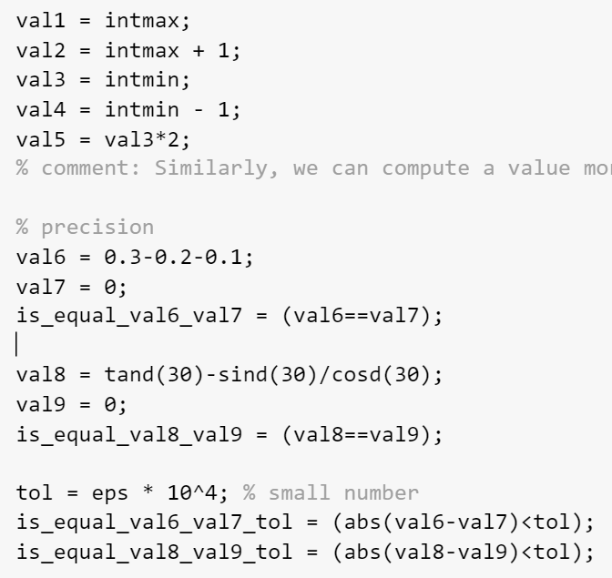
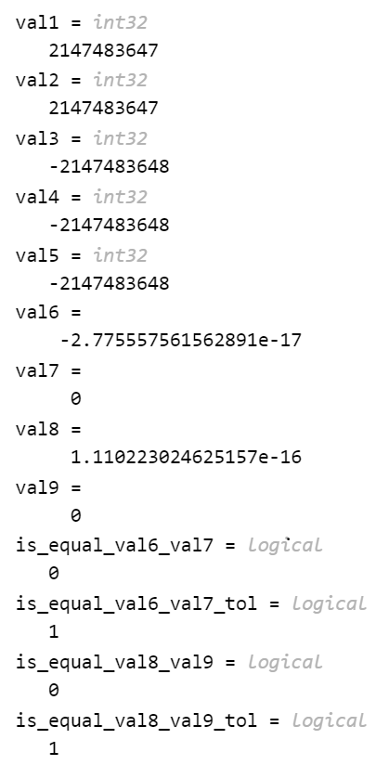
Example: Computational Limit
Precision!

Slide 27
Array Operations
reshape changes dimensions of a matrix to any matrix with the same number of elements
diag create diagonal matrix or get diagonal elements of matrix
rot90 rotates a matrix 90 degrees counter-clockwise
fliplr flips columns of a matrix from left to right
flipud flips rows of a matrix up to down
flip flips a row vector left to right, column vector or matrix up to down
repmat replicates an entire matrix; it creates m x n copies of the matrix
repelem replicates each element from a matrix in the dimensions specified

Slide 28
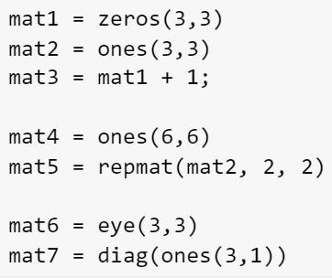
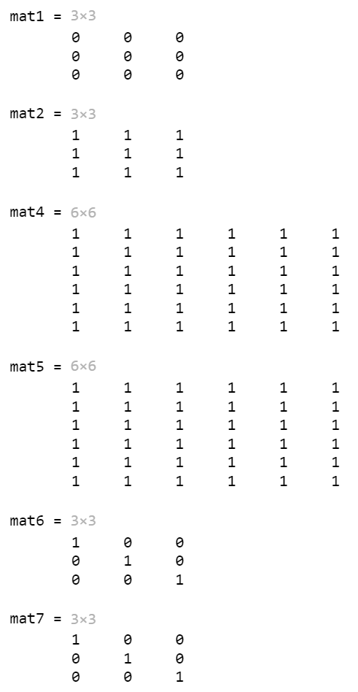
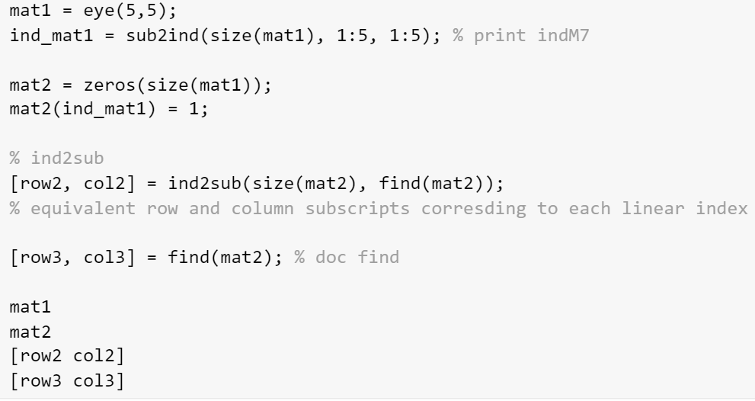
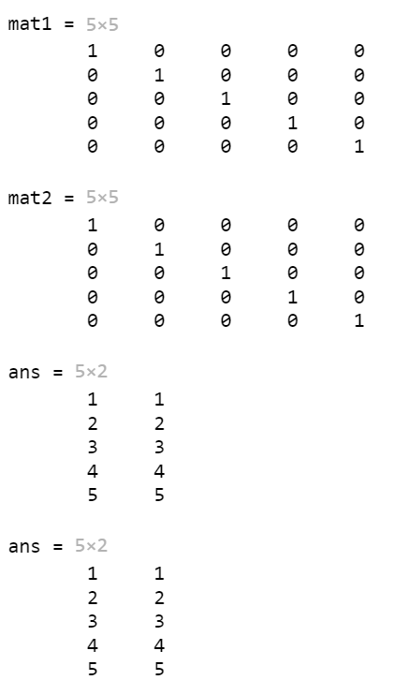
Example: Create and Index Arrays

Slide 29
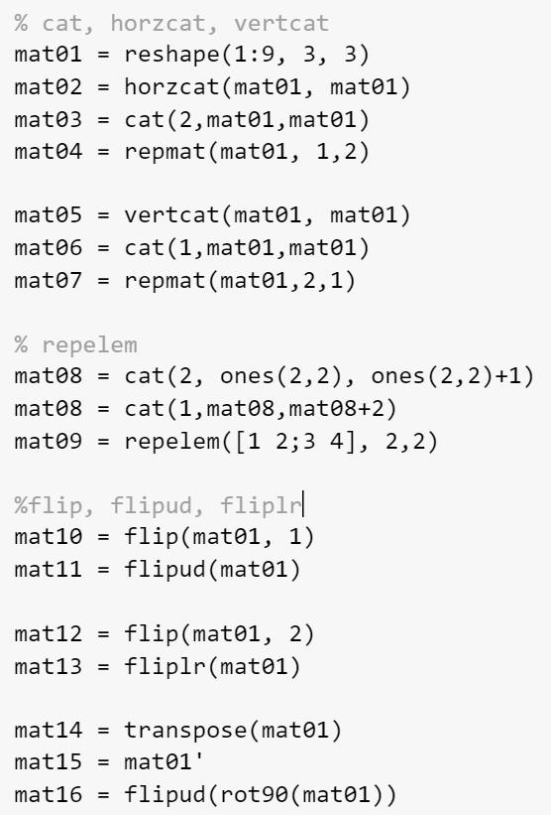
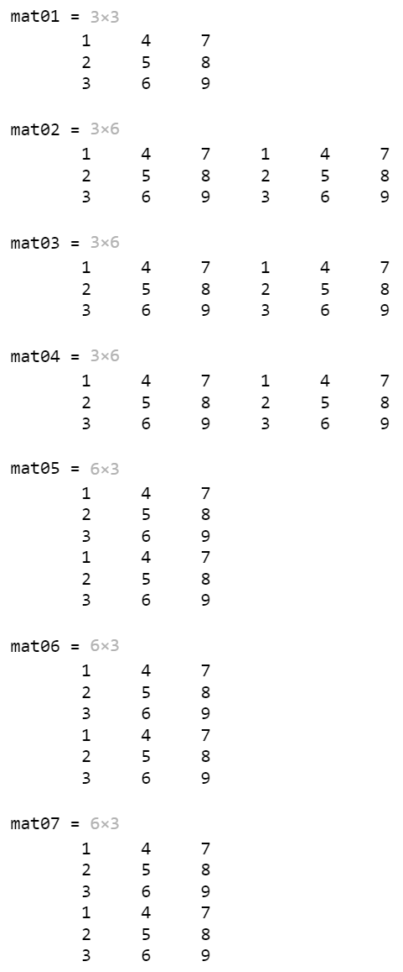
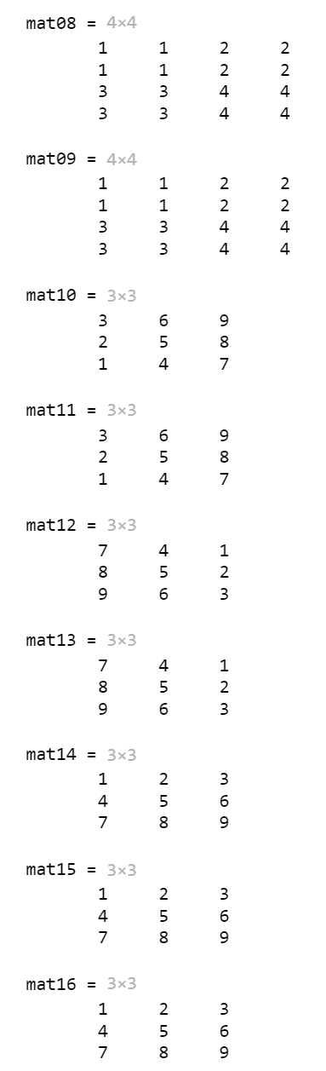
Example: Combine and Transform Array

Slide 30
Slide Credits and References
Stormy Attaway, 2018, Matlab: A Practical Introduction to Programming and Problem Solving, 5th edition
Lecture slides for “Matlab: A Practical Introduction to Programming and Problem Solving”
Holly Moore, 2018, MATLAB for Engineers, 5th edition

