Slide 1

How Popular is
my Birthday?
Springboard Data Storytelling
For Non Technical, Non Executive Audience
Anne Warren
The Jupyter Notebook is available on Github:
https://github.com/Aurenkeelin18/TheFoxerine/blob/master/DataStorytelling_HappyBirthday/DataStorytelling_HappyBirthday.ipynb
Picture from https://www.paws2purrfection.com/customized-birthday-cakes-for-dogs-blue-skull-theme/

Slide 2
The Data: U.S. Births (1994-2014)
Article written by Ravi Charan in Towards Data Science “How Popular is your Birthday?” that discussed the uniform birthday problem and created a model to understand the variations in birth
https://towardsdatascience.com/how-popular-is-your-birthday-91ab133f7fc4
After reading still wondering “How Popular is MY Birthday”: March 13th
Original article written by Carl Bialik "Some people are too superstitious to have a baby on Friday the 13th“. I celebrated my 13th birthday on a Friday.
https://fivethirtyeight.com/features/some-people-are-too-superstitious-to-have-a-baby-on-friday-the-13th/
Data from the National Center for Health Statistics (1994-2003) and the Social Security Administration (2000-2014).
https://github.com/fivethirtyeight/data/tree/master/births
Two stories already told from one data set. Here is a third (more granular) one...
Notes:
I read an article written by **Ravi Charan** in **Towards Data Science** that discussed the uniform birthday problem and created a model to understand the variations in birth https://towardsdatascience.com/how-popular-is-your-birthday-91ab133f7fc4] .
Thought the article was interesting I did not think the content of the article was really answering the question raised in the title **"How Popular is your Birthday"**, as in "How Popular is **MY** Birthday" **:)** So I set out to get the data https://github.com/fivethirtyeight/data/tree/master/births] and look into it.
This is the (granular) story...
The title of the original article written by Carl Bialik "Some people are too superstitious to have a baby on friday the 13th" amused me because my 13th birthday was a Friday and I was born at 13h00. [https://fivethirtyeight.com/features/some-people-are-too-superstitious-to-have-a-baby-on-friday-the-13th/]

Slide 3
The Thinking and The Questions
Birth may happen naturally or can be induced for practical or medical reasons.
According to the CDC the current rate of induction is 23% and the trend has been decreasing.
[https://www.cdc.gov/nchs/products/databriefs/db155.htm]
In other words induction is not a discrete practice, probably happening all year long.
My questions are:
Which birthdays have the most births? the least births?
Is it consistent throughout the years (1994-2014)?
What about births on my birthday (March 13th)?
How many kids are part of the "13th Birthday on Friday 13th" VIP13 club (like I do)?
Notes:
Birth may happen naturally or can be induced for practical or medical reasons. According to the CDC the current rate of induction is 23% and "Trends in induction rates vary by gestational age, with rates for most gestational age groups declining since 2010. Induction rates for births at 36, 37, and 38 weeks have declined since 2006, with the largest decrease at 38 weeks." [https://www.cdc.gov/nchs/products/databriefs/db155.htm] In other words there is no need to bother looking at births happening around major holidays because the rate of induction suggests it is not a discrete practice.
My questions are:
- which birthday has the most births? the least birth? is it consistent throughout the years (1994-2014)?
- where does my birthday (03/13) stand?
- how many kids are part of the "13 on Friday 13th" VIP club (like I do)?

Slide 4
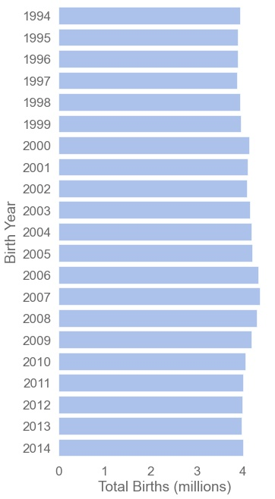
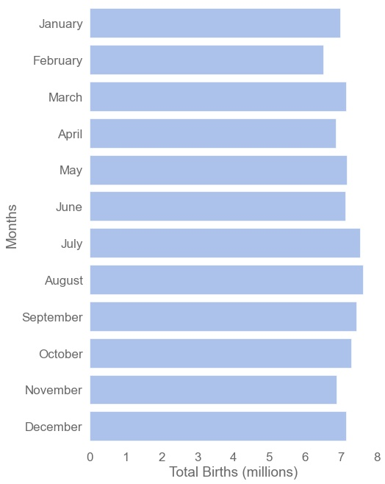
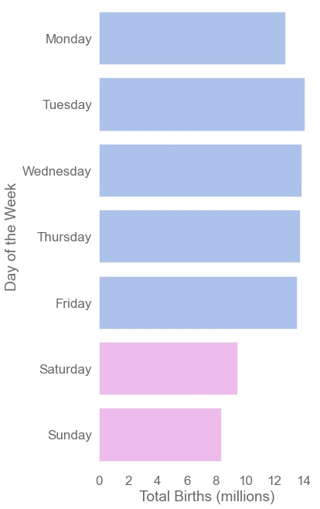
Overview of U.S. Births (1994-2014)
~4.08 millions per Year
No Leading Month
Rather on Weekdays
Notes:
There is an average of 4.1 million births in the U.S. each year from 1994 to 2014, ranging from 3.88 to 4.38 millions. This makes a total of 85.71 million babies born in the U.S. between 1994 and 2014. All in all there is not a huge variation of the total births throughout the years.
The distribution of births within months does not show much variation. It tends to reflect the number of days that contains each months i.e. months with 31 days tends to dominate, except September which bears more births than October.
Births tends to happen rather during the week than during the weekend. There were 8 to 9 million births on Saturday and Sunday, while there is at least 13 million births each weekday.

Slide 5
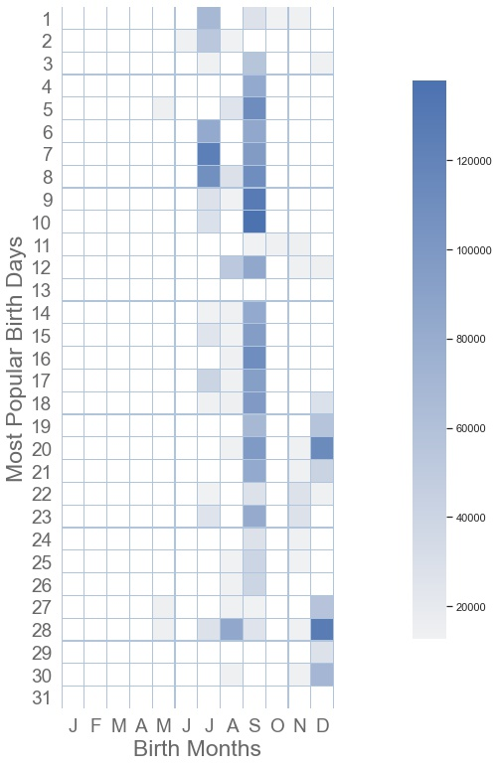
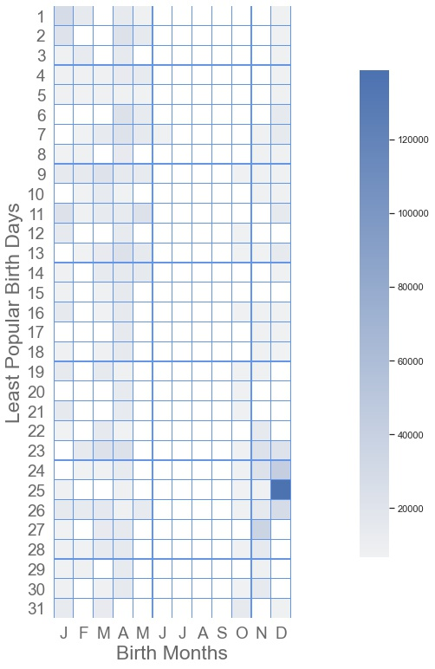
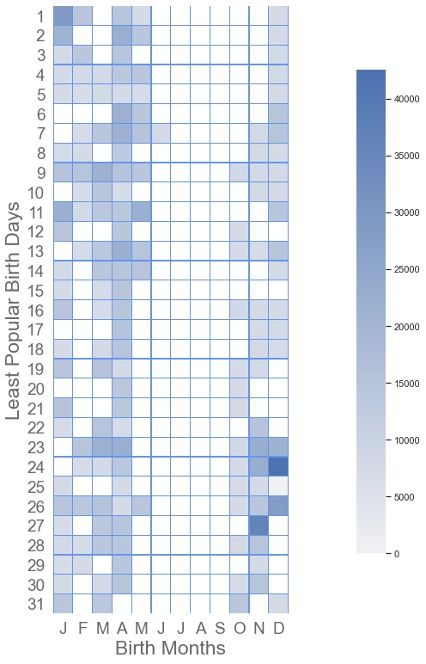
Most Births? Least Births?
Popular: 2nd semester
Least Popular
Least Popular*: Not Summer
September
Me
Xmas
*least popular birthday distribution after removing Xmas
Notes:
It is clear from the heatmap that the most popular birthdays occur in the second half of the year, with a clear concentration in September. Note the concentrations around the week of christmas (12/25) and independence day (07/04).
The least popular birthdays can be summarized as "not in Summer'. Interestingly christmas (12/25) showed one of the lowest daily births for some years, but when cumulated over 21 years it turns out to be a popular birthday.
Once christmas is removed from the least popular birthdays, the picture is clearer. We can see that christmas eve (12/24) and the new year (01/01) come second and third in the most popular of the unpopular. The month with the less popular birthdays are foudn in January, February and March.

Slide 6
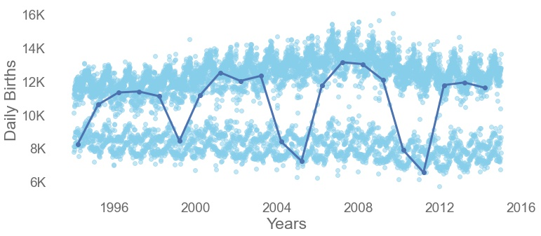
March 13th through time (1994-2014)
Being born is a process. On March 13th it’s a 5 year cycle.
224,642 americans were born on March 13th between 1994 and 2014.
Popular Birthdays
Unpopular Birthdays
Notes:
224,642 babies were born on March 13th between 1994 and 2014. The 'March 13th' time series plot shows an interesting cyclicity. The birth rate on March 13th tends to drop dramatically (-6,000) every five years.

Slide 7
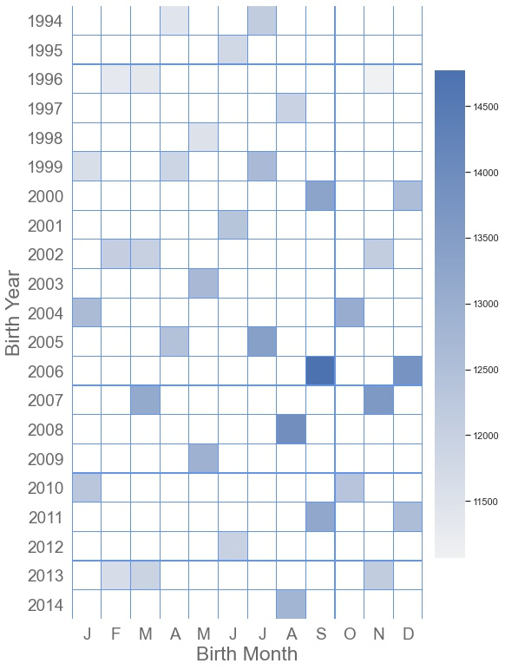
VIP13 Club: 13 on Friday 13th
The VIP Club from 1994 to 2014:
Welcome 460,584 new members who have celebrated or will celebrate their 13th birthday on a Friday 13th. (0.5% of babies born)
48,453 members were born on March 13th . (0.06% of babies born)
Note that March 13th 2013 fell on a Wednesday.
Notes:
The VIP Club from 1994 to 2014:
- welcome 460,584 new members who have celebrated or will celebrate their 13th birthday on a Friday 13th. This represent 0.5% of the 85.7 millions babies born between 1994 and 2014.
- 48,453 members were born on March 13th. This represent 0.06% of the 85.7 millions babies born between 1994 and 2014.
- Note that March 13th 2013 fell on a Wednesday.

Slide 8
Summary & Conclusion
U.S. Birth data from 1994 to 2014 showed:
About 4 million births per year.
Birth is more likely to happen on weekdays than weekends.
Most births happen in Summer. The most popular birth month is September.
Xmas is a cumulative popular birthday, though it falls in the unpopular birthday when looking at individual years.
March 13th:
March 13th births time series shows cyclicity.
Every 5 years births drop to unpopular rates.
224,642 americans were born on March 13th between 1994 and 2014.
VIP Club, born on a 13th:
Almost ½ a million americans were born on 13th between 1994 and 2014 and have
celebrated or will celebrate their 13th birthday on a Friday.
Among them 48,453 were born on March 13th.
Going Further with the Data: The dataset has many more stories to tell!
Notes:
Birth may happen naturally or can be induced for practical or medical reasons. According to the CDC the current rate of induction is 23% and "Trends in induction rates vary by gestational age, with rates for most gestational age groups declining since 2010. Induction rates for births at 36, 37, and 38 weeks have declined since 2006, with the largest decrease at 38 weeks." [https://www.cdc.gov/nchs/products/databriefs/db155.htm] In other words there is no need to bother looking at births happening around major holidays because the rate of induction suggests it is not a discrete practice.
My questions are:
- which birthday has the most births? the least birth? is it consistent throughout the years (1994-2014)?
- where does my birthday (03/13) stand?
- how many kids are part of the "13 on Friday 13th" VIP club (like I do)?

