Slide 1

How Popular is
my Birthday?
Springboard Data Storytelling
For Non Technical, Non Executive Audience
Anne Warren
Picture from https://www.paws2purrfection.com/customized-birthday-cakes-for-dogs-blue-skull-theme/

Slide 2
The Data: U.S. Births (1994-2014)
Article written by Ravi Charan in Towards Data Science “How Popular is your Birthday?” that discussed the uniform birthday problem and created a model to understand the variations in birth
https://towardsdatascience.com/how-popular-is-your-birthday-91ab133f7fc4
After reading still wondering “How Popular is MY Birthday”: March 13th
Original article written by Carl Bialik "Some people are too superstitious to have a baby on Friday the 13th“. I celebrated my 13th birthday on a Friday.
https://fivethirtyeight.com/features/some-people-are-too-superstitious-to-have-a-baby-on-friday-the-13th/
Data from the National Center for Health Statistics (1994-2003) and the Social Security Administration (2000-2014).
https://github.com/fivethirtyeight/data/tree/master/births
Two stories already told from one data set. Here is a third (more granular) one...
Notes:
I read an article written by **Ravi Charan** in **Towards Data Science** that discussed the uniform birthday problem and created a model to understand the variations in birth https://towardsdatascience.com/how-popular-is-your-birthday-91ab133f7fc4] .
Thought the article was interesting I did not think the content of the article was really answering the question raised in the title **"How Popular is your Birthday"**, as in "How Popular is **MY** Birthday" **:)** So I set out to get the data https://github.com/fivethirtyeight/data/tree/master/births] and look into it.
This is the (granular) story...
The title of the original article written by Carl Bialik "Some people are too superstitious to have a baby on friday the 13th" amused me because my 13th birthday was a Friday and I was born at 13h00. [https://fivethirtyeight.com/features/some-people-are-too-superstitious-to-have-a-baby-on-friday-the-13th/]

Slide 3
The Thinking and The Questions
Birth may happen naturally or can be induced for practical or medical reasons.
According to the CDC the current rate of induction is 23% and the trend has been decreasing.
[https://www.cdc.gov/nchs/products/databriefs/db155.htm]
In other words induction is not a discrete practice, probably happening all year long.
My questions are:
Which birthdays have the most births? the least births?
Is it consistent throughout the years (1994-2014)?
What about births on my birthday (March 13th)?
How many kids are part of the "13th Birthday on Friday 13th" VIP club (like I do)?
Notes:
Birth may happen naturally or can be induced for practical or medical reasons. According to the CDC the current rate of induction is 23% and "Trends in induction rates vary by gestational age, with rates for most gestational age groups declining since 2010. Induction rates for births at 36, 37, and 38 weeks have declined since 2006, with the largest decrease at 38 weeks." [https://www.cdc.gov/nchs/products/databriefs/db155.htm] In other words there is no need to bother looking at births happening around major holidays because the rate of induction suggests it is not a discrete practice.
My questions are:
- which birthday has the most births? the least birth? is it consistent throughout the years (1994-2014)?
- where does my birthday (03/13) stand?
- how many kids are part of the "13 on Friday 13th" VIP club (like I do)?

Slide 4
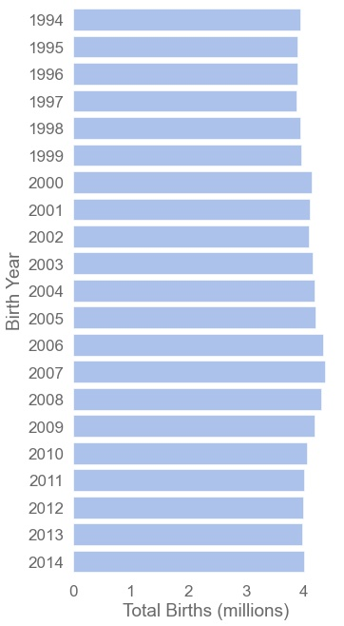
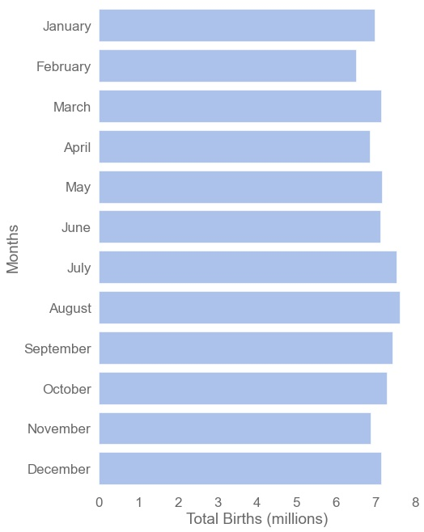
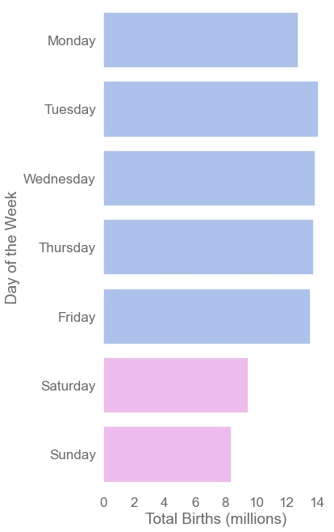
Overview of U.S. Births (1994-2014)
~4 millions per Year
No Leading Month
Rather on Weekdays

Slide 5
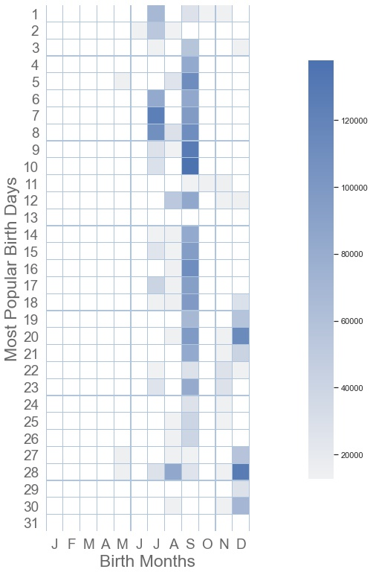
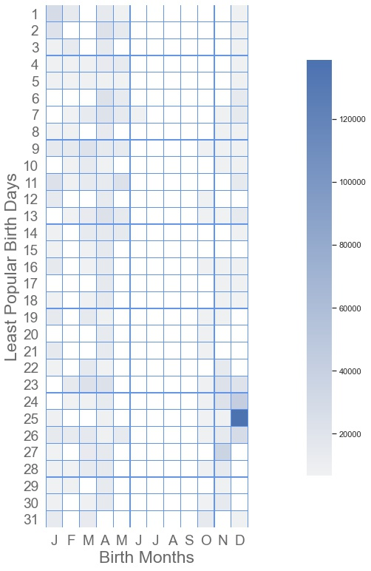
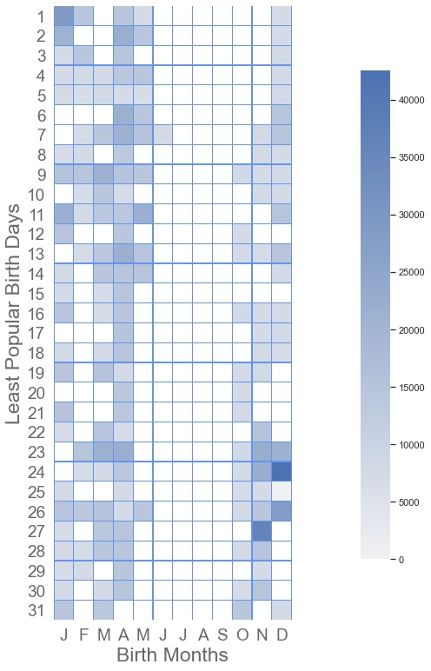
Most Births? Least Births?
Popular: 2nd semester
Least Popular
Least Popular*: Not Summer
September
Me
Xmas
*least popular birthday distribution after removing Xmas

Slide 6
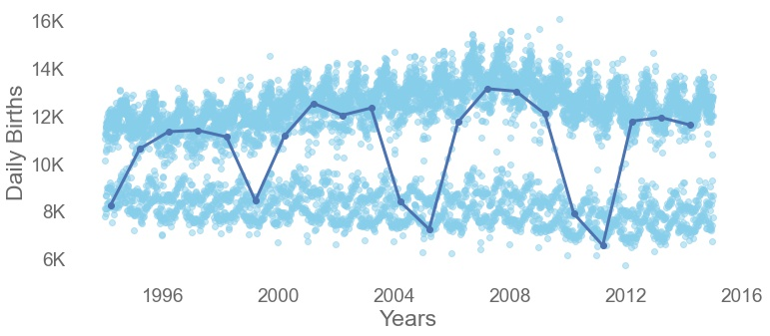
March 13th through time (1994-2014)
Being born is a process. On March 13th it’s a 5 year cycle.
224,642 americans were born on March 13th between 1994 and 2014.
Popular Birthdays
Unpopular Birthdays

Slide 7
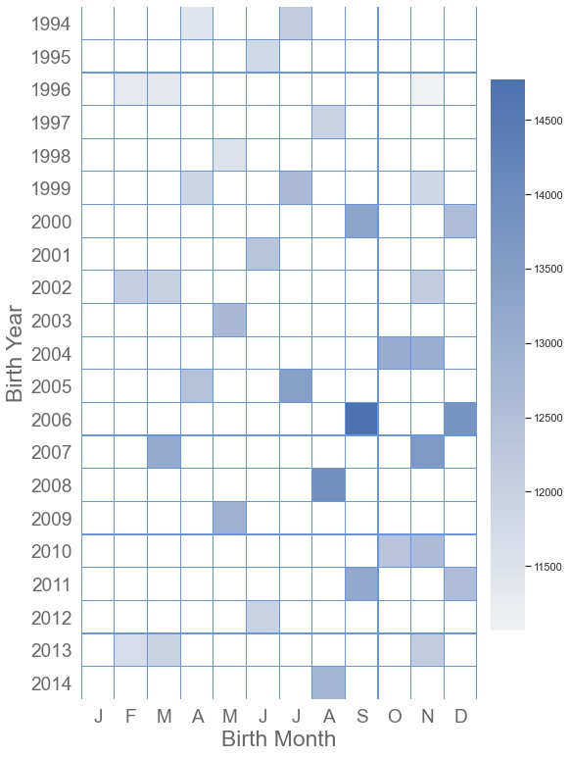
VIP Club: 13 on Friday 13th
New Members (1994-2014):
461,427 members
48,453 born on March 13th
None born in January

Slide 8
Summary & Conclusion
U.S. Birth data from 1994 to 2014 showed:
About 4 million births per year.
Birth is more likely to happen on weekdays than weekends.
Most births happen in Summer. The most popular birth month is September.
Xmas is a cumulative popular birthday, though it falls in the unpopular birthday when looking at individual years.
March 13th:
March 13th births time series shows cyclicity.
Every 5 years births drop to unpopular rates.
224,642 americans were born on March 13th between 1994 and 2014.
VIP Club, born on a 13th:
Almost ½ a million americans were born on 13th between 1994 and 2014 and have
celebrated or will celebrate their 13th birthday on a Friday.
Among them 48,453 were born on March 13th. None in January.
Going Further with the Data: The dataset has many more stories to tell!
Notes:
Birth may happen naturally or can be induced for practical or medical reasons. According to the CDC the current rate of induction is 23% and "Trends in induction rates vary by gestational age, with rates for most gestational age groups declining since 2010. Induction rates for births at 36, 37, and 38 weeks have declined since 2006, with the largest decrease at 38 weeks." [https://www.cdc.gov/nchs/products/databriefs/db155.htm] In other words there is no need to bother looking at births happening around major holidays because the rate of induction suggests it is not a discrete practice.
My questions are:
- which birthday has the most births? the least birth? is it consistent throughout the years (1994-2014)?
- where does my birthday (03/13) stand?
- how many kids are part of the "13 on Friday 13th" VIP club (like I do)?

