Slide 1

Database
By Charles Schmitz
May 2017

Slide 2
Table of contents
Table of contents…………………………………………2
Executive summary………………………………………3
E/R diagram……………………………………………….4
Tables…………………………………………………..5-16
Views………………………………………………….17-19
Stored Procedures……………………………………20-21
Trigger………………………………………………….…22
Reports………………………………………………..23-24
Roles………………………………………………..…25-26
Implementation Notes……………………………………27
Known Issues……………………………………….........28
Future Enhancements……………………………………29

Slide 3
Executive summary
Pokemon is a long-standing franchise containing many creatures, moves, items, typings, and evolution cases, which have been added over the course of its 20-year development span.
Newer players may find memorizing information regarding over 800 unique Pokemon daunting, and would likely appreciate a way to quickly find relevant information regarding a new Pokemon they’ve just encountered for the first time, or perhaps look for a good addition to their team.
The following pages demonstrate the database’s design as a whole, first with the E/R diagram, detailing all relationships, then the tables that contain the data, then the views, stored procedures, and report queries that will make working with this data meaningful. The roles shown will keep players from modifying the core information in the database. Implementation notes and possibilities for future expansion will be covered near the end.

Slide 4
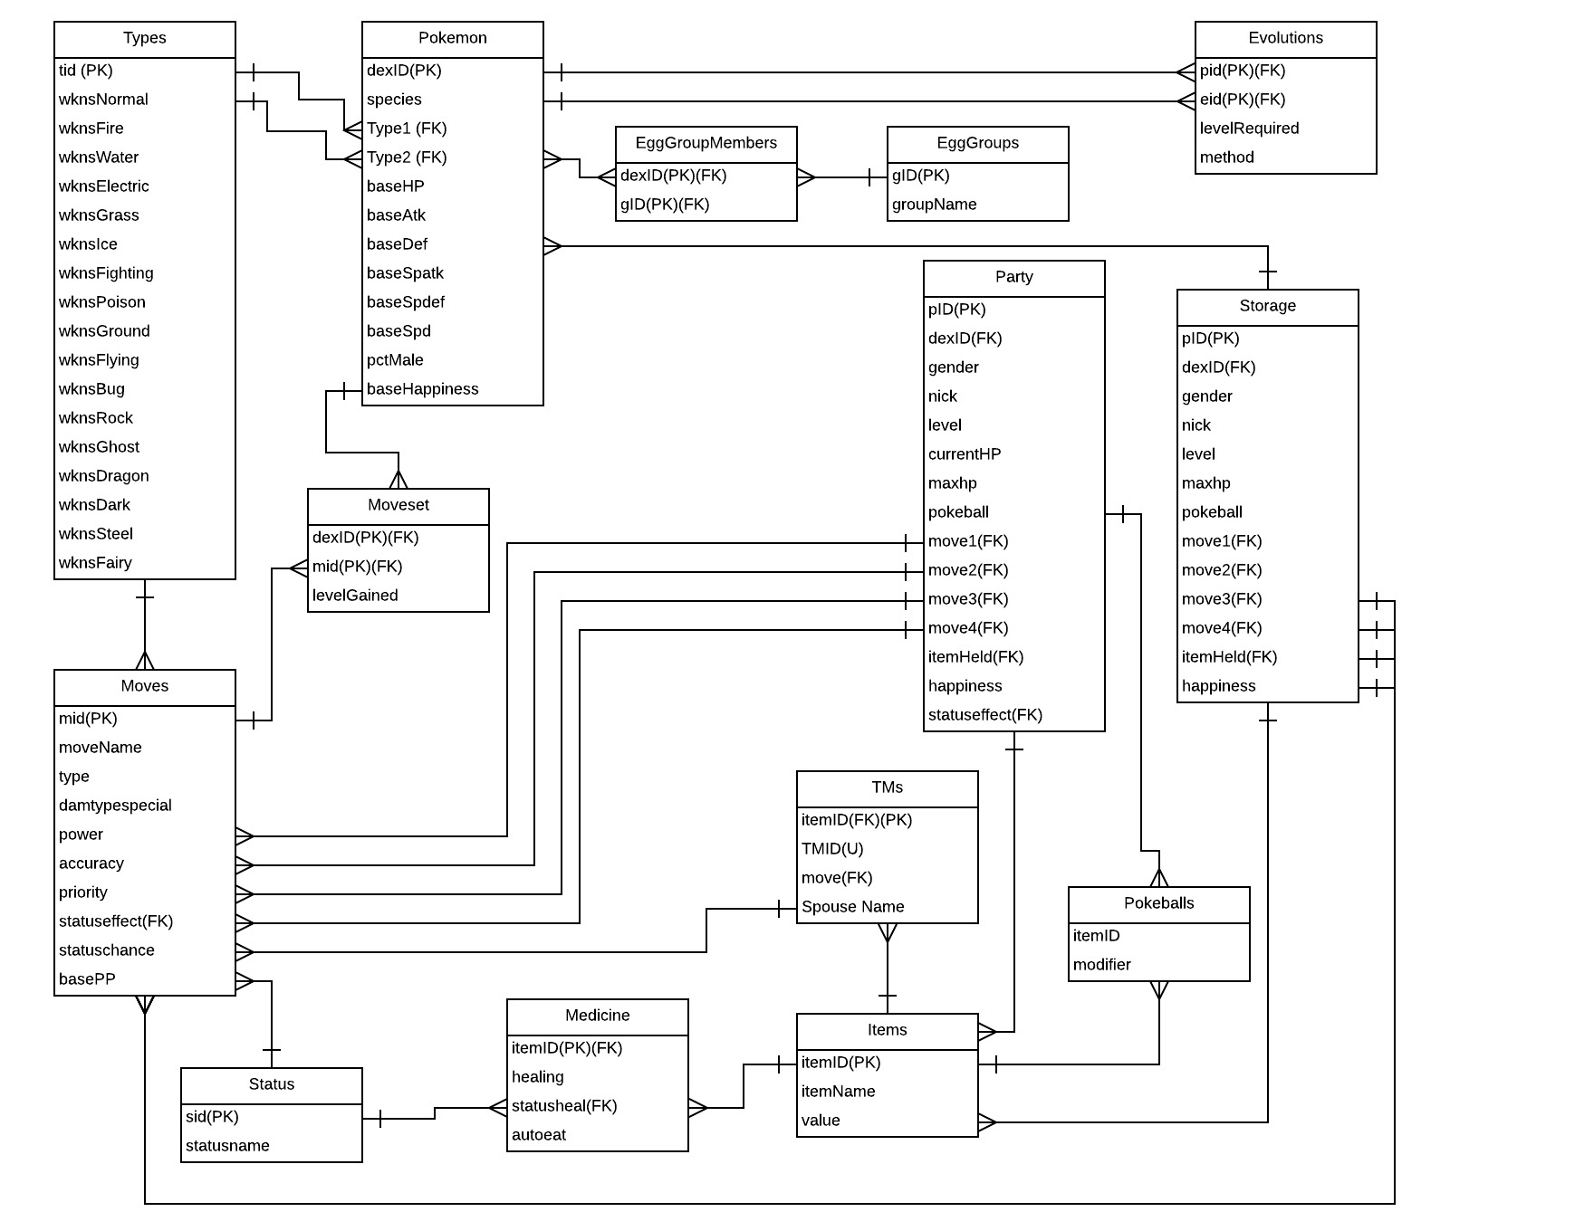
E/R Diagram

Slide 5
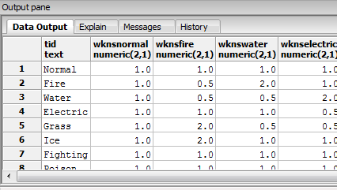
Types Table
This table maintains the various types used in the game both offensively and defensively.
CREATE TABLE Types (
tid text not null,
wknsNormal numeric(2,1),
wknsFire numeric(2,1),
wknsWater numeric(2,1),
wknsElectric numeric(2,1),
wknsGrass numeric(2,1),
wknsIce numeric(2,1),
wknsFighting numeric(2,1),
wknsPoison numeric(2,1),
wknsGround numeric(2,1),
wknsFlying numeric(2,1),
wknsPsychic numeric(2,1),
wknsBug numeric(2,1),
wknsRock numeric(2,1),
wknsGhost numeric(2,1),
wknsDragon numeric(2,1),
wknsDark numeric(2,1),
wknsSteel numeric(2,1),
wknsFairy numeric(2,1),
primary key(tid)
);
Dependencies: Type -> all weakness modifiers

Slide 6
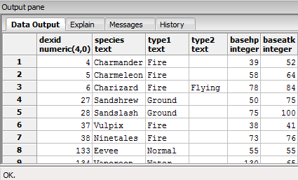
Pokemon Table
This table holds all the specific information regarding individual Pokemon. This table is used as a reference for many other tables to connect various information.
CREATE TABLE Pokemon (
dexID numeric(4,0) not null,
species text,
Type1 text not null references Types(tid),
Type2 text references Types(tid),
baseHP integer not null,
baseAtk integer not null,
baseDef integer not null,
baseSpAtk integer not null,
baseSpDef integer not null,
baseSpd integer not null,
pctMale numeric(4,3),
baseHappiness integer not null,
primary key(dexID)
);
Depedencies: dexID-> species, types, all base stats,
pctMale, basehappiness

Slide 7
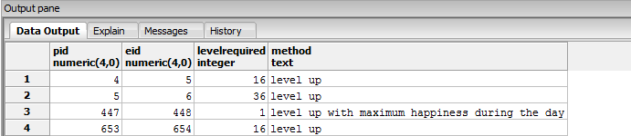
Evolutions Table
This is where we keep all the data relevent to how and what Pokemon evolve.
CREATE TABLE Evolutions(
pID numeric(4,0) not null references Pokemon(dexID),
eID numeric(4,0) not null references Pokemon(dexID),
levelRequired integer,
method text,
primary key(pID, eID)
);
Dependencies: pid + eid -> levelRequired, method

Slide 8
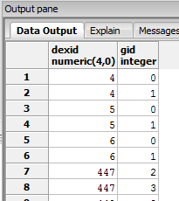
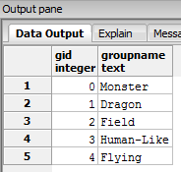
EggGroups and EggGroups Members Tables
These two tables handle the egg groups and how breeding functions in the game. EggGroupMembers references Pokemon and EggGroups tables, relating them.
CREATE TABLE EggGroups(
gID integer not null,
groupName text not null,
primary key(gID)
);
CREATE TABLE EggGroupMembers(
dexID numeric(4,0) not null references Pokemon(dexID),
gID integer not null references EggGroups(gID),
primary key (dexID, gID)

Slide 9
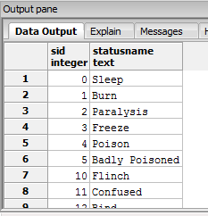
Status Table
This table holds all the status effects in the game used in battle, caused by moves
CREATE TABLE status(
sID integer,
statusname text,
primary key(sID)
);

Slide 10
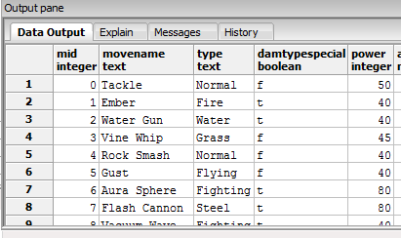
Moves Table
This table contains all the moves that are learnable by various Pokemon. This table references the status table and the types table, which are important in combat.
CREATE TABLE Moves(
mID integer not null,
MoveName text not null,
type text not null references Types(tid),
damtypespecial boolean,
power integer,
accuracy numeric(4,3),
priority integer,
statuseffect integer references status(sid),
statuschance numeric(4,3),
basePP integer not null,
primary key(mID)
);

Slide 11
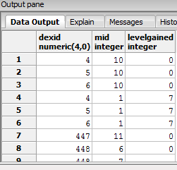
This table relates pokemon to the moves they can learn, and what level they can learn it at. NULL level fields indicate egg moves or moves learnable by TM only.
CREATE TABLE Moveset(
dexID numeric(4,0) not null references Pokemon(dexID),
mID integer not null references Moves(mID),
levelGained integer,
primary key (dexID, mID)
);

Slide 12
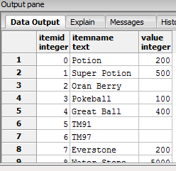
Items Table
This table acts as a base for all the items in the game and their pokedollar values, which are split into subsets of items, including medicine for recovery, TMs which teach moves, and Pokeballs for catching pokemon.
CREATE TABLE Items(
itemID integer not null,
itemName text not null,
value integer,
primary key(itemID)
);

Slide 13
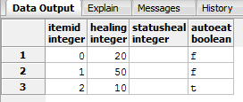
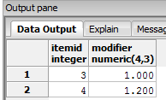
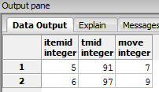
Item Subtables
CREATE TABLE Medicine(
itemID integer references Items(itemID),
healing integer,
statusheal integer references status(sid),
autoeat boolean not null,
primary key(itemId)
);
CREATE TABLE Pokeballs(
itemID integer references Items(itemID),
modifier numeric(4,3),
primary key(itemID)
);
CREATE TABLE TMs(
itemID integer references Items(itemID),
TMID integer unique,
move integer references Moves(mid),
primary key(itemID)
);

Slide 14
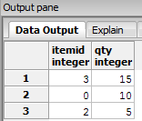
Inventory Table
This is where we maintain the player’s inventory
CREATE TABLE Inventory(
itemID integer references Items(itemID),
qty integer,
primary key(itemID)
);

Slide 15
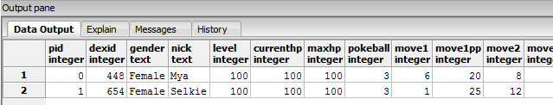
Party Table
This is where we maintain the records of the player’s current party pokemon and all of their statuses, moves, and HP total.
CREATE TABLE Party(
pid integer not null,
dexID integer not null references Pokemon(dexID),
gender text,
nick text,
level integer not null,
currentHP integer not null,
maxHP integer not null,
pokeball integer references Pokeballs(itemID),
move1 integer references Moves(mID),
move1PP integer,
move2 integer references Moves(mID),
move2PP integer,
move3 integer references Moves(mID),
move3PP integer,
move4 integer references Moves(mID),
move4PP integer,
itemHeld integer references Items(itemID),
happiness integer not null,
statuseffect integer references status(sID),
primary key(pid)

Slide 16
Storage Table
Similar to the party table, this is where the player’s Pokemon are stored when they are not in the party. Less information is needed here.
CREATE TABLE STORAGE(
bid integer not null,
dexID integer not null references Pokemon(dexID),
gender text,
nick text,
level integer not null,
currentHP integer not null,
maxHP integer not null,
pokeball integer references Pokeballs(itemID),
move1 integer references Moves(mID),
move2 integer references Moves(mID),
move3 integer references Moves(mID),
move4 integer references Moves(mID),
itemHeld integer references Items(itemID),
happiness integer not null,
primary key(bid)
);

Slide 17
View: Pokedex
This view shows the player all relevent type weaknesses and resistences per Pokemon in conjunction with the rest of the stats and information.
CREATE OR REPLACE VIEW Pokedex AS
SELECT pokemon.dexid, species, type1, type2, basehp, baseatk, basedef, basespdef, basespd, pctmale, basehappiness,
SUM(t1.wknsnormal*coalesce(t2.wknsnormal, 1)) as Normal_Dmg,
SUM(t1.wknsfire*coalesce(t2.wknsnormal, 1)) as Fire_Dmg,
SUM(t1.wknswater*coalesce(t2.wknswater, 1)) as Water_Dmg,
SUM(t1.wknselectric*coalesce(t2.wknselectric, 1)) as Electric_Dmg,
SUM(t1.wknsgrass*coalesce(t2.wknsgrass, 1)) as Grass_Dmg,
SUM(t1.wknsice*coalesce(t2.wknsice, 1)) as Ice_Dmg,
SUM(t1.wknsfighting*coalesce(t2.wknsfighting, 1)) as Fighting_Dmg,
SUM(t1.wknspoison*coalesce(t2.wknspoison, 1)) as Poison_Dmg,
SUM(t1.wknsground*coalesce(t2.wknsground, 1)) as Ground_Dmg,
SUM(t1.wknsflying*coalesce(t2.wknsflying, 1)) as Flying_Dmg,
SUM(t1.wknspsychic*coalesce(t2.wknspsychic, 1)) as Psychic_Dmg,
SUM(t1.wknsbug*coalesce(t2.wknsbug, 1)) as Bug_Dmg,
SUM(t1.wknsrock*coalesce(t2.wknsrock, 1)) as Rock_Dmg,
SUM(t1.wknsghost*coalesce(t2.wknsghost, 1)) as Ghost_Dmg,
SUM(t1.wknsdragon*coalesce(t2.wknsdragon, 1)) as Dragon_Dmg,
SUM(t1.wknsdark*coalesce(t2.wknsdark, 1)) as Dark_Dmg,
SUM(t1.wknssteel*coalesce(t2.wknssteel, 1)) as Steel_Dmg,
SUM(t1.wknsfairy*coalesce(t2.wknsfairy, 1)) as Fairy_Dmg
FROM pokemon
JOIN Types as t1 on Pokemon.type1 = T1.tid LEFT OUTER JOIN Types as T2 ON Pokemon.type2 = T2.tid
group by pokemon.dexID
order by pokemon.dexID;

Slide 18
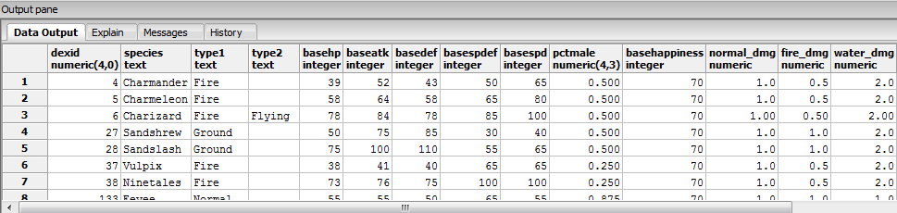
View: Pokedex (continued)

Slide 19
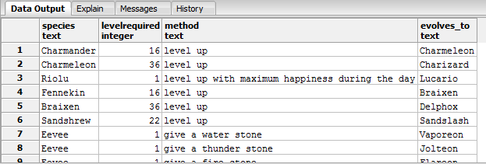
View: Evolve
Shows all evolution trends by species name, level, requirement, and resulting Pokemon species name
CREATE OR REPLACE VIEW Evolve AS
SELECT pokemon.species, evolutions.levelrequired, evolutions.method, x.species as evolves_to FROM Pokemon
join evolutions on pokemon.dexid = evolutions.pid
join pokemon as x on evolutions.eid = x.dexid;

Slide 20
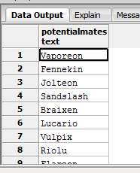
Stored procedure: potentialMates
If the player wishes to breed Pokemon to make stronger ones for competitive battling, they can use this function, with a species name specified, to return all pokemon which share an egg group with it.
CREATE OR REPLACE FUNCTION potentialMates(pokename TEXT)
RETURNS TABLE(species2 TEXT) AS
$$
DECLARE
pokename TEXT := $1;
BEGIN
return query
SELECT DISTINCT z.species
FROM pokemon as y
join EggGroupMembers as a on y.dexid = a.dexid
JOIN egggroupmembers as b on a.gid = b.gid
join pokemon as z on b.dexid = z.dexid
WHERE y.species = pokename;
return;
END;
$$ LANGUAGE plpgsql;

Slide 21
Stored procedure: transfer
If the player wishes to keep more than SIX Pokemon, it is canon in the Pokemon games that the player cannot have a party of size greater than 6. So, in order to keep their extra Pokemon, they need a storage box to contain those extras, as well as a way to deposit those pokemon.
CREATE OR REPLACE FUNCTION transfer(partynum integer)
RETURNS void AS
$$
DECLARE
partynum integer :=$1;
a integer ;
b integer ;
c text;
d text;
e integer;
f integer;
g integer;
h integer;
i integer;
j integer;
k integer;
l integer;
m integer;
BEGIN
SELECT pid, dexID, gender, nick, level, maxHP, pokeball, move1, move2, move3, move4, itemHeld, happiness
INTO a, b, c, d, e, f, g, h, i, j, k, l, m FROM Party
WHERE pid = partynum;
insert into storage (dexID, gender, nick, level, maxHP, pokeball, move1, move2, move3, move4, itemHeld, happiness)
values (b, c, d, e, f, g, h, i, j, k, l, m);
DELETE FROM PARTY WHERE pid = partynum;
END;
$$ LANGUAGE plpgsql;

Slide 22
Trigger: oversizedParty
In reference to the previously mentioned transfer, it is canon if the player captures another Pokemon with a full party , the new Pokemon is automatically transferred to storage to enforce the 6 party rule, but allow for the convinience of keeping a full party with the player and not having to worry about missing a capture of oportunity.
CREATE OR REPLACE FUNCTION oversizedParty() RETURNS TRIGGER AS
$$
DECLARE
a integer;
c integer;
BEGIN
SELECT COUNT(*) INTO c FROM Party;
IF c > 6 THEN
SELECT MAX(Party.pid) INTO a FROM Party;
PERFORM transfer(a);
END IF;
RETURN NEW;
END;
$$ LANGUAGE plpgsql;
CREATE TRIGGER osParty
AFTER INSERT ON PARTY
FOR EACH STATEMENT
EXECUTE PROCEDURE oversizedParty();

Slide 23
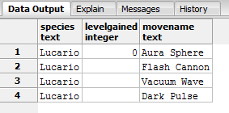
Reports:
We can use the following query to generate a full move list for a given pokemon if we use a “where” clause:
select pokemon.species, moveset.levelgained, moves.movename from pokemon join moveset on pokemon.dexid = moveset.dexid join moves on moveset.mid = moves.mid;
“WHERE pokemon.species = ‘Lucario’; yields the following output

Slide 24
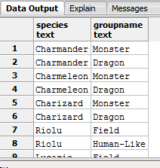
Reports: All pokemon by egg group
This query returns the egg group members table with names rather than ID numbers
select pokemon.species, egggroups.groupname
from pokemon join egggroupmembers
on pokemon.dexid = egggroupmembers.dexid
join egggroups on egggroupmembers.gid = egggroups.gid;

Slide 25
Roles
The admin role is used to add new content to the game
CREATE ROLE admin;
grant all on all tables in schema public to admin;

Slide 26
Roles
The player role is needed for the player to manage their inventory, team, and reserve Pokemon without giving them access to modifying the core game
CREATE ROLE player;
REVOKE ALL ON ALL TABLES IN SCHEMA public FROM player;
GRANT SELECT ON ALL TABLES IN SCHEMA public TO player;
GRANT INSERT ON Inventory, Party, Storage TO player;
GRANT UPDATE ON Inventory, Party, Storage TO player;

Slide 27
Implementation Notes
The gender ratio in the pokemon table refers to how often the pokemon appears male, and if it is not male, it is female. NULL indicates the pokemon is genderless.
The status effect table doesn’t contain information such as the hidden effects inside burn, poison, badly poisoned, paralysis, sleep, etc, as well as normal stat-reducing and boosting abilities.

Slide 28
Known Issues
The pokedex view doesn’t show egg groups inside of it
Removing pokemon from storage is currently unimplemented, making the storage box essentially a “black hole”

Slide 29
Future enhancements
Pokemon abilities
Withdrawing pokemon from storage
Simulating Battling/Capturing Pokemon
Leveling up pokemon

