Slide 2


Slide 5

AuriaOS User
Please insert your password
LOGIN
SHUT DOWN

Slide 6
AuriaOS User
Welcome!

Slide 8








Start
Your Applications
ALL APPS
AuriaOS User
LOG OUT
SHUT DOWN

Slide 9
All Apps

Slide 10

AuriaWeb
Bing
???
???
???
???
???
???
???
Copyright © 2022 AuriaWeb, Inspired by Office Mix (R.I.P) Web Viewer. All Rights Reserved.

Slide 11
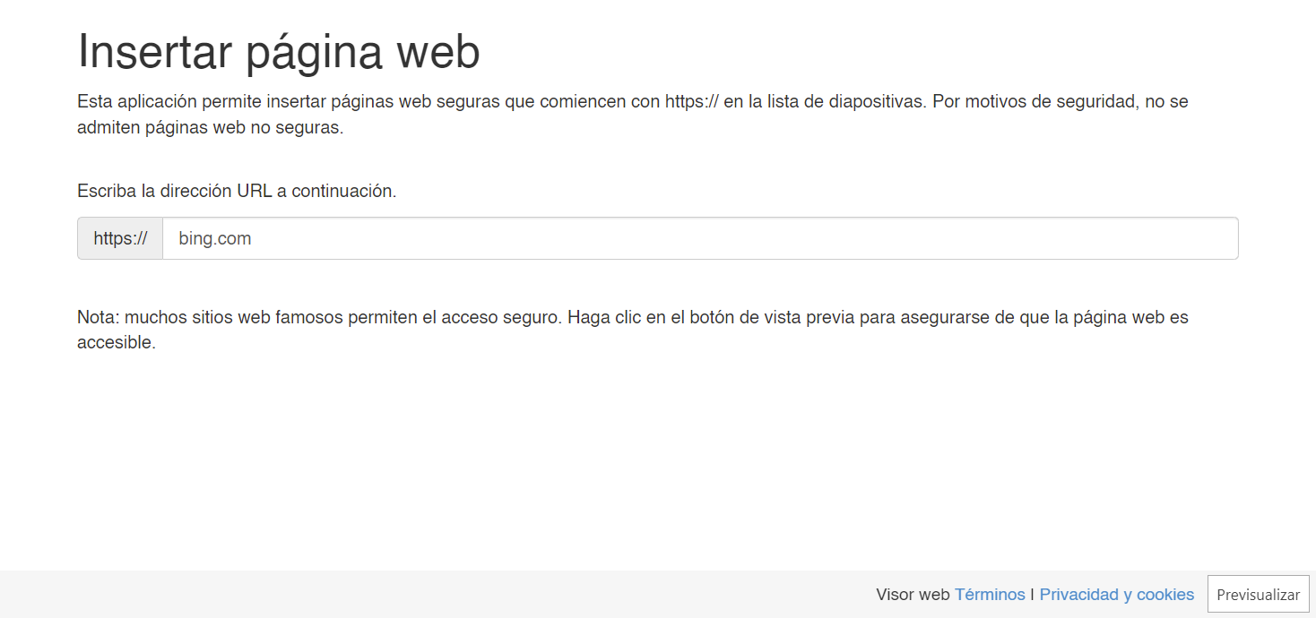
AuriaWeb
BACK

Slide 12
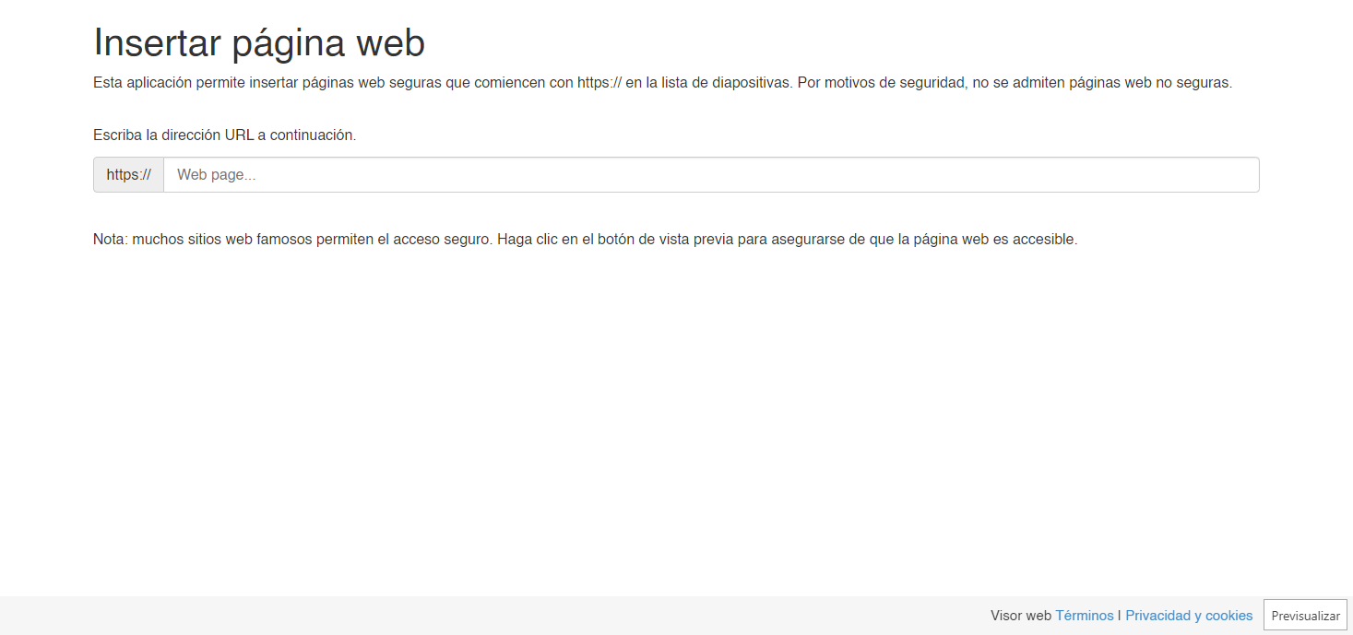
AuriaWeb
BACK

Slide 13


AuriaFiles
AuriaOS
Desktop
Documents
Downloads
Music
Pictures
Videos
Users
AuriaVer.exe

Slide 14
AuriaFiles
AuriaOS > Users
AuriaOS User

Slide 15
AuriaMelodies
Welcome to AuriaMelodies
Home of your favorite music
LET’S GO!
Now Playing: ???
by ???

Slide 16


AuriaMelodies
AuriaMelodies
Your tracks
Flourish
by ???
MID
Onestop
by ???
MID
Town
by ???
MID
Now Playing: ???
by ???

Slide 17


AuriaMelodies
AuriaMelodies
Your tracks
Flourish (Now Playing)
by ???
MID
Onestop
by ???
MID
Town
by ???
MID
Now Playing: Flourish
by ???

Slide 18
AuriaMelodies
AuriaMelodies
Your tracks
Flourish
by ???
MID
Onestop (Now Playing)
by ???
MID
Town
by ???
MID
Now Playing: Onestop
by ???

Slide 19
AuriaMelodies
AuriaMelodies
Your tracks
Flourish
by ???
MID
Onestop
by ???
MID
Town (Now Playing)
by ???
MID
Now Playing: Town
by ???

Slide 20

AuriaPlayer
AuriaOS Trailer.mp4
by AuriaOS
!!! AuriaPlayer is UNFINISHED. This app will be finished in a later build. !!!

Slide 21
It’s now safe to shutdown AuriaOS. Press "Esc" to exit.
AuriaOS is Shutting Down…

