Slide 1
Brewery analysis
Contributors:
Aurian Ghaemmaghami
Balaji Avvaru

Slide 2
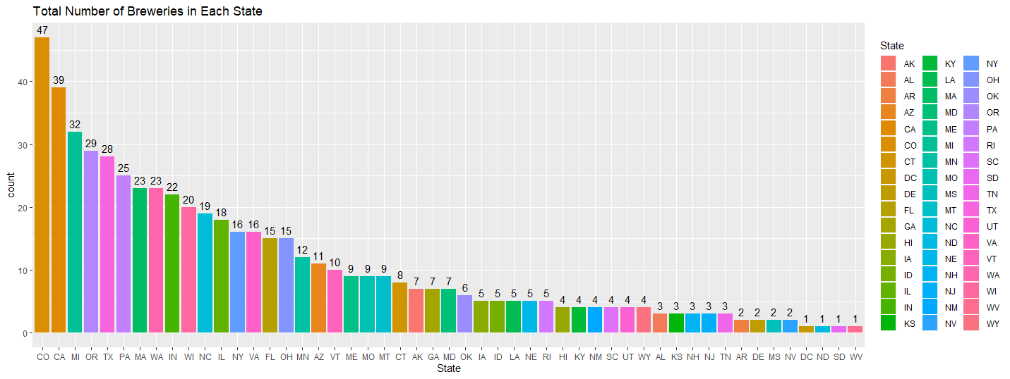
Number of Breweries Present in Each State
State | Count
CO | 47
CA | 39
MI | 32
OR | 29
TX | 28

Slide 3
Data Cleaning
Beers containing missing values were filtered from the data set for analysis
Only columns ABV and IBU contained missing values
ABV: 62 missing, about 2.6% of the data
IBU: 1005 missing, about 41.7% of the data

Slide 4
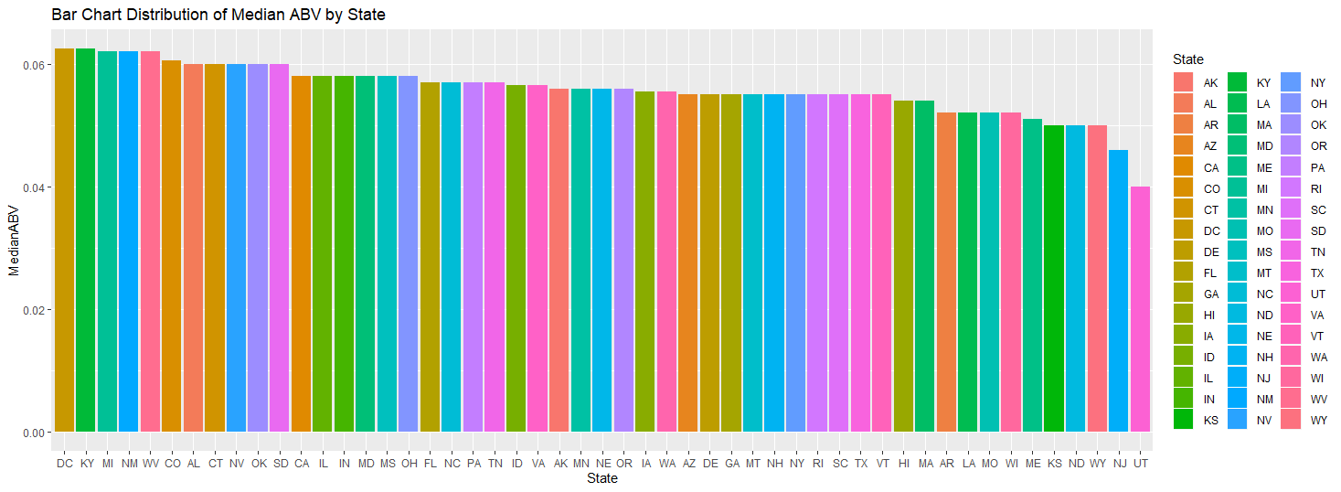
Median ABV by State
State | Median ABV(%)
DC | 6.25%
KY | 6.25%
MI | 6.20%
NM | 6.20%
WV | 6.20%

Slide 5
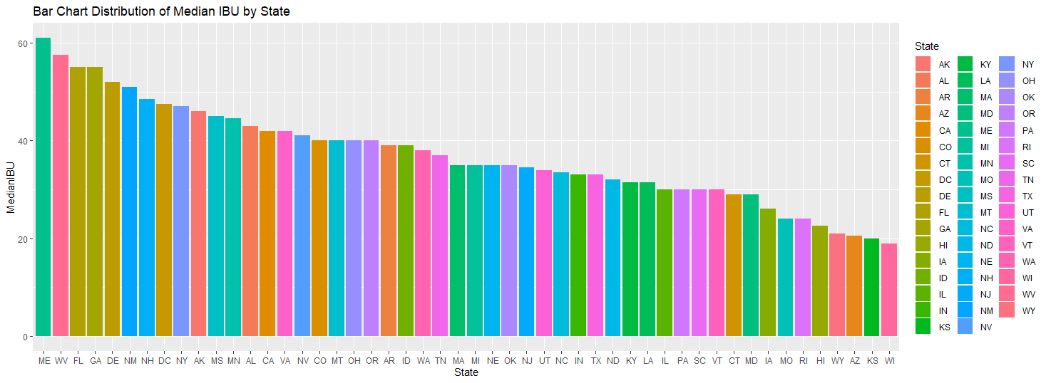
Median IBU by State
State | Median IBU
ME | 61
WV | 57.5
FL | 55
GA | 55
DE | 52

Slide 6
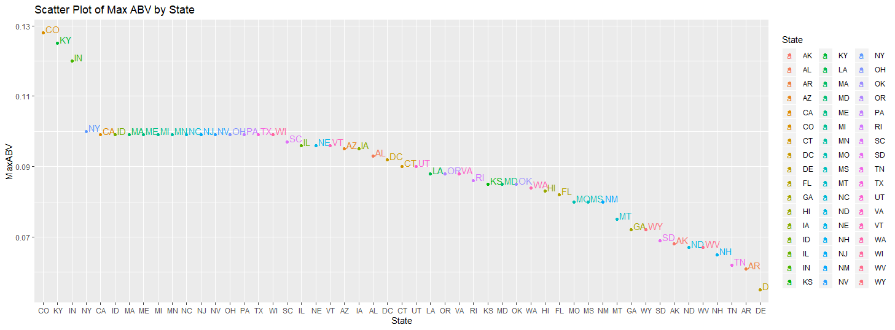
Max ABV by State
Lee Hill Series Vol. 5 – Belgian Style Quadruple Ale
State | Max ABV(%)
CO | 12.8%
KY | 12.5%
IN | 12.0%
NY | 10.0%
CA | 9.9%

Slide 7
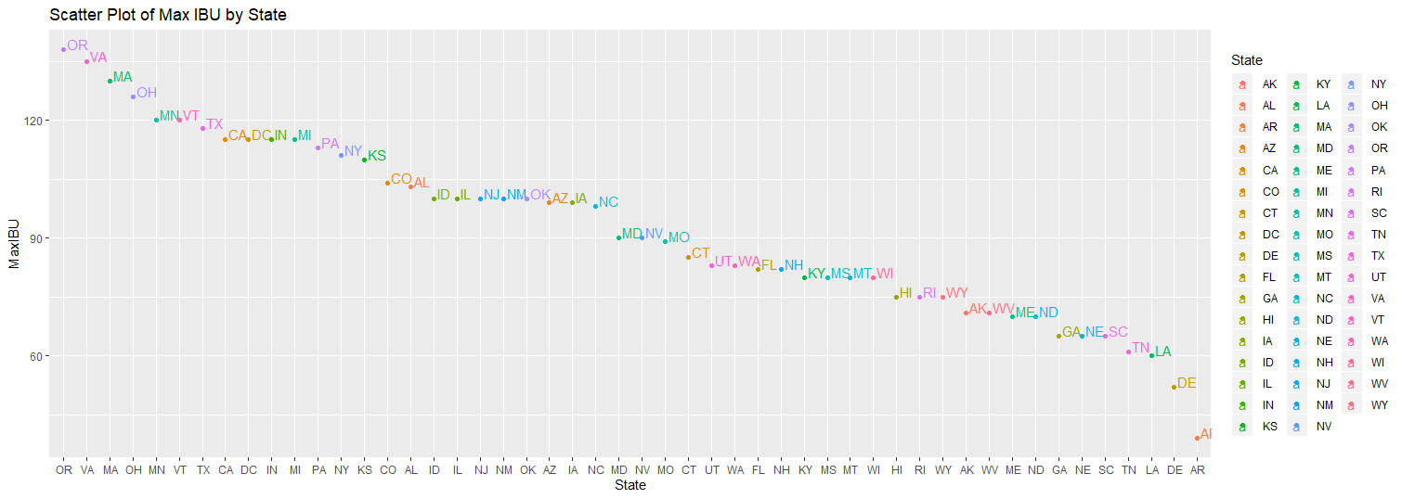
Max IBU by State
Oregon B.B. Imperial IPA
State | Max IBU
OR | 138
VA | 135
MA | 130
OH | 126
MN | 120

Slide 8
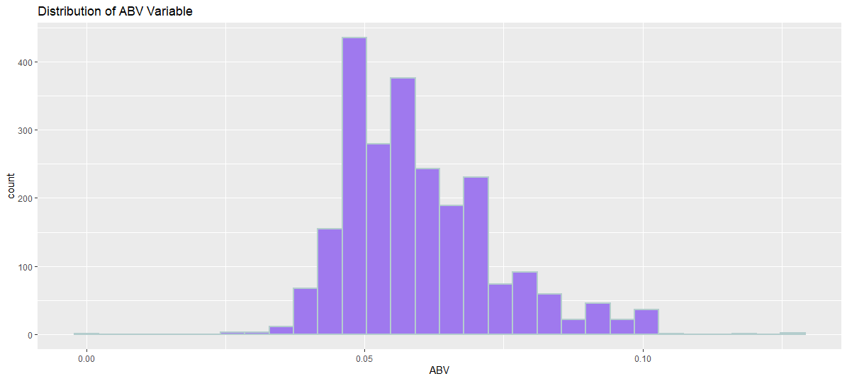
ABV Summary
Statistics | ABV(%)
Minimum | 0.1%
Q1 | 5%
Median | 5.6%
Q3 | 6.7%
Max | 12.8%
Mean | 6.0%
Count / Total Data | 2348 / 2410

Slide 9
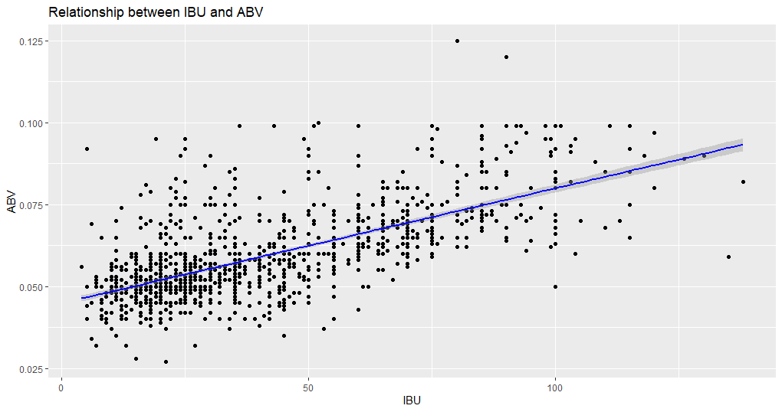
IBU vs ABV Relationship
Positive linear correlation between IBU and ABV
As bitterness increases, the ABV tends to increase slightly

Slide 10
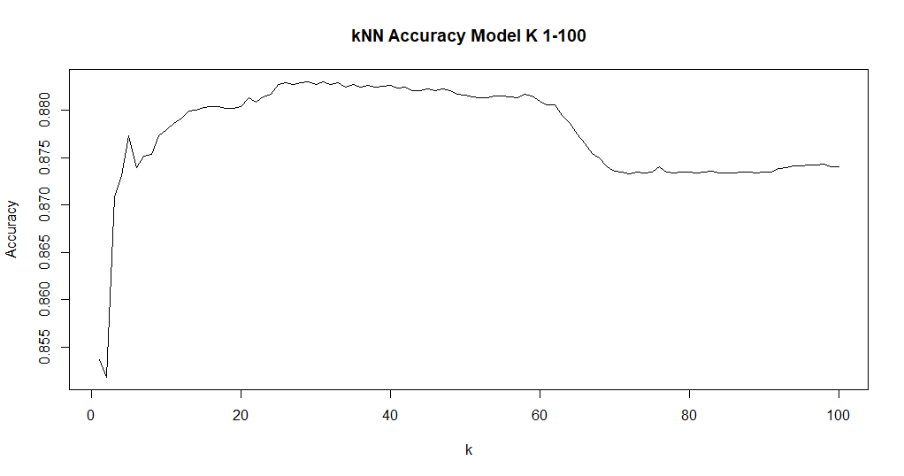
Predictive kNN Modeling (Ale vs IPA)
Model called K-NN (nearest neighbor)
Approximately k=36 should give us best accuracy
Accuracy of 88.16%

Slide 11
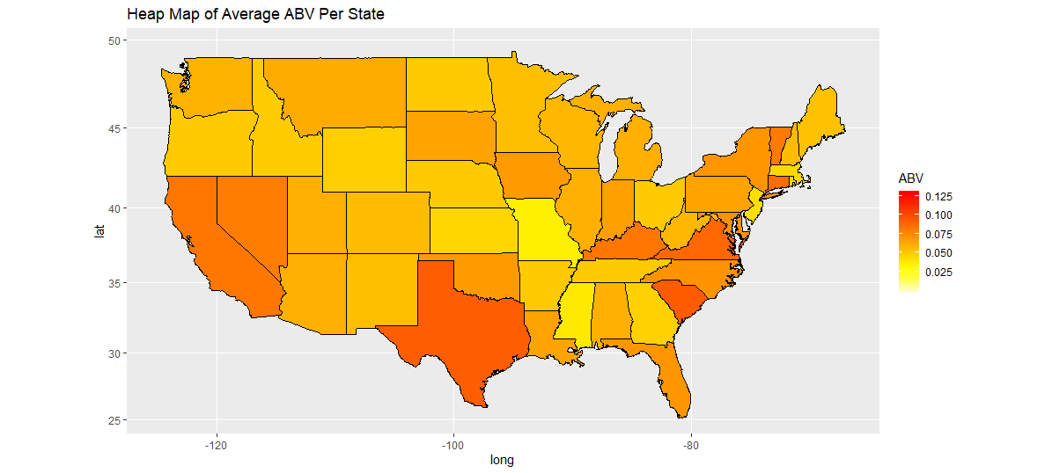
IPA Recommendations based on ABV
We ran a test to see if the average ABV was different in IPA vs Other Ale’s
We found strong evidence that suggested IPA’s have about 1.1%-1.4% more ABV
Heat Map to the right shows states that prefer higher ABV content
Suggestion: Target higher ABV areas to produce more IPA’s to increase sales
Top 3: Texas, South Carolina, Virginia

