Slide 1
Brewery analysis
A&B Incorporated
Contributors:
Aurian Ghaemmaghami
Balaji Avvaru

Slide 2
Case Study Analysis
We examined below topics as part of our analysis:
Breweries per state
Median alcohol content (ABV) per state
Median international bitterness (IBU) per state
Beers with highest alcohol by volume (ABV) and international bitterness unit (IBU)
Summary stats of alcohol by volume(abv)
Analysis of relationship between alcohol by volume (ABV) and international bitterness unit (IBU)
Investigate the difference with respect to ABV and IBU between IPAs and other types of ale

Slide 3
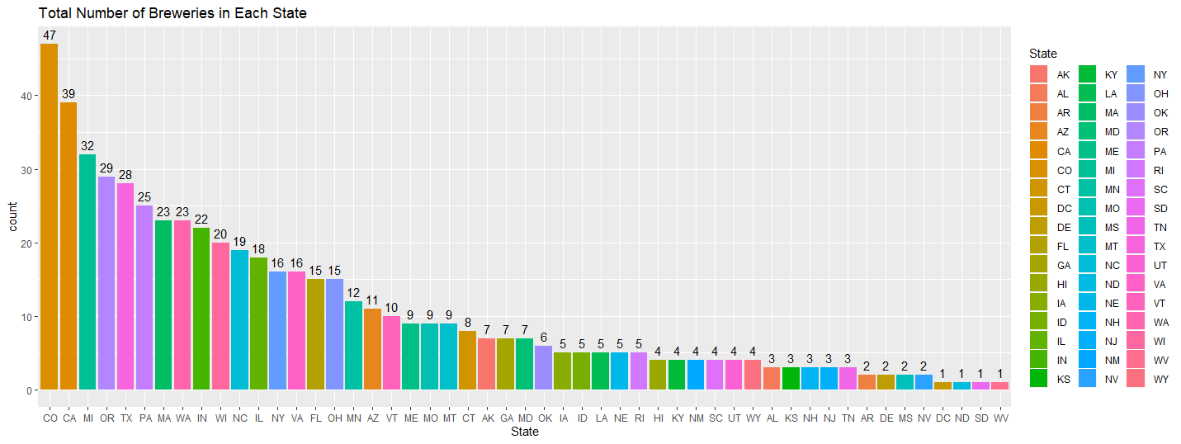
Number of Breweries Present in Each State
State | Count
CO | 47
CA | 39
MI | 32
OR | 29
TX | 28

Slide 4
Data Cleaning
Beers containing missing values were filtered from the data set for analysis
Only columns ABV and IBU contained missing values
ABV: 62 missing, about 2.6% of the data
IBU: 1005 missing, about 41.7% of the data

Slide 5
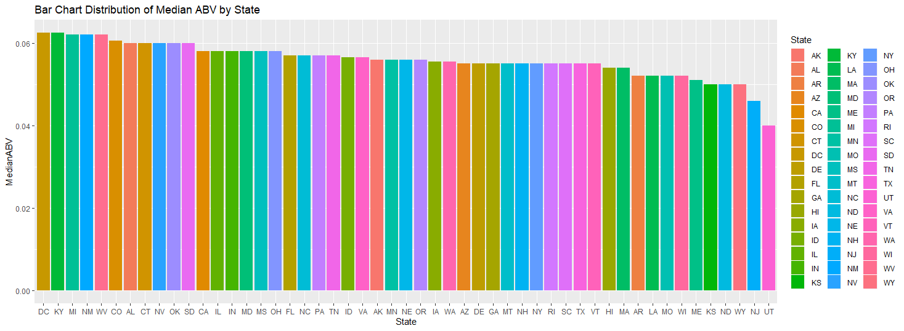
Median ABV by State
State | Median ABV(%)
DC | 6.25%
KY | 6.25%
MI | 6.20%
NM | 6.20%
WV | 6.20%

Slide 6
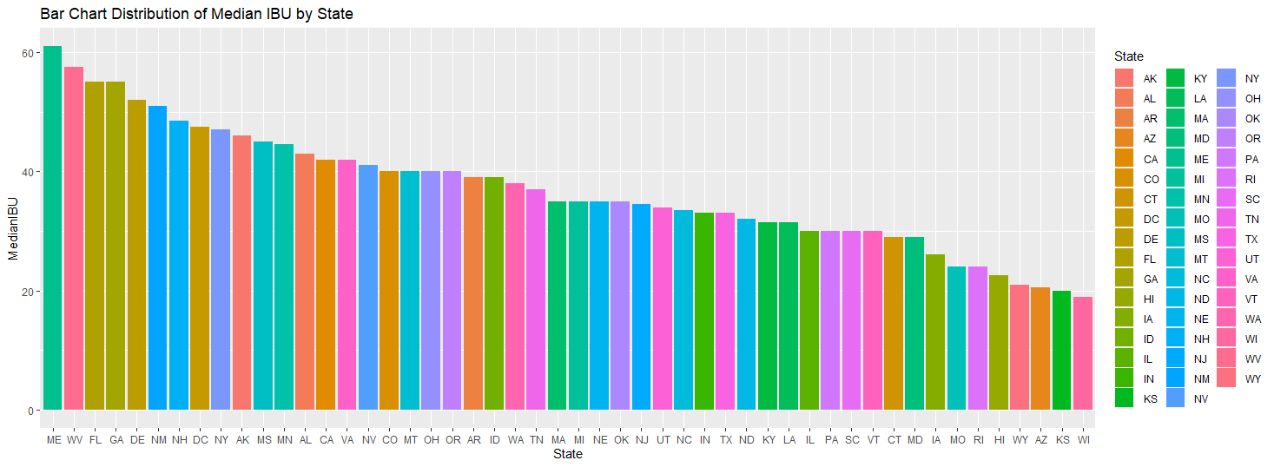
Median IBU by State
State | Median IBU
ME | 61
WV | 57.5
FL | 55
GA | 55
DE | 52

Slide 7
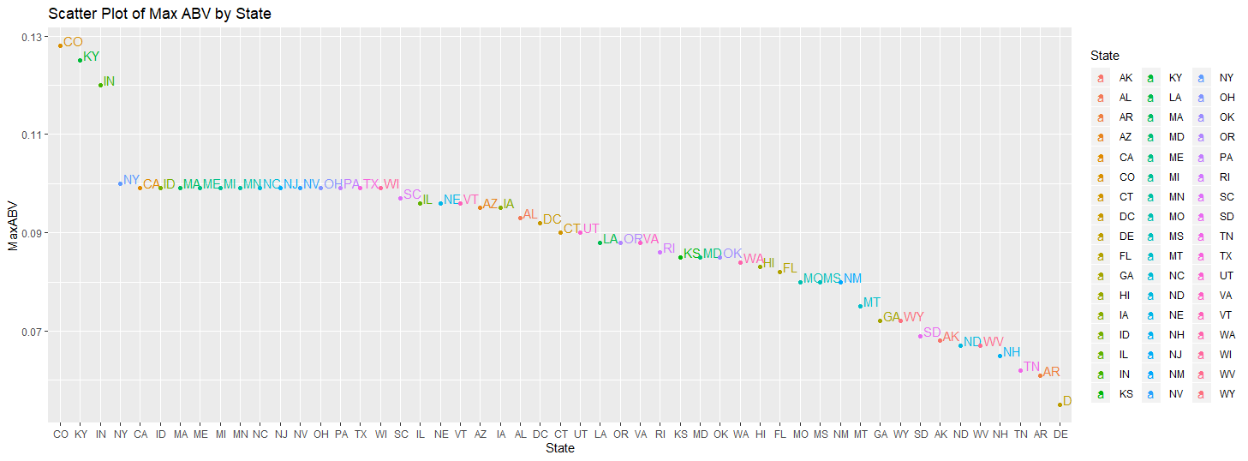
Max ABV by State
Lee Hill Series Vol. 5 – Belgian Style Quadruple Ale
State | Max ABV(%)
CO | 12.8%
KY | 12.5%
IN | 12.0%
NY | 10.0%
CA | 9.9%

Slide 8
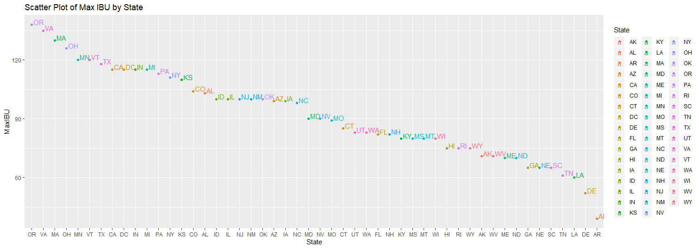
Max IBU by State
Oregon B.B. Imperial IPA
State | Max IBU
OR | 138
VA | 135
MA | 130
OH | 126
MN | 120

Slide 9
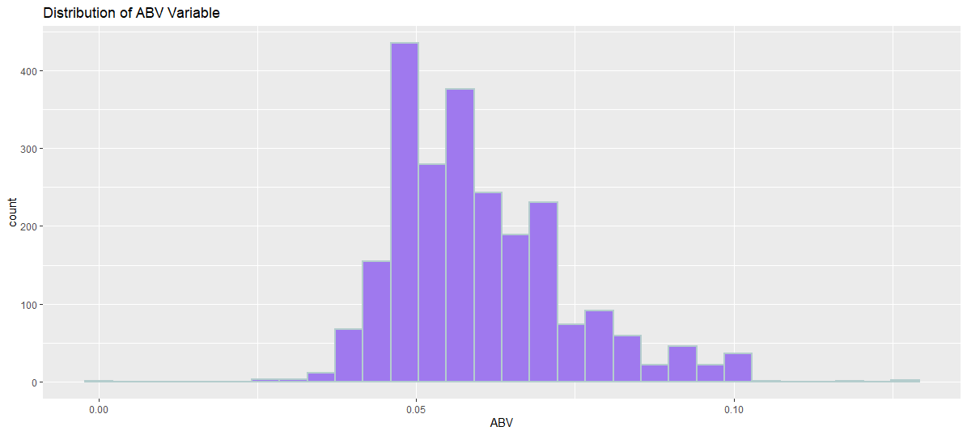
ABV Summary
Statistics | ABV(%)
Minimum | 0.1%
Q1 | 5%
Median | 5.6%
Q3 | 6.7%
Max | 12.8%
Mean | 6.0%
Count / Total Data | 2348 / 2410

Slide 10
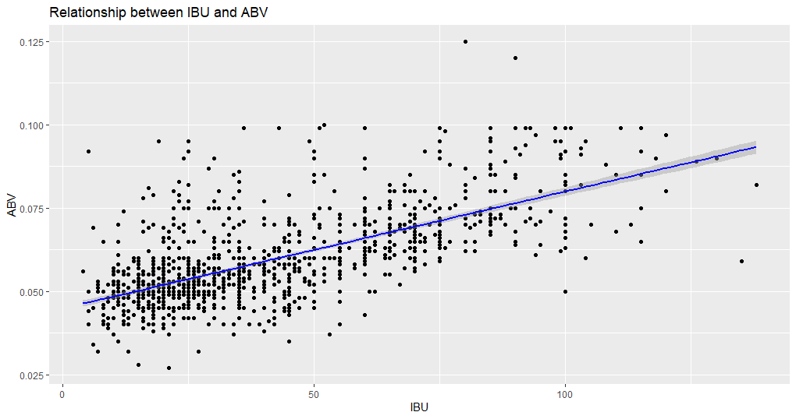
IBU vs ABV Relationship
Positive linear correlation between IBU and ABV
As bitterness increases, the ABV tends to increase slightly

Slide 11
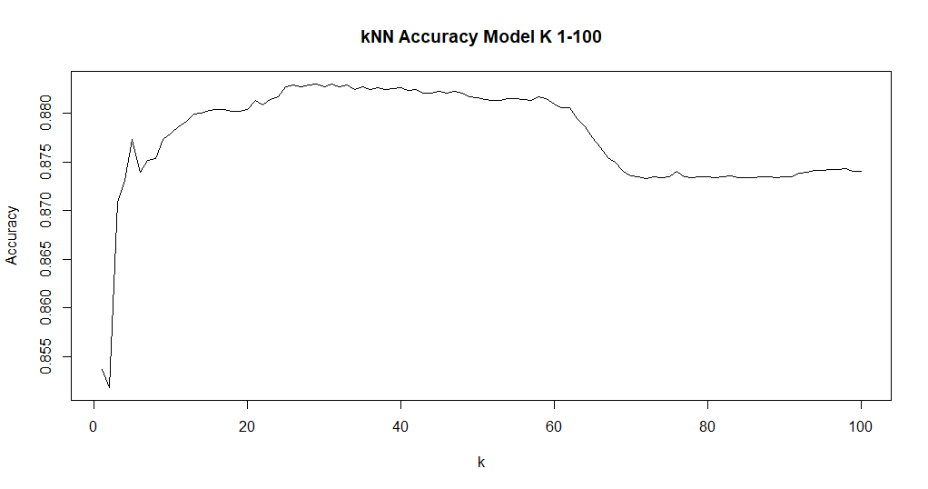
Predictive kNN Modeling (Ale vs IPA)
Model called K-NN (nearest neighbor)
Approximately k=36 should give us best accuracy
Accuracy of 88.16%

Slide 12
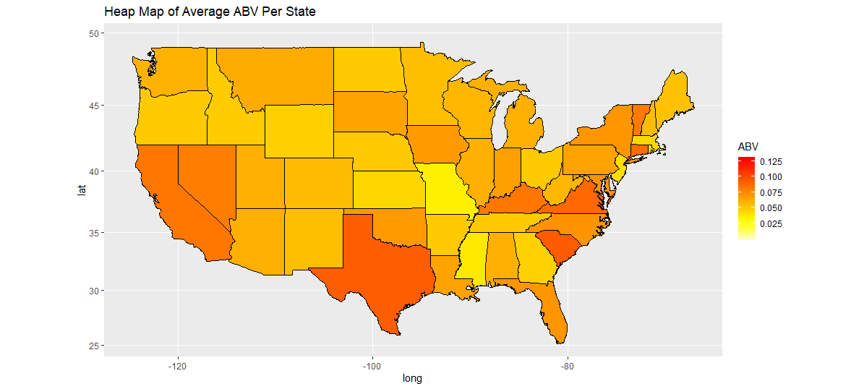
IPA Recommendations based on ABV
We ran a test to see if the average ABV was different in IPA vs Other Ale’s
We found strong evidence that suggested IPA’s have about 1.1%-1.4% more ABV
Heat Map to the right shows states that prefer higher ABV content
Suggestion: Target higher ABV areas to produce more IPA’s to increase sales
Top 3: Texas, South Carolina, Virginia

Slide 13
Conclusion
States with highest breweries – Colorado, California and Michigan
States with highest ABV and IBU are Colorado and Oregon
Medial alcohol content per state is fairly consistent around 6% and median international bitterness per state is very much varied.
There is evidence to suggest that a positive linear relationship exists between IBU and ABV
K-NN model to identify beer type based on ABV and IBU values – accuracy of 88.6%
Target higher ABV areas to produce more IPA’s to increase sales
Target higher ABV areas for new IPA product launches
Top 3: Texas, South Carolina, Virginia

