Slide 1
Talent Management - Attrition and Income Predictions
Aurian Ghaemmaghami – DDS Analytics Team

Slide 2
Introduction
Goal: Leverage predictive modeling to better understand the nuances of talent management and attrition for employee retention.
1) Identify factors that lead to employee turnover
2) Evaluating parameters for income prediction
Data
1470 Total Employee Observations
36 Variables (9 Categorical and 27 Numeric)

Slide 3
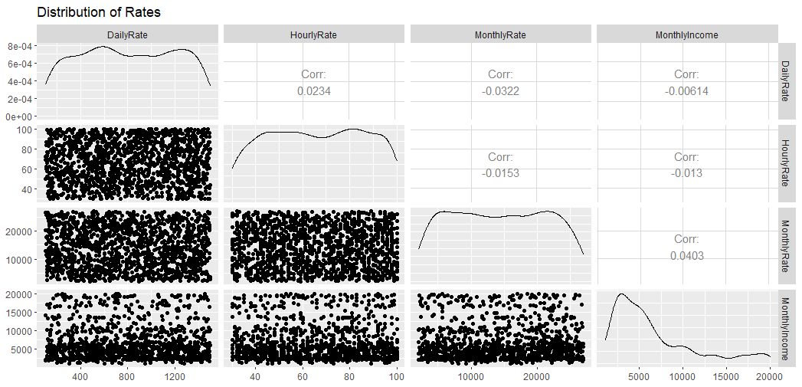
Data Cleaning
Single-Value Parameters
Over18
Employee Count
Standard Hours
Ambiguous Parameters
Daily Rate
Hourly Rate
Monthly Rate
Performance Rating
Employee Number

Slide 4
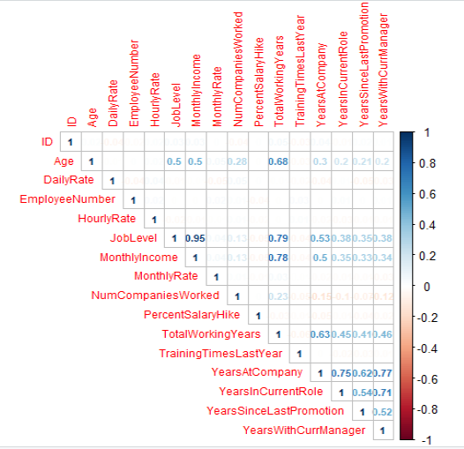
Numeric Variable Selection
Parameters of Interest
Age
Job Level
Monthly Income
Total Working Years
Years at Company
Years In Current Role
Years Since Last Promotion
Years With Current Manager

Slide 5
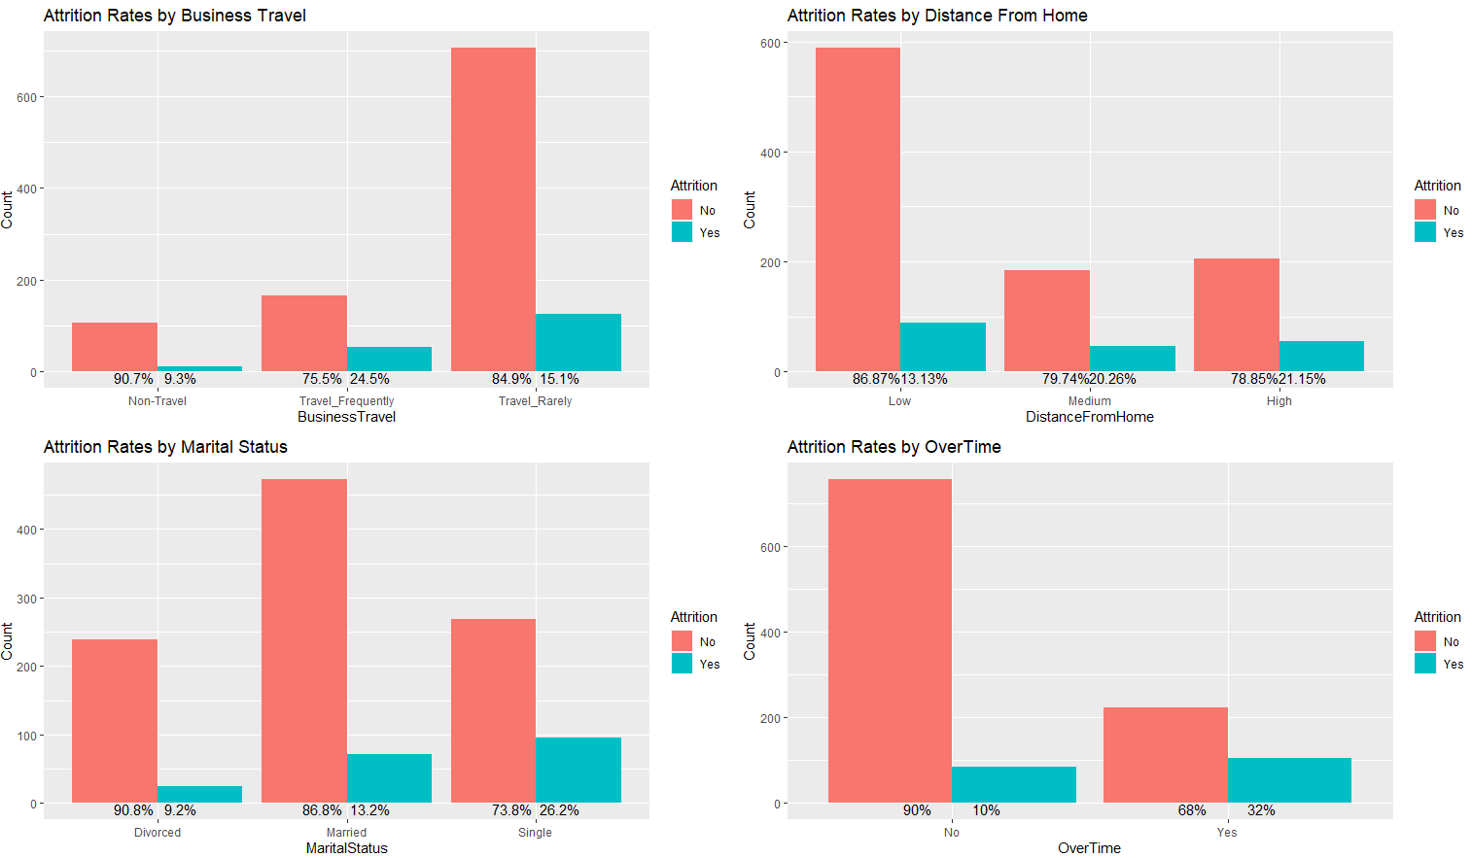
Categorical Variable Selection
Parameters of Interest
Business Travel
Distance From Home
Job Role
Marital Status
OverTime
Stock Option Level

Slide 6
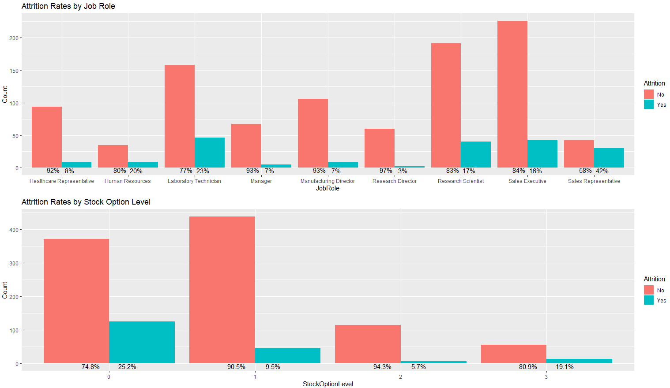
Categorical Variable Selection Cont…

Slide 7
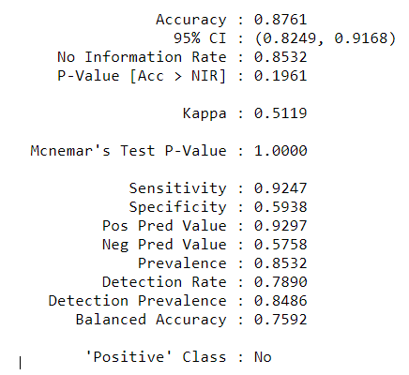
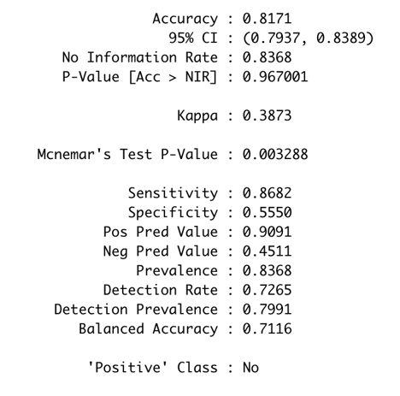
Attrition Models
kNN
Naïve-Bayes
Accuracy: 88%
Sensitivity: 92%
Specificity: 59%
Accuracy: 82%
Sensitivity: 87%
Specificity: 56%

Slide 8
High Attrition & Retention Factors
Attrition
Distance From Home of 8+ miles
Those who have Overtime – nonexempt employees
Job Role of Sales Representative or Lab Technician
“Single” Marital Status
Retention
Less travel
Upper Management Job Roles
Better work-life balance

Slide 9
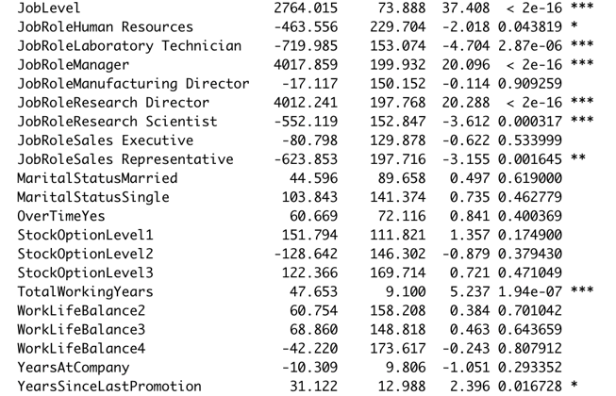
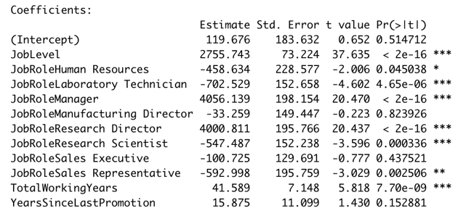
Monthly Income Models
Full MLR Model
Reduced MLR Model
R-Squared | 0.9477
Adj. R-Squared | 0.9465
RMSE | 1096.229
R-Squared | 0.9467
Adj. R-Squared | 0.9462
RMSE | 1106.516

Slide 10
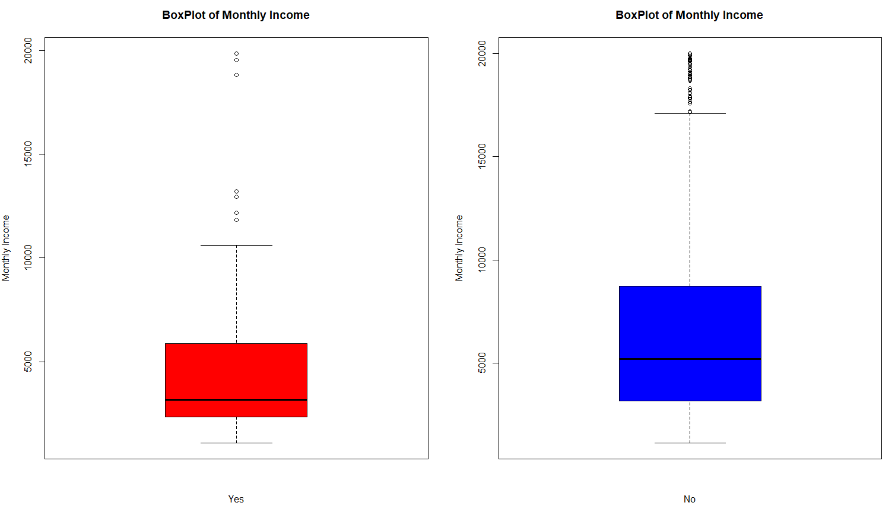
Monthly Income vs Attrition
Average of Attrition: $4764
Average of No Attrition: $6702
Evidence suggests there is an associated difference between Monthly Income in Yes vs No group (p-value: <0.0001)
The group with no Attrition has a higher salary than those with Attrition

Slide 11
Conclusion and Recommendation
Job Roles of Sales Reps are more likely to leave
may benefit from less overtime and incentivized stock option plans.
Job Roles of Managers/Directors seem to have highest retention
Those who are single disproportionately are more likely to leave
Most of those who are single fall into sales rep. category.
Longer commutes from home lead to higher attrition
Partial remote opportunity may be beneficial
Those who travel less tend to stay
Flexibility plans for those with children

