Slide 1

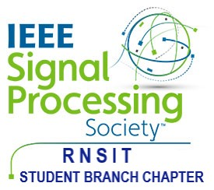

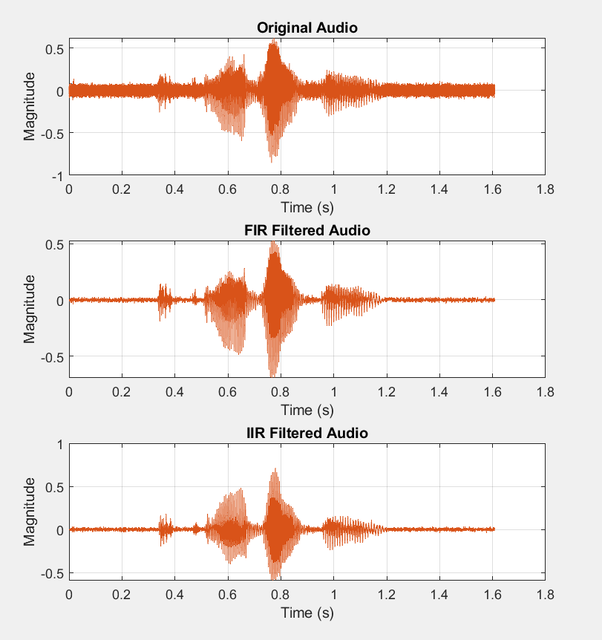
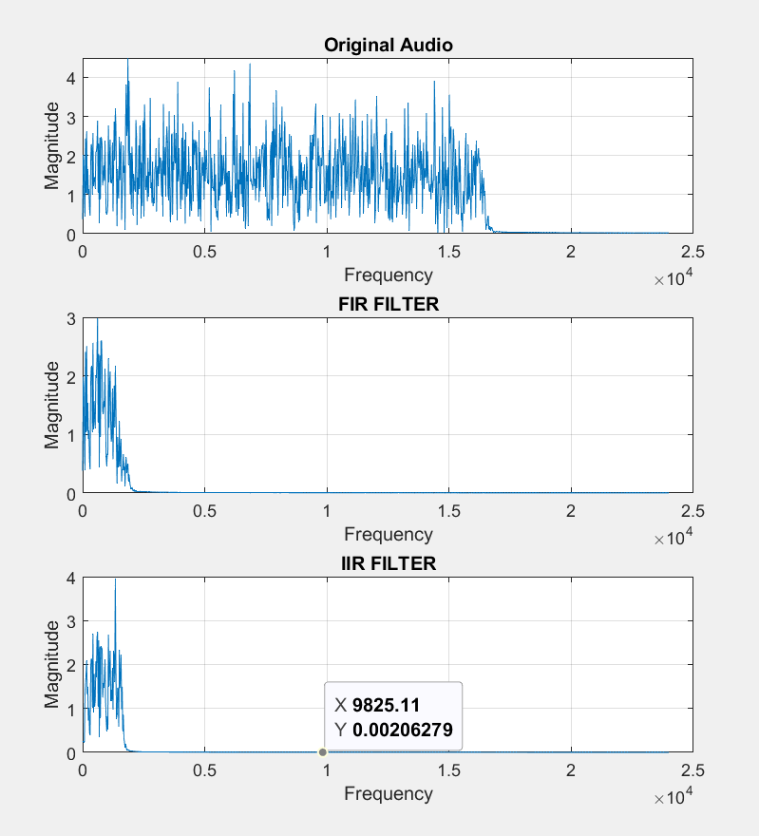
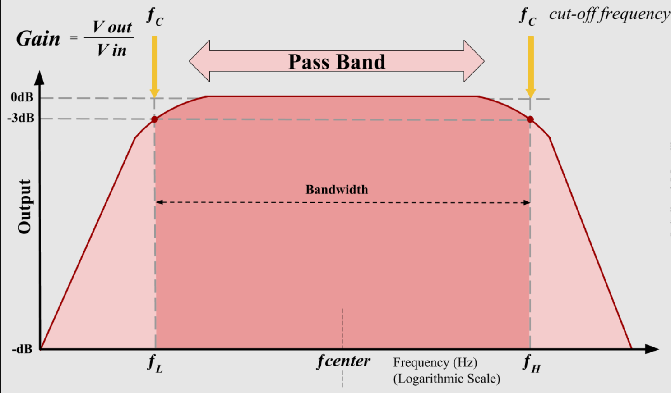
RNSIT – ECE OPEN HOUSE – PROJECT COMPETITION - AUGUST 2023
FIR & IIR Bandpass Filter
Utkarshni Jha, Vibhav Ranjan, Vansh Agarwal, Utkarsh Ku. Singh, Surya Pratap Singh
Guided by- Dr. Vipula Singh (HOD)
Electronics & Communication, RNS Institute of Technology
Abstract
This project investigates the design and application of FIR and IIR bandpass filters for precise signal processing.
Addressing telecommunications, audio, and biomedical analysis, it examines filter characteristics, design parameters, and real-time implementation using software and hardware approaches.
This study offers insights into trade-offs, computational efficiency, and filtering accuracy, aiding effective selection between
FIR and IIR filters for diverse frequency isolation tasks.e will be a number of posters presented during the conference, exhibited at each poster session. In order to make these sessions run smoothly, some cooperation from you, as a poster exhibitor, is necessary. Please make sure your plotted poster is put up before the start of the session and removed after it has ended.
Every poster must be presented by the indicated presenter at EDAS Conference server (the paper author declared , exhibited at each poster session.
2. Methodology
1. Define Filter Specifications: - Determine the characteristics of your desired bandpass filter, including center frequency, bandwidth, and filter order,etc.
2. FIR Bandpass Filter Design: Design: - Select a suitable window function (e.g., Hamming, Blackman) to shape the filter's frequency response.
3. IIR Bandpass Filter Design: Design: - Choose an appropriate IIR filter type (e.g., Butterworth, Chebyshev, elliptic) based on your application's requirements. - Design an analog prototype filter that meets the desired specifications.
4. Frequency Response Analysis: - Analyze the frequency response of the designed filter using tools like frequency response plots, pole-zero plots, and filter design software.
5. Real Time Implementation.
3. Results
Time
Domain
Plots :
Frequecy
Domain
Plots :
1. Introduction
Bandpass filters play a pivotal role in signal processing, allowing the extraction or suppression of specific frequency components from signals. Two fundamental types of bandpass filters are Finite Impulse Response (FIR) and Infinite Impulse Response (IIR) filters.FIR filters are characterized by their non-recursive nature, employing a finite number of coefficients to perform convolution with the input signal. They find utility in applications where precise control over the filter response is crucial.In contrast, IIR filters are recursive, leveraging feedback from previous output samples. Designing IIR filters involves transforming analog prototypes and carefully placing poles and zeros to meet desired specifications. IIR filters are computationally efficient but require attention to stability.
Understanding the principles of designing and implementing FIR and IIR bandpass filters is essential for various applications, from audio processing to communications and biomedical signal analysis.

