Slide 1
Flowchart of the derivation of the exponential model
First fitted with the LB sand, then applied following two different approaches on the HS sand
→ 3 iterations in the script

Slide 2
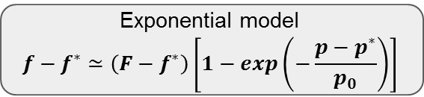
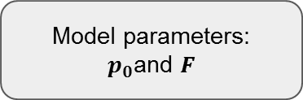
Exponential model
$$f−f^{∗}≃\left(F−f^{∗}\right)\left[1−exp\left(−\frac{p−p^{∗}}{p_{0}}\right)\right]$$
Model parameters:
$p_{0}$and $F$
Polyfit
1
2
3
Fit polynom of d-order on exp. data (d=3 or d=2)
f-f* = P(p)
Derive polynom and take the logarithm
ln((f - f*)’) = ln(P’(p))
Linear regression to obtain coefficients: ln(P’(p))=a*p+b
p0 = -1/a
F = f* + p0 exp(b - p*/p0)
Fit polynom of 1-order with random initial guess
P₁(p)=a₁p+a₀
(Unique solution independent of initial guess)
Fit polynom of d-order with specific initial guess :
P_{d}(p)=a_{d}p^{d}+a_{d-1}p^{d-1}+...+a₀
With
a_{d}= 0.0
(a_{d-1}...a₀) = best fit coefficients of previous order polynom P_{d-1}
P(p) is then a new pseudo-experimental curve to work on
Given on the whole data set p
Linear regression is done on the whole pressure range: p0 is actually related to the slope of the (whole) derivative, here given by a polynomial approximation.
Fitting only the beginning of the curve (close to p*) would mean to take the tangent of the derivative

Slide 3

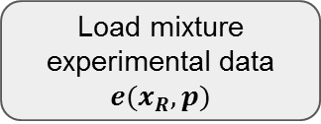
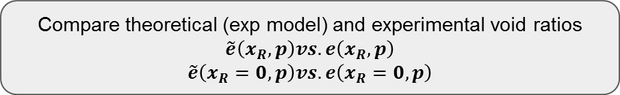
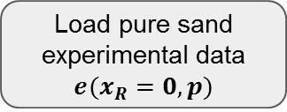
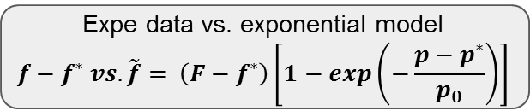

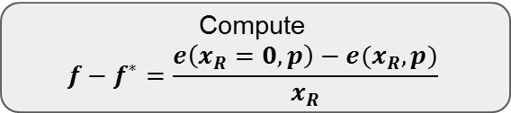
First iteration : compute p0 and F from LB sand data
Load pure sand experimental data
$$e(x_{R}=0,p)$$
Load mixture experimental data
$$e(x_{R},p)$$
Loop on$x_{R}$
Compute
$$f−f^{∗}=\frac{e\left(x_{R}=0,p\right)−e(x_{R},p)}{x_{R}}$$
Polyfit
LB_Fig0, LB_Fig1
$p_0$and $F$
LB_Fig3
Expe data vs. exponential model
$$f−f^{∗} vs.\tilde{f}= \left(F−f^{∗}\right)\left[1−exp\left(−\frac{p−p^{∗}}{p_{0}}\right)\right]$$
LB_Fig2
Compare theoretical (exp model) and experimental void ratios
$$\tilde{e}\left(x_{R},p\right)vs. e\left(x_{R},p\right)$$
$$\tilde{e}\left(x_{R}=0,p\right)vs. e\left(x_{R}=0,p\right)$$
LB_Fig4

Slide 4
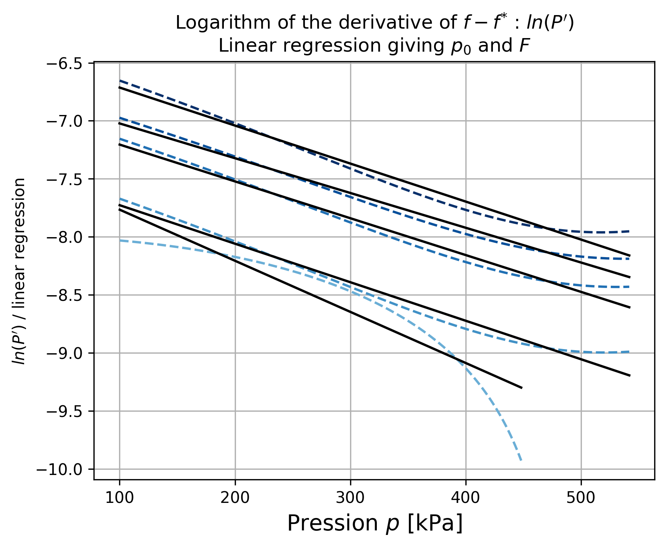
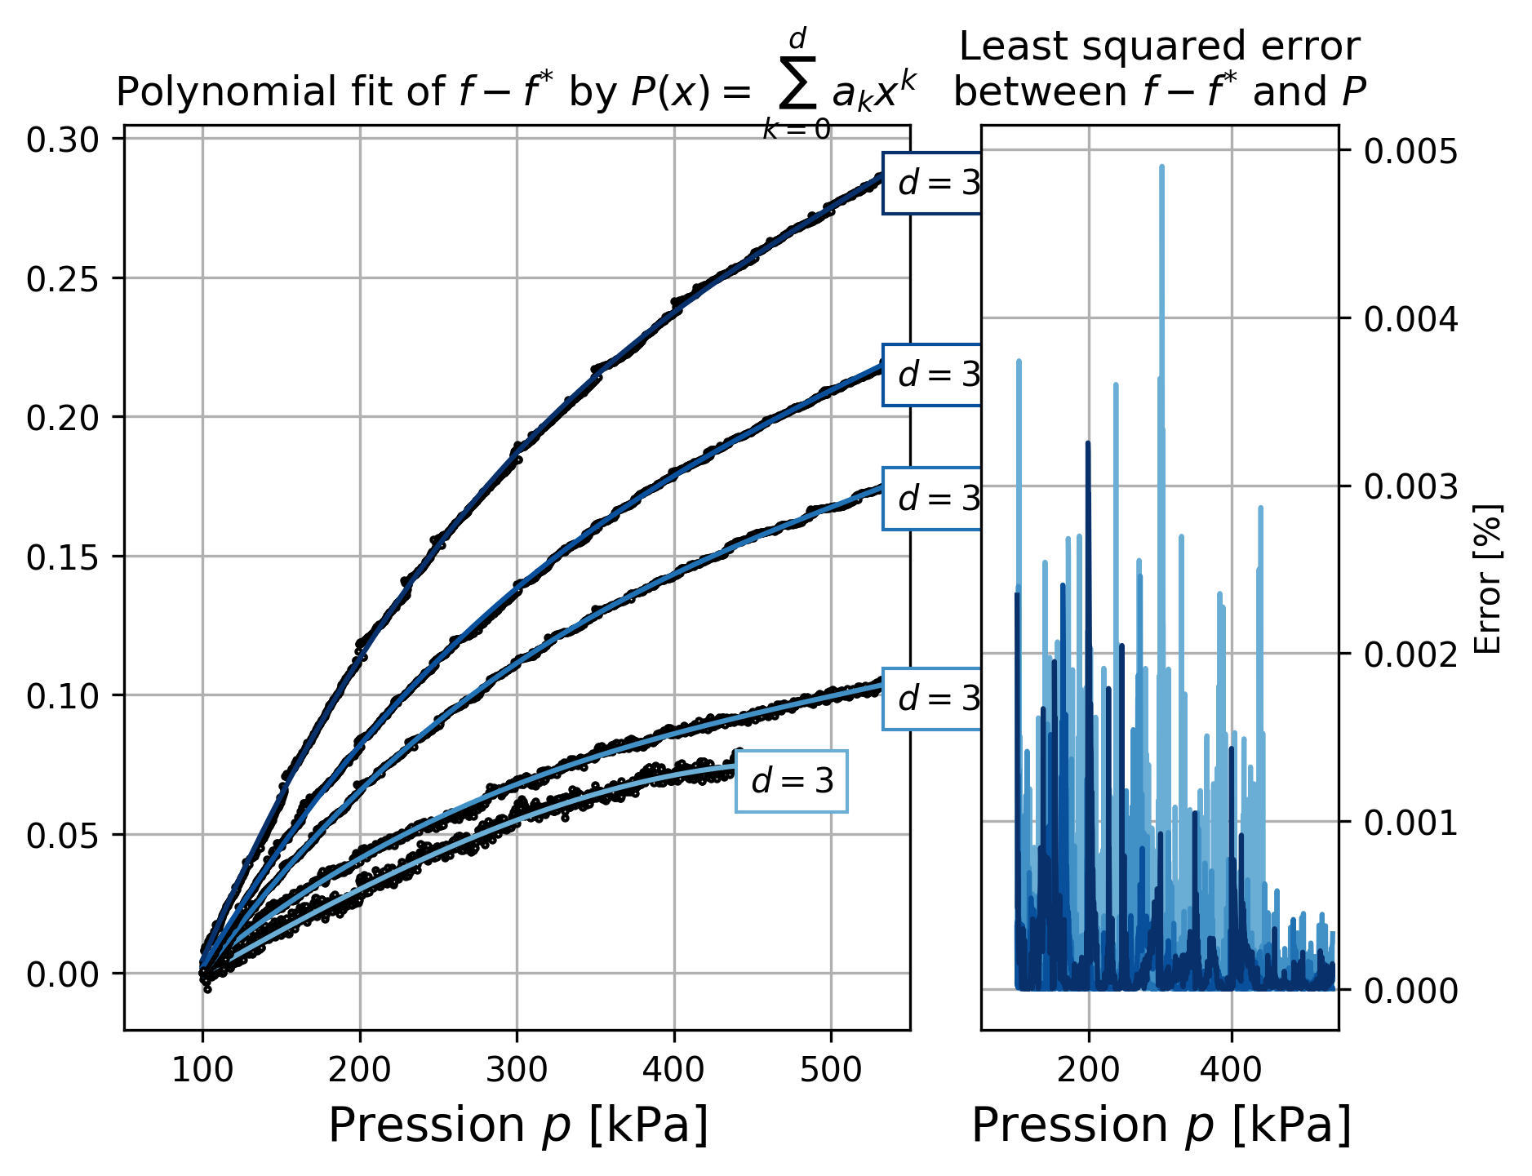
Figures

Slide 5
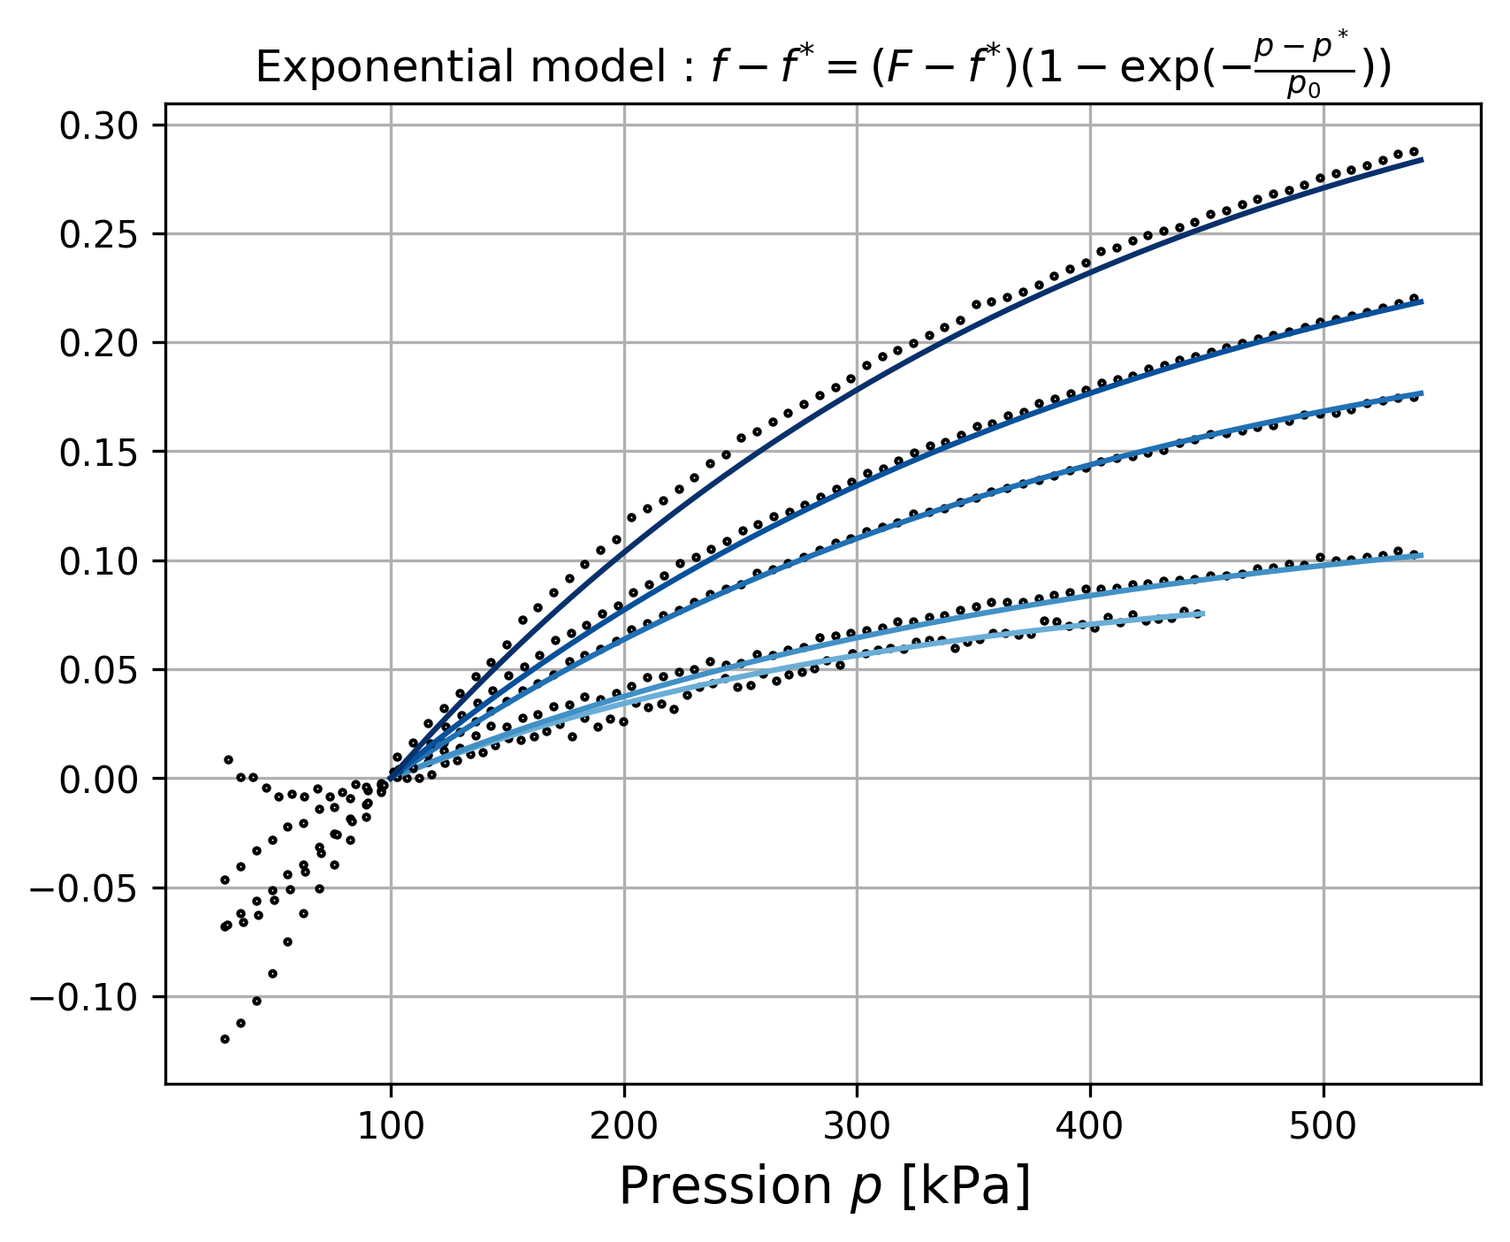
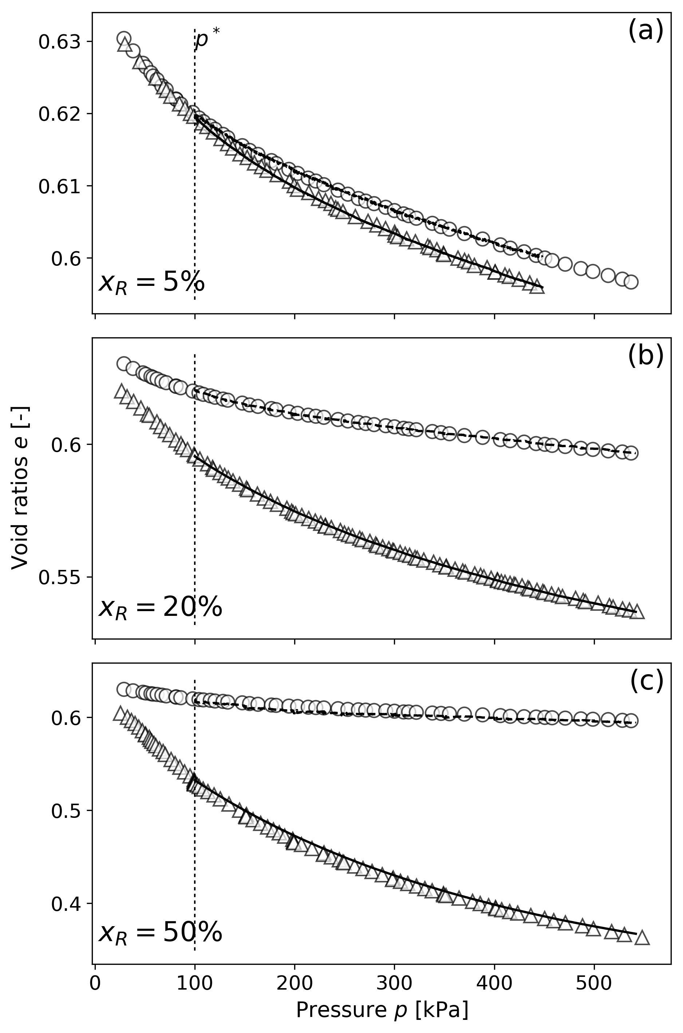
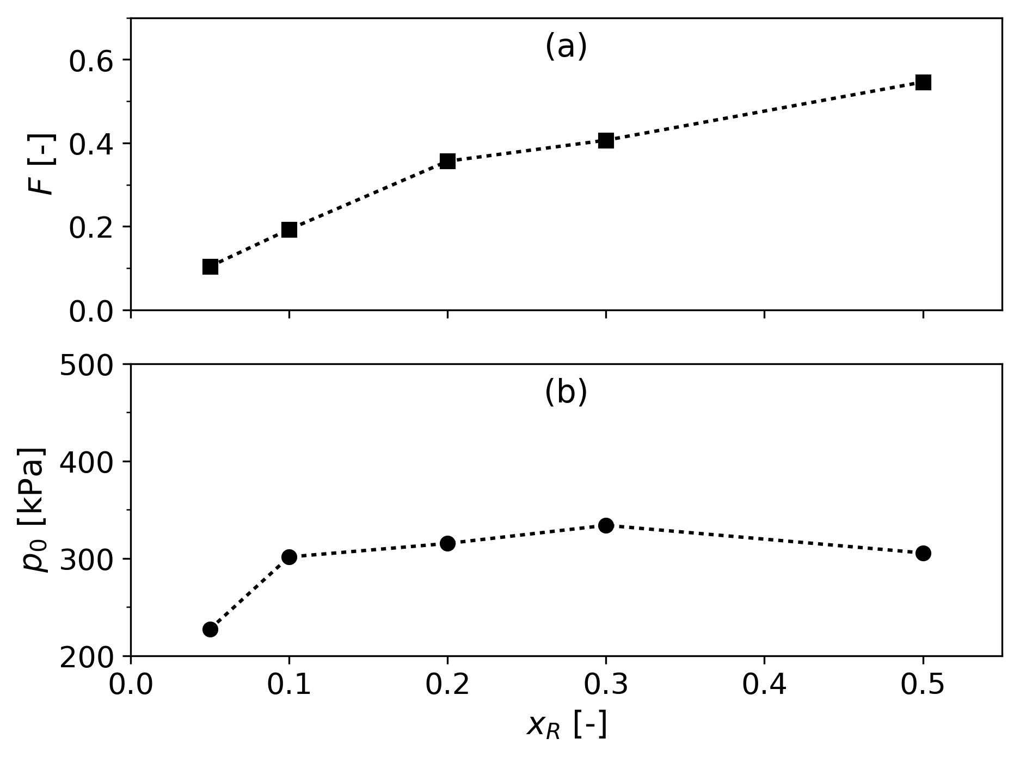

Slide 6
Second iteration: apply p0 and F to HS sand
Load pure sand experimental data
$$e(x_{R}=0,p)$$
Load mixture experimental data
$$e(x_{R},p)$$
Loop on$x_{R}$
Compute
$$f−f^{∗}=\frac{e\left(x_{R}=0,p\right)−e(x_{R},p)}{x_{R}}$$
Get p0 and F from previous iteration (LB polyfit)
$p_0$and $F$
HS_Fig3-1
Expe data vs. exponential model
$$f−f^{∗} vs.\tilde{f}= \left(F−f^{∗}\right)\left[1−exp\left(−\frac{p−p^{∗}}{p_{0}}\right)\right]$$
HS_Fig2-1
Compare theoretical (exp model) and experimental void ratios
$$\tilde{e}\left(x_{R},p\right)vs. e\left(x_{R},p\right)$$
$$\tilde{e}\left(x_{R}=0,p\right)vs. e\left(x_{R}=0,p\right)$$
HS_Fig4-1

Slide 7
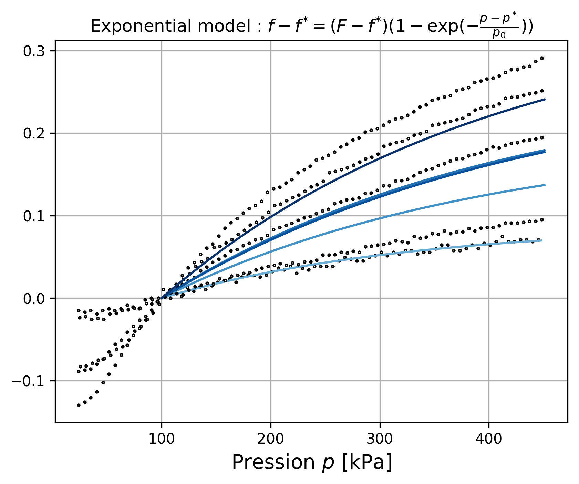
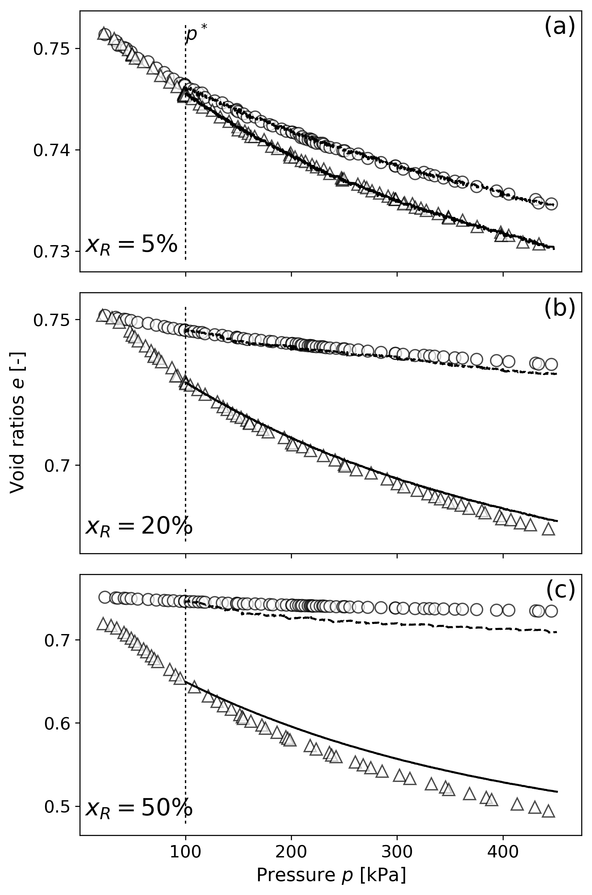
Figures
Idem as for LB

Slide 8

Third iteration: apply mean of p0 and linear regression of F to HS sand
Load pure sand experimental data
$$e(x_{R}=0,p)$$
Load mixture experimental data
$$e(x_{R},p)$$
Loop on$x_{R}$
Compute
$$f−f^{∗}=\frac{e\left(x_{R}=0,p\right)−e(x_{R},p)}{x_{R}}$$
Compute mean of p0
Compute linear regression of F
$p_{0}$and $F$
HS_Fig3-2
Expe data vs. exponential model
$$f−f^{∗} vs.\tilde{f}= \left(F−f^{∗}\right)\left[1−exp\left(−\frac{p−p^{∗}}{p_{0}}\right)\right]$$
HS_Fig2-2
Compare theoretical (exp model) and experimental void ratios
$$\tilde{e}\left(x_{R},p\right)vs. e\left(x_{R},p\right)$$
$$\tilde{e}\left(x_{R}=0,p\right)vs. e\left(x_{R}=0,p\right)$$
HS_Fig4-2

Slide 9
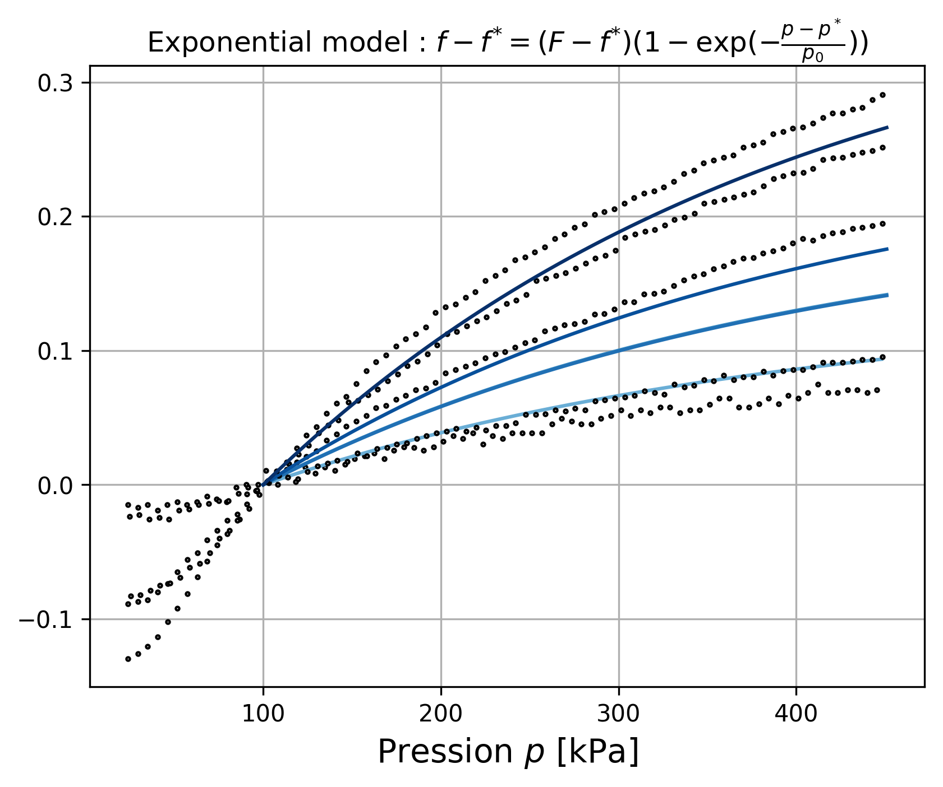
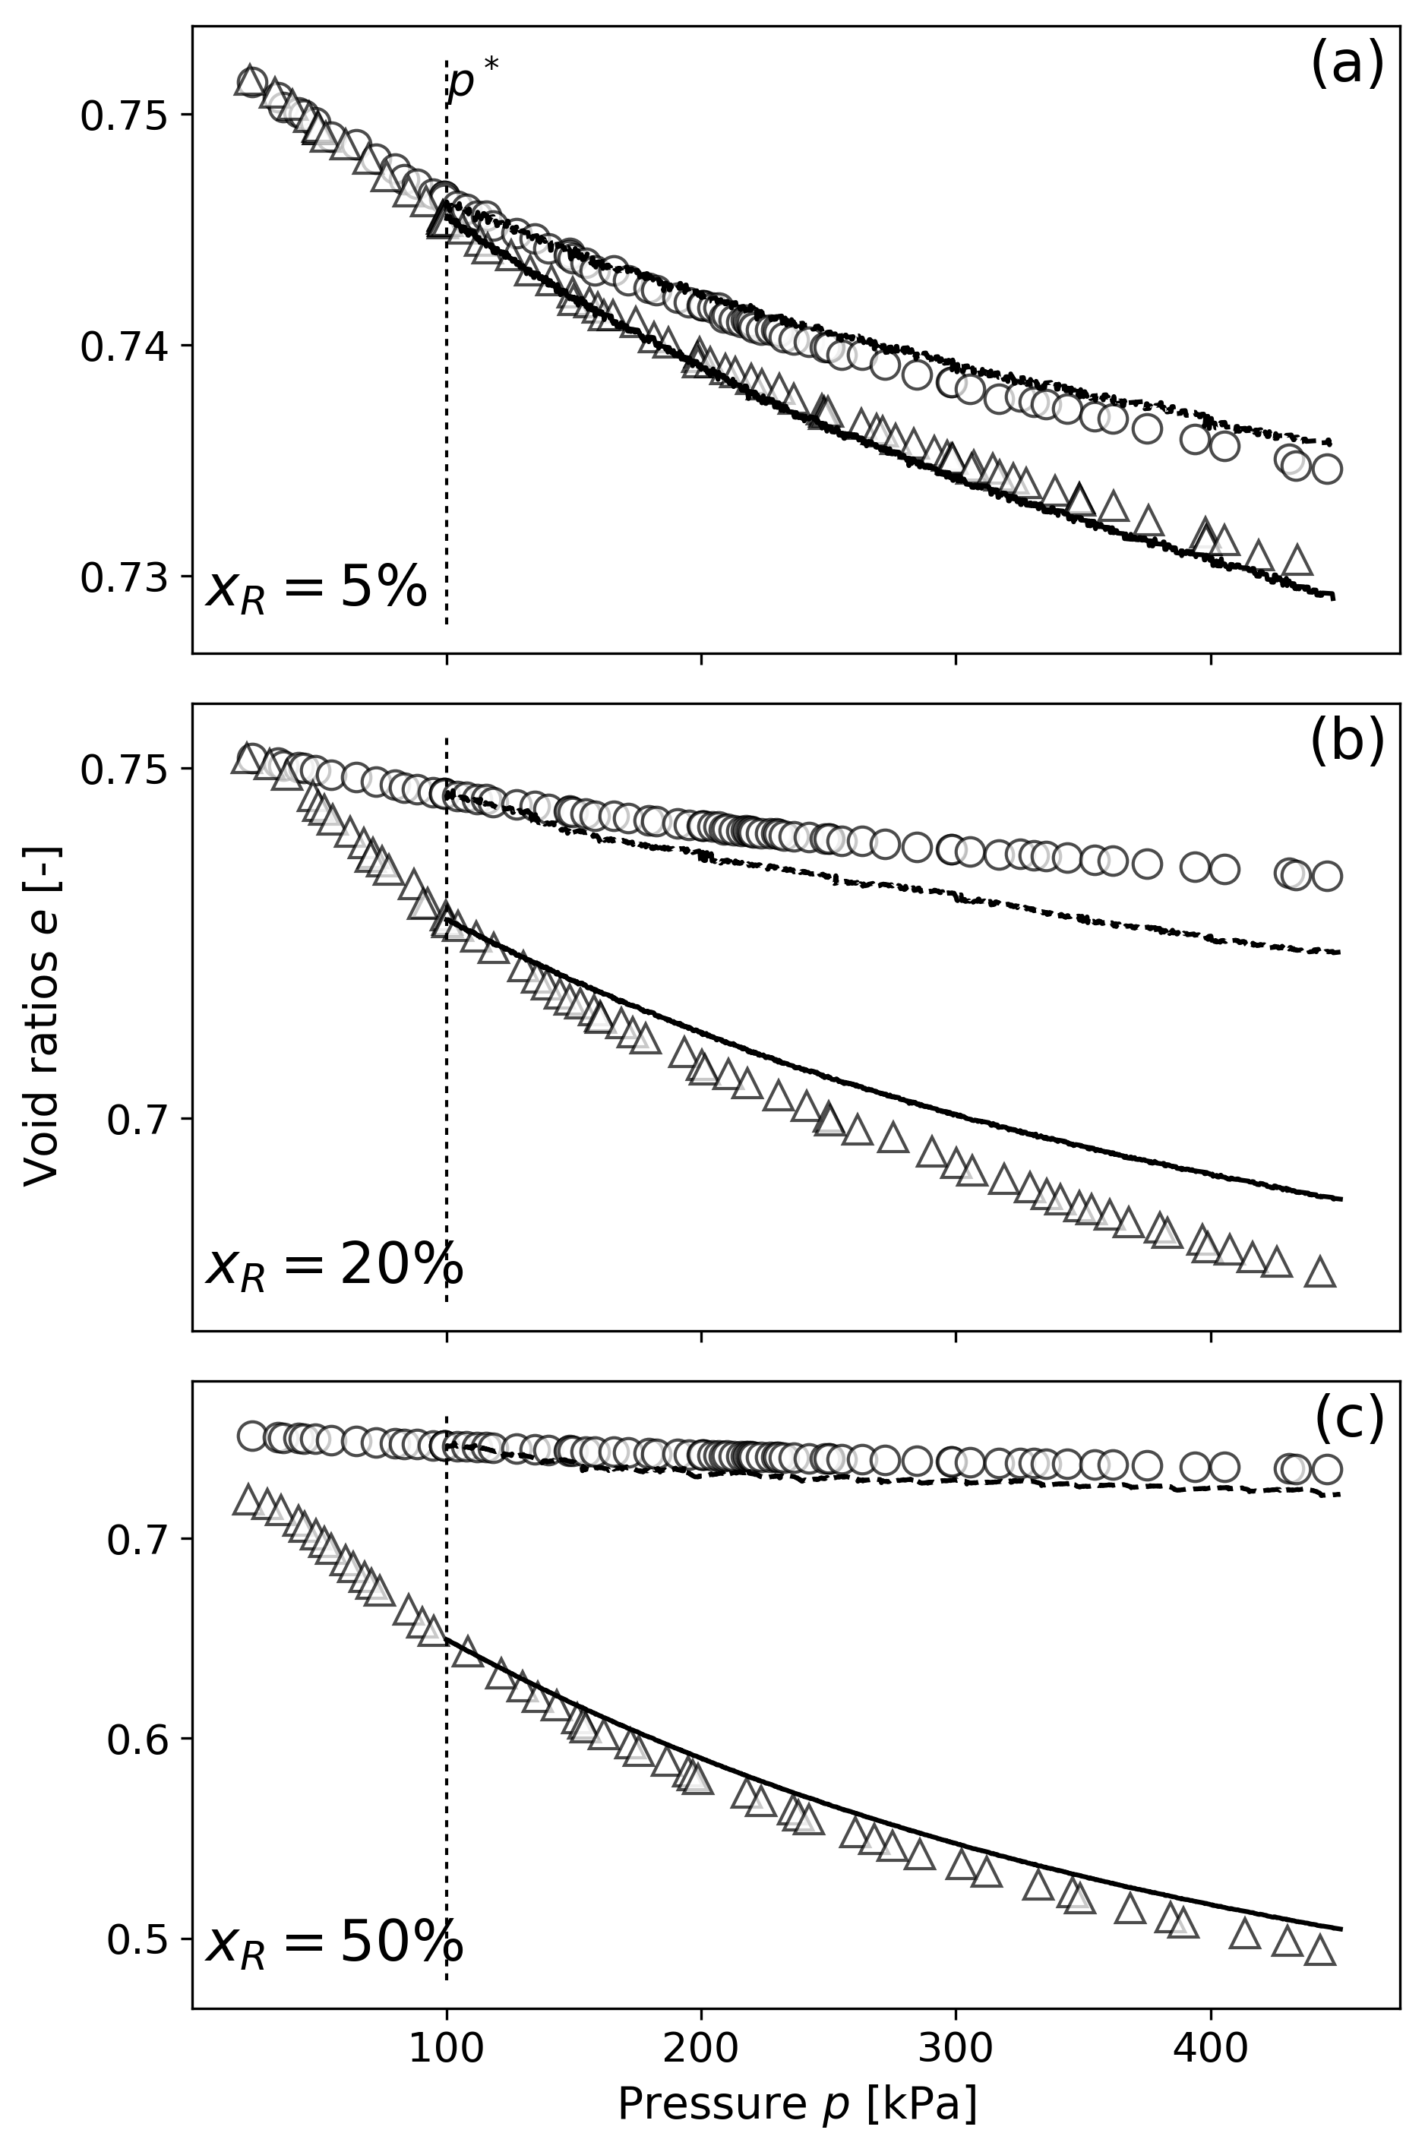
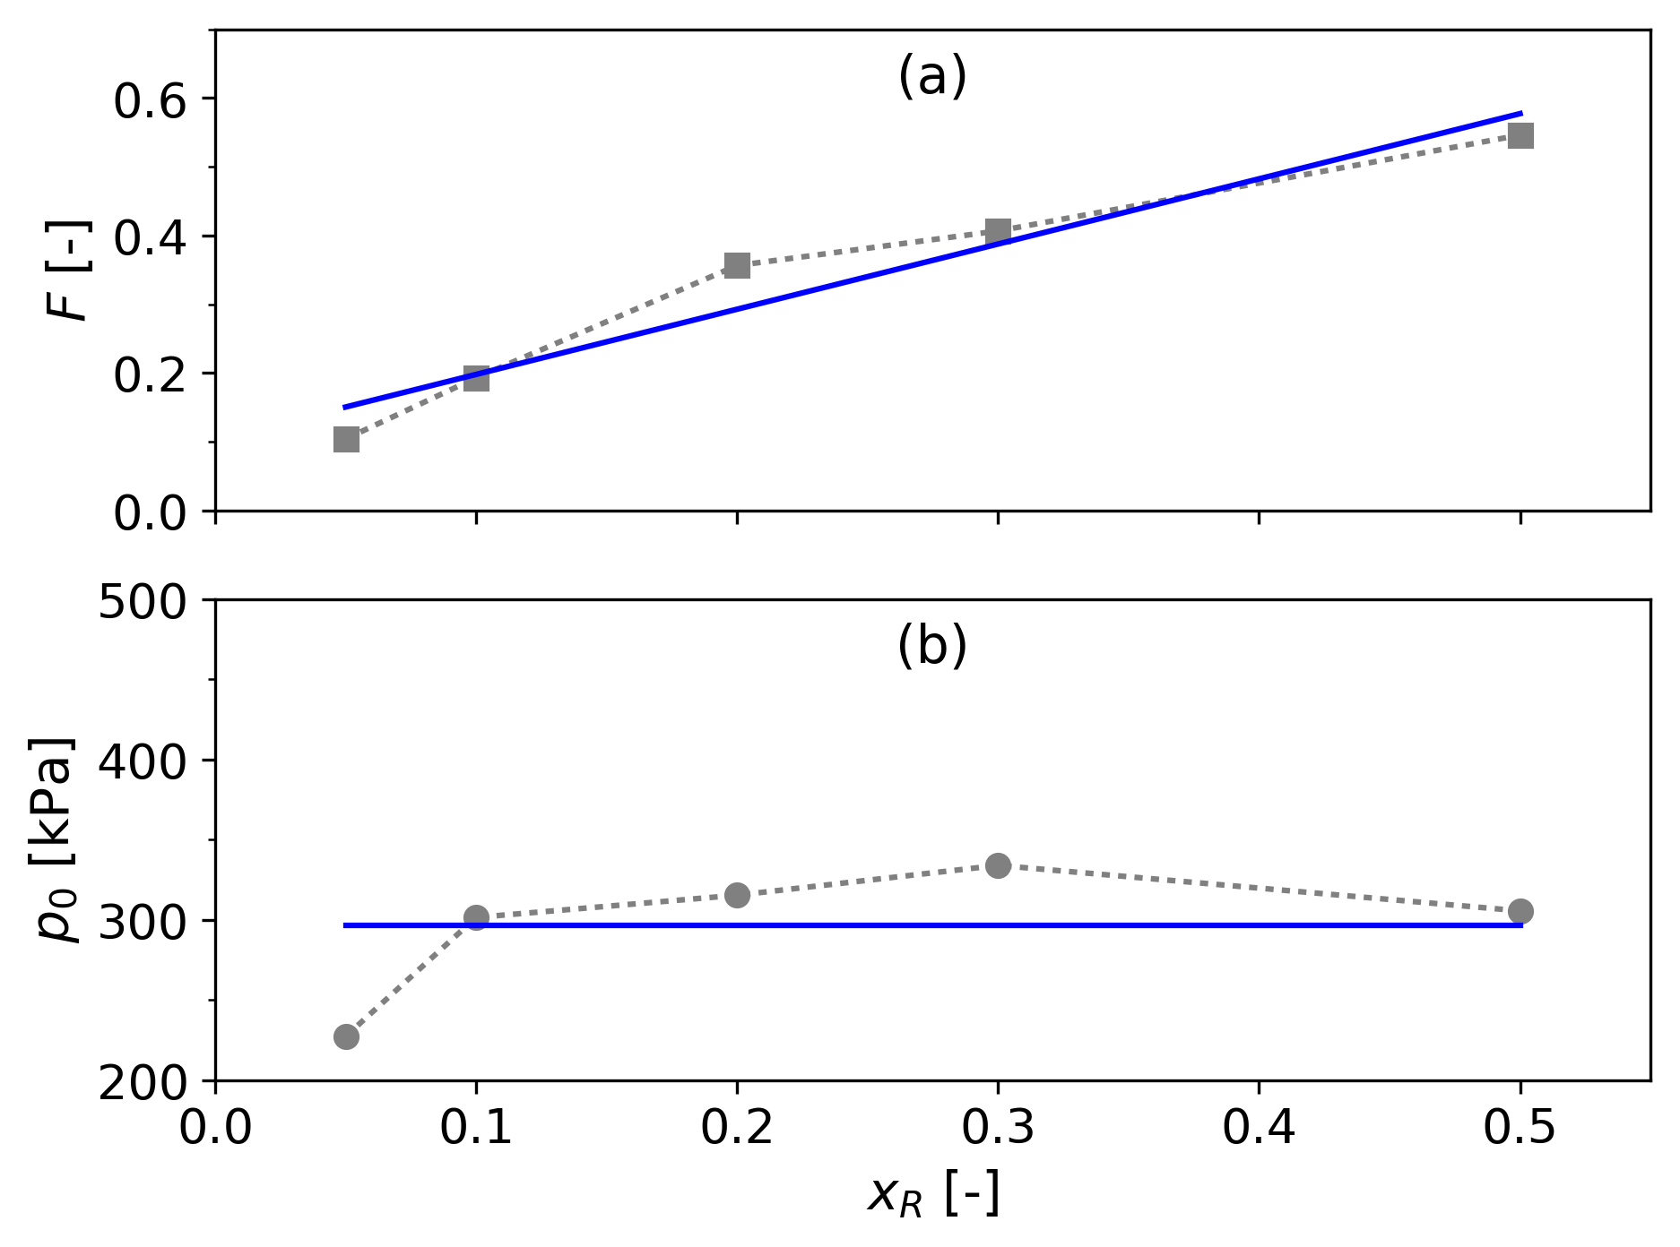
Figures
Mean and linear regression of LB

Slide 10
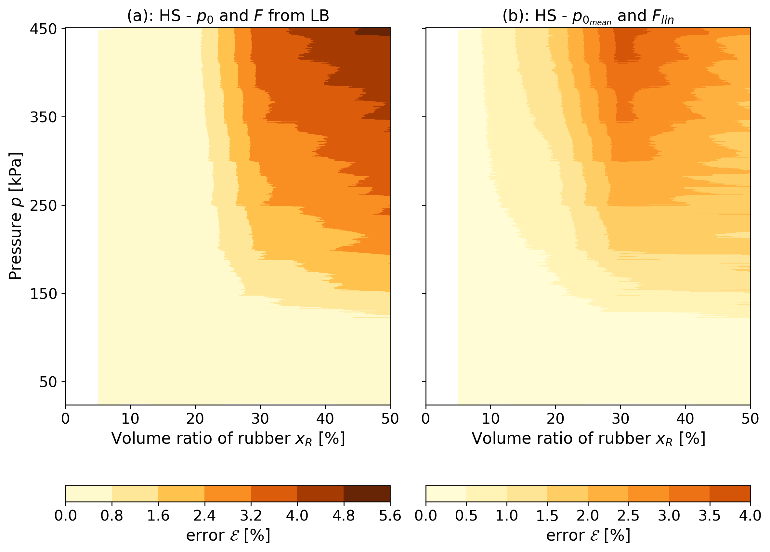
Error map between theoritical and experiemental voids ratios of mixtures for both method with HS sand Filled isolines (contourf in matplotlib)

