Slide 1
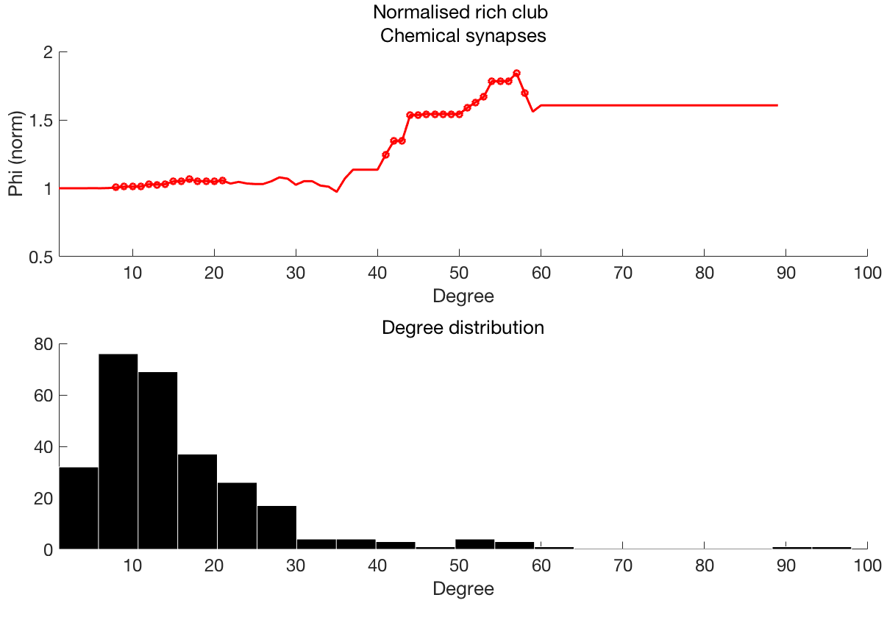
Normalised rich club coefficient
Degree>=k

Slide 2
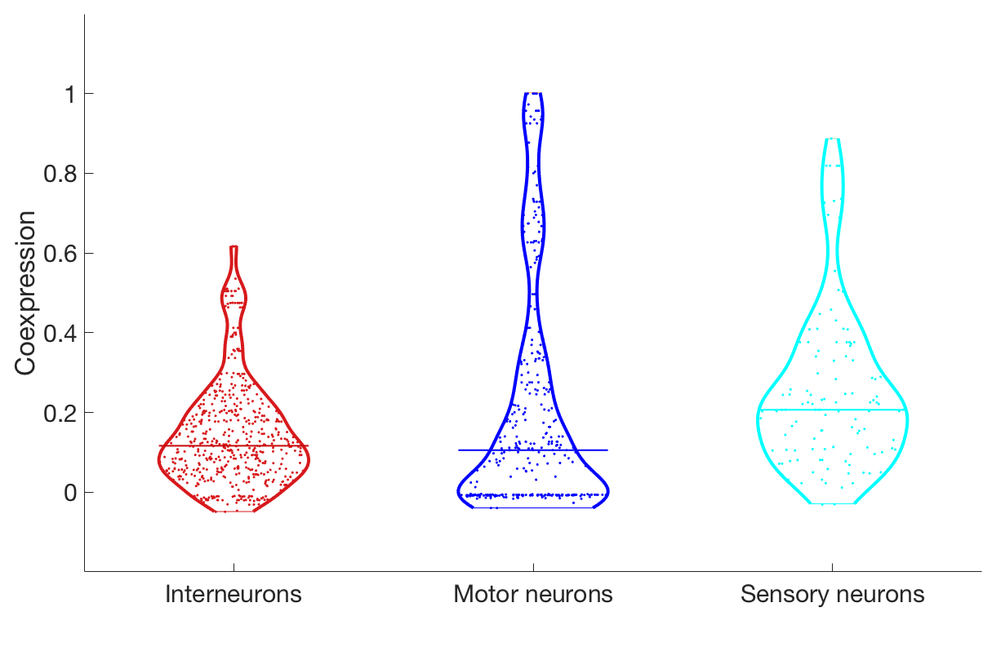
** p < 10⁻⁶
t=-5.34
** p < 10⁻⁴
t=-4.13
(φ)

Slide 3
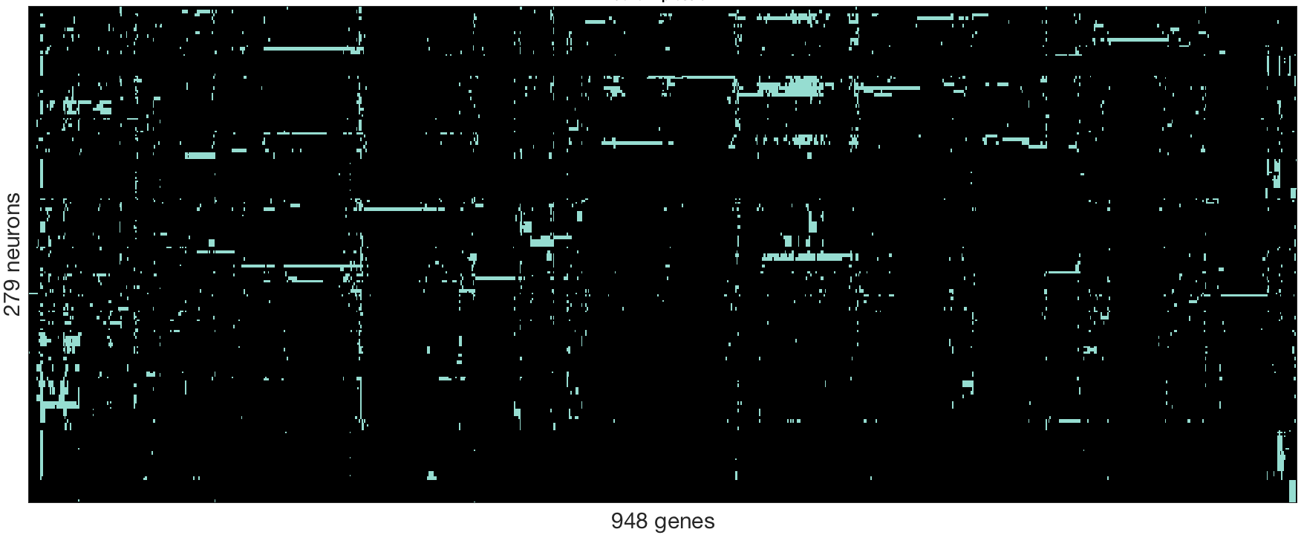
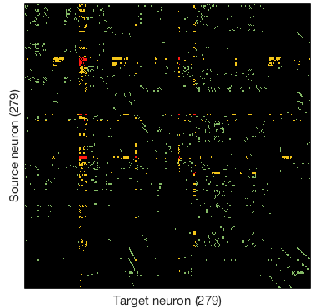
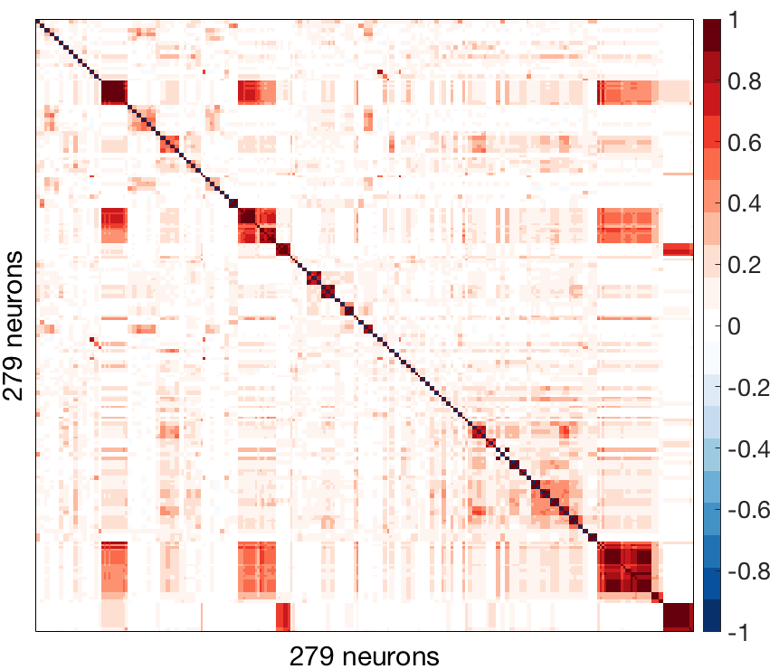
A: Gene expression
B: Connectivity
C: Gene coexpression

Slide 4
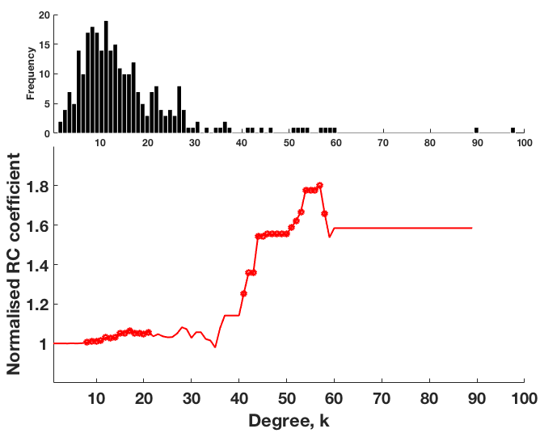

Slide 5
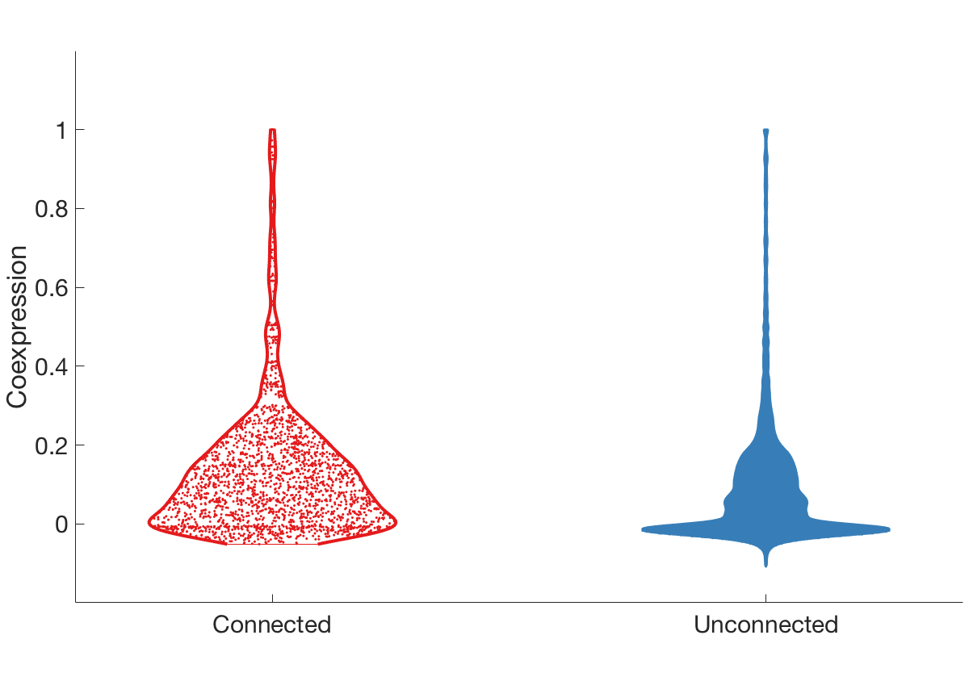
**p < 10⁻²⁴
(φ)

Slide 6
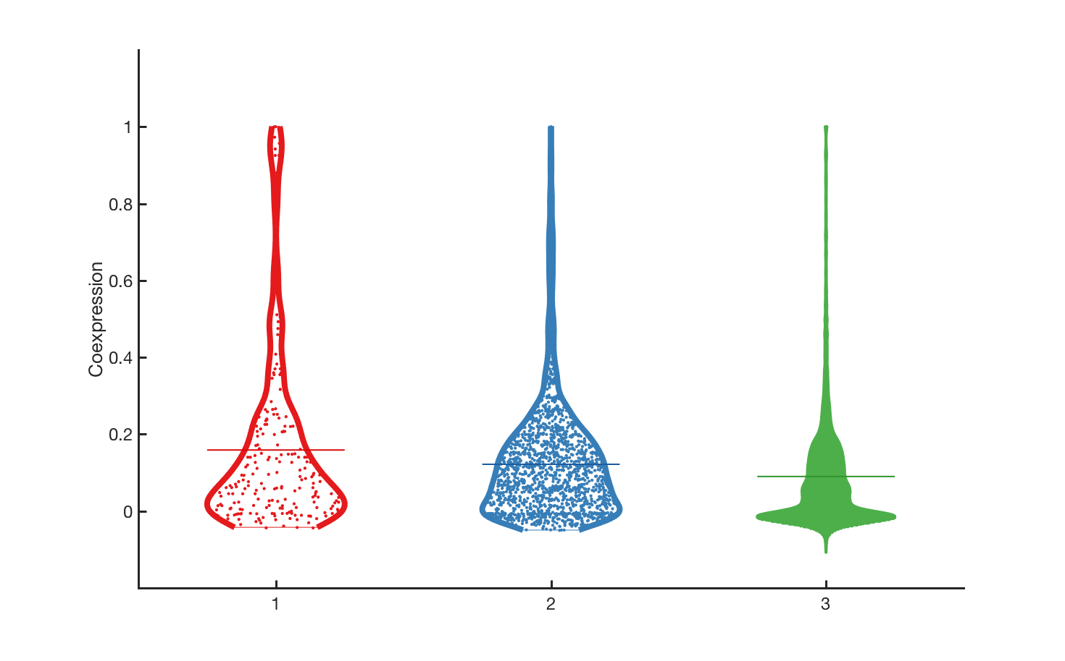
**p < 10⁻⁵
*p < 0.05
**p < 10⁻¹⁸
Coexpression (ϕ)
Reciprocal
connections
Unidirectional
connections
Unconnected

Slide 7
**p < 10⁻⁵
*p < 0.05
**p < 10⁻¹⁸
Coexpression (ϕ)
Reciprocal
connections
Unidirectional
connections
Unconnected

Slide 8
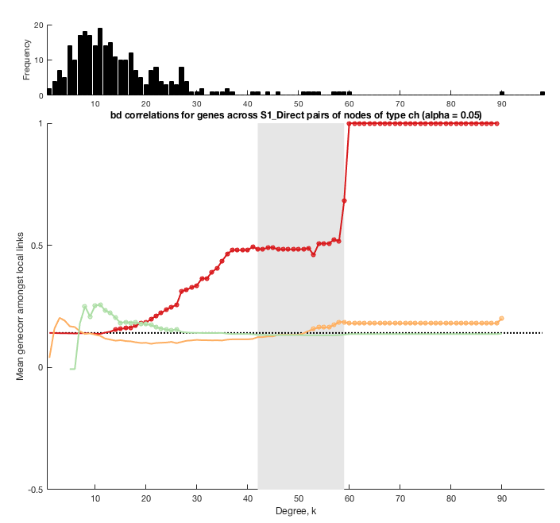

Slide 9
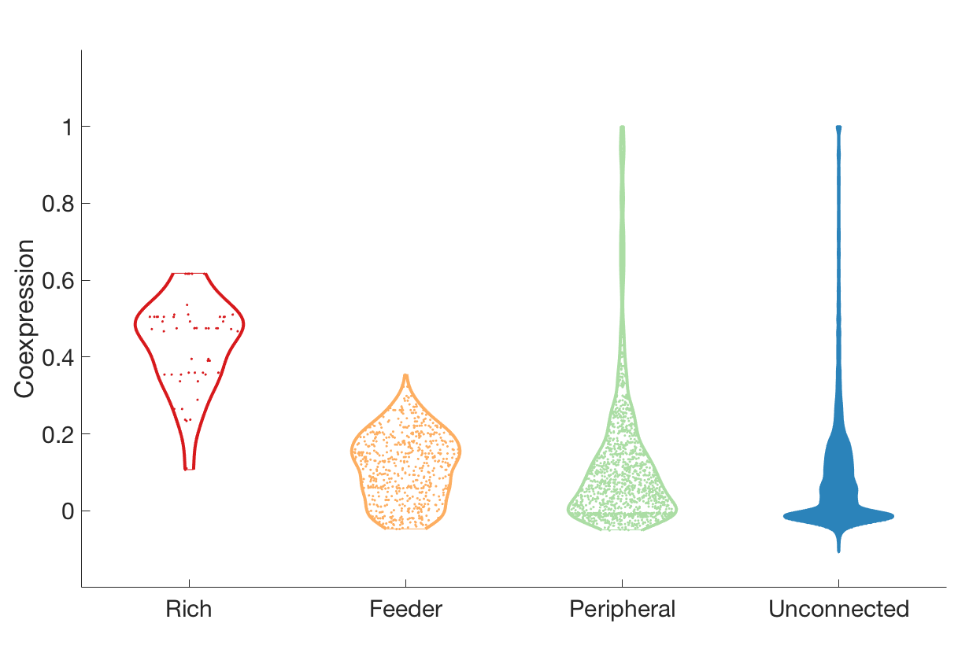
hub
non-hub
** p < 10⁻²⁸
** p < 10⁻¹⁰
(φ)
** p < 10⁻²⁸
** p < 10⁻⁷

Slide 10
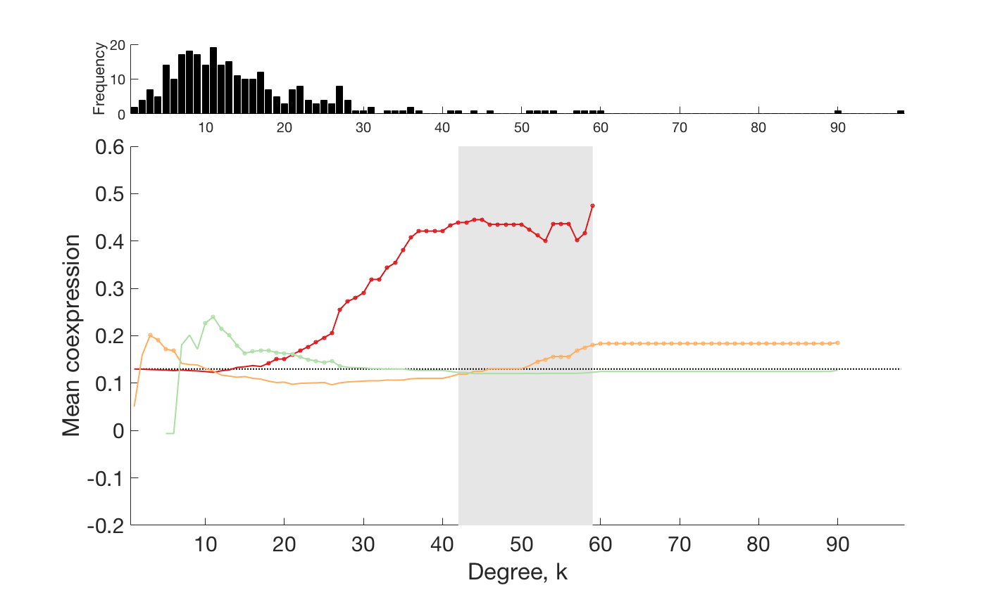
Rich
Feeder
Peripheral

Slide 11
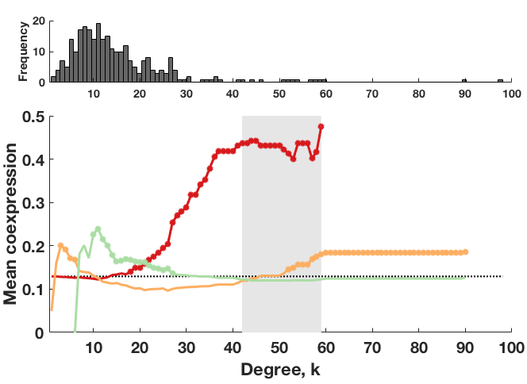
Rich
Feeder
Peripheral

Slide 12
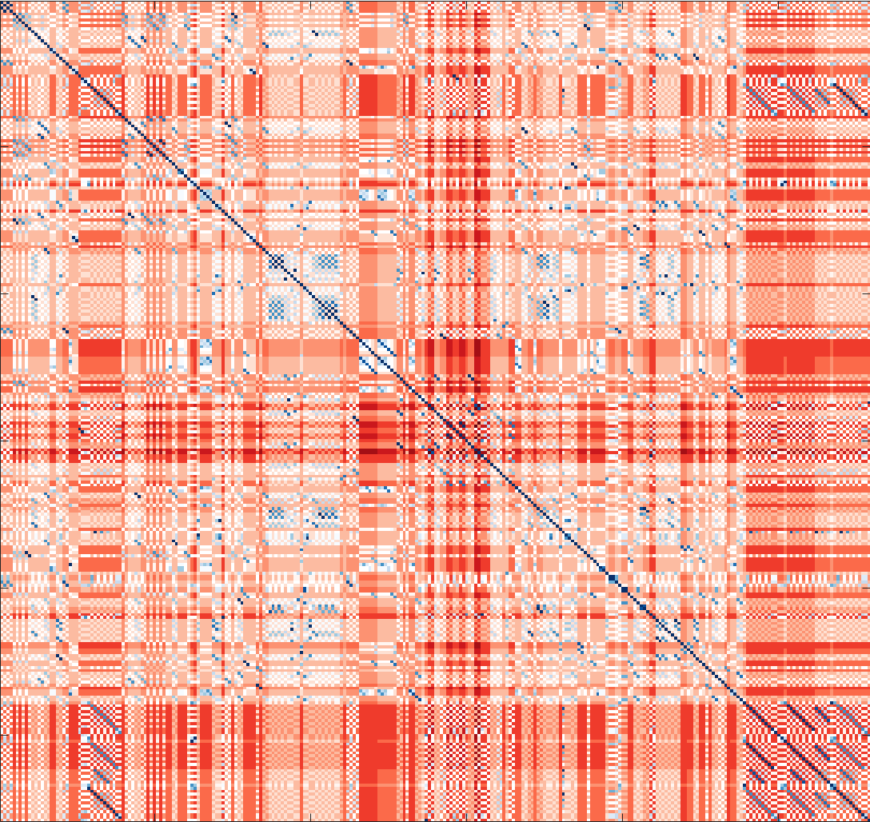

Slide 13
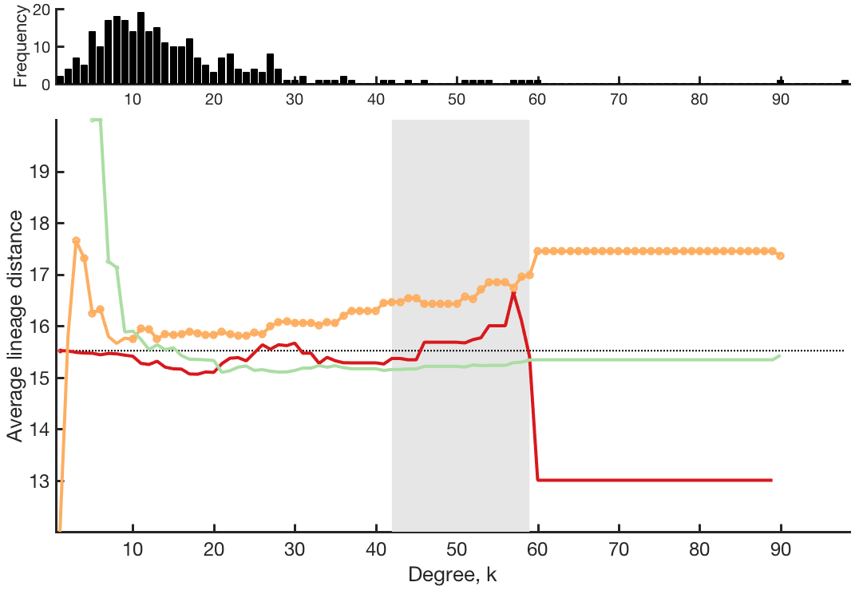
Rich
Feeder
Peripheral

