Slide 1
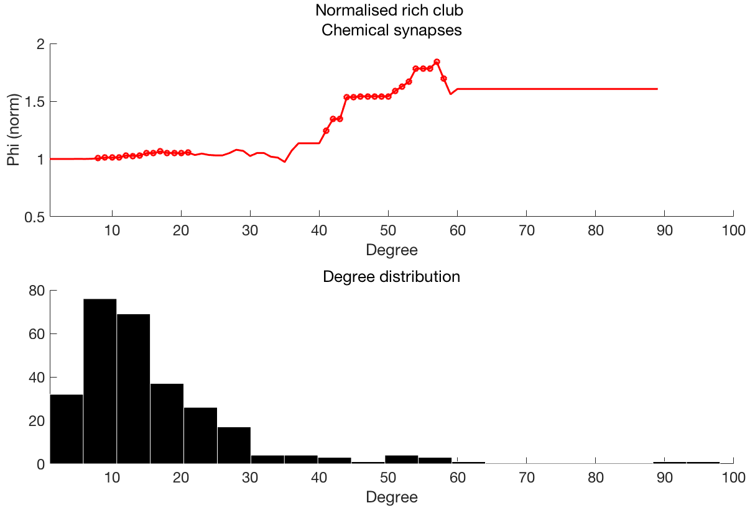
Normalised rich club coefficient
Degree>=k

Slide 2
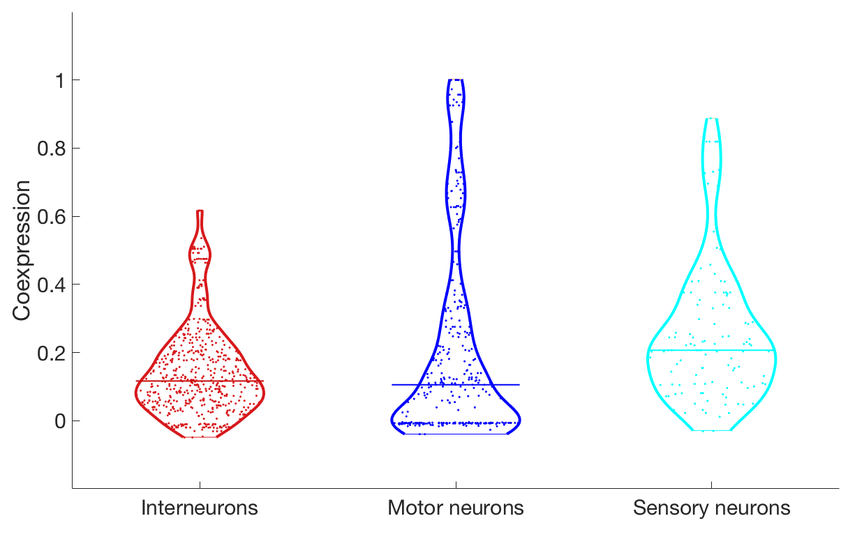
** p < 10⁻⁶
t=-5.34
** p < 10⁻⁴
t=-4.13
(φ)

Slide 3
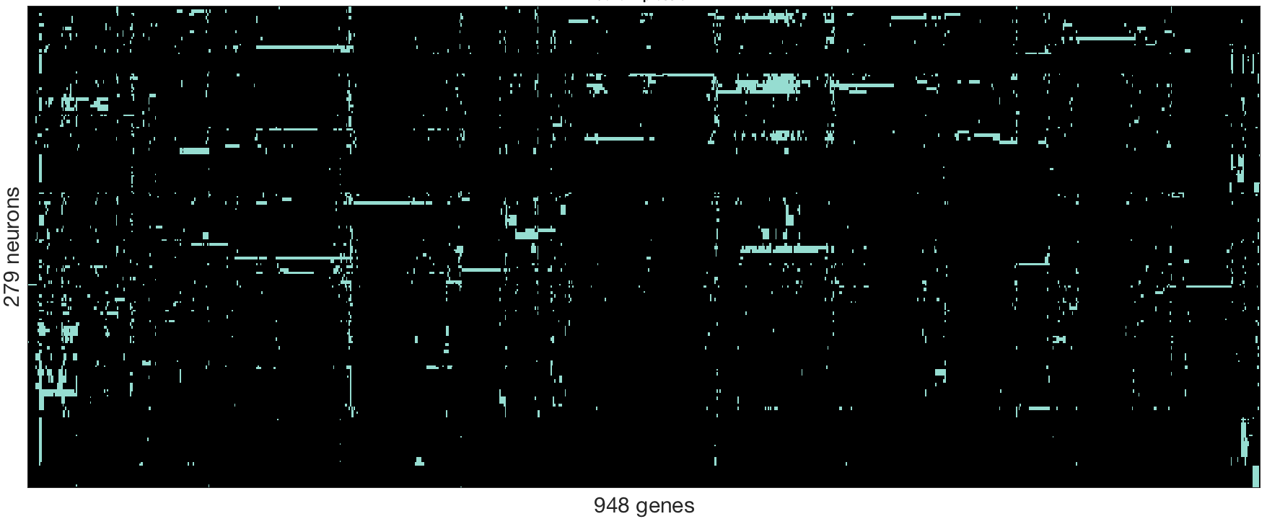
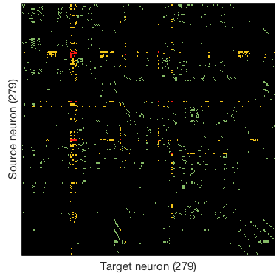
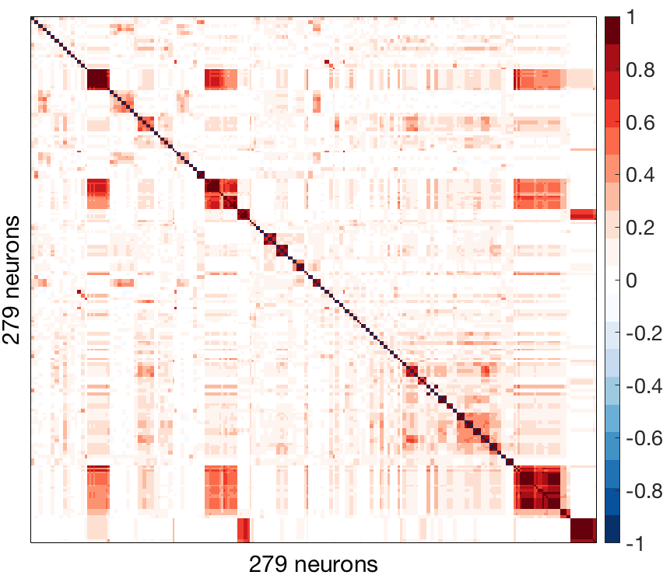
A: Gene expression
B: Connectivity
C: Gene coexpression

Slide 4
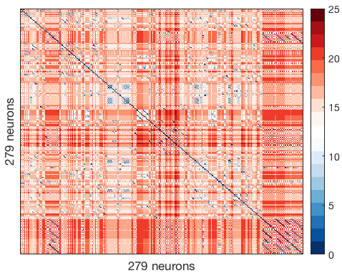
A: Gene expression
B: Connectivity
C: Gene coexpression
D: Lineage distance

Slide 5
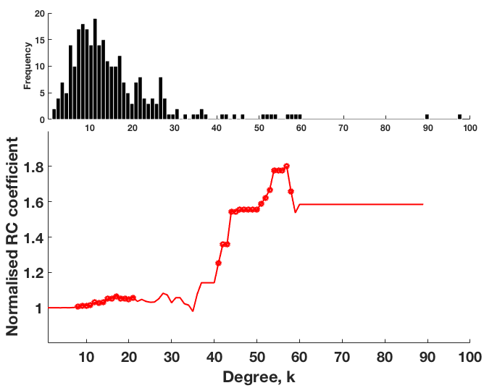

Slide 6
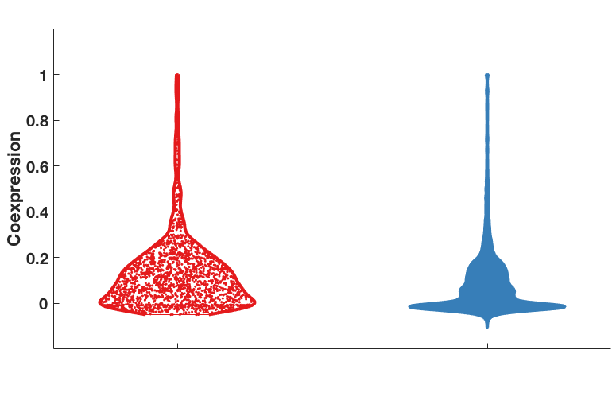
**p < 10⁻⁵⁰
(φ)
Connected
Unconnected

Slide 7
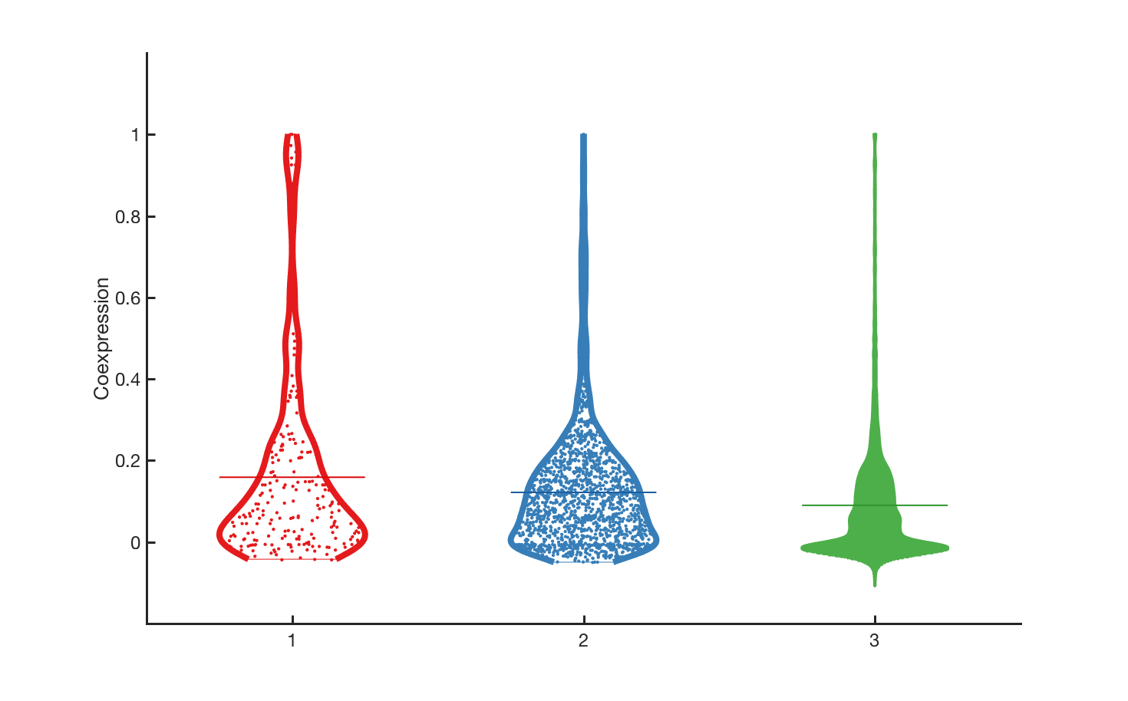
**p < 10⁻⁵
*p < 0.05
**p < 10⁻¹⁸
Coexpression (ϕ)
Reciprocal
connections
Unidirectional
connections
Unconnected

Slide 8
**p < 10⁻⁵
*p < 0.05
**p < 10⁻¹⁸
Coexpression (ϕ)
Reciprocal
connections
Unidirectional
connections
Unconnected

Slide 9
**p < 10⁻⁵
*p < 0.05
**p < 10⁻¹⁸
Coexpression (ϕ)
Reciprocal
connections
Unidirectional
connections
Unconnected

Slide 10
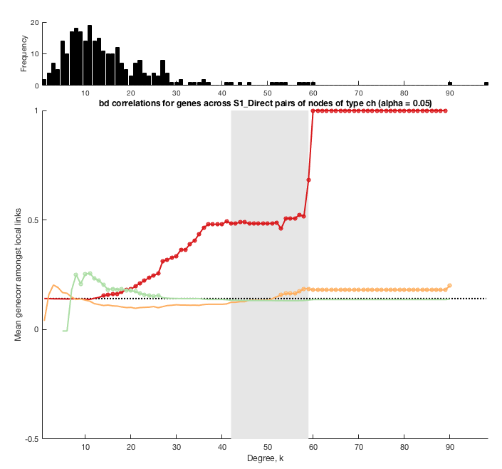

Slide 11
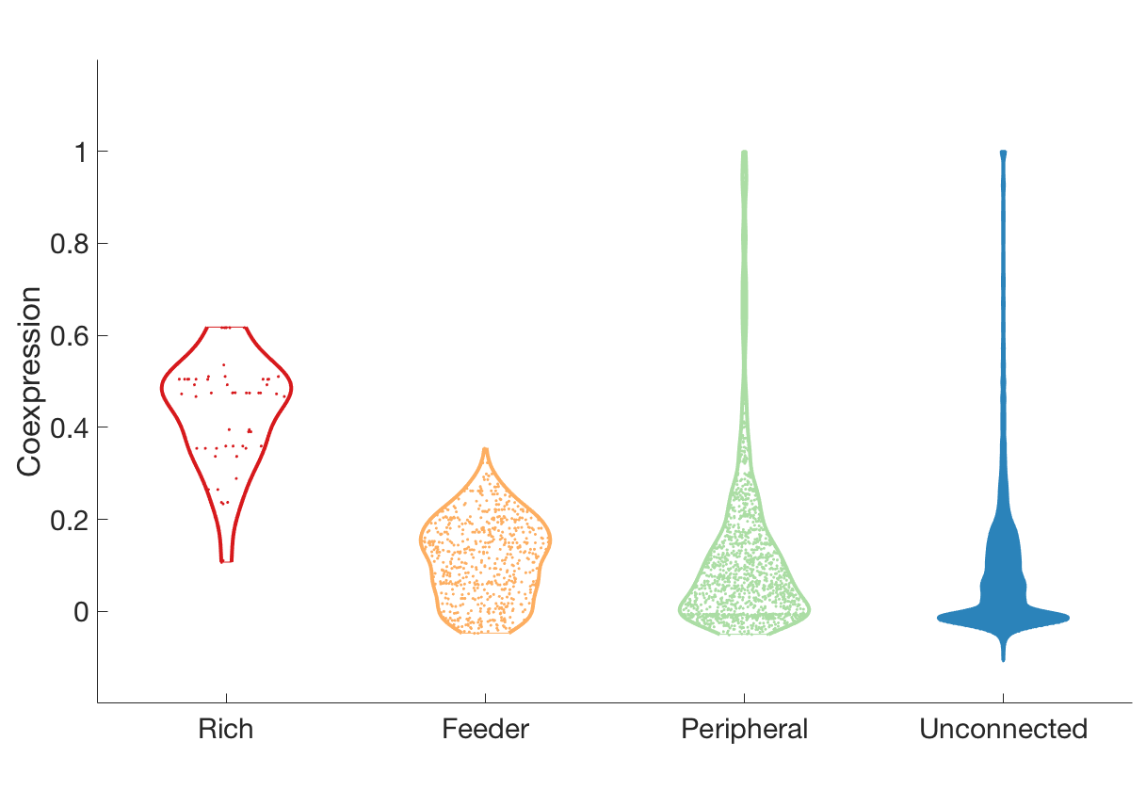
hub
non-hub
** p < 10⁻²⁸
** p < 10⁻¹⁰
(φ)
** p < 10⁻²⁸
** p < 10⁻⁷

Slide 12
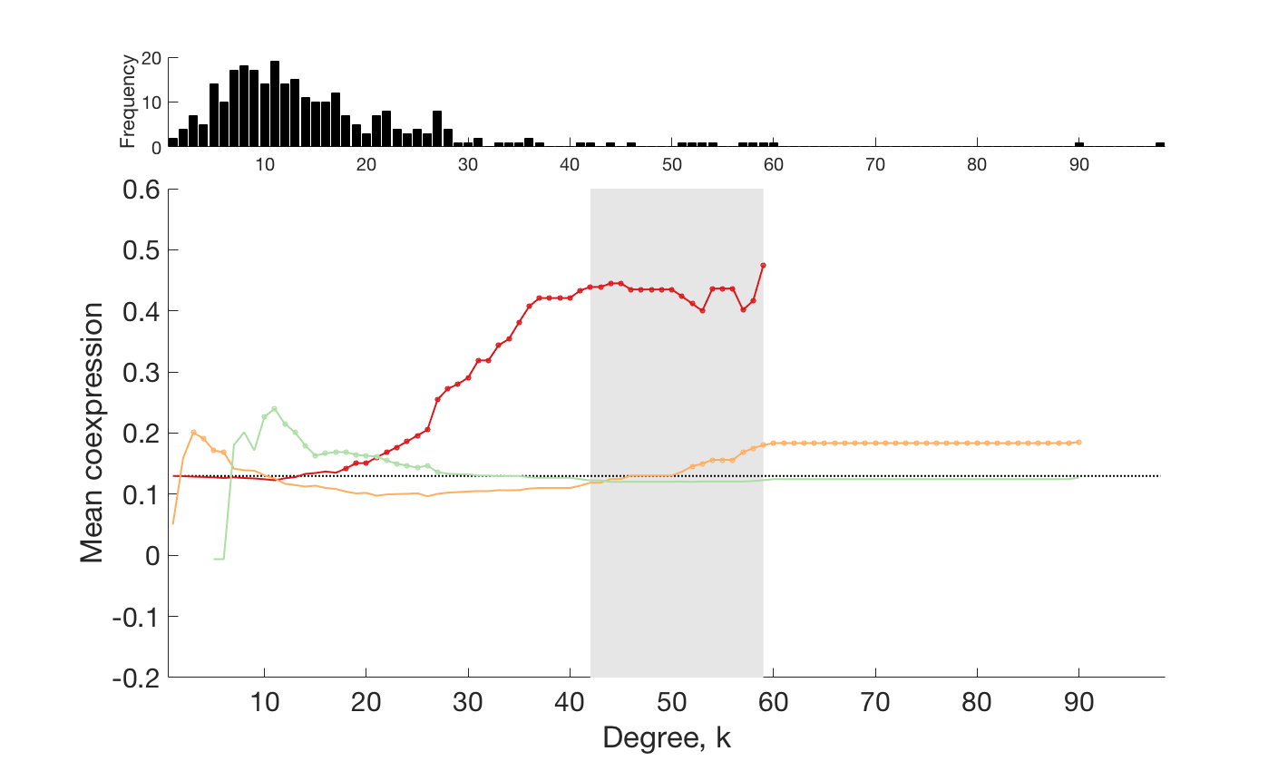
Rich
Feeder
Peripheral

Slide 13
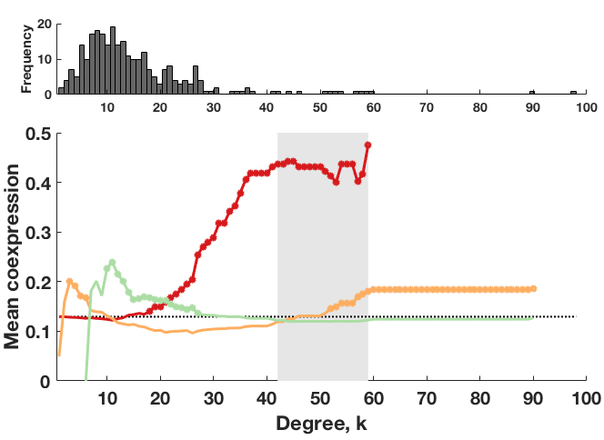
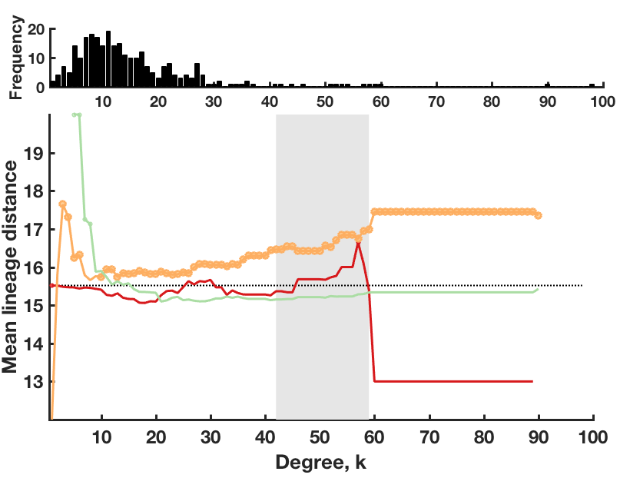
Rich
Feeder
Peripheral

Slide 14
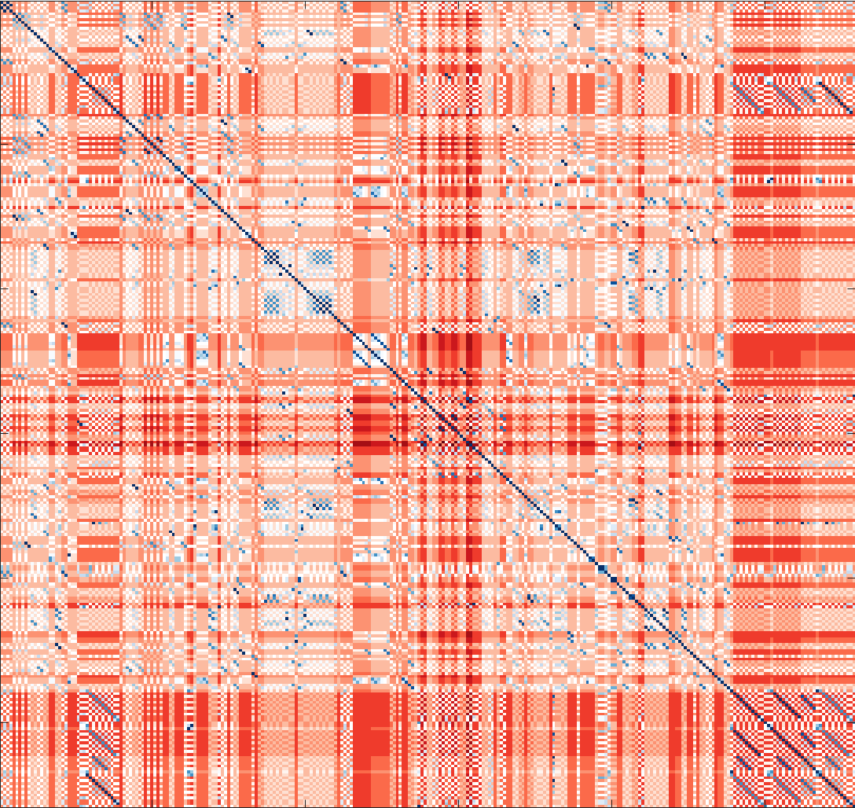

Slide 15
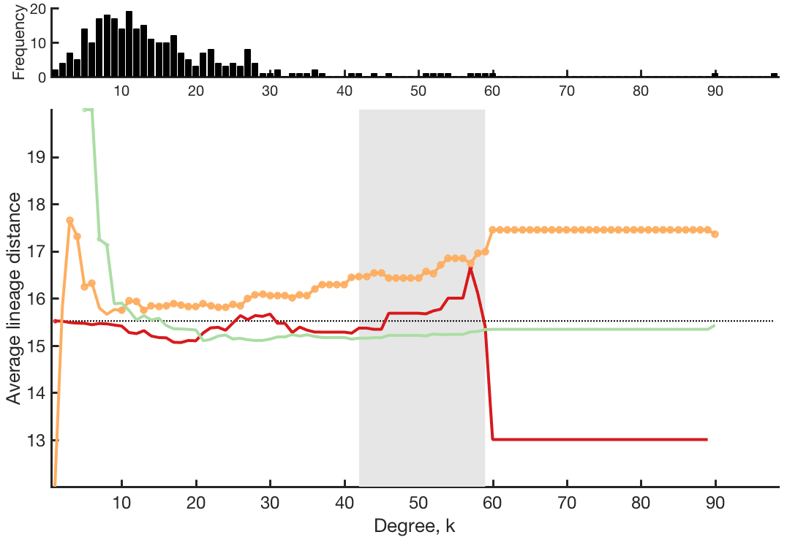

Slide 16
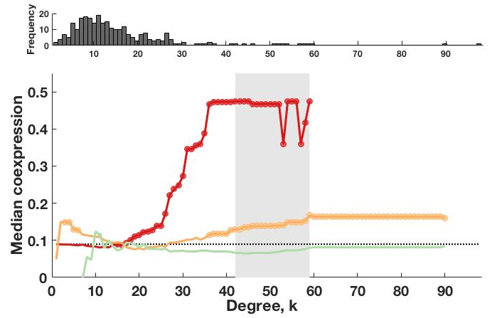
Rich
Feeder
Peripheral

Slide 17
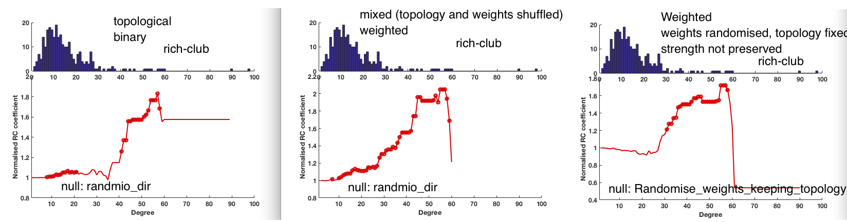

Slide 18
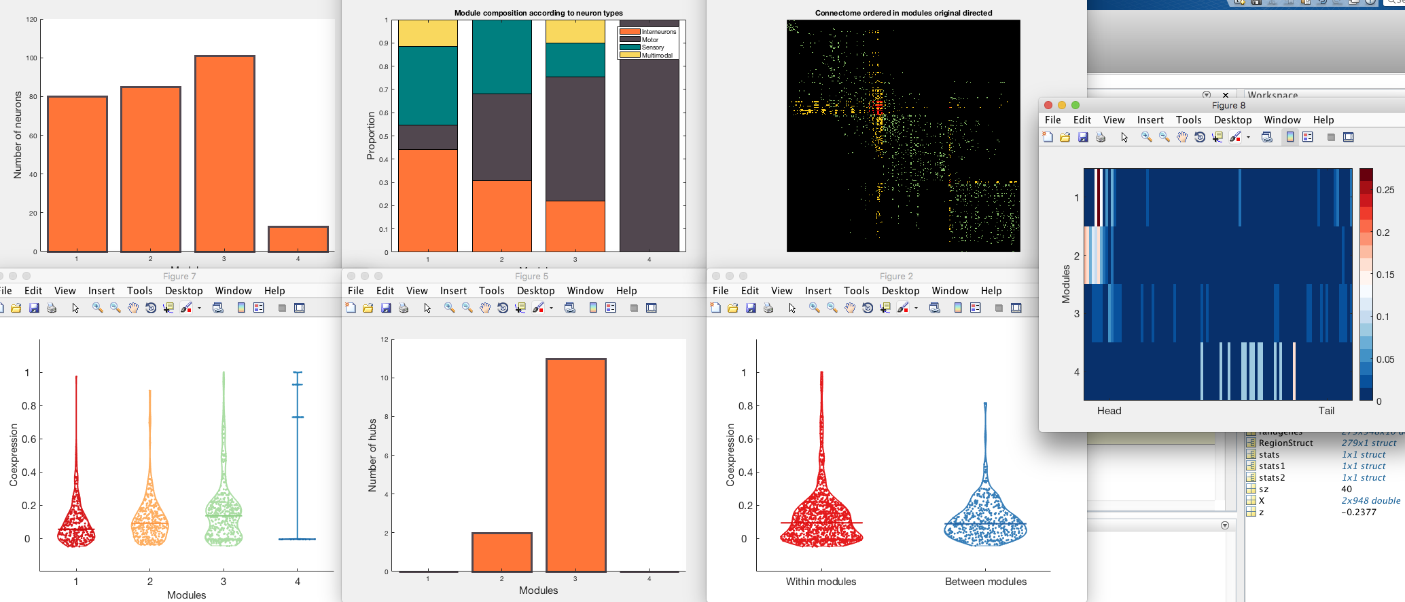


Slide 19
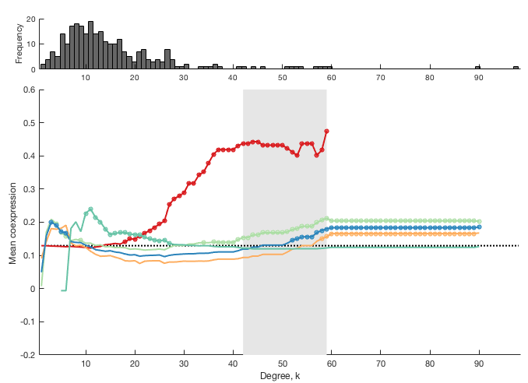

Slide 20
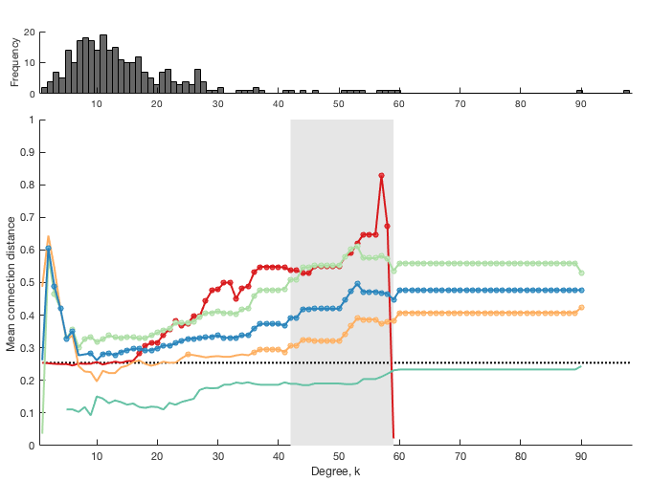

Slide 21
