Slide 1
AIBOS · CREATE PROJECT
A Note from
創
Create Project
Two products, a team of seven, and the quarter behind them.
二つのプロダクト、七人のチーム、そしてこの四半期の歩み。
クリエイト・プロジェクト便り
Q2 · 2026年春 · Spring 2026
FOR THE BOARD · 取締役会用

Slide 2
ご挨拶
A NOTE
A short note from Create Project —
on what the team has been building this quarter,
and where it is going next.
今期に作ってきたもの、そしてこれからの行き先について、一筆。
ご挨拶 · A NOTE
02 / 17

Slide 3
仲間
THE TEAM
Six makers. Two products. One team.
Every strength is known — every role assigned accordingly.
一人ひとりの強みを把握し、役割を的確に振り分けています。
統率
設計
基盤
Ambrose
Aita
Muzuva
Systems & Product
Workflow Engine
Backend & Pipeline
土台
表層
補佐
Lauben
Crispus
Otai
Infrastructure
Frontend
Backend Support
Engineering, product, infrastructure — all carried by the same six people.
仲間 · THE TEAM
03 / 17

Slide 4
流儀
HOW WE BUILD
Three principles every feature is held to.
すべての機能が通る、三つの原則。
Traceability
Ownership
Design first
追跡
責任
設計
Every feature
The engineer who ships it
We prove the design
maps back to a customer's exact words — no code without a request.
is the engineer who stands behind it when it runs in production.
on paper before we write a line of code — rework starts before the build.
顧客の言葉に紐づかない機能は、書かない。
作る者が、運用を支える者になる。
コードを書く前に、設計を確かめる。
流儀 · HOW WE BUILD
04 / 17

Slide 5
其ノ壱 · APPAREL
Apparel
A product photo becomes a full fashion campaign.
一枚の商品写真から、プロ仕様のキャンペーンへ。
A brand uploads one photo of a garment.
The team picks the model, the background, the mood.
In the time it takes to pour a coffee, a full campaign arrives —
every look, every angle, ready to publish.
其ノ壱 · APPAREL · PRODUCT ONE
05 / 17

Slide 6
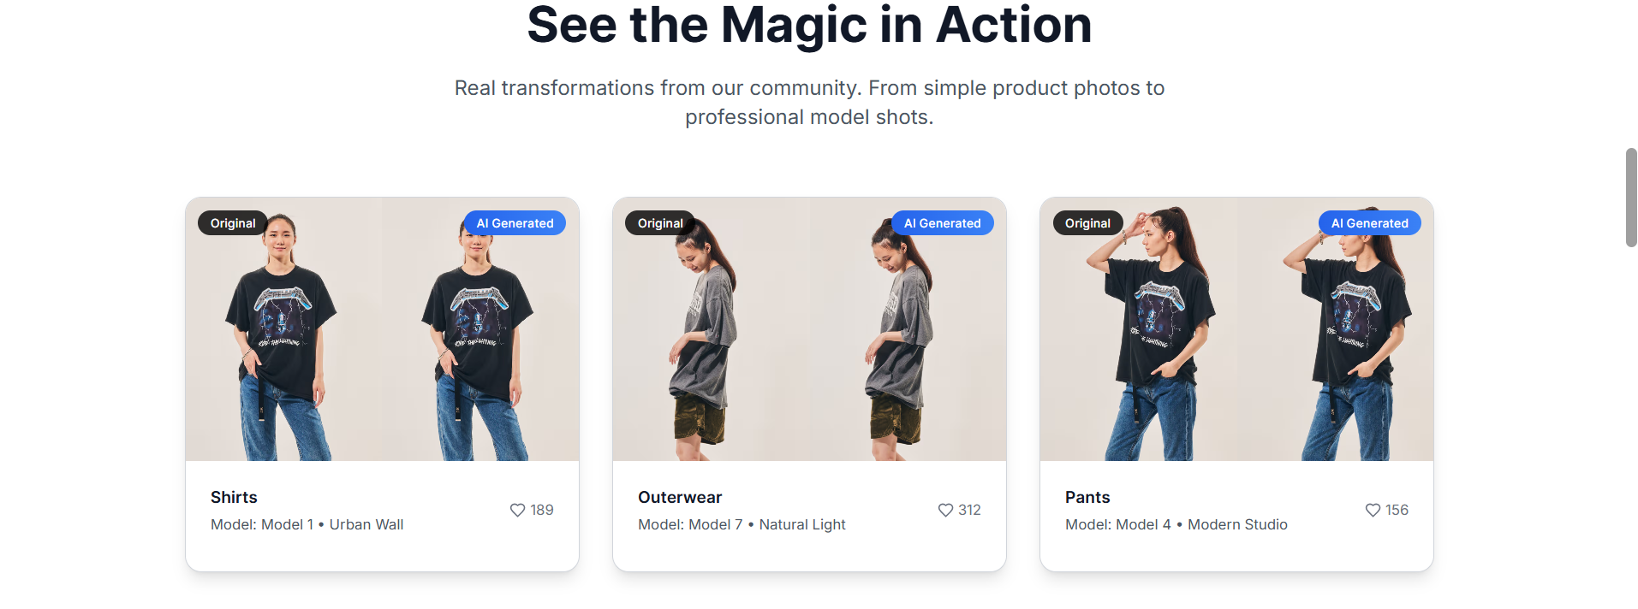
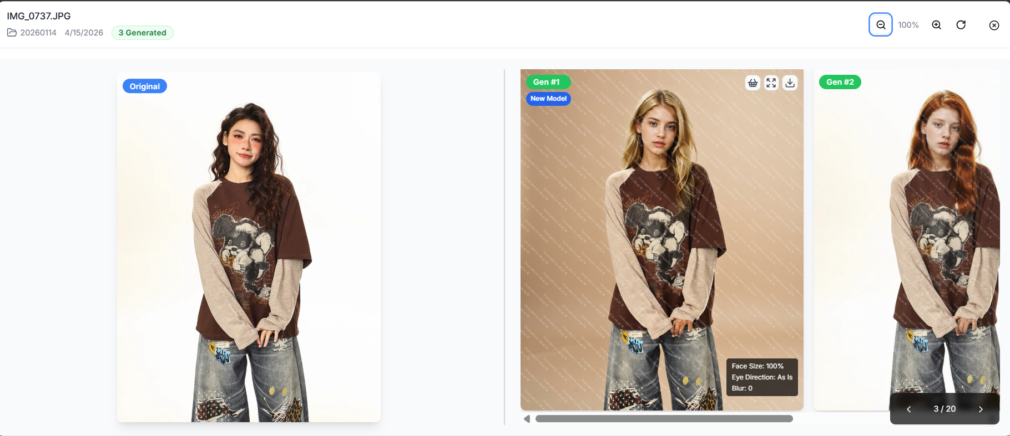
実例
APPAREL · IN ACTION
Apparel, in action.
The landing showcase, and the tool the team actually uses.
紹介ページと、実際のツール画面。
実例 · APPAREL · IN ACTION
06 / 17

Slide 7
進捗 · 其ノ壱
APPAREL · NOW & NEXT
Apparel — now and next.
What's running, what's coming, who's doing it.
今、進めていること。次に取り掛かること。担うのは誰か。
NOW · 進行中
NEXT · 60 DAYS · 次の60日
Production monitoring + GCP cost oversight
Sharper background engine — new perspectives, richer scenes
本番運用とGCP費用の監視
背景エンジンの精度と視点を一段引き上げる
Multi-angle background consistency — R&D
Onboard new paying customers
多角度背景の一貫性 — 検証中
新規有償顧客のオンボーディング
Client-driven UX adjustments
Document ComfyUI pipeline; assign a backup engineer
顧客要望によるUX調整
ComfyUIパイプラインの文書化と予備担当の任命
ComfyUI pipeline maintenance
進捗 · APPAREL · NOW & NEXT
07 / 17
ComfyUIパイプラインの保守

Slide 8
体制 · 其ノ壱
APPAREL · THE TEAM
The Apparel team.
A small dedicated pair, focused on the work.
アパレルを支える、二人組。
Muzuva
基盤
Crispus
表層
Backend & ComfyUI Lead
Frontend
≈ 40 h / week
≈ 16 h / week
Single point of ComfyUI knowledge — backup planned.
Client-facing UI changes and dependency upkeep.
ComfyUI知見の中心 — 予備担当の確保が課題。
顧客向けUIの調整と依存関係の保守。
2 contributors · ~56 hrs / week · Lean dedicated team — hold capacity, document the pipeline.
2名・約56時間/週・小さく専属の体制。現状維持しつつ、文書化が要点。
体制 · APPAREL · THE TEAM
08 / 17

Slide 9
其ノ弐 · BLUEPRINT
Blueprint
Upload a blueprint. Get instant analysis, parts list, and inspection.
図面を投げ込むだけで、解析・部品表・検査が返ってくる。
An engineer drops a technical drawing into Blueprint.
Minutes later, three answers come back —
the parts list, already tabled. The errors, circled with confidence.
The text, searchable as any document.
其ノ弐 · BLUEPRINT · PRODUCT TWO
09 / 17

Slide 10
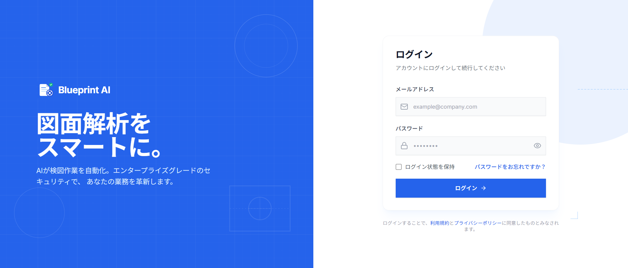
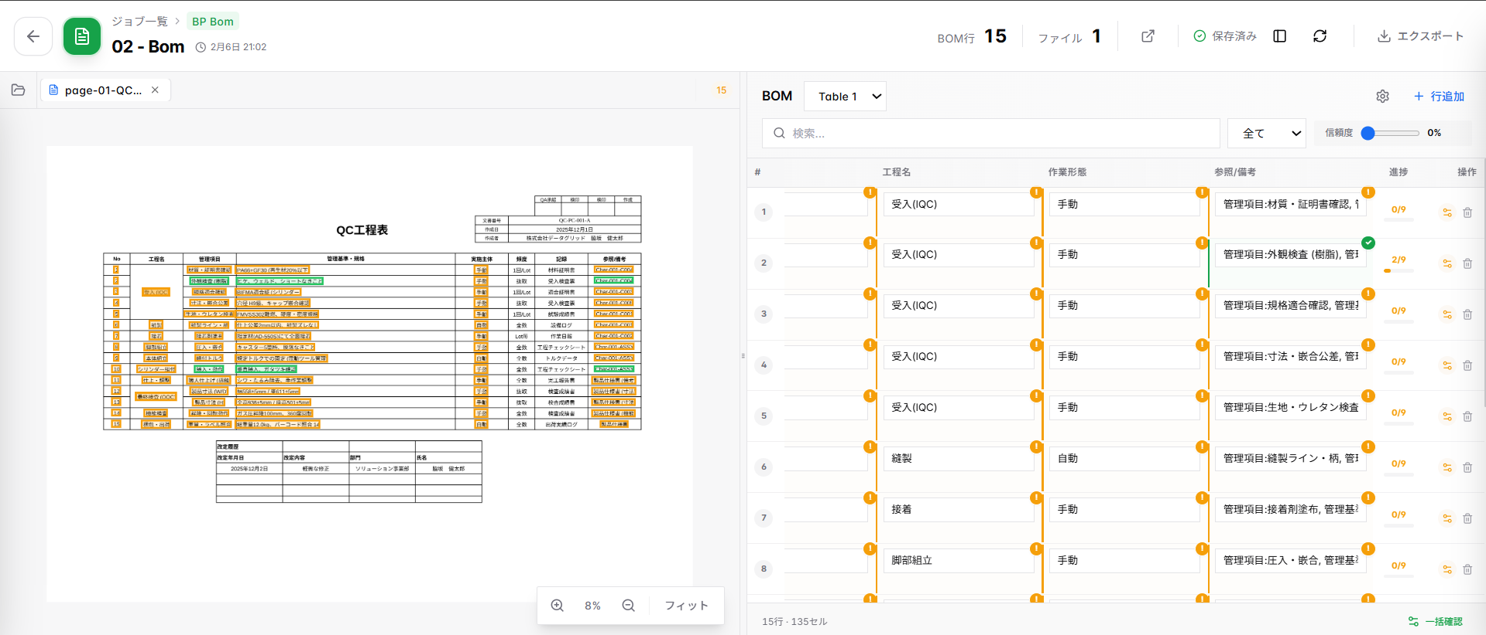
動作中
BLUEPRINT · AT WORK
Blueprint, at work.
From the entry page to the parts list it extracts from a drawing.
入口から、図面より抽出される構造化された部品表まで。
動作中 · BLUEPRINT · AT WORK
10 / 17

Slide 11
進捗 · 其ノ弐
BLUEPRINT · NOW & NEXT
Blueprint — now and next.
What's running, what's coming, who's doing it.
今、進めていること。次に取り掛かること。担うのは誰か。
NOW · 進行中
NEXT · 60 DAYS · 次の60日
BP Check · BOM · Scan running in production
New workflows tailored for specific organisations
BP Check / BOM / Scan が本番稼働中
特定組織向けの新ワークフロー追加
GPU / workflow decoupling — active rework
Stabilise + harden recently shipped features
GPU・ワークフロー分離の改修中
新規機能の安定化と強化検証
Continuous testing + monitoring
BP Check / BOM to first billed engineering teams
継続的なテストと監視
BP Check・BOMを初の有償運用へ
Per-tenant configuration support
進捗 · BLUEPRINT · NOW & NEXT
11 / 17
テナント別設定への対応

Slide 12
体制 · 其ノ弐
BLUEPRINT · THE TEAM
The Blueprint team.
Four contributors carrying the engine.
ブループリントを支える、四人。
Aita
設計
Ambrose
統率
Lauben
土台
Otai
補佐
Backend & Engine Lead
Systems & Product
Infrastructure
Backend Support
≈ 32 h / wk
≈ 24 h / wk
≈ 24 h / wk
≈ 16 h / wk
Owner of the workflow engine.
Cross-layer view, customer voice.
Picked up infra ownership in full.
API, migrations, dependencies.
ワークフローエンジンの責任者。
全体設計と顧客対応の視点。
インフラを全面的に引き継ぎ。
API・マイグレーション・依存関係。
4 contributors · ~96 hrs / week · Hold; +1 backend if client workflows scale.
4名・約96時間/週・現状維持。新案件が増える場合は+1名のバックエンドを検討。
体制 · BLUEPRINT · THE TEAM
12 / 17

Slide 13
学び
WHAT WE'VE LEARNED
Three lessons the quarter pressed into us.
今期、現場が教えてくれた三つのこと。
一
Responsibility
A process only one person can run is a risk the whole team carries.
責任
This quarter we retired two single-person dependencies by documenting them out loud.
一人しか動かせない工程は、チーム全体のリスクでした。
二
Listening to the client
Customers find the problems our tests and monitors cannot.
顧客の声
Our best fixes this quarter came from support tickets, not from dashboards.
最良の修正は、監視画面ではなく顧客の声から生まれました。
三
Documentation is engineering
Docs ship with the code, or they never ship at all.
文書化
Every shortcut we took on documentation became next sprint's delay.
省いた文書は、次のスプリントの遅延になりました。
学び · WHAT WE'VE LEARNED
13 / 17

Slide 14
概要
IN BRIEF
In Brief.
Four figures that map this quarter — the journey in numbers.
四つの数字でたどる、今期の歩み。
一
二
三
四
2
7
1 → 100+
hrs → min
products live
engineers
one product photo
blueprint reviews
in production
one end-to-end team
becomes a full campaign
hours down to minutes
本番稼働中
一つのチーム
一枚から百枚超へ
数時間から数分へ
Figures directional for this note; final numbers confirmed at quarter-end. 数字は目安、四半期締めに確定。
概要 · IN BRIEF
14 / 17

Slide 15
配置
THE TEAM PICTURE
Six people, two products, two dedicated teams.
Where the team currently sits — and where capacity could shift.
二つのプロダクトに分かれる、六人の現在地と今後の調整余地。
APPAREL · 2 人 · ~56 hrs / week
BLUEPRINT · 4 人 · ~96 hrs / week
Muzuva
Backend & ComfyUI Lead
40h
Aita
Backend & Engine Lead
32h
Crispus
Frontend
16h
Ambrose
Systems & Product
24h
Lauben
Infrastructure
24h
Otai
Backend Support
16h
Two dedicated teams, no shared people. Unique headcount: 6.
Open question · Where does Japan-side capacity best slot in over the next 60 days?
今後60日、日本側のリソースをどこに配置するのが最善か。
配置 · TEAM PICTURE
15 / 17

Slide 16
これから
THE NEXT 60 DAYS
Three concrete moves in the next 60 days.
今後60日間で、確実に進める三手。
Apparel
Users are already on board. We sharpen the background engine —
new perspectives, richer scenes, a visibly better experience.
背景生成の精度と構図を引き上げ、体験をもう一段高めます。
Blueprint
New workflows tailored for specific organisations.
Stabilise, test, and harden what's already shipped.
特定組織向けの新ワークフロー追加と、既存機能の安定化・検証。
The team
Close the last single-person dependencies.
Turn the learnings from both products into shared team playbooks.
単独依存を解消し、両プロダクトの学びをチームの手引きに。
これから · THE NEXT 60 DAYS
16 / 17

Slide 17
お伺い
ONE REQUEST
Which of the two would you like us to open next?
どちらの作品を、次にご覧になりたいですか。
We'd be glad to walk the team deeper into whichever one interests you.
其ノ壱 · APPAREL
其ノ弐 · BLUEPRINT
Apparel
Blueprint
One product photo, a full campaign.
One blueprint, a parts list and inspection.
一枚の写真が、キャンペーンに。
一枚の図面が、部品表と検査に。
承
alanda.ambrose@aibos.co.jp · Create Project
17 / 17

