Slide 1
AIBOS · CREATE PROJECT
A Note from
創
Create Project
Two products, a team of seven, and the quarter behind them.
二つのプロダクト、七人のチーム、そしてこの四半期の歩み。
クリエイト・プロジェクト便り
Q2 · 2026年春 · Spring 2026
FOR THE BOARD · 取締役会用

Slide 2
ご挨拶
A NOTE
A short note from Create Project —
on what the team has been building this quarter,
and where it is going next.
今期に作ってきたもの、そしてこれからの行き先について、一筆。
ご挨拶 · A NOTE
02 / 14

Slide 3
仲間
THE TEAM
Seven makers. One team.
Every strength is known — every role assigned accordingly.
一人ひとりの強みを把握し、役割を的確に振り分けています。
統率
設計
基盤
運用
Ambrose
Aita
Muzuva
Rodrick
Systems & Product
Workflow Engine
Backend & Pipeline
Deployment
土台
表層
補佐
Lauben
Crispus
Otai
Infrastructure
Frontend
Backend Support
Engineering, product, infrastructure — all carried by the same seven people.
仲間 · THE TEAM
03 / 14

Slide 4
流儀
HOW WE BUILD
Three principles every feature is held to.
すべての機能が通る、三つの原則。
Traceability
Ownership
Design first
追跡
責任
設計
Every feature
The engineer who ships it
We prove the design
maps back to a customer's exact words — no code without a request.
is the engineer who stands behind it when it runs in production.
on paper before we write a line of code — rework starts before the build.
顧客の言葉に紐づかない機能は、書かない。
作る者が、運用を支える者になる。
コードを書く前に、設計を確かめる。
流儀 · HOW WE BUILD
04 / 14

Slide 5
其ノ壱 · APPAREL
Apparel
A product photo becomes a full fashion campaign.
一枚の商品写真から、プロ仕様のキャンペーンへ。
A brand uploads one photo of a garment.
The team picks the model, the background, the mood.
In the time it takes to pour a coffee, a full campaign arrives —
every look, every angle, ready to publish.
其ノ壱 · APPAREL · PRODUCT ONE
05 / 14

Slide 6
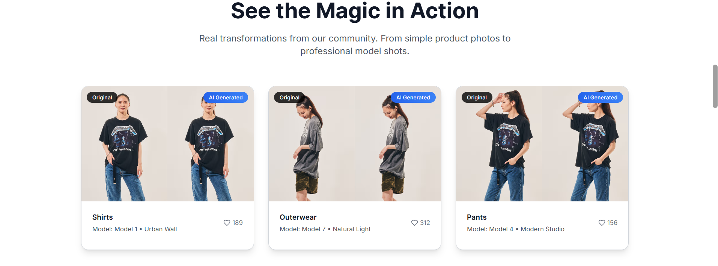
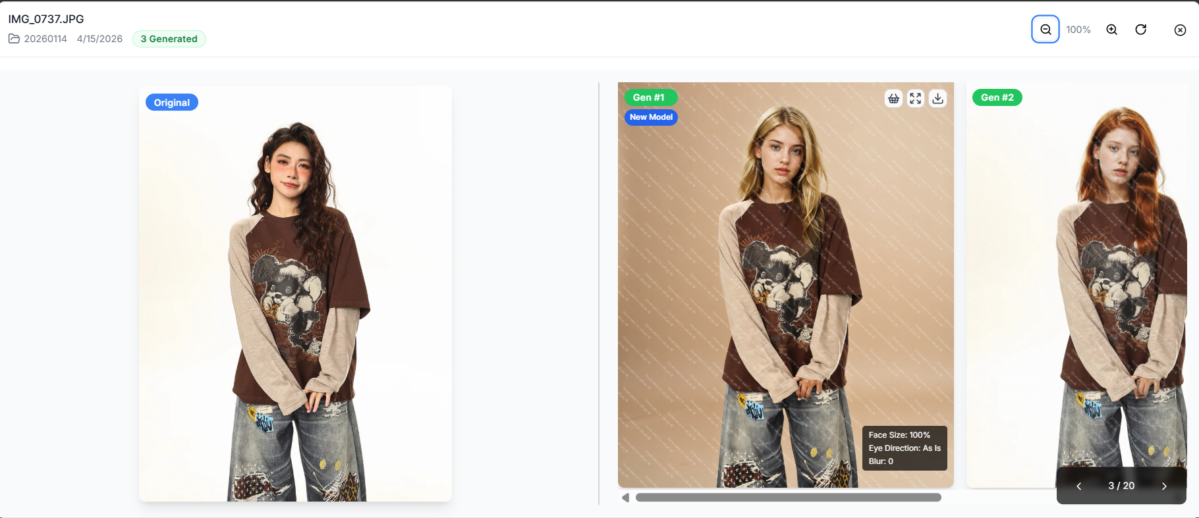
実例
APPAREL · IN ACTION
Apparel, in action.
The landing showcase, and the tool the team actually uses.
紹介ページと、実際のツール画面。
実例 · APPAREL · IN ACTION
06 / 14

Slide 7
其ノ壱 · 変化
APPAREL · WHAT CHANGES
What changes for the brands using it.
使う側のブランドにとって、何が変わるのか。
BEFORE · 以前
AFTER · 以後
A campaign shoot took weeks to arrange.
A studio, a model, a stylist, a flight.
One product, one set of photographs.
Full catalogues were a luxury only big brands bought.
A campaign is ready in an afternoon.
One product photo becomes a full catalogue.
Any model, any background, any market.
Small brands now publish at flagship quality.
其ノ壱 · 変化 · APPAREL · WHAT CHANGES
07 / 14

Slide 8
其ノ弐 · BLUEPRINT
Blueprint
Upload a blueprint. Get instant analysis, parts list, and inspection.
図面を投げ込むだけで、解析・部品表・検査が返ってくる。
An engineer drops a technical drawing into Blueprint.
Minutes later, three answers come back —
the parts list, already tabled. The errors, circled with confidence.
The text, searchable as any document.
其ノ弐 · BLUEPRINT · PRODUCT TWO
08 / 14

Slide 9
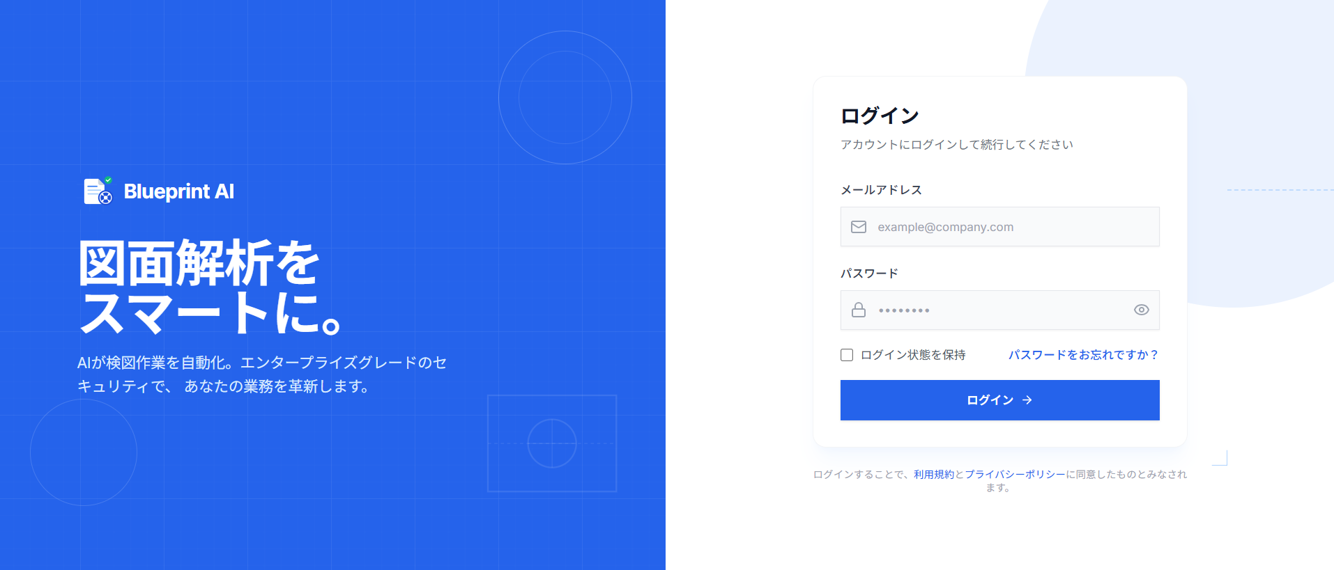
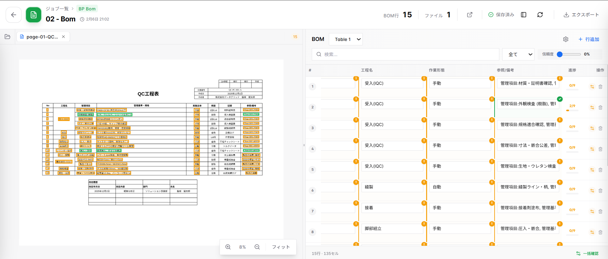
動作中
BLUEPRINT · AT WORK
Blueprint, at work.
From the entry page to the parts list it extracts from a drawing.
入口から、図面より抽出される構造化された部品表まで。
動作中 · BLUEPRINT · AT WORK
09 / 14

Slide 10
其ノ弐 · 変化
BLUEPRINT · WHAT CHANGES
What changes for the engineers using it.
使う側のエンジニアにとって、何が変わるのか。
BEFORE · 以前
AFTER · 以後
A single drawing took hours to review by hand.
Parts were counted one by one into spreadsheets.
Errors slipped through until the factory caught them.
Every revision meant starting the review over.
The same drawing takes minutes.
The parts list appears, already structured for export.
Inconsistencies are flagged before production begins.
Engineers move from checking to confirming.
其ノ弐 · 変化 · BLUEPRINT · WHAT CHANGES
10 / 14

Slide 11
学び
WHAT WE'VE LEARNED
Three lessons the quarter pressed into us.
今期、現場が教えてくれた三つのこと。
一
Responsibility
A process only one person can run is a risk the whole team carries.
責任
This quarter we retired two single-person dependencies by documenting them out loud.
一人しか動かせない工程は、チーム全体のリスクでした。
二
Listening to the client
Customers find the problems our tests and monitors cannot.
顧客の声
Our best fixes this quarter came from support tickets, not from dashboards.
最良の修正は、監視画面ではなく顧客の声から生まれました。
三
Documentation is engineering
Docs ship with the code, or they never ship at all.
文書化
Every shortcut we took on documentation became next sprint's delay.
省いた文書は、次のスプリントの遅延になりました。
学び · WHAT WE'VE LEARNED
11 / 14

Slide 12
概要
IN BRIEF
In Brief.
Four figures that map this quarter — the journey in numbers.
四つの数字でたどる、今期の歩み。
一
二
三
四
2
7
1 → 100+
hrs → min
products live
engineers
one product photo
blueprint reviews
in production
one end-to-end team
becomes a full campaign
hours down to minutes
本番稼働中
一つのチーム
一枚から百枚超へ
数時間から数分へ
Figures directional for this note; final numbers confirmed at quarter-end. 数字は目安、四半期締めに確定。
概要 · IN BRIEF
12 / 14

Slide 13
これから
THE NEXT 60 DAYS
Three concrete moves in the next 60 days.
今後60日間で、確実に進める三手。
Apparel
Users are already on board. We sharpen the background engine —
new perspectives, richer scenes, a visibly better experience.
背景生成の精度と構図を引き上げ、体験をもう一段高めます。
Blueprint
New workflows tailored for specific organisations.
Stabilise, test, and harden what's already shipped.
特定組織向けの新ワークフロー追加と、既存機能の安定化・検証。
The team
Close the last single-person dependencies.
Turn the learnings from both products into shared team playbooks.
単独依存を解消し、両プロダクトの学びをチームの手引きに。
これから · THE NEXT 60 DAYS
13 / 14

Slide 14
お伺い
ONE REQUEST
Which of the two would you like us to open next?
どちらの作品を、次にご覧になりたいですか。
We'd be glad to walk the team deeper into whichever one interests you.
其ノ壱 · APPAREL
其ノ弐 · BLUEPRINT
Apparel
Blueprint
One product photo, a full campaign.
One blueprint, a parts list and inspection.
一枚の写真が、キャンペーンに。
一枚の図面が、部品表と検査に。
承
alanda.ambrose@aibos.co.jp · Create Project
14 / 14

