Slide 1
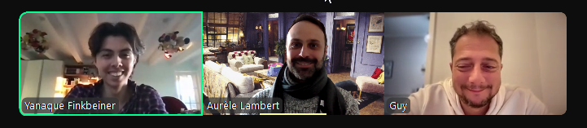
Iron Kaggle Challenge
Group 3
Yanaque, Guy, Aurele
Notes:
Yanaque

Slide 2
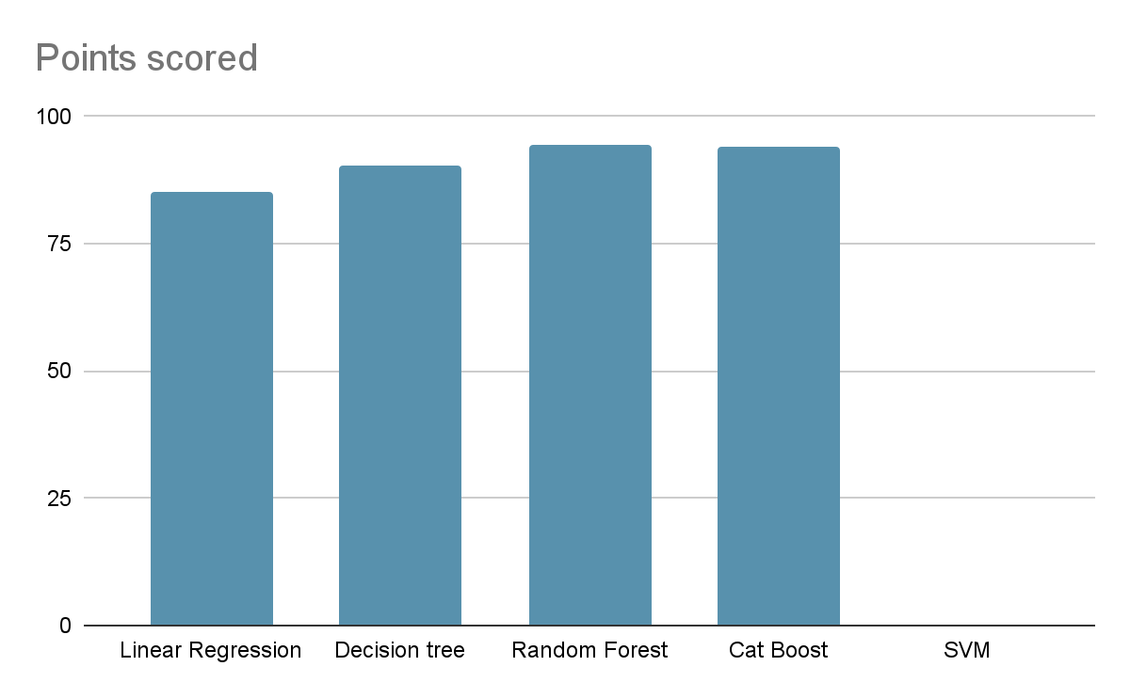
Executive summary
Best model : Random Forest
R² Prediction: 94.43
Also tested SVM but required too much computational power
Notes:
Guy

Slide 3
Methods (preprocessing)
Renamed unnamed column and indexed it as ID, transformed date to unix format and holidays to num values
Checked for correlation but nothing stood out (except customer nbr)
Other important considerations:
better preprocessing could have been done with further by factoring opening/closed days for training
Could have tried k-folding to improve training
Notes:
Aurele

Slide 4
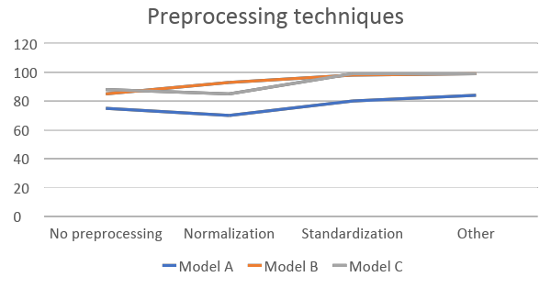
Methods (preprocessing)
Renamed unnamed column and indexed it as ID, transformed date to unix format and holidays to num values
Checked for correlation but nothing stood out

Slide 5
Methods (models)
Linear Regression - R² = 85.15%
(mistakenly used Logistic Regression at first)
OK results, simplest model but despite some tweaking did not overthrow the other models tested
SVM - FAILED
The first SVM method took about 20 minutes to process until time out. We have tried different approaches to optimize like using stochastic Gradient Descent Classifier or also trying to reduce the size of the data set but still it took over 20 minutes to process. We decide not to use this method.
Decision-Trees - R² = 90.19%
It is a model for regression and not for classification (which we learned was needed for this Dataset after misleadingly using Logistic Regression at first)
Looked up previous Labs (Supervised-Learning/Decision-Trees) for right syntax of code and Imports
Good result, simple model and quick processing time

Slide 6
Methods (models)
Random forest - R² = 94.43%
Obtained best results. Tested with different n_estimator parameters between 50 and 150. 120 seemed to be the sweet spot.
Cat Boost - R² = 94.03%
Interesting result - Cat boost take better account of the Categories like Promotion or State holidays but processing takes a long time and could only obtain results for a single test
Would deserve further exploration

Slide 7
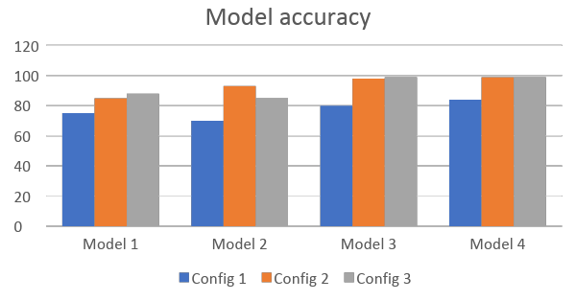
Methods (models) –
Explain the models you tried and why. Your reasoning is very important! But don’t be afraid to say “not really sure why but this one works better”
Chart comparing them.
Try to capture the key differences but don’t make it too complicated.

Slide 8
Methods (models) – 1 or 2 slides
Explain the models you tried and why. Your reasoning is very important! But don’t be afraid to say “not really sure why but this one works better”
Chart comparing them.
Try to capture the key differences but don’t make it too complicated.

Slide 9
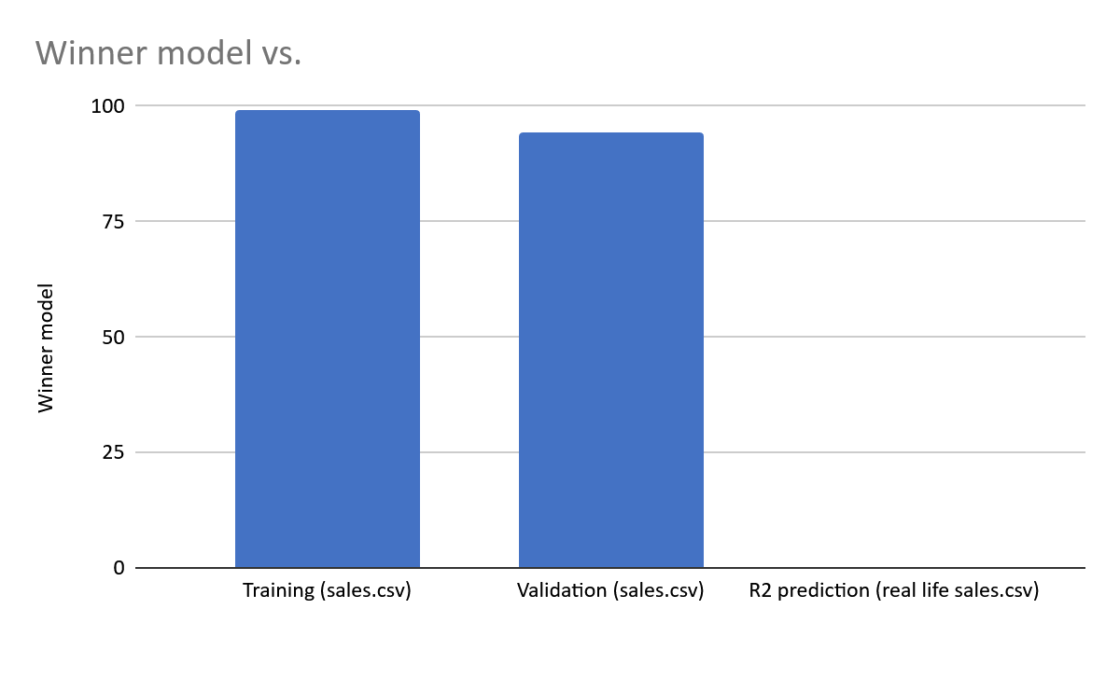
Random Forest
Gave the best results
Performed slightly better than Cat Boost despite Cat Boost being more Categorical Data Oriented
Metric | Value | Interpretation
R-squared (Training) | 0.9923 | Potential overfitting
R-squared (Testing) | 0.9443 | Good generalization.
Mean Absolute Error | 570.16 | Vs mean sales = 5777.4
Mean Squared Error | 822,819.44 | The average squared difference between predictions and actual values, penalizing large errors more.
Root Mean Squared Error | 907.09 | The standard deviation of prediction errors; average deviation from actual values.

Slide 10
Takeaways
Recap / conclusions
Fun Project with a slow start because of unstructured idea spilling of all the three teammates - one person took the initiative to help the team with a structured plan
After coding the first model together it was easier to each pick a new one and work on it alone
Challenges
Finding out which models to use and why
Model processing time can take be very heavy, crash computers or be a pain to run over and over to test/improve
Key learnings
Don’t blindly copy code from the Labs without understanding the actual required code
Talking slowly and detailed so all teammates understand and don’t get lost
Don’t understime the data exploration / preprocessing time

Slide 11
Instructions
You can make the charts with python or excel.
All team members must participate (either split the slides, or discuss the part that you did for each slide)
7 minutes maximum for presentation + 3 minutes for questions
7 is a HARD limit. Aim for 5, it should be enough.
Tip: Rehearse the presentation at least once

