Slide 1
Design Brief
Project to be completed by myself for you the client

Slide 2
Work Agreement
You as a client have outlined to me that you need a light-hearted arcade game that is mostly a game of skill with elements of chance. It must have a high score system and be competitive enough to incite competition yet casual enough that people wont shy away from playing. Although the actual design of said game is up to me the developer. In saying this is must fit into your environment which you have mentioned to be a restaurant. You also mentioned its purpose would be to entertain diners while they wait for their food. So it shouldn’t last too long.
From this information I will begin construction of your game to be completed before June 20th, the time you have highlighted you would like to integrate this game into your restaurant.

Slide 3
Social Issues
Some potential social issues of this game could be its appropriateness for audiences. As you are running a generic restaurant it is likely that there will be people of all ages playing this game. We must make sure that the content is deemed appropriate for all ages to play, varying from young children all the way to elderly people. To do this we will avoid all swearing, nudity, simulated sex, animated blood / gore and violence in the game.
Another issue could be offensive content in the user modified content. To combat this issue I wont be adding any user content to the game whatsoever. This eliminated anyone taking offense to the game and can also eliminate fights over high scores as people won’t know who beat their top score.

Slide 4
Ethical Issues
An ethical issue with this game is it could start fights due to cheaters. The best way to avoid this is the ensure it is Fullscreen and unable to be cheated on. If the tablets cant be tampered with than they shouldn’t be able to cheat and ruin the experience for everyone else.
Another ethical issue is gambling, the game will have little to no chance in it with the chance only being the randomisation of the size, location and time of which falling objects are spawned, this is designed to keep the game fresh with every play.
Originally my first idea was for players to press to the left of right of their sprite to move it, but I realised this adds an ethical issue that some peoples fingers are too big to click between the wall and their sprite, so to combat this I changed my design so players press on the left of right side of the screen regardless to the location of their sprite. This eliminates this inequality.
Colour-blindness is another potential ethical issue, giving colour-blind players a disadvantage, this is another reason why the monochromatic design was used to hopefully put all players on an event foot with the same ability to see what is going within the game.

Slide 5
Legal Issues
Copyright is one of the largest legal issues we will face. It is important we review the licenses of all products we use and cite them accordingly. All of the sprites used in this game have been made by myself and are free of copyright issues. You may choose to patent this game for yourself or potentially trademark a name you settle on, this way you can prevent others from stealing your product as well.
Another legal issue could arise in any injuries caused by the game. A potential injury associated with arcade games could be an epileptic seizure, to avoid this we haven’t included any flashing lights or extreme colour changes.

Slide 6
Proposed Solution
I will create for you a monochromatic game (more information in story boards on next slide) where the player gains score by surviving for longer periods of time. To survive they must stay on the screen and they also cannot be hit by any of the falling objects from the sky. These objects are spawned randomly with randomly generated shapes although the longer the player survives the more that will spawn. It is a fast game and is intended to take up to three minutes maximum, usually taking less than a minute to complete. It also stores a single high score but doesn’t store the users name. This way you could keep your own chalk board with high scores to easily and effectively monitor peoples usernames for appropriateness and you can easily remove and restart scores each week, month year etc. However you choose to run your competitions while keeping that restaurant family environment intact.

Slide 7
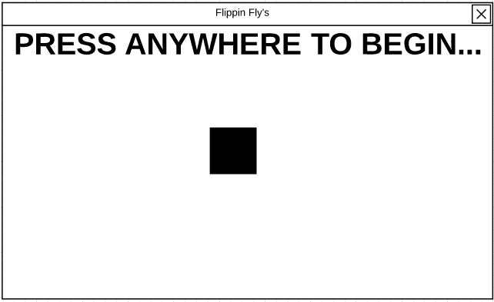
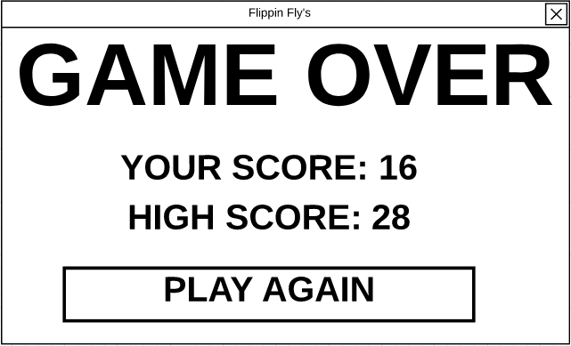
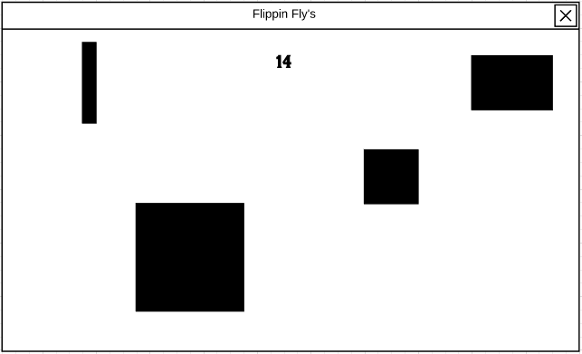
Story Boards
Start Screen End of Game
During Game

Slide 8
License Agreement
You as the client agree to not sell on this product to anyone else, instead you should refer these people to our services. You agree to not use our code for any other purposes or to share it with any third party. You agree to only use the program for its intended purpose. You agree to raise any issues you may have with us before turning to the community. You must not under any circumstance provide any of our rivals with the code or documents created during the undertaking of this code. By agreeing to this you confirm that you will follow all of these rules and if not could face legal repercussions totalling up to $12,000.

