Slide 1
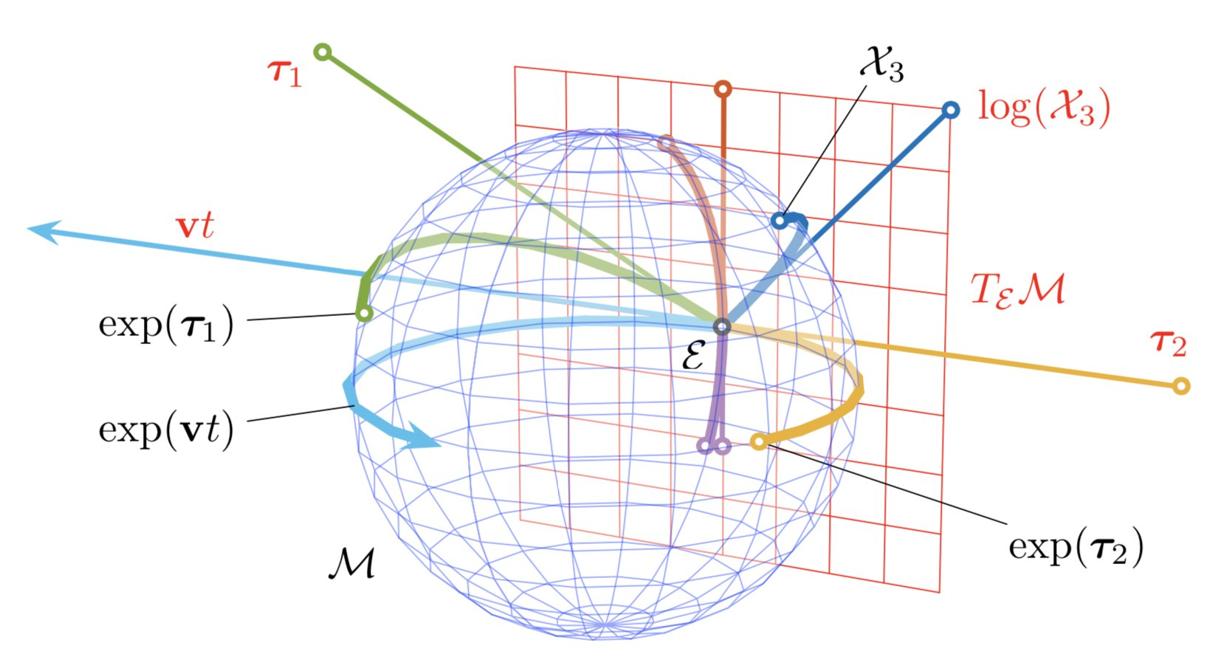
Lie Groups and Lie Algebras

Slide 2
Lie Groups

