Slide 2
Lie Groups

Slide 3




State-Space
Substituting the newly defined variables from the previous section:
into the first order equations yields:
Using vector-matrix notation we have:

Slide 5

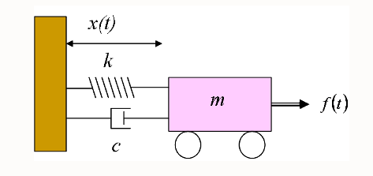

Mass-Spring-Damper Model

