Slide 1
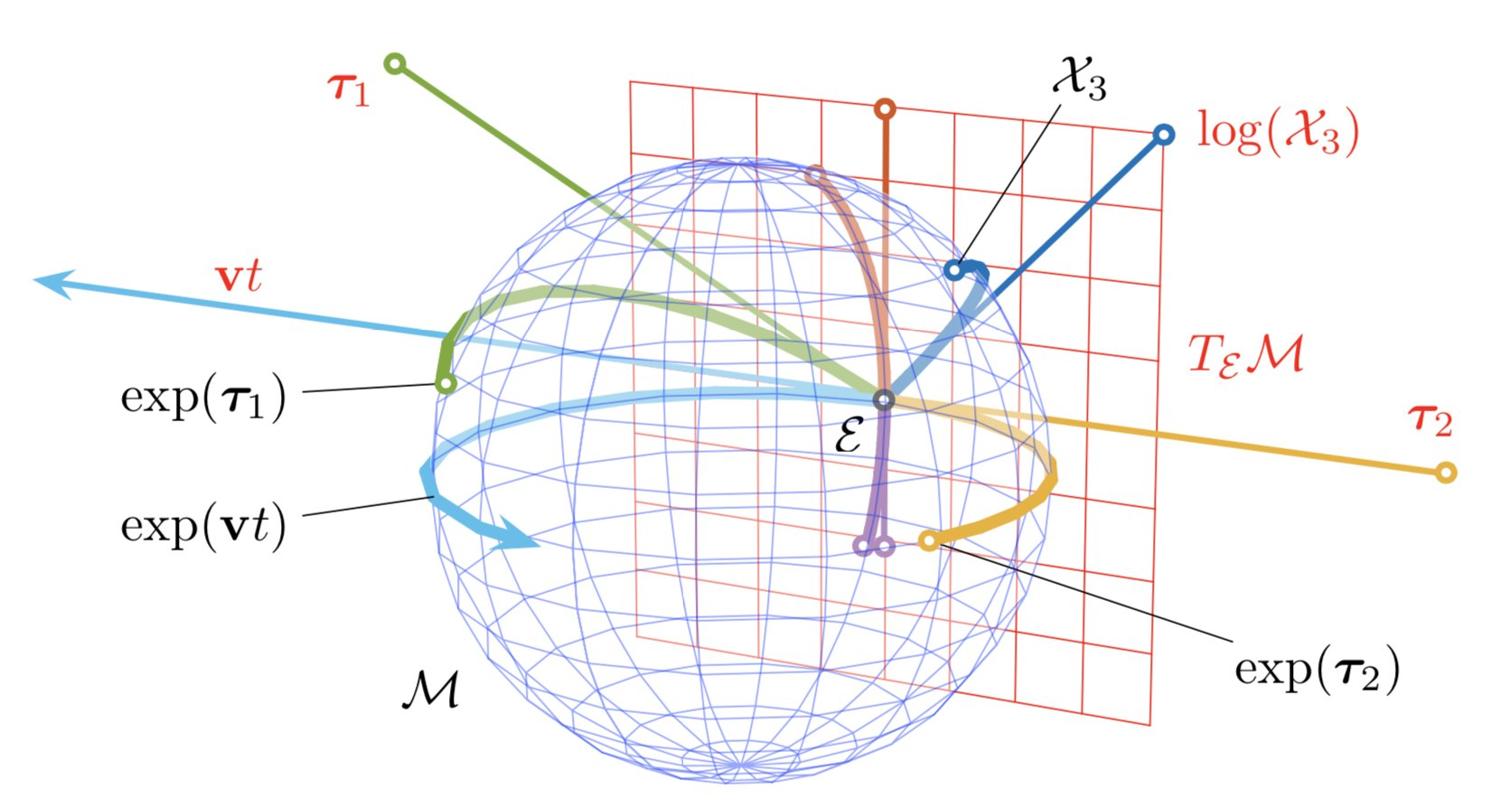
Lie Groups and Lie Algebras

Slide 2
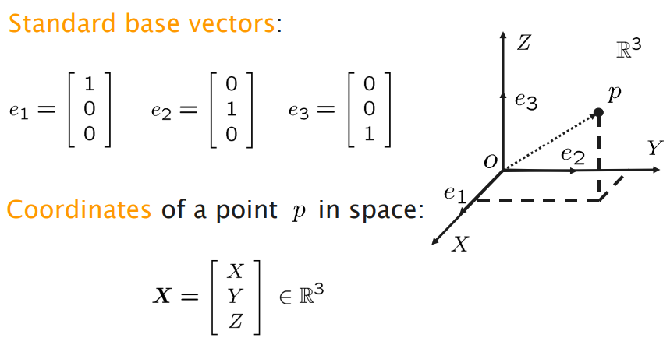
Rigid Body Transformations
Cartesian coordinates, Points and Vectors

Slide 3
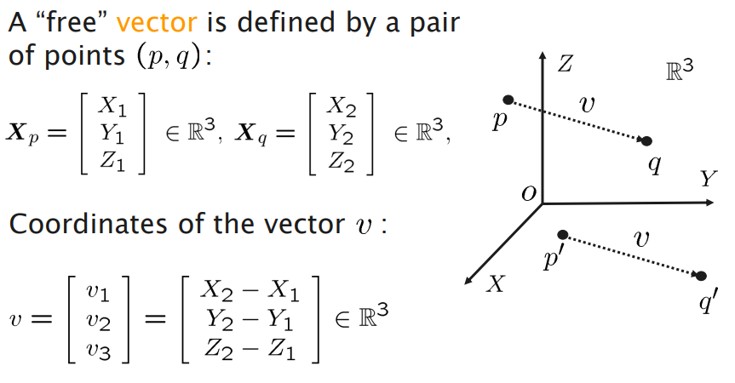
Rigid Body Transformations
Cartesian coordinates, Points and Vectors

Slide 4
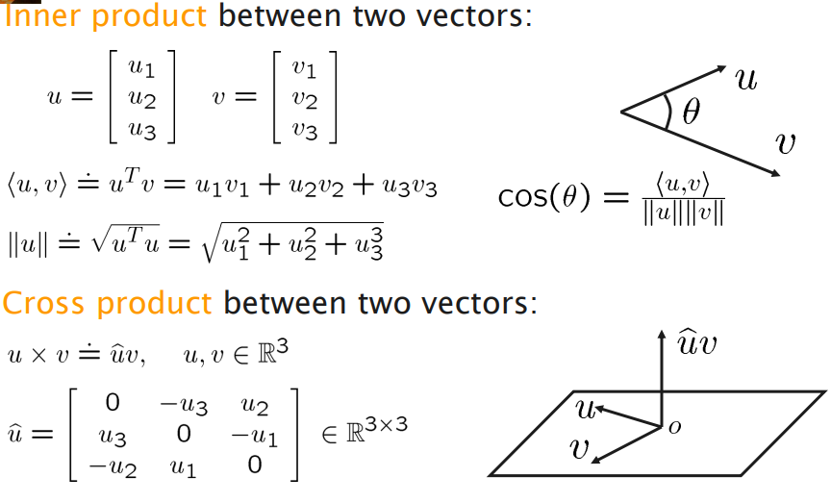
Rigid Body Transformations
Cartesian coordinates, Points and Vectors

Slide 5
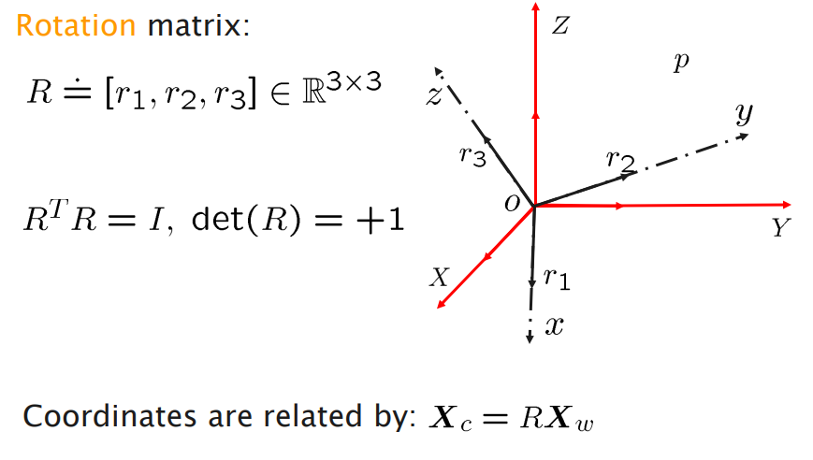
Rigid Body Transformations
Cartesian coordinates, Points and Vectors

Slide 6
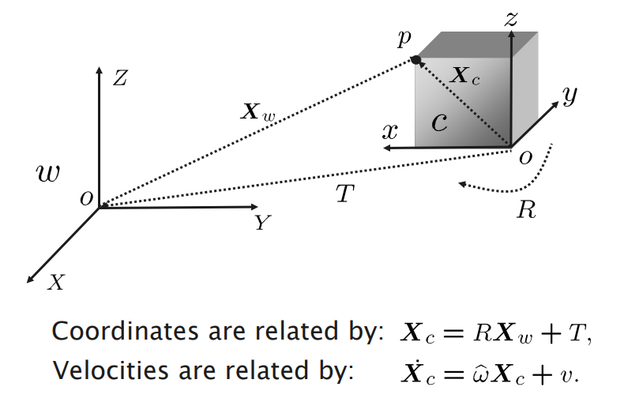
Rigid Body Transformations
Cartesian coordinates, Points and Vectors

Slide 7
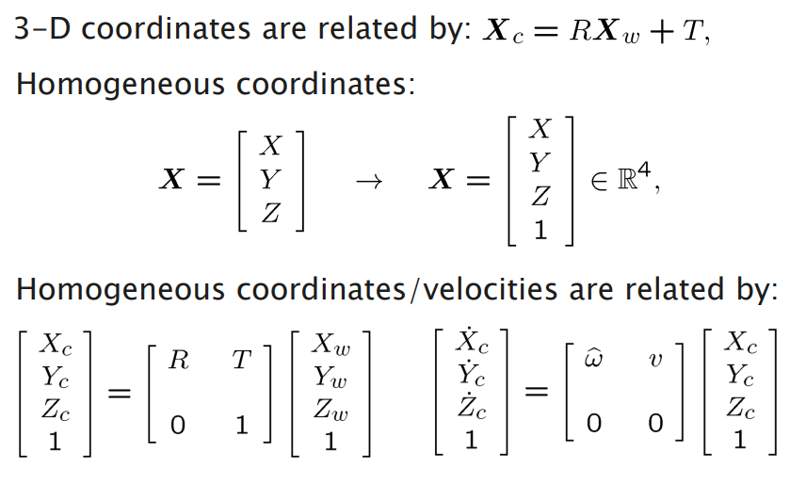
Rigid Body Transformations
Homogeneous Coordinates

Slide 8
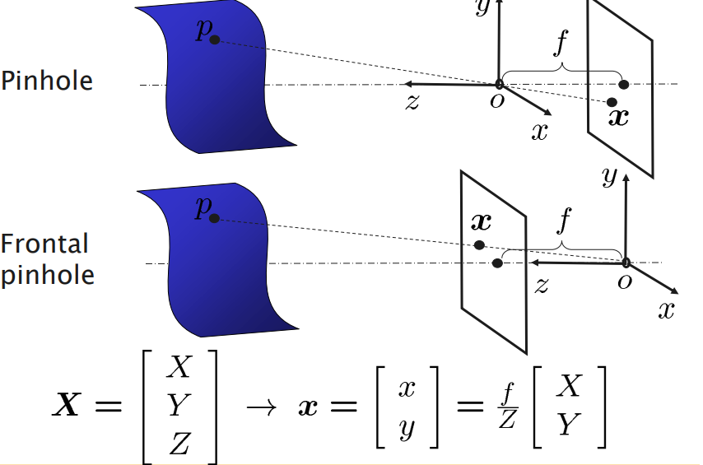
Rigid Body Transformations
Perspective Imaging

Slide 9
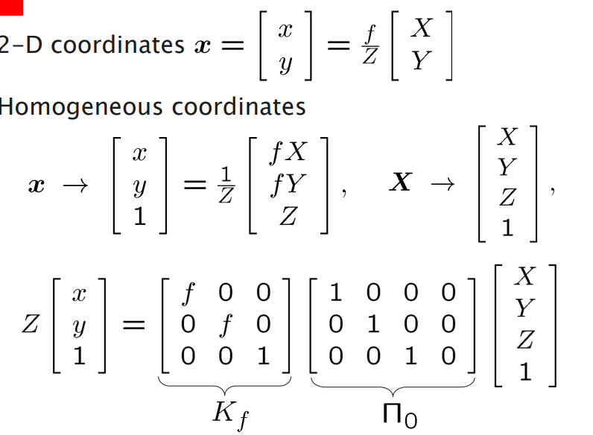
Rigid Body Transformations
Camera Model ging

Slide 10
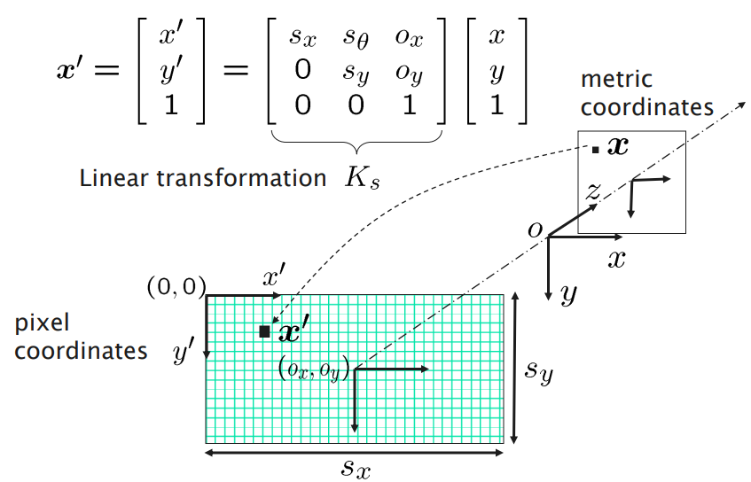
Rigid Body Transformations
Pixel Coordinates
https://www.uio.no/studier/emner/matnat/ifi/nedlagte-emner/INF3320/h03/undervisningsmateriale/lecture3.pdf

Slide 11
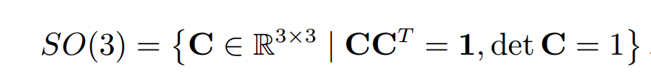
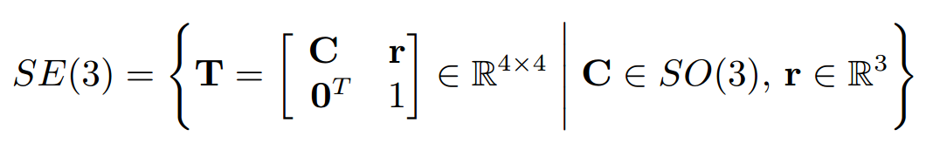
Lie Groups

Slide 12
Lie Groups

Slide 13
Lie Groups

Slide 14
Lie Groups

Slide 15
Lie Groups

