Slide 1
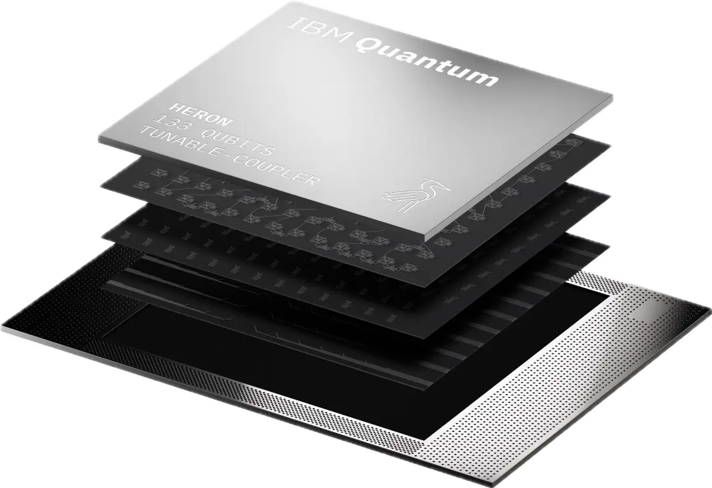
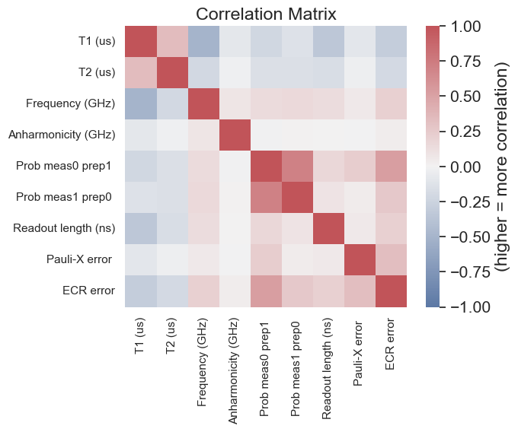
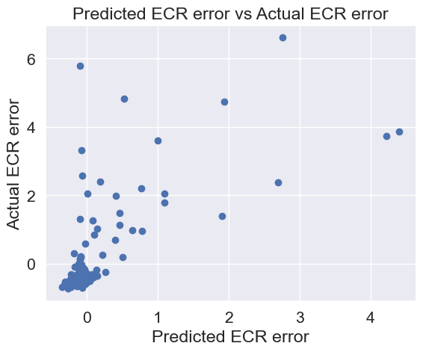
U43
Understanding the Influence of Qubit Features on Error Rates Henry Yu¹ and Nicholas LaRacuente*^{,1} Dept. of Computer Science, Indiana University, Bloomington, IN USA
*corresponding author: nlaracu@iu.edu
Introduction
Methods
Results
Discussion
What is a quantum computer [1]?
Uses quantum bits (qubits) to process info
Superposition allows the qubit to be in a state of one and zero simultaneously
Entanglement “binds” a group of qubits together; their individual states are dependent on each other, no matter how far they are from each other
There are a few challenges that hinders quantum computers’ performance [2, 3]:
Extremely susceptible to quantum noise, which can be anything from ambient temperature or local radiation from Wi-Fi
Scalability issues—the largest processor was just unveiled by IBM: the 1,121-qubit Condor processor
Relatively new field—in 1998, the first 2-qubit computer was built
Quantum gates
Used to manipulate qubit states
Analogous to classical logic gates like OR, NOT, etc.
All gates are unitary operators, which mean they preserve state probability outcomes
Reversible
Time series analysis can uncover underlying patterns
Used to understand relationships and highlight trends between features and the error rate
Common regression techniques can be used for analysis
Root mean square error (RMSE) and coefficient of determination (R2) determine how accurate the predictions are
Data Collection
Qiskit, an SDK used for working with quantum computers, allows access to IBM machines [4]
Accessed IBM system backends to retrieve data using Qiskit API [4]
ibm_perth, a 7-qubit system based on Falcon processor; 315 days of data
ibm_brisbane, ibm_cusco, ibm_kawasaki, ibm_kyoto, ibm_nazca, meibm_quebec, ibm_sherbrooke, 127-qubit systems based on Eagle processor; one day of data for each system
Preprocessing
Qubit Features [5]
decoherence time (T1 and T2)
frequency, anharmonicity
readout assignment error (prob meas0 prep1 and prob meas1 prep0) readout length
gate time
ID, rz, sx, Pauli-X (NOT gate), reset, √x gate errors
controlled NOT (CNOT) gate error (exclusive to 7-qubit)
ECR gate error (exclusive to 127-qubit)
Scaled features to have standard deviation of 1
Time Series Analysis of CNOT Gate Error on ibm_perth
LASSO regression is simple and allows for feature selection [6]
$$\min_{w}\frac{1}{2n_{\text{samples}}}∥Xw-y∥_{2}^{2}+α∥w∥_{1}$$
$n_{\text{samples}}$ = number of samples
$X$ = input features (independent variables)
$y$ = target value (what we are trying to predict; dependent variable)
$w$ = coefficient vector
$α∥w∥_{1}$ = LASSO regularization
Polynomial regression can capture nonlinear relationships [6]
$\overset{^}{y}(w,x)=w_{0}+w_{1}x_{1}+w_{2}x_{2}+w_{3}x_{1}x_{2}+w_{4}x_{1}^{2}+w_{5}x_{2}^{2}$ (quadratic order)
Five-fold cross-validation (traditional 80-20 split)
Dataset split into five subsets of approximately equal size
Model trained on 80% (or 4/5 of the folds) and tested on remaining 20% (or remaining fold)
Repeated five times using different training and testing combinations
Predicted error for one CNOT gate over time
ECR Gate Error Prediction (127-qubit)
Both linear and polynomial LASSO regression used again
Five-fold cross-validation
Predict one random ECR gate error
Instead of across time, across different qubits on all systems
Time Series Analysis
Optimal α-regularization = 0.07
avg R2 score ≈ -1.252, which means model performs worse than just using the average of the predicted value
Optimal R2 score is 1
avg RMSE score ≈ 4.319x10⁻³, which is inconclusive since the range of values is small
Optimal RMSE score is 0
Results suggest qubit data over time is not predictive of error rate
ECR Prediction Across Qubits
Optimal α-regularization = 0.11
avg R2 score ≈ 0.105, which means model has weak predictive power, but is better than time analysis
avg RMSE score ≈ 0.900, which is a very poor score because the range is very small
Results suggest qubit data over other qubits is slightly predictive of error rate but still has poor score
Correlation Matrix
Decoherence times (T1, T2) show negative relationship across variables
Anharmonicity is neutral across all variables
Shows that probability errors (prob meas0, prob meas1) and gate errors (Pauli-X, ECR) have a slight relationship
ECR Plot
Negative ECR error caused by scaling the features
Massive variation between predicted vs. actual values
Outliers could have caused evaluation metrics (RMSE, R2) to score lower
Suggests nonlinear relationship
Weak predictive power of qubit features for error rates for linear and low-order polynomials; stronger correlation among qubits compared to correlations across time
Limitations:
Limited dataset for 7-qubit and extremely limited dataset for 127-qubit
Dataset could contain lots of noise or improper cleaning
Next steps:
Check the discrepancy between the correlation matrix and the error coefficients
Correlation matrix suggests good relationship
Error coefficients suggests bad relationship
Understanding relationships between qubit features and error rates may help mitigate errors in the future
133-qubit Heron processor¹
References
[1] “What Is Quantum Computing?” Caltech Science Exchange, scienceexchange.caltech.edu/topics/quantum-science-explained/quantum-computing-computers. Accessed 6 Dec. 2023.
[2] Preskill, John. “Quantum Computing in the NISQ Era and Beyond.” Quantum, vol. 2, Aug. 2018, p. 79. Crossref, https://doi.org/10.22331/q-2018-08-06-79.
[3] Engdahl, Sylvia. “Noise in Quantum Computing.” Amazon, Greenhaven Press/Gale, 2008, aws.amazon.com/blogs/quantum-computing/noise-in-quantum-computing/
[4] Qiskit documentation. Version 0.45.0 https://docs.quantum.ibm.com/api/qiskit
[5] B. Baheri, Q. Guan, V. Chaudhary and A. Li, "Quantum Noise in the Flow of Time: A Temporal Study of the Noise in Quantum Computers," 2022 IEEE 28th International Symposium on On-Line Testing and Robust System Design (IOLTS), Torino, Italy, 2022, pp. 1-5, doi: 10.1109/IOLTS56730.2022.9897404.
[6] scikit-learn documentation. Version 1.3.2. https://scikit-learn.org/stable/modules/linear_model.html
1IBM Quantum
correlation matrix visually represented by heatmap
Acknowledgements
Objective
We want to thank Dr. Paul Macklin and the Luddy School of Informatics, Computing, and Engineering.
We acknowledge the use of the IBM Quantum Services for this work.
We aim to assess correlations between qubit features and ultimately predict error probability.
LaRacuente Lab
Undergraduate Research – Fall 2023

