Slide 1
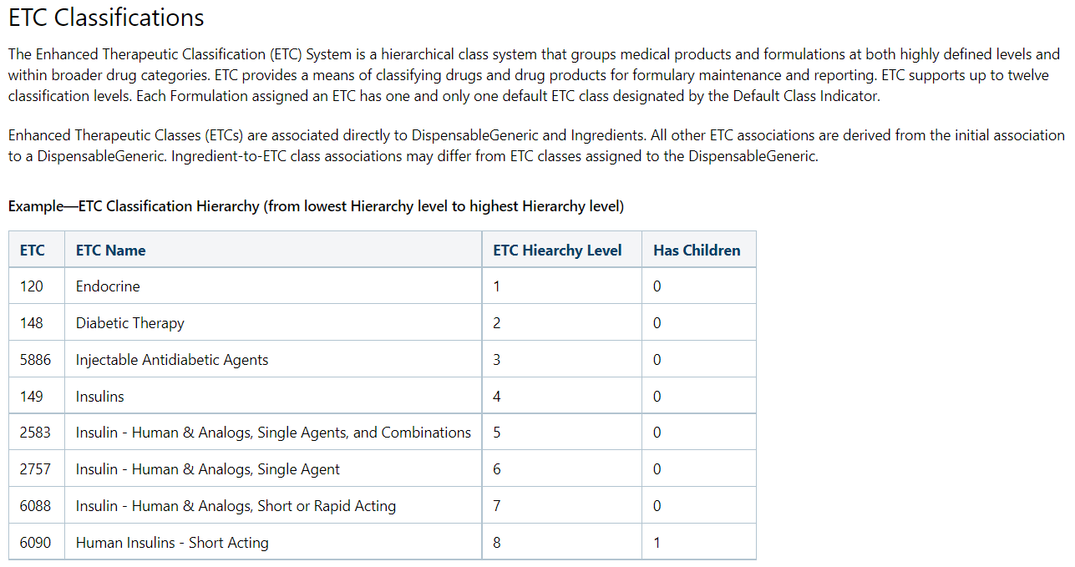

Slide 2
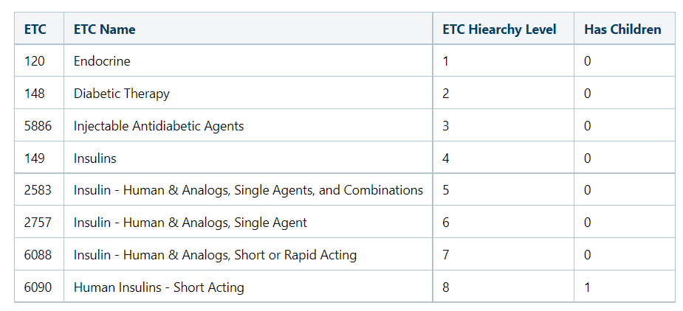
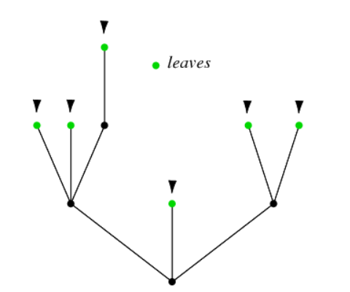

Slide 3
6090
149
5886
Root: Diabetic Therapy
148

Slide 4
Leaves: Drug group
6090
149
5886
Root: Diabetic Therapy
148

Slide 5
Leaves: Drug group
6090
149
Two “Roots” included in CKD project:
Diabetic Therapy (34 ETC leaves; 6014 NDC codes)
Cardiovascular Therapy (85 ETC leaves; 40,345 NDC codes)
5886
90.7% of NDC codes in the Final Rx Table (135) are found in the ETC crosswalk
Root: Diabetic Therapy
148

