Slide 1
Overview
Modeling donors with past 5 years of donor history that will or will not become an ideal donor; (ideal = donate >$20,000 in next 5 years)
Major assumption: If a candidate does not have a record of donation, this model assumes they donated $0. It does not assume their donation history is null
Date of prediction for model creation = 08-01-2016. Any donations after prediction date is a future donation any donation prior to prediction date is a historical donation
Imbalanced dataset: 481 ideal donors to 129,633 non-ideal donors (fraction target = .0037)

Slide 2
Methodology
Dropped candidates with null columns
20% ideal donors to 61% non-ideal donors dropped
385 ideal donors to 50,534 non-ideal donors (fraction target = (.0076).
***To be pursued . . .Could use donation history as features and build a separate model off candidates with missing data
xgboost was chosen to build the model because it can handle features that are skewed and/or on different scales

Slide 3
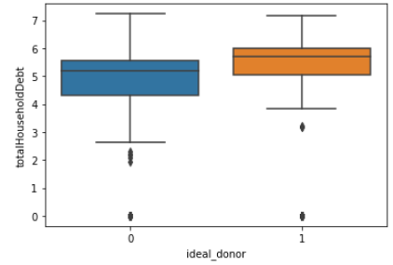
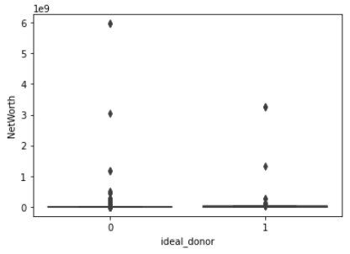
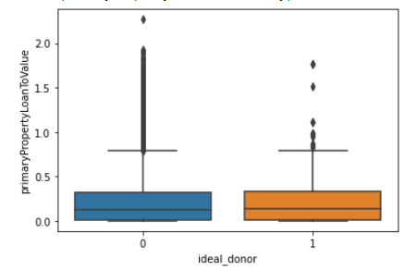
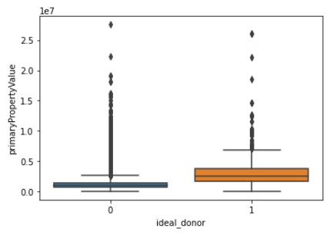

Slide 4
Methodology
Feature engineering was performed creating 11 additional features used for model creation.
primaryPropertyLoanToValue_ideal : LTV ratio of 80% or less is ideal
primaryPropertyValueToNetWorth_ratio
LoanAmount: primaryPropertyLoanToValue * primaryPropertyValue
amount_prev360d2: amount donated in 2014-2015
amount_prev360d3: amount donated in 2013-2014
amount_prev360d4: amount donated in 2012-2013
amount_prev360d5: amount donated in 2011-2012
amountscaled_prev360d3
amountscaled_prev360d5
count_trans_date_prev5y: count donations 2011-Predicted on date
random_value: baseline for feature importance

Slide 5
To be pursued . . .
Could potentially reduce the problem space down to members who have donated in previous 5 years from prediction date (i.e. 08-01-2016).
From 50,919 candidates to 6,808
Here chance (precision) would be 4%. A big step up from .8%!
Precision (293/6,808) = 4%
Recall (293/385) = 76%

Slide 6
Model structure
Train test split 70/30
Train: 385 to 50,225
Test: 270 to 35,157
14 features
Nested Cross Validation
5 inner cv
10 outer cv
.001 eta
500 boosted rounds
30 early stopping
Tree-structured Parzen Estimator (TPE) Hyperoptimization was used to tune the algorithm

Slide 7
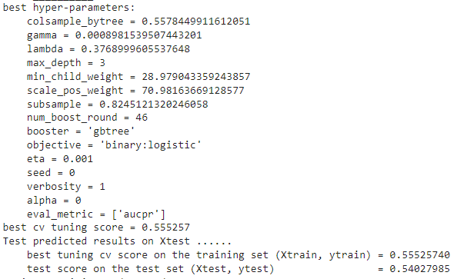
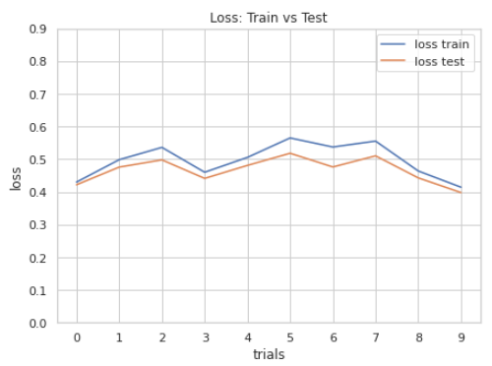
Results

Slide 8
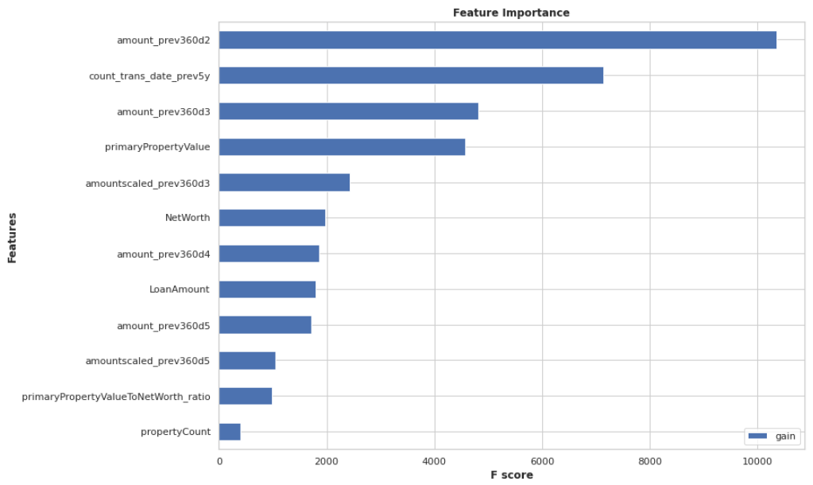
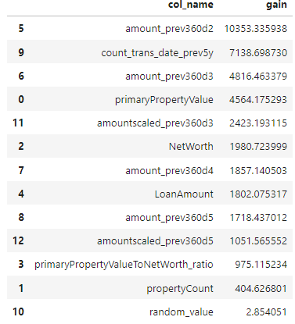
Results

Slide 9
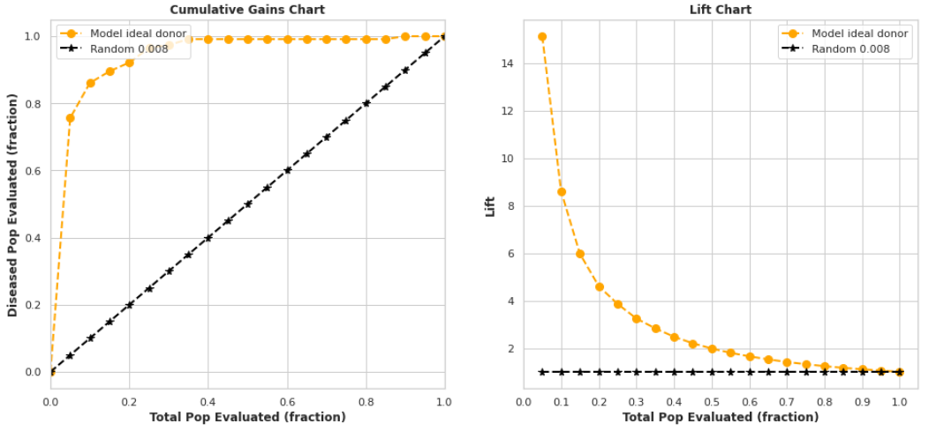
Results

Slide 10
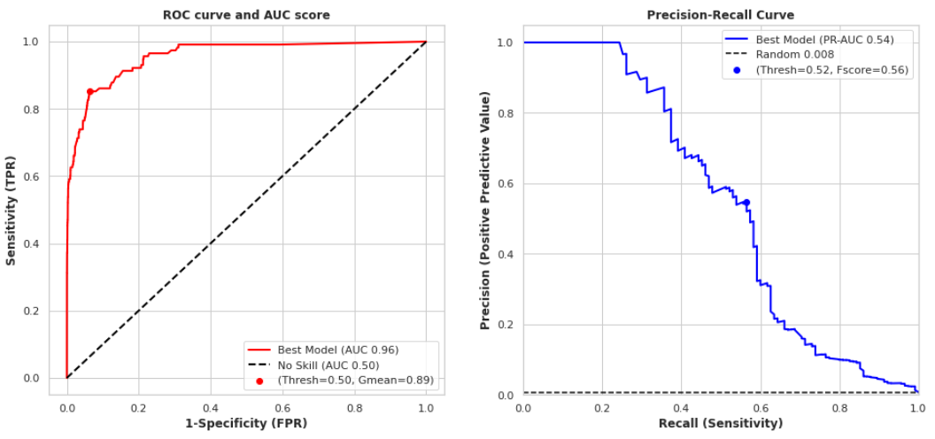
Results

Slide 11
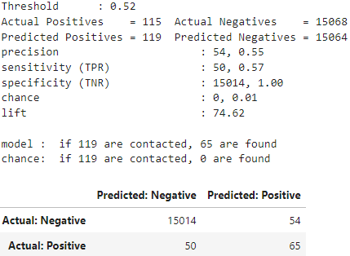
Results

Slide 12
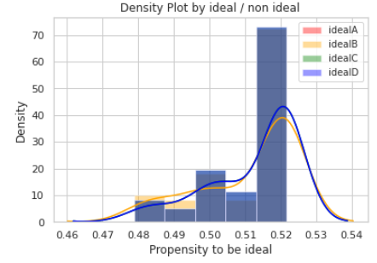

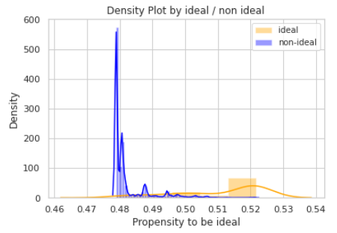
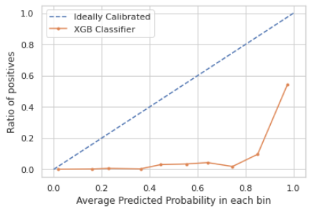
Results

