Slide 1

VASIREDDY VENKATADRI INSTITUTE OF TECHNOLOGY (Autonomous) Department of Computer Science and Engineering
IV B.Tech -II Semester
Distributed Systems
Unit-IV
Operating System Support

Slide 2
Introduction
An operating system that produces a single system image like this for all the resources in a distributed system is called a distributed operating system.
The task of any operating system is to provide problem-oriented abstractions of the underlying physical resources – the processors, memory, networks, and storage media.

Slide 3
Both UNIX and Windows are examples of network operating systems. They have a networking capability built into them and so can be used to access remote resources.

Slide 4
Middleware and network operating systems
There are no distributed operating systems in general use, only network operating systems such as UNIX, Mac OS and Windows.
The users have much invested in their application software, which often meets their current problem-solving needs; they will not adopt a new operating system that will not run their applications, whatever efficiency advantages it offers.

Slide 5
The combination of middleware and network operating systems provides an acceptable balance between the requirement for autonomy on the one hand and network transparent resource access on the other.

Slide 6
The operating system layer
The operating system layer at each of two nodes supports a common middleware layer in providing a distributed infrastructure for applications and services.
The impact of particular OS mechanisms on middleware’s ability to deliver distributed resource sharing to users.
Kernels and the client and server processes that execute upon them are the chief architectural components that concern us.
Kernels and server processes are the components that manage resources and present clients with an interface to the resources.

Slide 7
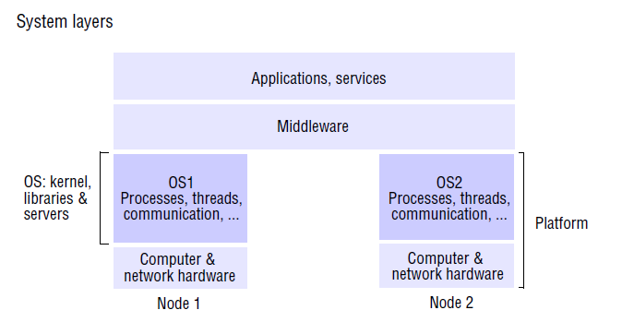

Slide 8
Encapsulation: They should provide a useful service interface to their resources – that is, a set of operations that meet their clients’ needs. Details such as management of memory and devices used to implement resources should be hidden from clients.
Protection: Resources require protection from illegitimate accesses – for example, files are protected from being read by users without read permissions, and device registers are protected from application processes.
Concurrent processing: Clients may share resources and access them concurrently. Resource managers are responsible for achieving concurrency transparency.

Slide 9
A combination of libraries, kernels and servers may be called upon to perform the following invocation related tasks:
Communication: Operation parameters and results have to be passed to and from resource managers, over a network or within a computer.
Scheduling: When an operation is invoked, its processing must be scheduled within the kernel or server.

Slide 10
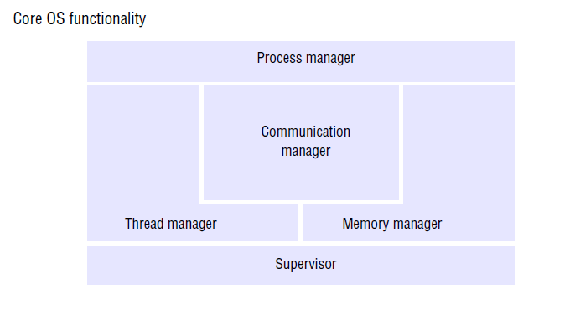

Slide 11
The core OS functionality that we shall be concerned with: process and thread management, memory management and communication between processes on the same computer.

Slide 12
The core OS components and their responsibilities are:
Process manager: Creation of and operations upon processes. A process is a unit of resource management, including an address space and one or more threads.
Thread manager: Thread creation, synchronization and scheduling. Threads are schedulable activities attached to processes.
Communication manager: Communication between threads attached to different processes on the same computer. Some kernels also support communication between threads in remote processes.

Slide 13
Memory manager: Management of physical and virtual memory , describe the utilization of memory management techniques for efficient data copying and sharing.
Supervisor: Dispatching of interrupts, system call traps and other exceptions; control of memory management unit and hardware caches; processor and floating-point unit register manipulations. This is known as the Hardware Abstraction Layer in Windows.

Slide 14
Protection:
The resources require protection from illegitimate accesses.
The open files have only two operations, read and write. Protecting the file consists of two sub-problems. The first is to ensure that each of the file’s two operations can be performed only by clients with the right to perform it.
The file, has read and write rights to it. If it has only perform the read operation.
An illegitimate access here would be if somehow managed to perform a write operation on the file.

Slide 15
A complete solution to this resource-protection sub-problem in a distributed system requires cryptographic techniques.
Kernels and protection:
The kernel is a program that is distinguished by the facts that it remains loaded from system initialization and its code is executed with complete access privileges for the physical resources on its host computer.

Slide 16
It can control the memory management unit and set the processor registers so that no other code may access the machine’s physical resources except in acceptable ways.
A kernel process executes with the processor in supervisor (privileged) mode; the kernel arranges that other processes execute in user (unprivileged) mode.
An address space is a collection of ranges of virtual memory locations, in each of which a specified combination of memory access rights applies, such as readonly or read-write.
A process cannot access memory outside its address space.

Slide 17
The terms user process or user-level process are normally used to describe one that executes in user mode and has a user-level address space (that is, one with restricted memory access rights compared with the kernel’s address space).
When a process executes application code, it executes in a distinct user-level address space for that application; when the same process executes kernel code, it executes in the kernel’s address space.

Slide 18
The process can safely transfer from a user-level address space to the kernel’s address space via an exception such as an interrupt or a system call trap – the invocation mechanism for resources managed by the kernel.
A system call trap is implemented by a machine-level TRAP instruction, which puts the processor into supervisor mode and switches to the kernel address space.

Slide 19
Processes and threads
To enhance the notion of a process so that it could be associated with multiple activities.
A process consists of an execution environment together with one or more threads.
A thread is the operating system abstraction of an activity.
An execution environment is the unit of resource management: a collection of local kernel managed resources to which its threads have access.

Slide 20
An execution environment primarily consists of:
• an address space;
• thread synchronization and communication resources such as semaphores and communication interfaces (for example, sockets);
• higher-level resources such as open files and windows.

Slide 21
Threads can be created and destroyed dynamically, as needed.
The central aim of having multiple threads of execution is to maximize the degree of concurrent execution between operations.
Thus enabling the overlap of computation with input and output, and enabling concurrent processing on multiprocessors.

Slide 22
An execution environment provides protection from threads outside it, so that the data and other resources contained in it are by default inaccessible to threads residing in other execution environments.
But certain kernels allow the controlled sharing of resources such as physical memory between execution environments residing at the same computer.

Slide 23
Address spaces:
An address space, is a unit of management of a process’s virtual memory.
It consists of one or more regions, separated by inaccessible areas of virtual memory.
A region is an area of contiguous virtual memory that is accessible by the threads of the owning process. Regions do not overlap.
Each region is specified by the following properties:
• its extent (lowest virtual address and size);
• read/write/execute permissions for the process’s threads;
• whether it can be grown upwards or downwards.

Slide 24
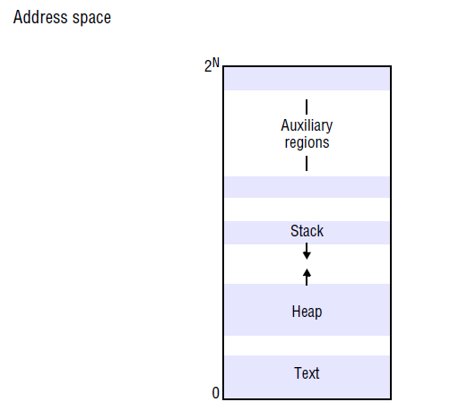

Slide 25
This representation of an address space as a sparse set of disjoint regions is a generalization of the UNIX address space, which has three regions:
a fixed, unmodifiable text region containing program code.
a heap, part of which is initialized by values stored in the program’s binary file, and which is extensible towards higher virtual addresses.
a stack, which is extensible towards lower virtual addresses.

Slide 26
The need to share memory between processes, or between processes and the kernel, is another factor leading to extra regions in the address space.
A shared memory region (or shared region for short) is one that is backed by the same physical memory as one or more regions belonging to other address spaces.
Processes therefore access identical memory contents in the regions that are shared, while their non-shared regions remain protected.

Slide 27
The uses of shared regions include the following:
Libraries: Library code can be very large and would waste considerable memory if it was loaded separately into every process that used it. Instead, a single copy of the library code can be shared by being mapped as a region in the address spaces of processes that require it.
Kernel: Often the kernel code and data are mapped into every address space at the same location. When a process makes a system call or an exception occurs, there is no need to switch to a new set of address mappings.

Slide 28
Data sharing and communication: Two processes, or a process and the kernel, might need to share data in order to cooperate on some task. It can be considerably more efficient for the data to be shared by being mapped as regions in both address spaces than by being passed in messages between them.

Slide 29
Creation of a new process
The creation of a new process has traditionally been an indivisible operation provided by the operating system.
The UNIX fork system call creates a process with an execution environment copied from the caller.
For a distributed system, the design of the process-creation mechanism has to take into account the utilization of multiple computers; consequently, the process-support infrastructure is divided into separate system services.

Slide 30
The creation of a new process can be separated into two independent aspects:
Choice of process host: The choice of the node at which the new process will reside – the process allocation decision – is a matter of policy.
Process allocation policies range from always running new processes at their originator’s workstation to sharing the processing load between a set of computers.

Slide 31
The transfer policy determines whether to situate a new process locally or remotely. This may depend, for example, on whether the local node is lightly or heavily loaded.
The location policy determines which node should host a new process selected for transfer. This decision may depend on the relative loads of nodes, on their machine architectures or on any specialized resources they may possess.

Slide 32
Creation of a new execution environment
Once the host computer has been selected, a new process requires an execution environment consisting of an address space with initialized contents (and perhaps other resources, such as default open files).
There are two approaches to defining and initializing the address space of a newly created process. The first approach is used where the address space is of a statically defined format.
The address space can be defined with respect to an existing execution environment.

Slide 33
This scheme has been generalized so that each region of the parent process may be inherited by the child process.
When parent and child share a region, the page frames (units of physical memory corresponding to virtual memory pages) belonging to the parent’s region are mapped simultaneously into the corresponding child region.

Slide 34
Apply an optimization called copy-on-write when an inherited region is copied from the parent.
The region is copied, but no physical copying takes place by default.
The page frames that make up the inherited region are shared between the two address spaces.
A page in the region is only physically copied when one or another process attempts to modify it.

Slide 35
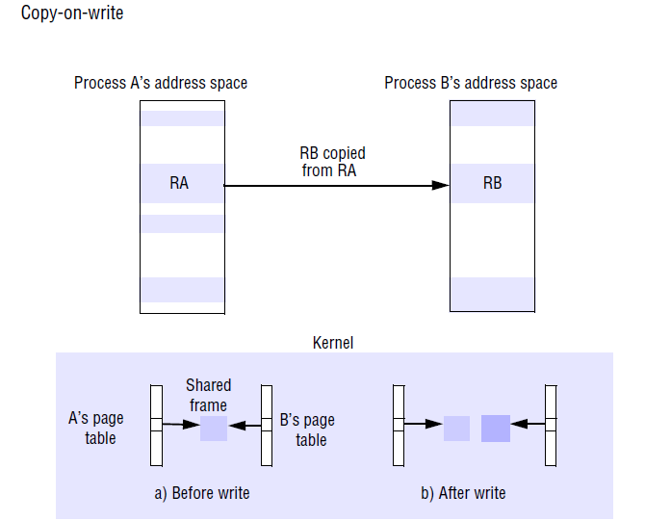

Slide 36
Let us follow through an example of regions RA and RB, whose memory is shared copy-on-write between two processes, A and B.
Let us assume that process A set region RA to be copy-inherited by its child, process B, and that the region RB was thus created in process B.
All page frames associated with the regions are shared between the two processes’ page tables.
The pages are initially write-protected at the hardware level, even though they may belong to regions that are logically writable.
If a thread in either process attempts to modify the data, a hardware exception called a page fault is taken.

Slide 37
Let us say that process B attempted the write. The page fault handler allocates a new frame for process B and copies the original frame’s data into it byte for byte.
The old frame number is replaced by the new frame number in one process’s page table – it does not matter which – and the old frame number is left in the other page table.
The two corresponding pages in processes A and B are then each made writable once more at the hardware level. After all of this has taken place, process B’s modifying instruction is allowed to proceed.

Slide 38
Threads
A process to consider in more detail is its threads.
We examine the advantages of enabling client and server processes to possess more than one thread.
Consider the server shown in Figure the server has a pool of one or more threads, each of which repeatedly removes a request from a queue of received requests and processes it.

Slide 39
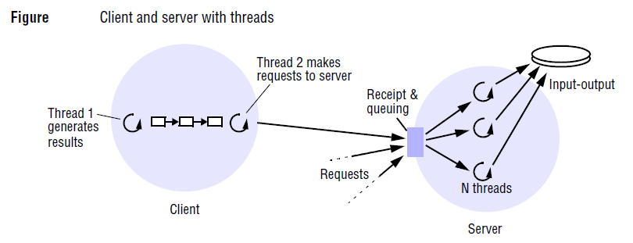

Slide 40
we assume that each thread applies the same procedure to process the requests.
Let us assume that each request takes, on average, 2 milliseconds of processing plus 8 milliseconds of I/O (input/output) delay when the server reads from a disk.
Let us further assume for the moment that the server executes at a single-processor computer.
Consider the maximum server throughput, measured in client requests handled per second, for different numbers of threads.
If a single thread has to perform all processing, then the turnaround time for handling any request is on average 2 + 8 = 10 milliseconds, so this server can handle 100 client requests per second.
Any new request messages that arrive while the server is handling a request are queued at the server port.

Slide 41
Now consider what happens if the server pool contains two threads. We assume that threads are independently schedulable – that is, one thread can be scheduled when another becomes blocked for I/O.
Then thread number two can process a second request while thread number one is blocked, and vice versa.
This increases the server throughput. Unfortunately, in our example, the threads may become blocked behind the single disk drive.
If all disk requests are serialized and take 8 milliseconds each, then the maximum throughput is 1000/8 = 125 requests per second.

Slide 42
Suppose, now, that disk block caching is introduced. The server keeps the data that it reads in buffers in its address space.
A server thread that is asked to retrieve data first examines the shared cache and avoids accessing the disk if it finds the data there.
If a 75% hit rate is achieved, the mean I/O time per request reduces to (0.75*0 + 0.25*8) = 2 milliseconds, and the maximum theoretical throughput increases to 500 requests per second.

Slide 43
The throughput can be increased by using a shared-memory multiprocessor to ease the processor bottleneck.
A multi-threaded process maps naturally onto a shared memory multiprocessor.
The shared execution environment can be implemented in shared memory, and the multiple threads can be scheduled to run on the multiple processors.
Consider now the case in which our example server executes at a multiprocessor with two processors.

Slide 44
Given that threads can be independently scheduled to the different processors, then up to two threads can process requests in parallel.
The reader should check that two threads can process 444 requests per second and three or more threads, bounded by the I/O time, can process 500 requests per second.

Slide 45
Architectures for multi-threaded servers:
To describe the various ways of mapping requests to threads within a server one of the possible threading architectures, the worker pool architecture.
In the thread-per-request architecture (Figure a) the I/O thread spawns a new worker thread for each request, and that worker destroys itself when it has processed the request against its designated remote object.

Slide 46
The advantage that the threads do not contend for a shared queue, and throughput is potentially maximized because the I/O thread can create as many workers as there are outstanding requests.
Its disadvantage is the overhead of the thread creation and destruction operations.

Slide 47
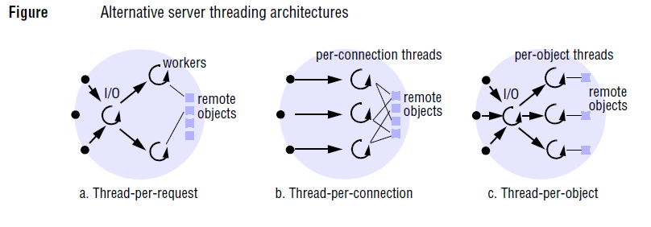

Slide 48
The thread-per-connection architecture (Figure b) associates a thread with each connection.
The server creates a new worker thread when a client makes a connection and destroys the thread when the client closes the connection.
The thread-per-object architecture (Figure c) associates a thread with each remote object. An I/O thread receives requests and queues them for the workers, but this time there is a per-object queue.

Slide 50
Threads within clients
Threads can be useful for clients as well as servers.
Figure also shows a client process with two threads. The first thread generates results to be passed to a server by remote method invocation, but does not require a reply.
This client process can incorporate a second thread, which performs the remote method invocations and blocks while the first thread is able to continue computing further results.

Slide 51
Threads versus multiple processes
Threads are cheaper to create and manage than processes, and resource sharing can be achieved more efficiently between threads than between processes because threads share an execution environment.
An execution environment has an address space, communication interfaces such as sockets, higher-level resources such as open files and thread synchronization objects such as semaphores; it also lists the threads associated with it.

Slide 52
A thread has a scheduling priority, an execution state (such as BLOCKED or RUNNABLE), saved processor register values when the thread is BLOCKED, and state concerning the thread’s software interrupt handling.
A software interrupt is an event that causes a thread to be interrupted (similar to the case of a hardware interrupt). If the thread has assigned a handler procedure, control is transferred to it.

Slide 53
Consider the cost of creating a new thread in an existing execution environment.
The main tasks are to allocate a region for its stack and to provide initial values for the processor registers and the thread’s execution state (it may initially be SUSPENDED or RUNNABLE) and priority.
Since the execution environment exists, only an identifier for this has to be placed in the thread’s descriptor record (which contains data necessary to manage the thread’s execution).
The overheads associated with creating a process are in general considerably greater than those of creating a new thread. A new execution environment must first be created, including address space tables.

Slide 54
Threads programming Threads programming is concurrent programming, the following concurrent programming concepts, which are : race conditions, critical sections (critical regions), monitors, condition variables and semaphores.
In threads implementation, Java provides methods for creating threads, destroying them and synchronizing them.
The Java Thread class includes the constructor and management methods listed in Figure.

Slide 55
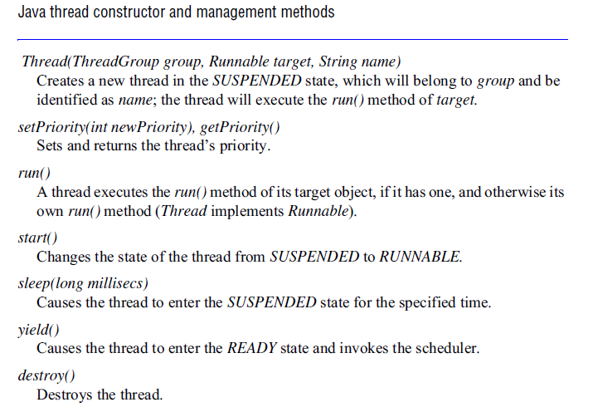

Slide 56
Thread lifetimes:
A new thread is created on the same Java virtual machine (JVM) as its creator, in the SUSPENDED state.
After it is made RUNNABLE with the start() method, it executes the run() method of an object designated in its constructor.
Threads can be assigned a priority, so that a Java implementation that supports priorities will run a particular thread in preference to any thread with lower priority.
A thread ends its life when it returns from the run() method or when its destroy() method is called.

Slide 57
Programs can manage threads in groups. Every thread belongs to one group, which it is assigned at the time of its creation.
Thread groups are useful when several applications coexist on the same JVM.

Slide 58
Thread synchronization
Java provides the synchronized keyword for programmers to designate the wellknown monitor construct for thread coordination.
Programmers designate either entire methods or arbitrary blocks of code as belonging to a monitor associated with an individual object.
The monitor’s guarantee is that at most one thread can execute within it at any time.
We could serialize the actions of the I/O and worker threads in our example by designating addTo() and removeFrom() methods in the Queue class as synchronized methods.

Slide 59
Java allows threads to be blocked and woken up via arbitrary objects that act as condition variables.
A thread that needs to block awaiting a certain condition calls an object’s wait() method.
All objects implement this method, since it belongs to Java’s root Object class.
Another thread calls notify() to unblock at most one thread or notifyAll() to unblock all threads waiting on that object.
Both notification methods also belong to the Object class.
when a worker thread discovers that there are no requests to process, it calls wait() on the instance of Queue.
When the I/O thread subsequently adds a request to the queue, it calls the queue’s notify() method to wake up a worker.

Slide 60
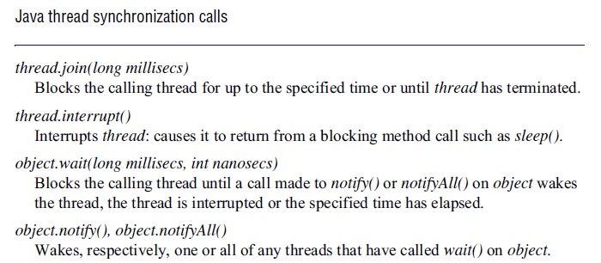

Slide 61
The Java synchronization methods are given in Figure.
In addition to the synchronization primitives that we have mentioned, the join() method blocks the caller until the target thread’s termination.
The interrupt() method is useful for prematurely waking a waiting thread.

Slide 62
Thread scheduling
An important distinction is between preemptive and nonpreemptive scheduling of threads.
In preemptive scheduling, a thread may be suspended at any point to make way for another thread, even when the preempted thread would otherwise continue running.
In non-preemptive scheduling , a thread runs until it makes a call to the threading system , when the system may deschedule it and schedule another thread to run.

Slide 63
The advantage of non-preemptive scheduling is that any section of code that does not contain a call to the threading system is automatically a critical section. Race conditions are thus conveniently avoided.

