Slide 1

VASIREDDY VENKATADRI INSTITUTE OF TECHNOLOGY (Autonomous) Department of Computer Science and Engineering
IV B.Tech -II Semester
Distributed Systems
Unit-VI
Transactions & Replications

Slide 2
UNIT-VI: Syllabus
Transactions : Introduction
System Model and Group Communication
Concurrency Control in Distributed Transactions
Distributed Dead Locks
Transaction Recovery
Replication-Introduction
Passive (Primary) Replication
Active Replication.

Slide 3
Transactions : Introduction
The goal of transactions is to ensure that all of the objects managed by a server remain in a consistent state when they are accessed by multiple transactions and in the presence of server crashes.
Objects that can be recovered after their server crashes are called recoverable objects.
In general, the objects managed by a server may be stored in volatile memory (for example, RAM) or persistent memory (for example, a hard disk).
Even if objects are stored in volatile memory, the server may use persistent memory to store sufficient information for the state of the objects to be recovered if the server process crashes.
This enables servers to make objects recoverable.

Slide 4
A transaction is specified by a client as a set of operations on objects to be performed as an indivisible unit by the servers managing those objects.
The servers must guarantee that either the entire transaction is carried out and the results recorded in permanent storage or, in the case that one or more of them crashes, its effects are completely erased.
A client’s transaction is also regarded as indivisible from the point of view of other clients’ transactions in the sense that the operations of one transaction cannot observe the partial effects of the operations of another.

Slide 5
To explain some of the points made in this chapter, we use a banking example, shown in Figure.
Each account is represented by a remote object whose interface, Account, provides operations for making deposits and withdrawals and for enquiring about and setting the balance.
Each branch of the bank is represented by a remote object whose interface, Branch, provides operations for creating a new account, for looking up an account by name and for enquiring about the total funds at that branch.

Slide 6
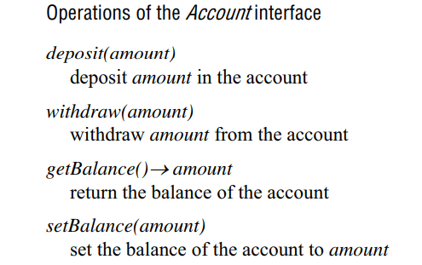

Slide 7
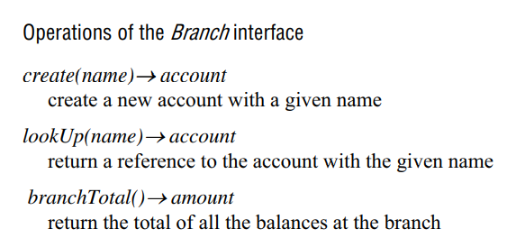

Slide 8
Simple synchronization (without transactions)
One of the main issues is that unless a server is carefully designed, its operations performed on behalf of different clients may sometimes interfere with one another.
Such interference may result in incorrect values in the objects. In this section, we discuss how client operations may be synchronized without recourse to transactions.
Atomic operations at the server
• We have seen that the use of multiple threads is beneficial to performance in many servers.
We have also noted that the use of threads allows operations from multiple clients to run concurrently and possibly access the same objects.

Slide 9
Therefore, the methods of objects should be designed for use in a multi-threaded context.
For example, if the methods deposit and withdraw are not designed for use in a multi-threaded program, then it is possible that the actions of two or more concurrent executions of the method could be interleaved arbitrarily and have strange effects on the instance variables of the account objects.
The use of the synchronized keyword, which can be applied to methods in Java to ensure that only one thread at a time can access an object.

Slide 10
In our example, the class that implements the Account interface will be able to declare the methods as synchronized.
For example:
public synchronized void deposit(int amount) throws RemoteException
{
// adds amount to the balance of the account
}
If one thread invokes a synchronized method on an object, then that object is effectively locked, and another thread that invokes one of its synchronized methods will be blocked until the lock is released.
This form of synchronization forces the execution of threads to be separated in time and ensures that the instance variables of a single object are accessed in a consistent manner.

Slide 11
Enhancing client cooperation by synchronization of server operations
• Clients may use a server as a means of sharing some resources.
This is achieved by some clients using operations to update the server’s objects and other clients using operations to access them.
The above scheme for synchronized access to objects provides all that is required in many applications – it prevents threads interfering with one another.
However, some applications require a way for threads to communicate with each other.

Slide 12
The Java wait and notify methods allow threads to communicate with one another in a manner that solves the above problems. They must be used within synchronized methods of an object.
A thread calls wait on an object so as to suspend itself and to allow another thread to execute a method of that object.
A thread calls notify to inform any thread waiting on that object that it has changed some of its data.
Access to an object is still atomic when threads wait for one another: a thread that calls wait gives up its lock and suspends itself as a single atomic action.
when a thread is restarted after being notified it acquires a new lock on the object and resumes execution from after its wait.
A thread that calls notify (from within a synchronized method) completes the execution of that method before releasing the lock on the object.

Slide 13
Consider the implementation of a shared Queue object with two methods:
First removes and returns the first object in the queue, and append adds a given object to the end of the queue.
The method first will test whether the queue is empty, in which case it will call wait on the queue.
If a client invokes first when the queue is empty, it will not get a reply until another client has added something to the queue – the append operation will call notify when it has added an object to the queue.
This allows one of the threads waiting on the queue object to resume and to return the first object in the queue to its client.
When threads can synchronize their actions on an object by means of wait and notify, the server holds onto requests that cannot immediately be satisfied and the client waits for a reply until another client has produced whatever it needs.

Slide 14
In some situations, clients require a sequence of separate requests to a server to be atomic in the sense that:
They are free from interference by operations being performed on behalf of other concurrent clients.
2. Either all of the operations must be completed successfully or they must have no effect at all in the presence of server crashes.
A client’s banking transaction
Transaction T:
a.withdraw(100);
b.deposit(100);
c.withdraw(200);
b.deposit(200);

Slide 15
We return to our banking example to illustrate transactions.
A client that performs a sequence of operations on a particular bank account on behalf of a user will first lookUp the account by name and then apply the deposit, withdraw and getBalance operations directly to the relevant account.
In our examples, we use accounts with names A, B and C. The client looks them up and stores references to them in variables a, b and c of type Account.
The details of looking up the accounts by name and the declarations of the variables are omitted from the examples.
Example of a simple client transaction specifying a series of related actions involving the bank accounts A, B and C.
The first two actions transfer $100 from A to B and the second two transfer $200 from C to B.
A client achieves a transfer operation by doing a withdrawal followed by a deposit.

Slide 16
A transaction is an execution of a sequence of client requests for file operations.
A transaction consists of the execution of a sequence of client requests such as, for example, those in Figure .
From the client’s point of view, a transaction is a sequence of operations that forms a single step, transforming the server data from one consistent state to another.
Transactions can be provided as a part of middleware.
For example, CORBA provides the specification for an Object Transaction Service with IDL interfaces allowing clients’ transactions to include multiple objects at multiple servers.

Slide 17
The client is provided with operations to specify the beginning and end of a transaction.
The client maintains a context for each transaction, which it propagates with each operation in that transaction.
In CORBA, transactional objects are invoked within the scope of a transaction and generally have some persistent store associated with them.
In all of these contexts, a transaction applies to recoverable objects and is intended to be atomic. It is often called an atomic transaction.

Slide 18
All or nothing:
A transaction either completes successfully, in which case the effects of all of its operations are recorded in the objects, or (if it fails or is deliberately aborted) has no effect at all.
This all-or-nothing effect has two further aspects of its own:
Failure atomicity: The effects are atomic even when the server crashes.
Durability: After a transaction has completed successfully, all its effects are saved in permanent storage. We use the term ‘permanent storage’ to refer to files held on disk or another permanent medium.
Data saved in a file will survive if the server process crashes.

Slide 19
Isolation: Each transaction must be performed without interference from other transactions; in other words, the intermediate effects of a transaction must not be visible to other transactions.
To support the requirement for failure atomicity and durability, the objects must be recoverable.
when a server process crashes unexpectedly due to a hardware fault or a software error, the changes due to all completed transactions must be available in permanent storage so that when the server is replaced by a new process, it can recover the objects to reflect the all-or-nothing effect.
By the time a server acknowledges the completion of a client’s transaction, all of the transaction’s changes to the objects must have been recorded in permanent storage.

Slide 20
The aim for any server that supports transactions is to maximize concurrency.
Therefore transactions are allowed to execute concurrently if this would have the same effect as a serial execution – that is, if they are serially equivalent or serializable.
Transaction capabilities can be added to servers of recoverable objects. Each transaction is created and managed by a coordinator, which implements the Coordinator interface shown in Figure.
The coordinator gives each transaction an identifier, or TID.
The client invokes the openTransaction method of the coordinator to introduce a new transaction – a transaction identifier or TID is allocated and returned.
At the end of a transaction, the client invokes the closeTransaction method to indicate its end – all of the recoverable objects accessed by the transaction should be saved. If, for some reason, the client wants to abort a transaction, it invokes the abortTransaction method – all of its effects should be removed from sight.

Slide 21
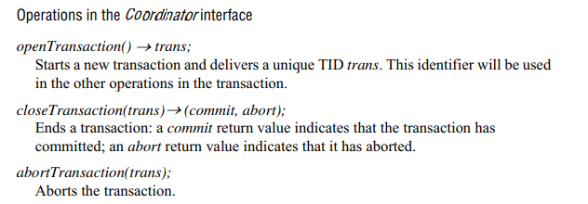

Slide 22
A transaction is achieved by cooperation between a client program, some recoverable objects and a coordinator.
The client specifies the sequence of invocations on recoverable objects that are to comprise a transaction.
To achieve this, the client sends with each invocation the transaction identifier returned by openTransaction.
One way to make this possible is to include an extra argument in each operation of a recoverable object to carry the TID.
For example, in the banking service the deposit operation might be defined:
deposit(trans, amount)
Deposits amount in the account for transaction with TID trans.
When transactions are provided as middleware, the TID can be passed implicitly with all remote invocations between openTransaction and closeTransaction or abortTransaction.
This is what the CORBA Transaction Service does.

Slide 23
A transaction completes when the client makes a closeTransaction request.
If the transaction has progressed normally, the reply states that the transaction is committed – this constitutes a promise to the client that all of the changes requested in the transaction are permanently recorded and that any future transactions that access the same data will see the results of all of the changes made during the transaction.
The transaction may have to abort for one of several reasons related to the nature of the transaction itself, to conflicts with another transaction or to the crashing of a process or computer.
When a transaction is aborted the parties involved (the recoverable objects and the coordinator) must ensure that none of its effects are visible to future transactions, either in the objects or in their copies in permanent storage.
A transaction is either successful or is aborted in one of two ways – the client aborts it (using an abortTransaction call to the server) or the server aborts it.

Slide 24
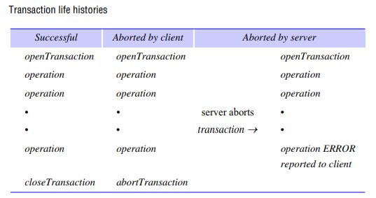

Slide 25
Concurrency control
Two well-known problems of concurrent transactions in the context of the banking example – the ‘lost update’ problem and the ‘inconsistent retrievals’ problem.
We assume throughout that each of the operations deposit, withdraw , getBalance and setBalance is a synchronized operation – that is, that its effects on the instance variable that records the balance of an account are atomic.

Slide 26
The lost update problem :
• The lost update problem is illustrated by the following pair of transactions on bank accounts A, B and C, whose initial balances are $100, $200 and $300, respectively.
Transaction T transfers an amount from account A to account B.
Transaction U transfers an amount from account C to account B.
In both cases, the amount transferred is calculated to increase the balance of B by 10%. The net effects on account B of executing the transactions T and U should be to increase the balance of account B by 10% twice, so its final value is $242.
Now consider the effects of allowing the transactions T and U to run concurrently, as in Figure .
Both transactions get the balance of B as $200 and then deposit $20.
The result is incorrect, increasing the balance of account B by $20 instead of $42.
This is an illustration of the ‘lost update’ problem. U’s update is lost because T overwrites it without seeing it.
Both transactions have read the old value before either writes the new value.

Slide 27
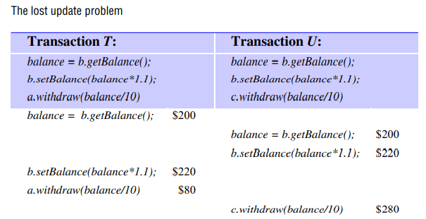
The lost update problem occurs when two transactions read the old value of a variable and then use it to calculate the new value. This cannot happen if one transaction is performed before the other, because the later transaction will read the value written by the earlier one.

Slide 28
Inconsistent retrievals
Another example related to a bank account in which transaction V transfers a sum from account A to B and transaction W invokes the branchTotal method to obtain the sum of the balances of all the accounts in the bank.
The balances of the two bank accounts, A and B, are both initially $200. The result of branchTotal includes the sum of A and B as $300, which is wrong.
This is an illustration of the ‘inconsistent retrievals’ problem. W’s retrievals are inconsistent because V has performed only the withdrawal part of a transfer at the time the sum is calculated.

Slide 29
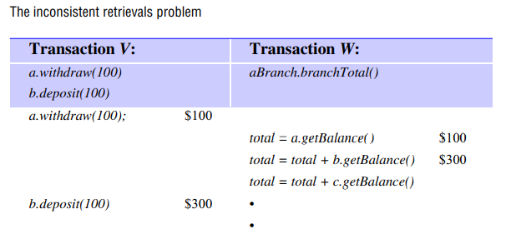

Slide 30
Serial equivalence:
An interleaving of the operations of transactions in which the combined effect is the same as if the transactions had been performed one at a time in some order is a serially equivalent interleaving.
When we say that two different transactions have the same effect as one another, we mean that the read operations return the same values and that the instance variables of the objects have the same values at the end.
The use of serial equivalence as a criterion for correct concurrent execution prevents the occurrence of lost updates and inconsistent retrievals.

Slide 31
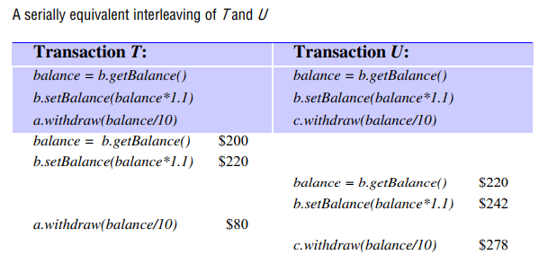

Slide 32
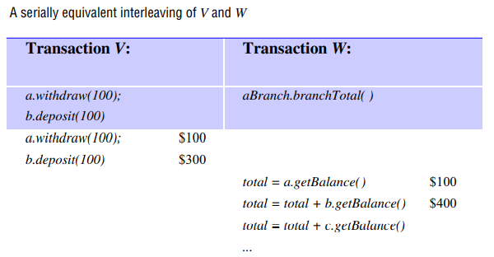

Slide 33
Conflicting operations :
• When we say that a pair of operations conflicts we mean that their combined effect depends on the order in which they are executed.
To simplify matters we consider a pair of operations, read and write. read accesses the value of an object and write changes its value.
The effect of an operation refers to the value of an object set by a write operation and the result returned by a read operation.
The conflict rules for read and write operations are given in Figure.
For any pair of transactions, it is possible to determine the order of pairs of conflicting operations on objects accessed by both of them. Serial equivalence can be defined in terms of operation conflicts as follows:
For two transactions to be serially equivalent, it is necessary and sufficient that all pairs of conflicting operations of the two transactions be executed in the same order at all of the objects they both access.

Slide 34
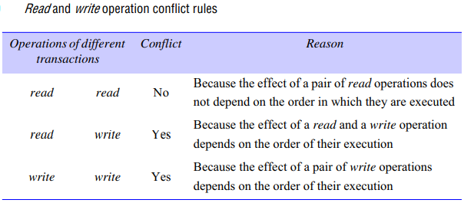

Slide 35
Dirty reads :
The isolation property of transactions requires that transactions do not see the uncommitted state of other transactions.
The ‘dirty read’ problem is caused by the interaction between a read operation in one transaction and an earlier write operation in another transaction on the same object.
Consider the executions illustrated in Figure .
A dirty read when transaction T aborts Transaction T: Transaction U: a.getBalance() a.setBalance(balance + 10) a.getBalance() a.setBalance(balance + 20) balance = a.getBalance() $100 a.setBalance(balance + 10) $110 balance = a.getBalance() $110 a.setBalance(balance + 20) $130 commit transaction abort transaction , in which T gets the balance of account A and sets it to $10 more, then U gets the balance of account A and sets it to $20 more, and the two executions are serially equivalent.

Slide 36
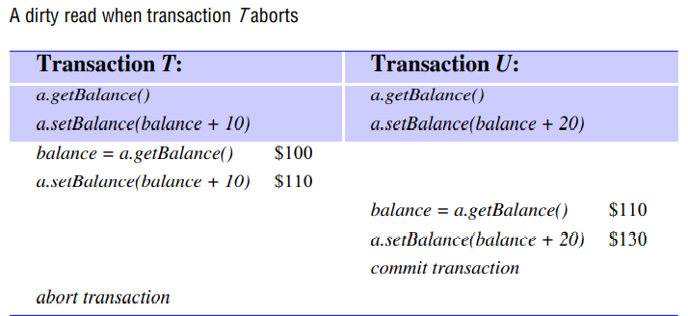
Now suppose that the transaction T aborts after U has committed. Then the transaction U will have seen a value that never existed, since A will be restored to its original value. We say that the transaction U has performed a dirty read. As it has committed, it cannot be undone.

Slide 37
Cascading aborts
• In Figure , suppose that transaction U delays committing until after T aborts. As we have said, U must abort as well. Unfortunately, if any other transactions have seen the effects due to U, they too must be aborted.
The aborting of these latter transactions may cause still further transactions to be aborted. Such situations are called cascading aborts.
To avoid cascading aborts, transactions are only allowed to read objects that were written by committed transactions.
To ensure that this is the case, any read operation must be delayed until other transactions that applied a write operation to the same object have committed or aborted. The avoidance of cascading aborts is a stronger condition than recoverability.

Slide 38
Premature writes
• Consider another implication of the possibility that a transaction may abort. This one is related to the interaction between write operations on the same object belonging to different transactions.
For an illustration, we consider two setBalance transactions, T and U, on account A, as shown in Figure Overwriting uncommitted values Transaction T: Transaction U: a.setBalance(105) a.setBalance(110) $100 a.setBalance(105) $105 a.setBalance(110) $110 .
Before the transactions, the balance of account A was $100. The two executions are serially equivalent, with T setting the balance to $105 and U setting it to $110. If the transaction U aborts and T commits, the balance should be $105.

Slide 39
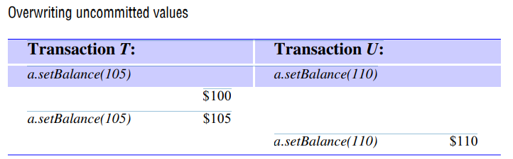

Slide 40
Strict executions of transactions
• Generally, it is required that transactions delay both their read and write operations so as to avoid both dirty reads and premature writes.
The executions of transactions are called strict if the service delays both read and write operations on an object until all transactions that previously wrote that object have either committed or aborted.
The strict execution of transactions enforces the desired property of isolation.

Slide 41
Locks
Transactions must be scheduled so that their effect on shared data is serially equivalent. A server can achieve serial equivalence of transactions by serializing access to the objects.
A simple example of a serializing mechanism is the use of exclusive locks. In this locking scheme, the server attempts to lock any object that is about to be used by any operation of a client’s transaction.
If a client requests access to an object that is already locked due to another client’s transaction, the request is suspended and the client must wait until the object is unlocked.

Slide 43
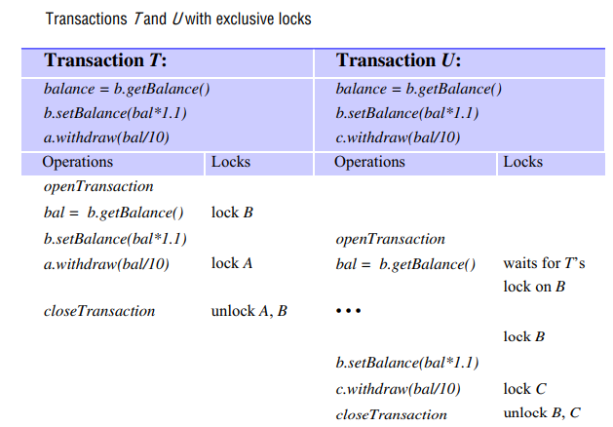

Slide 44
In this example, it is assumed that when transactions T and U start, the balances of the accounts A, B and C are not yet locked.
When transaction T is about to use account B, it is locked for T.
When transaction U is about to use B it is still locked for T, so transaction U waits. When transaction T is committed, B is unlocked, whereupon transaction U is resumed. The use of the lock on B effectively serializes the access to B.
Serial equivalence requires that all of a transaction’s accesses to a particular object be serialized with respect to accesses by other transactions. All pairs of conflicting operations of two transactions should be executed in the same order.
To ensure this, a transaction is not allowed any new locks after it has released a lock. The first phase of each transaction is a ‘growing phase’, during which new locks are acquired. In the second phase, the locks are released (a ‘shrinking phase’). This is called two-phase locking.

Slide 45
The transactions may abort, strict executions are needed to prevent dirty reads and premature writes.
Under a strict execution regime, a transaction that needs to read or write an object must be delayed until other transactions that wrote the same object have committed or aborted.
To enforce this rule, any locks applied during the progress of a transaction are held until the transaction commits or aborts. This is called strict two-phase locking.

Slide 46
Concurrency control protocols are designed to cope with conflicts between operations in different transactions on the same object.
The conflict rules for read and write operations are given in Figure, which shows that pairs of read operations from different transactions on the same object do not conflict.
A simple exclusive lock that is used for both read and write operations reduces concurrency more than is necessary.
It is preferable to adopt a locking scheme that controls the access to each object so that there can be several concurrent transactions reading an object, or a single transaction writing an object, but not both. This is commonly referred to as a ‘many readers/single writer’ scheme.

Slide 47
Two types of locks are used: read locks and write locks.
Before a transaction’s read operation is performed, a read lock should be set on the object.
Before a transaction’s write operation is performed, a write lock should be set on the object.
Whenever it is impossible to set a lock immediately, the transaction (and the client) must wait until it is possible to do so – a client’s request is never rejected.
As pairs of read operations from different transactions do not conflict, an attempt to set a read lock on an object with a read lock is always successful.
All the transactions reading the same object share its read lock – for this reason, read locks are sometimes called shared locks.

Slide 48
The operation conflict rules tell us that:
1. If a transaction T has already performed a read operation on a particular object, then a concurrent transaction U must not write that object until T commits or aborts.
2. If a transaction T has already performed a write operation on a particular object, then a concurrent transaction U must not read or write that object until T commits or aborts.
To enforce condition 1, a request for a write lock on an object is delayed by the presence of a read lock belonging to another transaction.
To enforce condition 2, a request for either a read lock or a write lock on an object is delayed by the presence of a write lock belonging to another transaction.

Slide 49
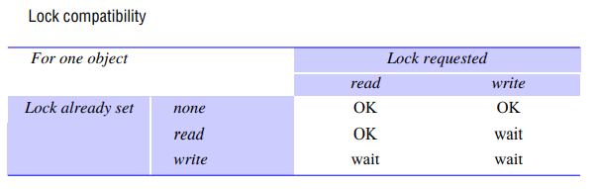

Slide 50
A transaction with a read lock that is shared with other transactions cannot promote its read lock to a write lock, because the latter would conflict with the read locks held by the other transactions.
Therefore, such a transaction must request a write lock and wait for the other read locks to be released.
Lock promotion refers to the conversion of a lock to a stronger lock – that is, a lock that is more exclusive. The lock compatibility table in Figure shows the relative exclusivity of locks.
The read lock allows other read locks, whereas the write lock does not. Neither allows other write locks. Therefore, a write lock is more exclusive than a read lock.
Locks may be promoted because the result is a more exclusive lock. It is not safe to demote a lock held by a transaction before it commits, because the result will be more permissive than the previous one and may allow executions by other transactions that are inconsistent with serial equivalence

Slide 51
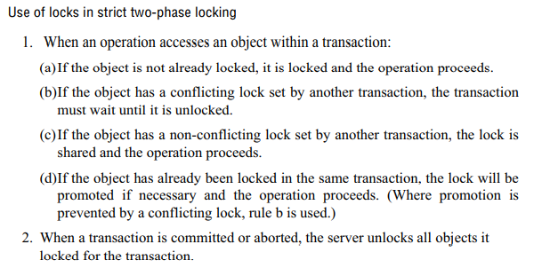

Slide 52
Deadlocks:
The use of locks can lead to deadlock. Consider the use of locks shown in Figure.
Since the deposit and withdraw methods are atomic, we show them acquiring write locks – although in practice they read the balance and then write it.
Each of them acquires a lock on one account and then gets blocked when it tries to access the account that the other one has locked. This is a deadlock situation – two transactions are waiting, and each is dependent on the other to release a lock so it can resume.

Slide 53
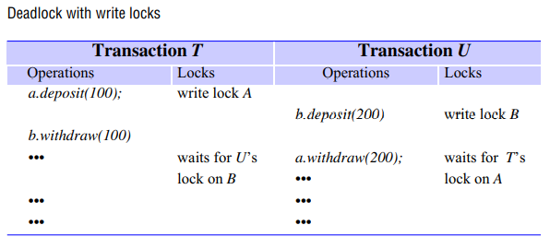

Slide 54
Definition of deadlock
• Deadlock is a state in which each member of a group of transactions is waiting for some other member to release a lock.
A wait-for graph can be used to represent the waiting relationships between current transactions.
In a wait-for graph the nodes represent transactions and the edges represent wait-for relationships between transactions – there is an edge from node T to node U when transaction T is waiting for transaction U to release a lock.
Figure illustrates the wait-for graph corresponding to the deadlock situation illustrated in previous Figure . Recall that the deadlock arose because transactions T and U both attempted to acquire an object held by the other. Therefore T waits for U and U waits for T.

Slide 55
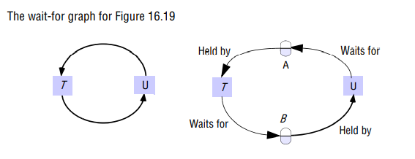
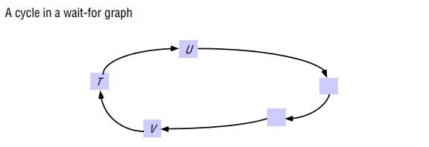

Slide 56
The dependency between transactions is indirect, via a dependency on objects.
The diagram on the right shows the objects held by and waited for by transactions T and U.
As each transaction can wait for only one object, the objects can be omitted from the wait-for graph – leaving the simple graph on the left.
Suppose that, as in Figure . A cycle in a wait-for graph U V T , a wait-for graph contains a cycle T ->U->… ->V ->T .
Each transaction is waiting for the next transaction in the cycle.
All of these transactions are blocked waiting for locks. None of the locks can ever be released, and the transactions are deadlocked.
If one of the transactions in a cycle is aborted, then its locks are released and that cycle is broken.
For example, if transaction T in Figure is aborted, it will release a lock on an object that V is waiting for – and V will no longer be waiting for T.

Slide 57
Deadlock prevention :
• One solution is to prevent deadlock. An apparently simple but not very good way to overcome the deadlock problem is to lock all of the objects used by a transaction when it starts.
This would need to be done as a single atomic step so as to avoid deadlock at this stage.
Such a transaction cannot run into deadlocks with other transactions, but this approach unnecessarily restricts access to shared resources.
In addition, it is sometimes impossible to predict at the start of a transaction which objects will be used.

Slide 58
Deadlock detection
• Deadlocks may be detected by finding cycles in the wait-for graph.
Having detected a deadlock, a transaction must be selected for abortion to break the cycle.
The software responsible for deadlock detection can be part of the lock manager.
It must hold a representation of the wait-for graph so that it can check it for cycles from time to time.
Edges are added to the graph and removed from the graph by the lock manager’s setLock and unLock operations.
At the point illustrated by Figure on the left, it will have the following information:

Slide 59
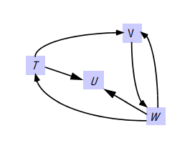
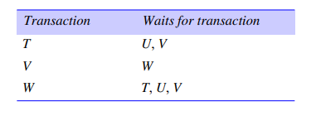
An edge T -> U is added whenever the lock manager blocks a request by transaction T for a lock on an object that is already locked on behalf of transaction U. Note that when a lock is shared, several edges may be added. An edge T -> U is deleted whenever U releases a lock that T is waiting for and allows T to proceed.

Slide 60
If a transaction shares a lock, the lock is not released, but the edges leading to a particular transaction are removed.
The presence of cycles may be checked each time an edge is added, or less frequently to avoid unnecessary overhead.
When a deadlock is detected, one of the transactions in the cycle must be chosen and then be aborted.
The corresponding node and the edges involving it must be removed from the wait-for graph.
This will happen when the aborted transaction has its locks removed.
The choice of the transaction to abort is not simple.
Some factors that may be taken into account are the age of the transaction and the number of cycles in which it is involved.

Slide 61
Timeouts
• Lock timeouts are a method for resolution of deadlocks that is commonly used.
Each lock is given a limited period in which it is invulnerable. After this time, a lock becomes vulnerable.
Provided that no other transaction is competing for the object that is locked, an object with a vulnerable lock remains locked.
However, if any other transaction is waiting to access the object protected by a vulnerable lock, the lock is broken (that is, the object is unlocked) and the waiting transaction resumes.
The transaction whose lock has been broken is normally aborted.
There are many problems with the use of timeouts as a remedy for deadlocks: the worst problem is that transactions are sometimes aborted due to their locks becoming vulnerable when other transactions are waiting for them, but there is actually no deadlock.

Slide 62
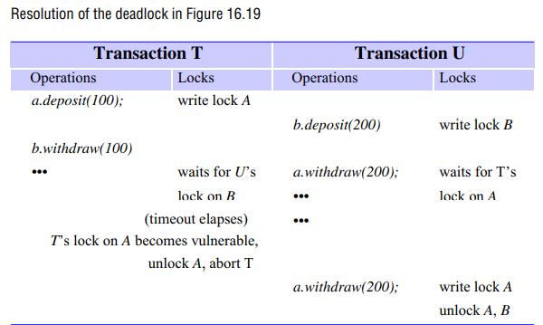

Slide 63
Using lock timeouts, we can resolve the deadlock in which the write lock for T on A becomes vulnerable after its timeout period.
Transaction U is waiting to acquire a write lock on A. Therefore, T is aborted and it releases its lock on A, allowing U to resume and complete the transaction.
When transactions access objects located in several different servers, the possibility of distributed deadlocks arises.
In a distributed deadlock, the wait-for graph can involve objects at multiple locations.

Slide 64
Increasing concurrency in locking schemes
Even when locking rules are based on the conflicts between read and write operations and the granularity at which they are applied is as small as possible, there is still some scope for increasing concurrency.
We discuss two approaches that have been used to deal with this issue.
In the first approach (two-version locking), the setting of exclusive locks is delayed until a transaction commits.
In the second approach (hierarchic locks), mixed-granularity locks are used.

Slide 65
Two-version locking:
This is an optimistic scheme that allows one transaction to write tentative versions of objects while other transactions read from the committed versions of the same objects.
Read operations only wait if another transaction is currently committing the same object.
This scheme allows more concurrency than read-write locks, but writing transactions risk waiting or even rejection when they attempt to commit.
Transactions cannot commit their write operations immediately if other uncompleted transactions have read the same objects.
Transactions that request to commit in such a situation are made to wait until the reading transactions have completed.
Deadlocks may occur when transactions are waiting to commit. Therefore, transactions may need to be aborted when they are waiting to commit, to resolve deadlocks.

Slide 66
This variation on strict two-phase locking uses three types of lock: a read lock, a write lock and a commit lock.
Before a transaction’s read operation is performed, a read lock must be set on the object – the attempt to set a read lock is successful unless the object has a commit lock, in which case the transaction waits.
Before a transaction’s write operation is performed, a write lock must be set on the object – the attempt to set a write lock is successful unless the object has a write lock or a commit lock, in which case the transaction waits.
When the transaction coordinator receives a request to commit a transaction, it attempts to convert all that transaction’s write locks to commit locks.
If any of the objects have outstanding read locks, the transaction must wait until the transactions that set these locks have completed and the locks are released.

Slide 68
Hierarchic locks:
In our banking example, the majority of the operations require locking at the granularity of an account.
The branchTotal operation is different – it reads the values of all the account balances and would appear to require a read lock on all of them.
To reduce locking overhead, it would be useful to allow locks of mixed granularity to coexist.
The use of a hierarchy of locks with different granularities. At each level, the setting of a parent lock has the same effect as setting all the equivalent child locks.
This economizes on the number of locks to be set. In our banking example, the branch is the parent and the accounts are children.

Slide 70
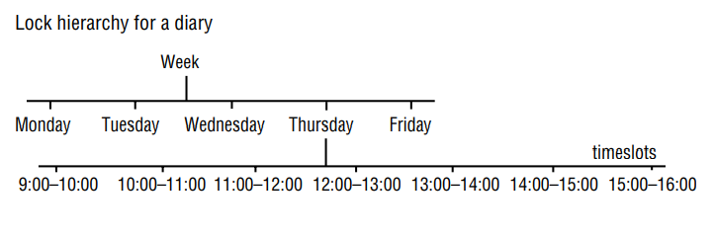

Slide 71
Mixed-granularity locks could be useful in a diary system in which the data could be structured with the diary for a week being composed of a page for each day and the latter subdivided further into a slot for each hour of the day, as shown in Figure.
The operation to view a week would cause a read lock to be set at the top of this hierarchy, whereas the operation to enter an appointment would cause a write lock to be set on a given time slot.
The effect of a read lock on a week would be to prevent write operations on any of the substructures – for example, the time slots for each day in that week.
Each node in the hierarchy can be locked, giving the owner of the lock explicit access to the node and giving implicit access to its children.
In our banking example, a read-write lock on the branch implicitly read-write locks all the accounts. Before a child node is granted a read-write lock, an intention to read-write lock is set on the parent node and its ancestors .
The intention lock is compatible with other intention locks but conflicts with read and write locks according to the usual rules.

Slide 72
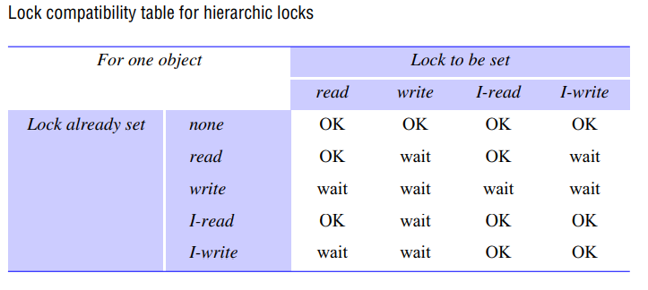

Slide 73
In our banking example, the branchTotal operation requests a read lock on the branch, which implicitly sets read locks on all the accounts.
A deposit operation needs to set a write lock on a balance, but first it attempts to set an intention to write lock on the branch. These rules prevent these operations running concurrently.

Slide 74
OPTIMISTIC CONCURRENCY CONTROL
A number of inherent disadvantages of locking and proposed an alternative optimistic approach to the serialization of transactions that avoids these drawbacks.
We can summarize the drawbacks of locking:
Lock maintenance represents an overhead that is not present in systems that do not support concurrent access to shared data.
For example, consider two client processes that are concurrently incrementing the values of n objects. If the client programs start at the same time and run for about the same amount of time, accessing the objects in two unrelated sequences and using a separate transaction to access and increment each item, the chances that the two programs will attempt to access the same object at the same time are just 1 in n on average, so locking is really needed only once in every n transactions.

Slide 75
The use of locks can result in deadlock. Deadlock prevention reduces concurrency severely, and therefore deadlock situations must be resolved either by the use of timeouts or by deadlock detection. Neither of these is wholly satisfactory for use in interactive programs.
To avoid cascading aborts, locks cannot be released until the end of the transaction. This may reduce significantly the potential for concurrency.
The alternative approach proposed is ‘optimistic’ because it is based on the observation that, in most applications, the likelihood of two clients’ transactions accessing the same object is low.
Transactions are allowed to proceed as though there were no possibility of conflict with other transactions until the client completes its task and issues a closeTransaction request.
When a conflict arises, some transaction is generally aborted and will need to be restarted by the client. Each transaction has the following phases:

Slide 76
Working phase: During the working phase, each transaction has a tentative version of each of the objects that it updates. This is a copy of the most recently committed version of the object.
The use of tentative versions allows the transaction to abort (with no effect on the objects), either during the working phase or if it fails validation due to other conflicting transactions.
read operations are performed immediately – if a tentative version for that transaction already exists, a read operation accesses it; otherwise, it accesses the most recently committed value of the object.
write operations record the new values of the objects as tentative values (which are invisible to other transactions).

Slide 77
When there are several concurrent transactions, several different tentative values of the same object may coexist.
In addition, two records are kept of the objects accessed within a transaction:
A read set containing the objects read by the transaction .
A write set containing the objects written by the transaction.
Note that as all read operations are performed on committed versions of the objects (or copies of them), dirty reads cannot occur.

Slide 78
Validation phase:
When the closeTransaction request is received, the transaction is validated to establish whether or not its operations on objects conflict with operations of other transactions on the same objects.
If the validation is successful, then the transaction can commit. If the validation fails, then some form of conflict resolution must be used and either the current transaction or, in some cases, those with which it conflicts will need to be aborted.
Update phase:
If a transaction is validated, all of the changes recorded in its tentative versions are made permanent.
Read-only transactions can commit immediately after passing validation.
Write transactions are ready to commit once the tentative versions of the objects have been recorded in permanent storage.

Slide 79
Validation of transactions:
• Validation uses the read-write conflict rules to ensure that the scheduling of a particular transaction is serially equivalent with respect to all other overlapping transactions.
To assist in performing validation, each transaction is assigned a transaction number when it enters the validation phase (that is, when the client issues a closeTransaction).
If the transaction is validated and completes successfully, it retains this number; if it fails the validation checks and is aborted, or if the transaction is read only, the number is released for reassignment.
Transaction numbers are integers assigned in ascending sequence; the number of a transaction therefore defines its position in time – a transaction always finishes its working phase after all transactions with lower numbers.

Slide 80
A transaction with the number Ti always precedes a transaction with the number Tj if i < j.
If the transaction number were to be assigned at the beginning of the working phase, then a transaction that reached the end of the working phase before one with a lower number would have to wait until the earlier one had completed before it could be validated.

Slide 81
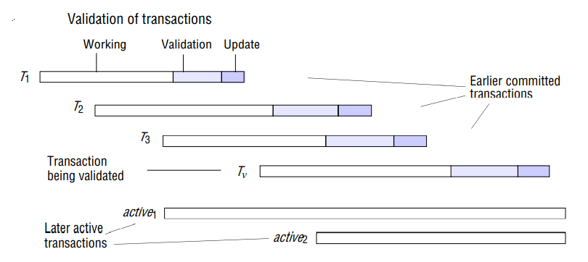
The validation of a transaction must ensure that rules 1 and 2 are obeyed by testing for overlaps between the objects of pairs of transactions Tv and Ti. There are two forms of validation – backward and forward .
Backward validation checks the transaction undergoing validation with other preceding overlapping transactions – those that entered the validation phase before it.
Forward validation checks the transaction undergoing validation with other later transactions, which are still active.

Slide 82
Backward validation
• As all the read operations of earlier overlapping transactions were performed before the validation of Tv started, they cannot be affected by the writes of the current transaction (and rule 1 is satisfied).
The validation of transaction Tv checks whether its read set (the objects affected by the read operations of Tv) overlaps with any of the write sets of earlier overlapping transactions, Ti (rule 2).
If there is any overlap, the validation fails.
In backward validation, the read set of the transaction being validated is compared with the write sets of other transactions that have already committed. Therefore, the only way to resolve any conflicts is to abort the transaction that is undergoing validation. In backward validation, transactions that have no read operations (only write operations) need not be checked.

Slide 83
Figure shows overlapping transactions that might be considered in the validation of a transaction Tv. Time increases from left to right. The earlier committed transactions are T1, T2 and T3.
T1 committed before Tv started. T2 and T3 committed before Tv finished its working phase. StartTn + 1 = T2 and finishTn = T3.
In backward validation, the read set of Tv must be compared with the write sets of T2 and T3.
The following program describes the algorithm for the validation of Tv:
boolean valid = true;
for (int Ti = startTn+1; Ti <= finishTn; Ti++)
{
if (read set of Tv intersects write set of Ti)
valid = false; }

Slide 84
Forward validation
• In forward validation of the transaction Tv, the write set of Tv is compared with the read sets of all overlapping active transactions – those that are still in their working phase (rule 1).
Rule 2 is automatically fulfilled because the active transactions do not write until after Tv has completed.
Let the active transactions have (consecutive) transaction identifiers active1 to activeN.
The following program describes the algorithm for the forward validation of Tv:
boolean valid = true;
for (int Tid = active1; Tid <= activeN; Tid++)
{
if (write set of Tv intersects read set of Tid)
valid = false; }

Slide 85
The write set of transaction Tv must be compared with the read sets of the transactions with identifiers active1 and active2. (Forward validation should allow for the fact that read sets of active transactions may change during validation and writing.)
As the read sets of the transaction being validated are not included in the check, read-only transactions always pass the validation check.

Slide 86
DISTRIBUTED TRANSACTIONS
we discussed flat transactions that accessed objects at a single server.
In the general case, a transaction, whether flat or nested, will access objects located in several different computers.
We use the term distributed transaction to refer to a flat or nested transaction that accesses objects managed by multiple servers.
When a distributed transaction comes to an end, the atomicity property of transactions requires that either all of the servers involved commit the transaction or all of them abort the transaction.
To achieve this, one of the servers takes on a coordinator role, which involves ensuring the same outcome at all of the servers. The manner in which the coordinator achieves this depends on the protocol chosen.
A protocol known as the ‘two-phase commit protocol’ is the most commonly used. This protocol allows the servers to communicate with one another to reach a joint decision as to whether to commit or abort.

Slide 87
Concurrency control in distributed transactions is based on the methods discussed.
Each server applies local concurrency control to its own objects, which ensures that transactions are serialized locally. But distributed transactions must also be serialized globally.
How this is achieved varies depending upon whether locking, timestamp ordering or optimistic concurrency control is in use.
In some cases, the transactions may be serialized at the individual servers, but a cycle of dependencies between the different servers may occur and a distributed deadlock arise.
Transaction recovery is concerned with ensuring that all the objects involved in transactions are recoverable.
In addition to that, it guarantees that the values of the objects reflect all the changes made by committed transactions and none of those made by aborted ones.

Slide 88
FLAT AND NESTED DISTRIBUTED TRANSACTIONS
A client transaction becomes distributed if it invokes operations in several different servers.
There are two different ways that distributed transactions can be structured: as flat transactions and as nested transactions.
In a flat transaction, a client makes requests to more than one server. For example, in Figure , transaction T is a flat transaction that invokes operations on objects in servers X, Y and Z.
A flat client transaction completes each of its requests before going on to the next one. Therefore, each transaction accesses servers’ objects sequentially.
When servers use locking, a transaction can only be waiting for one object at a time.

Slide 89
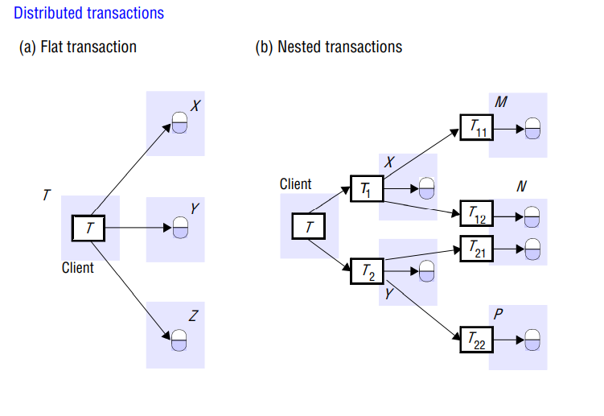

Slide 90
In a nested transaction, the top-level transaction can open subtransactions, and each subtransaction can open further subtransactions down to any depth of nesting.
Figure shows a client transaction T that opens two subtransactions, T1 and T2, which access objects at servers X and Y.
The subtransactions T1 and T2 open further subtransactions T11, T12, T21, and T22, which access objects at servers M, N and P.
In the nested case, subtransactions at the same level can run concurrently, so T1 and T2 are concurrent, and as they invoke objects in different servers, they can run in parallel.
The four subtransactions T11, T12, T21 and T22 also run concurrently.

Slide 91
Consider a distributed transaction in which a client transfers $10 from account A to C and then transfers $20 from B to D.
Accounts A and B are at separate servers X and Y and accounts C and D are at server Z.
If this transaction is structured as a set of four nested transactions, as shown in Figure.
The four requests (two deposits and two withdraws) can run in parallel and the overall effect can be achieved with better performance than a simple transaction in which the four operations are invoked sequentially.

Slide 92
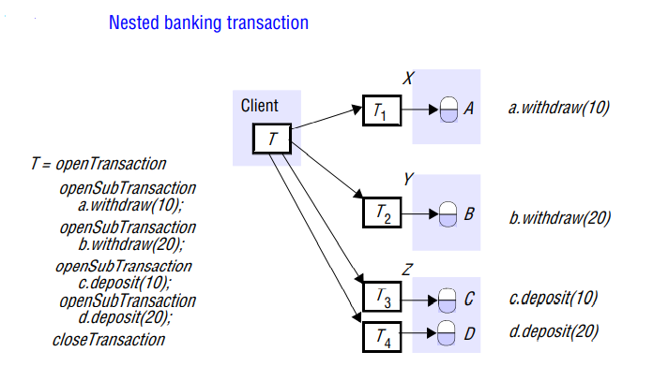

Slide 93
The coordinator of a distributed transaction:
Servers that execute requests as part of a distributed transaction need to be able to communicate with one another to coordinate their actions when the transaction commits.
A client starts a transaction by sending an openTransaction request to a coordinator in any server.
The coordinator that is contacted carries out the openTransaction and returns the resulting transaction identifier (TID) to the client. Transaction identifiers for distributed transactions must be unique within a distributed system.
A simple way to achieve this is for a TID to contain two parts: the identifier (for example, an IP address) of the server that created it and a number unique to the server.

Slide 94
The coordinator that opened the transaction becomes the coordinator for the distributed transaction and at the end is responsible for committing or aborting it.
Each of the servers that manages an object accessed by a transaction is a participant in the transaction and provides an object we call the participant.
Each participant is responsible for keeping track of all of the recoverable objects at that server that are involved, in the transaction.
The participants are responsible for cooperating with the coordinator in carrying out the commit protocol.
During the progress of the transaction, the coordinator records a list of references to the participants, and each participant records a reference to the coordinator.

Slide 95
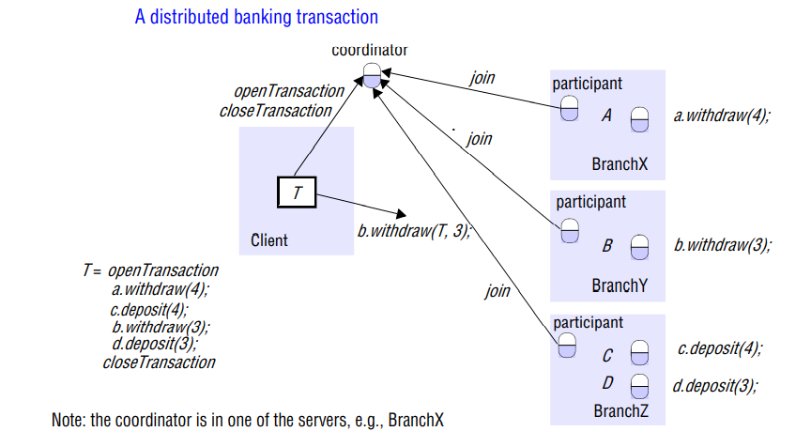

Slide 96
The interface for Coordinator shown in Figure provides an additional method, join, which is used whenever a new participant joins the transaction:
join(Trans, reference to participant) Informs a coordinator that a new participant has joined the transaction Trans.
The coordinator records the new participant in its participant list. The fact that the coordinator knows all the participants and each participant knows the coordinator will enable them to collect the information that will be needed at commit time.
Figure shows a client whose (flat) banking transaction involves accounts A, B, C and D at servers BranchX, BranchY and BranchZ.
The client’s transaction, T, transfers $4 from account A to account C and then transfers $3 from account B to account D.
The transaction described on the left is expanded to show that openTransaction and closeTransaction are directed to the coordinator, which would be situated in one of the servers involved in the transaction.

Slide 97
Each server is shown with a participant, which joins the transaction by invoking the join method in the coordinator.
When the client invokes one of the methods in the transaction, for example b.withdraw(T, 3), the object receiving the invocation (B at BranchY, in this case) informs its participant object that the object belongs to the transaction T.
If it has not already informed the coordinator, the participant object uses the join operation to do so.
In this example, we show the transaction identifier being passed as an additional argument so that the recipient can pass it on to the coordinator.
By the time the client calls closeTransaction, the coordinator has references to all of the participants.
Note that it is possible for a participant to call abortTransaction in the coordinator if for some reason it is unable to continue with the transaction.

Slide 98
CONCURRENCY CONTROL IN DISTRIBUTED TRANSACTIONS
Each server manages a set of objects and is responsible for ensuring that they remain consistent when accessed by concurrent transactions.
Therefore, each server is responsible for applying concurrency control to its own objects.
The members of a collection of servers of distributed transactions are jointly responsible for ensuring that they are performed in a serially equivalent manner.
This implies that if transaction T is before transaction U in their conflicting access to objects at one of the servers, then they must be in that order at all of the servers whose objects are accessed in a conflicting manner by both T and U.

Slide 99
Locking:
In a distributed transaction, the locks on an object are held locally (in the same server).
The local lock manager can decide whether to grant a lock or make the requesting transaction wait.
However, it cannot release any locks until it knows that the transaction has been committed or aborted at all the servers involved in the transaction.
When locking is used for concurrency control, the objects remain locked and are unavailable for other transactions during the atomic commit protocol, although an aborted transaction releases its locks after phase 1 of the protocol.
A simple way to complete the transaction in an atomic manner is for the coordinator to communicate the commit or abort request to all of the participants in the transaction and to keep on repeating the request until all of them have acknowledged that they have carried it out.
This is an example of a one phase atomic commit protocol.

Slide 100
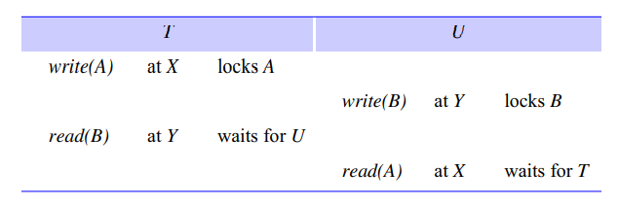
As lock managers in different servers set their locks independently of one another, it is possible that different servers may impose different orderings on transactions.
Consider the following interleaving of transactions T and U at servers X and Y:

Slide 101
The transaction T locks object A at server X, and then transaction U locks object B at server Y.
After that, T tries to access B at server Y and waits for U’s lock. Similarly, transaction U tries to access A at server X and has to wait for T’s lock.
Therefore, we have T before U in one server and U before T in the other. These different orderings can lead to cyclic dependencies between transactions, giving rise to a distributed deadlock situation.
When a deadlock is detected, a transaction is aborted to resolve the deadlock.
In this case, the coordinator will be informed and will abort the transaction at the participants involved in the transaction.

Slide 102
Timestamp ordering concurrency control:
In a single server transaction, the coordinator issues a unique timestamp to each transaction when it starts.
Serial equivalence is enforced by committing the versions of objects in the order of the timestamps of transactions that accessed them.
In distributed transactions, we require that each coordinator issue globally unique timestamps.
A globally unique transaction timestamp is issued to the client by the first coordinator accessed by a transaction.
The transaction timestamp is passed to the coordinator at each server whose objects perform an operation in the transaction.

Slide 103
The servers of distributed transactions are jointly responsible for ensuring that they are performed in a serially equivalent manner.
For example, if the version of an object accessed by transaction U commits after the version accessed by T at one server, if T and U access the same object as one another at other servers they must commit them in the same order.
To achieve the same ordering at all the servers, the coordinators must agree as to the ordering of their timestamps. A timestamp consists of a pair.
The agreed ordering of pairs of timestamps is based on a comparison in which the server-id part is less significant.
The same ordering of transactions can be achieved at all the servers even if their local clocks are not synchronized.
However, for reasons of efficiency it is required that the timestamps issued by one coordinator be roughly synchronized with those issued by the other coordinators.

Slide 104
When this is the case, the ordering of transactions generally corresponds to the order in which they are started in real time.
Timestamps can be kept roughly synchronized by the use of synchronized local physical clocks.
When timestamp ordering is used for concurrency control, conflicts are resolved as each operation is performed using the rules given.
If the resolution of a conflict requires a transaction to be aborted, the coordinator will be informed and it will abort the transaction at all the participants.
Therefore any transaction that reaches the client request to commit should always be able to commit, and participants in the two-phase commit protocol will normally agree to commit.
The only situation in which a participant will not agree to commit is if it has crashed during the transaction.

Slide 105
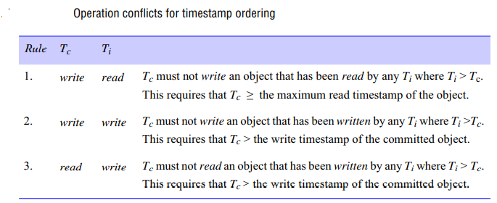

Slide 106
Optimistic concurrency control:
In optimistic concurrency control, each transaction is validated before it is allowed to commit.
Transaction numbers are assigned at the start of validation and transactions are serialized according to the order of the transaction numbers.
A distributed transaction is validated by a collection of independent servers, each of which validates transactions that access its own objects.
This validation takes place during the first phase of the two-phase commit protocol.

Slide 107
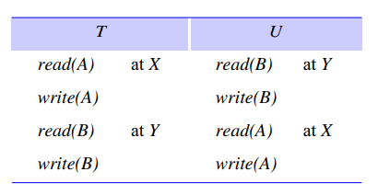
Consider the following interleavings of transactions T and U, which access objects A and B at servers X and Y, respectively:
The transactions access the objects in the order T before U at server X and in the order U before T at server Y.
Now suppose that T and U start validation at about the same time, but server X validates T first and server Y validates U first.

Slide 108
A simplification of the validation protocol that makes a rule that only one transaction may perform validation and update phases at a time.
Therefore each server will be unable to validate the other transaction until the first one has completed. This is an example of commitment deadlock.
The validation rules assume that validation is fast, which is true for single-server transactions.
However, in a distributed transaction, the two-phase commit protocol may take some time to complete, and other transactions will be prevented from entering validation until a decision on the current transaction has been obtained.
In distributed optimistic transactions, each server applies a parallel validation protocol.
This is an extension of either backward or forward validation to allow multiple transactions to be in the validation phase at the same time.

Slide 109
In this extension, rule 3 must be checked as well as rule 2 for backward validation. That is, the write set of the transaction being validated must be checked for overlaps with the write set of earlier overlapping transactions.
If parallel validation is used, transactions will not suffer from commitment deadlock. However, if servers simply perform independent validations, it is possible that different servers in a distributed transaction may serialize the same set of transactions in different orders .
For example, with T before U at server X and U before T at server Y, in our example. The servers of distributed transactions must prevent this happening.
One approach is that after a local validation by each server, a global validation is carried out .
The global validation checks that the combination of the orderings at the individual servers is serializable; that is, that the transaction being validated is not involved in a cycle.

Slide 110
Agrawal algorithm that favours read-only transactions, together with an algorithm called MVGV (multi-version generalized validation).
MVGV is a form of parallel validation that ensures that transaction numbers reflect serial order, but it requires that in some cases, other transactions are unable to read their effects immediately after they have committed.
It also allows the transaction number to be changed so as to permit some transactions to validate that otherwise would have failed.

Slide 111
The paper also proposes an algorithm for committing distributed transactions. It is similar to Schlageter’s proposal in that a global transaction number has to be found.
At the end of the read phase, the coordinator proposes a value for the global transaction number and each participant attempts to validate its local transactions using that number.
However, if the proposed global transaction number is too small, some participants may not be able to validate their transactions, and they will have to negotiate with the coordinator for an increased number.
If no suitable number can be found, then those participants will have to abort their transactions. Eventually, if all of the participants can validate their transactions, the coordinator will have received proposals for transaction numbers from each of them. If common numbers can be found then the transaction will be committed.

Slide 112
DISTRIBUTED DEADLOCKS
The discussion of deadlocks showed that deadlocks can arise within a single server when locking is used for concurrency control.
Servers must either prevent or detect and resolve deadlocks. Using timeouts to resolve possible deadlocks is a clumsy approach – it is difficult to choose an appropriate timeout interval, and transactions may be aborted unnecessarily.
With deadlock detection schemes, a transaction is aborted only when it is involved in a deadlock.

Slide 113
Most deadlock detection schemes operate by finding cycles in the transaction wait-for graph.
In a distributed system involving multiple servers being accessed by multiple transactions, a global wait-for graph can in theory be constructed from the local ones.
There can be a cycle in the global wait-for graph that is not in any single local one – that is, there can be a distributed deadlock.
The wait-for graph is a directed graph in which nodes represent transactions and objects, and edges represent either an object held by a transaction or a transaction waiting for an object. There is a deadlock if and only if there is a cycle in the wait-for graph.

Slide 114
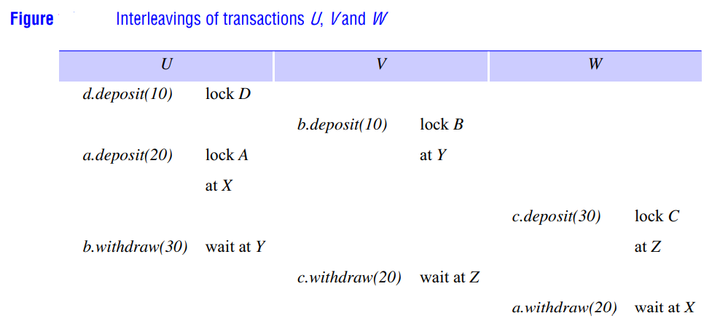

Slide 115
Figure shows the interleavings of the transactions U, V and W involving the objects A and B managed by servers X and Y and objects C and D managed by server Z.
The complete wait-for graph in Figure (a) shows that a deadlock cycle consists of alternate edges, which represent a transaction waiting for an object and an object held by a transaction.
As any transaction can only be waiting for one object at a time, objects can be left out of wait-for graphs, as shown in Figure (b).
Detection of a distributed deadlock requires a cycle to be found in the global transaction wait-for graph that is distributed among the servers that were involved in the transactions.
Local wait-for graphs can be built by the lock manager at each server.

Slide 116
In the above example, the local wait-for graphs of the servers are:
server Y: U o V (added when U requests b.withdraw(30))
server Z: V o W (added when V requests c.withdraw(20))
server X: W o U (added when W requests a.withdraw(20))
As the global wait-for graph is held in part by each of the several servers involved, communication between these servers is required to find cycles in the graph.

Slide 117
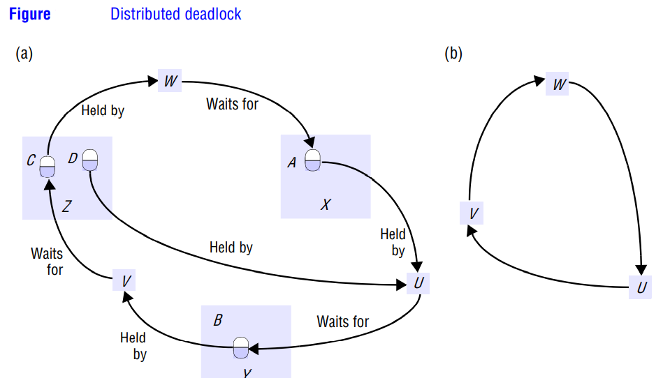

Slide 118
Phantom deadlocks :
• A deadlock that is ‘detected’ but is not really a deadlock is called a phantom deadlock. In distributed deadlock detection, information about wait-for relationships between transactions is transmitted from one server to another.
If there is a deadlock, the necessary information will eventually be collected in one place and a cycle will be detected.
As this procedure will take some time, there is a chance that one of the transactions that holds a lock will meanwhile have released it, in which case the deadlock will no longer exist.
Consider the case of a global deadlock detector that receives local wait-for graphs from servers X and Y, as shown in Figure .
Suppose that transaction U then releases an object at server X and requests the one held by V at server Y.
Suppose also that the global detector receives server Y’s local graph before server X’s.
In this case, it would detect a cycle T o U o V o T, although the edge T o U no longer exists. This is an example of a phantom deadlock.

Slide 119
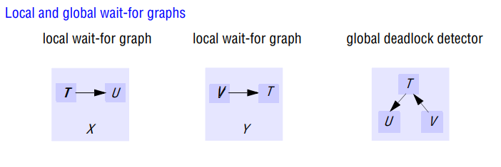
A phantom deadlock could be detected if a waiting transaction in a deadlock cycle aborts during the deadlock detection procedure. For example, if there is a cycle T o U o V o T and U aborts after the information concerning U has been collected, then the cycle has been broken already and there is no deadlock.

Slide 120
Edge chasing:
A distributed approach to deadlock detection uses a technique called edge chasing or path pushing.
In this approach, the global wait-for graph is not constructed, but each of the servers involved has knowledge about some of its edges.
The servers attempt to find cycles by forwarding messages called probes, which follow the edges of the graph throughout the distributed system.
A probe message consists of transaction wait-for relationships representing a path in the global wait-for graph.

Slide 122
Consider the situation at server X in Figure. This server has just added the edge W -> U to its local wait-for graph, and at this time transaction U is waiting to access object B, which transaction V holds at server Y.
This edge could possibly be part of a cycle such as V ->T1->T2 -> … -> W -> U -> V involving transactions using objects at other servers.
This indicates that there is a potential distributed deadlock cycle, which could be found by sending out a probe to server Y.
Now consider the situation a little earlier, when server Z added the edge V ->W to its local graph.
At this point in time W is not waiting, so there is no point in sending out a probe.

Slide 123
Each distributed transaction starts at a server (called the coordinator of the transaction) and moves to several other servers (called participants in the transaction), which can communicate with the coordinator.
At any point in time, a transaction can be either active or waiting at just one of these servers.
The coordinator is responsible for recording whether the transaction is active or is waiting for a particular object, and participants can get this information from their coordinator.
Lock managers inform coordinators when transactions start waiting for objects and when transactions acquire objects and become active again.
When a transaction is aborted to break a deadlock, its coordinator will inform the participants and all of its locks will be removed, with the effect that all edges involving that transaction will be removed from the local wait-for graphs.

Slide 124
Edge-chasing algorithms have three steps:
Initiation: When a server notes that a transaction T starts waiting for another transaction U, where U is waiting to access an object at another server, it initiates detection by sending a probe containing the edge < T -> U > to the server of the object at which transaction U is blocked.
If U is sharing a lock, probes are sent to all the holders of the lock. Sometimes further transactions may start sharing the lock later on, in which case probes can be sent to them too.

Slide 125
Detection: Detection consists of receiving probes and deciding whether a deadlock has occurred and whether to forward the probes.
For example, when a server of an object receives a probe < T -> U > (indicating that T is waiting for a transaction U that holds a local object), it checks to see whether U is also waiting.
If it is, the transaction it waits for (for example, V) is added to the probe (making it < T ->U-> V ) and if the new transaction (V) is waiting for another object elsewhere, the probe is forwarded.
In this way, paths through the global wait-for graph are built one edge at a time.
Before forwarding a probe, the server checks to see whether the transaction (for example, T) it has just added has caused the probe to contain a cycle (for example, < T -> U -> V -> T >).
If this is the case, it has found a cycle in the graph and a deadlock has been detected.

Slide 126
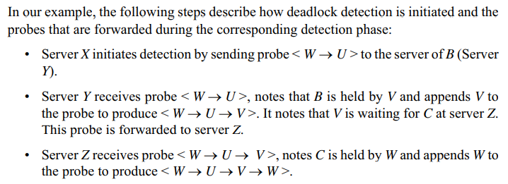
Resolution: When a cycle is detected, a transaction in the cycle is aborted to break the deadlock.
This path contains a cycle. The server detects a deadlock. One of the transactions in the cycle must
be aborted to break the deadlock. The transaction to be aborted can be chosen according to transaction priorities, which are described.

Slide 127
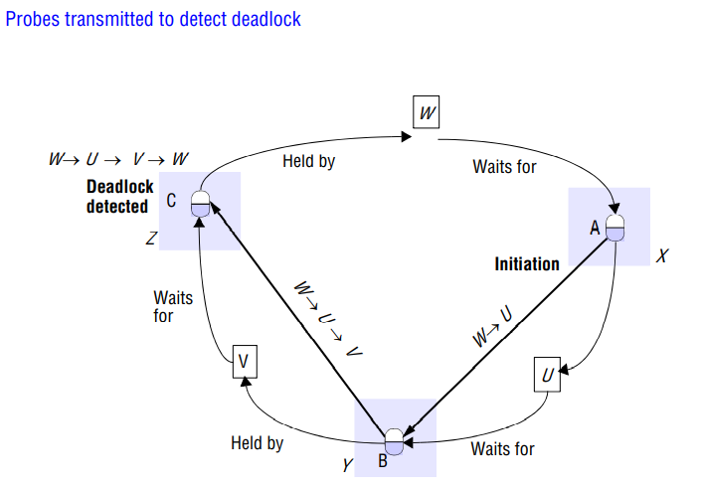

Slide 128
Figure shows the progress of the probe messages from the initiation by the server of A to the deadlock detection by the server of C.
Probes are shown as heavy arrows, objects as ovals (as usual) and transaction coordinators as rectangles.
Each probe is shown as going directly from one object to another.
In reality, before a server transmits a probe to another server, it consults the coordinator of the last transaction in the path to find out whether the latter is waiting for another object elsewhere.
For example, before the server of B transmits the probe it consults the coordinator of V to find out that V is waiting for C.
In most of the edge-chasing algorithms, the servers of objects send probes to transaction coordinators, which then forward them (if the transaction is waiting) to the server of the object for which the transaction is waiting.
In our example, the server of B transmits the probe to the coordinator of V, which then forwards it to the server of C. This shows that when a probe is forwarded, two messages are required.

Slide 129
A probe that detects a cycle involving N transactions will be forwarded by (N – 1) transaction coordinators via (N – 1) servers of objects, requiring 2(N – 1) messages.
Transaction priorities:
In the above algorithm, every transaction involved in a deadlock cycle can cause deadlock detection to be initiated.
The effect of several transactions in a cycle initiating deadlock detection is that detection may happen at several different servers in the cycle, with the result that more than one transaction in the cycle is aborted.

Slide 130
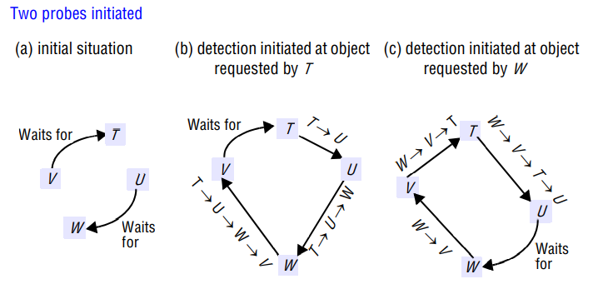

Slide 131
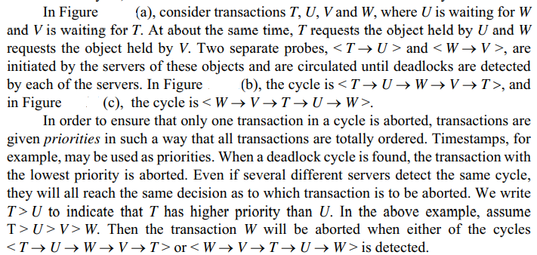

Slide 132
TRANSACTION RECOVERY
The atomic property of transactions requires that all the effects of committed transactions and none of the effects of incomplete or aborted transactions are reflected in the objects they accessed.
This property can be described in terms of two aspects: durability and failure atomicity.
Durability requires that objects are saved in permanent storage and will be available indefinitely thereafter. Therefore an acknowledgement of a client’s commit request implies that all the effects of the transaction have been recorded in permanent storage as well as in the server’s (volatile) objects.
Failure atomicity requires that effects of transactions are atomic even when the server crashes. Recovery is concerned with ensuring that a server’s objects are durable and that the service provides failure atomicity.

Slide 133
we assume that when a server is running it keeps all of its objects in its volatile memory and records its committed objects in a recovery file or files.
Therefore recovery consists of restoring the server with the latest committed versions of its objects from permanent storage. Databases need to deal with large volumes of data.
They generally hold the objects in stable storage on disk with a cache in volatile memory.
The requirements for durability and failure atomicity are not really independent of one another and can be dealt with by a single mechanism – the recovery manager. The tasks of a recovery manager are:
• to save objects in permanent storage (in a recovery file) for committed transactions;
• to restore the server’s objects after a crash;
• to reorganize the recovery file to improve the performance of recovery;
• to reclaim storage space (in the recovery file).

Slide 134
Intentions list :
• Any server that provides transactions needs to keep track of the objects accessed by clients’ transactions.
when a client opens a transaction, the server first contacted provides a new transaction identifier and returns it to the client.
Each subsequent client request within a transaction up to and including the commit or abort request includes the transaction identifier as an argument.
During the progress of a transaction, the update operations are applied to a private set of tentative versions of the objects belonging to the transaction.

Slide 135
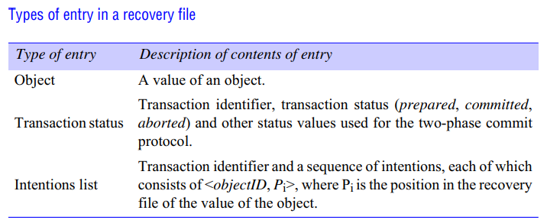

Slide 136
At each server, an intentions list is recorded for all of its currently active transactions – an intentions list of a particular transaction contains a list of the references and the values of all the objects that are altered by that transaction.
When a transaction is committed, that transaction’s intentions list is used to identify the objects it affected.
The committed version of each object is replaced by the tentative version made by that transaction, and the new value is written to the server’s recovery file.
When a transaction aborts, the server uses the intentions list to delete all the tentative versions of objects made by that transaction.

Slide 137
A distributed transaction must carry out an atomic commit protocol before it can be committed or aborted.
Our discussion of recovery is based on the two-phase commit protocol, in which all the participants involved in a transaction first say whether they are prepared to commit and later, if all the participants agree, carry out the actual commit actions.
If the participants cannot agree to commit, they must abort the transaction. Figure Types of entry in a recovery file Type of entry Description of contents of entry Object A value of an object.
Transaction status Transaction identifier, transaction status (prepared, committed, aborted) and other status values used for the two-phase commit protocol.
Intentions list Transaction identifier and a sequence of intentions, each of which consists of , where Pi is the position in the recovery file of the value of the object.
At the point when a participant says it is prepared to commit a transaction, its recovery manager must have saved both its intentions list for that transaction and the objects in that intentions list in its recovery file, so that it will be able to carry out the commitment later, even if it crashes in the interim.

Slide 138
When all the participants involved in a transaction agree to commit it, the coordinator informs the client and then sends messages to the participants to commit their part of the transaction.
Once the client has been informed that a transaction has committed, the recovery files of the participating servers must contain sufficient information to ensure that the transaction is committed by all of the servers, even if some of them crash between preparing to commit and committing.

Slide 139
Entries in recovery file :
• To deal with recovery of a server that can be involved in distributed transactions, further information in addition to the values of the objects is stored in the recovery file.
This information concerns the status of each transaction – whether it is committed, aborted or prepared to commit.
In addition, each object in the recovery file is associated with a particular transaction by saving the intentions list in the recovery file.
Two approaches to the use of recovery files: logging and shadow versions.

Slide 140
Logging:
In the logging technique, the recovery file represents a log containing the history of all the transactions performed by a server.
The history consists of values of objects, transaction status entries and transaction intentions lists.
The order of the entries in the log reflects the order in which transactions have prepared, committed and aborted at that server.
In practice, the recovery file will contain a recent snapshot of the values of all the objects in the server followed by a history of transactions.
During the normal operation of a server, its recovery manager is called whenever a transaction prepares to commit, commits or aborts a transaction.
When the server is prepared to commit a transaction, the recovery manager appends all the objects in its intentions list to the recovery file, followed by the current status of that transaction (prepared) together with its intentions list.
When a transaction is eventually committed or aborted, the recovery manager appends the corresponding status of the transaction to its recovery file.

Slide 141
It is assumed that the append operation is atomic in the sense that it writes one or more complete entries to the recovery file.
After a crash, any transaction that does not have a committed status in the log is aborted. Therefore when a transaction commits, its committed status entry must be forced to the log – that is, written to the log together with any other buffered entries.
The recovery manager associates a unique identifier with each object so that the successive versions of an object in the recovery file may be associated with the server’s objects.
Figure illustrates the log mechanism for the banking service transactions T and U .
The log was recently reorganized, and entries to the left of the double line represent a snapshot of the values of A, B and C before transactions T and U started.
In this diagram, we use the names A, B and C as unique identifiers for objects. We show the situation when transaction T has committed and transaction U has prepared but not committed.

Slide 142
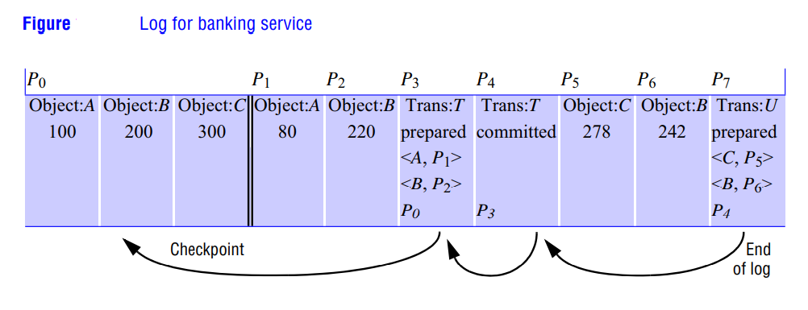

Slide 143
When transaction T prepares to commit, the values of objects A and B are written at positions P1 and P2 in the log, followed by a prepared transaction status entry for T with its intentions list (< A, P1 >, < B, P2 >).
When transaction T commits, a committed transaction status entry for T is put at position P4.
Then when transaction U prepares to commit, the values of objects C and B are written at positions P5 and P6 in the log, followed by a prepared transaction status entry for U with its intentions list (< C, P5 >, < B, P6 >).
Each transaction status entry contains a pointer to the position in the recovery file of the previous transaction status entry to enable the recovery manager to follow the transaction status entries in reverse order through the recovery file.
The last pointer in the sequence of transaction status entries points to the checkpoint.

Slide 144
Recovery of objects :
• When a server is replaced after a crash, it first sets default initial values for its objects and then hands over to its recovery manager.
The recovery manager is responsible for restoring the server’s objects so that they include all the effects of the committed transactions performed in the correct order and none of the effects of incomplete or aborted transactions.
The most recent information about transactions is at the end of the log.
There are two approaches to restoring the data from the recovery file.
In the first, the recovery manager starts at the beginning and restores the values of all of the objects from the most recent checkpoint

Slide 145
It then reads in the values of each of the objects, associates them with their transaction’s intentions lists and for committed transactions replaces the values of the objects.
In this approach, the transactions are replayed in the order in which they were executed and there could be a large number of them.
In the second approach, the recovery manager will restore a server’s objects by ‘reading the recovery file backwards’.
The recovery file has been structured so that there is a backwards pointer from each transaction status entry to the next.
The recovery manager uses transactions with committed status to restore those objects that have not yet been restored.
It continues until it has restored all of the server’s objects. This has the advantage that each object is restored once only.

Slide 146
To recover the effects of a transaction, a recovery manager gets the corresponding intentions list from its recovery file. The intentions list contains the identifiers and positions in the recovery file of values of all the objects affected by the transaction.
If the server fails at the point reached in Figure , its recovery manager will recover the objects as follows.
It starts at the last transaction status entry in the log (at P7) and concludes that transaction U has not committed and its effects should be ignored.
It then moves to the previous transaction status entry in the log (at P4) and concludes that transaction T has committed.
To recover the objects affected by transaction T, it moves to the previous transaction status entry in the log (at P3) and finds the intentions list for T (< A, P1 >, < B, P2 >).
It then restores objects A and B from the values at P1 and P2. As it has not yet restored C, it moves back to P0, which is a checkpoint, and restores C.

Slide 147
Shadow versions:
The logging technique records transaction status entries, intentions lists and objects all in the same file – the log.
The shadow versions technique is an alternative way to organize a recovery file. It uses a map to locate versions of the server’s objects in a file called a version store.
The map associates the identifiers of the server’s objects with the positions of their current versions in the version store.
The versions written by each transaction are ‘shadows’ of the previous committed versions. As we shall see, the transaction status entries and intentions lists are stored separately. Shadow versions are described first.

Slide 148
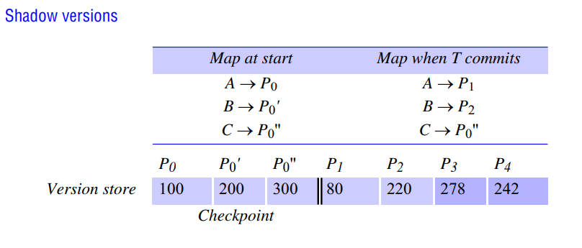

Slide 149
When a transaction is prepared to commit, any of the objects changed by the transaction are appended to the version store, leaving the corresponding committed versions unchanged.
These new as-yet-tentative versions are called shadow versions.
When a transaction commits, a new map is made by copying the old map and entering the positions of the shadow versions.
.To complete the commit process, the new map replaces the old map.
To restore the objects when a server is replaced after a crash, its recovery manager reads the map and uses the information in the map to locate the objects in the version store.
Figure illustrates this technique with the same example involving transactions T and U .
The first column in the table shows the map before transactions T and U, when the balances of the accounts A, B and C are $100, $200 and $300, respectively.
The second column shows the map after transaction T has committed.

Slide 150
The version store contains a checkpoint, followed by the versions of A and B at P1 and P2 made by transaction T.
It also contains the shadow versions of B and C made by transaction U, at P3 and P4. The map must always be written to a well-known place (for example, at the start of the version store or a separate file) so that it can be found when the system needs to be recovered.
The shadow versions method provides faster recovery than logging because the positions of the current committed objects are recorded in the map, whereas recovery from a log requires searching throughout the log for objects.
Logging should be faster than shadow versions during the normal activity of the system, though.
This is because logging requires only a sequence of append operations to the same file, whereas shadow versions require an additional stable storage write.

Slide 151
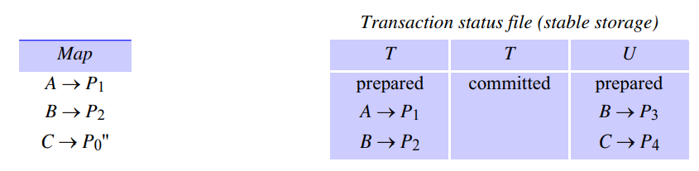
Shadow versions on their own are not sufficient for a server that handles distributed transactions.
Transaction status entries and intentions lists are saved in a file called the transaction status file.
Each intentions list represents the part of the map that will be altered by a transaction when it commits.
The transaction status file may, for example, be organized as a log.
The figure below shows the map and the transaction status file for our current example when T has committed and U is prepared to commit.

Slide 152
There is a chance that a server may crash between the time when a committed status is written to the transaction status file and the time when the map is updated – in which case the client will not have been acknowledged.
The recovery manager must allow for this possibility when the server is replaced after a crash.

Slide 153
The need for transaction status and intentions list entries in a recovery file:
It is possible to design a simple recovery file that does not include entries for transaction status items and intentions lists.
This sort of recovery file may be suitable when all transactions are directed to a single server.
The use of transaction status items and intentions lists in the recovery file is essential for a server that is intended to participate in distributed transactions.

Slide 154
Two-phase commit protocol
The two-phase commit protocol is designed to allow any participant to abort its part of a transaction.
Due to the requirement for atomicity, if one part of a transaction is aborted, then the whole transaction must be aborted.
In the first phase of the protocol, each participant votes for the transaction to be committed or aborted.
Once a participant has voted to commit a transaction, it is not allowed to abort it.
Therefore, before a participant votes to commit a transaction, it must ensure that it will eventually be able to carry out its part of the commit protocol, even if it fails.
A participant in a transaction is said to be in a prepared state for a transaction if it will eventually be able to commit it.
To make sure of this, each participant saves in permanent storage all of the objects that it has altered in the transaction, together with its status – prepared.

Slide 155
In the second phase of the protocol, every participant in the transaction carries out the joint decision. If any one participant votes to abort, then the decision must be to abort the transaction.
If all the participants vote to commit, then the decision is to commit the transaction. The problem is to ensure that all of the participants vote and that they all reach the same decision.
This is fairly simple if no errors occur, but the protocol must work correctly even when some of the servers fail, messages are lost or servers are temporarily unable to communicate with one another.
During the progress of a transaction, there is no communication between the coordinator and the participants apart from the participants informing the coordinator when they join the transaction.

Slide 156
A client’s request to commit (or abort) a transaction is directed to the coordinator.
If the client requests abortTransaction, or if the transaction is aborted by one of the participants, the coordinator informs all participants immediately.
It is when the client asks the coordinator to commit the transaction that the two-phase commit protocol comes into use.
In the first phase of the two-phase commit protocol the coordinator asks all the participants if they are prepared to commit; in the second, it tells them to commit (or abort) the transaction.
If a participant can commit its part of a transaction, it will agree as soon as it has recorded the changes it has made (to the objects) and its status in permanent storage and is therefore prepared to commit.

Slide 157
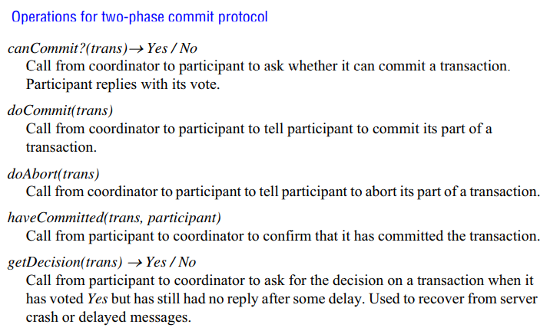
The coordinator in a distributed transaction communicates with the participants to carry out the two-phase commit protocol by means of the operations summarized in Figure

Slide 158
The methods canCommit, doCommit and doAbort are methods in the interface of the participant. The methods haveCommitted and getDecision are in the coordinator interface.
The two-phase commit protocol consists of a voting phase and a completion phase, as shown in Figure.
The exchange of information between the coordinator and participants can fail when one of the servers crashes, or when messages are lost.
Timeouts are used to avoid processes blocking forever. When a timeout occurs at a process, it must take an appropriate action.
To allow for this the protocol includes a timeout action for each step at which a process may block.
These actions are designed to allow for the fact that in an asynchronous system, a timeout may not necessarily imply that a server has failed

Slide 159
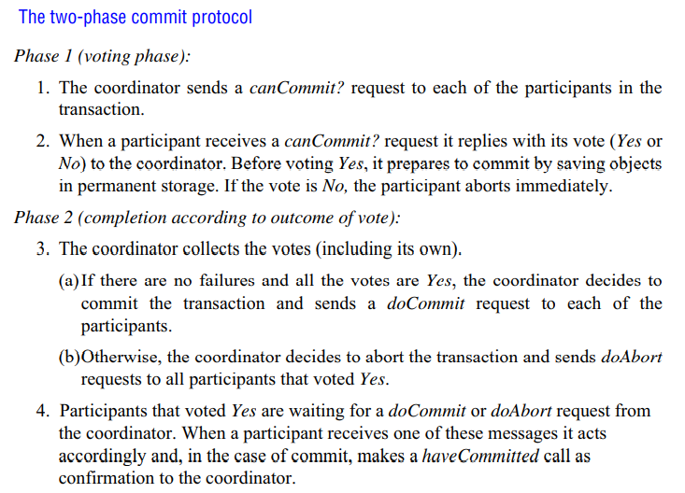

Slide 160
Timeout actions in the two-phase commit protocol
• There are various stages in the protocol at which the coordinator or a participant cannot progress its part of the protocol until it receives another request or reply from one of the others.
Consider first the situation where a participant has voted Yes and is waiting for the coordinator to report on the outcome of the vote by telling it to commit or abort the transaction .
Such a participant is uncertain of the outcome and cannot proceed any further until it gets the outcome of the vote from the coordinator.
The participant cannot decide unilaterally what to do next, and meanwhile the objects used by its transaction cannot be released for use by other transactions.
The participant can make a getDecision request to the coordinator to determine the outcome of the transaction. When it gets the reply, it continues the protocol at step 4.

Slide 161
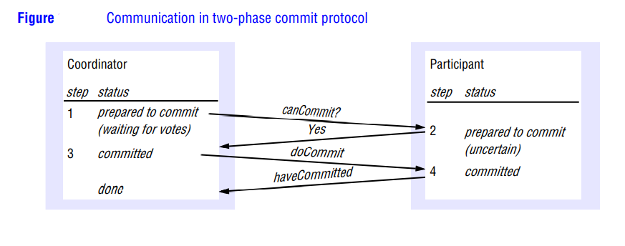

Slide 162
Recovery of the two-phase commit protocol :
In a distributed transaction, each server keeps its own recovery file.
The recovery management described in the previous section must be extended to deal with any transactions that are performing the two-phase commit protocol at the time when a server fails.
The recovery managers use two new status values for this purpose: done and uncertain.
A coordinator uses committed to indicate that the outcome of the vote is Yes and done to indicate that the two-phase commit protocol is complete.
A participant uses uncertain to indicate that it has voted Yes but does not yet know the outcome of the vote.

Slide 163
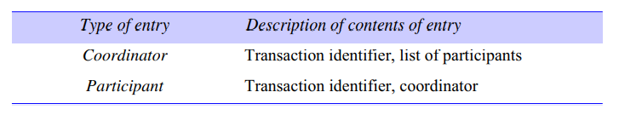
Two additional types of entry allow a coordinator to record a list of participants and a participant to record its coordinator.
In phase 1 of the protocol, when the coordinator is prepared to commit (and has already added a prepared status entry to its recovery file), its recovery manager adds a coordinator entry to its recovery file.
Before a participant can vote Yes, it must have already prepared to commit (and must have already added a prepared status entry to its recovery file). When it votes Yes, its recovery manager records a participant entry and adds an uncertain transaction status to its recovery file as a forced write.
When a participant votes No, it adds an abort transaction status to its recovery file.

Slide 164
In phase 2 of the protocol, the recovery manager of the coordinator adds either a committed or an aborted transaction status to its recovery file, according to the decision.
This must be a forced write (that is, it is written immediately to the recovery file).
Recovery managers of participants add a commit or abort transaction status to their recovery files according to the message received from the coordinator.
When a coordinator has received a confirmation from all of its participants, its recovery manager adds a done transaction status to its recovery file – this need not be forced.
The done status entry is not part of the protocol but is used when the recovery file is reorganized.

Slide 165
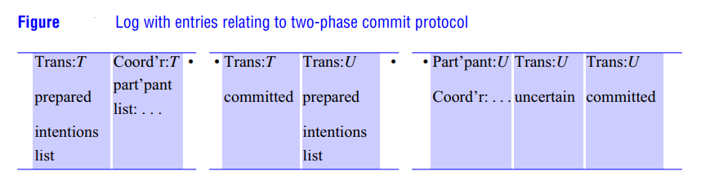
Figure shows the entries in a log for transaction T, in which the server played the coordinator role, and for transaction U, in which the server played the participant role.

Slide 166
When a server is replaced after a crash, the recovery manager has to deal with the two-phase commit protocol in addition to restoring the objects.
For any transaction where the server has played the coordinator role, it should find a coordinator entry and a set of transaction status entries.
For any transaction where the server played the participant role, it should find a participant entry and a set of transaction status entries.
In both cases, the most recent transaction status entry – that is, the one nearest the end of the log – determines the transaction status at the time of failure.
The action of the recovery manager with respect to the two-phase commit protocol for any transaction depends on whether the server was the coordinator or a participant and on its status at the time of failure, as shown in Figure.

Slide 167
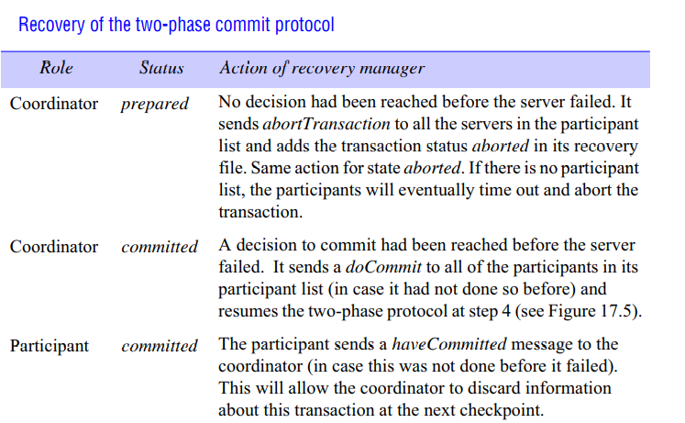

Slide 168
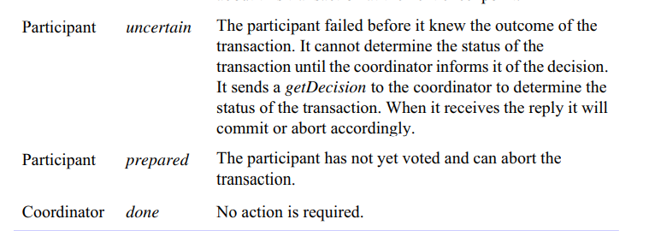

Slide 169
REPLICATION
The replication of data: the maintenance of copies of data at multiple computers. Replication is a key to the effectiveness of distributed systems in that it can provide enhanced performance, high availability and fault tolerance.
Replication is used widely. For example, the caching of resources from web servers in browsers and web proxy servers is a form of replication, since the data held in caches and at servers are replicas of one another.

Slide 170
Replication is a technique for enhancing services. The motivations for replication include:
Performance enhancement: The caching of data at clients and servers is by now familiar as a means of performance enhancement.
The browsers and proxy servers cache copies of web resources to avoid the latency of fetching resources from the originating server.
More sophisticated load-balancing strategies are required for more complex services based on data replicated between thousands of servers.
Replication of immutable data is trivial: it increases performance with little cost to the system. Replication of changing data, such as that of the Web, incurs overheads in the form of protocols designed to ensure that clients receive up-to-date data .
Thus there are limits to the effectiveness of replication as a performance-enhancement technique.

Slide 171
Increased availability:
Users require services to be highly available.
That is, the proportion of time for which a service is accessible with reasonable response times should be close to 100%.
Apart from delays due to pessimistic concurrency control conflicts (due to data locking), the factors that are relevant to high availability are:
• server failures;
• network partitions and disconnected operation (communication disconnections that are often unplanned and are a side effect of user mobility).

Slide 172
Replication is a technique for automatically maintaining the availability of data despite server failures.
If data are replicated at two or more failure-independent servers, then client software may be able to access data at an alternative server should the default server fail or become unreachable.
That is, the percentage of time during which the service is available can be enhanced by replicating server data.
If each of n servers has an independent probability p of failing or becoming unreachable, then the availability of an object stored at each of these servers is:
1 – probability(all managers failed or unreachable) = 1 -p ^{n}
For example, if there is a 5% probability of any individual server failing over a given time period and if there are two servers, then the availability is 1 – 0.052 = 1 – 0.0025 = 99.75%.

Slide 173
Network partitions and disconnected operation are the second factor that have effect against high availability.
Mobile users may deliberately disconnect their computers or become unintentionally disconnected from a wireless network as they move around.
Fault tolerance: Highly available data is not necessarily strictly correct data. It may be out of date, for example; or two users on opposite sides of a network partition may make updates that conflict and need to be resolved.
A fault-tolerant service, by contrast, always guarantees strictly correct behaviour despite a certain number and type of faults.
The correctness concerns the freshness of data supplied to the client and the effects of the client’s operations upon the data. Correctness sometimes also concerns the timeliness of the service’s responses – such as, for example, in the case of a system for air traffic control, where correct data are needed on short timescales.

Slide 174
The same basic technique used for high availability – that of replicating data and functionality between computers – is also applicable for achieving fault tolerance.
If up to f of f + 1 servers crash, then in principle at least one remains to supply the service. And if up to f servers can exhibit Byzantine failures, then in principle a group of 2f + 1 servers can provide a correct service, by having the correct servers outvote the failed servers.
A common requirement when data are replicated is for replication transparency. That is, clients should not normally have to be aware that multiple physical copies of data exist.
As far as clients are concerned, data are organized as individual logical objects and they identify only one item in each case when they request an operation to be performed.

Slide 175
SYSTEM MODEL AND THE ROLE OF GROUP COMMUNICATION
The data in our system consist of a collection of items that we shall call objects.
An ‘object’ could be a file, say, or a Java object. But each such logical object is implemented by a collection of physical copies called replicas.
The replicas are physical objects, each stored at a single computer, with data and behaviour that are tied to some degree of consistency by the system’s operation.
The ‘replicas’ of a given object are not necessarily identical, at least not at any particular point in time. Some replicas may have received updates that others have not received.

Slide 176
System model:
The model involves replicas held by distinct replica managers which are components that contain the replicas on a given computer and perform operations upon them directly.
This general model may be applied in a client-server environment, in which case a replica manager is a server.
We shall always require that a replica manager applies operations to its replicas recoverably. This allows us to assume that an operation at a replica manager does not leave inconsistent results if it fails part way through.
We sometimes require each replica manager to be a state machine. Such a replica manager applies operations to its replicas atomically (indivisibly), so that its execution is equivalent to performing operations in some strict sequence.
Moreover, the state of its replicas is a deterministic function of their initial states and the sequence of operations that it applies to them.

Slide 177
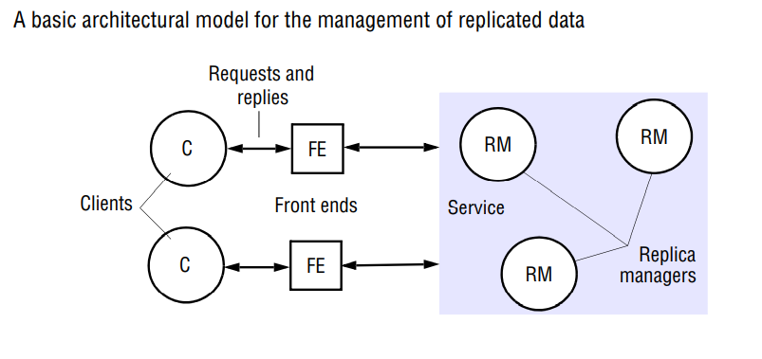

Slide 178
The system can only determine which operations to apply at all replica managers and in what order – it cannot reproduce non-deterministic effects.
The assumption implies that it may not be possible, depending upon the threading architecture, for the servers to be multi-threaded.
Often each replica manager maintains a replica of every object, the replicas of different objects may be maintained by different sets of replica managers.
For example, one object may be needed mostly by clients on one network and another by clients on another network. There is little to be gained by replicating them at managers on the other network.
The set of replica managers may be static or dynamic. In a dynamic system, new replica managers may appear this is not allowed in a static system.

Slide 179
In a dynamic system, replica managers may crash, and they are then deemed to have left the system (although they may be replaced).
In a static system, replica managers do not crash (crashing implies never executing another step), but they may cease operating for an indefinite period.
The general model of replica management is shown in Figure. A collection of replica managers provides a service to clients. The clients see a service that gives them access to objects , which in fact are replicated at the managers.
. Each client requests a series of operations – invocations upon one or more of the objects. An operation may involve a combination of reads of objects and updates to objects.
Requested operations that involve no updates are called read-only requests; requested operations that update an object are called update requests (these may also involve reads).

Slide 181
Each client’s requests are first handled by a component called a front end.
The role of the front end is to communicate by message passing with one or more of the replica managers, rather than forcing the client to do this itself explicitly.
It is the vehicle for making replication transparent. A front end may be implemented in the client’s address space, or it may be a separate process.

Slide 182
In general, five phases are involved in the performance of a single request upon the replicated objects . The actions in each phase vary according to the type of system.
The phases are as follows:
Request: The front end issues the request to one or more replica managers:
– either the front end communicates with a single replica manager, which in turn communicates with other replica managers;
– or the front end multicasts the request to the replica managers.
Coordination: The replica managers coordinate in preparation for executing the request consistently. They agree, if necessary at this stage, on whether the request is to be applied.

Slide 183
They also decide on the ordering of this request relative to others. All of the types of ordering defined for multicast also apply to request handling and we define those orders again for this context:
FIFO ordering: If a front end issues request r and then request r’, any correct replica manager that handles r’ handles r before it.
Causal ordering: If the issue of request r happened-before the issue of request r’, then any correct replica manager that handles r’ handles r before it.
Total ordering: If a correct replica manager handles r before request r’, then any correct replica manager that handles r’ handles r before it.
Most applications require FIFO ordering.

Slide 184
Execution: The replica managers execute the request – perhaps tentatively: that is, in such a way that they can undo its effects later.
Agreement: The replica managers reach consensus on the effect of the request – if any – that will be committed. For example, in a transactional system the replica managers may collectively agree to abort or commit the transaction at this stage.
Response: One or more replica managers responds to the front end. In some systems, one replica manager sends the response. In others, the front end receives responses from a collection of replica managers and selects or synthesizes a single response to pass back to the client.
For example, it could pass back the first response to arrive, if high availability is the goal.

Slide 185
FAULT-TOLERANT SERVICES
To provide a service that is correct despite up to f process failures, by replicating data and functionality at replica managers.
For the sake of simplicity, we assume that communication remains reliable and that no partitions occur.
Each replica manager is assumed to behave according to a specification of the semantics of the objects it manages, when they have not crashed.
For example, a specification of bank accounts would include an assurance that funds transferred between bank accounts can never disappear, and that only deposits and withdrawals affect the balance of any particular account.

Slide 186
Consider a naive replication system, in which a pair of replica managers at computers A and B each maintain replicas of two bank accounts, x and y.
Clients read and update the accounts at their local replica manager but try another replica manager if the local one fails.
Replica managers propagate updates to one another in the background after responding to the clients. Both accounts initially have a balance of $0.
Client 1 updates the balance of x at its local replica manager B to be $1 and then attempts to update y’s balance to be $2, but discovers that B has failed. Client 1 therefore applies the update at A instead.
Now client 2 reads the balances at its local replica manager A. It finds first that y has $2 and then that x has $0 – the update to bank account x from B has not arrived, since B failed.
The situation is shown below, where the operations are labelled by the computer at which they first took place and lower operations happen later:

Slide 187
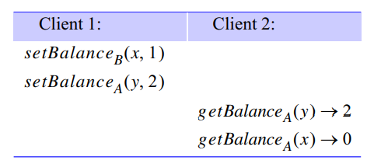
This execution does not match a common-sense specification for the behaviour of bank accounts: client 2 should have read a balance of $1 for x, given that it read the balance of $2 for y, since y’s balance was updated after that of x.
The anomalous behaviour in the replicated case could not have occurred if the bank accounts had been implemented by a single server. We can construct systems that manage replicated objects without the anomalous behaviour produced by the naive protocol in our example.
First, we need to understand what counts as correct behaviour for a replicated system.

Slide 188
Linearizability and sequential consistency:
There are various correctness criteria for replicated objects. The most strictly correct systems are linearizable, and this property is called linearizability.
In order to understand linearizability, consider a replicated service implementation with two clients.
Let the sequence of read and update operations that client i performs in some execution be O_{i0} O_{i1} O_{i2…….}} . Each operation oij in these sequences is specified by the operation type and the arguments and return values as they occurred at runtime.
We assume that every operation is synchronous. That is, clients wait for one operation to complete before requesting the next.

Slide 189
A single server managing a single copy of the objects would serialize the operations of the clients. In the case of an execution with only client 1 and client 2, this interleaving of the operations could be O₂₀ O₂₁ O₁₀ O₂₂ O₁₁ O₁₂ ……, say.
We define our correctness criteria for replicated objects by referring to a virtual interleaving of the clients’ operations, which does not necessarily physically occur at any particular replica manager but that establishes the correctness of the execution.
A replicated shared object service is said to be linearizable if for any execution there is some interleaving of the series of operations issued by all the clients that satisfies the following two criteria:
The interleaved sequence of operations meets the specification of a (single) correct copy of the objects.
• The order of operations in the interleaving is consistent with the real times at which the operations occurred in the actual execution.

Slide 190
The real-time requirement in linearizability is desirable in an ideal world, because it captures our notion that clients should receive up-to-date information.
But, equally, the presence of real time in the definition raises the issue of linearizability’s practicality, because we cannot always synchronize clocks to the required degree of accuracy.
A weaker correctness condition is sequential consistency, which captures an essential requirement concerning the order in which requests are processed without appealing to real time.
The definition keeps the first criterion from the definition for linearizability but modifies the second.

Slide 191
A replicated shared object service is said to be sequentially consistent if for any execution there is some interleaving of the series of operations issued by all the clients that satisfies the following two criteria:
• The interleaved sequence of operations meets the specification of a (single) correct copy of the objects.
• The order of operations in the interleaving is consistent with the program order in which each individual client executed them.
Every linearizable service is also sequentially consistent, since real-time order reflects each client’s program order. The converse does not hold.

Slide 192
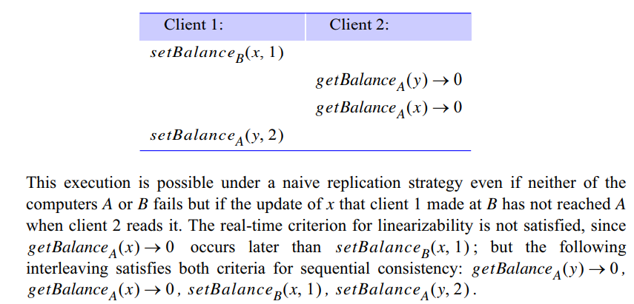
An example execution for a service that is sequentially consistent but not linearizable follows.

Slide 193
Passive (primary-backup) replication
In the passive or primary-backup model of replication for fault tolerance (Figure), there is at any one time a single primary replica manager and one or more secondary replica managers – ‘backups’ or ‘slaves’.
In the pure form of the model, front ends communicate only with the primary replica manager to obtain the service.
The primary replica manager executes the operations and sends copies of the updated data to the backups. If the primary fails, one of the backups is promoted to act as the primary.

Slide 195
The sequence of events when a client requests an operation to be performed is as follows:
1. Request: The front end issues the request, containing a unique identifier, to the primary replica manager.
2. Coordination: The primary takes each request atomically, in the order in which it receives it. It checks the unique identifier, in case it has already executed the request, and if so it simply resends the response.
3. Execution: The primary executes the request and stores the response.
4. Agreement: If the request is an update, then the primary sends the updated state, the response and the unique identifier to all the backups. The backups send an acknowledgement.
5. Response: The primary responds to the front end, which hands the response back to the client.

Slide 196
This system obviously implements linearizability if the primary is correct, since the primary sequences all the operations upon the shared objects.
If the primary fails, then the system retains linearizability if a single backup becomes the new primary and if the new system configuration takes over exactly where the last left off. That is if:
• The primary is replaced by a unique backup (if two clients began using two backups, then the system could perform incorrectly).
• The replica managers that survive agree on which operations had been performed at the point when the replacement primary takes over.
Both of these requirements are met if the replica managers (primary and backups) are organized as a group and if the primary uses view-synchronous group communication to send the updates to the backups.
The first of the above two requirements is then easily satisfied. When the primary crashes, the communication system eventually delivers a new view to the surviving backups, one that excludes the old primary.

Slide 197
The backup that replaces the primary can be chosen by any function of that view.
For example, the backups can choose the first member in that view as the replacement. That backup can register itself as the primary with a name service that the clients consult when they suspect that the primary has failed (or when they require the service in the first place).
The second requirement is also satisfied, by the ordering property of view-synchrony and the use of stored identifiers to detect repeated requests.
The view-synchronous semantics guarantee that either all the backups or none of them will deliver any given update before delivering the new view.
Thus the new primary and the surviving backups all agree on whether any particular client’s update has or has not been processed.

Slide 198
Consider a front end that has not received a response. The front end retransmits the request to whichever backup takes over as the primary.
The primary may have crashed at any point during the operation. If it crashed before the agreement stage (4), then the surviving replica managers cannot have processed the request.
If it crashed during the agreement stage, then they may have processed the request. If it crashed after that stage, then they have definitely processed it.
But the new primary does not have to know what stage the old primary was in when it crashed. When it receives a request, it proceeds from stage 2 above.
By view-synchrony, no consultation with the backups is necessary, because they have all processed the same set of messages.

Slide 199
Active replication
In the active model of replication for fault tolerance (see Figure 18.4), the replica managers are state machines that play equivalent roles and are organized as a group.
Front ends multicast their requests to the group of replica managers and all the replica managers process the request independently but identically and reply.
If any replica manager crashes, this need have no impact upon the performance of the service, since the remaining replica managers continue to respond in the normal way.
We shall see that active replication can tolerate Byzantine failures, because the front end can collect and compare the replies it receives.

Slide 200


Slide 201
Under active replication, the sequence of events when a client requests an operation to be performed is as follows:
1. Request: The front end attaches a unique identifier to the request and multicasts it to the group of replica managers, using a totally ordered, reliable multicast primitive. The front end is assumed to fail by crashing at worst. It does not issue the next request until it has received a response.
2. Coordination: The group communication system delivers the request to every correct replica manager in the same (total) order.
3. Execution: Every replica manager executes the request. Since they are state machines and since requests are delivered in the same total order, correct replica managers all process the request identically. The response contains the client’s unique request identifier.
4. Agreement: No agreement phase is needed, because of the multicast delivery semantics.

Slide 202
5. Response: Each replica manager sends its response to the front end. The number of replies that the front end collects depends upon the failure assumptions and the multicast algorithm.
If, for example, the goal is to tolerate only crash failures and the multicast satisfies uniform agreement and ordering properties, then the front end passes the first response to arrive back to the client and discards the rest (it can distinguish these from responses to other requests by examining the identifier in the response).
This system achieves sequential consistency. All correct replica managers process the same sequence of requests.
The reliability of the multicast ensures that every correct replica manager processes the same set of requests and the total order ensures that they process them in the same order.

Slide 203
If clients do not communicate with other clients while waiting for responses to their requests, then their requests are processed in happened-before order.
If clients are multi-threaded and can communicate with one another while awaiting responses from the service, then to guarantee request processing in happened-before order we would have to replace the multicast with one that is both causally and totally ordered.
The active replication system does not achieve linearizability. This is because the total order in which the replica managers process requests is not necessarily the same as the real-time order in which the clients made their requests.
In a synchronous system with approximately synchronized clocks, the total order in which the replica managers process requests can be based on the order of physical timestamps that the front ends supply with their requests.

Slide 204
It may be possible to relax the system that we have described.
First, we have assumed that all updates to the shared replicated objects must occur in the same order. However, in practice some operations may commute: that is, the effect of two operations performed in the order o1 o2 ; may be the same as if they were performed in the reverse order,o2o1; .
For example, any two read-only operations (from different clients) commute, and any two operations that do not perform reads but update distinct objects commute.
An active replication system may be able to exploit knowledge of commutativity in order to avoid the expense of ordering all the requests.
Finally, front ends may send read-only requests only to individual replica managers. In doing so, they lose the fault tolerance that comes with multicasting requests, but the service remains sequentially consistent.
Moreover, the front end can easily mask the failure of a replica manager in this case, simply by submitting the read-only request to another replica manager.

