Slide 1

VASIREDDY VENKATADRI INSTITUTE OF TECHNOLOGY (Autonomous) Department of Computer Science and Engineering
IV B.Tech -II Semester
Distributed Systems
Unit-1

Slide 2
Introduction
A distributed system as one in which hardware or software components located at networked computers communicate and coordinate their actions only by passing messages.
Our definition of distributed systems has the following significant consequences:
Concurrency
No global clock
Independent failures

Slide 3
Concurrency: In a network of computers, concurrent program execution is something that is usual, typical, or standard.
I can do my work on my computer while you do your work on yours, sharing resources such as web pages or files when necessary.
The capacity of the system to handle shared resources can be increased by adding more resources to the network.
The coordination of concurrently executing programs that share resources is also important.

Slide 4
No global clock: When programs need to cooperate they coordinate their actions by exchanging messages.
Close coordination often depends on a shared idea of the time at which the programs’ actions occur.
But it turns out that there are limits to the accuracy with which the computers in a network can synchronize their clocks – there is no single global notion of the correct time.

Slide 5
Independent failures: All computer systems can fail, and it is the responsibility of system designers to plan for the consequences of possible failures.
Distributed systems can fail in new ways. Faults in the network result in the isolation of the computers that are connected to it, but that doesn’t mean that they stop running.
In fact, the programs on them may not be able to detect whether the network has failed or has become unusually slow.

Slide 6
Trends in distributed systems
Distributed systems are undergoing a period of significant change and this can be traced back to a number of influential trends:
1.Pervasive(spreading widely) networking and the modern Internet.
The modern Internet is a vast interconnected collection of computer networks of many different types, with the range of types increasing all the time.
For example, a wide range of wireless communication technologies such as WiFi, WiMAX, Bluetooth and third-generation mobile phone networks.

Slide 7
The Internet is also a very large distributed system. It enables users, wherever they are, to make use of services such as the World Wide Web, email and file transfer.
The figure shows a collection of intranets – subnetworks operated by companies and other organizations and typically protected by firewalls.
The role of a firewall is to protect an intranet by preventing unauthorized messages from leaving or entering.

Slide 8
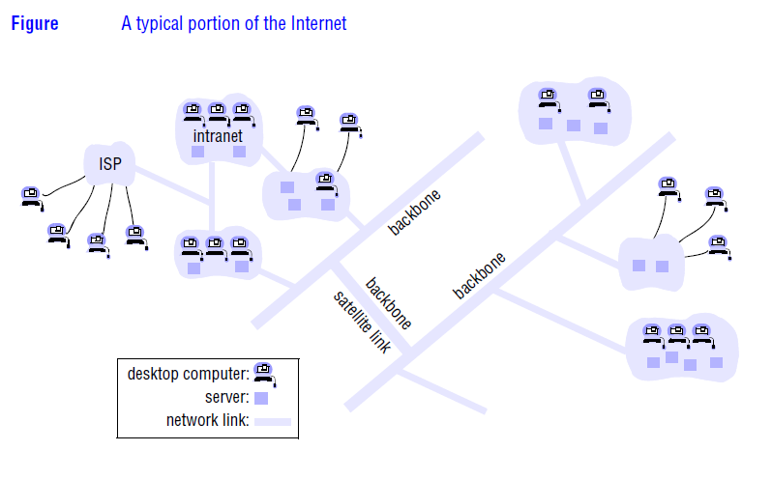

Slide 9
A firewall is implemented by filtering incoming and outgoing messages. Filtering might be done by source or destination, or a firewall might allow only those messages related to email and web access to pass into or out of the intranet that it protects.
The intranets are linked together by backbones. A backbone is a network link with a high transmission capacity, employing satellite connections, fibre optic cables and other high-bandwidth circuits.

Slide 10
2. Mobile and ubiquitous (every where) computing.
The portability of many of these devices, together with their ability to connect conveniently to networks in different places, makes mobile computing possible.
Mobile computing is the performance of computing tasks while the user is on the move, or visiting places other than their usual environment.
In mobile computing, users who are away from their ‘home’ intranet (the intranet at work, or their residence) are still provided with access to resources via the devices they carry with them.

Slide 11
Mobility introduces a number of challenges for distributed systems, including the need to deal with variable connectivity and indeed disconnection, and the need to maintain operation in the face of device mobility.
The presence of computers everywhere only becomes useful when they can communicate with one another.
Ubiquitous and mobile computing overlap, since the mobile user can in principle benefit from computers that are everywhere.

Slide 12
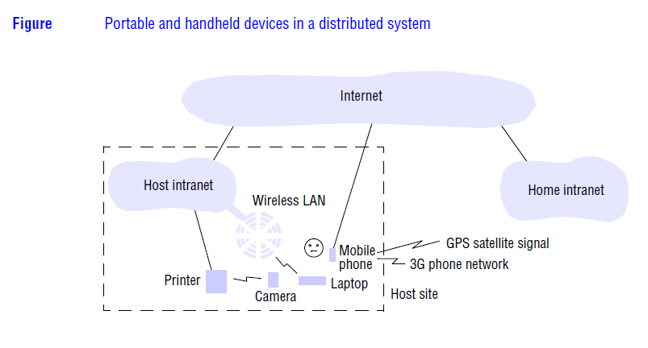

Slide 13
The figure shows the user’s home intranet and the host intranet at the site that the user is visiting.
Both intranets are connected to the rest of the Internet. The user has access to three forms of wireless connection.
Their laptop has a means of connecting to the host’s wireless LAN.

Slide 14
3. Distributed multimedia systems
One can expect a distributed system to support the storage, transmission and presentation of what are often referred to as discrete media types, such as pictures or text messages.
A distributed multimedia system should be able to perform the same functions for continuous media types such as audio and video.
It should be able to store and locate audio or video files, to transmit them across the network (possibly in real time as the streams emerge from a video camera), to support the presentation of the media types to the user and optionally also to share the media types across a group of users.

Slide 15
In a video presentation it is necessary to preserve a given throughput in terms of frames per second and, for real-time streams, a given maximum delay or latency for the delivery of frames.
To access to live or pre-recorded television broadcasts, access to film libraries offering video-on-demand services, access to music libraries, the provision of audio and video conferencing facilities and integrated telephony features including IP telephony.

Slide 16
Webcasting is an application of distributed multimedia technology. Webcasting is the ability to broadcast continuous media, typically audio or video, over the Internet.
To provide support for an (extensible) range of encoding and encryption formats, such as the MPEG series of standards (including for example the popular MP3 standard otherwise known as MPEG-1, Audio Layer 3) and HDTV.

Slide 17
4.Distributed computing as a utility
A number of companies are promoting the view of distributed resources as a commodity or utility, drawing the analogy between distributed resources and other utilities such as water or electricity.
Physical resources such as storage and processing can be made available to networked computers, removing the need to own such resources on their own.

Slide 18
Users can access sophisticated data centres (networked facilities offering access to repositories of often large volumes of data to users or organizations) or indeed computational infrastructure using the sort of services now provided by companies such as Amazon and Google.
Operating system virtualization is a key enabling technology for this approach, implying that users may actually be provided with services by a virtual rather than a physical node.

Slide 19
Software services can also be made available across the global Internet using this approach.
Indeed, many companies now offer a comprehensive range of services for effective rental, including services such as email and distributed calendars.
The term cloud computing is used to capture this vision of computing as a utility. A cloud is defined as a set of Internet-based application, storage and computing services
sufficient to support most users’ needs, thus enabling them to largely or totally dispense with local data storage and application software.
The term also promotes a view of everything as a service, from physical or virtual infrastructure through to software, often paid for on a per-usage basis rather than purchased.

Slide 20
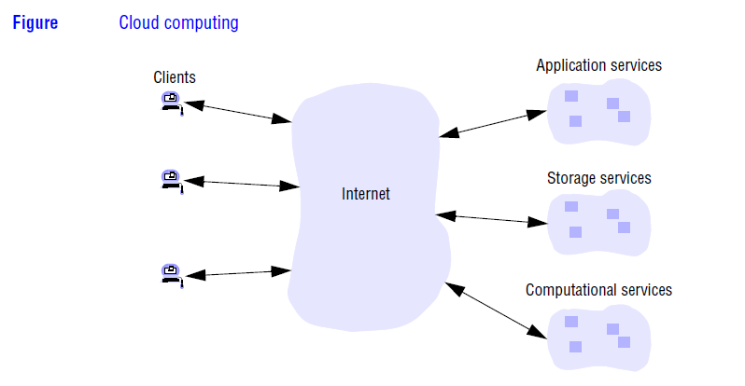

Slide 21
Clouds are generally implemented on cluster computers to provide the necessary scale and performance required by such services.
A cluster computer is a set of interconnected computers that cooperate closely to provide a single, integrated high performance computing capability.
The overall goal of cluster computers is to provide a range of cloud services, including high-performance computing capabilities, mass storage (for example through data centres), and richer application services such as web search (Google, for example relies on a massive cluster computer architecture to implement its search engine and other services.

Slide 22
Focus on resource sharing
We access shared files through a file service; we send documents to printers through a printing service.
Sharing of the higher-level resources that play a part in their applications.
The term service for a distinct part of a computer system that manages a collection of related resources and presents their functionality to users and applications.

Slide 23
The only access we have to the service is via the set of operations that it exports. For example, a file service provides read, write and delete operations on files.
Resources in a distributed system are physically encapsulated within computers and can only be accessed from other computers by means of communication.
For effective sharing, each resource must be managed by a program that offers a communication interface enabling the resource to be accessed and updated reliably and consistently.

Slide 24
The term server is probably familiar to most readers. It refers to a running program (a process) on a networked computer that accepts requests from programs running on other computers to perform a service and responds appropriately.
The requesting processes are referred to as clients, and the overall approach is known as client-server computing.

Slide 25
In this approach, requests are sent in messages from clients to a server and replies are sent in messages from the server to the clients.
When the client sends a request for an operation to be carried out, we say that the client invokes an operation upon the server.
A complete interaction between a client and a server, from the point when the client sends its request to when it receives the server’s response, is called a remote invocation.

Slide 26
The same process may be both a client and a server, since servers sometimes invoke operations on other servers.
Clients are active (making requests) and servers are passive (only waking up when they receive requests); servers run continuously, whereas clients last only as long as the applications of which they form a part.

Slide 27
Challenges
1.Heterogeneity
The Internet enables users to access services and run applications over a heterogeneous
collection of computers and networks. Heterogeneity (that is, variety and difference)
applies to all of the following:
• networks;
• computer hardware;
• operating systems;
• programming languages;
• implementations by different developers.

Slide 28
Although the Internet consists of many different sorts of network , their differences are masked by the fact that all of the computers attached to them use the Internet protocols to communicate with one another.
Middleware
• The term middleware applies to a software layer that provides a programming abstraction as well as masking the heterogeneity of the underlying networks, hardware, operating systems and programming languages.
The Common Object Request Broker (CORBA), is an example. Some middleware, such as Java Remote Method Invocation (RMI) , supports only a single programming language.

Slide 29
Heterogeneity and mobile code
The term mobile code is used to refer to program code that can be transferred from one computer to another and run at the destination – Java applets.
The virtual machine approach provides a way of making code executable on a variety of host computers: the compiler for a particular language generates code for a virtual machine instead of a particular hardware order code.

Slide 30
2.Openness
The openness of a computer system is the characteristic that determines whether the system can be extended and reimplemented in various ways.
The openness of distributed systems is determined primarily by the degree to which new resource-sharing services can be added and be made available for use by a variety of client programs.
The publication of interfaces is only the starting point for adding and extending services in a distributed system.

Slide 31
Systems that are designed to support resource sharing in this way are termed open distributed systems to emphasize the fact that they are extensible.
They may be extended at the hardware level by the addition of computers to the network and at the software level by the introduction of new services and the reimplementation of old ones, enabling application programs to share resources.

Slide 32
3. Security:
The security has a considerable importance. Security for information resources has three components:
confidentiality (protection against disclosure to unauthorized individuals),
integrity (protection against alteration or corruption), and
availability (protection against interference with the means to access the resources).

Slide 33
Although a firewall can be used to form a barrier around an intranet, restricting the traffic that can enter and leave.
The challenge is to send sensitive information in a message over a network in a secure manner.
It also involves knowing for sure the identity of the user or other agent on whose behalf a message was sent.
Both of these challenges can be met by the use of encryption techniques developed for this purpose.

Slide 34
The following two security challenges have not yet been fully met:
Denial of service attacks: Another security problem is that a user may wish to disrupt a service for some reason.
This can be achieved by bombarding the service with such a large number of pointless requests that the serious users are unable to use it. This is called a denial of service attack.
Security of mobile code: Mobile code needs to be handled with care. Consider someone who receives an executable program as an electronic mail attachment: the possible effects of running the program are unpredictable.

Slide 35
4. Scalability:
Distributed systems operate effectively and efficiently at many different scales, ranging from a small intranet to the Internet.
A system is described as scalable if it will remain effective when there is a significant increase in the number of resources and the number of users.

Slide 36
The design of scalable distributed systems presents the following challenges:
Controlling the cost of physical resources: As the demand for a resource grows, it should be possible to extend the system, at reasonable cost, to meet it.
Controlling the performance loss: Consider the management of a set of data whose size is proportional to the number of users or resources in the system. For a system to be scalable, the maximum performance loss should be no worse than O(log n).

Slide 37
Preventing software resources running out: An example of lack of scalability is shown by the numbers used as Internet (IP) addresses (computer addresses in the Internet).
It was decided to use 32 bits for this purpose, the supply of available Internet addresses is running out.
For this reason, a new version of the protocol with 128-bit Internet addresses is being adopted, and this will require modifications to many software components.

Slide 38
Avoiding performance bottlenecks: In general, algorithms should be decentralized to avoid having performance bottlenecks.
Some shared resources are accessed very frequently; for example, many users may access the same web page, causing a decline in performance.

Slide 39
5. Failure handling:
Computer systems sometimes fail. When faults occur in hardware or software, programs may produce incorrect results or may stop before they have completed the intended computation.
Failures in a distributed system are partial – that is, some components fail while others continue to function. Therefore the handling of failures is particularly difficult.

Slide 40
The following techniques for dealing with failures are:
Detecting failures: Some failures can be detected. For example, checksums can be used to detect corrupted data in a message or a file.
It is difficult or even impossible to detect some other failures, such as a remote crashed server in the Internet.
The challenge is to manage in the presence of failures that cannot be detected but may be suspected.

Slide 41
Masking failures: Some failures that have been detected can be hidden or made less severe.
Two examples of hiding failures:
1. Messages can be retransmitted when they fail to arrive.
2. File data can be written to a pair of disks so that if one is corrupted, the other may still be correct.

Slide 42
Tolerating failures: Most of the services in the Internet do exhibit failures – it would not be practical for them to attempt to detect and hide all of the failures that might occur in such a large network with so many components.
when a web browser cannot contact a web server, it does not make the user wait for ever while it keeps on trying – it informs the user about the problem, leaving them free to try again later.

Slide 43
Recovery from failures: Recovery involves the design of software so that the state of permanent data can be recovered or ‘rolled back’ after a server has crashed.
Redundancy: Services can be made to tolerate failures by the use of redundant components. Consider the following examples:
1. There should always be at least two different routes between any two routers in the Internet.
2. In the Domain Name System, every name table is replicated in at least two different servers.
3. A database may be replicated in several servers to ensure that the data remains accessible after the failure of any single server; the servers can be designed to detect faults in their peers; when a fault is detected in one server, clients are redirected to the remaining servers.

Slide 44
6. Concurrency:
Both services and applications provide resources that can be shared by clients in a distributed system. There is therefore a possibility that several clients will attempt to access a shared resource at the same time.
The process that manages a shared resource could take one client request at a time. But that approach limits throughput.
Therefore services and applications generally allow multiple client requests to be processed concurrently.
To make this more concrete, suppose that each resource is encapsulated as an object and that invocations are executed in concurrent threads.

Slide 45
Any object that represents a shared resource in a distributed system must be responsible for ensuring that it operates correctly in a concurrent environment , its operations must be synchronized in such a way that its data remains consistent.

Slide 46
7. Transparency:
Transparency is defined as the hiding some thing from the user and the application programmer of the separation of components in a distributed system.
The implications of transparency are a major influence on the design of the system software.
Access transparency enables local and remote resources to be accessed using identical operations.
Location transparency enables resources to be accessed without knowledge of their physical or network location (for example, which building or IP address).
Concurrency transparency enables several processes to operate concurrently using shared resources without interference between them.

Slide 47
Replication transparency enables multiple instances of resources to be used to increase reliability and performance without knowledge of the replicas by users or application programmers.
Failure transparency enables the concealment of faults, allowing users and application programs to complete their tasks despite the failure of hardware or software components.
Mobility transparency allows the movement of resources and clients within a system without affecting the operation of users or programs.
Performance transparency allows the system to be reconfigured to improve performance as loads vary.
Scaling transparency allows the system and applications to expand in scale without change to the system structure or the application algorithms.

Slide 48
8. Quality of service:
Once users are provided with the functionality that they require of a service, such as the file service in a distributed system, we can go on to ask about the quality of the service provided.
The main nonfunctional properties of systems that affect the quality of the service experienced by clients and users are reliability, security and performance.
Adaptability to meet changing system configurations and resource availability has been recognized as a further important aspect of service quality.

Slide 49
Reliability and security issues are critical in the design of most computer systems.
The performance aspect of quality of service was originally defined in terms of responsiveness and computational throughput, but it has been redefined in terms of ability to meet timeliness guarantees.
Some applications, including multimedia applications, handle time-critical data – streams of data that are required to be processed or transferred from one process to another at a fixed rate.

Slide 50
Physical Model
A physical model is a representation of the underlying hardware elements of a distributed system that abstracts away from specific details of the computer and networking technologies employed.
Baseline physical model
Early distributed systems
Internet-scale distributed systems
Contemporary distributed systems
Distributed systems of systems

Slide 51
Baseline physical model: A distributed system is as one in which hardware or software components located at networked computers communicate and coordinate their actions only by passing messages.
This leads to a minimal physical model of a distributed system as an extensible set of computer nodes interconnected by a computer network for the required passing of messages.

Slide 52
Early distributed systems: These systems typically consisted of between 10 and 100 nodes interconnected by a local area network, with limited Internet connectivity and supported a small range of services such as shared local printers and file servers as well as email and file transfer across the Internet.
Internet-scale distributed systems: An extensible set of nodes interconnected by a network of networks (the Internet).
They incorporate large numbers of nodes and provide distributed system services for global organizations and across organizational boundaries.

Slide 53
The level of heterogeneity in such systems is significant in terms of networks, computer architecture, operating systems, languages employed and the development teams involved.
This has led to an increasing emphasis on open standards and associated middleware technologies such as CORBA and more recently, web services.

Slide 54
Contemporary distributed systems:
The emergence of mobile computing has led to physical models where nodes such as laptops or smart phones may move from location to location in a distributed system, leading to the need for added capabilities such as service discovery and support for spontaneous interoperation.
The emergence of cloud computing and, in particular, cluster architectures has led to a move from autonomous nodes performing a given role to pools of nodes that together provide a given service .

Slide 55
Distributed systems of systems:
A system of systems can be defined as a complex system consisting of a series of subsystems that are systems in their own right and that come together to perform a particular task or tasks.
As an example of a system of systems, consider an environmental management system for flood prediction. In such a scenario, there will be sensor networks deployed to monitor the state of various environmental parameters relating to rivers, flood plains, tidal effects and so on.

Slide 56
Architectural models:
The architecture of a system is its structure in terms of separately specified components and their interrelationships. The overall goal is to ensure that the structure will meet present and likely future demands on it.
The section adopts a three-stage approach:
Architectural elements
Architectural patterns
Middleware platforms

Slide 57
Architectural elements
To understand the fundamental building blocks of a distributed system, it is necessary to consider four key questions:
What are the entities that are communicating in the distributed system?
How do they communicate, or, more specifically, what communication paradigm is used?
What (potentially changing) roles and responsibilities do they have in the overall architecture?
How are they mapped on to the physical distributed infrastructure (what is their placement)?

Slide 58
Communicating Entities
The entities that communicate in a distributed system are typically processes, leading to the prevailing view of a distributed system as processes coupled with appropriate interprocess communication paradigms.
In most distributed system environments, processes are supplemented by threads, so, strictly speaking, it is threads that are the endpoints of communication.

Slide 59
Objects: Objects have been introduced to enable and encourage the use of object oriented approaches in distributed systems (including both object-oriented design and object- oriented programming languages).
Objects are accessed via interfaces, with an associated interface definition language (or IDL) providing a specification of the methods defined on an object. Distributed objects have become a major area of study in distributed systems.

Slide 60
Components: Components resemble objects in that they offer problem-oriented abstractions for building distributed systems and are also accessed through interfaces.
Component-based middleware often provides additional support for key areas such as deployment and support for server-side programming.
Web services: Web services represent the third important paradigm for the development of distributed systems . Web services are closely related to objects and components, again taking an approach based on encapsulation of behaviour and access through interfaces.

Slide 61
Communication paradigms
How entities communicate in a distributed system, and consider three types of communication paradigm:
• interprocess communication;
• remote invocation;
• indirect communication.
Interprocess communication refers to the relatively low-level support for communication between processes in distributed systems, including message-passing primitives, direct access to the API offered by Internet protocols (socket programming) and support for multicast communication.

Slide 62
Remote invocation represents the most common communication paradigm in distributed systems, covering a range of techniques based on a two-way exchange between communicating entities in a distributed system and resulting in the calling of a remote operation, procedure or method.
Request-reply protocols: Request-reply protocols are effectively a pattern imposed on an underlying message-passing service to support client-server computing.
Remote procedure calls: In RPC, procedures in processes on remote computers can be called as if they are procedures in the local address space. The underlying RPC system then hides important aspects of distribution, including the encoding and decoding of parameters and results, the passing of messages and the preserving of the required semantics for the procedure call.

Slide 63
Remote method invocation: Remote method invocation (RMI) strongly resembles remote procedure calls but in a world of distributed objects. With this approach, a calling object can invoke a method in a remote object.

Slide 64
Indirect communication
Group communication: Group communication is concerned with the delivery of messages to a set of recipients and hence is a multiparty communication paradigm supporting one-to-many communication.
Publish-subscribe systems all share the crucial feature of providing an intermediary service that efficiently ensures information generated by producers is routed to consumers who desire this information.

Slide 65
Message queues: publish-subscribe systems offer a one-to-many style of communication, message queues offer a point-to-point service whereby producer processes can send messages to a specified queue and consumer processes can receive messages from the queue or be notified of the arrival of new messages in the queue. Queues therefore offer an indirection between the producer and consumer processes.
Tuple spaces: Tuple spaces offer a further indirect communication service by supporting a model whereby processes can place arbitrary items of structured data, called tuples, in a persistent tuple space and other processes can either read or remove such tuples from the tuple space by specifying patterns of interest. Since the tuple space is persistent, readers and writers do not need to exist at the same time. This

Slide 66
Distributed shared memory: Distributed shared memory (DSM) systems provide an abstraction for sharing data between processes that do not share physical memory.
Programmers are nevertheless presented with a familiar abstraction of reading or writing (shared) data structures as if they were in their own local address spaces, thus presenting a high level of distribution transparency.

Slide 67
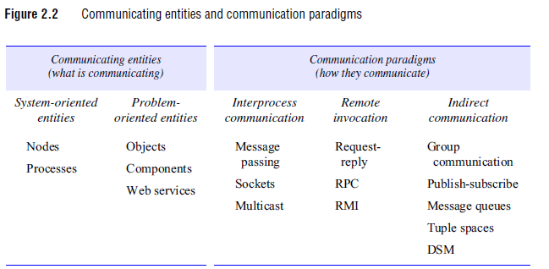

Slide 68
Architectural styles stemming from the role of
individual processes: client-server and peer-to-peer.
Client-server: This is the architecture that is most often cited when distributed systems. Figure illustrates the simple structure in which processes take on the roles of being clients or servers. In particular, client processes interact with individual server processes in potentially separate host computers in order to access the shared resources that they manage.

Slide 69
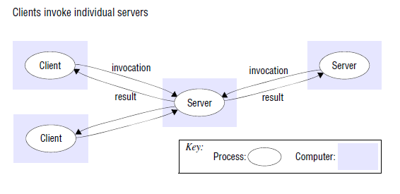

Slide 70
Peer-to-peer: In this architecture all of the processes involved in a task or activity play similar roles, interacting cooperatively as peers without any distinction between client and server processes or the computers on which they run. In practical terms, all participating processes run the same program and offer the same set of interfaces to each other.

Slide 71
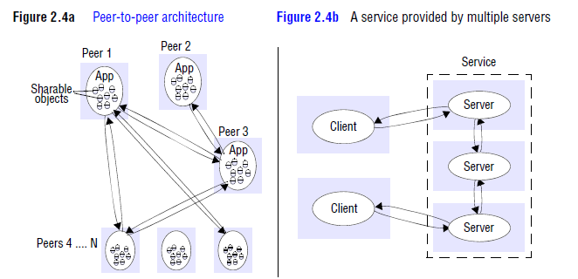

Slide 72
Placement
Placement is crucial in terms of determining the properties of the distributed system, most obviously with regard to performance but also to other aspects, such as reliability and security.
Placement must be determined with strong application knowledge, and there are few universal guidelines to obtaining an optimal solution.

Slide 73
Mapping of services to multiple servers
Services may be implemented as several server processes in separate host computers interacting as necessary to provide a service to client processes . The servers may partition the set of objects on which the service is based and distribute those objects between themselves, or they may maintain replicated copies of them on several hosts.

Slide 74
Caching
A cache is a store of recently used data objects that is closer to one client or a particular set of clients than the objects themselves. When a new object is received from a server it is added to the local cache store, replacing some existing objects.
Web browsers maintain a cache of recently visited web pages and other web resources in the client’s local file system, using a special HTTP request to check with the original server that cached pages are up-todate before displaying them.
The purpose of proxy servers is to increase the availability and performance of the service by reducing the load on the wide area network and web servers.

Slide 75
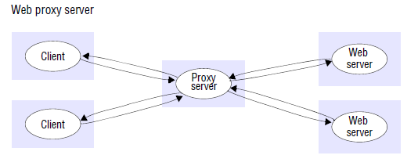

Slide 76
Architectural patterns
Layering - The concept of layering is a familiar one and is closely related to abstraction. In a layered approach, a complex system is partitioned into a number of layers, with a given layer making use of the services offered by the layer below.
A distributed service can be provided by one or more server processes, interacting with each other and with client processes in order to maintain a consistent system-wide view of the service’s resources.

Slide 77
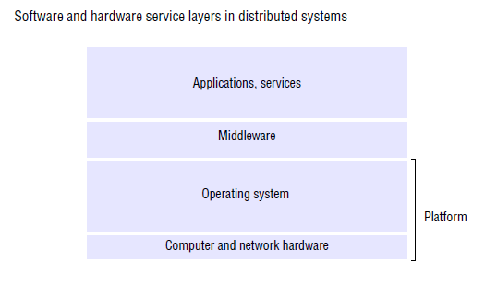

Slide 78
A platform for distributed systems and applications consists of the lowest-level hardware and software layers. These low-level layers provide services to the layers above them, which are implemented independently in each computer, bringing the system’s programming interface up to a level that facilitates communication and coordination between processes.
Middleware layer of software whose purpose is to mask heterogeneity and to provide a convenient programming model to application programmers. Middleware is represented by processes or objects in a set of computers that interact with each other to implement communication and resource-sharing support for distributed applications.

Slide 79
It is concerned with providing useful building blocks for the construction of software components that can work with one another in a distributed system.
It raises the level of the communication activities of application programs through the support of abstractions such as remote method invocation; communication between a group of processes; notification of events; the partitioning, placement and retrieval of shared data objects amongst cooperating computers; the replication of shared data objects; and the transmission of multimedia data in real time.

Slide 80
Tiered architecture
Tiered architectures are complementary to layering. Whereas layering deals with the vertical organization of services into layers of abstraction, tiering is a technique to organize functionality of a given layer and place this functionality into appropriate servers and, as a secondary consideration, on to physical nodes.

Slide 81
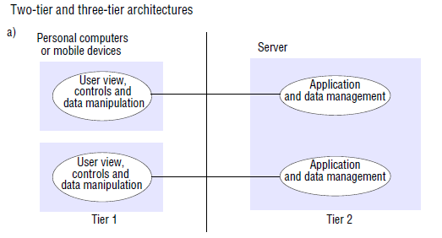

Slide 82
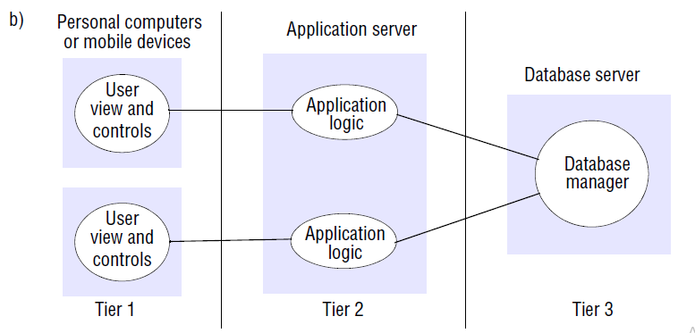

Slide 83
The presentation logic, which is concerned with handling user interaction and updating the view of the application as presented to the user;
The application logic, which is concerned with the detailed application-specific processing associated with the application (also referred to as the business logic, although the concept is not limited only to business applications);
The data logic, which is concerned with the persistent storage of the application, typically in a database management system.

Slide 84
Thin clients:
The trend in distributed computing is towards moving complexity away from the end-user device towards services in the Internet.
This trend has given rise to interest in the concept of a thin client, enabling access to sophisticated networked services.
The term thin client refers to a software layer that supports a window-based user interface that is local to the user while executing application programs or, more generally, accessing services on a remote computer.

Slide 85
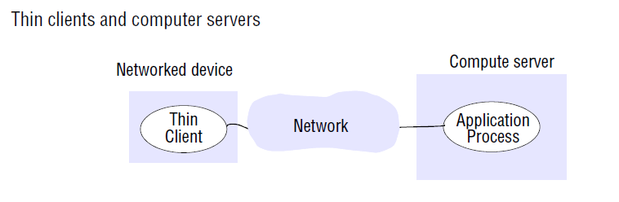

Slide 86
Associated Middleware solutions
The task of middleware is to provide a higher-level programming abstraction for the development of distributed systems and, through layering, to abstract over heterogeneity in the underlying infrastructure to promote interoperability and portability.

Slide 87
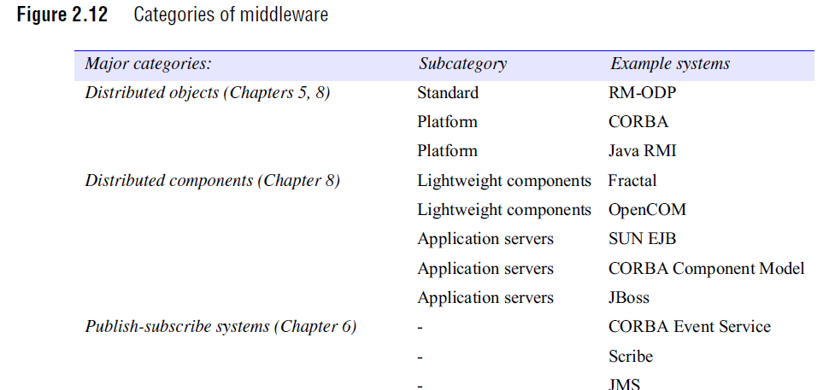

Slide 88
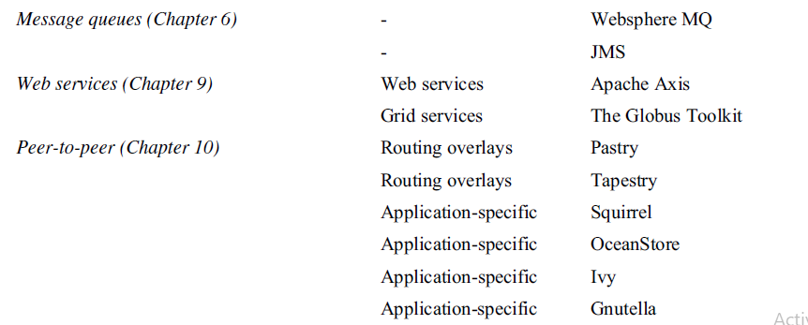

Slide 89
Fundamental models
This model is based on the fundamental properties that allow us to be more specific about their characteristics and the failures and security risks they might exhibit.
The aspects of distributed systems that we wish to capture in our fundamental models are intended to help us to discuss and reason about:
Interaction
Failure
Security

Slide 90
Interaction model
The processes interact by passing messages, resulting in communication (information flow) and coordination (synchronization and ordering of activities) between processes.
The interaction model must reflect the facts that communication takes place with delays that are often of considerable duration, and that the accuracy with which independent processes can be coordinated is limited by these delays and by the difficulty of maintaining the same notion of time across all the computers in a distributed system.

Slide 91
The behaviour of the program and the state of the program described by a distributed algorithm – a definition of the steps to be taken by each of the processes of which the system is composed, including the transmission of messages between them.
Messages are transmitted between processes to transfer information between them and to coordinate their activity.
Interacting processes perform all of the activity in a distributed system. Each process has its own state, consisting of the set of data that it can access and update, including the variables in its program.
The state belonging to each process is completely private – that is, it cannot be accessed or updated by any other process.

Slide 92
Two significant factors affecting interacting processes in a distributed system:
Performance of communication channels-
Communication over a computer network has the following performance characteristics relating to latency, bandwidth and jitter.
The delay between the start of a message’s transmission from one process and the beginning of its receipt by another is referred to as latency.
The delay in accessing the network, which increases significantly when the network is heavily loaded. The time taken by the operating system communication services at both the sending and the receiving processes, which varies according to the current load on the operating systems.

Slide 93
The bandwidth of a computer network is the total amount of information that can be transmitted over it in a given time. When a large number of communication channels are using the same network, they have to share the available bandwidth.
Jitter is the variation in the time taken to deliver a series of messages. Jitter is relevant to multimedia data. For example, if consecutive samples of audio data are played with differing time intervals, the sound will be badly distorted.

Slide 94
Computer clocks and timing events
Each computer in a distributed system has its own internal clock, which can be used by local processes to obtain the value of the current time. Therefore two processes running on different computers can each associate timestamps with their events.
However, even if the two processes read their clocks at the same time, their local clocks may supply different time values.
This is because computer clocks drift from perfect time and, more importantly, their drift rates differ from one another. The term clock drift rate refers to the rate at which a computer clock deviates from a perfect reference clock.

Slide 95
There are several approaches to correcting the times on computer clocks.
For example, computers may use radio receivers to get time readings from the Global Positioning System with an accuracy of about 1 microsecond.

Slide 96
Two variants of the interaction model
Synchronous distributed systems:
synchronous distributed system to be one in which the following bounds are defined:
• The time to execute each step of a process has known lower and upper bounds.
• Each message transmitted over a channel is received within a known bounded time.
• Each process has a local clock whose drift rate from real time has a known bound.

Slide 97
Synchronous distributed systems can be built. What is required is for the processes to perform tasks with known resource requirements for which they can be guaranteed sufficient processor cycles and network capacity, and for processes to be supplied with clocks with bounded drift rates.

Slide 98
Asynchronous distributed systems:
An asynchronous distributed system is one in which there
are no bounds on:
• Process execution speeds – for example, one process step may take only a picosecond and another a century; all that can be said is that each step may take an arbitrarily long time.
• Message transmission delays – for example, one message from process A to process B may be delivered in negligible time and another may take several years. In other words, a message may be received after an arbitrarily long time.
• Clock drift rates – again, the drift rate of a clock is arbitrary.

Slide 99
Actual distributed systems are very often asynchronous because of the need for processes to share the processors and for communication channels to share the network.

Slide 100
Event ordering
In many cases, we are interested in knowing whether an event (sending or receiving a message) at one process occurred before, after or concurrently with another event at another process.
The execution of a system can be described in terms of events and their ordering despite the lack of accurate clocks.

Slide 101
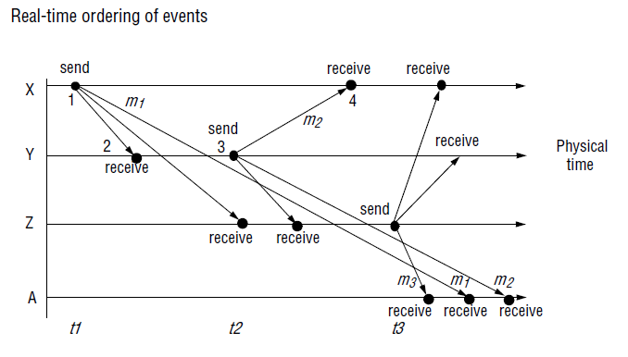

Slide 102
considering only the events concerning X and Y:
X sends m1 before Y receives m1; Y sends m2 before X receives m2.
We also know that replies are sent after receiving messages, so we have the following
logical ordering for Y:
Y receives m1 before sending m2.

Slide 103
Failure model:
In a distributed system both processes and communication channels may fail, The failure model defines the ways in which failure may occur in order to provide an understanding of the effects of failures.
Omission failures
• The faults classified as omission failures refer to cases when a process or communication channel fails to perform actions that it is supposed to do.

Slide 104
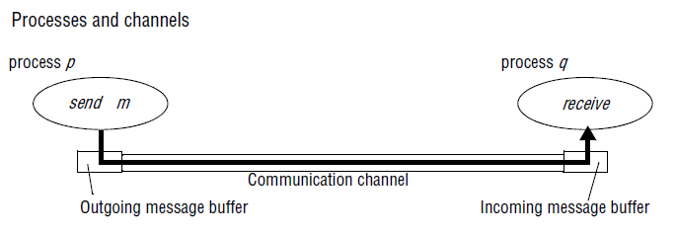

Slide 105
Process omission failures: The chief omission failure of a process is to crash. When we say that a process has crashed we mean that it has halted and will not execute any further steps of its program ever.
Other processes may be able to detect such a crash by the fact that the process repeatedly fails to respond to invocation messages.
However, this method of crash detection relies on the use of timeouts – that is, a method in which one process allows a fixed period of time for something to occur.

Slide 106
A process crash is called fail-stop if other processes can detect certainly that the process has crashed.
Fail-stop behaviour can be produced in a synchronous system if the processes use timeouts to detect when other processes fail to respond and messages are guaranteed to be delivered.

Slide 107
Communication omission failures:
Consider the communication primitives send and receive. A process p performs a send by inserting the message m in its outgoing message buffer.
The communication channel transports m to q’s incoming message buffer. Process q performs a receive by taking m from its incoming message buffer and delivering it.
The outgoing and incoming message buffers are typically provided by the operating system.

Slide 108
The communication channel produces an omission failure if it does not transport a message from p’s outgoing message buffer to q’s incoming message buffer.
This is known as ‘dropping messages’ and is generally caused by lack of buffer space at the receiver or at an intervening gateway, or by a network transmission error, detected by a checksum carried with the message data.

Slide 109
The loss of messages between the sending process and the outgoing message buffer as sendomission failures, to loss of messages between the incoming message buffer and the receiving process as receive-omission failures, and to loss of messages in between as channel omission failures.

Slide 110
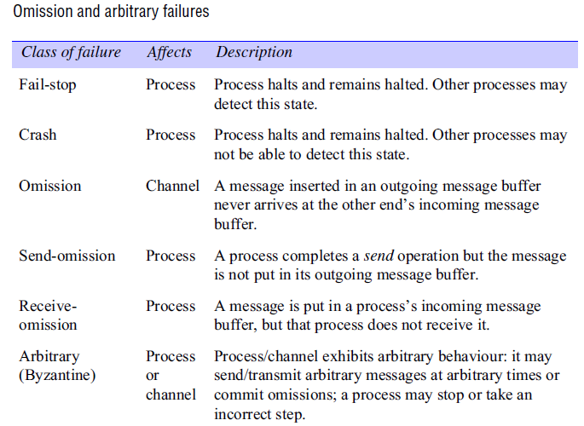

Slide 111
Arbitrary failures: The term arbitrary or Byzantine failure is used to describe the worst possible failure semantics, in which any type of error may occur.
An arbitrary failure of a process is one in which it arbitrarily omits intended processing steps or takes unintended processing steps.
Arbitrary failures in processes cannot be detected by seeing whether the process responds to invocations, because it might arbitrarily omit to reply.

Slide 112
Arbitrary failures of communication channels are rare because the communication software is able to recognize them and reject the faulty messages.
For example, checksums are used to detect corrupted messages, and message sequence numbers can be used to detect nonexistent and duplicated messages.

Slide 113
Timing failures: Timing failures are applicable in synchronous distributed systems where time limits are set on process execution time, message delivery time and clock drift rate.
Any one of these failures may result in responses being unavailable to clients within a specified time interval.
In an asynchronous distributed system, an overloaded server may respond too slowly, but we cannot say that it has a timing failure since no guarantee has been offered.

Slide 114
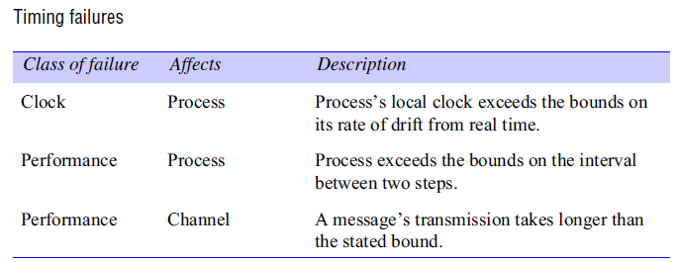
Timing is particularly relevant to multimedia computers with audio and video channels. Video information can require a very large amount of data to be transferred.
Delivering such information without timing failures can make very special demands on both the operating system and the communication system.

Slide 115
Masking failures: A knowledge of the failure characteristics of a component can enable a new service to be designed to mask the failure of the components on which it depends.
A service masks a failure either by hiding it altogether or by converting it into a more acceptable type of failure.

Slide 116
Reliability of one-to-one communication
The term reliable communication is defined in terms of validity and integrity as follows:
Validity: Any message in the outgoing message buffer is eventually delivered to the incoming message buffer.
Integrity: The message received is identical to one sent, and no messages are delivered twice.

Slide 117
The threats to integrity come from two independent sources:
Any protocol that retransmits messages but does not reject a message that arrives twice. Protocols can attach sequence numbers to messages so as to detect those that are delivered twice.
Malicious users that may inject spurious messages, replay old messages or tamper with messages. Security measures can be taken to maintain the integrity property in the face of such attacks.

Slide 118
Security model
The security of a distributed system can be achieved by securing the processes and the channels used for their interactions and by protecting the objects that they encapsulate against unauthorized access.
Protecting objects: A server manages a collection of objects on behalf of some users. The users can run client programs that send invocations to the server to perform operations on the objects. The server carries out the operation specified in each invocation and sends the result to the client.

Slide 119
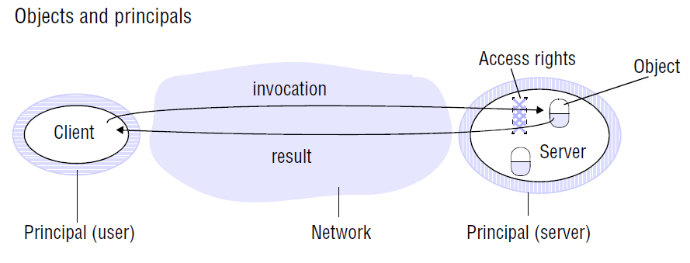

Slide 120
we must include users in our model as the beneficiaries of access rights.
A principal is an authority associating with each invocation and each result the authority on which it is issued.
The server is responsible for verifying the identity of the principal behind each invocation and checking that they have sufficient access rights to perform the requested operation on the particular object invoked, rejecting those that do not.
The client may check the identity of the principal behind the server to ensure that the result comes from the required server.

Slide 121
Securing processes and their interactions
Processes interact by sending messages.
The messages are exposed to attack because the network and the communication service that they use are open, to enable any pair of processes to interact.
Distributed systems are often deployed and used in tasks that are likely to be subject to external attacks for applications that handle financial transactions, confidential or classified information or any other information whose secrecy or integrity is crucial.

Slide 122
The enemy: To model security threats, we postulate an enemy (sometimes also known as the adversary) that is capable of sending any message to any process and reading or copying any message sent between a pair of processes.
Such attacks can be made simply by using a computer connected to a network to run a program that reads network messages addressed to other computers on the network, or a program that generates messages that make false requests to services, purporting to come from authorized users.
The threats from a potential enemy include threats to processes and threats to communication channels.

Slide 123
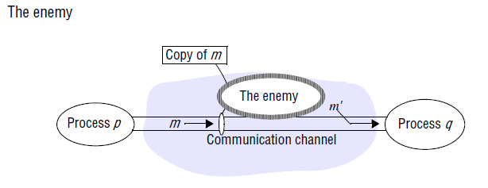

Slide 124
Threats to processes:
A process that is designed to handle incoming requests may receive a message from any other process in the distributed system, and it cannot necessarily determine the identity of the sender.
This lack of reliable knowledge of the source of a message is a threat to the correct functioning of both servers and clients, as explained below:

Slide 125
Servers: Since a server can receive invocations from many different clients, it cannot necessarily determine the identity of the principal behind any particular invocation.
Even if a server requires the inclusion of the principal’s identity in each invocation, an enemy might generate an invocation with a false identity.
Clietns: When a client receives the result of an invocation from a server, it cannot necessarily tell whether the source of the result message is from the intended server or from an enemy.

Slide 126
Threats to communication channels:
An enemy can copy, alter or inject messages as they travel across the network and its extending gateways.
Such attacks present a threat to the privacy and integrity of information as it travels over the network and to the integrity of the system.
Another form of attack is the attempt to save copies of messages and to replay them at a later time, making it possible to reuse the same message over and over again.

Slide 127
Defeating security threats
All these threats can be defeated by the use of secure channels, which are described below and are based on cryptography and authentication.
Cryptography and shared secrets: Suppose that a pair of processes (for example, a particular client and a particular server) share a secret; that is, they both know the secret but no other process in the distributed system knows it.

Slide 128
Cryptography is the science of keeping messages secure, and encryption is the process of scrambling a message in such a way as to hide its contents.
Modern cryptography is based on encryption algorithms that use secret keys – large numbers that are difficult to guess – to transform data in a manner that can only be reversed with knowledge of the corresponding decryption key.

Slide 129
Authentication: The basic authentication technique is to include in a message an encrypted portion that contains enough of the contents of the message to guarantee its authenticity.
The server would decrypt this and check that it corresponds to the unencrypted details specified in the request.
Secure channels: Encryption and authentication are used to build secure channels as a service layer on top of existing communication services.
A secure channel is a communication channel connecting a pair of processes, each of which acts on behalf of a principal, as shown in Figure.
A secure channel has the following properties:

Slide 130
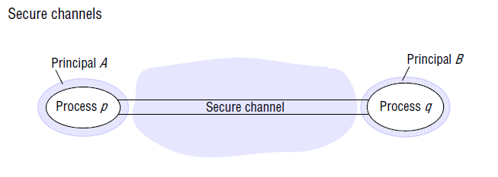

Slide 131
Each of the processes knows reliably the identity of the principal on whose behalf the other process is executing.
A secure channel ensures the privacy and integrity (protection against tampering) of the data transmitted across it.
• Each message includes a physical or logical timestamp to prevent messages from being replayed or reordered.

Slide 132
Other possible threats from an enemy:
Denial of service: This is a form of attack in which the enemy interferes with the activities of authorized users by making excessive and pointless invocations on services or message transmissions in a network, resulting in overloading of physical resources (network bandwidth, server processing capacity).
Mobile code: Mobile code raises new and interesting security problems for any process that receives and executes program code from elsewhere, Such code may easily play a Trojan horse role, purporting to fulfil an innocent purpose but in fact including code that accesses or modifies resources that are legitimately available to the host process but not to the originator of the code.

Slide 133
The uses of security models
• It might be thought that the achievement of security in distributed systems would be a straight forward matter involving the control of access to objects according to predefined access rights and the use of secure channels for communication.

