Slide 1

VASIREDDY VENKATADRI INSTITUTE OF TECHNOLOGY
(Autonomous)
Department of Computer Science and Engineering
IV B.Tech -II Semester
Distributed Systems
Unit-II
Interprocess Communication

Slide 2
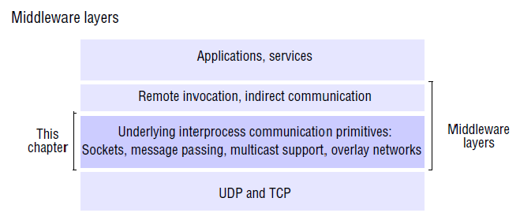

Slide 3
The application program interface to UDP provides a message passing abstraction – the simplest form of interprocess communication.
This enables a sending process to transmit a single message to a receiving process. The independent packets containing these messages are called datagrams.
A socket is one endpoint of a two-way communication link between two programs running on the network.
In the Java and UNIX APIs, the sender specifies the destination using a socket – an indirect reference to a particular port used by the destination process at a destination computer.

Slide 4
The application program interface to TCP provides the abstraction of a two-way stream between pairs of processes.
Multicast communication: a form of interprocess communication in which one process in a group of processes transmits the same message to all members of the group.

Slide 5
The API for the Internet protocols
The characteristics of interprocess communication
Message passing between a pair of processes can be supported by two message communication operations, send and receive, defined in terms of destinations and messages.
To communicate, one process sends a message (a sequence of bytes) to a destination and another process at the destination receives the message.
This activity involves the communication of data from the sending process to the receiving process and may involve the synchronization of the two processes.

Slide 6
Synchronous and asynchronous communication
A queue is associated with each message destination.
Sending processes cause messages to be added to remote queues and receiving processes remove messages from local queues.
In the synchronous form of communication, the sending and receiving processes synchronize at every message.
In this case, both send and receive are blocking operations. Whenever a send is issued the sending process (or thread) is blocked until the corresponding receive is issued.
Whenever a receive is issued by a process (or thread), it blocks until a message arrives.

Slide 7
In the asynchronous form of communication, the use of the send operation is non blocking in that the sending process is allowed to proceed as soon as the message has been copied to a local buffer, and the transmission of the message proceeds in parallel with the sending process.
The receive operation can have blocking and non-blocking variants.
In the non-blocking variant, the receiving process proceeds with its program after issuing a receive operation, which provides a buffer to be filled in the background, but it must separately receive notification that its buffer has been filled, by polling or interrupt.

Slide 8
Message destinations: In the Internet protocols, messages are sent to (Internet address, local port) pairs.
A local port is a message destination within a computer, specified as an integer. A port has exactly one receiver but can have many senders.
Any process that knows the number of a port can send a message to it. Servers generally publicize their port numbers for use by clients.

Slide 9
Reliability: Defines reliable communication in terms of validity and integrity.
For integrity, messages must arrive uncorrupted and without duplication.
As far as the validity property is concerned, a point-to-point message service can be described as reliable if messages are guaranteed to be delivered despite a ‘reasonable’ number of packets being dropped or lost.

Slide 10
Ordering:
Some applications require that messages be delivered in sender order – that is, the order in which they were transmitted by the sender. The delivery of messages out of sender order is regarded as a failure by such applications.

Slide 11
Sockets
Both forms of communication (UDP and TCP) use the socket abstraction, which provides an end point for communication between processes.
Interprocess communication consists of transmitting a message between a socket in one process and a socket in another process.
For a process to receive messages, its socket must be bound to a local port and one of the Internet addresses of the computer on which it runs.

Slide 12
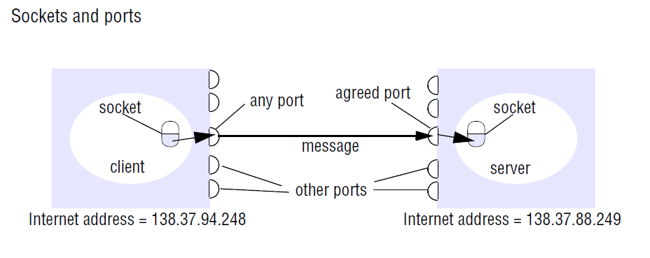

Slide 13
Messages sent to a particular Internet address and port number can be received only by a process whose socket is associated with that Internet address and port number.
Any process may make use of multiple ports to receive messages, but a process cannot share ports with other processes on the same computer.
Each computer has a large number (2¹⁶) of possible port numbers for use by local processes for receiving messages.

Slide 14
Java API for Internet addresses:
As the IP packets underlying UDP and TCP are sent to Internet addresses, Java provides a class, InetAddress, that represents Internet addresses. (java.net. InetAddress )
Users of this class refer to computers by Domain Name System (DNS) hostnames .
The method uses the DNS to get the corresponding Internet address. (getByName())
This method can throw an UnknownHostException.

Slide 15
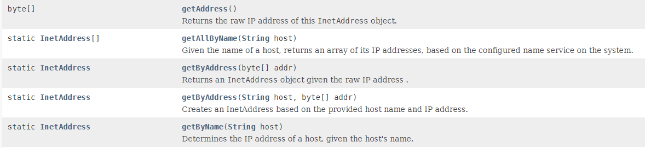

Slide 16
UDP datagram communication
A datagram sent by UDP is transmitted from a sending process to a receiving process without acknowledgement. If a failure occurs, the message may not arrive.
A datagram is transmitted between processes when one process sends it and another receives it.
To send or receive messages a process must first create a socket bound to an Internet address of the local host and a local port.

Slide 17
A client binds its socket to any free local port.
A server will bind its socket to a server port – one that it makes known to clients so that they can send messages to it.
The receive method returns the Internet address and port of the sender, in addition to the message, allowing the recipient to send a reply.

Slide 18
The following are some issues relating to datagram communication:
Message size: The receiving process needs to specify an array of bytes of a particular size in which to receive a message. If the message is too big for the array, it is truncated on arrival.
Any application requiring messages larger than the maximum must fragment them into chunks of that size.

Slide 19
Blocking: Sockets normally provide non-blocking sends and blocking receives for datagram communication.
The send operation returns when it has handed the message to the underlying UDP and IP protocols, which are responsible for transmitting it to its destination.
On arrival, the message is placed in a queue for the socket that is bound to the destination port.
The message can be collected from the queue by an outstanding or future invocation of receive on that socket.

Slide 20
Timeouts: But in some programs, it is not appropriate that a process that has invoked a receive operation should wait indefinitely in situations where the sending process may have crashed or the expected message may have been lost.
To allow for such requirements, timeouts can be set on sockets.

Slide 21
Receive from any: The receive method does not specify an origin for messages.
Instead, an invocation of receive gets a message addressed to its socket from any origin.
The receive method returns the Internet address and local port of the sender, allowing the recipient to check where the message came from.
It is possible to connect a datagram socket to a particular remote port and Internet address, in which case the socket is only able to send messages to and receive messages from that address.

Slide 22
Failure model for UDP datagrams
communication channels and defines reliable communication in terms of two properties:
integrity and validity. The integrity property requires that messages should not be corrupted or duplicated. The use of a checksum ensures that there is a negligible probability that any message received is corrupted.
UDP datagrams suffer from the following failures:
Omission failures: Messages may be dropped occasionally, either because of a checksum error or because no buffer space is available at the source or destination.
Ordering: Messages can sometimes be delivered out of sender order.

Slide 23
Use of UDP
For some applications, it is acceptable to use a service that is liable to occasional omission failures.
For example, the Domain Name System, which looks up DNS names in the Internet, is implemented over UDP.
Voice over IP (VOIP) also runs over UDP. UDP datagrams are sometimes an attractive choice because they do not suffer from the overheads associated with guaranteed message delivery.
There are three main sources of overhead:
the need to store state information at the source and destination;
the transmission of extra messages;
latency for the sender.

Slide 24
Java API for UDP datagrams
The Java API provides datagram communication by means of two classes: DatagramPacket and DatagramSocket.
DatagramPacket: This class provides a constructor that makes an instance out of an array of bytes comprising a message, the length of the message and the Internet address and local port number of the destination socket, as follows:
Datagram packet
array of bytes containing message length of message Internet address port number

Slide 25
An instance of DatagramPacket may be transmitted between processes when one process sends it and another receives it.
A received message is put in the DatagramPacket together with its length and the Internet address and port of the sending socket.
The message can be retrieved from the DatagramPacket by means of the method getData. The methods getPort and getAddress access the port and Internet address.

Slide 26
DatagramSocket: This class supports sockets for sending and receiving UDP datagrams.
It provides a constructor that takes a port number as its argument, for use by processes that need to use a particular port.
It also provides a no-argument constructor that allows the system to choose a free local port.

Slide 27
The class DatagramSocket provides methods that include the following:
send and receive: These methods are for transmitting datagrams between a pair of sockets.
The argument of send is an instance of DatagramPacket containing a message and its destination.
The argument of receive is an empty DatagramPacket in which to put the message, its length and its origin.
The methods send and receive can throw IOExceptions.

Slide 28
setSoTimeout: This method allows a timeout to be set. With a timeout set, the receive method will block for the time specified and then throw an InterruptedIOException.
connect: This method is used for connecting to a particular remote port and Internet address, in which case the socket is only able to send messages to and receive messages from that address.

Slide 29
The program for a client that creates a socket, sends a message to a server at port 6789 and then waits to receive a reply.
The arguments of the main method supply a message and the DNS hostname of the server.
The message is converted to an array of bytes, and the DNS hostname is converted to an Internet address.

Slide 30
The program for the corresponding server, which creates a socket bound to its server port (6789) and then repeatedly waits to receive a request message from a client, to which it replies by sending back the same message.

Slide 31
TCP stream communication
The API to the TCP protocol, provides the abstraction of a stream of bytes to which data may be written and from which data may be read.
The following characteristics of the network are hidden by the stream abstraction:
Message sizes
Lost messages
Flow control
Message duplication and ordering
Message destinations

Slide 32
Message sizes: The application can choose how much data it writes to a stream or reads from it.
It may deal in very small or very large sets of data.
The underlying implementation of a TCP stream decides how much data to collect before transmitting it as one or more IP packets.

Slide 33
Lost messages: The TCP protocol uses an acknowledgement scheme.
As an example of a simple scheme, the sending end keeps a record of each IP packet sent and the receiving end acknowledges all the arrivals.
If the sender does not receive an acknowledgement within a timeout, it retransmits the message.
The more sophisticated sliding window scheme cuts down on the number of acknowledgement messages required.

Slide 34
Flow control: The TCP protocol attempts to match the speeds of the processes that read from and write to a stream.
If the writer is too fast for the reader, then it is blocked until the reader has consumed sufficient data.
Message duplication and ordering: Message identifiers are associated with each IP packet, which enables the recipient to detect and reject duplicates, or to reorder messages that do not arrive in sender order.

Slide 35
Message destinations: A pair of communicating processes establish a connection before they can communicate over a stream.
Once a connection is established, the processes simply read from and write to the stream without needing to use Internet addresses and ports.
Establishing a connection involves a connect request from client to server followed by an accept request from server to client before any communication can take place.
This could be a considerable overhead for a single client-server request and reply.

Slide 36
The API for stream communication assumes that when a pair of processes are establishing a connection, one of them plays the client role and the other plays the server role.
The client role involves creating a stream socket bound to any port and then making a connect request asking for a connection to a server at its server port.
The server role involves creating a listening socket bound to a server port and waiting for clients to request connections.
The listening socket maintains a queue of incoming connection requests.

Slide 37
The pair of sockets in the client and server are connected by a pair of streams, one in each direction.
Thus each socket has an input stream and an output stream.
One of the pair of processes can send information to the other by writing to its output stream, and the other process obtains the information by reading from its input stream.

Slide 38
When an application closes a socket, this indicates that it will not write any more data to its output stream.
Any data in the output buffer is sent to the other end of the stream and put in the queue at the destination socket, with an indication that the stream is broken.
The process at the destination can read the data in the queue, but any further reads after the queue is empty will result in an indication of end of stream.

Slide 39
Failure model
To satisfy the integrity property of reliable communication, TCP streams use checksums to detect and reject corrupt packets and sequence numbers to detect and reject duplicate packets.
For the sake of the validity property, TCP streams use timeouts and retransmissions to deal with lost packets. Therefore, messages are guaranteed to be delivered even when some of the underlying packets are lost.

Slide 40
When a connection is broken, a process using it will be notified if it attempts to read or write. This has the following effects:
The processes using the connection cannot distinguish between network failure and failure of the process at the other end of the connection.
The communicating processes cannot tell whether the messages they have sent recently have been received or not.

Slide 41
Use of TCP
Many frequently used services run over TCP connections, with reserved port numbers.
These include the following:
HTTP(80): The Hypertext Transfer Protocol is used for communication between web browsers and web servers.
FTP(21): The File Transfer Protocol allows directories on a remote computer to be browsed and files to be transferred from one computer to another over a connection.
Telnet(23): Telnet provides access by means of a terminal session to a remote computer.
SMTP(25): The Simple Mail Transfer Protocol is used to send mail between computers.

Slide 42
Java API for TCP streams
The Java interface to TCP streams is provided in the classes ServerSocket and Socket:
ServerSocket: This class is intended for use by a server to create a socket at a server port for listening for connect requests from clients.
Its accept method gets a connect request from the queue or, if the queue is empty, blocks until one arrives.
The result of executing accept is an instance of Socket – a socket to use for communicating with the client.

Slide 43
Socket: This class is for use by a pair of processes with a connection.
The client uses a constructor to create a socket, specifying the DNS hostname and port of a server.
This constructor not only creates a socket associated with a local port but also connects it to the specified remote computer and port number.
It can throw an UnknownHostException if the hostname is wrong or an IOException if an IO error occurs.

Slide 44
The Socket class provides the methods getInputStream and getOutputStream for accessing the two streams associated with a socket.
The return types of these methods are InputStream and OutputStream, respectively – abstract classes that define methods for reading and writing bytes.
The return values can be used as the arguments of constructors for suitable input and output streams.
Our example uses DataInputStream and DataOutputStream, which allow binary representations of primitive data types to be read and written in a machine-independent manner.

Slide 45
A client program in which the arguments of the main method supply a message and the DNS hostname of the server.
The client creates a socket bound to the hostname and server port 7896.
It makes a DataInputStream and a DataOutputStream from the socket’s input and output streams, then writes the message to its output stream and waits to read a reply from its input stream.

Slide 46
The server program opens a server socket on its server port (7896) and listens for connect requests.
When one arrives, it makes a new thread in which to communicate with the client.
The new thread creates a DataInputStream and a DataOutputStream from its socket’s input and output streams and then waits to read a message and write the same one back.
When a process has closed its socket, it will no longer be able to use its input and output streams.
The process to which it has sent data can read the data in its queue, but any further reads after the queue is empty will result in an EOFException.
Attempts to use a closed socket or to write to a broken stream result in an IOException.

Slide 47
Multicast communication
A multicast operation is more appropriate – this is an operation that sends a single message from one process to each of the members of a group of processes, usually in such a way that the membership of the group is transparent to the sender.

Slide 48
Multicast messages provide a useful infrastructure for constructing distributed systems with the following characteristics.
1. Fault tolerance based on replicated services: A replicated service consists of a group of servers. Client requests are multicast to all the members of the group, each of which performs an identical operation. Even when some of the members fail, clients can still be served.

Slide 49
2. Discovering services in spontaneous networking :
Multicast messages can be used by servers and clients to locate available discovery services in order to register their interfaces or to look up the interfaces of other services in the distributed system.
3. Better performance through replicated data: Data are replicated to increase the performance of a service – in some cases replicas of the data are placed in users computers.

Slide 50
4. Propagation of event notifications: Multicast to a group may be used to notify processes when something happens. For example, in Facebook, when someone changes their status, all their friends receive notifications.

Slide 51
IP multicast – An implementation of multicast communication
IP multicast is built on top of the Internet Protocol (IP). Note that IP packets are addressed to computers – ports belong to the TCP and UDP levels.
IP multicast allows the sender to transmit a single IP packet to a set of computers that form a multicast group.
A multicast group is specified by a Class D Internet address – that is, an address whose first 4 bits are 1110 in IPv4.

Slide 52
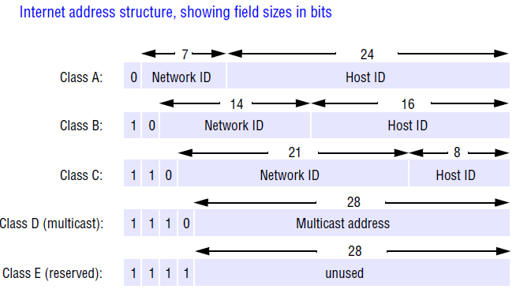

Slide 53
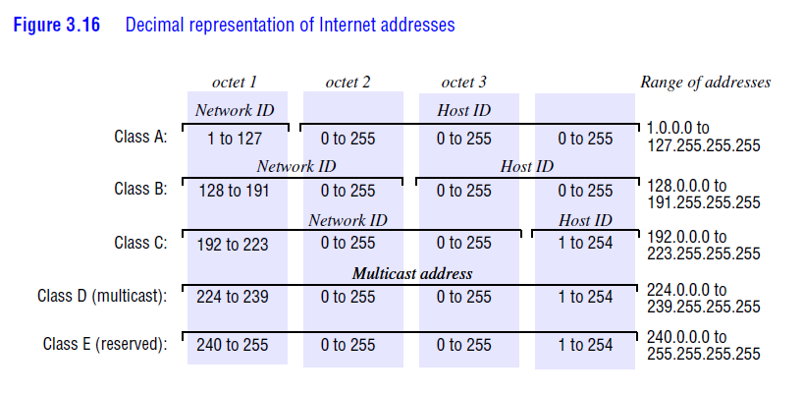

Slide 54
At the application programming level, IP multicast is available only via UDP.
An application program performs multicasts by sending UDP datagrams with multicast addresses and ordinary port numbers.
When a multicast message arrives at a computer, copies are forwarded to all of the local sockets that have joined the specified multicast address and are bound to the specified port number.

Slide 55
The following details are specific to IPv4
Multicast routers: IP packets can be multicast both on a local network and on the wider Internet.
Internet multicasts make use of multicast routers, which forward single datagrams to routers on other networks, where they are again multicast to local members.
To limit the distance of propagation of a multicast datagram, the sender can specify the number of routers it is allowed to pass – called the time to live, or TTL.

Slide 56
Multicast address allocation: Class D addresses (that is, addresses in the range 224.0.0.0 to 239.255.255.255) are reserved for multicast traffic and managed globally by the Internet Assigned Numbers Authority (IANA).
• Local Network Control Block (224.0.0.0 to 224.0.0.225), for multicast traffic within a given local network.
• Internet Control Block (224.0.1.0 to 224.0.1.225).
• Ad Hoc Control Block (224.0.2.0 to 224.0.255.0), for traffic that does not fit any other block.
• Administratively Scoped Block (239.0.0.0 to 239.255.255.255), which is used to implement a scoping mechanism for multicast traffic (to constrain
propagation).

Slide 57
Failure model for multicast datagrams
Datagrams multicast over IP multicast have the same failure characteristics as UDP datagrams – that is, they suffer from omission failures.
The effect on a multicast is that messages are not guaranteed to be delivered to any particular group member in the face of even a single omission failure.
That is, some but not all of the members of the group may receive it. This can be called unreliable multicast, because it does not guarantee that a message will be delivered to any member of a group.

Slide 58
Java API to IP multicast
The Java API provides a datagram interface to IP multicast through the class MulticastSocket, which is a subclass of DatagramSocket with the additional capability of being able to join multicast groups.
The class MulticastSocket provides two alternative constructors, allowing sockets to be created to use either a specified local port (6789 ) or any free local port.

Slide 59
A process can join a multicast group with a given multicast address by invoking the joinGroup method of its multicast socket. Effectively, the socket joins a multicast group at a given port and it will receive datagrams sent by processes on other computers to that group at that port.
A process can leave a specified group by invoking the leaveGroup method of its multicast socket.

Slide 60
The arguments to the main method specify a message to be multicast and the multicast address of a group (for example, "228.5.6.7").
After joining that multicast group, the process makes an instance of DatagramPacket containing the message and sends it through its multicast socket to the multicast group address at port 6789.
The Java API allows the TTL to be set for a multicast socket by means of the setTimeToLive method. The default is 1, allowing the multicast to propagate only on the local network.

Slide 61
Reliability and ordering of multicast
The failure model for IP multicast, which suffers from omission failures.
A datagram sent from one multicast router to another may be lost, thus preventing all recipients beyond that router from receiving the message.
when a multicast on a local area network uses the multicasting capabilities of the network to allow a single datagram to arrive at multiple recipients, any one of those recipients may drop the message because its buffer is full.

Slide 62
Another factor is that any process may fail. If a multicast router fails, the group members beyond that router will not receive the multicast message.
Ordering is another issue. IP packets sent over an internetwork do not necessarily arrive in the order in which they were sent, with the possible effect that some group members receive datagrams from a single sender in a different order from other group members.

Slide 63
Some examples of the effects of reliability and ordering
1. Fault tolerance based on replicated services:
This application of multicast requires that either all of the replicas or none of them should receive each request to perform an operation – if one of them misses a request, it will become inconsistent with the others.

Slide 64
2.Discovering services in spontaneous networking:
One way for a process to discover services in spontaneous networking is to multicast requests at periodic intervals, and for the available services to listen for those multicasts and respond.
3. Better performance through replicated data:
Consider the case where the replicated data itself, rather than operations on the data, are distributed by means of multicast messages.
4. Propagation of event notifications: The particular application determines the qualities required of multicast.

Slide 65
External data representation and marshalling
The information stored in running programs is represented as data structures.
Irrespective of the form of communication used, the data structures must be flattened (converted to a sequence of bytes) before transmission and rebuilt on arrival.
There are two variants for the ordering of integers: the so-called big-endian order, in which the most significant byte comes first; and little-endian order, in which it comes last.

Slide 66
The set of codes used to represent characters: for example, the majority of applications on systems such as UNIX use ASCII character coding, taking one byte per character, whereas the Unicode standard allows for the representation of texts in many different languages and takes two bytes per character.

Slide 67
The following methods can be used to enable any two computers to exchange binary data values:
The values are converted to an agreed external format before transmission and converted to the local form on receipt.
If the two computers are known to be the same type, the conversion to external format can be omitted.
The values are transmitted in the sender’s format, together with an indication of the format used, and the recipient converts the values if necessary.

Slide 68
To support RMI or RPC, any data type that can be passed as an argument or returned as a result must be able to be flattened and the individual primitive data values represented in an agreed format.
An agreed standard for the representation of data structures and primitive values is called an external data representation.

Slide 69
Marshalling is the process of taking a collection of data items and assembling them into a form suitable for transmission in a message.
Unmarshalling is the process of disassembling them on arrival to produce an equivalent collection of data items at the destination.

Slide 70
Three alternative approaches to external data representation and marshalling are:
CORBA’s common data representation, which is concerned with an external representation for the structured and primitive types that can be passed as the arguments and results of remote method invocations in CORBA.
Java’s object serialization, which is concerned with the flattening and external data representation of any single object or tree of objects that may need to be transmitted in a message or stored on a disk. It is for use only by Java.
XML (Extensible Markup Language), which defines a textual fomat for representing structured data. It was originally intended for documents containing textual self-describing structured data – for example documents accessible on the Web – but it is now also used to represent the data sent in messages exchanged by clients and servers in web services

Slide 71
CORBA’s Common Data Representation (CDR)
CORBA CDR is the external data representation defined with CORBA 2.0 .
CDR can represent all of the data types that can be used as arguments and return values in remote invocations in CORBA.
These consist of 15 primitive types, which include short (16-bit), long (32-bit), unsigned short, unsigned long, float (32-bit), double (64-bit), char, boolean (TRUE, FALSE), octet (8-bit).

Slide 72
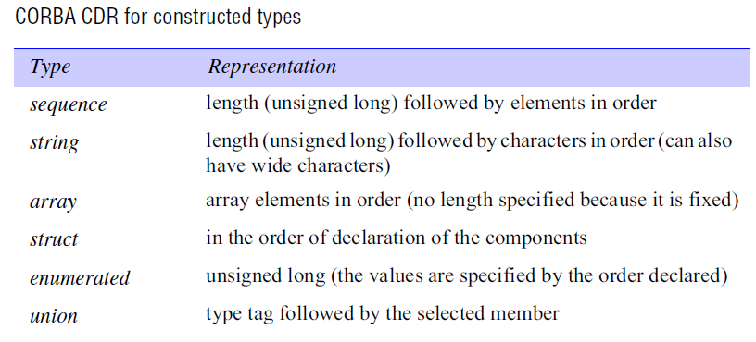

Slide 73
Primitive types: CDR defines a representation for both big-endian and little-endian orderings. Values are transmitted in the sender’s ordering, which is specified in each message. The recipient translates if it requires a different ordering.
Each primitive value is placed at an index in the sequence of bytes according to its size.
Constructed types: The primitive values that comprise each constructed type are added to a sequence of bytes in a particular order.

Slide 74
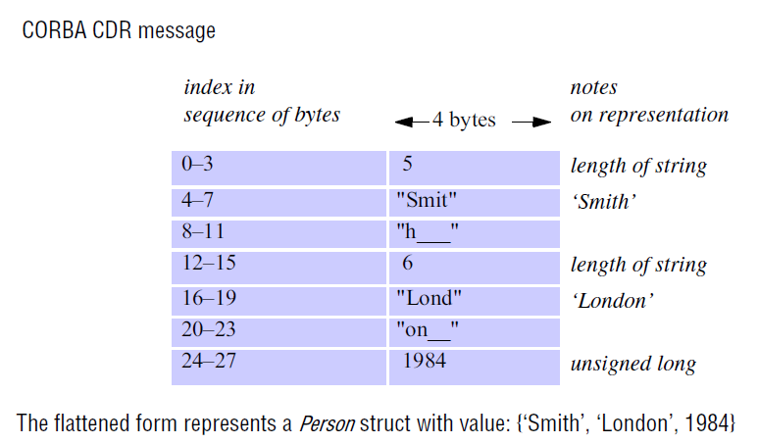
A message in CORBA CDR that contains the three fields of a struct whose respective types are string, string and unsigned long. The figure shows the
sequence of bytes with four bytes in each row.

Slide 75
Marshalling in CORBA
Marshalling operations can be generated automatically from the specification of the types of data items to be transmitted in a message.
The types of the data structures and the types of the basic data items are described in CORBA IDL, which provides a notation for describing the types of the arguments and results of RMI methods.

Slide 76
Java object serialization
In Java RMI, both objects and primitive data values may be passed as arguments and results of method invocations. An object is an instance of a Java class. For example, the Java class equivalent to the Person struct defined in CORBA IDL might be:
public class Person implements Serializable {
private String name;
private String place;
private int year;
public Person(String aName, String aPlace, int aYear) {
name = aName;
place = aPlace;
year = aYear;
}
// followed by methods for accessing the instance variables
}

Slide 77
In Java, the term serialization refers to the activity of flattening an object or a connected set of objects into a serial form that is suitable for storing on disk or transmitting in a message.
Deserialization consists of restoring the state of an object or a set of objects from their serialized form.
When an object is serialized, all the objects that it references are serialized together with it to ensure that when the object is reconstructed, all of its references can be fulfilled at the destination. References are serialized as handles.

Slide 78
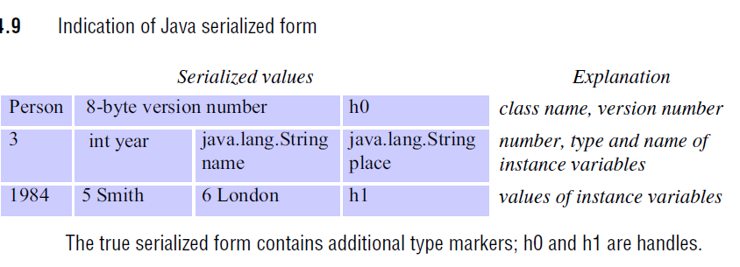

Slide 79
The contents of the instance variables that are primitive types, such as integers, chars, booleans, bytes and longs, are written in a portable binary format using methods of the ObjectOutputStream class.
Strings and characters are written by its writeUTF method using the Universal Transfer Format (UTF-8), which enables ASCII characters to be represented unchanged (in one byte), whereas Unicode characters are represented by multiple bytes.

Slide 80
To make use of Java serialization, for example to serialize the Person object, create an instance of the class ObjectOutputStream and invoke its writeObject method, passing the Person object as its argument.
To deserialize an object from a stream of data, open an ObjectInputStream on the stream and use its readObject method to reconstruct the original object.
Serialization and deserialization of the arguments and results of remote invocations are generally carried out automatically by the middleware, without any participation by the application programmer.

Slide 81
Extensible Markup Language (XML)
XML is a markup language that was defined by the World Wide Web Consortium (W3C) for general use on the Web.
XML was intended to be used by multiple applications for different purposes.
XML is extensible in the sense that users can define their own tags, in contrast to HTML, which uses a fixed set of tags.
However, if an XML document is intended to be used by more than one application, then the names of the tags must be agreed between them.

Slide 82
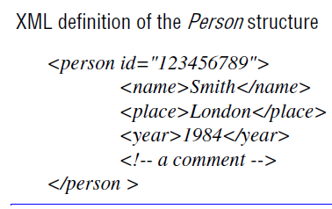

Slide 83
XML elements and attributes
Parsing and well-formed documents
CDATA: XML parsers normally parse the contents of elements because they may contain further nested structures.
XML prolog: Every XML document must have a prolog as its first line.
The prolog must at least specify the version of XML in use (which is currently 1.0).
For example:
<?XML version = "1.0" encoding = "UTF-8" standalone = "yes"?>

Slide 84
Document type definitions: Document type definitions (DTDs) were provided as a part of the XML 1.0 specification for defining the structure of XML documents and are still widely used for that purpose.
XML schemas:
An XML schema defines the elements and attributes that can appear in a document, how the elements are nested and the order and number of elements, and whether an element is empty or can include text. For each element, it defines the type and default value.

Slide 85
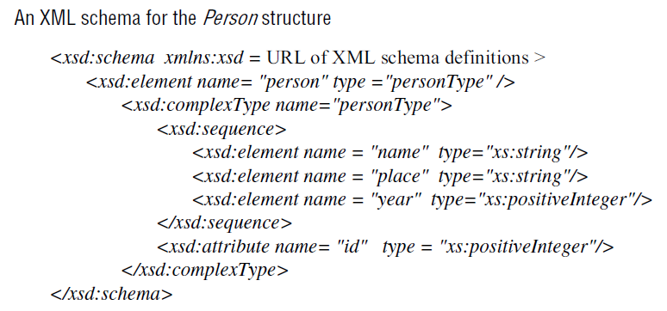

Slide 86
APIs for accessing XML
XML parsers and generators are available for most commonly used programming languages.

