Slide 1
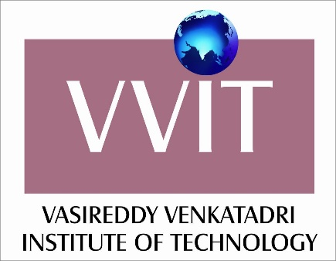
VASIREDDY VENKATADRI INSTITUTE OF TECHNOLOGY (Autonomous) Department of Computer Science and Engineering
IV B.Tech -II Semester
Distributed Systems
Unit-III
Distributed Objects and Remote Invocation

Slide 2
UNIT-III:
Distributed Objects and Remote Invocation:
Introduction
Communication between Distributed Objects Object Model
Distributed Object Modal
Design Issues for RMI
Implementation of RMI
Distributed Garbage Collection
Remote Procedure Call
Events and Notifications
Case Study: JAVA RMI

Slide 3
Introduction
This chapter is concerned with how processes communicate in a distributed system, examining, in particular, the remote invocation paradigms.
Request-reply protocols
Remote procedure call (RPC)
Remote method invocation (RMI)

Slide 4
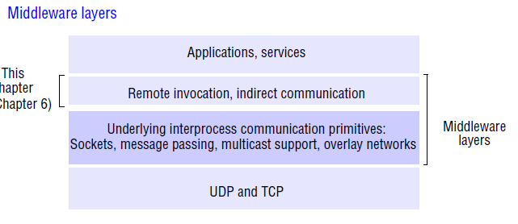

Slide 5
Request-reply protocols
This form of communication is designed to support the roles and message exchanges in typical client-server interactions.
In the normal case, request-reply communication is synchronous because the client process blocks until the reply arrives from the server.
It can also be reliable because the reply from the server is effectively an acknowledgement to the client.
Asynchronous request-reply communication is an alternative that may be useful in situations where clients can afford to retrieve replies later.

Slide 6
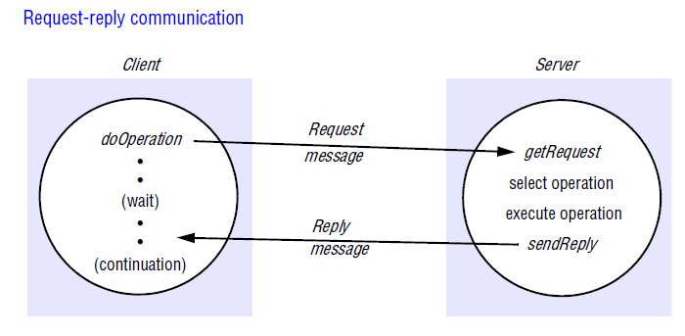

Slide 7
The client-server exchanges are described in the following paragraphs in terms of the send and receive operations in the Java API for UDP datagrams, although many current implementations use TCP streams.
A protocol built over datagrams avoids unnecessary overheads associated with the TCP stream protocol.
Acknowledgements are redundant, since requests are followed by replies.
Establishing a connection involves two extra pairs of messages in addition to the pair required for a request and a reply.
Flow control is redundant for the majority of invocations, which pass only small arguments and results.

Slide 8
The request-reply protocol
The protocol we describe here is based on the communication primitives, doOperation, getRequest and sendReply.
The doOperation method is used by clients to invoke remote operations.
The client calling doOperation marshals the arguments into an array of bytes and unmarshals the results from the array of bytes that is returned.

Slide 9
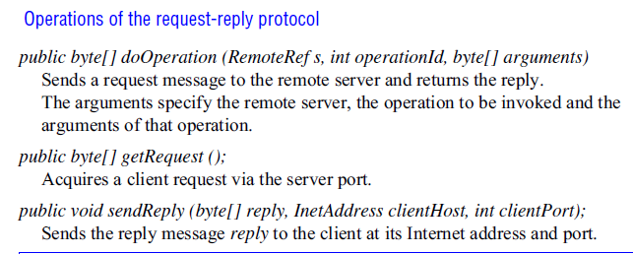

Slide 10
The first argument of doOperation is an instance of the class RemoteRef, which represents references for remote servers. This class provides methods for getting the Internet address and port of the associated server.
The caller of doOperation is blocked until the server performs the requested operation and transmits a reply message to the client process.

Slide 11
getRequest is used by a server process to acquire service requests.
When the server has invoked the specified operation, it then uses sendReply to send the reply message to the client.
When the reply message is received by the client the original doOperation is unblocked and execution of the client program continues.

Slide 12
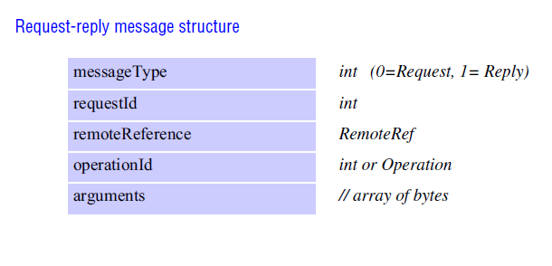

Slide 13
The first field indicates whether the message is a Request or a Reply message.
The second field, requestId, contains a message identifier. A doOperation in the client generates a requestId for each request message, and the server copies these IDs into the corresponding reply messages. This enables doOperation to check that a reply message is the result of the current request, not a delayed earlier call.
The third field is a remote reference.
The fourth field is an identifier for the operation to be invoked.

Slide 14
Styles of exchange protocols
Three protocols, that produce differing behaviours in the presence of communication failures are used for implementing various types of request behaviour.
the request (R) protocol;
the request-reply (RR) protocol;
the request-reply-acknowledge reply (RRA) protocol.

Slide 15
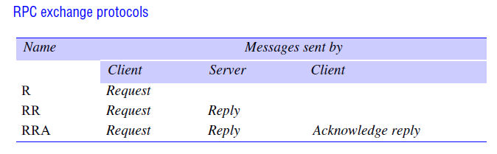

Slide 16
In the R protocol, a single Request message is sent by the client to the server.
The R protocol may be used when there is no value to be returned from the remote operation and the client requires no confirmation that the operation has been executed.
The client may proceed immediately after the request message is sent as there is no need to wait for a reply message.
This protocol is implemented over UDP datagrams and therefore suffers from the same communication failures.

Slide 17
The RR protocol is useful for most client- server exchanges because it is based on the request-reply protocol.
Special acknowledgement messages are not required, because a server’s reply message is regarded as an acknowledgement of the client’s request message.
Similarly, a subsequent call from a client may be regarded as an acknowledgement of a server’s reply message.

Slide 18
The RRA protocol is based on the exchange of three messages: request-reply acknowledge
reply.
The Acknowledge reply message contains the requestId from the reply message being acknowledged.
This will enable the server to discard entries from its history.

Slide 19
Remote procedure call
The concept of a remote procedure call (RPC) represents a major intellectual breakthrough in distributed computing, with the goal of making the programming of distributed systems look similar, to conventional programming – that is, achieving a high level of distribution transparency.

Slide 20
Design issues for RPC
Before looking at the implementation of RPC systems, we look at three issues that are important in understanding this concept:
The style of programming promoted by RPC – programming with interfaces;
The call semantics associated with RPC;
The key issue of transparency and how it relates to remote procedure calls.

Slide 21
Implementation of RPC
The software components required to implement RPC are shown in Figure.
The client that accesses a service includes one stub procedure for each procedure in the service interface.
The stub procedure behaves like a local procedure to the client, but instead of executing the call, it marshals the procedure identifier and the arguments into a request message, which it sends via its communication module to the server.
When the reply message arrives, it unmarshals the results. The server process contains a dispatcher together with one server stub procedure and one service procedure for each procedure in the service interface.
The dispatcher selects one of the server stub procedures according to the procedure identifier in the request message.

Slide 22
The server stub procedure then unmarshals the arguments in the request message, calls the corresponding service procedure and marshals the return values for the reply message.
The service procedures implement the procedures in the service interface.
The client and server stub procedures and the dispatcher can be generated automatically by an interface compiler from the interface definition of the service.

Slide 23
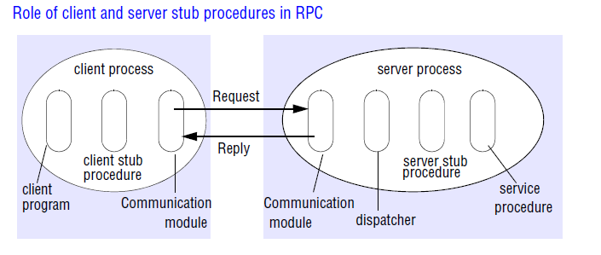

Slide 24
Interfaces in distributed systems: In a distributed program, the modules can run in separate processes.
In the client-server model, in particular, each server provides a set of procedures that are available for use by clients.
It is not possible for a client module running in one process to access the variables in a module in another process. Therefore the service interface cannot specify direct access to variables.

Slide 25
The parameter-passing mechanisms used in local procedure calls – for example, call by value and call by reference, are not suitable when the caller and procedure are in different processes.
In particular, call by reference is not supported. Rather, the specification of a procedure in the interface of a module in a distributed program describes the parameters as input or output.

Slide 26
Interface definition languages:
Interface definition languages (IDLs) are designed to allow procedures implemented in different languages to invoke one another.
An IDL provides a notation for defining interfaces in which each of the parameters of an operation may be described as for input or output in addition to having its type specified.

Slide 27
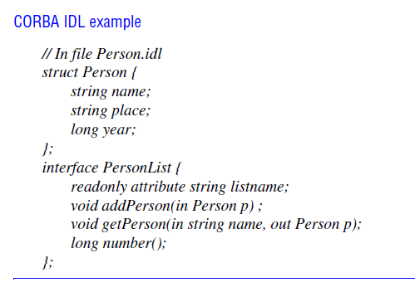

Slide 28
Figure shows a simple example of CORBA IDL.
The Person structure is the same as the one used to illustrate marshalling .
The interface named PersonList specifies the methods available for RMI in a remote object that implements that interface.
For example, the method addPerson specifies its argument as in, meaning that it is an input argument, and the method getPerson that retrieves an instance of Person by name specifies its second argument as out, meaning that it is an output argument.

Slide 29
Remote method invocation
Remote method invocation (RMI) is closely related to RPC but extended into the world of distributed objects. In RMI, a calling object can invoke a method in a potentially remote object.
The commonalities between RMI and RPC are as follows:
They both support programming with interfaces, with the resultant benefits.
They are both typically constructed on top of request-reply protocols and can offer a range of call semantics such as at-least-once and at-most-once.
They both offer a similar level of transparency – that is, local and remote calls employ the same syntax but remote interfaces typically expose the distributed nature of the underlying call.

Slide 30
The following differences lead to added expressiveness when it comes to the programming of complex distributed applications and services.
The programmer is able to use the full expressive power of object-oriented programming in the development of distributed systems software, including the use of objects, classes and inheritance.

Slide 31
Building on the concept of object identity in object-oriented systems, all objects in an RMI-based system have unique object references (whether they are local or remote), such object references can also be passed as parameters, thus offering significantly richer parameter-passing semantics than in RPC.
The remote end, on receiving an object reference, can then access this object using remote method invocation, instead of having to transmit the object value across the network.

Slide 32
Design issues for RMI
The object model
An object-oriented program, consists of a collection of interacting objects, each of which consists of a set of data and a set of methods.
An object communicates with other objects by invoking their methods, generally passing arguments and receiving results.
Objects can encapsulate their data and the code of their methods.
But for use in a distributed object system, an object’s data should be accessible only via its methods.

Slide 33
Interfaces: An interface provides a definition of the signatures of a set of methods (that is, the types of their arguments, return values and exceptions) without specifying their implementation.
In Java, a class may implement several interfaces, and the methods of an interface may be implemented by any class.
An interface also defines types that can be used to declare the type of variables or of the parameters and return values of methods.

Slide 34
Actions : Action in an object-oriented program is initiated by an object invoking a method in another object.
An invocation can include additional information (arguments) needed to carry out the method.
The receiver executes the appropriate method and then returns control to the invoking object, sometimes supplying a result.
As an invocation can lead to further invocations of methods in other objects, an action is a chain of related method invocations, each of which eventually returns.

Slide 35
Exceptions: Programs can encounter many sorts of errors and unexpected conditions of varying seriousness. During the execution of a method, many different problems may be discovered.
Exceptions provide a clean way to deal with error conditions without complicating the code.
In addition, each method heading explicitly lists as exceptions the error conditions it might encounter, allowing users of the method to deal with them.

Slide 36
A block of code may be defined to throw an exception whenever particular unexpected conditions or errors arise.
This means that control passes to another block of code that catches the exception.

Slide 37
Garbage collection: It is necessary to provide a means of freeing the space occupied by objects when they are no longer needed.
A language such as Java, that can detect automatically when an object is no longer accessible recovers the space and makes it available for allocation to other objects. This process is called garbage collection.
When a language (for example, C++) does not support garbage collection, the programmer has to cope with the freeing of space allocated to objects.

Slide 38
Distributed objects
Distributed object systems may adopt the client-server architecture. In this case, objects are managed by servers and their clients invoke their methods using remote method invocation.
In RMI, the client’s request to invoke a method of an object is sent in a message to the server managing the object.

Slide 39
The invocation is carried out by executing a method of the object at the server and the result is returned to the client in another message.
To allow for chains of related invocations, objects in servers are allowed to become clients of objects in other servers.
Having client and server objects in different processes enforces encapsulation.
That is, the state of an object can be accessed only by the methods of the object, which means that it is not possible for unauthorized methods to act on the state.

Slide 40
The possibility of concurrent RMIs from objects in different computers implies that an object may be accessed concurrently.
Therefore the possibility of conflicting accesses arises.
The fact that the data of an object is accessed only by its own methods allows objects to provide methods for protecting themselves against incorrect accesses.
For example, they may use synchronization primitives such as condition variables to protect access to their instance variables.

Slide 41
The distributed object model
The object model to make it applicable to distributed objects. Each process contains a collection of objects, some of which can receive both local and remote invocations, whereas the other objects can receive only local invocations.
Method invocations between objects in different processes, whether in the same computer or not, are known as remote method invocations. Method invocations between objects in the same process are local method invocations.

Slide 42
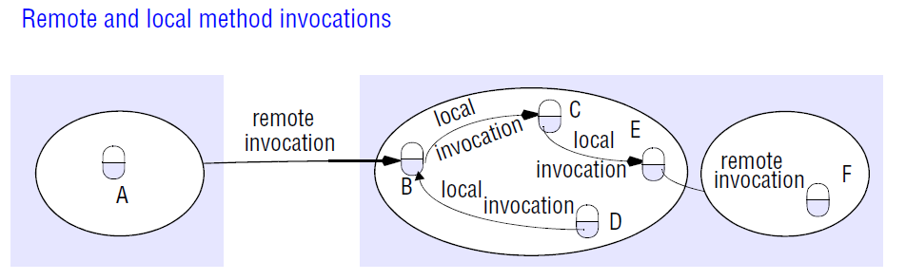

Slide 43
We refer to objects that can receive remote invocations as remote objects. In Figure, the objects B and F are remote objects.
All objects can receive local invocations, although they can receive them only from other objects that hold references to them.
For example, object C must have a reference to object E so that it can invoke one of its methods.

Slide 44
The following two fundamental concepts are at the heart of the distributed object model:
Remote object references: Other objects can invoke the methods of a remote object if they have access to its remote object reference. For example, a remote object reference for B in Figure must be available to A.
Remote interfaces: Every remote object has a remote interface that specifies which of its methods can be invoked remotely. For example, the objects B and F in Figure must have remote interfaces.

Slide 45
Remote object references:
The notion of object reference is extended to allow any object that can receive an RMI to have a remote object reference.
A remote object reference is an identifier that can be used throughout a distributed system to refer to a particular unique remote object.
To construct a remote object reference by concatenating the Internet address of its host computer and the port number of the process that created it with the time of its creation and a local object number.
The local object number is incremented each time an object is created in that process.

Slide 46
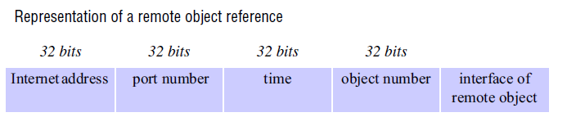

Slide 47
The port number and time together produce a unique process identifier on that computer.
The simplest implementations of RMI, remote objects live only in the process that created them and survive only as long as that process continues to run.
In such cases, the remote object reference can be used as the address of the remote object.
In other words, invocation messages are sent to the Internet address in the remote reference and to the process on that computer using the given port number.

Slide 48
The remote object to receive a remote method invocation is specified by the invoker as a remote object reference.
Remote object references may be passed as arguments and results of remote method invocations.

Slide 49
Remote interfaces:
The class of a remote object implements the methods of its remote interface .
Objects in other processes can invoke only the methods that belong to its remote interface as shown in Figure.
Local objects can invoke the methods in the remote interface as well as other methods implemented by a remote object.
The CORBA system provides an interface definition language (IDL), which is used for defining remote interfaces.

Slide 50
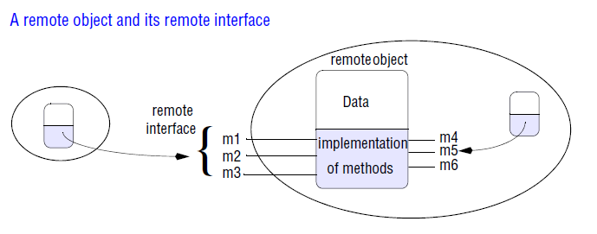

Slide 51
The classes of remote objects and the client programs may be implemented in any language for which an IDL compiler is available, such as C++, Java or Python.
CORBA clients need not use the same language as the remote object in order to invoke its methods remotely.
In Java RMI, remote interfaces are defined in the same way as any other Java interface. They acquire their ability to be remote interfaces by extending an interface named Remote.

Slide 52
Actions in a distributed object system
In the non-distributed case, an action is initiated by a method invocation, which may result in further invocations on methods in other objects.
But in the distributed case, the objects involved in a chain of related invocations may be located in different processes or different computers.

Slide 53
When an invocation crosses the boundary of a process or computer, RMI is used, and the remote reference of the object must be available to the invoker.
In Figure, object A needs to hold a remote object reference to object B.
Remote object references may be obtained as the results of remote method invocations.
For example, object A in Figure might obtain a remote reference to object F from object B.

Slide 55
Distributed applications may provide remote objects with methods for instantiating objects that can be accessed by RMI, thus effectively providing the effect of remote instantiation of objects.
For example, if the object L in Figure contains a method for creating remote objects, then the remote invocations from C and K could lead to the instantiation of the objects M and N, respectively.

Slide 56
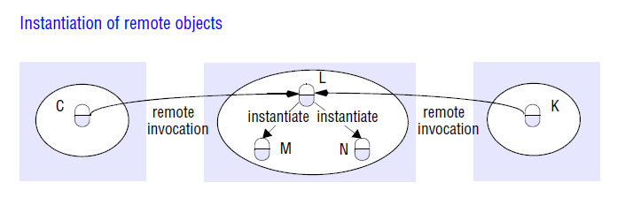

Slide 57
Garbage collection in a distributed-object system:
Distributed garbage collection is generally achieved by cooperation between the existing local garbage collector and an added module that carries out a form of distributed garbage collection, usually based on reference counting.
If garbage collection is not available, then remote objects that are no longer required should be deleted.

Slide 58
Exceptions:
Any remote invocation may fail for reasons related to the invoked object being in a different process or computer from the invoker.
the process containing the remote object may have crashed or may be too busy to reply, or the invocation or result message may be lost.
Therefore, remote method invocation should be able to raise exceptions.

Slide 59
CORBA IDL provides a notation for specifying application-level exceptions, and the underlying system generates standard exceptions when errors due to distribution occur.

Slide 60
Implementation of RMI
Several separate objects and modules are involved in achieving a remote method invocation.
These are shown in Figure , in which an application-level object A invokes a method in a remote application-level object B for which it holds a remote object reference.

Slide 61
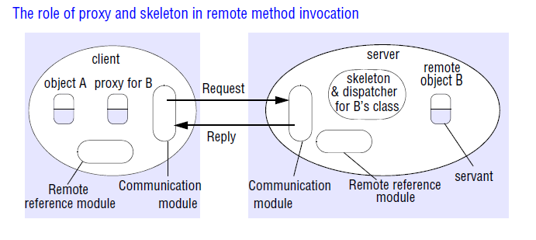

Slide 62
Communication module
The two cooperating communication modules carry out the request-reply protocol, which transmits request and reply messages between the client and server.
The communication module uses only the first three items, which specify the message type, its requestId and the remote reference of the object to be invoked.
The operationId and all the marshalling and unmarshalling are the concern of the RMI software.

Slide 64
The communication module in the server selects the dispatcher for the class of the object to be invoked, passing on its local reference, which it gets from the remote reference module in return for the remote object identifier in the request message.

Slide 65
Remote reference module
A remote reference module is responsible for translating between local and remote object references and for creating remote object references.
To support its responsibilities, the remote reference module in each process has a remote object table that records the correspondence between local object references in that process and remote object references.

Slide 66
The table includes:
An entry for all the remote objects held by the process. For example, in Figure the remote object B will be recorded in the table at the server.
An entry for each local proxy. For example, in Figure the proxy for B will be recorded in the table at the client.

Slide 67
When a remote object is to be passed as an argument or a result for the first time, the remote reference module is asked to create a remote object reference, which it adds to its table.
When a remote object reference arrives in a request or reply message, the remote reference module is asked for the corresponding local object reference, which may refer either to a proxy or to a remote object.
The remote object reference is not in the table, the RMI software creates a new proxy and asks the remote reference module to add it to the table.

Slide 68
Servants
A servant is an instance of a class that provides the body of a remote object.
It is the servant that eventually handles the remote requests passed on by the corresponding skeleton.
Servants live within a server process.
They are created when remote objects are instantiated and remain in use until they are no longer needed, finally being garbage collected or deleted.

Slide 69
The RMI software
This consists of a layer of software between the application-level objects and the communication and remote reference modules.
The roles of the middleware objects shown in Figure are as follows:
Proxy: The role of a proxy is to make remote method invocation transparent to clients by behaving like a local object to the invoker; but instead of executing an invocation, it forwards it in a message to a remote object.

Slide 70
It hides the details of the remote object reference, the marshalling of arguments, unmarshalling of results and sending and receiving of messages from the client.
The class of a proxy implements the methods in the remote interface of the remote object it represents, which ensures that remote method invocations are suitable for the type of the remote object.
Each method of the proxy marshals a reference to the target object, its own operationId and its arguments into a request message and sends it to the target.
It then awaits the reply message, unmarshals it and returns the results to the invoker.

Slide 71
Dispatcher:
A server has one dispatcher and one skeleton for each class representing a remote object.
In our example, the server has a dispatcher and a skeleton for the class of remote object B.
The dispatcher receives request messages from the communication module.
It uses the operationId to select the appropriate method in the skeleton, passing on the request message.
The dispatcher and the proxy use the same allocation of operationIds to the methods of the remote interface.

Slide 72
Skeleton: The class of a remote object has a skeleton, which implements the methods in the remote interface. They are implemented quite differently from the methods in the servant that incarnates a remote object.
A skeleton method unmarshals the arguments in the request message and invokes the corresponding method in the servant.
It waits for the invocation to complete and then marshals the result, together with any exceptions, in a reply message to the sending proxy’s method.

Slide 73
Dynamic invocation: An alternative to proxies
Dynamic invocation gives the client access to a generic representation of a remote invocation like the doOperation method , which is available as part of the infrastructure for RMI .
The client will supply the remote object reference, the name of the method and the arguments to doOperation and then wait to receive the results.

Slide 74
Dynamic skeletons: It is clear that a server will need to host remote objects whose interfaces were not known at compile time.
For example, a client may supply a new type of shape to the shared whiteboard server for it to store.
A server with dynamic skeletons would be able to deal with this situation.

Slide 75
Server and client programs
The server program contains the classes for the dispatchers and skeletons, together with the implementations of the classes of all of the servants that it supports.
In addition, the server program contains an initialization section.
The initialization section is responsible for creating and initializing at least one of the servants to be hosted by the server.

Slide 76
Factory methods:
The term factory method is sometimes used to refer to a method that creates servants, and a factory object is an object with factory methods.
Any remote object that needs to be able to create new remote objects on demand for clients must provide methods in its remote interface for this purpose.
Such methods are called factory methods.

Slide 77
The binder:
A binder in a distributed system is a separate service that maintains a table containing mappings from textual names to remote object references.
It is used by servers to register their remote objects by name and by clients to look them up.

Slide 78
Server threads
Whenever an object executes a remote invocation, that execution may lead to further invocations of methods in other remote objects, which may take some time to return.
To avoid the execution of one remote invocation delaying the execution of another, servers generally allocate a separate thread for the execution of each remote invocation.
When this is the case, the designer of the implementation of a remote object must allow for the effects on its state of concurrent executions.

Slide 79
Distributed garbage collection
The aim of a distributed garbage collector is to ensure that if a local or remote reference to an object is still held anywhere in a set of distributed objects, the object itself will continue to exist, but as soon as no object any longer holds a reference to it, the object will be collected and the memory it uses recovered.

Slide 81
Each server process maintains a set of the names of the processes that hold remote object references for each of its remote objects.
For example, B.holders is the set of client processes (virtual machines) that have proxies for object B. (In Figure this set will include the client process illustrated.)
This set can be held in an additional column in the remote object table.

Slide 82
When a client C first receives a remote reference to a particular remote object, B, it makes an addRef(B) invocation to the server of that remote object and then creates a proxy; the server adds C to B.holders.
When a client C’s garbage collector notices that a proxy for remote object B is no longer reachable, it makes a removeRef(B) invocation to the corresponding server and then deletes the proxy; the server removes C from B.holders.
When B.holders is empty, the server’s local garbage collector will reclaim the space occupied by B unless there are any local holders.

Slide 83
Case study: Java RMI
Java RMI extends the Java object model to provide support for distributed objects in the Java language.
It allows objects to invoke methods on remote objects using the same syntax as for local invocations.
The implementor of a remote object is aware that it is remote because it must implement the Remote interface.

Slide 84
The programming of distributed applications in Java RMI should be relatively simple because it is a single-language system – remote interfaces are defined in the Java language.
If a multiple-language system such as CORBA is used, the programmer needs to learn an IDL and to understand how it maps onto the implementation language.

Slide 85
Remote interfaces in Java RMI
Remote interfaces are defined by extending an interface called Remote provided in the java.rmi package.
The methods must throw RemoteException, but application-specific exceptions may also be thrown.

Slide 86
Java Remote interfaces Shape and ShapeList
import java.rmi.*;
import java.util.Vector;
public interface Shape extends Remote {
int getVersion() throws RemoteException;
GraphicalObject getAllState() throws RemoteException; 1
}
public interface ShapeList extends Remote {
Shape newShape(GraphicalObject g) throws RemoteException; 2
Vector allShapes() throws RemoteException;
int getVersion() throws RemoteException;
}

Slide 87
An example of two remote interfaces called Shape and ShapeList.
In this example, GraphicalObject is a class that holds the state of a graphical object – for example, its type, its position, enclosing rectangle, line colour and fill colour – and provides operations for accessing and updating its state.
Consider the interface Shape first: the getVersion method returns an integer, whereas the getAllState method returns an instance of the class GraphicalObject.

Slide 88
Now consider the interface ShapeList: its newShape method passes an instance of GraphicalObject as its argument but returns an object with a remote interface (that is, a remote object) as its result.
Both ordinary objects and remote objects can appear as arguments and results in a remote interface.

Slide 89
Parameter and result passing
In Java RMI, the parameters of a method are assumed to be input parameters and the result of a method is a single output parameter.
Any object that is serializable – that is, that implements the Serializable interface – can be passed as an argument or result in Java RMI.

Slide 90
Passing remote objects:
When the type of a parameter or result value is defined as a remote interface, the corresponding argument or result is always passed as a remote object reference.
For example, in the code, line 2, the return value of the method newShape is defined as Shape – a remote interface.
When a remote object reference is received, it can be used to make RMI calls on the remote object to which it refers.

Slide 91
Passing non-remote objects:
All serializable non-remote objects are copied and passed by value.
For example, in the code(lines 2 and 1) the argument of newShape and the return value of getAllState are both of type GraphicalObject, which is serializable and is passed by value.
When an object is passed by value, a new object is created in the receiver’s process. The methods of this new object can be invoked locally, possibly causing its state to differ from the state of the original object in the sender’s process.

Slide 92
In our example, the client uses the method newShape to pass an instance of GraphicalObject to the server; the server makes a remote object of type Shape containing the state of the GraphicalObject and returns a remote object reference to it.

Slide 93
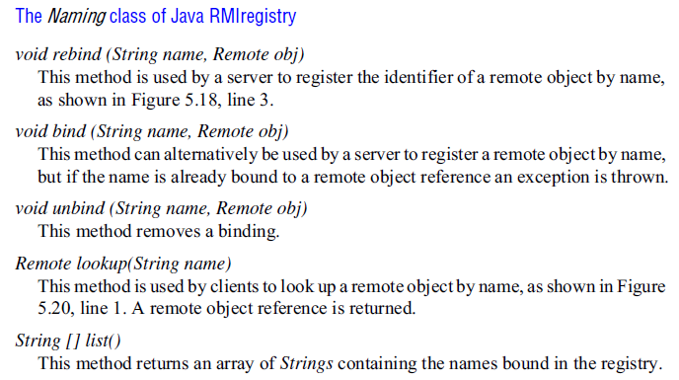

Slide 94
The arguments and return values in a remote invocation are serialized to a stream using the method described, with the following modifications:
1. Whenever an object that implements the Remote interface is serialized, it is replaced by its remote object reference, which contains the name of its (the remote object’s) class.
2. When any object is serialized, its class information is annotated with the location of the class (as a URL), enabling the class to be downloaded by the receiver.

Slide 95
Downloading of classes
Java is designed to allow classes to be downloaded from one virtual machine to another. This is particularly relevant to distributed objects that communicate by means of remote invocation.
We have seen that non-remote objects are passed by value and remote objects are passed by reference as arguments and results of RMIs.

Slide 96
If the recipient does not already possess the class of an object passed by value, its code is downloaded automatically.
Similarly, if the recipient of a remote object reference does not already possess the class for a proxy, its code is downloaded automatically.
This has two advantages:
1. There is no need for every user to keep the same set of classes in their working environment.
2. Both client and server programs can make transparent use of instances of new classes whenever they are added.

Slide 97
consider the whiteboard program and suppose that its initial implementation of GraphicalObject does not allow for text.
A client with a textual object can implement a subclass of GraphicalObject that deals with text and pass an instance to the server as an argument of the newShape method.
After that, other clients may retrieve the instance using the getAllState method.
The code of the new class will be downloaded automatically from the first client to the server and then to other clients as needed.

Slide 98
RMIregistry
The RMIregistry is the binder for Java RMI.
An instance of RMIregistry should normally run on every server computer that hosts remote objects.
It maintains a table mapping textual, URL-style names to references to remote objects hosted on that computer.
//computerName:port/objectName

Slide 99
It is necessary to run an instance of the RMIregistry in the networked environment and then use the class LocateRegistry, which is in java.rmi.registry, to discover this registry.
More specifically, this class contains a getRegistry method that returns an object of type Registry representing the remote binding service:
public static Registry getRegistry() throws RemoteException
Following this, it is then necessary to issue a call of rebind on this returned Registry object to establish a connection with the remote RMIregistry.

Slide 100
Building client and server programs
To produce client and server programs that use the Remote interfaces Shape and ShapeList.
Server program
The server is a whiteboard server: it represents each shape as a remote object instantiated by a servant that implements the Shape interface and holds the state of a graphical object as well as its version number; it represents its collection of shapes by using another servant that implements the ShapeList interface and holds a collection of shapes in a Vector.

Slide 101
The server program consists of a main method and a servant class to implement each of its remote interfaces.
The main method of the server class is shown in Figure, with the key steps contained in the lines marked 1 to 4:
In line 1, the server creates an instance of ShapeListServant.
Lines 2 and 3 use the method exportObject (defined on UnicastRemoteObject) to make this object available to the RMI runtime, thereby making it available to receive incoming invocations.
The second parameter of exportObject specifies the TCP port to be used for incoming invocations.
Finally, line 4 binds the remote object to a name in the RMIregistry. Note that the value bound to the name is a remote object reference, and its type is the type of its remote interface – ShapeList.

Slide 102
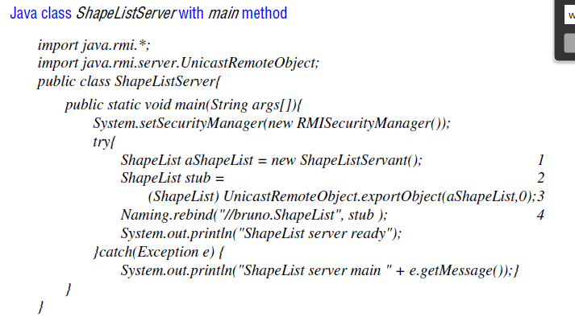

Slide 103
The main method of a server needs to create a security manager to enable Java security to apply the protection appropriate for an RMI server.
A default security manager called RMISecurityManager is provided.

Slide 104
Consider the method newShape in Figure (line 1), which could be called a factory method because it allows the client to request the creation of a servant.
It uses the constructor of ShapeServant, which creates a new servant containing the GraphicalObject and version number passed as arguments.
The type of the return value of newShape is Shape – the interface implemented by the new servant. Before returning, the method newShape adds the new shape to its vector that contains the list of shapes (line 2).

Slide 105
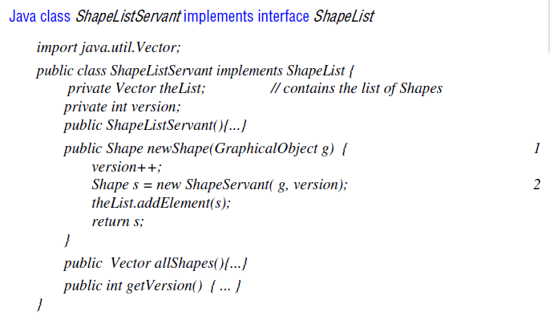

Slide 106
Client program
Any client program needs to get started by using a binder to look up a remote object reference.
Our client sets a security manager and then looks up a remote object reference for the remote object using the lookup operation of the RMIregistry (line 1).
In our example, the client invokes the method allShapes in the remote object (line 2) and receives a vector of remote object references to all of the shapes currently stored in the server.

Slide 107
Each time the user finishes drawing a graphical object, it will invoke the method newShape in the server, passing the new graphical object as its argument.
The client will keep a record of the latest version number at the server, and from time to time it will invoke getVersion at the server to find out whether any new shapes have been added by other users.

Slide 108
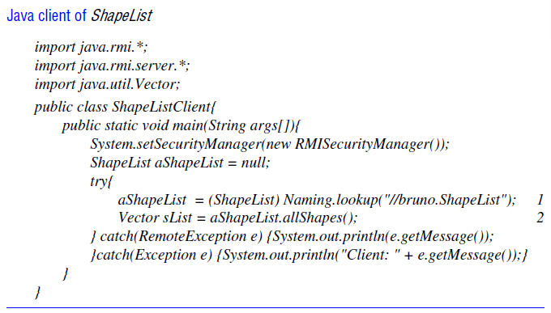

Slide 109
Callbacks
The general idea behind callbacks is that instead of clients polling the server to find out whether some event has occurred, the server should inform its clients whenever that event occurs.
The term callback is used to refer to a server’s action of notifying clients about an event. Callbacks can be implemented in RMI as follows:

Slide 110
We illustrate the use of callbacks in the context of the whiteboard application.
The WhiteboardCallback interface could be defined as follows:
public interface WhiteboardCallback implements Remote {
void callback(int version) throws RemoteException;
};
This interface is implemented as a remote object by the client, enabling the server to send the client a version number whenever a new object is added.
But before the server can do this, the client needs to inform the server about its callback object.
To make this possible, the ShapeList interface requires additional methods such as register and deregister, defined as follows:
int register(WhiteboardCallback callback) throws RemoteException;
void deregister(int callbackId) throws RemoteException;

Slide 111
The register method returns an integer (the callbackId) referring to the registration.
When the client is finished it should call deregister to inform the server it no longer requires callbacks.
The server is responsible for keeping a list of interested clients and notifying all of them each time its version number increases.

