Slide 1
11
JavaScript: Objects

Slide 2
My object all sublime
I shall achieve in time.
  —W. S. Gilbert
Is it a world to hide virtues in?
  —William Shakespeare
Good as it is to inherit a library, it is better to collect one.
  —Augustine Birrell
A philosopher of imposing stature doesn’t think in a vacuum. Even his most abstract ideas are, to some extent, conditioned by what is or is not known in the time when he lives.
  —Alfred North Whitehead

Slide 3
OBJECTIVES
In this chapter you will learn:
Object-based programming terminology and concepts.
The concepts of encapsulation and data hiding.
The value of object orientation.
To use the JavaScript objects Math, String, Date, Boolean and Number.
To use the browser’s document and window objects.
To use cookies.
To represent objects simply using JSON.

Slide 4
11.1 Introduction
11.2 Introduction to Object Technology
11.3 Math Object
11.4 String Object
11.5 Date Object
11.6 Boolean and Number Objects
11.7 document Object
11.8 window Object
11.9 Using Cookies
11.10 Final JavaScript Example
11.11 Using JSON to Represent Objects
11.12 Wrap-Up
11.13 Web Resources

Slide 5
11.1 Introduction
This chapter describes several of JavaScript’s built-in objects, which will serve as a basis for understanding browser objects in the chapters on Dynamic HTML

Slide 6
11.2 Introduction to Object Technology
Objects are a natural way of thinking about the world and about scripts that manipulate XHTML documents
JavaScript uses objects to perform many tasks
  It is referred to as an object-based programming language
Objects have attributes and exhibit behaviors

Slide 7
11.2 Introduction to Object Technology (Cont.)
Object-oriented design (OOD)
  Models software in terms similar to those that people use to describe real-world objects
  It takes advantage of class relationships, where objects of a certain class, such as a class of vehicles, have the same characteristics
  It takes advantage of inheritance relationships, where new classes of objects are derived by absorbing characteristics of existing classes and adding unique characteristics of their own
  Provides a natural and intuitive way to view the software design
  Models communication between objects
  Encapsulates attributes and operations (behaviors) into objects

Slide 8
11.2 Introduction to Object Technology (Cont.)
Objects have the property of information hiding
  Objects may know how to communicate with one another across well-defined interfaces, but normally they are not allowed to know how other objects are implemented
Web browsers
  Contain a set of objects that encapsulate an XHTML document’s elements
  The objects expose to a JavaScript programmer the attributes and behaviors that enable a JavaScript program to interact with (or script) those elements (objects)

Slide 9
11.2 Introduction to Object Technology (Cont.)
Procedural languages
  C
  Programming tends to be action oriented
  Unit of programming is the function
Object-oriented programming languages
  Java, Visual Basic, C# and C
  Programming in such a language is called object-oriented programming (OOP), and it allows computer programmers to implement object-oriented designs as working software systems
  unit of programming is the class from which objects are eventually instantiated
  Classes contain functions that implement operations and data that implements attributeS
Procedural programmers concentrate on writing functions. Programmers group actions that perform some common task into functions, and group functions to form programs
Object-oriented programmers concentrate on creating their own user-defined types called classes. Each class contains data as well as the set of functions that manipulate that data and provide services to clients

Slide 10
11.2 Introduction to Object Technology (Cont.)
Data components of a class are called properties
Function components of a class are called methods.
Nouns in a system specification help you determine the set of classes from which objects are created that work together to implement the system
Classes are to objects as blueprints are to houses
Classes can have relationships with other classes called associations
Packaging software as classes makes it possible for future software systems to reuse the classes
Groups of related classes are often packaged as reusable components
With object technology, you can build much of the new software you’ll need by combining existing classes

Slide 11
11.3 Math Object
Math object methods allow you to perform many common mathematical calculations.
An object’s methods are called by writing the name of the object followed by a dot operator (.) and the name of the method
In parentheses following the method name is the argument (or a comma-separated list of arguments) to the method

Slide 12
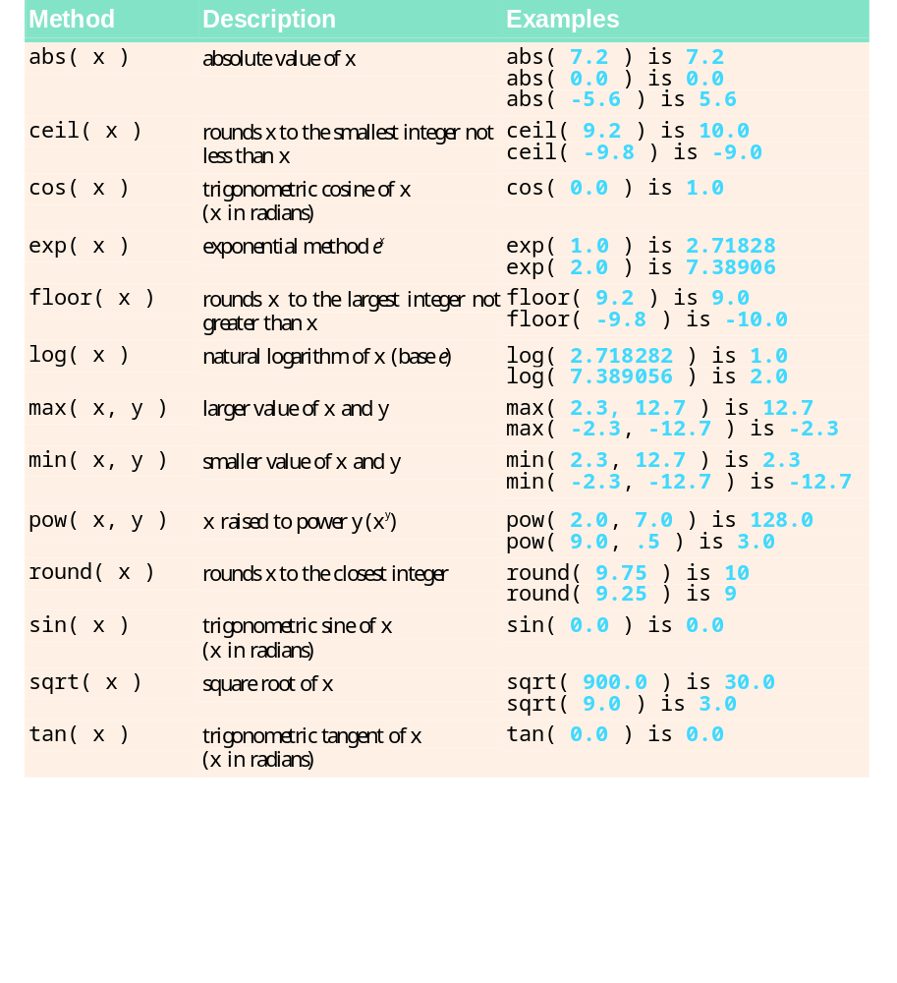
Fig. 11.1 | Math object methods.

Slide 13
Common Programming Error 11.1
Forgetting to invoke a Math method by preceding the method name with the object name Math and a dot (.) is an error.

Slide 14
Software Engineering Observation 11.1
The primary difference between invoking a standalone function and invoking a method of an object is that an object name and a dot are not required to call a standalone function.

Slide 15
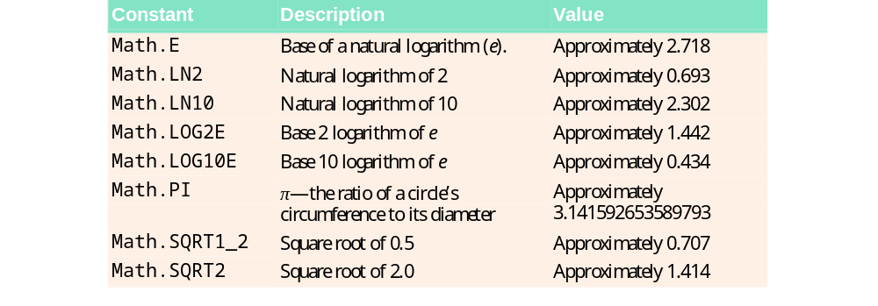
Fig. 11.2 | Properties of the Math object.

Slide 16
Good Programming Practice 11.1
Use the mathematical constants of the Math object rather than explicitly typing the numeric value of the constant.

Slide 17
11.4 String Object
Characters are the fundamental building blocks of JavaScript programs
Every program is composed of a sequence of characters grouped together meaningfully that is interpreted by the computer as a series of instructions used to accomplish a task
A string is a series of characters treated as a single unit
A string may include letters, digits and various special characters, such as +, -, *, /, and $
JavaScript supports Unicode, which represents a large portion of the world’s languages
String literals or string constants (often called anonymous String objects) are written as a sequence of characters in double quotation marks or single quotation marks

Slide 18
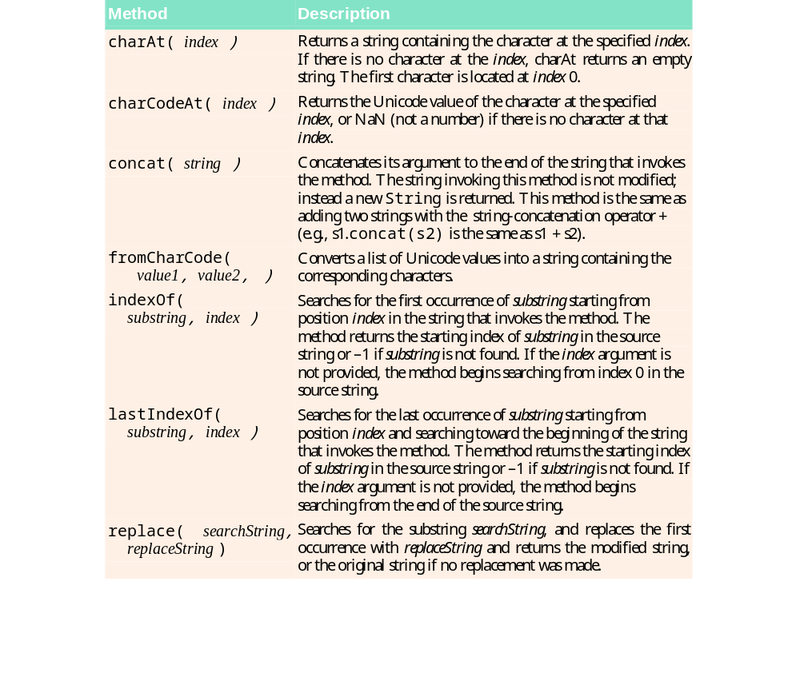
Fig. 11.3 | Some String object methods (Part 1 of 2).

Slide 19
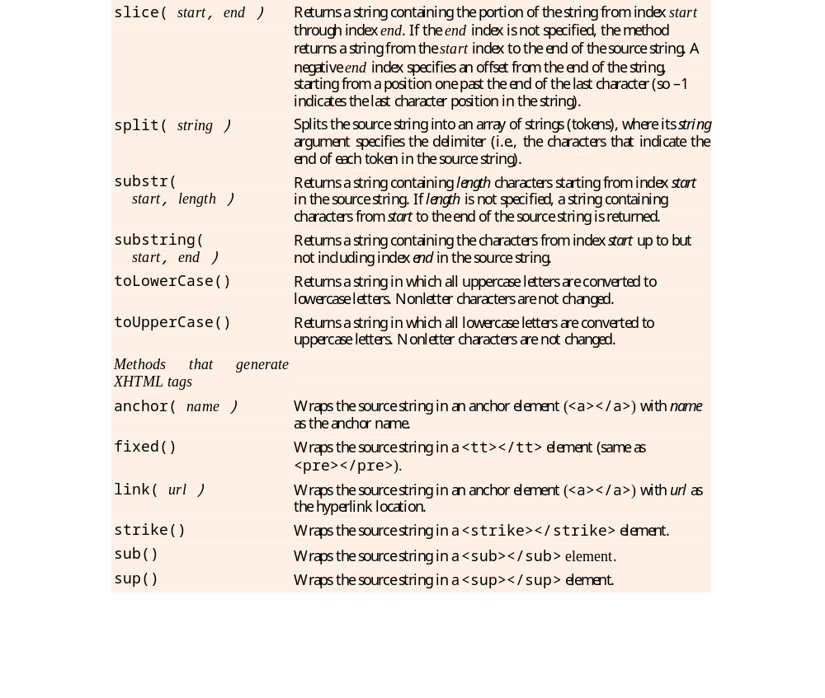
Fig. 11.3 | Some String object methods (Part 2 of 2).

Slide 20
11.4 String Object (Cont.)
Combining strings is called concatenation
String method charAt
  Returns the character at a specific index in a string
  Indices for the characters in a string start at 0 (the first character) and go up to (but do not include) the string’s length
  If the index is outside the bounds of the string, the method returns an empty string
String method charCodeAt
  Returns the Unicode value of the character at a specific index in a string
  If the index is outside the bounds of the string, the method returns NaN.
String method fromCharCode
  creates a string from a list of Unicode values
String method toLowerCase
  Returns the lowercase version of a string
String method toUpperCase
  Returns the uppercase version of a string

Slide 21
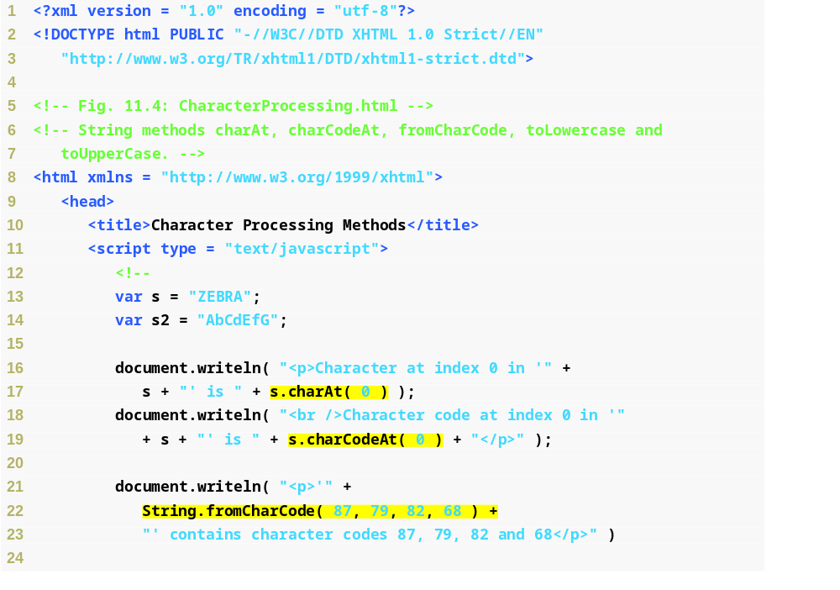
Fig. 11.4 |
String methods charAt, charCodeAt, fromCharCode, toLowercase and toUpperCase (Part 1 of 2).
Returns the character at index 0 of string s
Returns the Unicode value of the character at index 0 of string s
Creates a string from the characters with the Unicode values 87, 79, 82 and 68

Slide 22
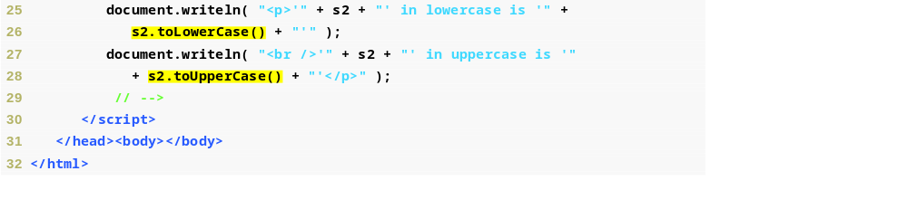
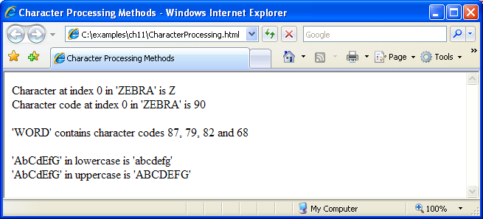
Fig. 11.4 | String methods charAt, charCodeAt, fromCharCode, toLowercase and toUpperCase (Part 2 of 2).
Converts s2 to lowercase
Converts s2 to uppercase

Slide 23
11.4 String Object (Cont.)
String method indexOf
  Determines the location of the first occurrence of its argument in the string used to call the method
  If the substring is found, the index at which the first occurrence of the substring begins is returned; otherwise, -1 is returned
  Receives an optional second argument specifying the index from which to begin the search
String method lastIndexOf
  Determines the location of the last occurrence of its argument in the string used to call the method
  If the substring is found, the index at which the last occurrence of the substring begins is returned; otherwise, -1 is returned
  Receives an optional second argument specifying the index from which to begin the search

Slide 24
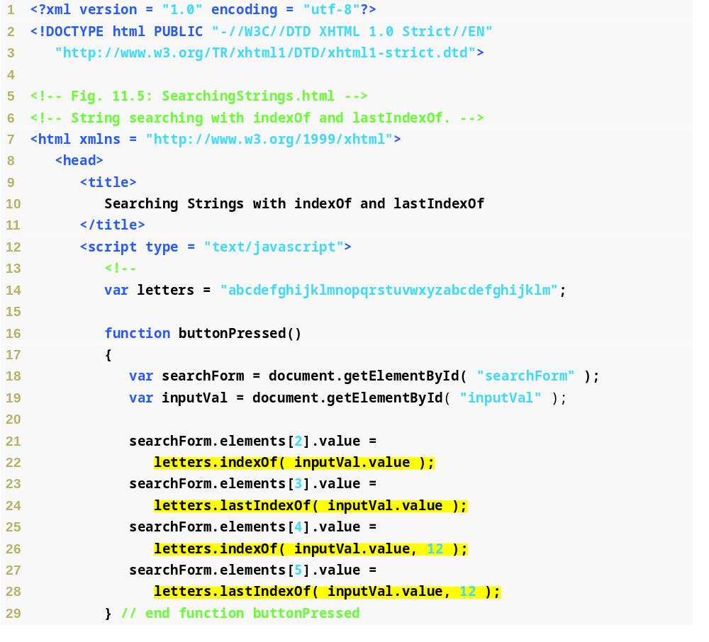
Fig. 11.5 | String searching with indexOf and lastIndexOf (Part 1 of 3).
Searches letters for the first occurrence of the text in inputVal, and returns its index
Searches letters for the last occurrence of the text in inputVal, and returns its index
Searches letters for the first occurrence of the text in inputVal starting from position 12, and returns its index
Searches letters for the last occurrence of the text in inputVal from the beginning of the string until position 12, and returns its index

Slide 25
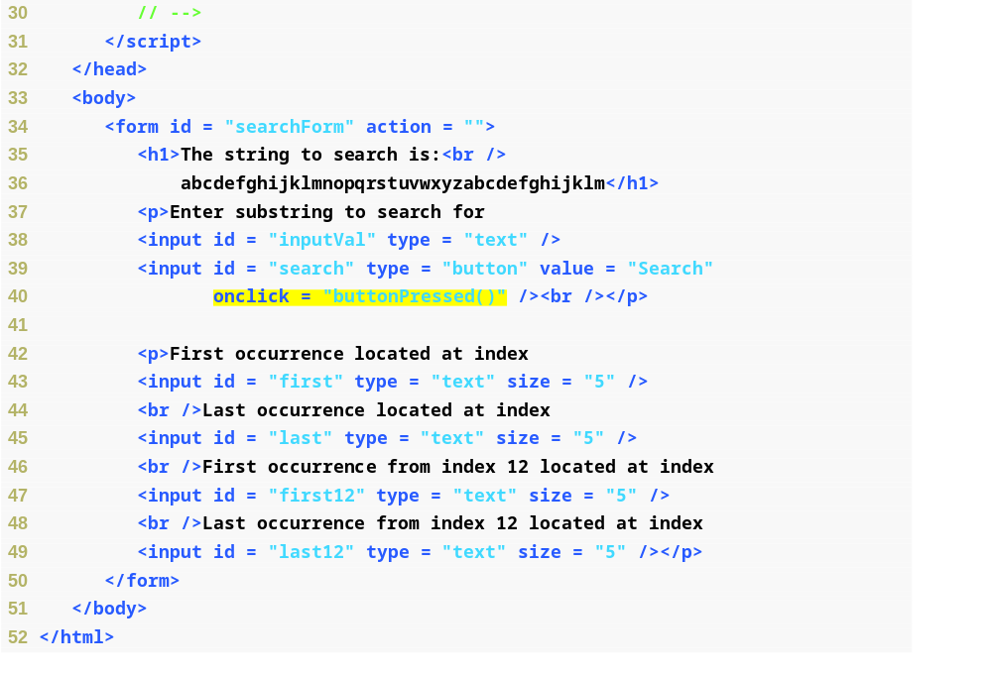
Fig. 11.5 | String searching with indexOf and lastIndexOf (Part 2 of 3).
When the Search button is clicked, execute function buttonPressed

Slide 26
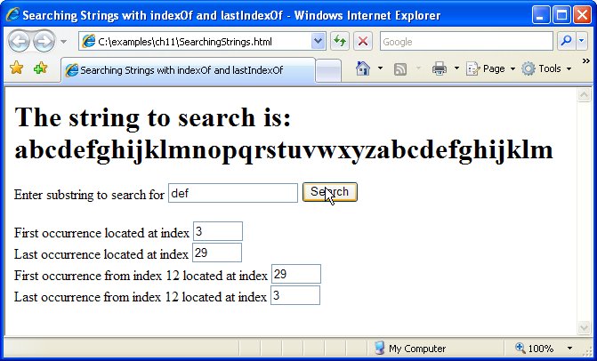

Fig. 11.5 | String searching with indexOf and lastIndexOf (Part 3 of 3).

Slide 27
Software Engineering Observation 11.2
String methods indexOf and lastIndexOf, with their optional second argument (the starting index from which to search), are particularly useful for continuing a search through a large amount of text.

Slide 28
11.4 String Object (Cont.)
Breaking a string into tokens is called tokenization
Tokens are separated from one another by delimiters, typically white-space characters such as blank, tab, newline and carriage return
  Other characters may also be used as delimiters to separate tokens
String method split
  Breaks a string into its component tokens
  Argument is the delimiter string
  Returns an array of strings containing the tokens
String method substring
  Returns the substring from the starting index (its first argument) up to but not including the ending index (its second argument)
  If the ending index is greater than the length of the string, the substring returned includes the characters from the starting index to the end of the original string

Slide 29
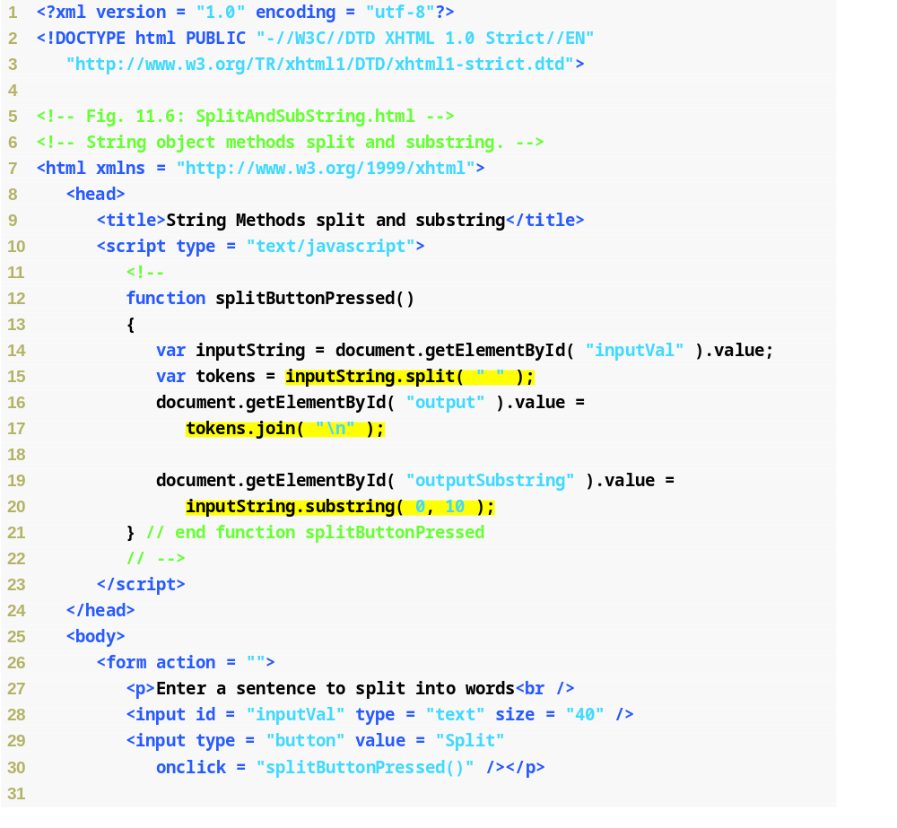
Fig. 11.6 | String object methods split and substring (Part 1 of 2).
Splits inputString into new strings at each space and stores them in array tokens
Creates a string from the elements in tokens, inserting a newline character between each element
Inserts the first 10 characters of inputString into the outputSubstring text field

Slide 30
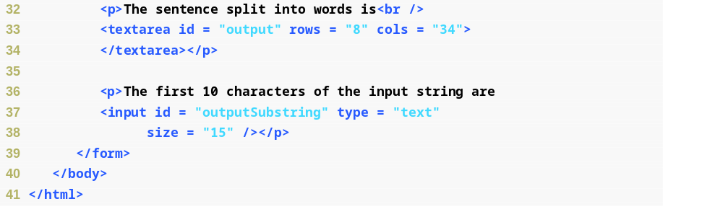
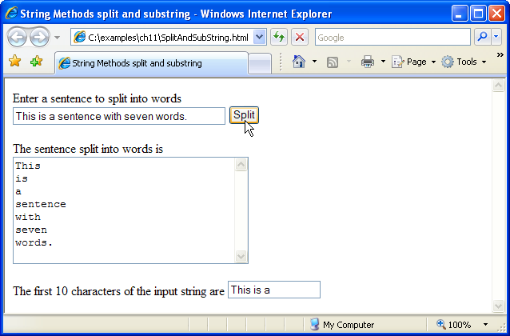
Fig. 11.6 | String object methods split and substring (Part 2 of 2).

Slide 31
11.4 String Object (Cont.)
String method anchor
  Wraps the string that calls the method in XHTML element <a></a> with the name of the anchor supplied as the argument to the method
String method fixed
  Displays text in a fixed-width font by wrapping the string that calls the method in a <tt></tt> XHTML element
String method strike
  Displays struck-out text (i.e., text with a line through it) by wrapping the string that calls the method in a <strike></strike> XHTML element
String method sub
  Displays subscript text by wrapping the string that calls the method in a <sub></sub> XHTML element
String method sup
  Displays superscript text by wrapping the string that calls the method in a <sup></sup> XHTML element
String method link
  Creates a hyperlink by wrapping the string that calls the method in XHTML element <a></a>. The target of the hyperlink (i.e, value of the href property) is the argument to the method and can be any URL

Slide 32
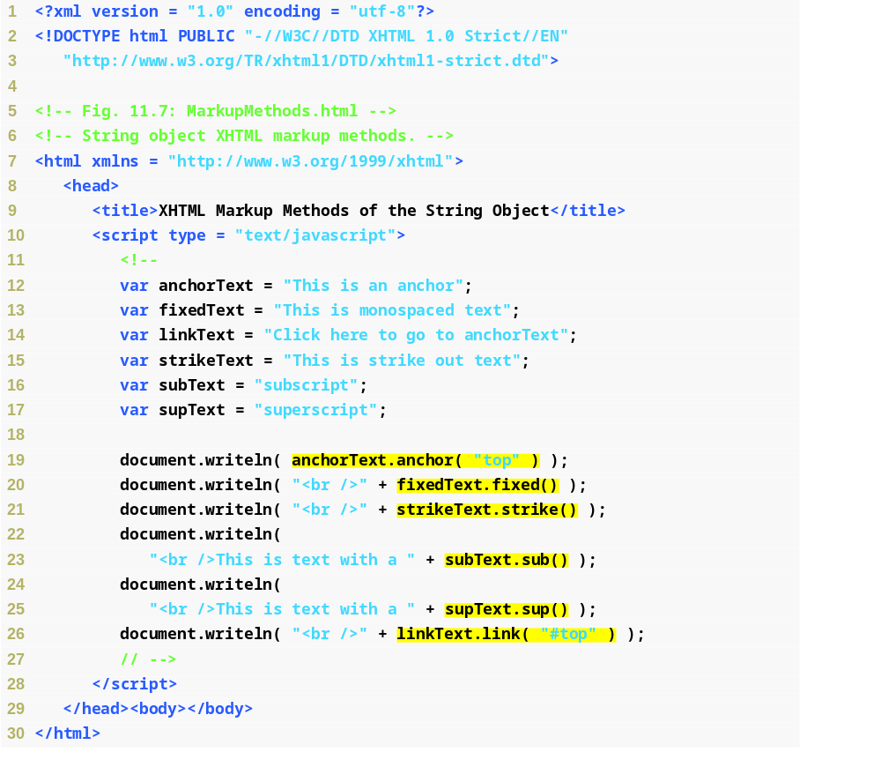
Fig. 11.7 | String object XHTML markup methods (Part 1 of 2).
Puts anchor element tags around the text in anchorText with a name attribute of “top”
Puts text in a fixed-width font by wrapping it in <tt> and </tt> tags
Puts a line through text by wrapping it in <strike> and </strike> tags
Puts text in a subscript font by wrapping it in <sub> and </sub> tags
Puts text in a superscript font by wrapping it in <sup> and </sup> tags
Creates a link to anchorText by putting anchor tags around the text in linkText with an href element of #top

Slide 33
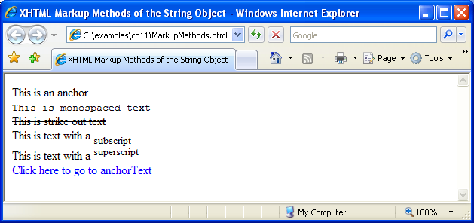
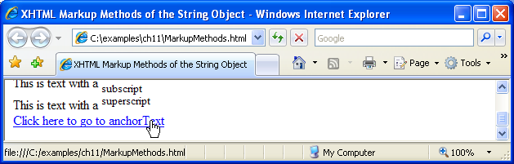
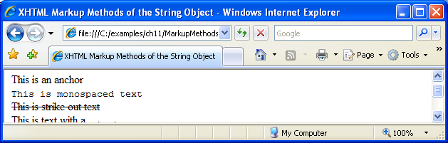
Fig. 11.7 | String object XHTML markup methods (Part 2 of 2).

Slide 34
11.5 Date Object
Date object provides methods for date and time manipulations
  Based either on the computer’s local time zone or on World Time Standard’s Coordinated Universal Time (abbreviated UTC)
Most methods have a local time zone and a UTC version
Empty parentheses after an object name indicate a call to the object’s constructor with no arguments
  A constructor is an initializer method for an object
  Called automatically when an object is allocated with new
  The Date constructor with no arguments initializes the Date object with the local computer’s current date and time
  A new Date object can be initialized by passing the number of milliseconds since midnight, January 1, 1970, to the Date constructor
  Can also create a new Date object by supplying arguments to the Date constructor for year, month, date, hours, minutes, seconds and milliseconds.
    Hours, minutes, seconds and milliseconds arguments are all optional
    If any one of these arguments is not specified, a zero is supplied in its place
    If an argument is specified, all arguments to its left must be specified

Slide 35
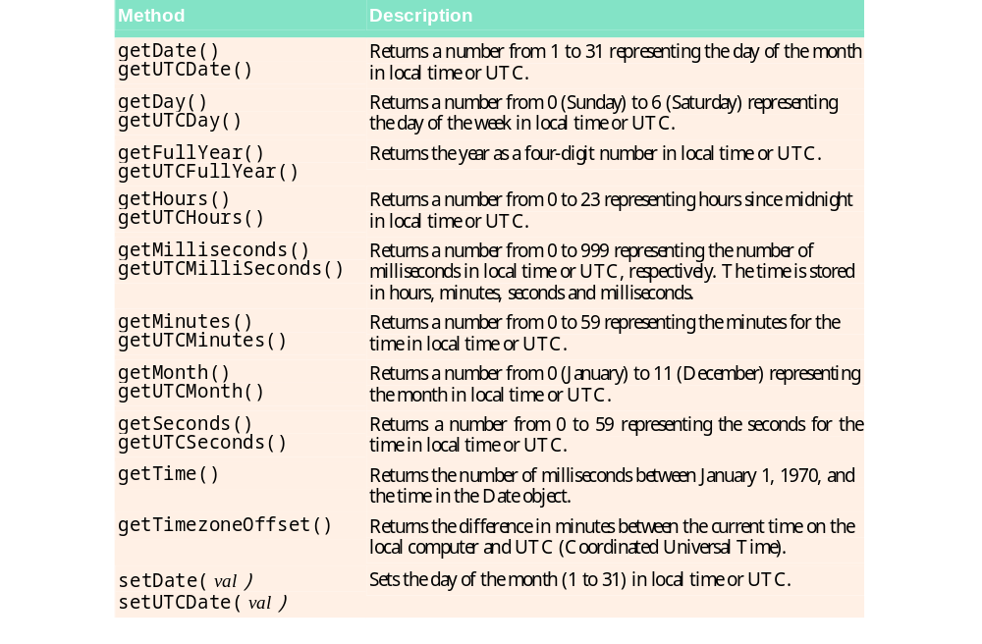
Fig. 11.8 | Date object methods (Part 1 of 2).

Slide 36
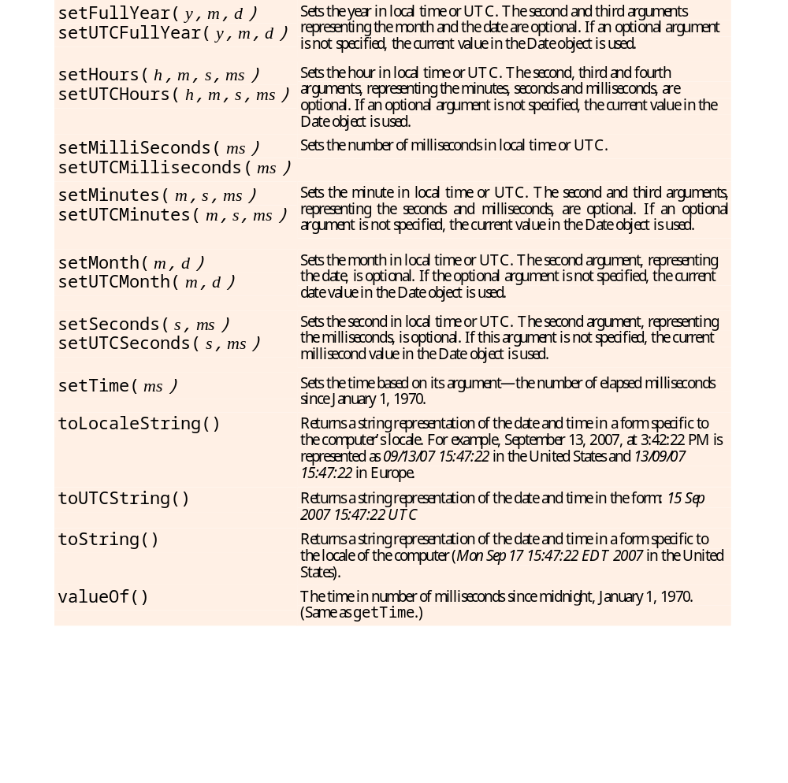
Fig. 11.8 | Date object methods (Part 2 of 2).

Slide 37
Software Engineering Observation 11.3
When an object is allocated with new, the object’s constructor is called automatically to initialize the object before it is used in the program.

Slide 38
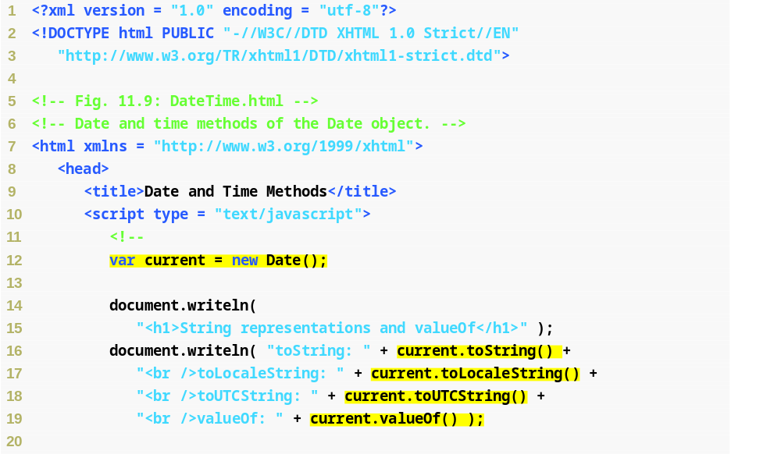
Fig. 11.9 | Date and time methods of the Date object (Part 1 of 3).
Initializes current as a new Date object with the local computer’s time and date
Converts current to a string representation of the date
Converts current to the locale’s string representation of the date
Converts current to a string representation of the UTC time
Calculates the number of milliseconds since midnight, January 1, 1970

Slide 39
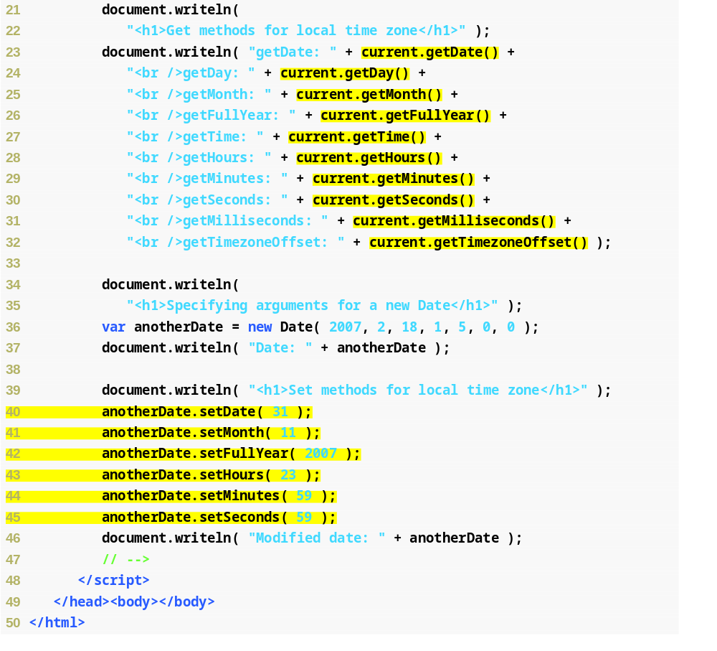
Fig. 11.9 | Date and time methods of the Date object (Part 2 of 3).
Returns the date, day, month, year, milliseconds since 1/1/1970, hours, minutes, seconds, milliseconds, and UCT time zone offset in minutes of the current Date object
Creates a new Date object by passing the year, month, date, hours, minutes, seconds and milliseconds to the Date constructor
Sets the date, month, year, hours, minutes, and seconds of a new Date object

Slide 40
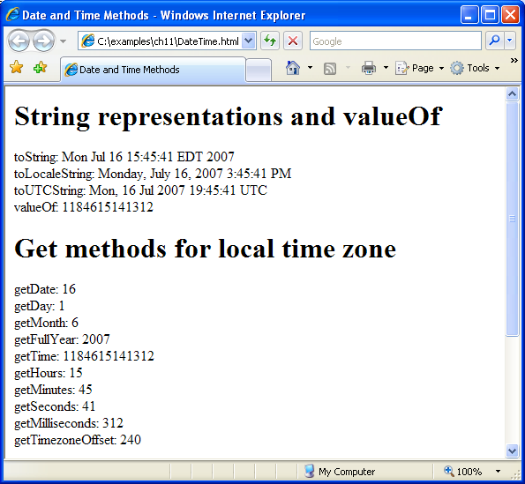
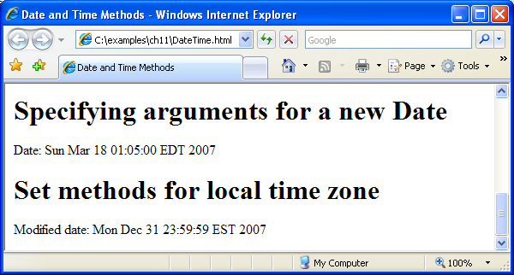
Fig. 11.9 | Date and time methods of the Date object (Part 3 of 3).

Slide 41
Common Programming Error 11.2
Assuming that months are represented as numbers from 1 to 12 leads to off-by-one errors when you are processing Dates.

Slide 42
11.5 Date Object (Cont.)
Date method parse
  Receives as its argument a string representing a date and time and returns the number of milliseconds between midnight, January 1, 1970, and the specified date and time
Date method UTC
  Returns the number of milliseconds between midnight, January 1, 1970, and the date and time specified as its arguments
  Arguments include the required year, month and date, and the optional hours, minutes, seconds and milliseconds
  If any of the hours, minutes, seconds or milliseconds arguments is not specified, a zero is supplied in its place
  For the hours, minutes and seconds arguments, if the argument to the right of any of these arguments is specified, that argument must also be specified

Slide 43
11.6 Boolean and Number Objects
The Boolean and Number objects are object wrappers for boolean true/false values and numbers, respectively
When a boolean value is required in a JavaScript program, JavaScript automatically creates a Boolean object to store the value
JavaScript programmers can create Boolean objects explicitly
var b = new Boolean( booleanValue );
booleanValue specifies the value of the Boolean object (true or false).
  If booleanValue is false, 0, null, Number.NaN or the empty string (""), or if no argument is supplied, the new Boolean object contains false
  Otherwise, the new Boolean object contains true

Slide 44
11.6 Boolean and Number Objects (Cont.)
JavaScript automatically creates Number objects to store numeric values in a JavaScript program
Can create a Number object with the statement
var n = new Number( numericValue );
numericValue is the number to store in the object
Although you can explicitly create Number objects, normally they are created when needed by the JavaScript interpreter

Slide 45
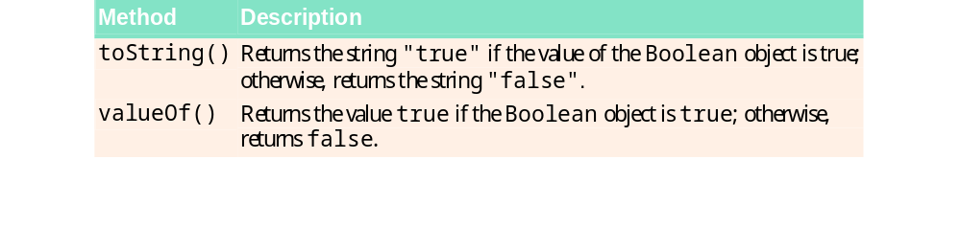
Fig. 11.10 | Boolean object methods.

Slide 46
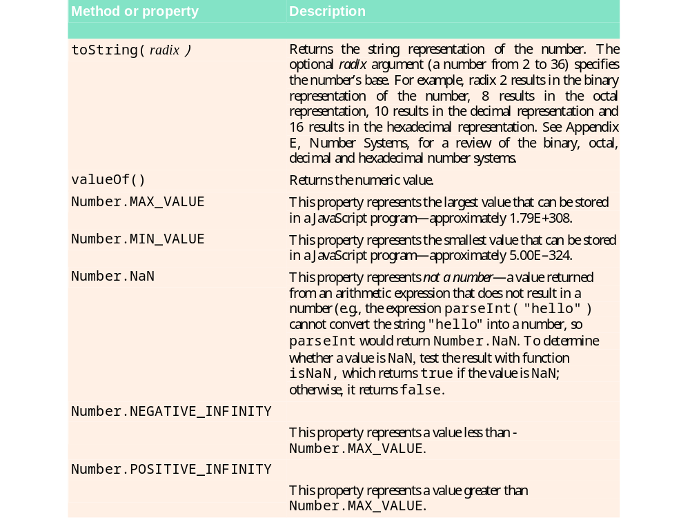
Fig. 11.11 | Number object methods and properties.

Slide 47
11.7 document Object
document object
  For manipulating the document that is currently visible in the browser window

Slide 48
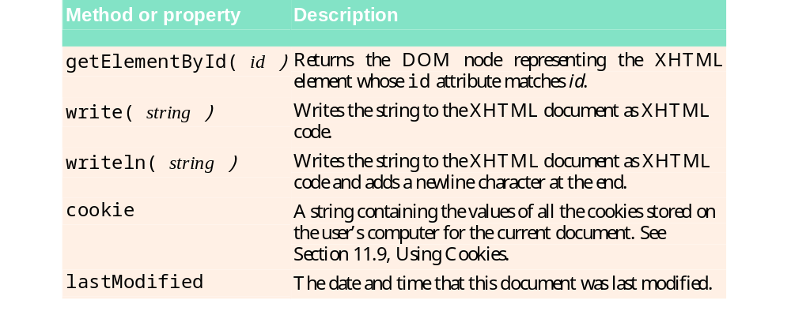
Fig. 11.12 | Important document object methods and properties.

Slide 49
11.8 window Object
window object provides methods for manipulating browser windows
window object open method
  Creates a window
  Three parameters—the URL of the page to open in the new window, the name of the window, a string of comma-separated, all-lowercase feature names, each followed by an = sign and either "yes" or "no" to determine whether that feature should be displayed in the new window
  If these parameters are omitted, the browser defaults to a new window containing an empty page, no title and all features visible.

Slide 50
11.8 window Object (Cont.)
window object closed property
  Contains a boolean value that is true if the window is closed and false if the window is open
close method
  Closes the current window and deletes its object from memory
location property
  contains a string representation of the URL displayed in the current window

Slide 51
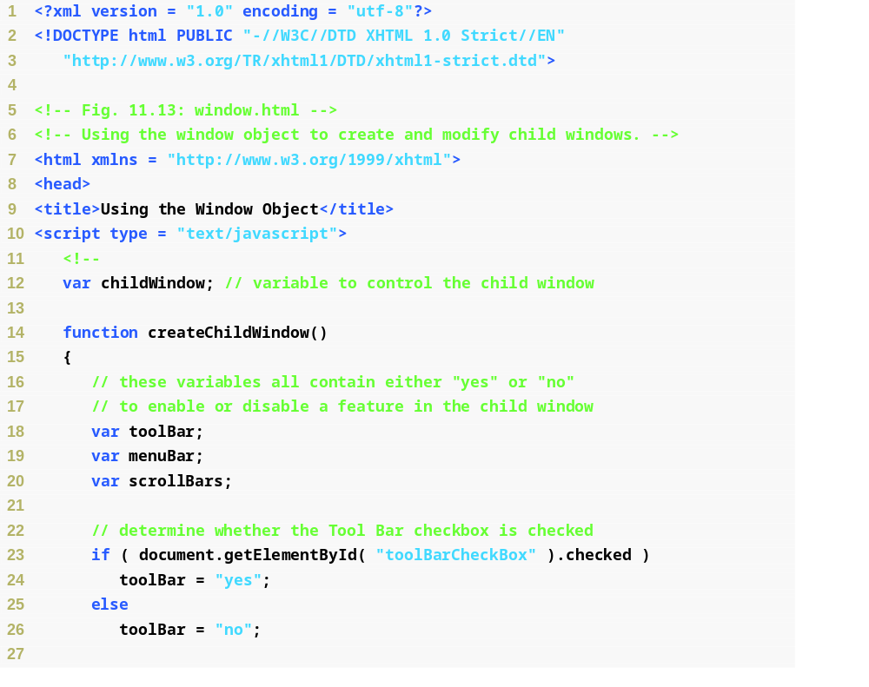
Fig. 11.13 | Using the window object to create and modify child windows (Part 1 of 6).

Slide 52
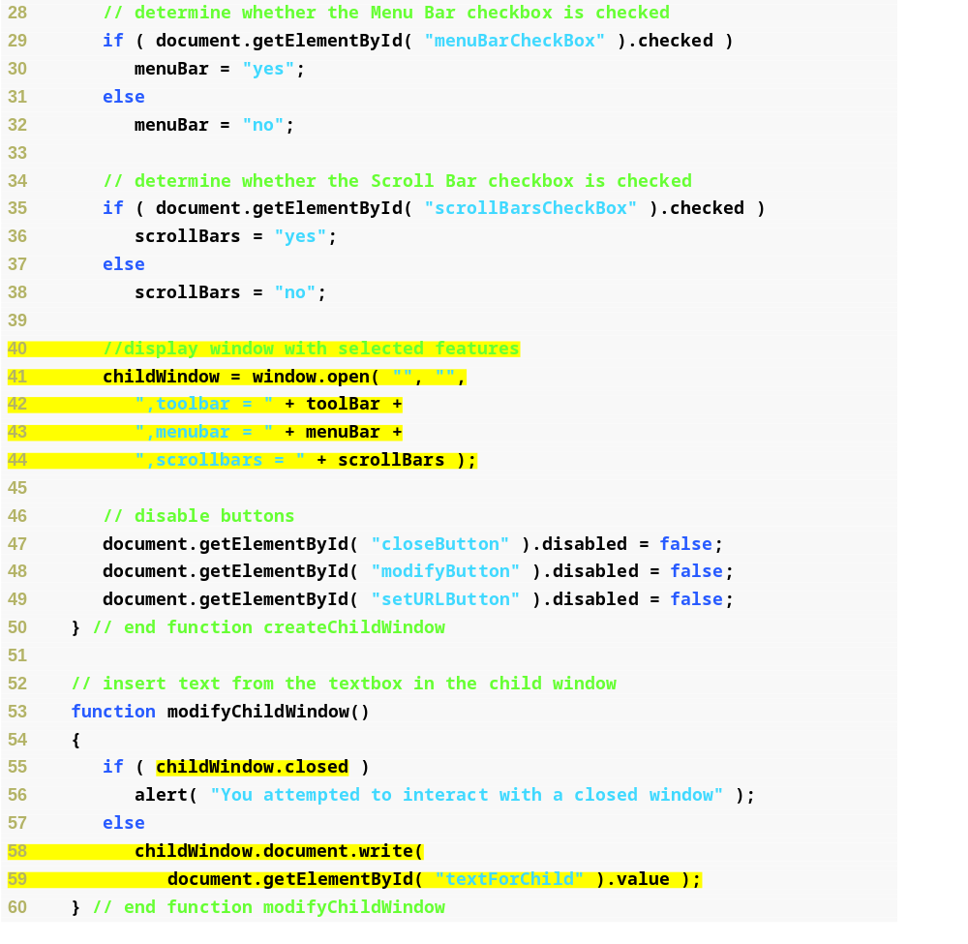
Fig. 11.13 | Using the window object to create and modify child windows (Part 2 of 6).
Creates a new window with an empty URL and name, and the options specified by the user
Checks childwindow’s closed property
Writes text in textForChild to the child window

Slide 53
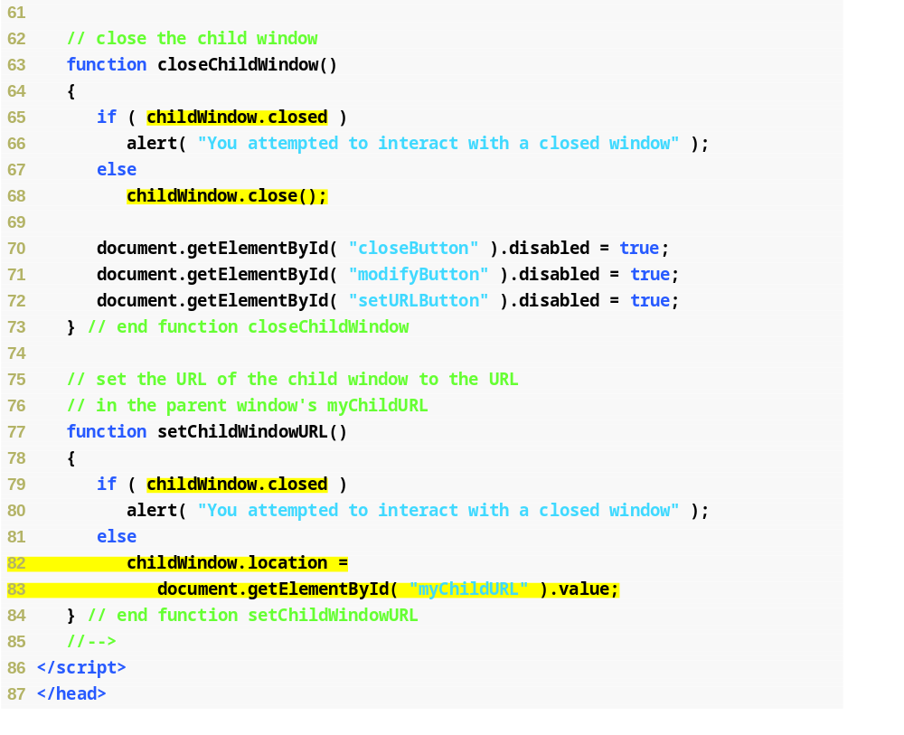
Fig. 11.13 | Using the window object to create and modify child windows (Part 3 of 6).
Checks childwindow’s closed property
Closes childWindow and deletes the object from memory
Checks childwindow’s closed property
Sets the location of childWindow to the string in the myChildURL textbox, changing the child window’s URL

Slide 54
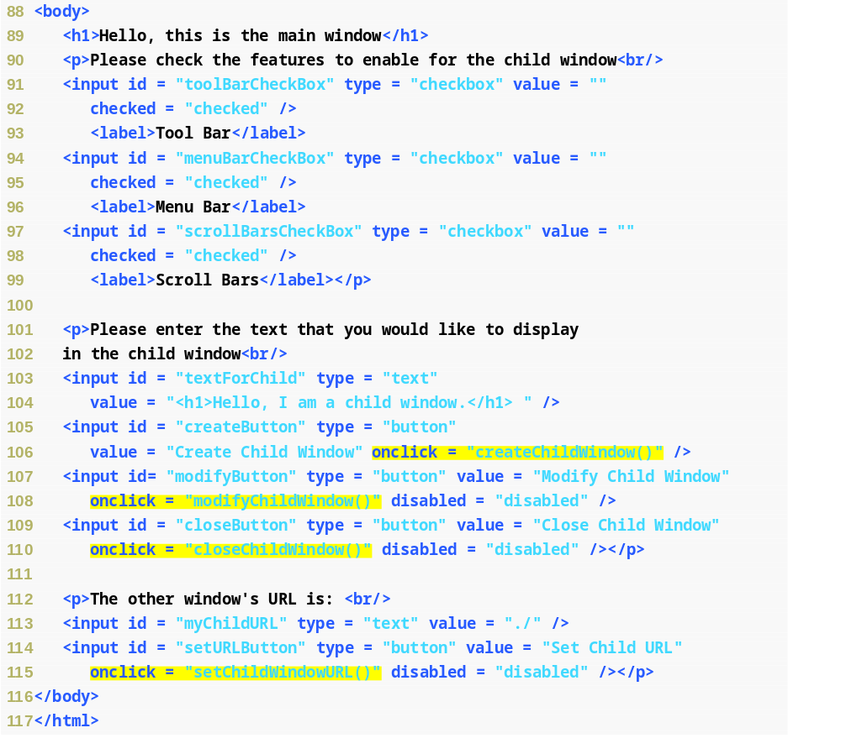
Fig. 11.13 | Using the window object to create and modify child windows (Part 4 of 6).
When the Create Child Window button is clicked, call function createChildWindow
When the Modify Child Window button is clicked, call function modifyChildWindow
When the Close Child Window button is clicked, call function closeChildWindow
When the Set Child URL button is clicked, call function setChildWindowURL

Slide 55
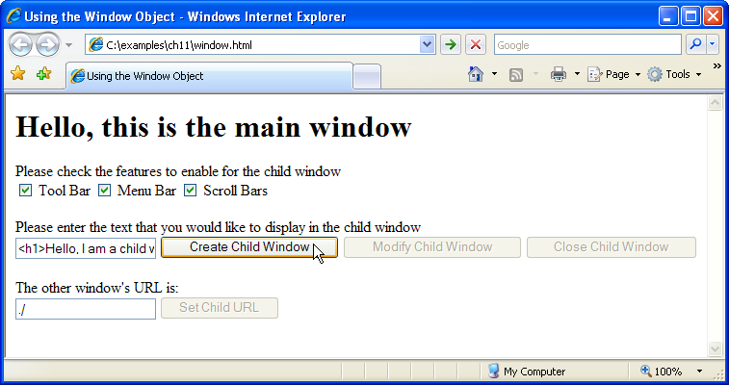
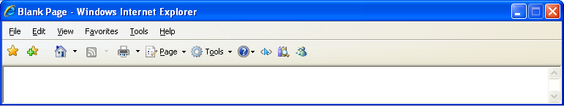
Fig. 11.13 | Using the window object to create and modify child windows (Part 5 of 6).

Slide 56
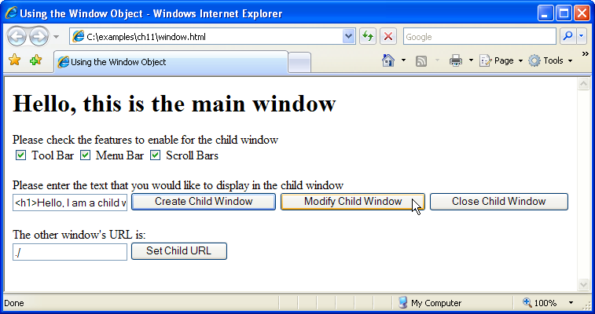
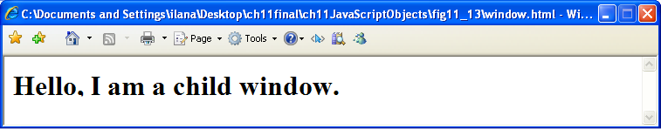
Fig. 11.13 | Using the window object to create and modify child windows (Part 6 of 6).

Slide 57
Look-and-Feel Observation 11.1
Popup windows should be used sparingly. Many users dislike websites that open additional windows, or that resize or reposition the browser. Some some users have popup blockers that will prevent new windows from opening.

Slide 58
Software Engineering Observation 11.4
window.location is a property that always contains a string representation of the URL displayed in the current window. Typically, web browsers will allow a script to retrieve the window.location property of another window only if the script belongs to the same website as the page in the other window.

Slide 59
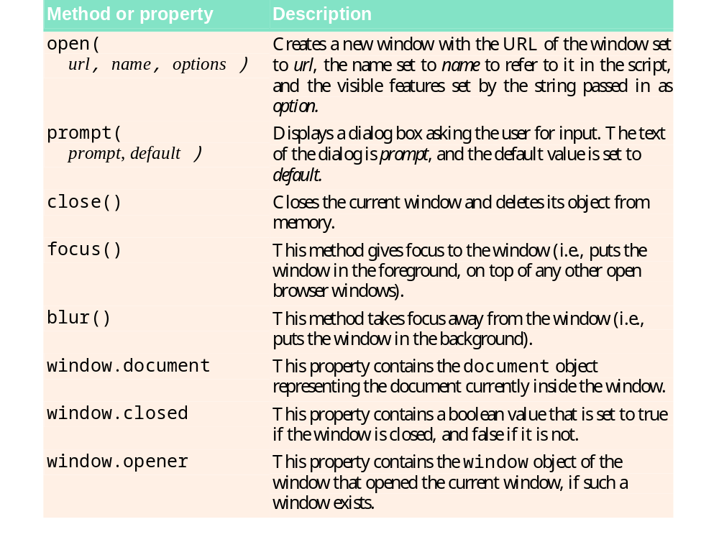
Fig. 11.14 | Important window object methods and properties.

Slide 60
11.9 Using Cookies
Cookie—a piece of data that is stored on the user’s computer to maintain information about the client during and between browser sessions
  Accessible in JavaScript through the document object’s cookie property
  Has the syntax “identifier=value” where identifier is any valid JavaScript variable identifier, and value is the value of the cookie variable
  When multiple cookies exist for one website, identifier-value pairs are separated by semicolons in the document.cookie string
  expires property in a cookie string sets an expiration date, after which the web browser deletes the cookie
  If a cookie’s expiration date is not set, then the cookie expires by default after the user closes the browser window
  A cookie can be deleted immediately by setting the expires property to a date and time in the past
Assignment operator does not overwrite the entire list of cookies, but appends a cookie to the end of it
Function escape converts any non-alphanumeric characters, such as spaces and semicolons, in a string to their equivalent hexadecimal escape sequences
Applying the function unescape to cookies when they are read out of the document.cookie string converts the hexadecimal escape sequences back to English characters

Slide 61
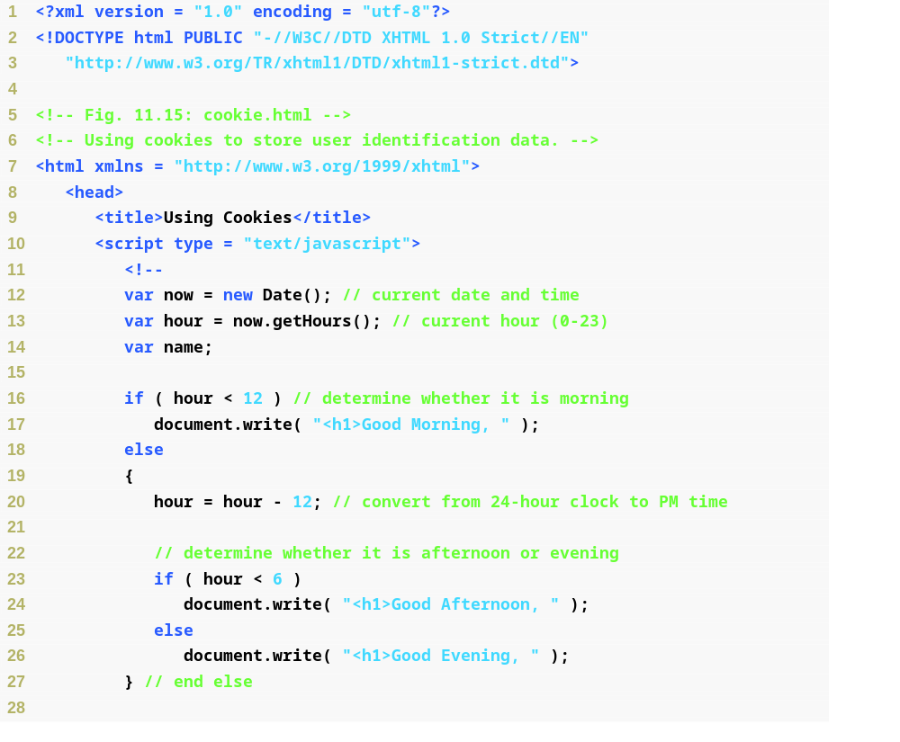
Fig. 11.15 | Using cookies to store user identification data (Part 1 of 4).
Outputs a time-appropriate greeting message

Slide 62
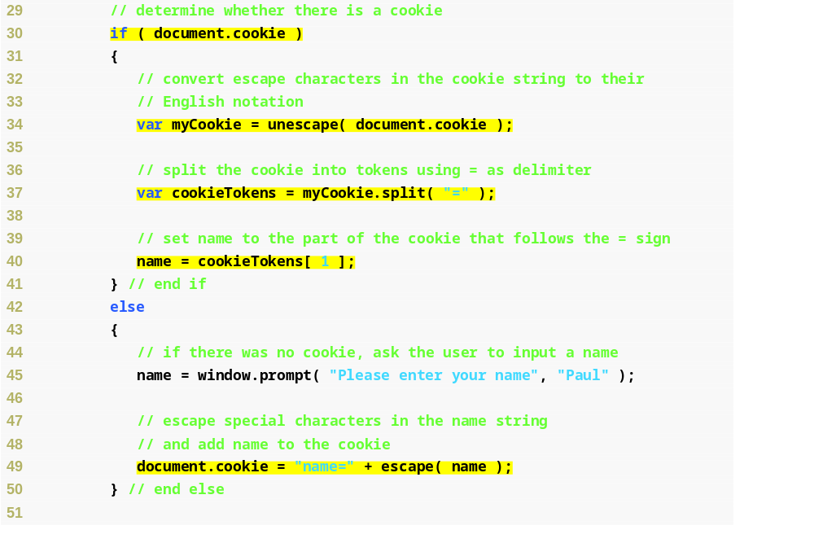
Fig. 11.15 | Using cookies to store user identification data (Part 2 of 4).
Determines if a cookie exists on the client computer
Variable myCookie holds the unescaped cookie value
Breaks myCookie into identifier and value tokens in the cookieTokens array
Assigns global variable name’s value to the value of the original cookie
Assigns the cookie’s name to an escaped value

Slide 63
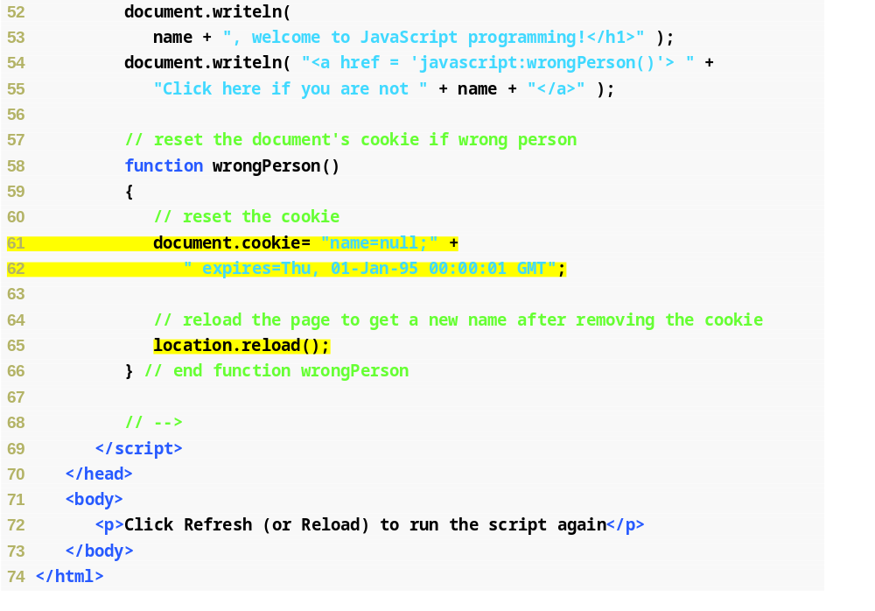
Fig. 11.15 | Using cookies to store user identification data (Part 3 of 4).
Resets the cookie with a new one that immediately expires
Forces the page to refresh, and will prompt the user to enter a name, as there will be no cookie

Slide 64
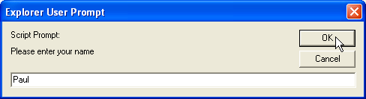
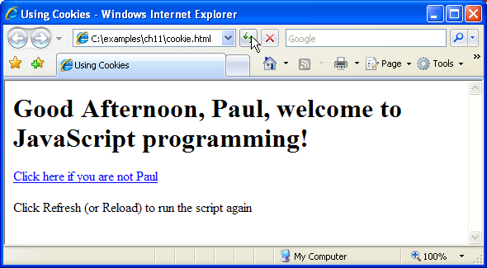
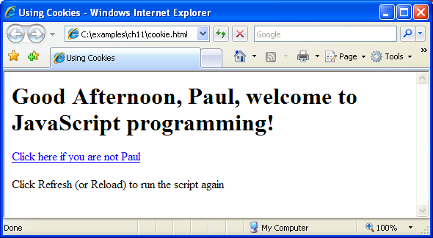
Fig. 11.15 | Using cookies to store user identification data (Part 4 of 4).

Slide 65
Good Programming Practice 11.2
Always store values in cookies with self-documenting identifiers. Do not forget to include the identifier followed by an = sign before the value being stored.

Slide 66
11.10 Final JavaScript Example
window.opener always contains a reference to the window that opened the current window
Property innerHTML refers to the HTML code inside the current paragraph element
Method focus puts the window it references on top of all the others
window object close method closes the browser window represented by the window object

Slide 67
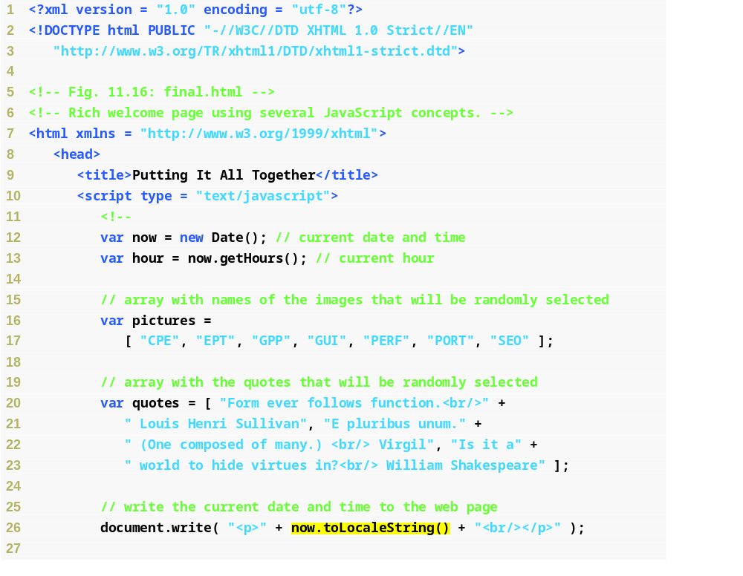
Fig. 11.16 | Rich welcome page using several JavaScript concepts (Part 1 of 8).
Outputs the current date as a string in the locale’s format

Slide 68
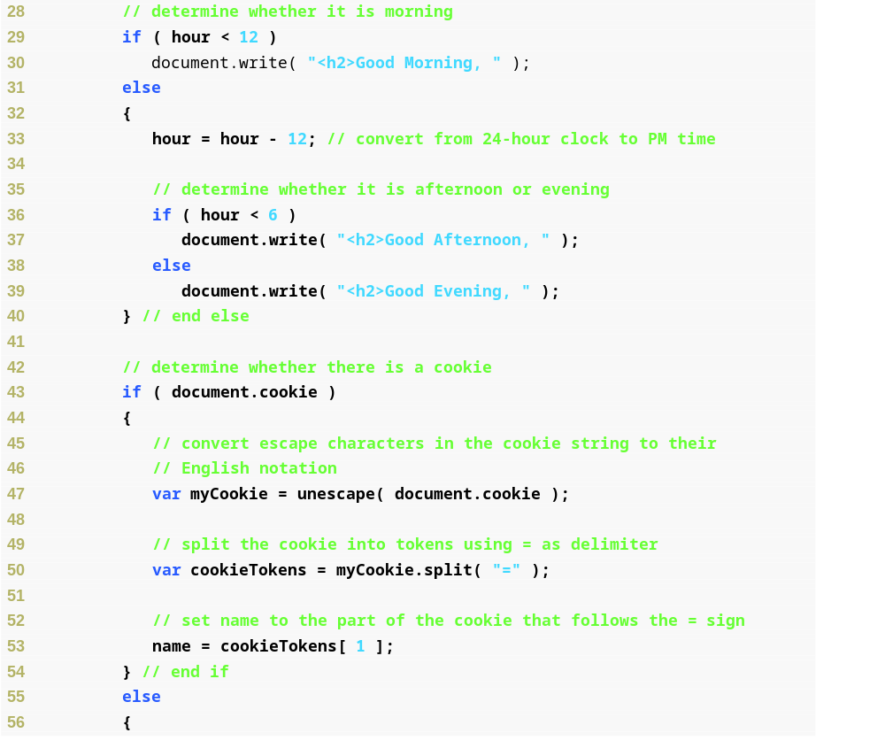
Fig. 11.16 | Rich welcome page using several JavaScript concepts (Part 2 of 8).

Slide 69
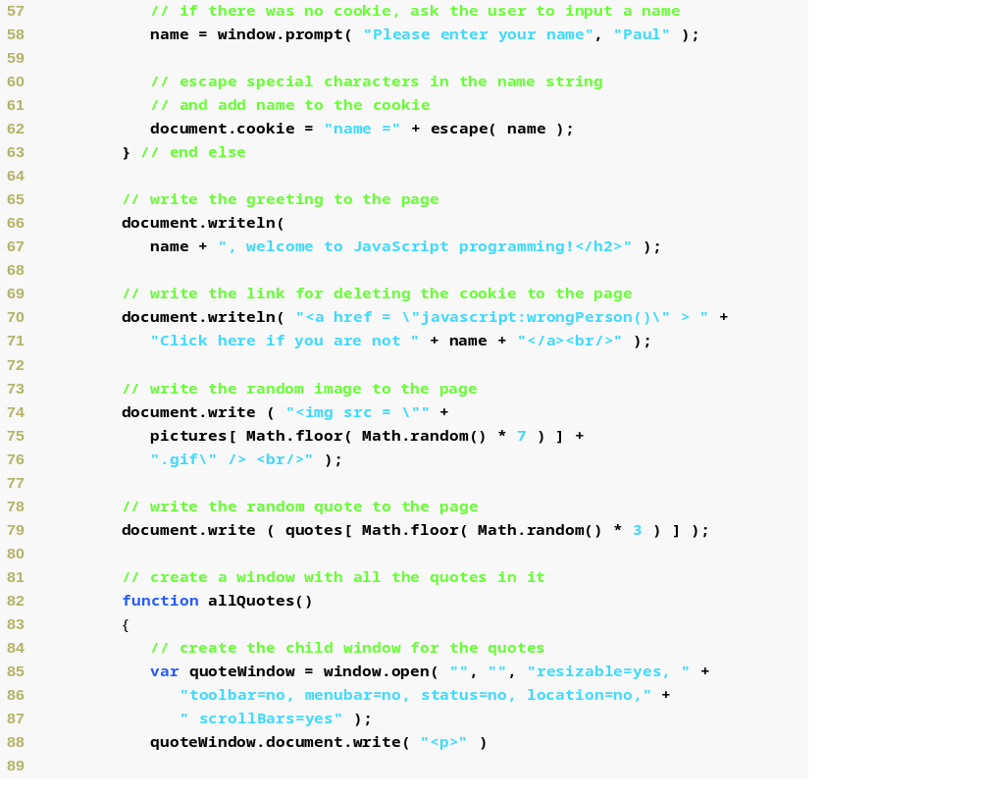
Fig. 11.16 | Rich welcome page using several JavaScript concepts (Part 3 of 8).

Slide 70
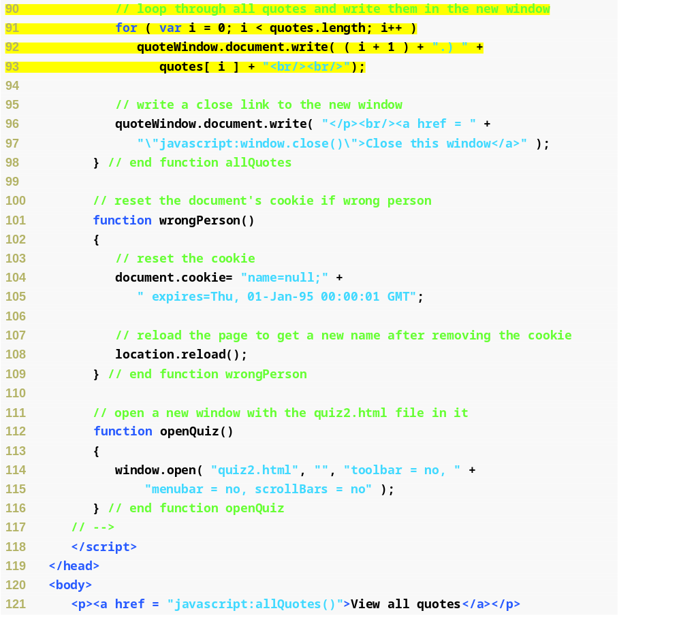
Fig. 11.16 | Rich welcome page using several JavaScript concepts (Part 4 of 8).
Iterates through all quotes in the quotes array and writes them in the new window

Slide 71
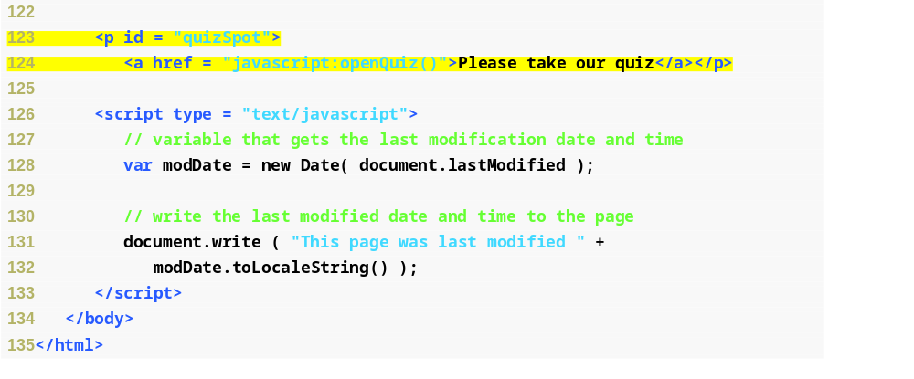
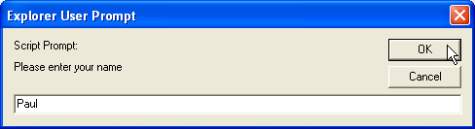
Fig. 11.16 | Rich welcome page using several JavaScript concepts (Part 5 of 8).
Links to the quiz

Slide 72
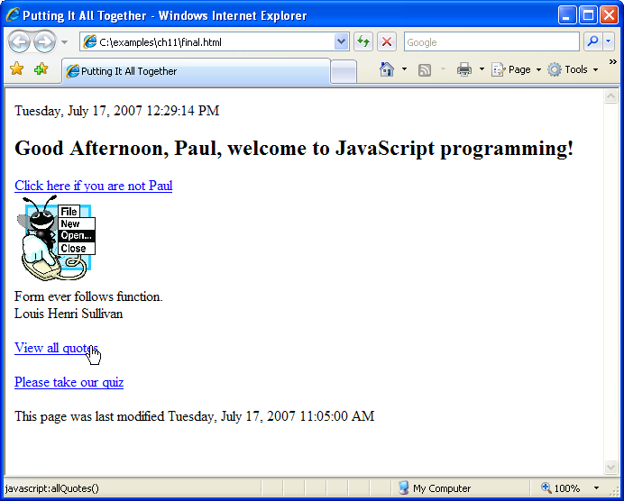
Fig. 11.16 | Rich welcome page using several JavaScript concepts (Part 6 of 8).

Slide 73
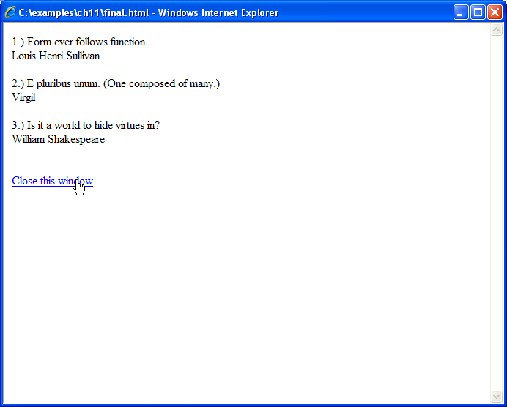
Fig. 11.16 | Rich welcome page using several JavaScript concepts (Part 7 of 8).

Slide 74
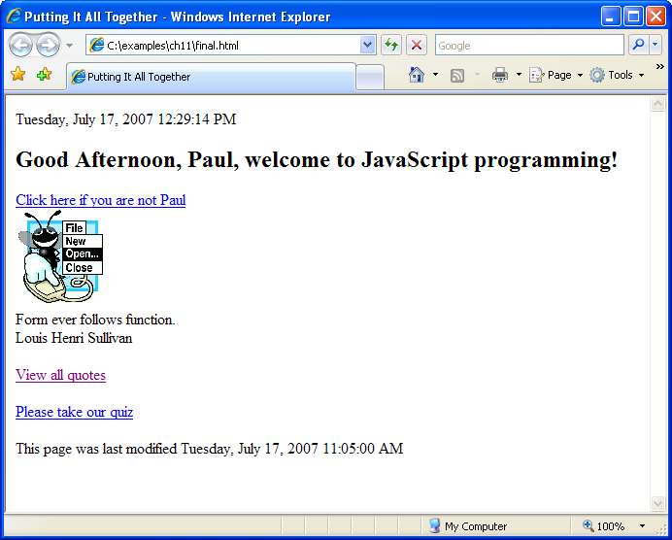
Fig. 11.16 | Rich welcome page using several JavaScript concepts (Part 8 of 8).

Slide 75

Fig. 11.17 | Online quiz in a child window (Part 1 of 5).
Writes a congratulatory message to replace the link in the quizSpot element in the window that opened the quiz
Replaces the quizSpot element in the window that opened the quiz with a “try again” message and a new copy of the link
Gives the main window focus so that the user can see the response to the quiz input

Slide 76

Fig. 11.17 | Online quiz in a child window (Part 2 of 5).

Slide 77

Fig. 11.17 | Online quiz in a child window (Part 3 of 5).

Slide 78

Fig. 11.17 | Online quiz in a child window (Part 4 of 5).

Slide 79

Fig. 11.17 | Online quiz in a child window (Part 5 of 5).

Slide 80
11.9 Using JSON to Represent Objects
JSON (JavaScript Object Notation) is a simple way to represent JavaScript objects as strings.
JSON was introduced in 1999 as an alternative to XML for data exchange.
Each JSON object is represented as a list of property names and values contained in curly braces, in the following format:
{ propertyName1 : value1, propertyName2 : value2 }
Arrays are represented in JSON with square brackets in the following format:
[ value1, value2, value3 ]
Values in JSON can be strings, numbers, JSON objects, true, false or null.

