Slide 1
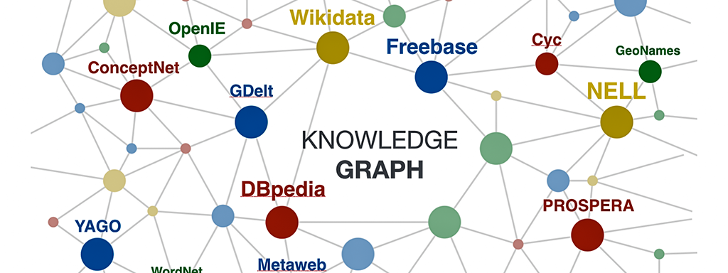
Open Data and Knowledge Graphs
Hands-on Group 01
November 2020
Máster Universitario en Ingeniería Informática
Universidad Politécnica de Madrid
Eduard Aymerich @eduayme
Jose Dominguez @jose-dp
Sol Domínguez @solDC
Rafael Timermans @Rafata8

Slide 2
Contents
Ontology development process
Application

Slide 3






I. Ontology creation process
Select, Obtain Access and Analyse Data Source
Create Ontolgy
Clean, Preparare
Transform Data Source
Link and Reuse
Develop Application
Tasks
Select dataset
Analyse License
Describe dataset
Define naming strategy
Create ontology
Clean and prepare data
Data mapping
Link data with other data sources
Reuse existing ontologies
Develop application using rdf data
Tools

Slide 4
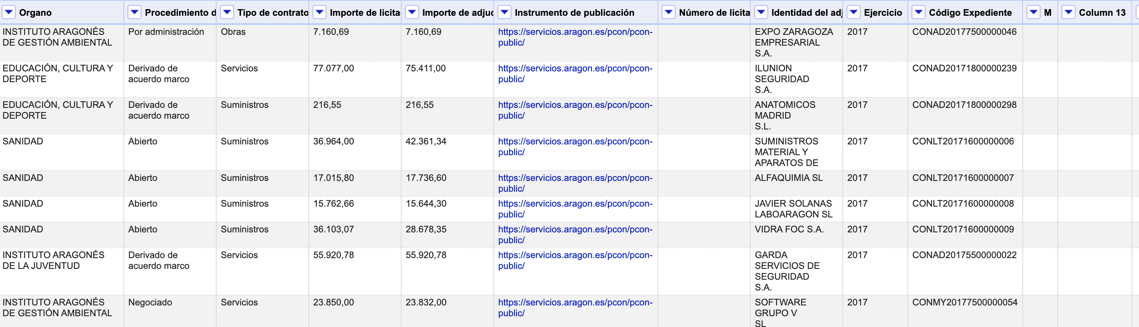
Select, Obtain Access and Analyse Data Source
Contracts awarded by the Government of Aragon. The data includes the winning companies, the awarding bodies and the award prices of the contracts tendered by the Government of Aragon during 2017.
Creative Commons Licensing Share & Adapt using same type of license
5170 rows
14 attributes

Slide 5
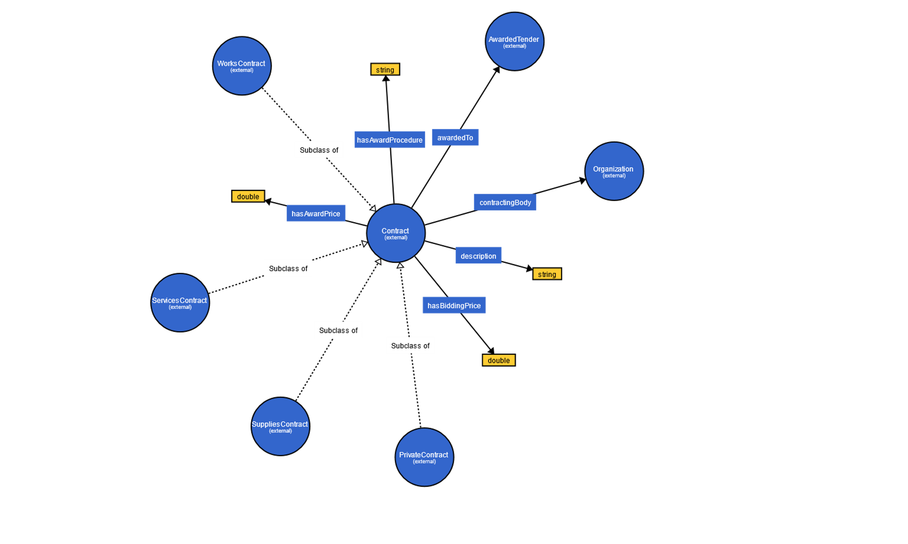
Define Naming Strategy
Base Uri: http://www.group01.org/aragon
Ontology: /ontology
Resources: /resource
Examples:
http://group01.org/aragon/ontology/hasAwardPrice
http://group01.org/aragon/resource/Company/RETEVISION%20I%20S.A.

Slide 6
Clean and Prepare
Remove some columns we are not insterested in, such as public instrument, year...
Remove rows with blank cells
Identify a unique key for every contract
Cluster similar values for companies and government requesters (Facets)
Convert prices to numbers in order to search for wrong or unusual values (Facets)

Slide 7
Link and Reuse
Ontologies reused were :
http://purl.org/dc/terms -> Description
http://contsem.unizar.es/def/sector-publico/pproc# -> Several classes and properties
http://www.w3.org/ns/org#Organization -> Goverment Requester
The entities that we were able to link with other datasets are the Companies and the Goverment Requester (Organization)
Wikidata
OpenCorporate

Slide 8
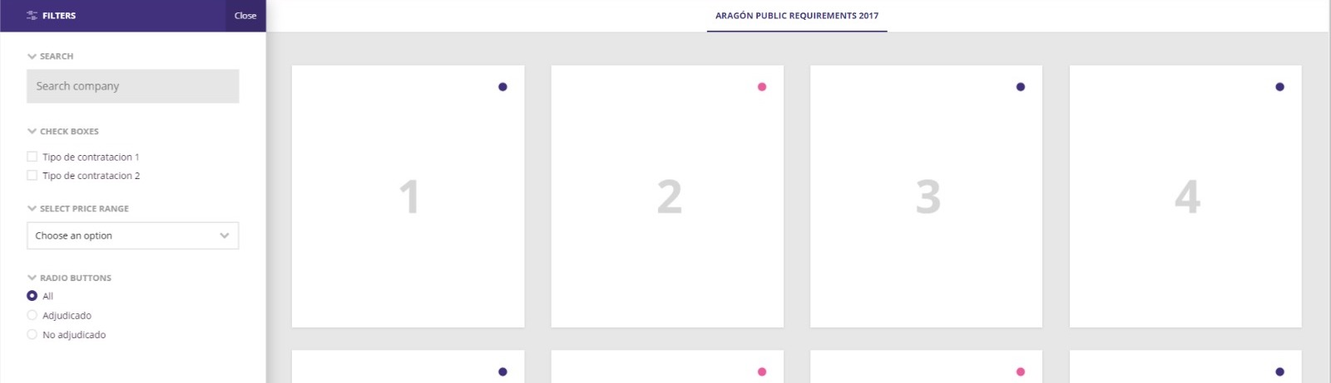
II. Application
Search engine to find all public procurements in Aragon on 2017.
Users can filter by each type of info.
Filter by dataset column
Display each row inside a card

Slide 9
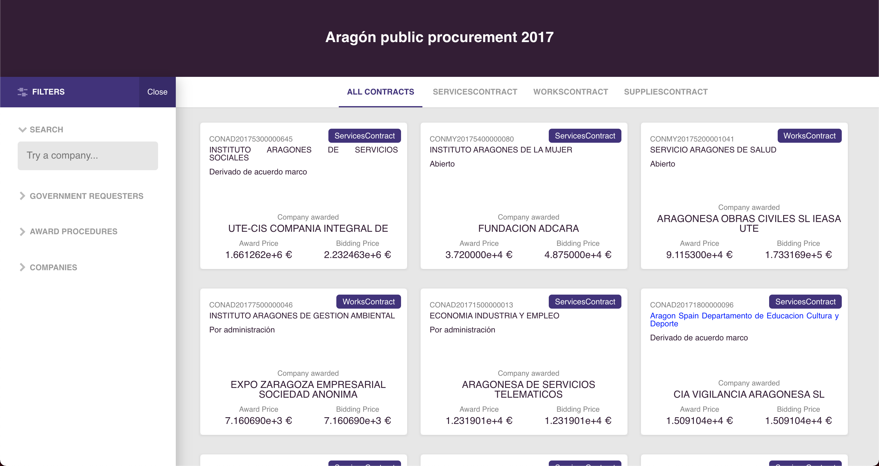
II. Application

Slide 10
Demo

Slide 11
Q&A

