Slide 1
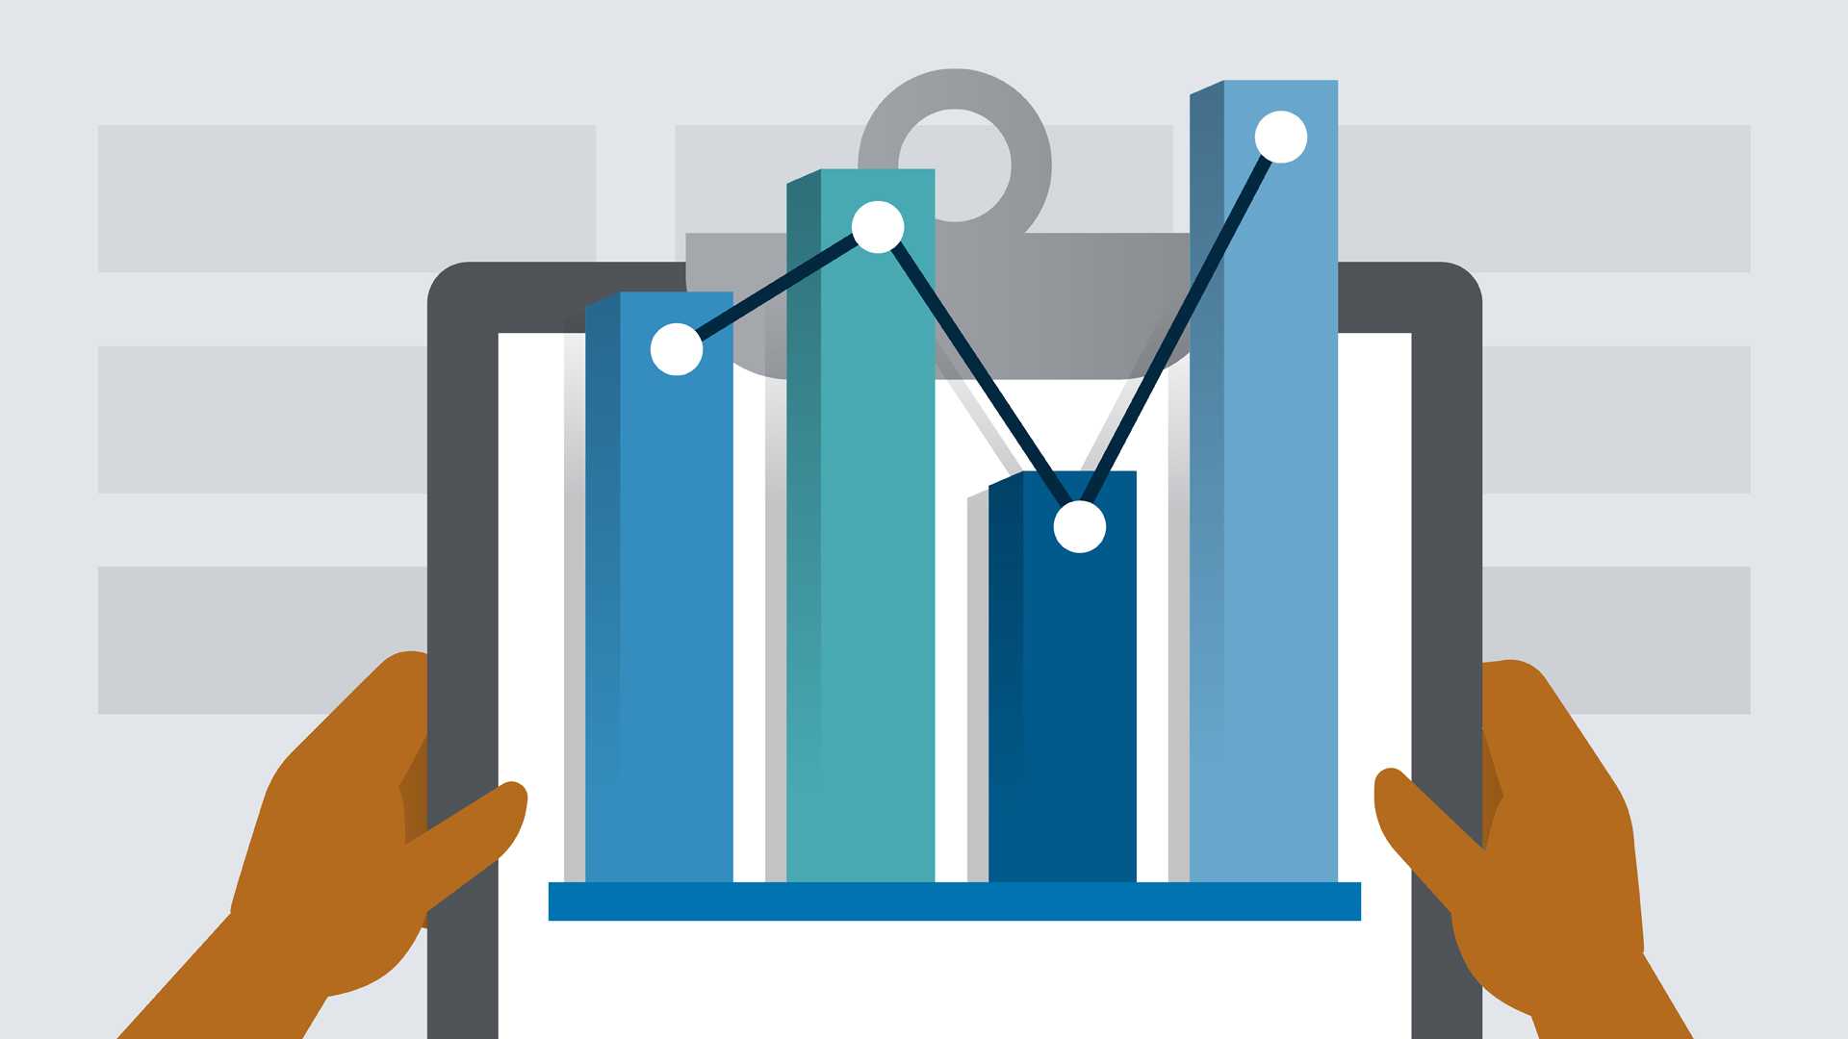
Python for Data Analysis Project
Clément MUFFAT-JOLY Jean MARCHAND – DIA4
INTRODUCTION
We worked on the Dataset for estimation of obesity levels based on eating habits and physical condition in individuals from Colombia, Peru and Mexico.
The information has 17 features and 2111 records.

Slide 2
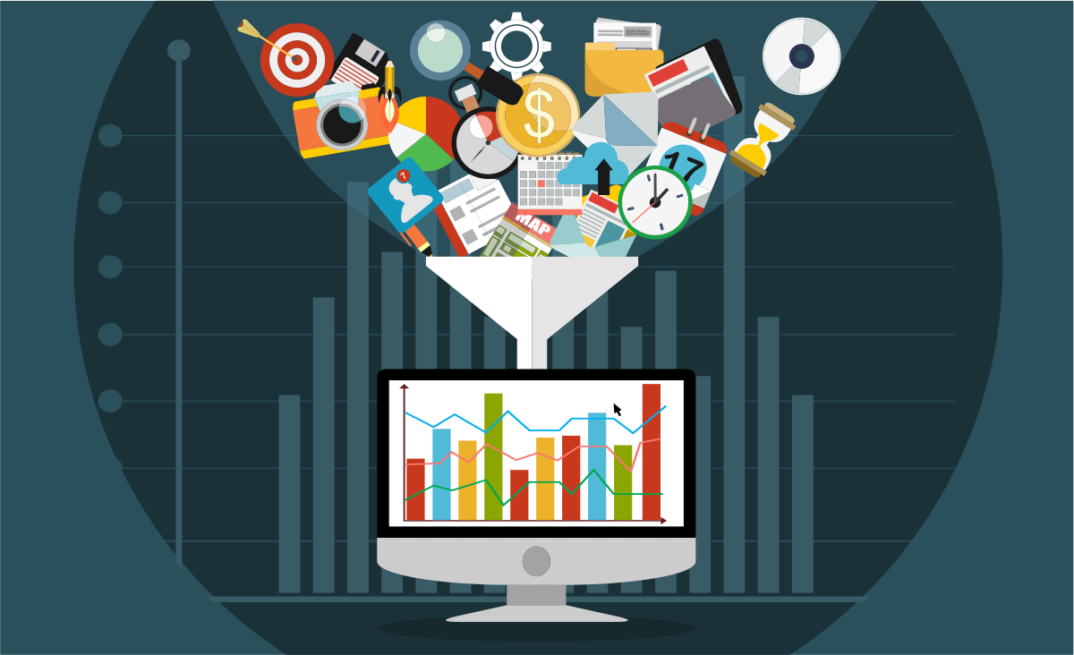
About the features of the dataset
The attributes related with eating habits are:
Frequent consumption of high caloric food (FAVC)
Frequency of consumption of vegetables (FCVC)
Number of main meals (NCP)
Consumption of food between meals (CAEC)
Consumption of water daily (CH20)
Consumption of alcohol (CALC)
The attributes related with the physical condition are:
Calories consumption monitoring (SCC),
Physical activity frequency (FAF)
Time using technology devices (TUE)
Transportation used (MTRANS),
The targert is NObesity with differents values:
Insufficient Weight
Normal Weight
Overweight Level I
Overweight Level II
Obesity Type I
Obesity Type II
Obesity Type III

Slide 3
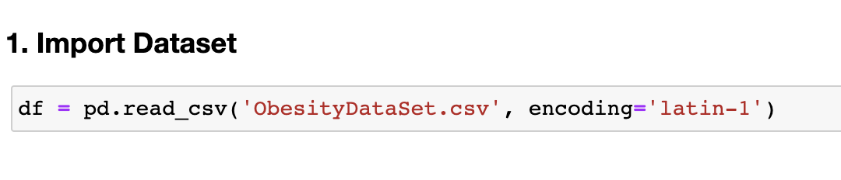
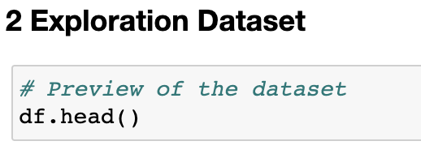
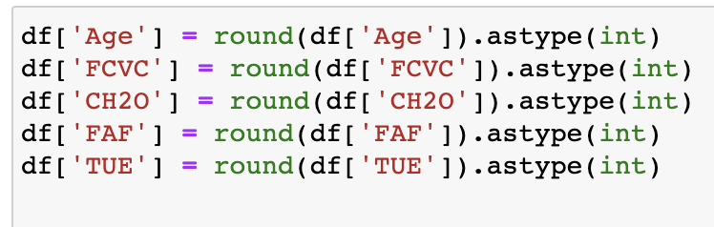
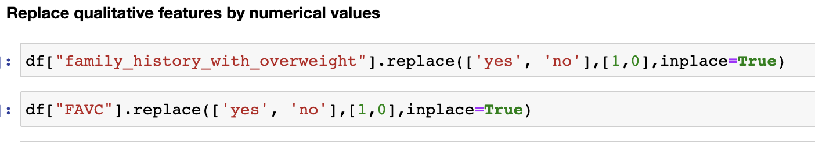
Import Dataset and EDA
We first import the dataset :
Then we started to explore the dataset with the head function:
We had to convert all quantitative features to int type:
And we had to convert all qualitative features by replace with int values

Slide 4
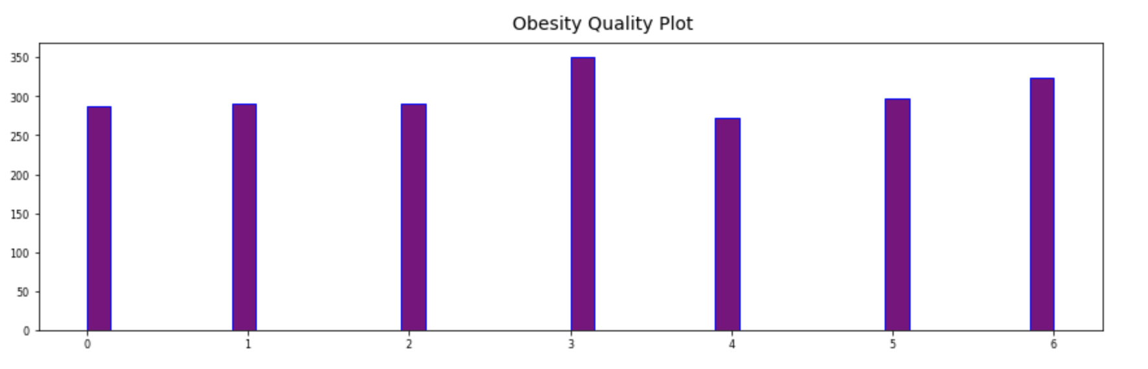
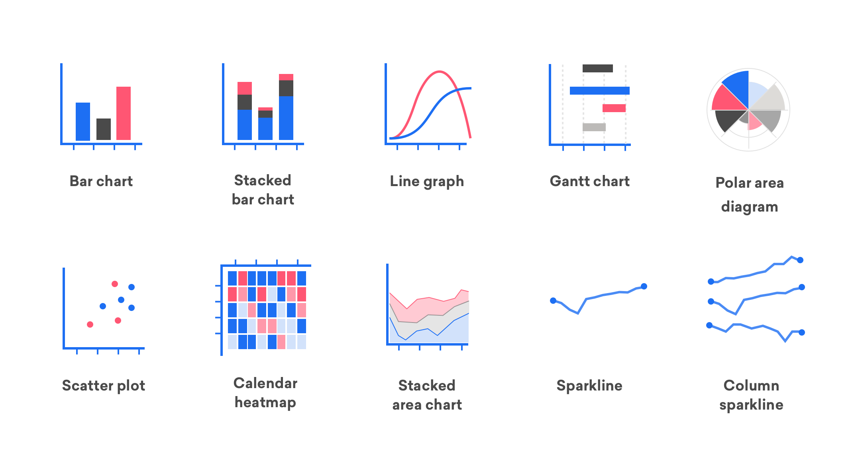
Data Visualization
Distribution of obesity categories
We have explored several data visualizations in the notebook. Here are 3 interesting graphs that we present to you. First, here is the distribution of the number of values (people) for each level of obesity. Since the qualitative values have been transformed into numbers, 0 corresponds to the most underweight people and 6 the most overweight. In 1 these are the so-called normal weight people. We can see that this category includes the most people is the 3 corresponds to overweight level 2.
However, we can see that the more extreme weight categories are very represented, which is not a guarantee of good health for most of the people who participated in this survey. Let's try to study two other graphs to better understand these data

Slide 5
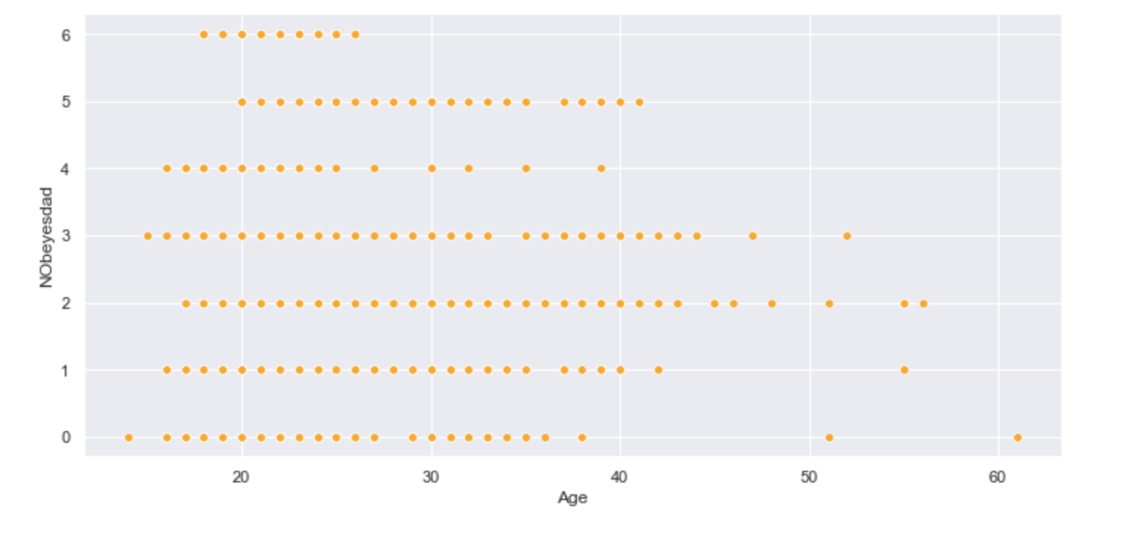
Data Visualization
Distribution of obesity categories according to age
In this second graph we can see how the categories of obesity are distributed according to age. At first glance the data are rather well distributed but we can observe that no person over 26 years old is at level 3 of obesity (the highest). We also note that the majority of obesity levels 1 and 2 are made up of young people. Conversely, the oldest people are divided between the level of overweight 2 and the level of underweight. Is age therefore a determining variable in the level of obesity? This is what we will see next with the matrix of

Slide 6
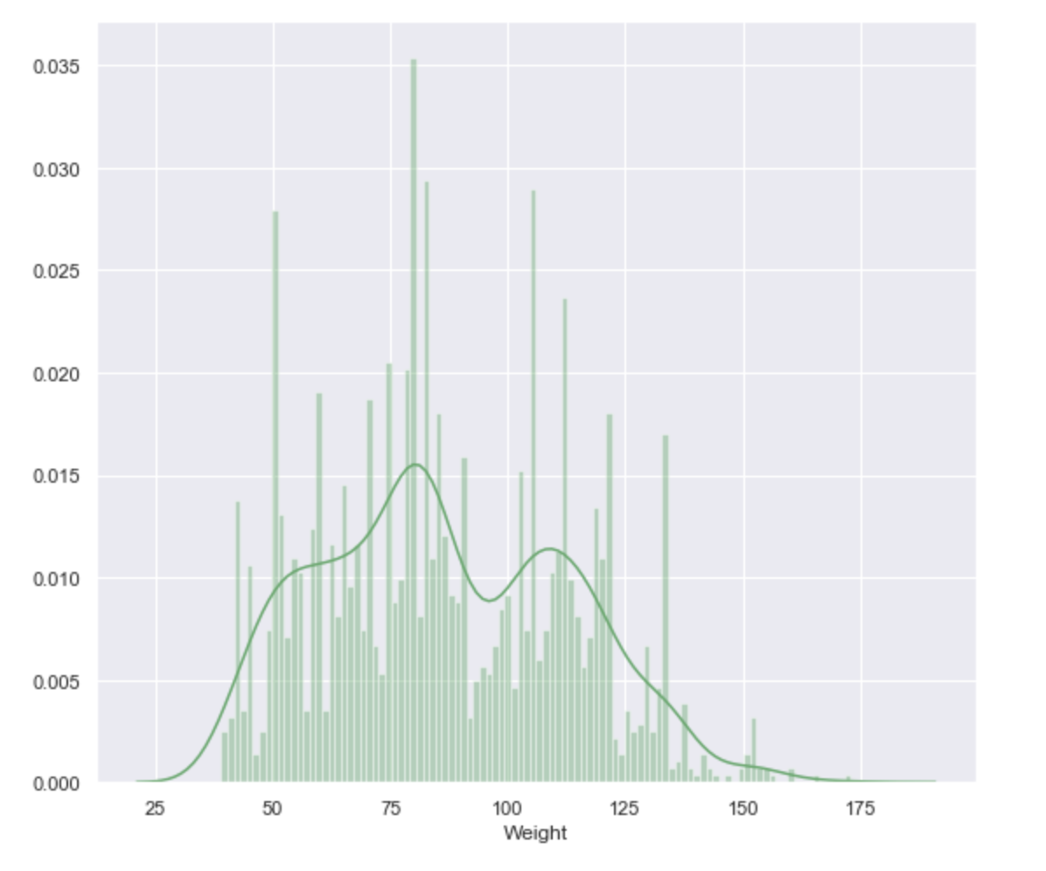
Data Visualization
We can distinguish 3 bumps on the curve which could imply that the population is divided into 3 large weight groups. We can see that there are about as many people in the underweight part as overweight. An interesting data is the high distribution, about 15% of the population towards an average weight of 75 kg which is more than the average weight and confirms the tendency that this population is overweight.
Percentage distribution of the population weight distribution

Slide 7
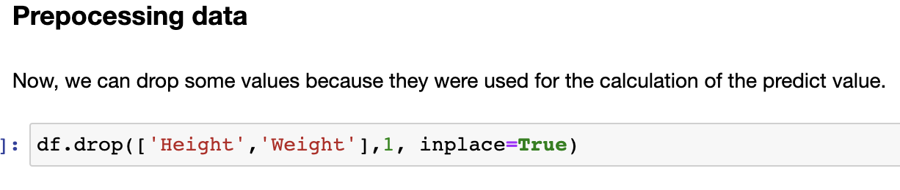
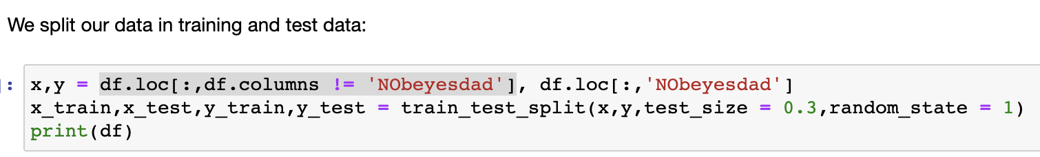
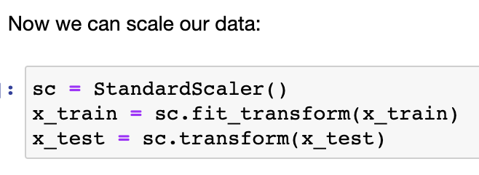
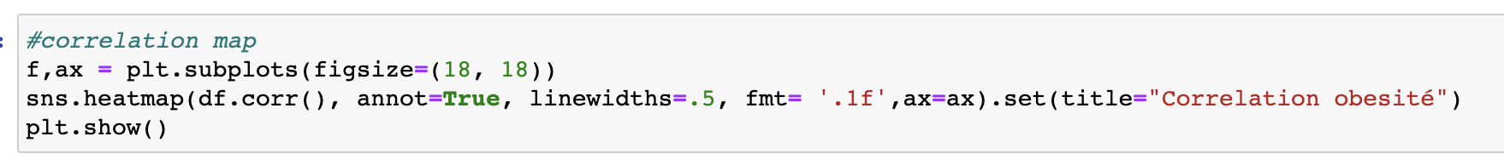
Pre-Processing
We drop features using the calculation of the predict value :
Then we split the data without ‘Nobeyesdad’ which is the target value.
We scale the value using StandartScaler function on x_train and x_test.
We display the correlation map with sns.heatmap to see the correlation between features

Slide 8
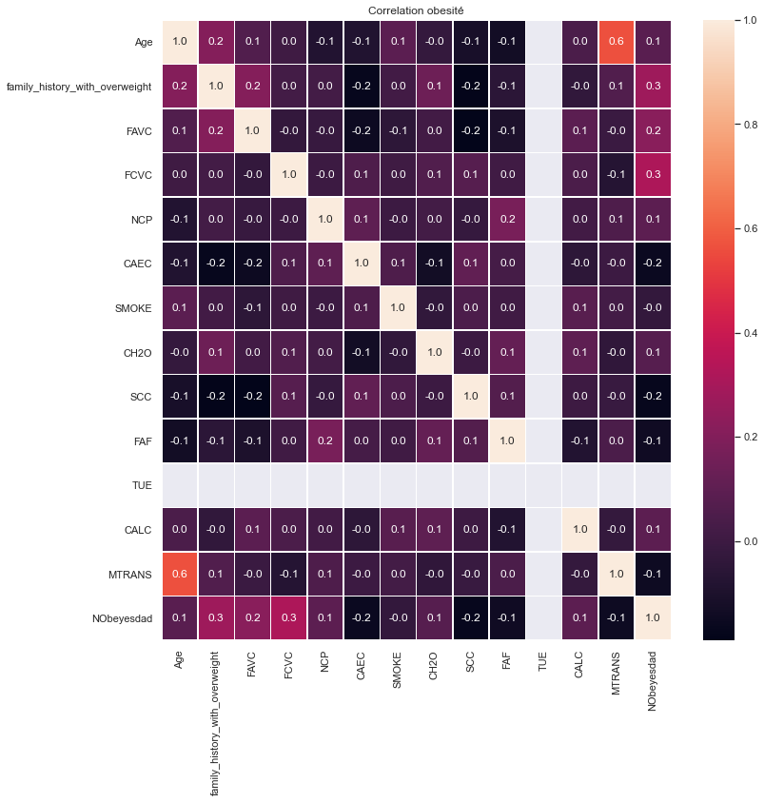
Pre-Processing
Correlation map
Important features to predict obesity:
We can see that the family history of obesity and (FCVC) the frequency of vegetable consumption are the two variables most correlated with the level of obesity (with a correlation of 0.3). They are therefore decisive.
Next comes a correlation of 0.2 (FAVC) for the frequency of consuming high calorie foods.
And finally we have a correlation of 0.1: age, the (NCP) the number of meat-based meals, (CH20) the water consumption per day and finally (CALC) the alcohol consumption .

Slide 9
Machine Learning Models

Slide 10
Bar Charts Infographics
Analysis of different brands and products.
Cash Flow
$1,025,549
Business professionals like you connecting. Promotions only work as well.
Business professionals like you connecting. Promotions only work as well.
Business professionals like you connecting. Promotions only work as well.

Slide 11
Pie Charts Infographics
Analysis of different brands and products.
24%
There are people who have a significant number.
Marketing
1 month ago
120%
2.34%
3 month ago
70%
There are people who have a significant number.
160%
Business
4.92%
Financial
52%
There are people who have a significant number.
6.53%
6 month ago
183%

Slide 12
Chart Infographics
Is a great way to visualize information about users
Total Earning
Total Earning
$34,750
$12,590
70%
34%
There are people who have a significant number of followers in every business domain.
There are people who have a significant number of followers in every business domain.

Slide 13
Bar Charts Infographics
Analysis of different brands and products.
1 month ago
24%
120%
3 month ago
70%
160%
6 month ago
52%
183%

Slide 14
c
Chart Infographics
Customers, most businesses already know that platforms.
Is a great way to visualize information about users
Analysis of different brands and products.
Sales, most businesses already know that platforms.
$672
There are people who have a significant number of followers in every business domain. There are people who have a significant number of followers in every business domain on social media.
Payments, most businesses already know that platforms.

Slide 15
Chart Infographics
Is a great way to visualize information about users
Payments
Transactions
Products
Most businesses already know that platforms.
Most businesses already know that platforms.
Most businesses already know that platforms.

Slide 16
Chart Infographics
Is a great way to visualize information about users
Payments
Customer 01
There are people who have a significant number of followers in every business.
Customer 02
Transactions
Customer 03
There are people who have a significant number of followers in every business.
Product
There are people who have a significant number of followers in every business.
Most businesses already know that platforms.
Analysis of different brands and products.
There are people who have a significant.

