Slide 1
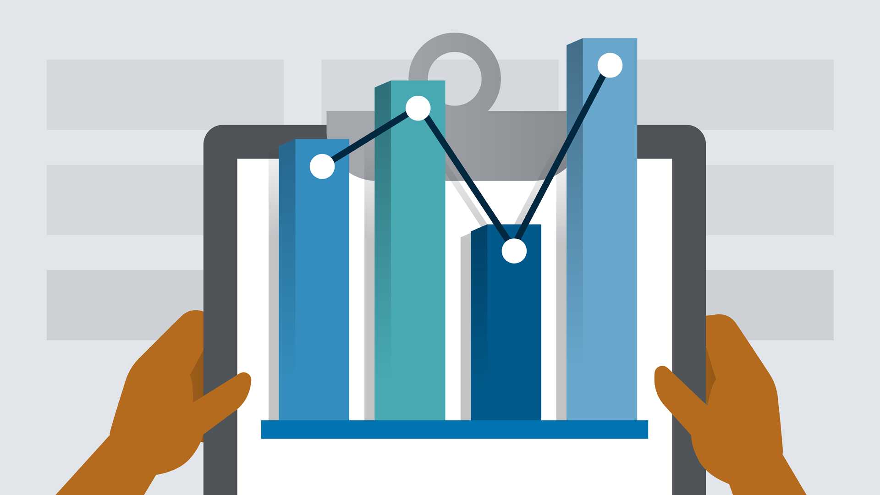
Python for Data Analysis Project
Clément MUFFAT-JOLY Jean MARCHAND – DIA4
INTRODUCTION
We worked on the Dataset for estimation of obesity levels based on eating habits and physical condition in individuals from Colombia, Peru and Mexico.
The information has 17 features and 2111 records.

Slide 2
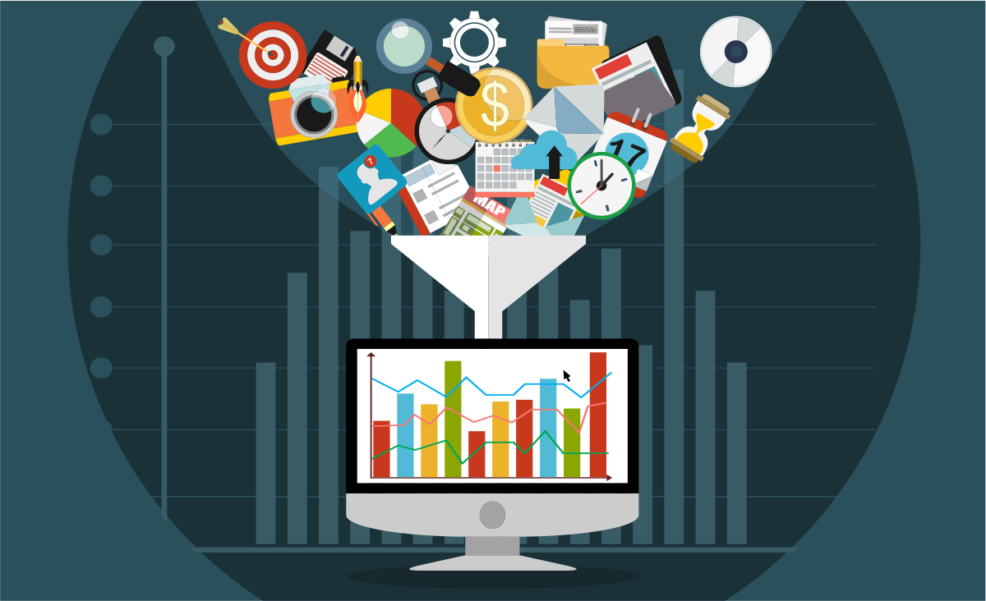
About the features of the dataset
The attributes related with eating habits are:
Frequent consumption of high caloric food (FAVC)
Frequency of consumption of vegetables (FCVC)
Number of main meals (NCP)
Consumption of food between meals (CAEC)
Consumption of water daily (CH20)
Consumption of alcohol (CALC)
The attributes related with the physical condition are:
Calories consumption monitoring (SCC),
Physical activity frequency (FAF)
Time using technology devices (TUE)
Transportation used (MTRANS),
The targert is NObesity with differents values:
Insufficient Weight
Normal Weight
Overweight Level I
Overweight Level II
Obesity Type I
Obesity Type II
Obesity Type III

Slide 3
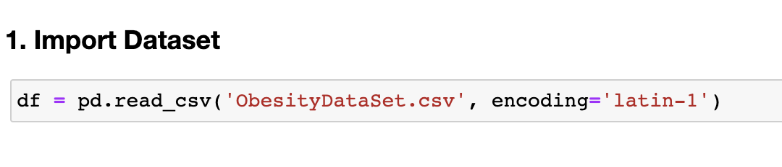
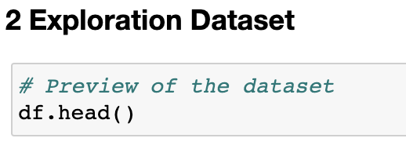
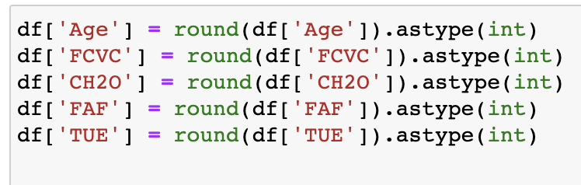
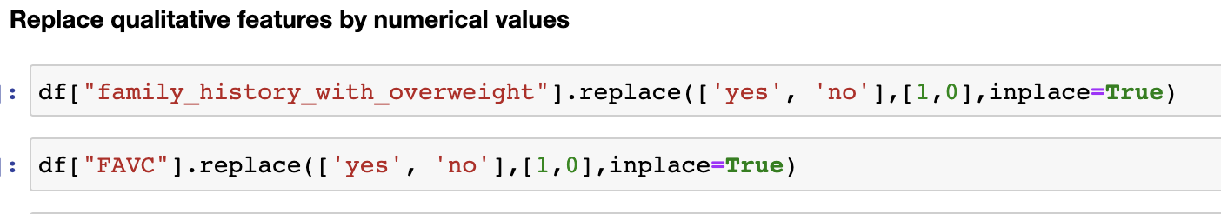
Import Dataset and EDA
We first import the dataset :
Then we started to explore the dataset with the head function:
We had to convert all quantitative features to int type:
And we had to convert all qualitative features by replace with int values

Slide 4
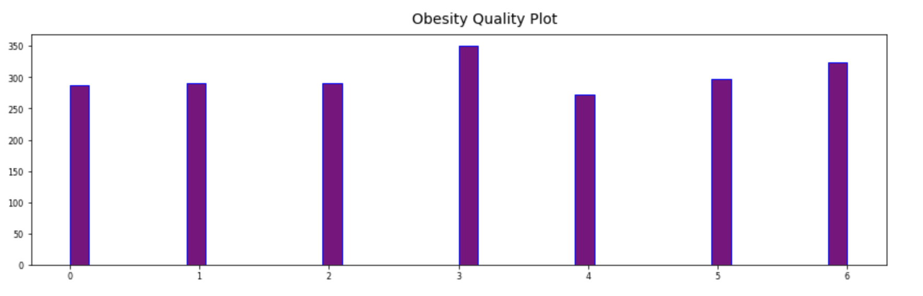
Data Visualization
We have explored several data visualizations in the notebook. Here are 3 interesting graphs that we present to you. First, here is the distribution of the number of values (people) for each level of obesity. Since the qualitative values have been transformed into numbers, 0 corresponds to the most underweight people and 6 the most overweight. In 3 these are the so-called normal weight people and we see that this category includes the most people.

Slide 5
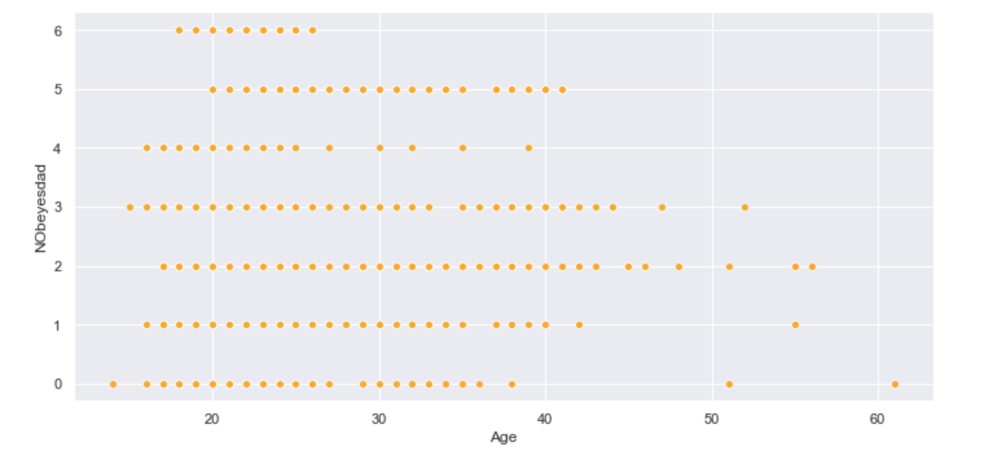
Data Visualization

Slide 6
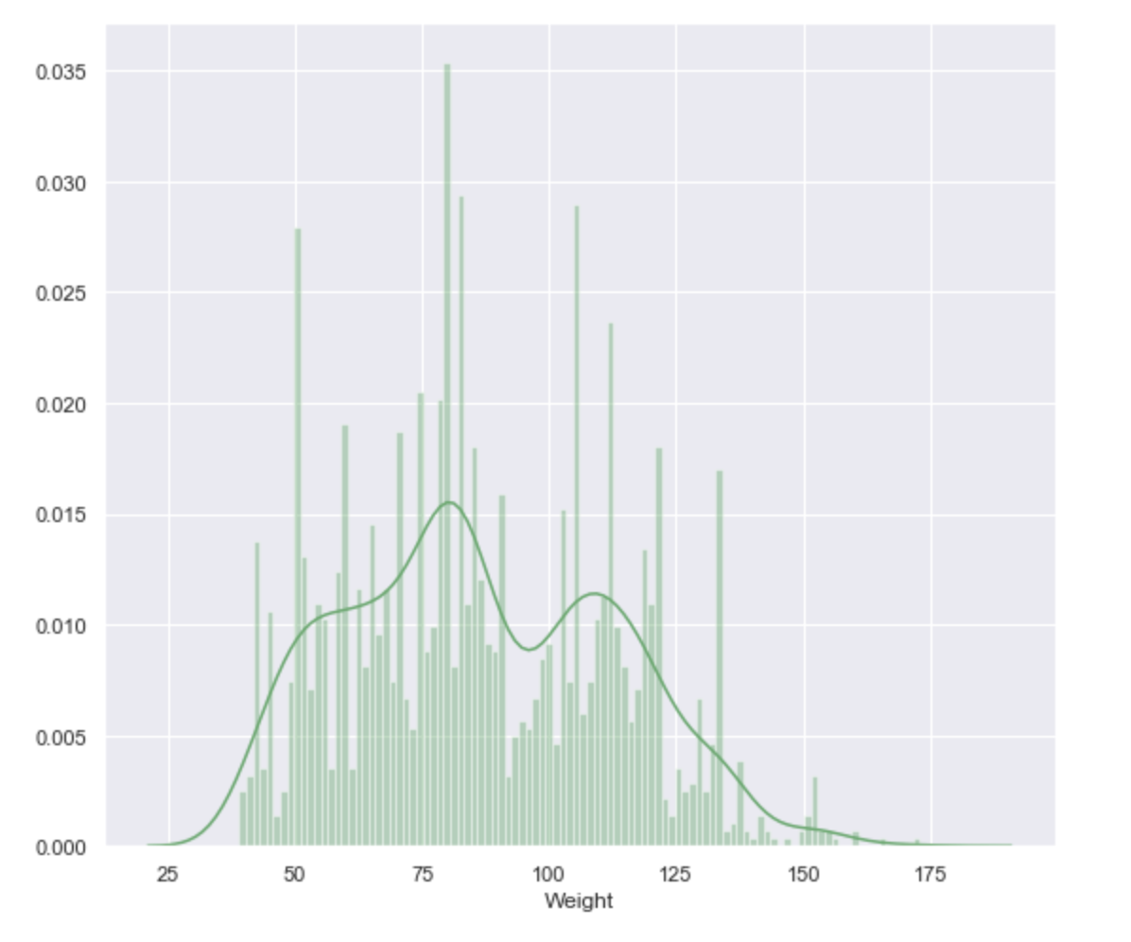
Data Visualization

Slide 7
Pre Processing

Slide 8
Bar Charts Infographics
Analysis of different brands and products.
Cash Flow
$1,025,549
Business professionals like you connecting. Promotions only work as well.
Business professionals like you connecting. Promotions only work as well.
Business professionals like you connecting. Promotions only work as well.

Slide 9
Pie Charts Infographics
Analysis of different brands and products.
24%
There are people who have a significant number.
Marketing
1 month ago
120%
2.34%
3 month ago
70%
There are people who have a significant number.
160%
Business
4.92%
Financial
52%
There are people who have a significant number.
6.53%
6 month ago
183%

Slide 10
Chart Infographics
Is a great way to visualize information about users
Total Earning
Total Earning
$34,750
$12,590
70%
34%
There are people who have a significant number of followers in every business domain.
There are people who have a significant number of followers in every business domain.

Slide 11
Bar Charts Infographics
Analysis of different brands and products.
1 month ago
24%
120%
3 month ago
70%
160%
6 month ago
52%
183%

Slide 12
c
Chart Infographics
Customers, most businesses already know that platforms.
Is a great way to visualize information about users
Analysis of different brands and products.
Sales, most businesses already know that platforms.
$672
There are people who have a significant number of followers in every business domain. There are people who have a significant number of followers in every business domain on social media.
Payments, most businesses already know that platforms.

Slide 13
Chart Infographics
Is a great way to visualize information about users
Payments
Transactions
Products
Most businesses already know that platforms.
Most businesses already know that platforms.
Most businesses already know that platforms.

Slide 14
Chart Infographics
Is a great way to visualize information about users
Payments
Customer 01
There are people who have a significant number of followers in every business.
Customer 02
Transactions
Customer 03
There are people who have a significant number of followers in every business.
Product
There are people who have a significant number of followers in every business.
Most businesses already know that platforms.
Analysis of different brands and products.
There are people who have a significant.

