Slide 1
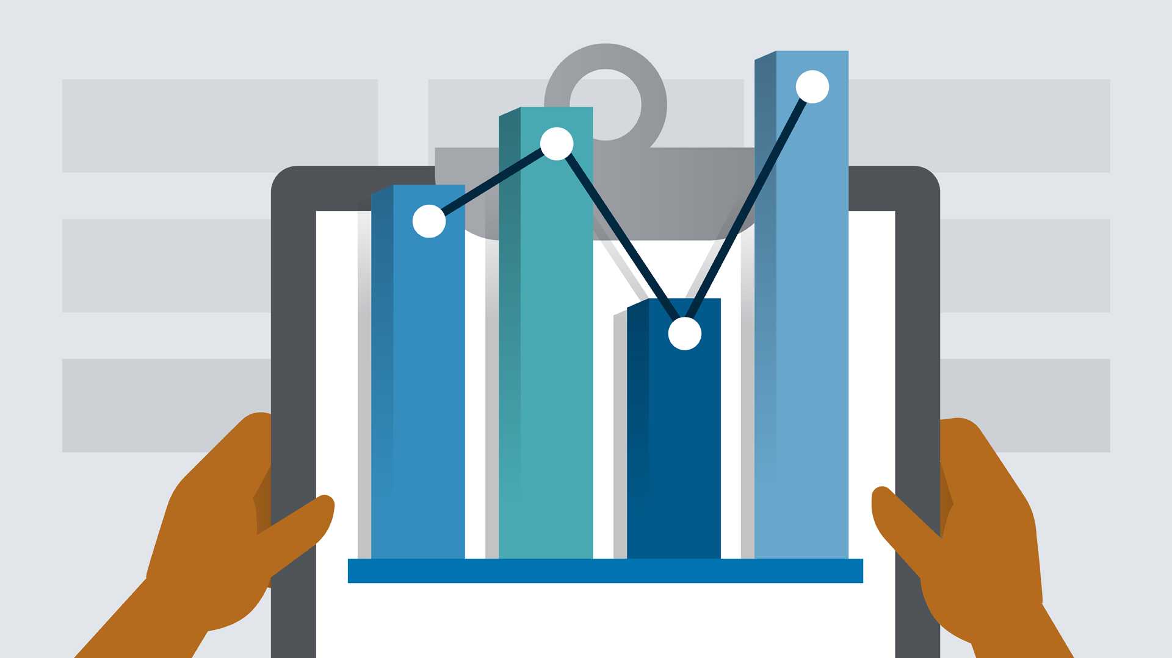
Python for Data Analysis Project
Clément MUFFAT-JOLY Jean MARCHAND – DIA4
INTRODUCTION
We worked on the Dataset for estimation of obesity levels based on eating habits and physical condition in individuals from Colombia, Peru and Mexico.
The information has 17 features and 2111 records.

Slide 2

About the features of the dataset
The attributes related with eating habits are:
Frequent consumption of high caloric food (FAVC)
Frequency of consumption of vegetables (FCVC)
Number of main meals (NCP)
Consumption of food between meals (CAEC)
Consumption of water daily (CH20)
Consumption of alcohol (CALC)
The attributes related with the physical condition are:
Calories consumption monitoring (SCC)
Physical activity frequency (FAF)
Time using technology devices (TUE)
Transportation used (MTRANS)
The targert is NObesity with differents values:
Insufficient Weight
Normal Weight
Overweight Level I
Overweight Level II
Obesity Type I
Obesity Type II
Obesity Type III

Slide 3
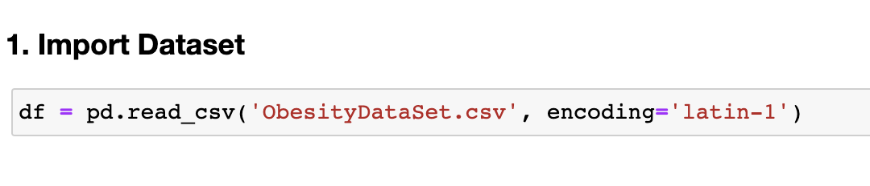
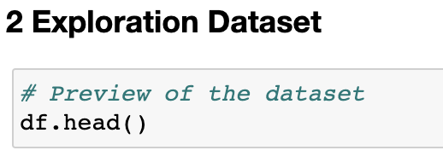
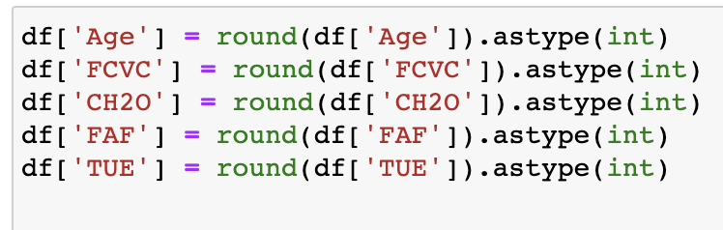
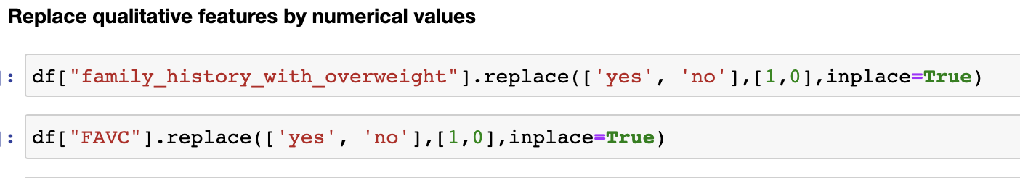
Import Dataset and EDA
We first import the dataset :
Then we started to explore the dataset with the head function:
We had to convert all quantitative features to int type:
And we had to convert all qualitative features by replace with int values

Slide 4
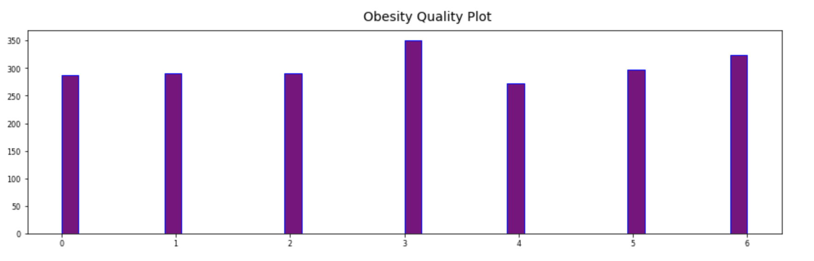
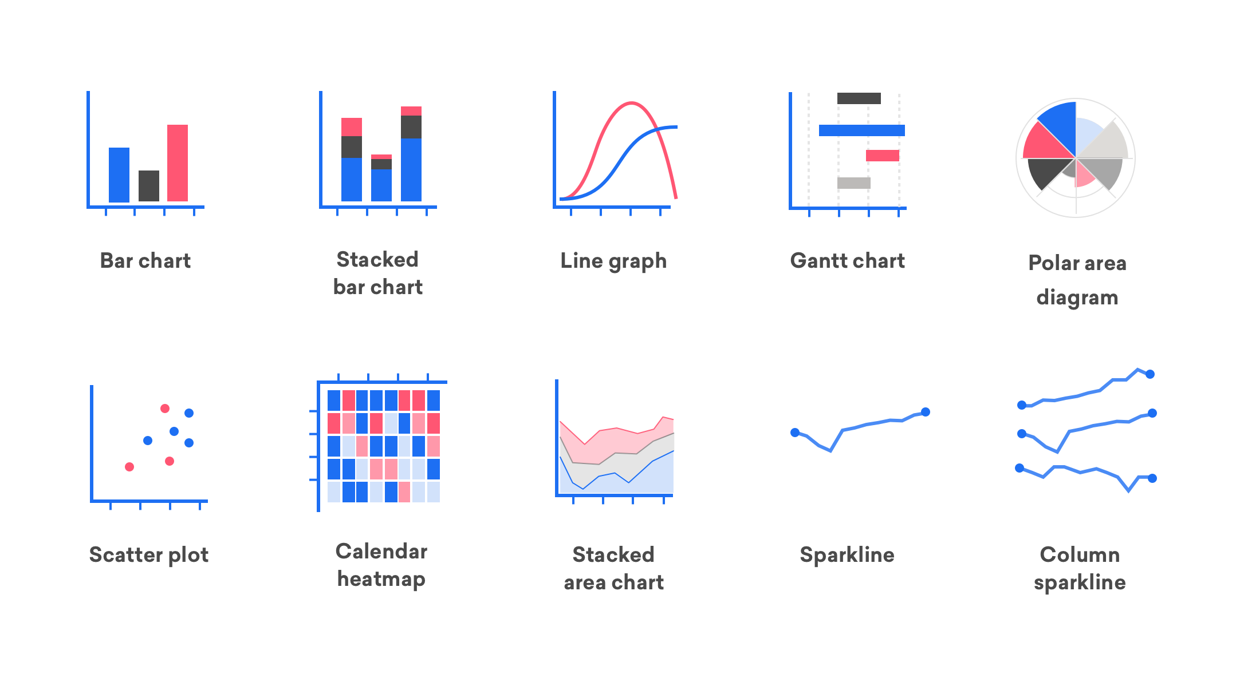
Data Visualization
Distribution of obesity categories
We have explored several data visualizations in the notebook. Here are 3 interesting graphs that we present to you. First, here is the distribution of the number of values (people) for each level of obesity. Since the qualitative values have been transformed into numbers, 0 corresponds to the most underweight people and 6 the most overweight. In 1 these are the so-called normal weight people. We can see that this category includes the most people is the 3 corresponds to overweight level 2.
However, we can see that the more extreme weight categories are very represented, which is not a guarantee of good health for most of the people who participated in this survey. Let's try to study two other graphs to better understand these data

Slide 5
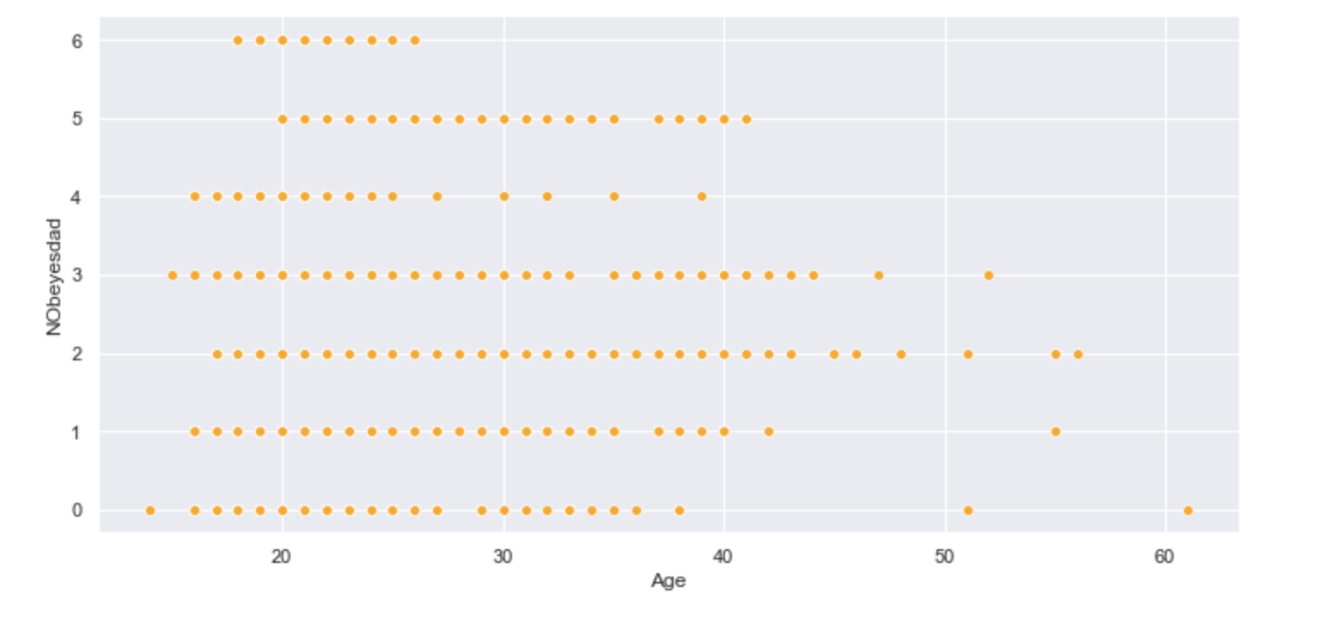
Data Visualization
Distribution of obesity categories according to age
In this second graph we can see how the categories of obesity are distributed according to age. At first glance the data are rather well distributed but we can observe that no person over 26 years old is at level 3 of obesity (the highest). We also note that the majority of obesity levels 1 and 2 are made up of young people. Conversely, the oldest people are divided between the level of overweight 2 and the level of underweight. Is age therefore a determining variable in the level of obesity? This is what we will see next with the matrix of

Slide 6
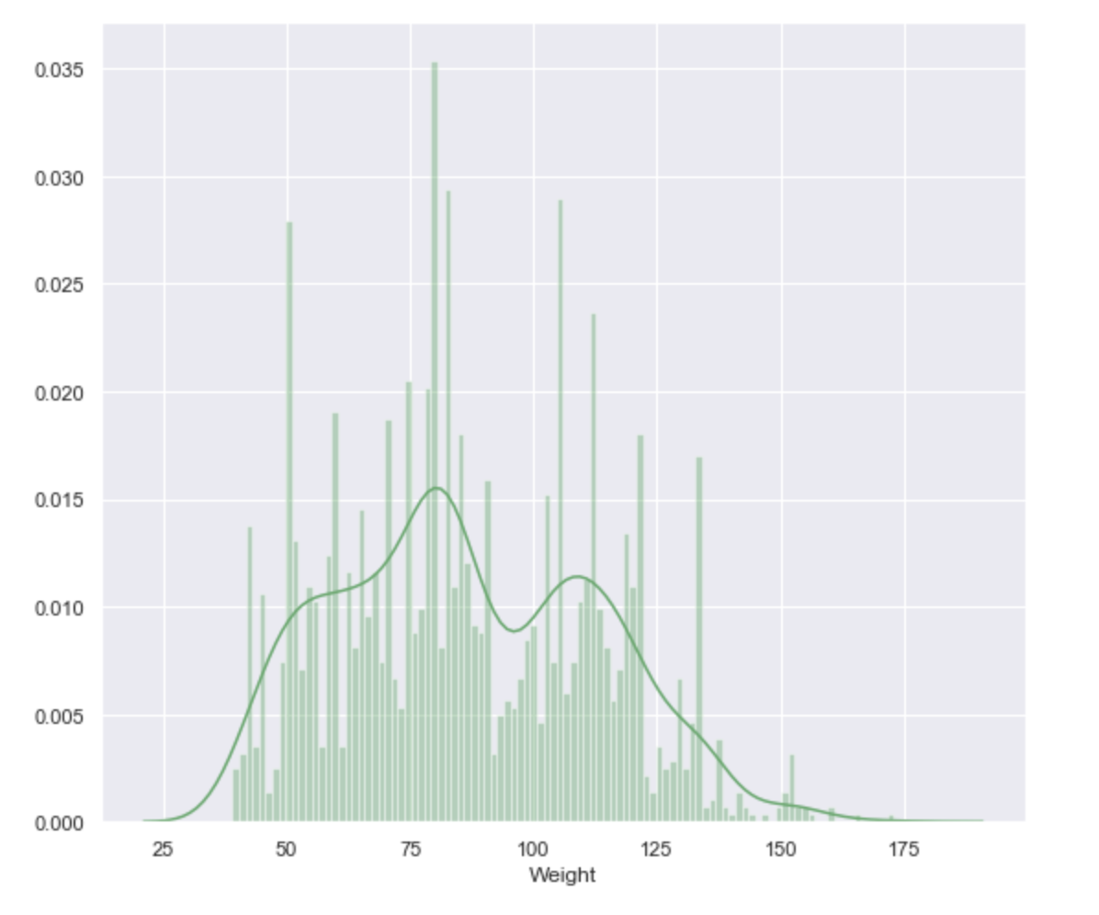
Data Visualization
Percentage distribution of the population weight distribution
We can distinguish 3 bumps on the curve which could imply that the population is divided into 3 large weight groups. We can see that there are about as many people in the underweight part as overweight. An interesting data is the high distribution, about 15% of the population towards an average weight of 75 kg which is more than the average weight and confirms the tendency that this population is overweight.

Slide 7
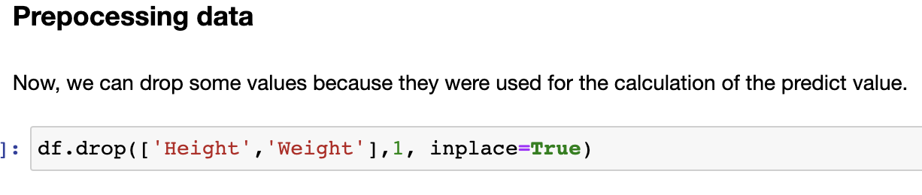
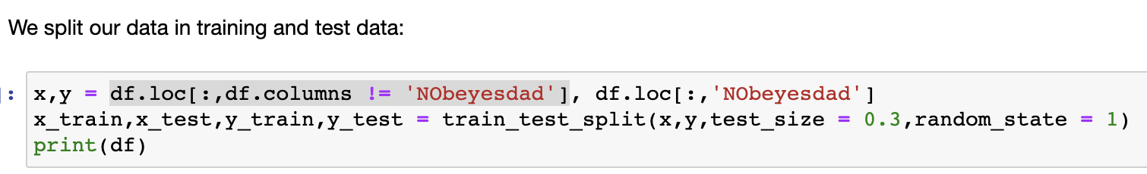
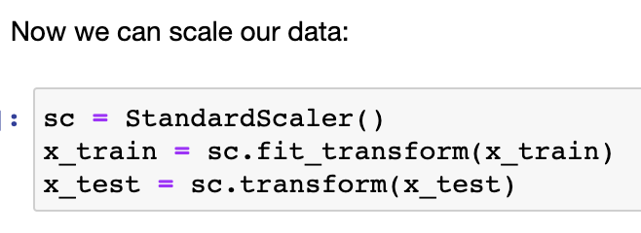
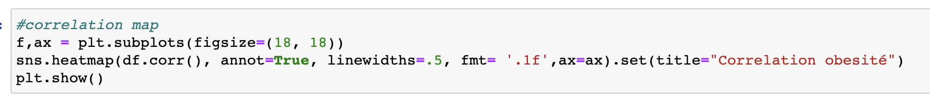
Pre-Processing
We drop features using the calculation of the predict value :
Then we split the data without ‘Nobeyesdad’ which is the target value.
We scale the value using StandartScaler function on x_train and x_test.
We display the correlation map with sns.heatmap to see the correlation between features

Slide 8
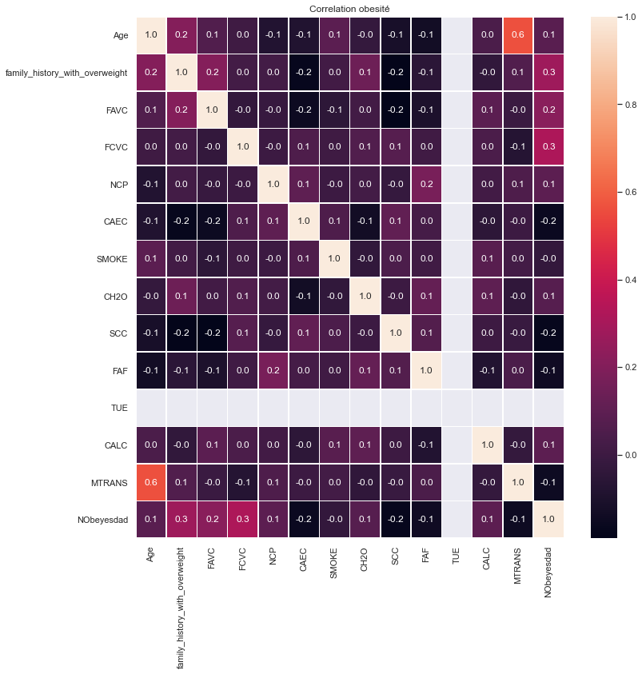
Pre-Processing
Correlation map
Important features to predict obesity:
We can see that the family history of obesity and (FCVC) the frequency of vegetable consumption are the two variables most correlated with the level of obesity (with a correlation of 0.3). They are therefore decisive.
Next comes a correlation of 0.2 (FAVC) for the frequency of consuming high calorie foods.
And finally we have a correlation of 0.1: age, the (NCP) the number of meat-based meals, (CH20) the water consumption per day and finally (CALC) the alcohol consumption .

Slide 9
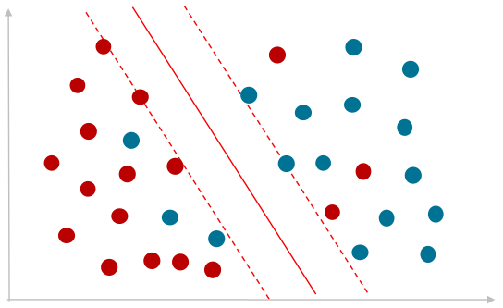
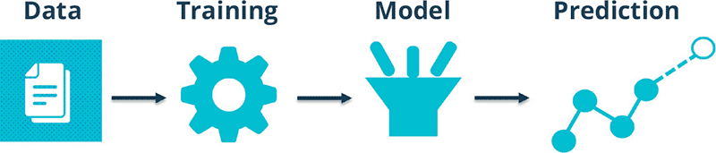
Machine Learning Models
In this part we try to define a model capable of best predicting the level of obesity based on certain variables.
We have tested several models that we will present to you one by one and you show at the end the classification between them.
We did :
KNN
Logistic Regression
LDA
Classification Tree
Random Forest
Bagging
Boosting

Slide 10
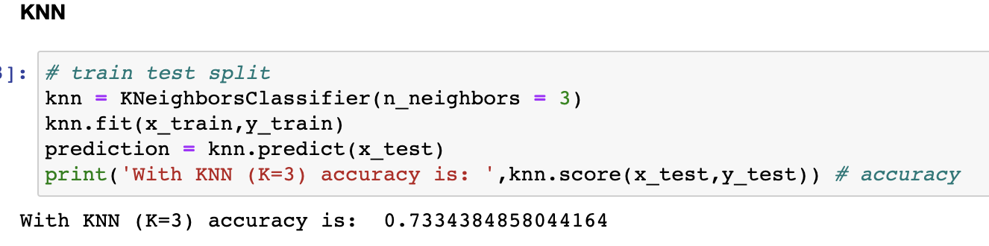
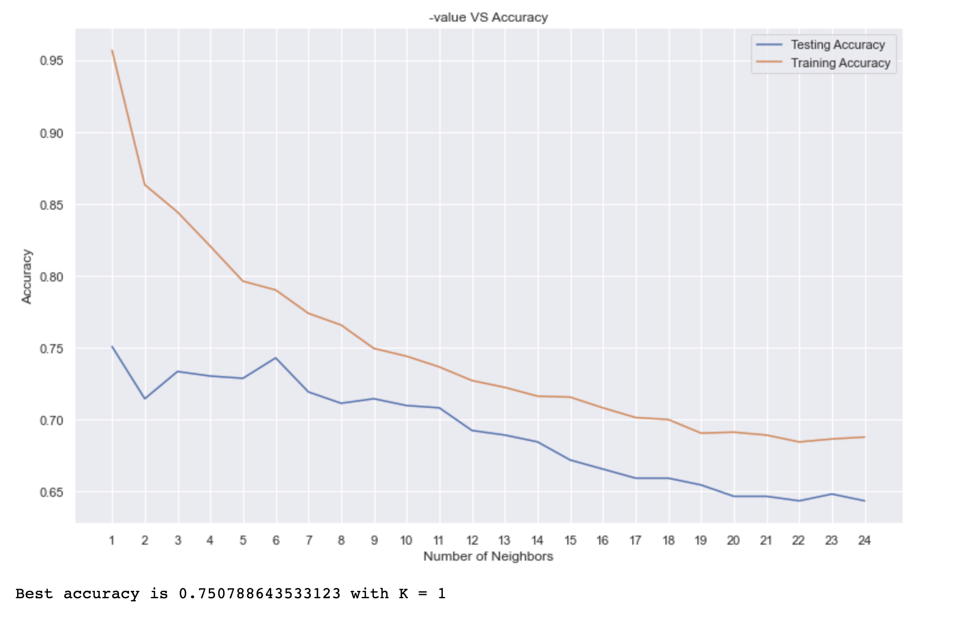
Machine Learning
KNN
We fit the KNN model using KneighborsClassifier from sklearn collection. We set to 3 the number of neighbors. We can see we have 0,73 accuracy.
We chose to display the accuracy of training_set and test_set according to the number of neighbors defined in the knn.
We can see that the best model is with 1 neighbor, which gives an accuracy of 0.75.

Slide 11
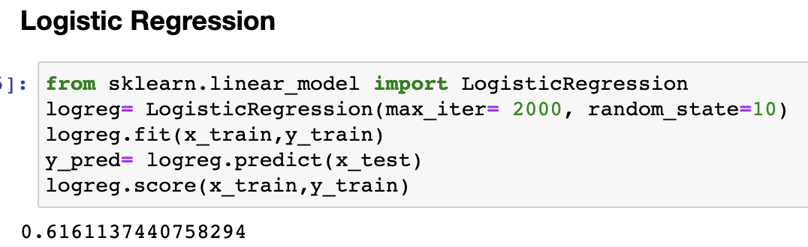
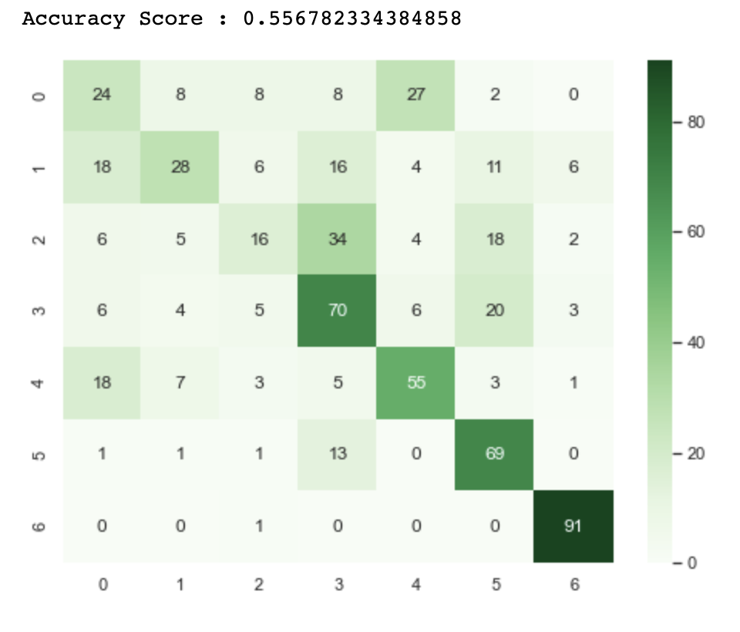
Machine Learning
Logistic Regression
We fit the Logistic Regression model using LogisticRegression from sklearn collection.
Thanks to the confusion matrix we see that the accuracy of the model is 0.55. It’s less than the KNN model.

Slide 12
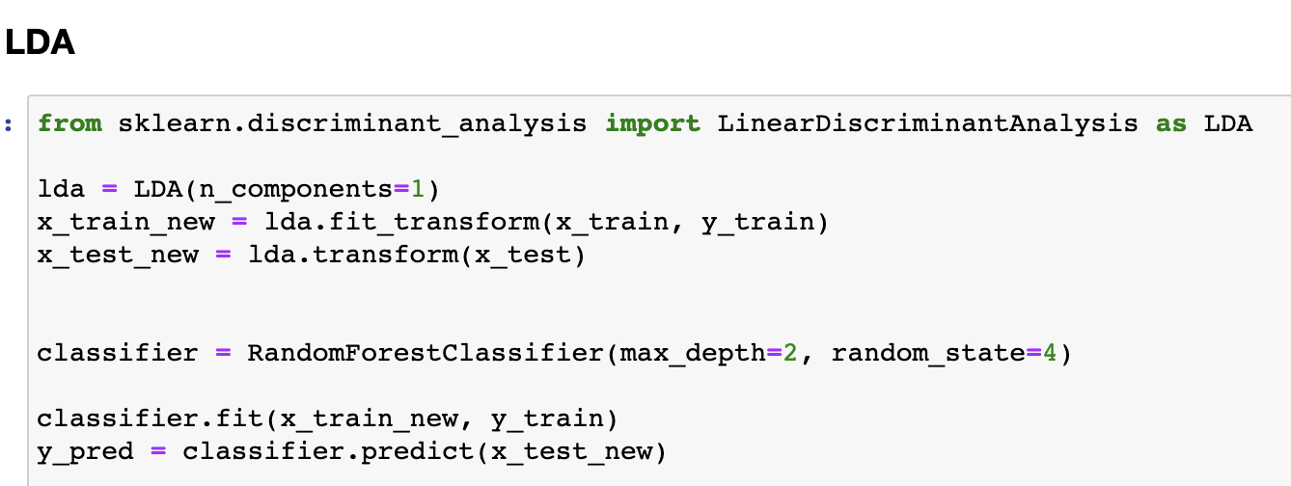
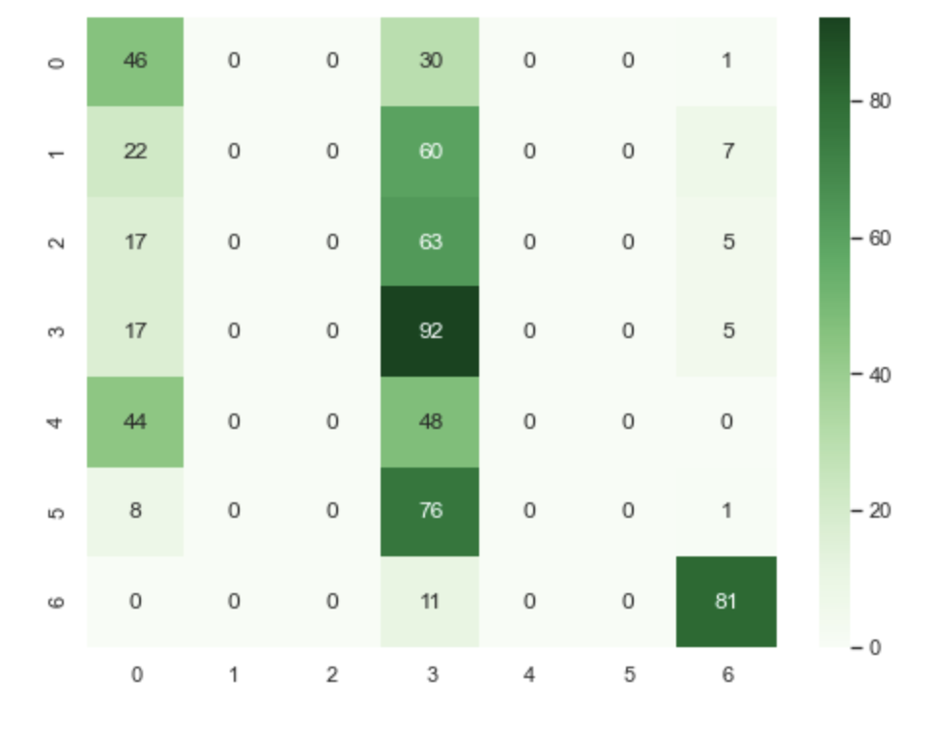
Machine Learning
LDA
We fit the LDA model using LinearDiscriminantAnalysis from sklearn collection.
Thanks to the confusion matrix we see that the accuracy of the model is 0.34. It’s less than the KNN and the Logistic Regression model.

Slide 13
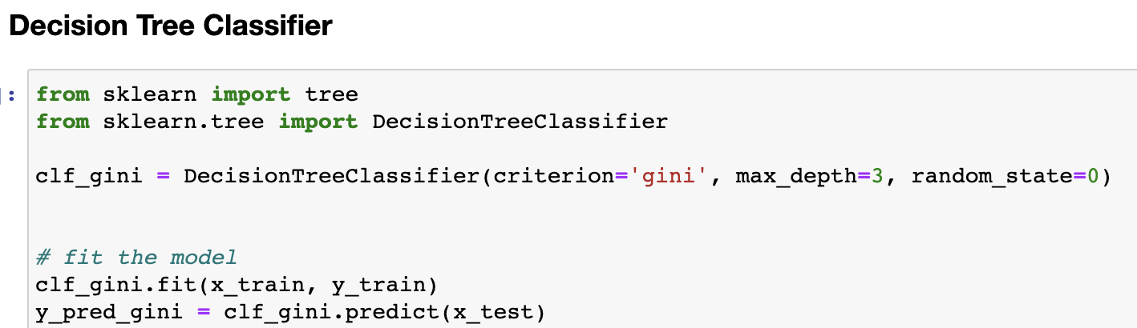
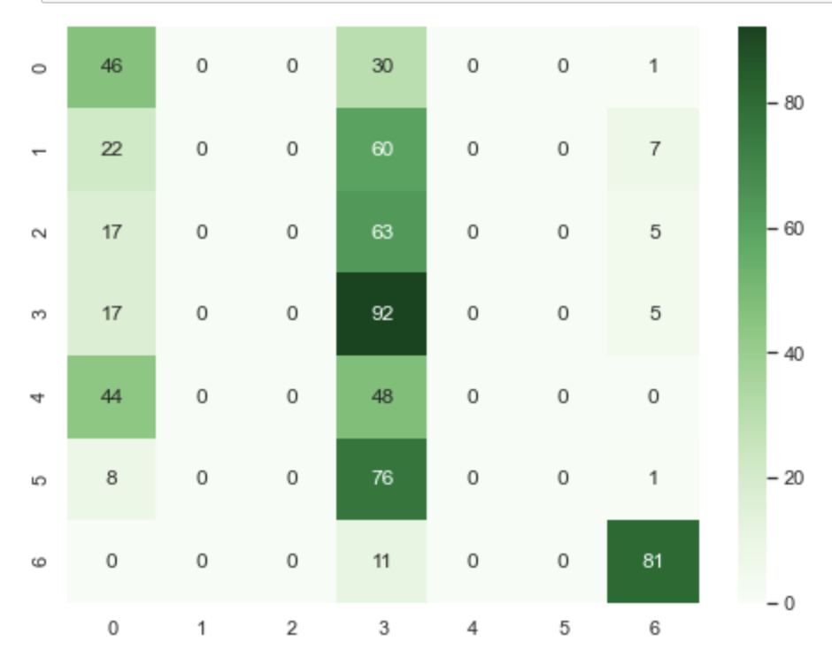
Machine Learning
Decision Tree Classifier
We fit the Decision Tree model using DecisionTreeClassifier from sklearn collection. We use the ‘gini’ criterion.
Thanks to the confusion matrix we see that the accuracy of the model is 0,48. It’s less than the KNN and the Logistic Regression model but better than LDA model.

Slide 14
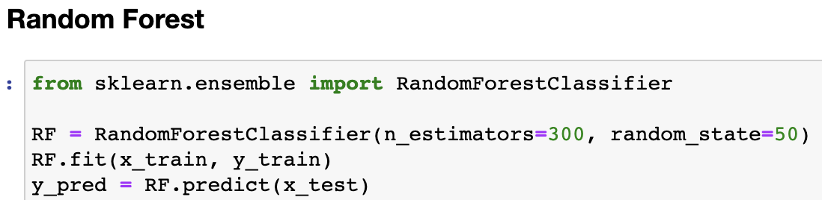
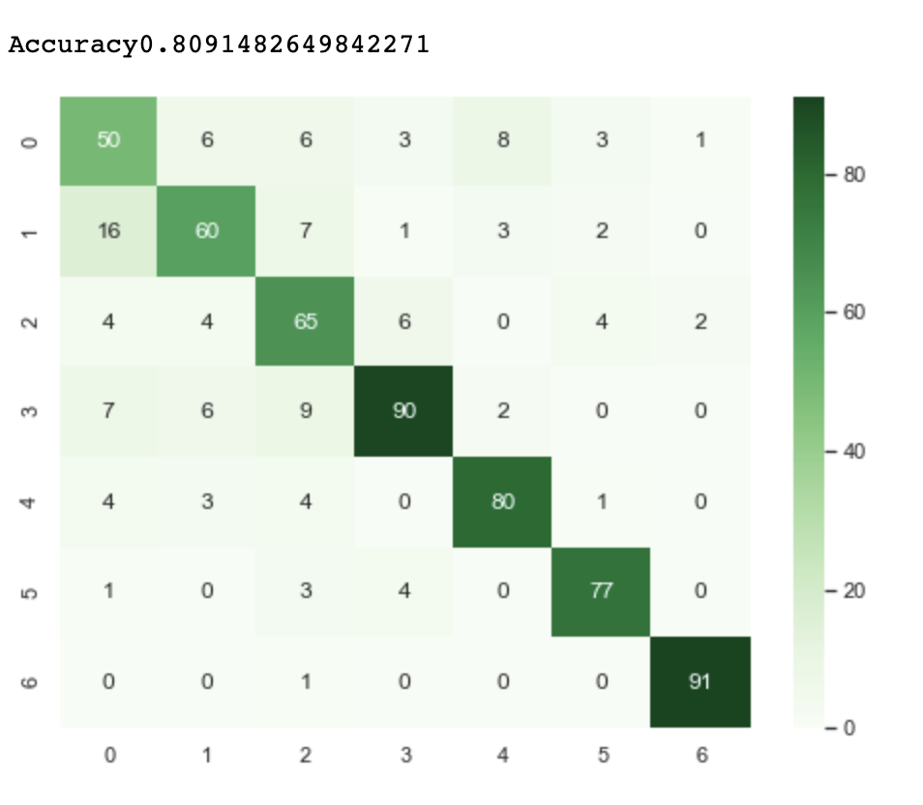
Machine Learning
Random Forest
We fit the Random Forest model using RandomForestClassifier from sklearn collection.
Thanks to the confusion matrix we see that the accuracy of the model is 0,81. It’s better than the KNN, the Logistic Regression, LDA and the Decision Tree model.

Slide 15
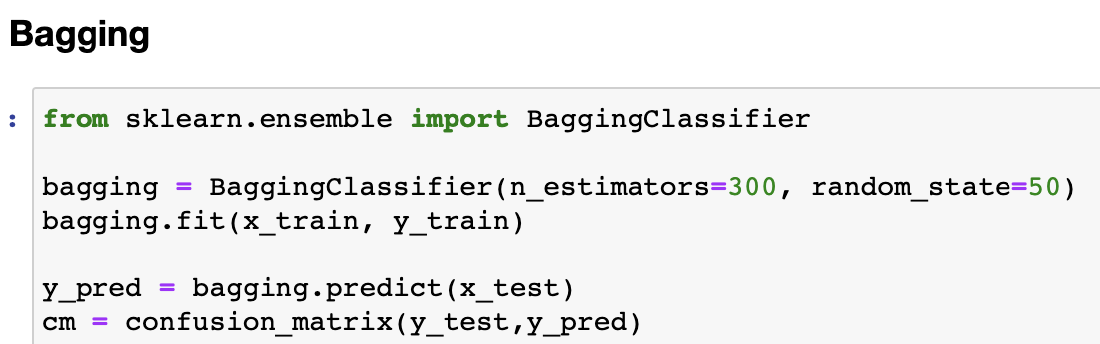
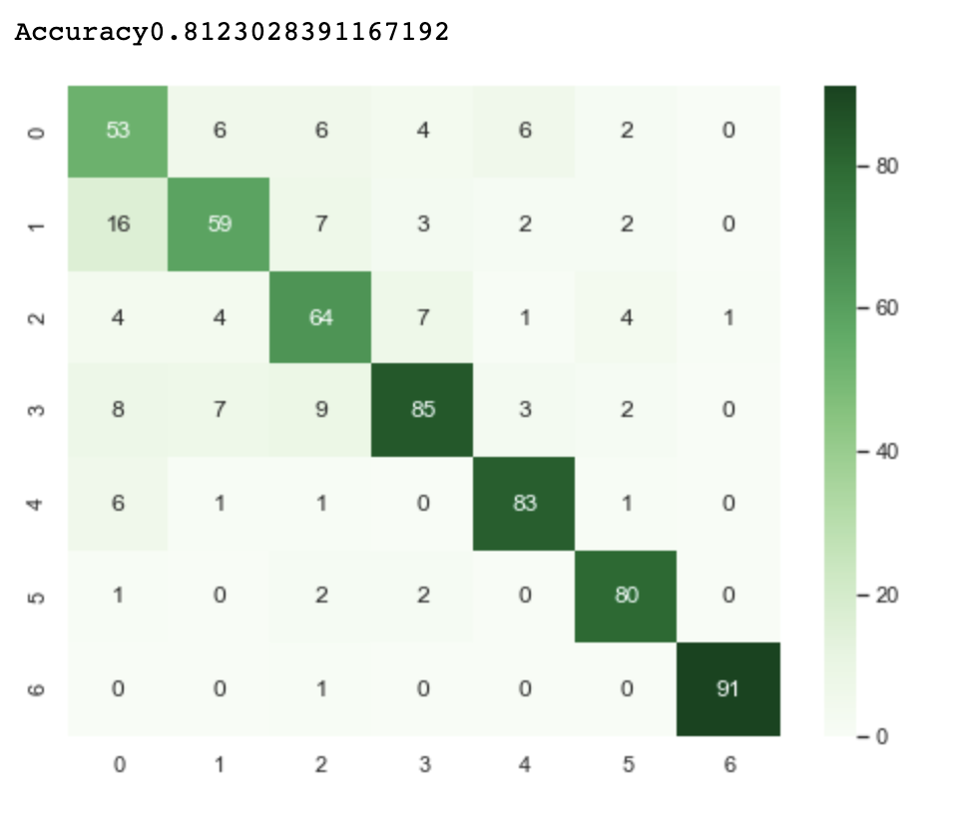
Machine Learning
Bagging
We fit the Bagging model using BaggingClassifier from sklearn collection.
Thanks to the confusion matrix we see that the accuracy of the model is 0,81. It’s better than the KNN, the Logistic Regression, LDA, Decision Tree and the Random Forest model.

Slide 16
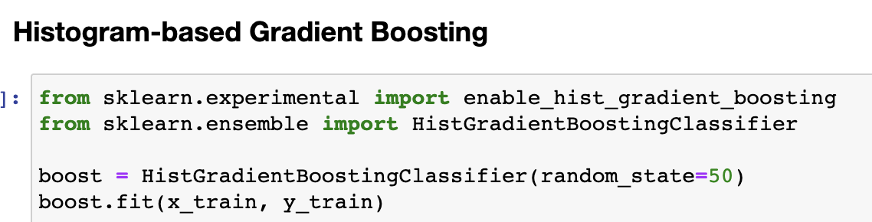
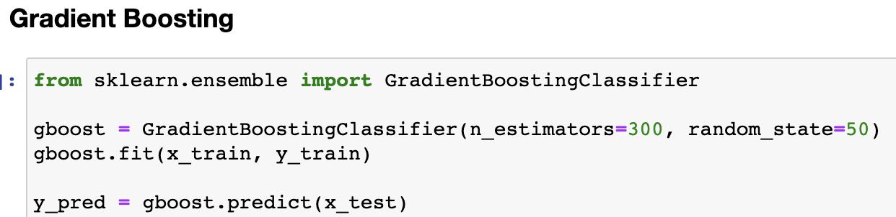
Machine Learning
Boosting
We fit two Boosting model. The first one using HistGrandientBoostingClassifier and the second using GradientBoostingClassifier.
Thanks to the confusion matrix we see that the accuracy of the two model is 0,80. It’s better than the KNN, the Logistic Regression, LDA, Decision Tree, Random Forest model but less than Bagging

Slide 17
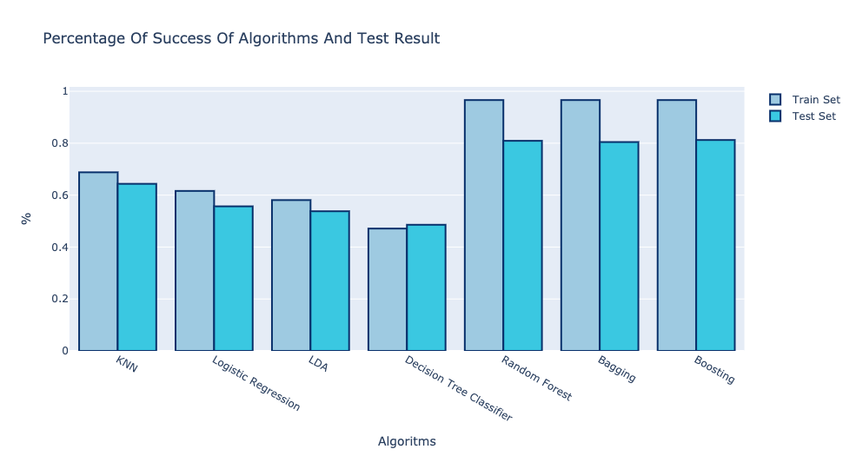
Machine Learning
Results
We can see on this graph all the accuracies scores of each of the models on the train_set and on the test_set. We have decided to keep the RandomForest model which offers very good results.

Slide 18
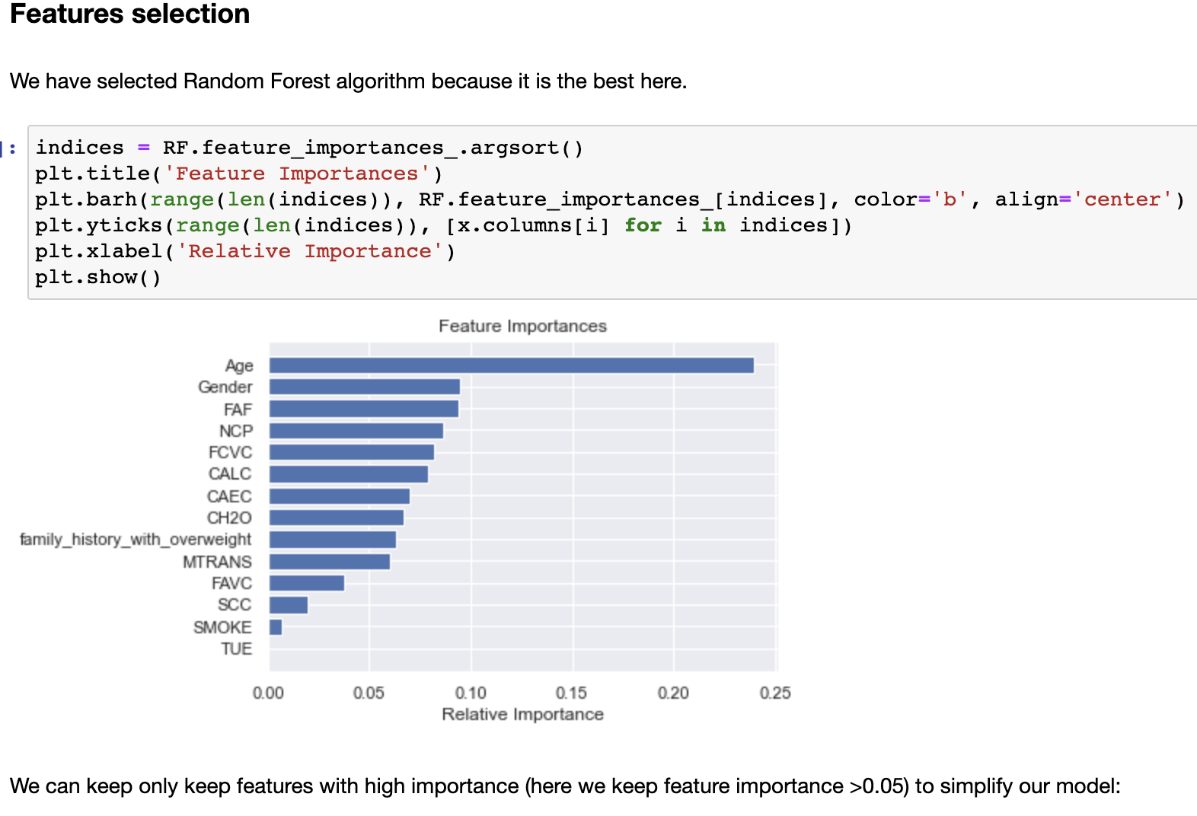
Machine Learning
Features Selection
Before finalizing the model to be used on our API, we wanted to simplify it by removing the very unimportant variables in the role of predicting the level of obesity. So here are the least important values on the graph.
Finally we keep these variables:
Gender
Age
Family_history_with_overweight
FCVC
NCP
CAEC
CH2O
FAF
CALC
The accuracy drops by 2% but the model is simpler.

Slide 19
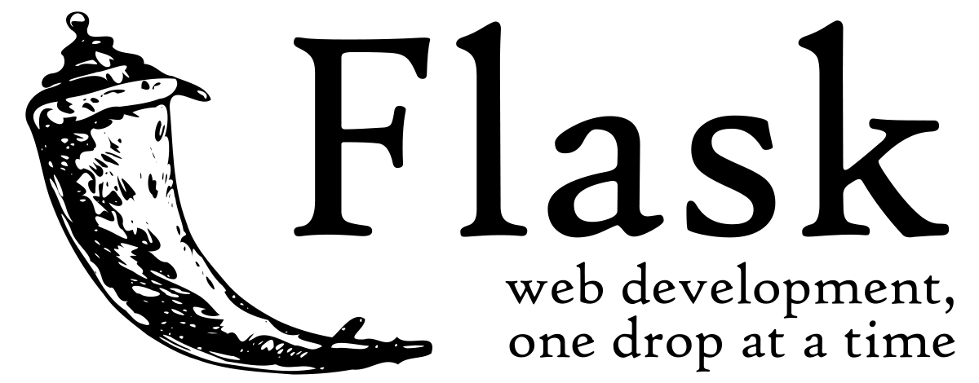
API
Framework used
To develop our API with python, we had two choices: Django or Flask. We chose Flask because it is lightweight than Django. And we didn’t need complicated structures to our API, user just need to make a single POST request to obtain the prediction.

Slide 20
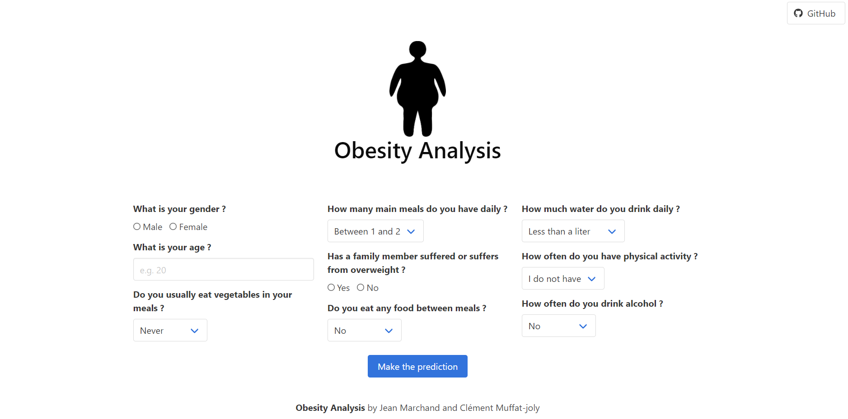

API
Website
Moreover, the Flask project is composed in two parts. One is the API that any program can call. And the second one is the website where any user can interact with to obtain a prediction. To predict the obesity level, we used the model’s dump obtained by the notebook. Also, we used Bulma for the CSS of our website and Pickle to use the model’s dump for the website and the API.

