Slide 1
Title: System Performance Dashboard Course: Operating Systems
Presented By: Aurshia Mudassar

Slide 2
What My Project Does:
This project monitors real-time system performance, including:
CPU Usage
RAM Usage
Disk Usage
Network Speed
Battery Status
It helps visualize how the Operating System manages hardware resources.

Slide 3
Why This Project Matters:
Detects system slowness
Shows CPU load during multitasking
Shows memory pressure
Tracks battery health
Helps with troubleshooting and optimization

Slide 4
OS Concepts Covered:
CPU Scheduling
Memory Management
Process Management
Disk I/O & File System
Network Stack Management
Power Management
System Calls

Slide 5
Tools & Technologies Used:
Tech Stack:
Python
psutil
Tkinter (UI)
Matplotlib (optional)
Why psutil?
Reads system metrics from OS
Uses system calls
Cross‑platform

Slide 6
How psutil Works:
psutil accesses OS-level data using:
/proc (Linux)
Windows Management API
macOS system APIs
It collects:
CPU %, RAM %, Disk usage, Network stats, Battery data.

Slide 7
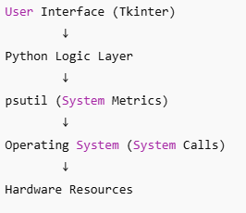
Project Architecture:

Slide 8
Features of the Dashboard:
Live CPU usage
Live RAM usage
Disk space info
Network upload/download speed
Battery percentage
Auto-refresh every second

Slide 9
Real-Life Use Cases:
IT system monitoring
Laptop health checking
Gaming performance checking
Educational OS demonstration
Troubleshooting slow systems

