Slide 1
DATA SCIENCE
10 WEEK PART TIME COURSE
Week 2 – Command History and Definitely the last bit of GIT

Slide 2
AGENDA
Recalling history

Slide 3
ipython history
DATA SCIENCE PART TIME COURSE

Slide 4
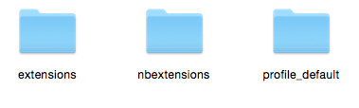
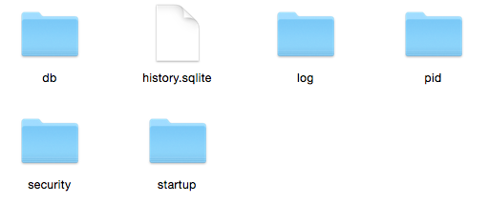
ipython history
Semi-invisible folder called “.ipython” in your home directory
Windows: C:\Users\yourname\.ipython
OSX/Linux: ~/.ipython
Command history database

Slide 5

What is SQLite?
Free, tiny, embedded SQL database
The most popular database in the world
Python (including pandas) can read it
Command-line interface: sqlite
Download it manually if nothing else has
Small. Fast. Reliable.
Choose any three.

Slide 6
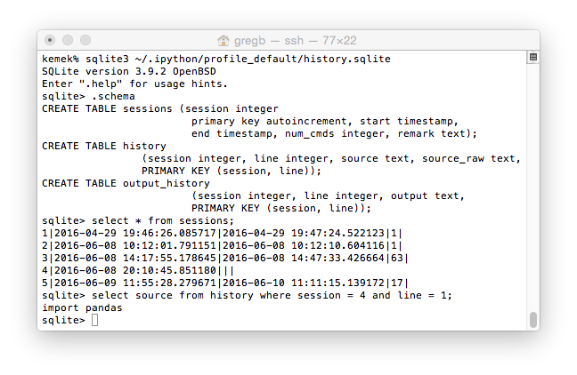
SQLite session

Slide 7
Command Shell
DATA SCIENCE PART TIME COURSE

Slide 8
BASH (Default UNIX / Linux / OSX Shell)
Stored in a plain text file
Environment variable called “HISTFILE”
Default file is ~/.bash_history
Show last 20 with history 20
Or tail -20 ~/.bash_history

Slide 9
MS-WINDOWS
Cmd.exe: doskey /history
Powershell: Get-History 10 –count 10

Slide 10
Any Requests? Cities & Populations?
DATA SCIENCE - Week 2 Day 1

Slide 11
Definitely the last bit of git Unless you want to learn about the branching workflow
DATA SCIENCE PART TIME COURSE

Slide 12
Keeping in Sync with the course repository
Plan B
git remote add upstream \
https://github.com/solresol/SYD_DAT_5.git
git pull --no-edit upstream master
git push
Plan A
Create pull requests each Monday when you get to class
Approve your pull request

