Slide 1
DATA SCIENCE
11 WEEK PART TIME COURSE
Week 3 - Regression
Monday 4th April

Slide 2
AGENDA
Motivation
Supervised Vs Unsupervised learning
What is Linear Regression?
How do Run a Linear Regression Model?
Lab
Discussion / Review / Homework

Slide 3
WHAT ARE THE GOALS OF STATISTICAL LEARNING?
DATA SCIENCE PART TIME COURSE

Slide 4
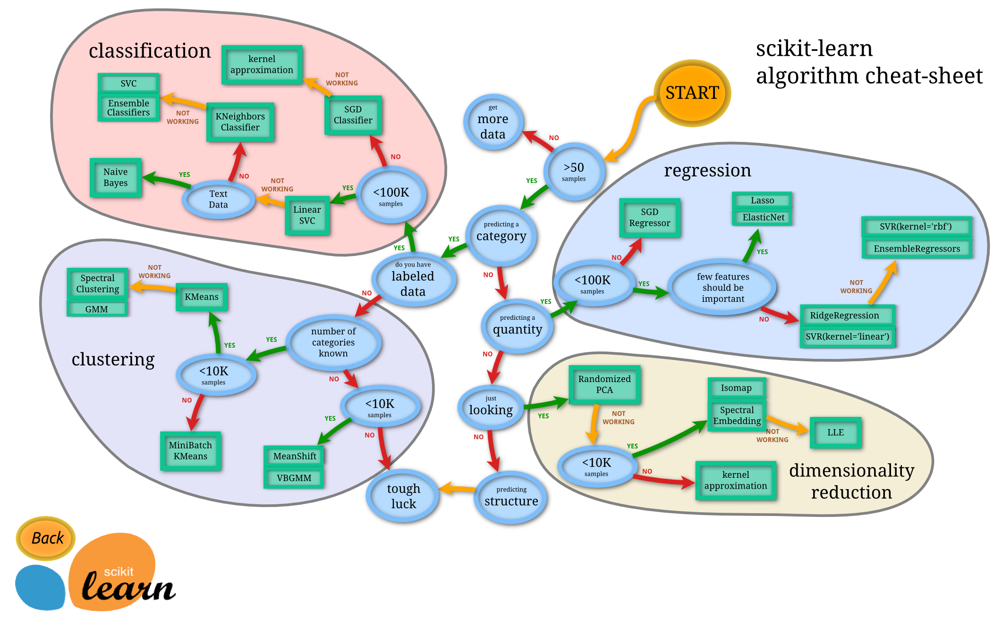

Slide 5
SUPERVISED LEARNING
We want to predict some value, let’s call it y, based on some observed data we have, let’s call that x.
We will use statistical learning to estimate a function that approximates y based on the input, x.
y is also called; label, dependent variable, target
x is also called; predictor, independent variable, features

Slide 6
SUPERVISED LEARNING - EXAMPLE
We want to predict the price of a house, let’s call it y, based on some observed data we have about the area, number of bedrooms, size of the house, and if it has a pool or not.
The area, number of bedrooms, size of the house, and if it has a pool or not would be our x variables (sometimes you might see this denoted as X)
What we want is y = f(X), a way to describe the house price based on observed data

Slide 7
SUPERVISED LEARNING - REGRESSION & CLASSIFICATION
If the y variable is numeric then we have a regression problem - we are trying to predict a continuous number
If the y variable is a category (for example trying to predict a type of flower) the we have a classification problem - we are trying to classify what group that y belongs to.

Slide 8
UNSUPERVISED LEARNING
We want to find some underlying structure or patterns in the data but in this case we don’t have any labeled data.
So for example, if we have a large group of customers but would like to separate them into groups (or clusters) to better target them.

Slide 9
WHAT IS LINEAR REGRESSION?
DATA SCIENCE PART TIME COURSE

Slide 10
LINEAR REGRESSION
We want to model a linear relationship (think straight line) between our target variable y and our input variable x.
y=Xβ+ϵ

Slide 11
LINEAR REGRESSION
y=Xβ+ϵ
y = target variable
X = input variable
β = coefficients
ϵ = error term
Note, one of our input variables can be 1 so we have an intercept parameter

Slide 12
LINEAR REGRESSION - REQUIREMENTS
Linear relationship in the parameters, β, we can transform the actual values of the inputs if we want
Variance of the error term, ϵ, is constant. This means there is no systematic pattern in the values of X and the variance of ϵ
The mean of ϵ = 0
ϵ has a normal distribution
No perfect (or near perfect) co-linearity between any of the input variables. Otherwise the fitting procedure will break.

Slide 13
HOW TO RUN LINEAR REGRESSION?
DATA SCIENCE PART TIME COURSE

Slide 14
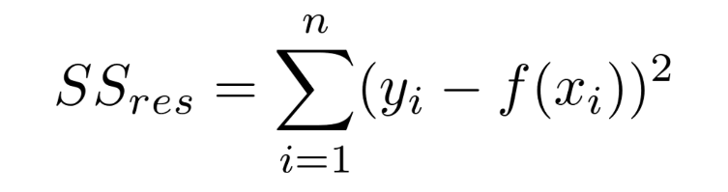
ORDINARY LEAST SQUARES
y=Xβ+ϵ
Basically, what we are trying to do is minimise the Residual Sum of Squares. This is the Sum of the squared difference between our observed value and the value from the model

Slide 15
ORDINARY LEAST SQUARES
y=Xβ+ϵ
Basically, what we are trying to do is minimise the Residual Sum of Squares. This is the Sum of the squared difference between our observed value and the value from the model

Slide 16
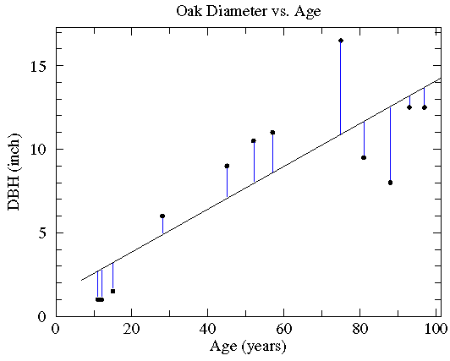
ORDINARY LEAST SQUARES

Slide 17
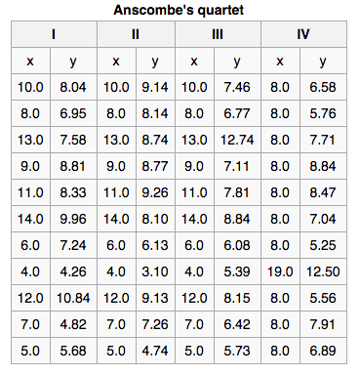
LINEAR REGRESSION - IMPORTANT STEP
Make sure you visualise your data and check the actual model fit !!!
The fitting a model to the four datasets in the table on the right produce the same fit statistics, model coefficients and standard error
See anything wrong?

Slide 18
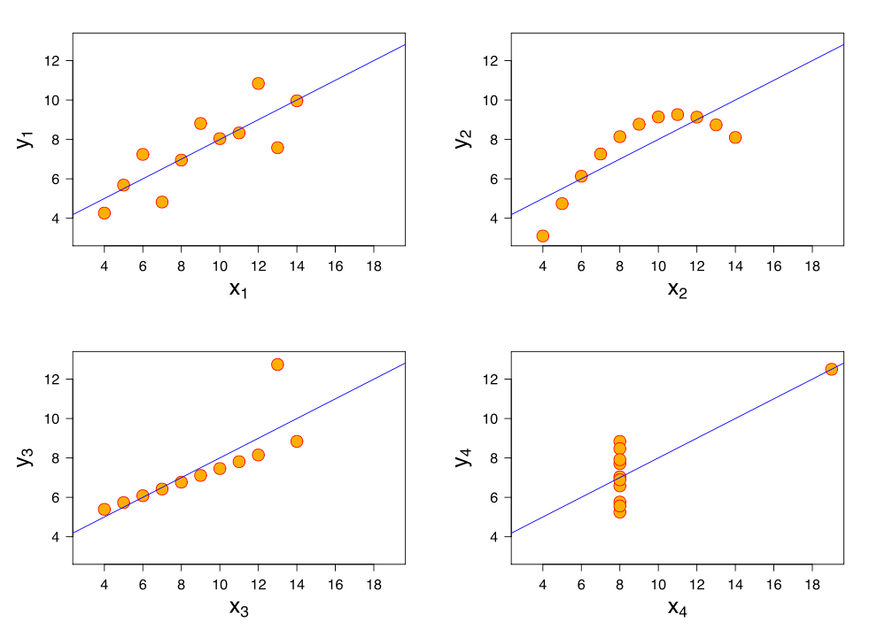
LINEAR REGRESSION - IMPORTANT STEP

Slide 19
LAB
DATA SCIENCE PART TIME COURSE

Slide 20
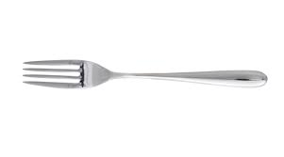
SYNCHING A FORK
git remote -v
git remote add upstream https://github.com/ihansel/SYD_DAT_4.git
git remote -v
git fetch upstream
git checkout master
git merge upstream/master

Slide 21
DISCUSSION TIME
DATA SCIENCE - Week 2 Day 2
DISCUSSION TIME
Review of last class
Further Reading for Regression
Check in with homework/course project

Slide 22
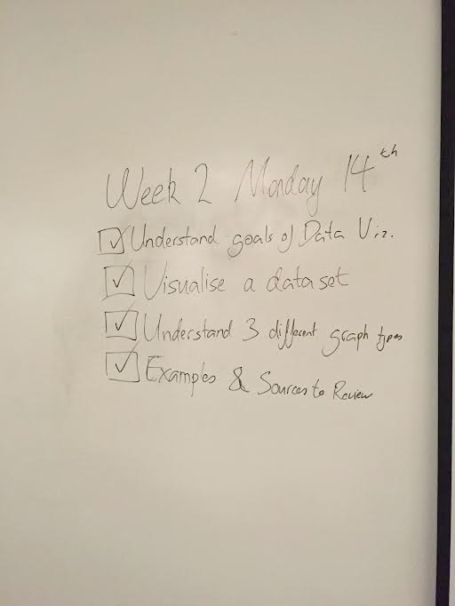
WEEK 2 - Wednesday

Slide 23
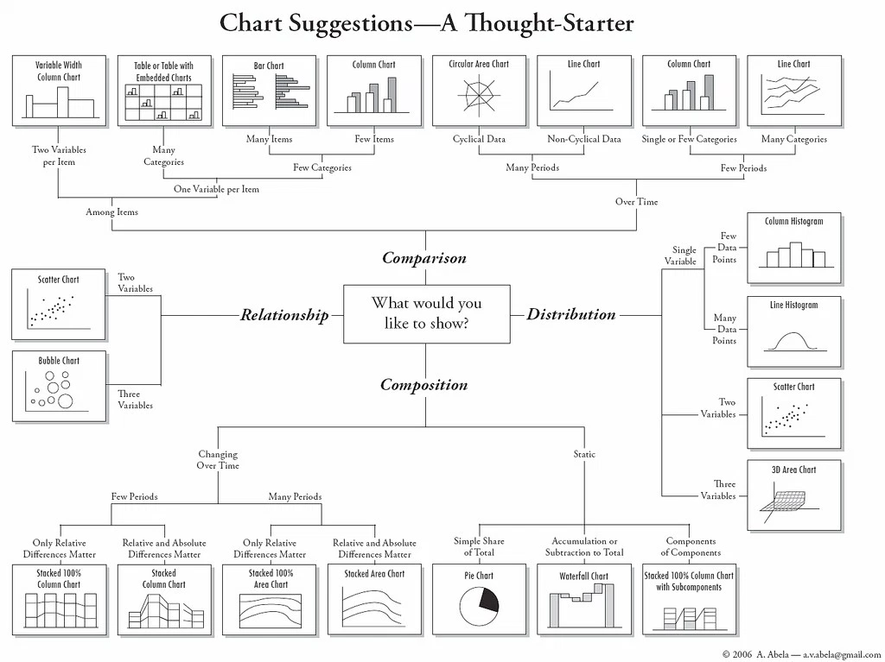

Slide 24
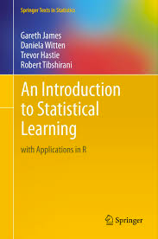
DISCUSSION TIME
An Introduction to Statistical Learning
Chapter 3 - Linear Regression (59 -75)
Chapter 4 - Classification (127 - 137) by Wednesday
DATA SCIENCE - Week 3 Day 1

Slide 25
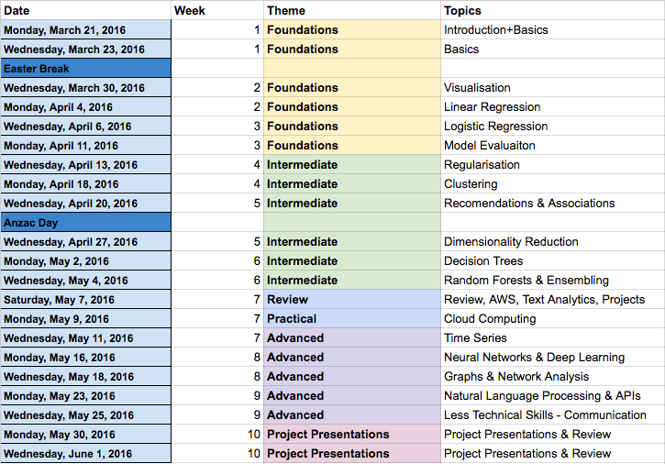

Slide 26
DISCUSSION TIME
Homework/Course Project
How’s it going ?
DATA SCIENCE - Week 3 Day 1

