Slide 1

PROJECT PRESENTATION ON “Inquisitive Minds”
Presented by Ayushi Singh
Email :ayushic2210@ gmail.com

Slide 2
CONTENTS:
Introduction
System Requirement Specification
1)Purpose
2)Scope
3)Overall Description
3.1)Project Perspective
3.1.1)User Interface
3.1.2)Software Requirements
3.1.3)Hardware Requirements
3.1.4)Communication Interface
3.1.5)Operations
3.1.6)Site Adaptation Requirements
3.2)Product Functions
3.3)User Characteristics
3.4)Assumption and dependencies

Slide 3
4)Specific Requirements
4.1)External Interface Requirements
4.1.1)User Interface
4.2)Functional Requirements
4.3)Software System Attributes
Software Design Specification
1)Introduction
2)System Architectural Design
2.1)High Level Design Overview
2.2)Structure Chart
2.3)Sequence Diagram
2.4)Activity Diagram
3)Data Design
3.1)Class Diagram
3.2)Database Description
4)Human Interface Design
5)Testing Issues
References

Slide 4

INTRODUCTION
“Inquisitive Minds” offers you an amazing platform
to put forth your queries, dilemmas and confusion
and resolve them. It also offers an stage to showcase
your knowledge and help others with your skills.

Slide 5
SOFTWARE REQUIREMENT SPECIFICATION

Slide 6
PURPOSE
“A software requirements specification (SRS) is a document that
captures complete description about how the system is expected to
perform.”
The purpose of this document is to give a detailed description of the
requirements for the website “INQUISITIVE MINDS". It will
Illustrate the purpose and complete declaration for the development
of system. It will also explain system constraints, interface .
The intended audience for this SRS are:
Developer.
Designer.
Project Tester.
End-User.

Slide 7
SCOPE
The website “INQUISITIVE_MINDS” is a question answer portal which can be used within any organisation.
A user can ask their query and view responses of others to his queries. He can also resolve query of any other user.
An administrator here is a Database Administrator who keeps the record of all user information and keeps them accurate at database server.
The only requirement to query and answer is that the user must be a part of same network. All user information is maintained in database. Their submitted queries and answers are submitted in corresponding files.

Slide 8

OVERALL DESCRIPTION
PRODUCT PERSPECTIVE:
This project is based on “Client-Server” architecture. The
website will be used to resolve user’s query. The client can be
any Guest User who can view website’s home page and can
register themselves or the client can be any Registered User
who can ask his query as well as answer query of other users.
The server (Database Server) will be used to manage user
information and their queries and answer.

Slide 9
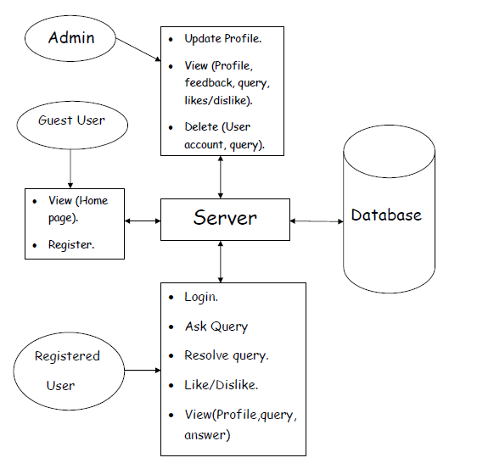
A block diagram showing system interface.

Slide 10
USER INTERFACE:
The website provides simple and interactive Graphical User Interface with description of every available option.
Each page will contain following menus (except the home page) that will direct you to respective pages:
About Us
Contact Us
FAQs
Help
Each page will contain navigation bar containing links to various pages user wants to visit for easy navigation.

Slide 11
SOFTWARE REQUIREMENTS:
Server Side:
OS – Windows Server 2003 or onwards
Web Server – Apache Tomcat 7.0.63
Database Server – SQL Server 2005
Client Side:
OS -Any Operating System (above Windows-7).
Browser – Any browser compatible with IE 5.0 or onwards.
Developer Side:
OS – Windows 7 or above.
IDE- Net Beans 8.2
Front-End– JSP, HTML, CSS
Back End – Microsoft SQL Server 2005
Browser– Any browser compatible with IE 5.0 or onwards.
Web Server– Apache Tomcat 7.0.63

Slide 12
HARDWARE REQUIREMENTS:
Server Side
Processor –2.50 GHz (ex. P-IV or onwards)
RAM – 4 GB
HDD – 20GB or more (free space excluding data size)
Client Side
Processor – 450 MHz (ex. P-IV or onwards)
RAM – 2GB or above
HDD – 20GB or more (free space excluding data size)
Developer Side
Processor – 2.50 GHz (ex. P-IV or onwards)
RAM – 4 GB
HDD – 20GB or more (free space excluding data size)

Slide 13
COMMUNICATION INTERFACE:
PROTOCOLS:HTTPS,HTTP,TCP/IP
OPERATIONS:
The website will be available 24*7hrs and all its functionalities are user-initiated. The developer will have a separate login account to make changes in the website and manage user informations.The admin will handle all its data processing functionalities
SITE ADAPTATION REQUIREMENTS:
The client should have a java enabled browser.
Internetworking is required among all client systems and the server.
Firewall setting of all the client systems must be same.

Slide 14
PRODUCT FUNCTIONS:
Register .
Login.
Authentication.
Recovery of account.
Updatation of account.
Deleting of account.
Ask query.
Resolve query.
Like/dislike particular answer.
View answer.
Provide feedback for the website.
Logout from account.

Slide 15
User Characteristics:
Administrator
End users
Developer
Assumption And Dependencies:
All the clients must be interconnected through same network along with the server.
Client system must have Windows 7 or above operating system.
Client system must support TCP/IP protocol.

Slide 16
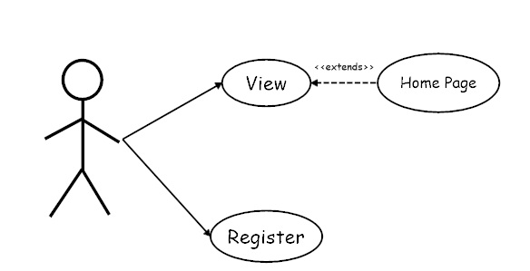
SPECIFIC REQUIREMENTS:
External Interface Requirements:
User Interfaces:
The following interfaces will be provided by the website:
GUEST USER:

Slide 17
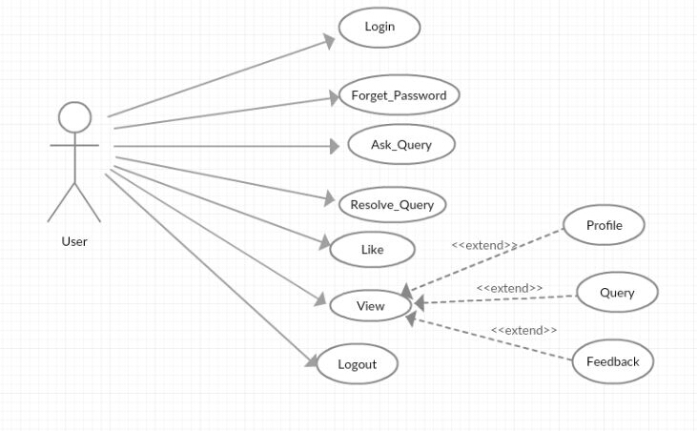
REGISTERED USER:

Slide 18
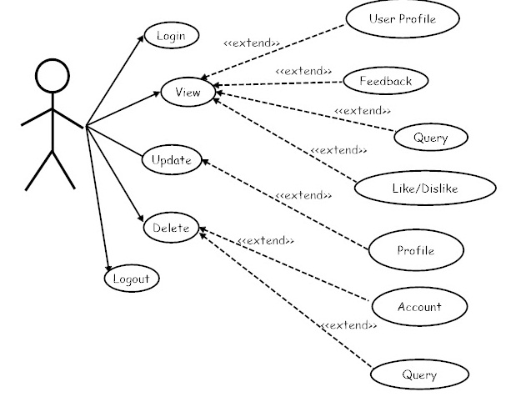
ADMIN:

Slide 19
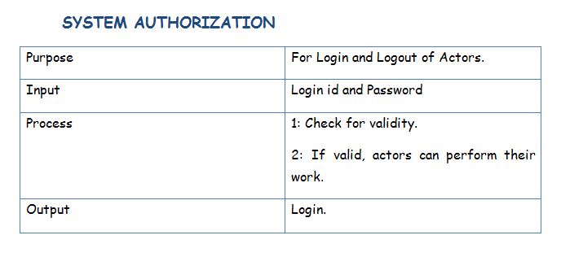
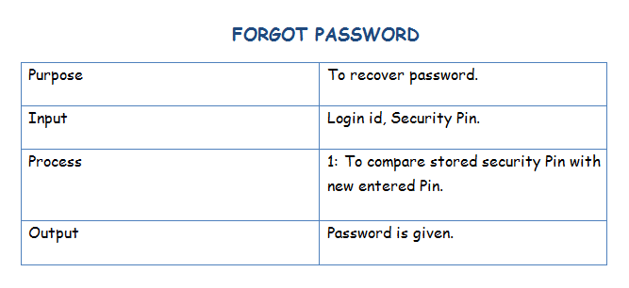
FUNCTIONAL REQUIREMENTS:

Slide 20
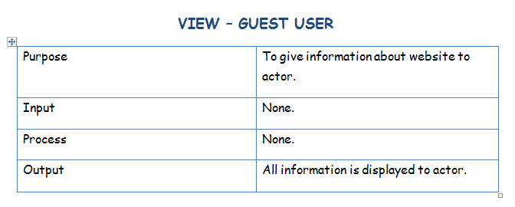
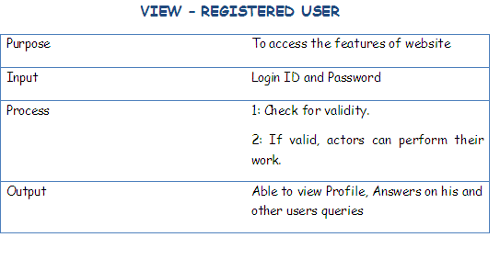

Slide 21
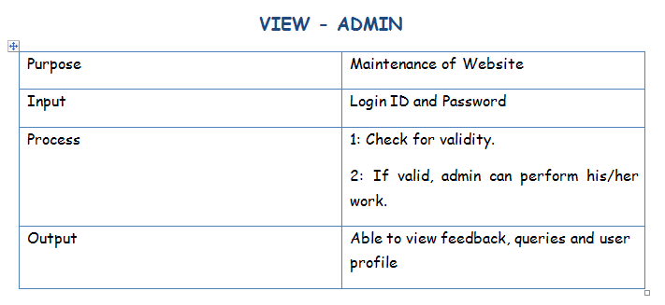
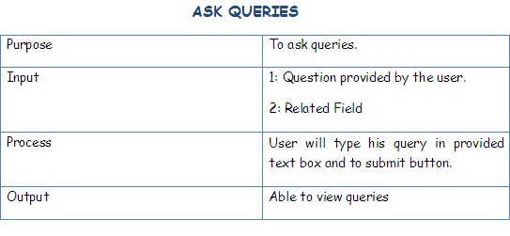

Slide 22
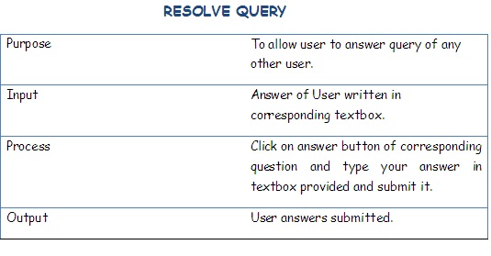
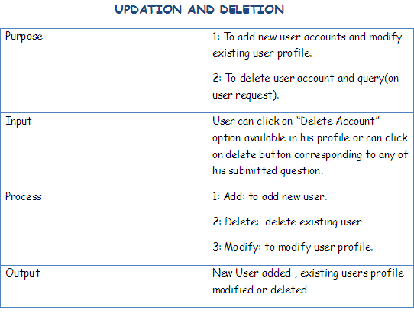

Slide 23
Software System Attributes:
There are a number of quality attributes of software that can serve as requirements. It is important that required attributes be specified so that their achievement can be objectively verified :
Reliability.
Availability.
Security.
Maintainability.
Portability.
Flexibility.

Slide 24
SOFTWARE DESIGN SPECIFICATION

Slide 25
Introduction
The software design specification is made with
purpose of outlining the system architecture and
design of INQUISITIVE MINDS. The document
facilitates the communication and understanding of
the system by providing several views of system
design.

Slide 26
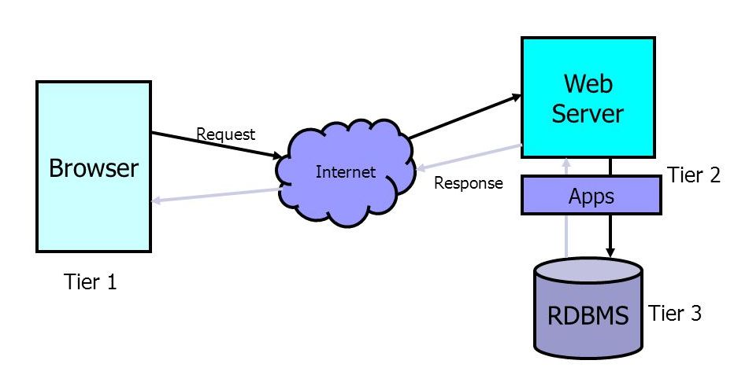
System Architectural Design:
High Level Design Overview

Slide 27
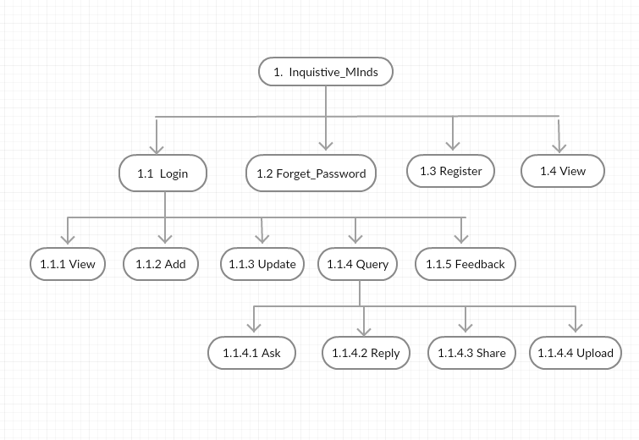
Structure Chart

Slide 28
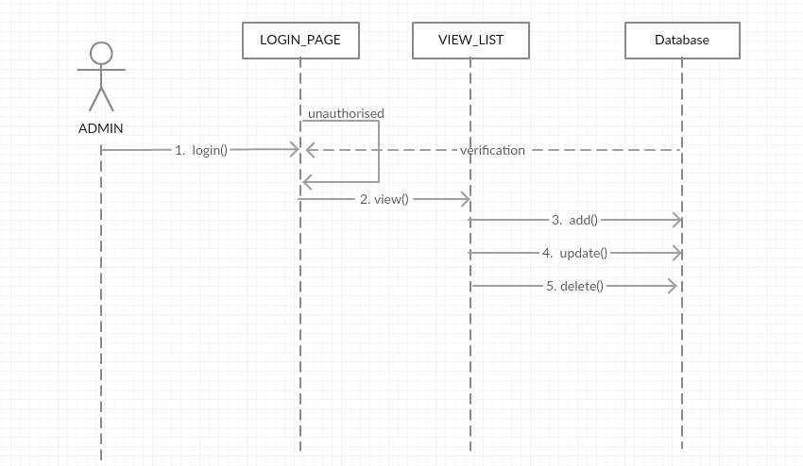
Sequence Diagrams
Admin

Slide 29
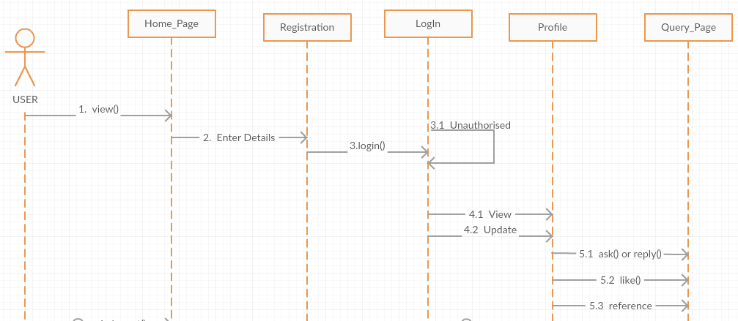
USER:

Slide 30
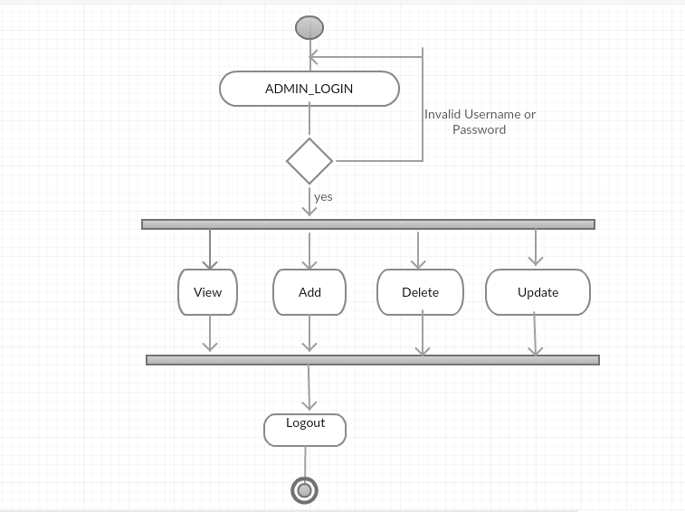
Activity Diagram
Admin

Slide 31
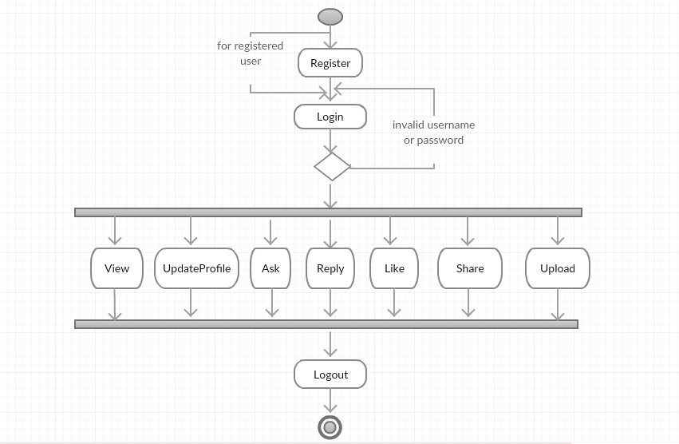
USER:

Slide 32
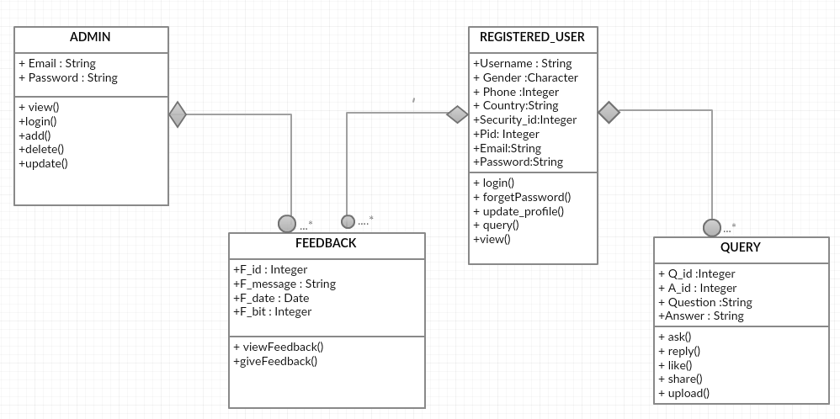
Data Design
Class Diagram

Slide 33
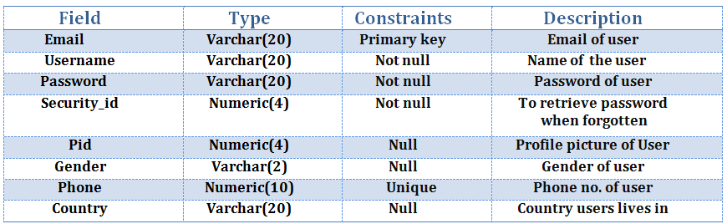
Database Description
User

Slide 34
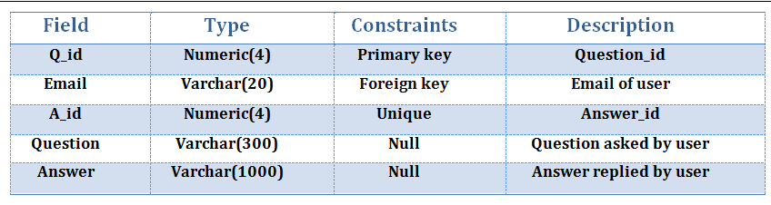
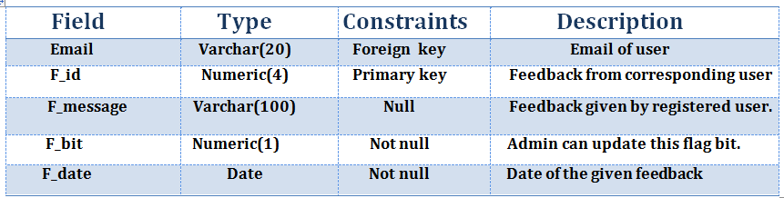
QUERY TABLE:
FEEDBACK TABLE:

Slide 35
Class Diagram

Slide 36
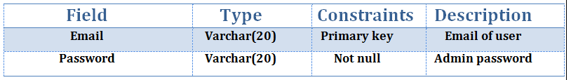
ADMIN TABLE:

Slide 37

HUMAN INTERFACE DESIGN

Slide 38
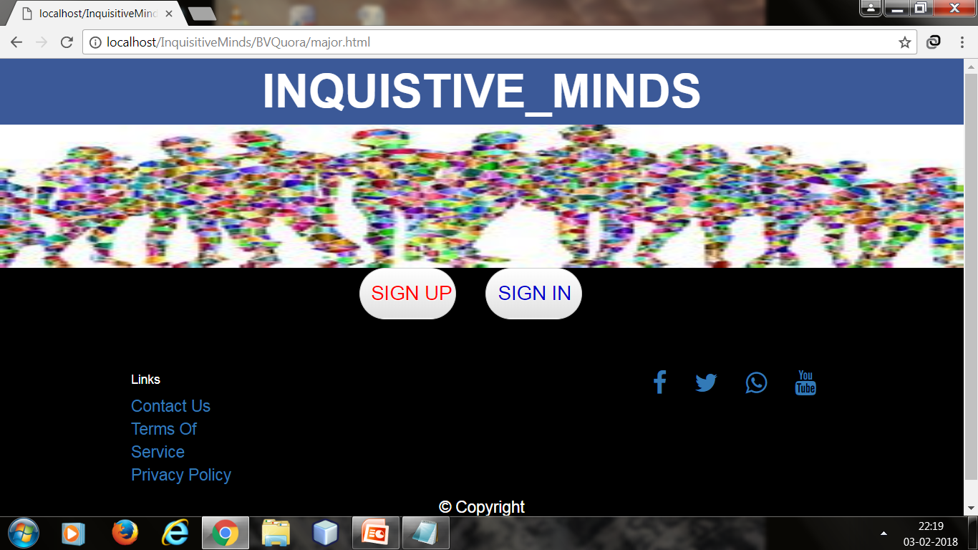
Home Page(Desktop View):

Slide 39
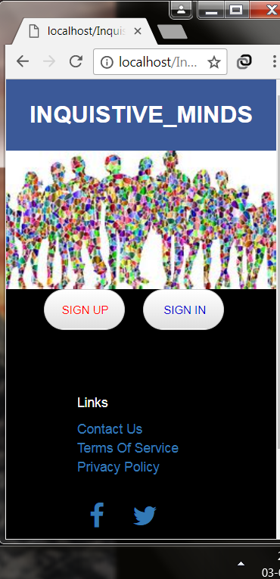
Home Page(Mobile View):

Slide 40
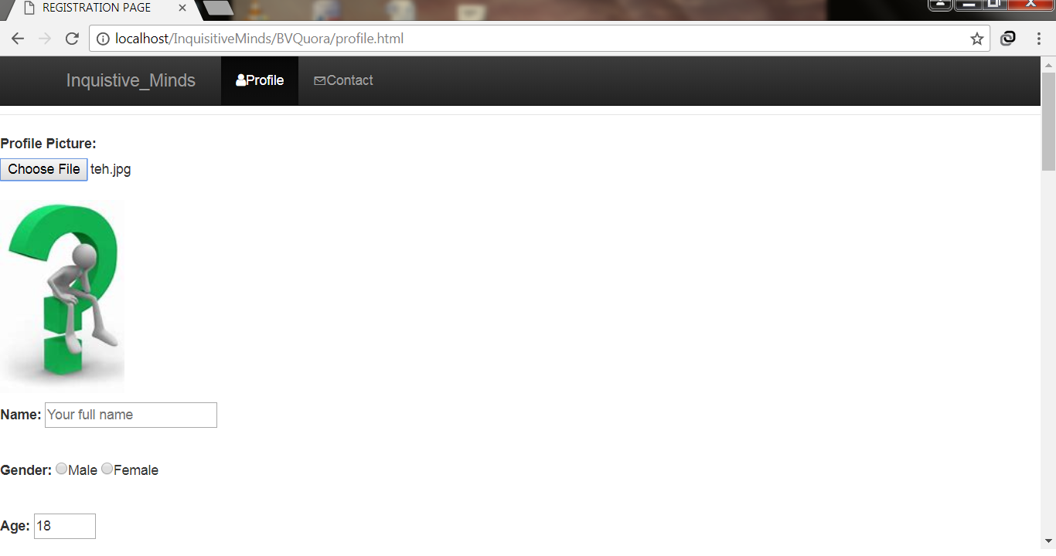
Profile Page:

Slide 41
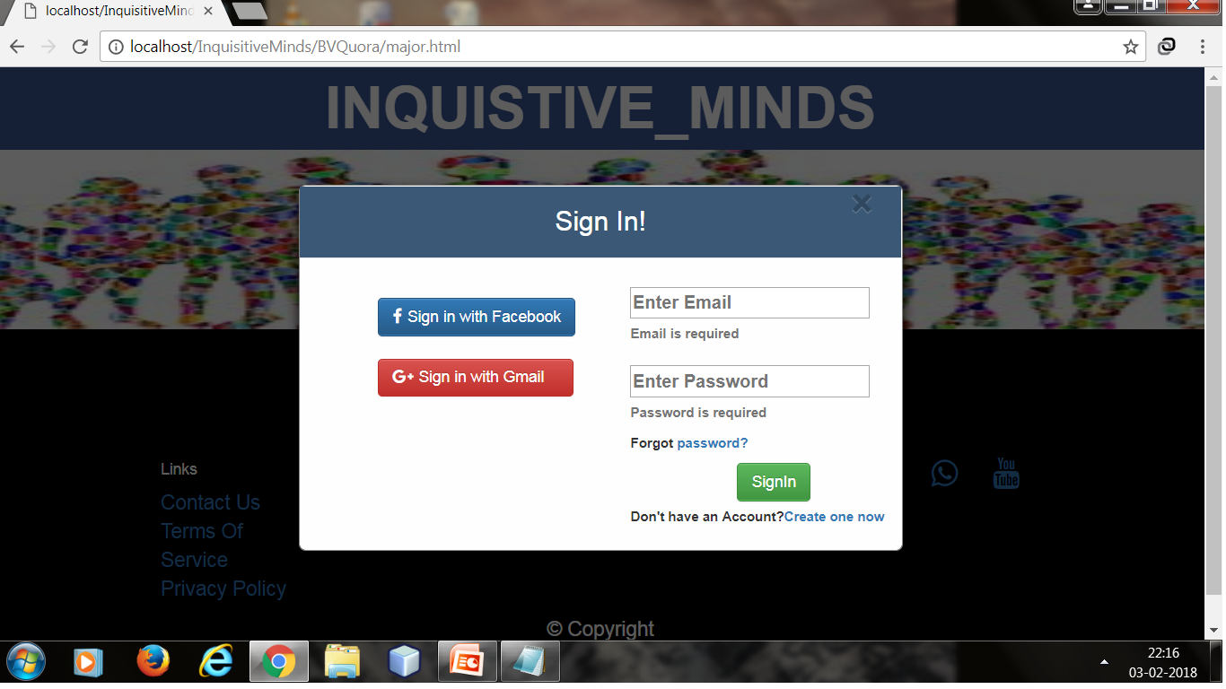
Login Page:

Slide 42
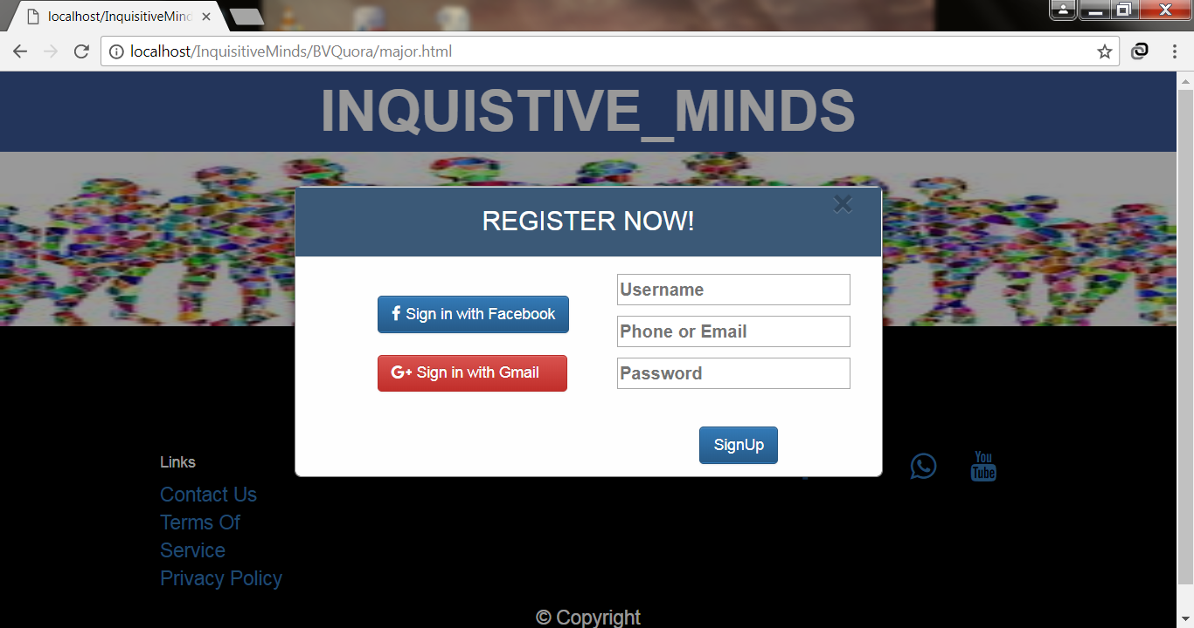
REGISTRATION PAGE:

Slide 43
Testing Issues:
Software testing is an investigation conducted to provide users
with information about the quality of the software product or
service under test.
Unit Testing :Refers to test that verify functionality of a specific section of code usually at function level. In an object oriented environment usually at class level.
Integration testing: Any type of software testing that seeks to verify the interfaces between components against a software design. It may be integrated in an iterative way.
System testing : System testing tests a completely integrated system to verify that the meets its requirement.

Slide 44
REFERENCES
IEEE Recommended Practice for Software Requirements Specification - IEEE Std. 830-1993.
IEEE Recommended Practice for Software Requirements Specification - IEEE Std. 830-1993.
Pressman Roger S., Software Engineering “A Practitioner’s Approach” Fifth Edition McGraw-Hill Publication, 2000.
Navathe Shamkant B., Fundamentals of Database Systems, Fifth Edition, Pearson Publications.

Slide 45
!!!THANK YOU!!!!

