Slide 1

Welcome
#MelbIoT 5/Mar/2020

Slide 2
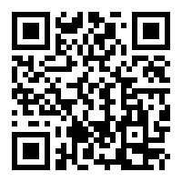
Code of Conduct
Inclusive, diverse, respectful, and friendly
https://github.com/MelbIOT/CodeOfConduct

Slide 3


Thank you sponsors
Venue, food, logistics
IoT Kits

Slide 4


Social media
#MelbIoT MelbIoT

Slide 5
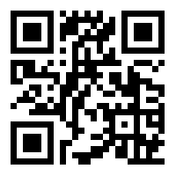
Speakers
Come and give a talk
yas.fyi/32OJSaC

Slide 6
Agenda
Intro
Patrick Haralabidis - Machine Learning on the 'edge’
DeveleporSteve – Announcements
Brendan Myers - Over-Engineering for Home IoT
Quiz
Dinner & Networking
Close

Slide 7
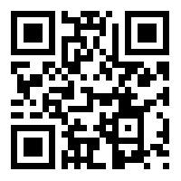
Survey
Help us, and win an Arduni MKR NB 1500 with a free SIM, packed with 6 months data
yas.fyi/2TR4z1N

Slide 8
Quiz
Join at Slido.com
Event: #D057

Slide 9
Additional question
1- John Romkey 2- Massimo Banzi
3- Yas 4- DeveloperSteve
Notes:
John Romkey

