Slide 1
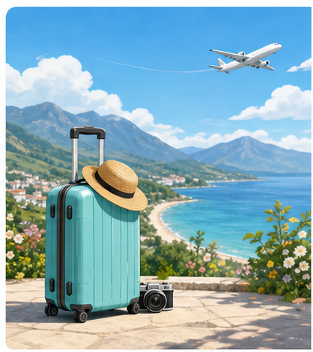
新人教版英语八年级上
Unit 1-8 作文讲义
课堂投影新版 · 排版修复验收版
01

Slide 2
Unit 1
Happy Holiday
作文讲义 · 课堂投影新版
02

Slide 3
Unit 1 Happy Holiday · 写作任务与审题
editable
写作任务
审题指导
读万卷书,不如行万里路。请以“A trip
I’ll never
forget”为题,根据以下要点和要求,用英语
写一篇短文,
介绍你曾经的一次旅行。
要点:
1)你和谁一起去的以及当地的天气状况;
2)你在当地都做了什么、吃了什么以及最喜
欢什么;
3)你对这次旅行的感受如何。
审主题：一次难忘的旅行
审文体：记叙文
审人称：第一人称
审时态：一般过去时
审要点：本题给出问题提示，包含：
a.和谁一起去的以及天气如何;
b.做了什么、吃了什么以及最喜欢什么
c.自己的感受。。
03

Slide 4
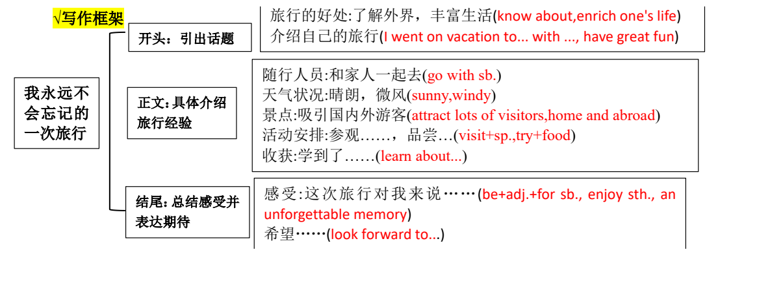
Unit 1 Happy Holiday · 写作框架
framework crop
04

Slide 5
Unit 1 Happy Holiday · 词汇/短语积累 1
click reveal
1. 风景;景色
landscape
5. 风景
scenery
2. 假期;度假
vacation
6. 旅馆; 旅社
hotel
3. 镇;商业区
town
7. 艺术作品
artwork
4. 呼吸;气
breath
8. 正午;中午
noon
05

Slide 6
Unit 1 Happy Holiday · 词汇/短语积累 2
click reveal
9. 车站;所;站
station
13. 乡 村 ; 农 村
countryside
10. 宫殿
palace
14. 提 醒
remind
11. 塔 ; 塔 楼
tower
15. 忘 记
forget
12. 护 照
passport
16. 古代的
ancient
06

Slide 7
Unit 1 Happy Holiday · 词汇/短语积累 3
click reveal
17. 奇怪的
strange
21. 惊奇的;惊讶的
surprised
18. 极好的
fantastic
22. 尤其;特别;格外
especially
19. 舒服的
comfortable
23. 玩得开心
have fun
20. 遥远的
faraway
24. 在度假
on holiday/vacation
07

Slide 8
Unit 1 Happy Holiday · 词汇/短语积累 4
click reveal
25. 准备好做某事
be ready to do sth.
29. 拜访;参观
pay a visit to
26. 有…的感觉;感受到
feel like
30. 参观古建筑
visit ancient buildings
27. 拍照片
take photos
31. 美丽的景色
beautiful scenery
28. 买特别的东西
buy something special
32. 暑假
summer holiday
08

Slide 9
Unit 1 Happy Holiday · 词汇/短语积累 5
click reveal
33. 寒假
winter holiday
37. 到达
arrive at / in
34. 有趣的事
something interesting
38. 决定做某事
decide to do sth
35. 去爬山
go to the mountains
39. 做决定
make a decision
36. 成千上万的
thousands of
40. 去参加夏令营
go to a summer camp
09

Slide 10
Unit 1 Happy Holiday · 词汇/短语积累 6
click reveal
41. 返回
go back to
45. 呆在古镇
stay in the old town
42. 去参加草莓节
go to a strawberry festival
46. 令人惊叹
take sb's breath away
43. 看日出
see the sunrise
47. 汽锅鸡
steamed chicken soup
44. 待在家里
stay at home
48. 待在酒店
stay in the hotel
10

Slide 11
Unit 1 Happy Holiday · 词汇/短语积累 7
click reveal
49. 美丽的双彩虹
a beautiful double rainbow
53. 在乡下
in the countryside
50. 在阳光下
in the sun
54. 让你的身心得到休息
rest your mind and body
51. 讲诉关于...的故事
tell stories about
55. 从旅行经历中学习
learn from travel experiences
52. 聚会; 相聚
get together
56. 经历美好的时光
have a wonderful experience
11

Slide 12
Unit 1 Happy Holiday · 词汇/短语积累 8
click reveal
57. 回到你的日常生活
go back to your regular life
58. 某人花费时间或金钱在某事上/做某事
spend (spent) time/money on sth./ (in) doing sth.
12

Slide 13
Unit 1 Happy Holiday · 句型练习 1
click reveal
1.开篇点题
①旅行的好处:了解外界，丰富生活(know about,enrich one's life)
②介绍自己的旅行
1. 旅行帮助我更多地了解外面的世界，也丰富了我的生活。
Travelling helps me know more about the outside world as well as enriches my life.
2. 今年夏天，我和家人去云南省度假，我们玩得很开心。
This summer, I went on vacation to Yunnan Province with my family and we had great fun.
13

Slide 14
Unit 1 Happy Holiday · 句型练习 2
click reveal
3. 今年夏天我和父母去北京度假
I went to Beijing on vacation with my parents this summer.
4. 我的父母和我有一个美好的海南之旅
My parents and I had a wonderful journey to Hainan.
5. 我仍然记得和家人去三亚的旅行。
I still remember the trip to Sanya with my family.
16

Slide 15
Unit 1 Happy Holiday · 句型练习 3
click reveal
2.具体介绍旅行经验
①First we went to … and watched …Then we visited …The next day, we
visited …
②We took quite a few photos there and we learnt …
③It was time for us to …
④We tried many...like...
⑤I am going to/plan to...
19

Slide 16
Unit 1 Happy Holiday · 句型练习 4
click reveal
6. 起初，我们在湖上划船两个小时。然后，我了们爬上山顶。
At first, we went boating on the lake for two hours.Then,we climbed up to the top of a hill.
7. 泸沽湖作为一个著名的名胜，吸引了许多国内外的游客。
As a famous place of interest, Lugu Lake has attracted lots of visitors home and abroad.
8.当我看到山下美丽的湖泊和村庄时，我觉得自己仿佛置身于一幅美妙的画中。
When I saw the beautiful lake and villages below the hill, I felt like l was in a wonderful painting.
21

Slide 17
Unit 1 Happy Holiday · 句型练习 5
click reveal
9. 我们品尝了著名的面条，真的很好吃！
We tasted the famous noodles, which were really delicious!
10.
我们在那里拍了不少照片，还学到了一些关于中国历史的重要知识。
We took quite a few photos there and we learnt something important about Chinese history.
11. 我们可以和我们的朋友一起玩，在假期和家人聚在一起。
We can play with our friends and get together with our families during holidays.
24

Slide 18
Unit 1 Happy Holiday · 句型练习 6
12. 你可以在暑假的星期一参观故宫和故宫博物馆。
You can visit the Forbidden City and the Palace Museum on Monday in summer vacation.
13. 我们一到海边，就被大海的美丽惊呆了。
As soon as we arrived at the seaside, all of us were amazed at the beauty of the sea.
14. 我和爸爸尝试了很多有趣的活动，比如冲浪和潜水。
My father and I tried many wonderful activities, like surfing and diving.
26

Slide 19
Unit 1 Happy Holiday · 句型练习 7
click reveal
15. 我们乘飞机去那里，花了一个星期欣赏美丽的景色。
We went there by plane, and spent a week enjoying the beautiful views.
16. 太棒了!我们在那里拍了不少照片。
It was wonderful! We took quite a few photos there.
30

Slide 20
Unit 1 Happy Holiday · 句型练习 8
click reveal
3,对假期/旅行的感受及看法
①I was so … that …
②We enjoyed the trip so … that …
③感叹句 What＋a/an＋(adj.)＋单数可数名词＋主语＋谓语！
31

Slide 21
Unit 1 Happy Holiday · 句型练习 9
click reveal
17. 总之，3 天的旅行很愉快，我期待着下次去那里。
All in all,,the 3-day trip was enjoyable and I am looking forward to visiting there next time.
18.我们很累，但很高兴。我们非常喜欢这次旅行，希望能再去一次。
We were very tired but happy. We enjoyed the trip so much that we hoped to visit it again.
19. 总之，我真的很享受这个假期，它给我带来了难忘的记忆。
In short, I really enjoyed the vacation, which brought me an unforgettable memory.
33

Slide 22
Unit 1 Happy Holiday · 句型练习 10
click reveal
20. 一切都很好，所以我们玩得很开心。我期待着再次去那里。
Everything was great, so we had a good time. I'm looking forward to going there again.
21. 多好的天气啊!
What nice weather it is!
22. 多么奇妙啊！
How wonderful it is!
23. 这是我第一次去那里，所以一切都很有趣。
It was my first time there,so everything was really interesting.
35

Slide 23
Unit 1 Happy Holiday · 句型练习 11
click reveal
4.经典名句：
24. 读万卷书，行万里路。
Read ten thousand books and travel ten thousand miles.
25. 见多识广。
He who travels far knows much.
40

Slide 24
A trip I'll never forget
Travelling helps me know more about the outside world as well as enriches my life. This summer, I went on vacation to Yunnan Province with my family and we had great fun.
The weather there was sunny and windy, As a famous place of interest, Lugu Lake has attracted lots of visitors home and abroad. At first, we went boating on the lake for two hours.Then,we climbed up to the top of a hill, When I saw the beautiful lake and villages below the hill, I felt like l was in a wonderful painting.I enjoyed the fresh air very much. Also, we tasted the famous Cross-bridge Rice Noodles, which were really delicious!
In short, I really enjoyed the vacation, which brought me an unforgettable memory. Everything was great, so we had a good time. I'm looking forward to going there again.
42

