Slide 1

新人教版英语八年级上
Unit 1-8 作文讲义
课堂投影新版 · 排版修复验收版
01

Slide 2
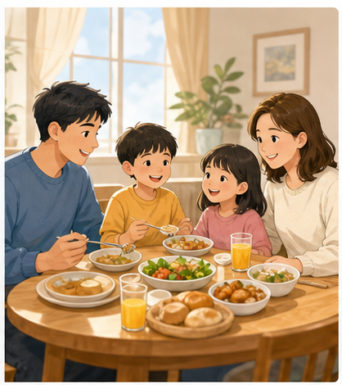
Unit 2
Home Sweet Home
作文讲义 · 课堂投影新版
43

Slide 3
Unit 2 Home Sweet Home · 写作任务与审题
editable
写作任务
审题指导
在中国传统文化中，“家”是一个永恒的话题
。家人相聚一堂,才是完整的家,温暖而有力
量。
请你以“Home”为题,写一篇约 110
词的英语短文,让外国朋友了解中国文化中
的“家”。
审主题：介绍“家”文化
审文体：说明文
审人称：第一人称
审时态：一般现在时
44

Slide 4
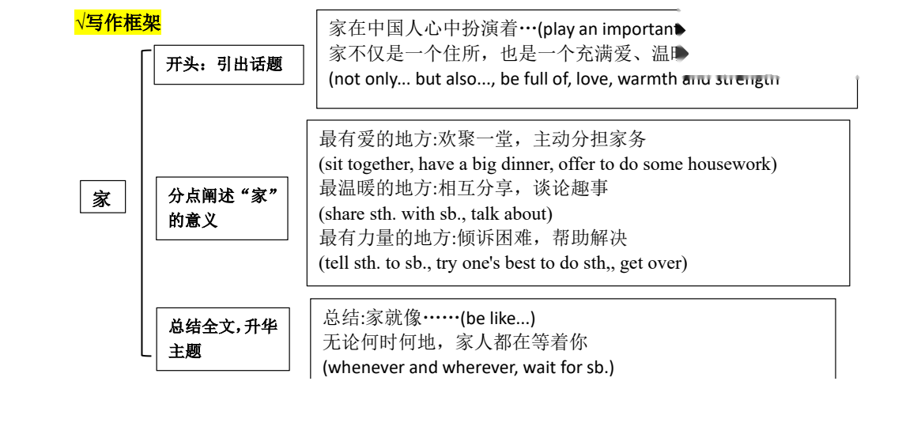
Unit 2 Home Sweet Home · 写作框架
framework crop
45

Slide 5
Unit 2 Home Sweet Home · 词汇/短语积累 1
click reveal
1. 浴室; 洗手间
bathroom
5. 喜悦;乐趣
joy
2. 卧室
bedroom
6. 房间;公寓套房
apartment
3. 阳台
balcony
7. 邀请
invite
4. 社区
community
8. 熟悉的
familiar
46

Slide 6
Unit 2 Home Sweet Home · 词汇/短语积累 2
click reveal
9. 宝物;财富
treasure
13. 扫地
sweep the floor
10. 旅行
journey
14. 打扫浴室
clean the bathroom
11. 笑话
joke
15. 喂鱼
feed the fish
12. 收拾东西
pack up things
16. 挂照片
hang up photos
47

Slide 7
Unit 2 Home Sweet Home · 词汇/短语积累 3
click reveal
17. 给植物浇水
water plants
21. 不得不
have to
18. 和朋友闲逛
hang out with friends
23. 邀请...到...
invite...to...
19. 把东西分类到盒子里
sort things into boxes
24. 需要做某事
need to do sth.
20. 种花
grow flowers
25. 打扫
clean up
48

Slide 8
Unit 2 Home Sweet Home · 词汇/短语积累 4
click reveal
26. 拖地
mop the floor
30. 帮助某人做某事
help sb. do sth.
27. 擦窗户
clean the windows
31. 在墙上
on the wall
28. 做得不错; 干得漂亮
good job
32. 为某人买某物
buy sth. for sb.
29. 等不及做某事
can't wait to do sth.
33. 在......前面
in front of
49

Slide 9
Unit 2 Home Sweet Home · 词汇/短语积累 5
click reveal
34. 没问题
no problem
38. 制作饼干
make biscuits
35. 让人感到宾至如归
make sb. feel at home
39. 做饭
cook a meal
36. 去购物
go shopping
40. 借一套国际象棋
borrow a chess set
37. 买饮料
buy drinks
41. 计划一次寻宝
plan a treasure hunt
50

Slide 10
Unit 2 Home Sweet Home · 词汇/短语积累 6
click reveal
42. 不回家，待得很晚
stay out
46. 忙于做某事
be busy doing sth.
43. 垃圾袋
rubbish bags
47. 很高兴做某事
be happy to.do sth.
44. 春节
the Spring Festival
48. 和某人分享....
share...with sb.
45. 起床
get up
49. 摆放餐具
set the table
51

Slide 11
Unit 2 Home Sweet Home · 词汇/短语积累 7
click reveal
50. 熟悉的家的味道
the familiar taste of home
54. 帮忙
give a hand
51. 讲笑话
tell jokes
55. 制作海报
make a poster
52. 握住某人的手
hold one's hands
56. 制作剪纸
make paper cuttings
53. 想要做某事
would like to do sth.
57. 倒垃圾
take out the rubbish
52

Slide 12
Unit 2 Home Sweet Home · 词汇/短语积累 8
click reveal
58. 洗衣服
do the laundry
62. 整理床铺
make the bed
59. 洗碗
do the dishes
63. 在公寓 1 楼
on the first floor of the apartment
60. 叠衣服
fold the clothes
64. 开车顺便送某人
give sb. a lift/ride
61. 遛狗
walk the dog
65. 整天在家工作
work from home all day
53

Slide 13
Unit 2 Home Sweet Home · 词汇/短语积累 9
click reveal
66. 家庭成员
family member
69. 与某人一起玩某物
play sth.with sb.
67. 把墙漆成浅绿色
paint the walls light green
70. 尽某人最大的努力
try one ' s best
68. 鼓励某人做某事
encourage sb. to do sth.
71. 在…的帮助下
with the help of
54

Slide 14
Unit 2 Home Sweet Home · 句型练习 1
click reveal
1.开篇点题--引出“家”的话题
1. 家在中国人心中扮演着重要的角色。
(play an important role in...)
Home plays an important role in the hearts of Chinese people.
2. 家不仅仅是一个居住的地方，也是一个充满爱、温暖和力量的地方。
(not only...but also...)
Home is not only just a place to live in but also a place full of love, warmth and strength.
55

Slide 15
Unit 2 Home Sweet Home · 句型练习 2
click reveal
2.分点阐述“家”的意义
介绍家庭成员
3. 我们是一个六口之家，有我的祖父母，我的父母，我的兄弟和我。
We are a family of six and there are my grandparents, my parents, my brother and me.
4. 我家有三口人，包括爸爸、妈妈和我。
There are three people in my family, including my father, my mother and me.
5. 这些是我可爱的家人。
These are my lovely family members.
56

Slide 16
Unit 2 Home Sweet Home · 句型练习 3
click reveal
6. 如你所见，我家有六口人。
As you can see ,there are six people in my family.
7. 这是我的全家福。
Here is a photo of my family.
57

Slide 17
Unit 2 Home Sweet Home · 句型练习 4
click reveal
最有爱的地方: 欢聚一堂，主动分担家务(sit together, have a big dinner, offer to do some housework)
8. 没有什么比和我们的父母和祖父母坐在一起吃一顿丰盛的晚餐更令人愉快的了。
Nothing is more enjoyable than sitting together and having a big dinner with our parents and grandparents.
9. 晚饭后，我们可以做一些家务或分享一些我们在生活中遇到的有趣的故事。
After dinner, we can offer to do some housework or share some interesting stories we encountered in life.
58

Slide 18
Unit 2 Home Sweet Home · 句型练习 5
click reveal
最温暖的地方:相互分享，谈论趣事(share sth. with sb., talk about)
10. 此外，在我的脑海中，谈论我们的日常事物是最温暖的。
In addition, talking about our everyday stuff is the warmest in my mind.
11. 分享快乐是非常奇妙的。
Sharing the happiness is very fantastic.
例句：在日常生活中，我们珍惜与家人和朋友共度的时光。
We value the time we spend with our family and friends in our everyday lives.
59

Slide 19
Unit 2 Home Sweet Home · 句型练习 6
click reveal
最有力量的地方:倾诉困难，帮助解决(tell sth. to sb., try one's best to do sth,, get over)
12. 然而，我们也可以告诉我们遇到的困难，我们的家人，他们会尽最大努力帮助我们克服他们。
However, we can also tell the difficulties we have met to our family members, and they will try their best to help us get over them.
60

Slide 20
Unit 2 Home Sweet Home · 句型练习 7
click reveal
3.总结全文，升华主题：对家感受及看法
13. 我爱我的家庭，因为它带给我温暖和幸福。
I love my family because it brings me warmth and happiness.
14. 我有一个多么和谐温暖的家庭啊。
What a harmonious and warm family I have.
15. 俗话说，金窝银窝，不如自己的草窝。
As an old saying goes,east or west,home is the best
61

Slide 21
Unit 2 Home Sweet Home · 句型练习 8
click reveal
16. 这就是我的家庭，充满欢笑和爱。
This is my family, full of laughter and love.
17. 这就是我们家的样子。
That is what our home is like.
62

Slide 22
Unit 2 Home Sweet Home · 句型练习 9
click reveal
18. 无论何时何地，请记住，总有人在家等着你。
Whenever and wherever you are, please remember there is always someone waiting for you at home.
19. 家就像阳光，温暖了我们很多。
Home is like sunshine,warming us a lot.
63

Slide 23
Unit 2 Home Sweet Home · 句型练习 10
click reveal
4.俗语谚语
20. 金窝银窝,不如自家的草窝。
East or west,home is the best.
21. 没有一个地方可以和家相提并论。
There's no place like home.
22. 哪里有家,哪里就有爱。哪里有爱,哪里就有温暖和幸福。
Where there is home,there is love. Where there is love,there is warmth and happiness.
64

Slide 24
Home
Home plays an important role in the hearts of Chinese people. Home is not only just a place to live in but also a place full of love, warmth and strength.
Nothing is more enjoyable than sitting together and having a big dinner with our parents and grandparents, After dinner, we can offer to do some housework or share some interesting stories we encountered in life. In addition, talking about our everyday stuff is the warmest in my mind. Sharing the happiness is very fantastic, However, we can also tell the difficulties we have met to our family members, and they will try their best to help us get over them.
That is what our home is like.So, whenever and wherever you are, please remember there is always someone waiting for you at home.
77

