Slide 1

读后续写---高级句型仿写---小文段仿写
读后续写 高级句型仿写 小文段仿写
小文段仿写

Slide 2
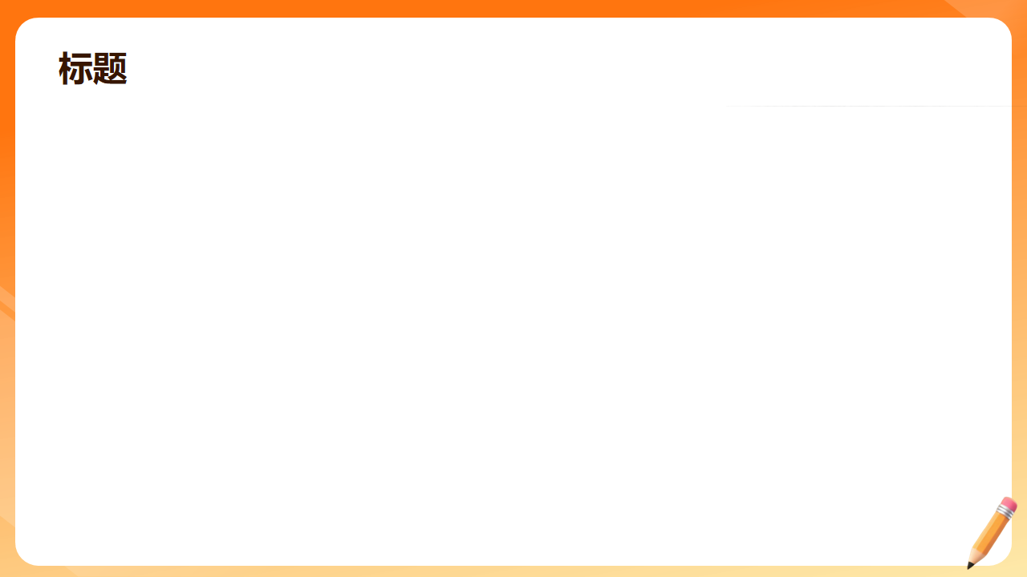
结尾段写作----强调句+谚语： (1/8)
It is/was+被强调部分+that/who +剩余部分。
It is/was not until …that …
As the saying goes,“……”正如谚语所说，
There is an old Chinese saying /proverb, “……”这里有一句中国古话，
正是这次难忘且有意义的经历让我懂得了面对问题时要冷静处理。正如谚语所说，“天助自助者。”
It was this unforgettable and meaningful experience that taught me to handle problems calmly when facing them. As the proverb goes, "God helps those who help themselves."

Slide 3
结尾段写作----强调句+谚语： (2/8)
It is/was+被强调部分+that/who +剩余部分。
It is/was not until …that …
As the saying goes,“……”正如谚语所说，
There is an old Chinese saying /proverb, “……”这里有一句中国古话，
正是这次去Peter家做客的体验告诉我，当你不知道如何使用筷子的时候，跟着别人做就行了。正如谚语所说，“入乡随俗。”
It was the experience of visiting Peter's home that told me that when you don't know how to use chopsticks, you can just follow others. As the proverb goes, "When in Rome, do as the Romans do."

Slide 4
结尾段写作----强调句+谚语： (3/8)
It is/was+被强调部分+that/who +剩余部分。
It is/was not until …that …
As the saying goes,“……”正如谚语所说，
There is an old Chinese saying /proverb, “……”这里有一句中国古话，
这是这次爬山的经历让我明白了坚持的意义，正如这句谚语所说，“平静的湖面练不出强悍的水手。”
It was this mountain - climbing experience that made me understand the significance of perseverance. Just as the proverb says, "A smooth sea never made a skillful mariner."

Slide 5
结尾段写作----强调句+谚语： (4/8)
It is/was+被强调部分+that/who +剩余部分。
It is/was not until …that …
As the saying goes,“……”正如谚语所说，
There is an old Chinese saying /proverb, “……”这里有一句中国古话，
正是有了齐心协力的精神，我们小组才按时完成了这个项目。这里有一句中国古话，“三个臭皮匠顶一个诸葛亮。”
It was the spirit of working together that enabled our group to complete the project on time. There is an old Chinese saying, "Two heads are better than one."

Slide 6
结尾段写作----强调句+谚语： (5/8)
It is/was+被强调部分+that/who +剩余部分。
It is/was not until …that …
As the saying goes,“……”正如谚语所说，
There is an old Chinese saying /proverb, “……”这里有一句中国古话，
正是这次经历让我明白了持续练习的重要性。正如这句谚语所说，“失败乃成功之母。”
It was this experience that made me understand the importance of continuous practice. As the proverb goes, "Failure is the mother of success."

Slide 7
结尾段写作----强调句+谚语： (6/8)
It is/was+被强调部分+that/who +剩余部分。
It is/was not until …that …
As the saying goes,“……”正如谚语所说，
There is an old Chinese saying /proverb, “……”这里有一句中国古话，
正是这次经历让我明白了坚持的重要性。正如这样谚语所说，“有志者，事竟成。”
It was this experience that made me understand the importance of perseverance. As the proverb goes, "Where there's a will, there's a way."

Slide 8
结尾段写作----强调句+谚语： (7/8)
It is/was+被强调部分+that/who +剩余部分。
It is/was not until …that …
As the saying goes,“……”正如谚语所说，
There is an old Chinese saying /proverb, “……”这里有一句中国古话，
正是这次经历让我明白了犯错也是正常的。最重要的是，我们应该从错误中学习。正如这句谚语所说，“失败乃成功之母。”
It was this experience that made me understand that it's normal to make mistakes. The most important thing is that we should learn from our mistakes. As the proverb goes, "Failure is the mother of success."

Slide 9
结尾段写作----强调句+谚语： (8/8)
It is/was+被强调部分+that/who +剩余部分。
It is/was not until …that …
As the saying goes,“……”正如谚语所说，
There is an old Chinese saying /proverb, “……”这里有一句中国古话，
正是这次经历让我明白了，只有通过努力，我们才能达成目标，实现梦想。正如这句谚语所说，“平静的湖面练不出强悍的水手。”
It was this experience that made me understand that only through hard work can we achieve our goals and realize our dreams. As the proverb goes, "A smooth sea never made a skillful mariner."

Slide 10
小文段写作： (1/5)
There be all kinds of…这里有各种各样的….
We did A ，did B and did C, 我们做了A,B and C.
which is not only adj but also adj.那不仅是…的而且是…的。
这里有各种各样的活动在那一天。我们赏月了，吃了月饼还讲了嫦娥的故事，那不仅是有趣的而且是传统的。
There were various activities on that day. We admired the moon, ate mooncakes and told the story of Chang'e, which was not only interesting but also traditional.

Slide 11
小文段写作： (2/5)
There be all kinds of…这里有各种各样的….
We did A ，did B and did C, 我们做了A,B and C.
which is not only adj but also adj.那不仅是…的而且是…的。
在端午节那天有很多活动。我们看了龙舟比赛，吃了粽子还了解了屈原的故事，那不仅是有趣的而且是有意义的。
There were many activities on the Dragon Boat Festival. We watched the dragon boat races, ate zongzi and learned about the story of Qu Yuan, which was not only interesting but also meaningful.

Slide 12
小文段写作： (3/5)
There be all kinds of…这里有各种各样的….
We did A ，did B and did C, 我们做了A,B and C.
which is not only adj but also adj.那不仅是…的而且是…的。
在母亲节那天，我做了许多事。我亲手给妈妈制作了一个礼物，做了一顿早餐还打扫了卫生，那不仅是有意义的而且是重要的。
On Mother's Day, I did many things. I made a gift for my mom with my own hands, cooked a breakfast and did some cleaning, which was not only meaningful but also important.

Slide 13
小文段写作： (4/5)
There be all kinds of…这里有各种各样的….
We did A ，did B and did C, 我们做了A,B and C.
which is not only adj but also adj.那不仅是…的而且是…的。
在艺术节那天，有很多活动。我们观看了汉服表演，品尝了美味的小吃还收到了精美的礼物，那不是有意义的而且是令人放松的。
On the Art Festival, there were a lot of activities. We watched the Hanfu show, tasted delicious snacks and received beautiful gifts, which was not only meaningful but also relaxing.

Slide 14
小文段写作： (5/5)
There be all kinds of…这里有各种各样的….
We did A ，did B and did C, 我们做了A,B and C.
which is not only adj but also adj.那不仅是…的而且是…的。
上周六我们学校举办了徒步活动，我们爬了山，欣赏到了沿途的风景还拍到了漂亮的照片，那不仅是有意义的而且是令人放松的。
Last Saturday, our school held a hiking activity. We climbed the mountain, enjoyed the scenery along the way and took beautiful pictures, which was not only meaningful but also relaxing.

Slide 15
结尾段写作有关文化传统的： (1/5)
If you want to know more about…,you can come to China to experience it in person.如果你想了解….，你可以亲自来中国体验。
Only in this way can you have a deeper understanding of…
只有以这种方式，你才能对…有更深的理解。
如果你想更多了解中国文化，你可以亲自来中国。只有以这种方式，你才能对中国剪纸有更深的理解。
If you want to know more about Chinese culture, you can come to China in person Only in this way can you gain a deeper understanding of Chinese paper - cutting..

Slide 16
结尾段写作有关文化传统的： (2/5)
If you want to know more about…,you can come to China to experience it in person.如果你想了解….，你可以亲自来中国体验。
Only in this way can you have a deeper understanding of…
只有以这种方式，你才能对…有更深的理解。
如果你想了解簪花，你可以来中国亲自感受。只有以这种方式，你才能对它有更深的理解。
If you're interested in learning about hair - adorning flowers, you can come to China and experience it firsthand. Only through this approach can you understand it more deeply.

Slide 17
结尾段写作有关文化传统的： (3/5)
If you want to know more about…,you can come to China to experience it in person.如果你想了解….，你可以亲自来中国体验。
Only in this way can you have a deeper understanding of…
只有以这种方式，你才能对…有更深的理解。
如果你想更多了解茶的制作，你可以来我的家乡感受。只有以这种方式，你才能更好地了解茶的精髓。
If you wish to know more about tea - making, you can come to my hometown to have a feel. Only in this way can you better understanding of the essence of tea.

Slide 18
结尾段写作有关文化传统的： (4/5)
If you want to know more about…,you can come to China to experience it in person.如果你想了解….，你可以亲自来中国体验。
Only in this way can you have a deeper understanding of…
只有以这种方式，你才能对…有更深的理解。
如果你想更多了解书法，你可以亲自来中国感受。只有以这种方式，你才能更好地了解它。
If you want to know more about Chinese calligraphy, you can come to China and experience it personally. Only in this way can you have a better understanding of it.

Slide 19
结尾段写作有关文化传统的： (5/5)
If you want to know more about…,you can come to China to experience it in person.如果你想了解….，你可以亲自来中国体验。
Only in this way can you have a deeper understanding of…
只有以这种方式，你才能对…有更深的理解。
如果你想更多了解舞狮和舞龙，你可以亲自来中国体验。只有以这种方式，你才能对它有更好的了解。
If you want to know more about lion and dragon dances, you can come to China and experience them by yourself. Only in this way can you understanding of them better.

Slide 20
主语从句+状语从句句型 (1/5)
第一句：(What interested/attracted/appealed/impressed/inspired me most) is (that….)最使我感兴趣的是/最吸引我的是/最让我印象深刻的是/最鼓舞我的是…
第二句：主句,which 定语从句解释，说明，补充
第三句：It is/was +被强调部分+that/who +剩余部分
例句：(What attracted me most )is( that we experienced the process of making Qingtuan), (which is a traditional food during the Qingming festival).
最吸引我的是我们体验了青团的制作过程，那在清明节期间是一种传统的食物。

Slide 21
主语从句+状语从句句型 (2/5)
第一句：(What interested/attracted/appealed/impressed/inspired me most) is (that….)最使我感兴趣的是/最吸引我的是/最让我印象深刻的是/最鼓舞我的是…
第二句：主句,which 定语从句解释，说明，补充
第三句：It is/was +被强调部分+that/who +剩余部分
最吸引我的是那天我们亲手制作了油纸伞，这帮助我们更好地理解中国传统手工艺的制作过程。
What attracted me most was that we made oil - paper umbrellas by hand that day，which helped us better understand the process of traditional Chinese handicrafts.

Slide 22
主语从句+状语从句句型 (3/5)
第一句：(What interested/attracted/appealed/impressed/inspired me most) is (that….)最使我感兴趣的是/最吸引我的是/最让我印象深刻的是/最鼓舞我的是…
第二句：主句,which 定语从句解释，说明，补充
第三句：It is/was +被强调部分+that/who +剩余部分
2.最令我印象深刻的是我们体验了油纸伞的制作过程，这帮助我更深地理解中国传统文化。
What impressed me most was that we experienced the process of making oil - paper umbrellas, which helped me have a deeper understanding of Chinese traditional culture.

Slide 23
主语从句+状语从句句型 (4/5)
第一句：(What interested/attracted/appealed/impressed/inspired me most) is (that….)最使我感兴趣的是/最吸引我的是/最让我印象深刻的是/最鼓舞我的是…
第二句：主句,which 定语从句解释，说明，补充
第三句：It is/was +被强调部分+that/who +剩余部分
3.让我印象最深刻的是我们请观看了打铁花的表演，那是一种非物质文化遗产。正是这次经历让我明白我们应该采取行动来保护和传承我们宝贵的文化和风俗。
What impressed me the most was that we watched the performance of molten iron fireworks, which is an intangible cultural heritage. It was this experience that made me realize that we should take action to protect and inherit our precious culture and customs.

Slide 24
主语从句+状语从句句型 (5/5)
第一句：(What interested/attracted/appealed/impressed/inspired me most) is (that….)最使我感兴趣的是/最吸引我的是/最让我印象深刻的是/最鼓舞我的是…
第二句：主句,which 定语从句解释，说明，补充
第三句：It is/was +被强调部分+that/who +剩余部分
4.最令我印象深刻的是通过辛勤工作后，我脸上的汗水，这不仅让我明白了农民的不易，而且也提醒我今后要节约粮食。
What impressed me most was the sweat on my face after hard work, which not only made me understand the hardships of farmers, but also reminded me to save food in the future.

