Slide 1

Unit
3 Smart Learning
单元作文梳理
（教学版）

Slide 2
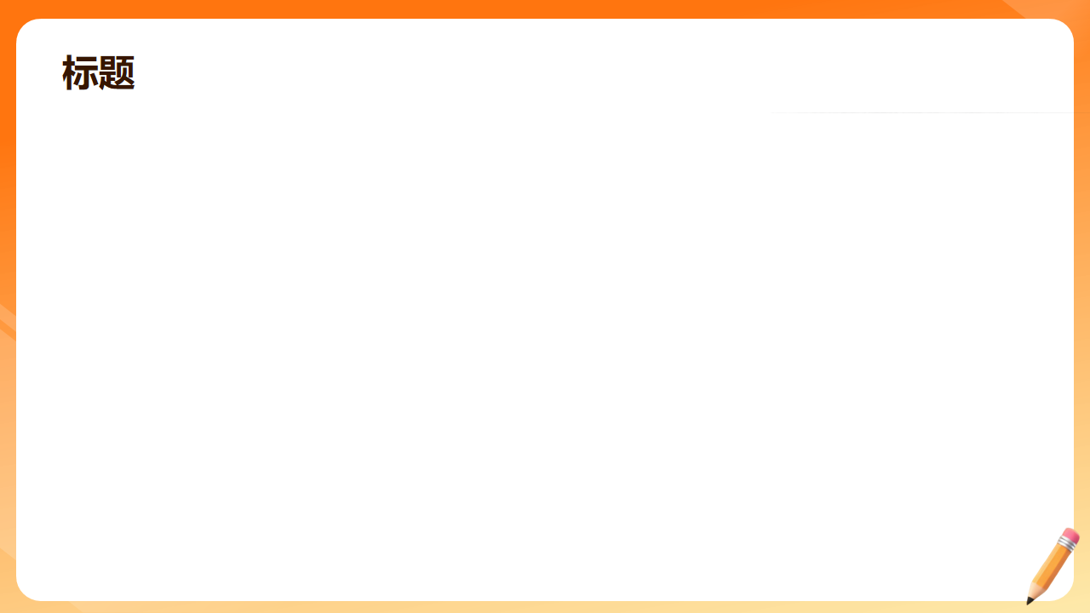
Unit 3 Smart Learning 单元作文梳理
本单元核心主题为“智慧学习/高效学习方法/如何成为优秀的学习者”，涵盖英语学习技巧、学科学习方法、成长型学习思维、主动学习习惯四大中考高频写作方向，同步融入单元核心语法「that/if/whether引导的宾语从句」，完全对标中考英语书面表达评分标准，兼顾教学实用性与学生应试需求。

Slide 3
一、审题指导（中考标准审题流程）
审主题
介绍自己的高效学习方法、学习习惯的养成，分享学习经验，阐述对“智慧学习”的理解，以及学习方法给自己带来的改变与成长
审文体
记叙文（夹叙夹议），中考书面表达最高频考查文体，也是“成长类”话题的核心考查文体
审人称
以第一人称为主，分享自身学习经历与方法；介绍通用学习技巧可搭配第二人称

Slide 4
一、审题指导（中考标准审题流程）
审时态
介绍学习方法、陈述客观道理用一般现在时；描述过去的学习经历、方法的养成过程用一般过去时；表达未来的学习规划用一般将来时
审要点
a. 点明核心的学习方法/主题；b. 方法的具体内容、自己的实践经历；c. 方法带来的效果、对学习的感悟与升华

Slide 5
二、写作框架（中考满分三段式结构）
开头段：
引入话题，点明核心学习方法
正文段：
方法阐述+实践经历+效果反馈
结尾段：
升华主题，表达感悟与展望

Slide 6
开头段：引入话题，点明核心学习方法
对应逻辑：总起全文，直接点明对自己帮助最大的学习方法，或自己对“智慧学习”的理解，呼应标题，可融入单元核心宾语从句句型奠定全文基调
参考框架：
每个人都有适合自己的学习方法，对我来说，最高效的学习方法是______。我相信，正确的学习方法能让我们的学习事半功倍。
Everyone has their own learning methods. For me, the most efficient learning way is ______. I believe that right learning methods can help us learn better and faster.

Slide 7
正文段：方法阐述+实践经历+效果反馈
对应逻辑：分2-3个层次写清学习方法的具体内容、自己的实践过程，贴合单元课文内容，同步运用单元核心语法与句型
参考框架：
① 过去的学习困境（用一般过去时，写自己之前学习中遇到的问题，如记不住单词、不会做数学题、不敢开口说英语等）
② 具体的学习方法与实践（用一般现在时，分点写方法的细节，结合单元课文核心学习技巧，如做思维导图、小组合作学习、从错误中学习等，融入宾语从句句型）
③ 方法带来的改变与效果（写学习上的进步、心态的变化，贴合单元“成长型思维”核心）

Slide 8
结尾段：升华主题，表达感悟与展望
对应逻辑：总结全文，点明“智慧学习”的意义，分享自己的学习感悟，表达未来持续进步的决心，贴合中考作文“正能量成长升华”的评分要求
参考框架：
学习不仅是学知识，更是学会如何学习。我会继续坚持好的学习方法，不断进步，成为一名更优秀的学习者。
Learning is not only about knowledge, but also about how to learn. I will keep on using good learning methods to make progress, and become a better learner.

Slide 9
三、核心短语积累（单元课文核心+高频）
三、核心短语积累（单元课文核心+高频）

Slide 10
1. 学习方法类核心短语（单元课文核心）
take notes
记笔记
create mind maps
制作思维导图
review key ideas
复习核心知识点
set learning goals
制定学习目标

Slide 11
1. 学习方法类核心短语（单元课文核心）
work in groups/teams
小组合作学习
take part in class discussions
参与课堂讨论
read aloud to practise speaking
大声朗读练习口语
use flashcards to learn new words
用单词卡学习生词

Slide 12
1. 学习方法类核心短语（单元课文核心）
do research projects
做研究性课题
test oneself on the key points
自测核心知识点
learn from mistakes
从错误中学习
get guidance and feedback from teachers
获得老师的指导与反馈
practise new and difficult things
练习新的、有难度的内容

Slide 13
2. 学习思维类核心短语（单元课文核心+高频）
have a growth mindset
拥有成长型思维
be an active learner
做一名主动学习者
see mistakes as chances for learning
把错误看作学习的机会
see learning as a part of daily life
把学习看作日常生活的一部分

Slide 14
2. 学习思维类核心短语（单元课文核心+高频）
develop one's own learning strategies
制定自己的学习策略
believe in oneself
相信自己
never lose heart
永不灰心
step by step
循序渐进

Slide 15
2. 学习思维类核心短语（单元课文核心+高频）
make progress in...
在……方面取得进步
have trouble (in) doing sth.
做某事有困难

Slide 16
3. 中考衔接短语
not only... but also...
不仅……而且……
what's more
此外；而且
as a result
结果；因此
in this way
通过这种方式

Slide 17
3. 中考衔接短语
little by little
逐渐地
practice makes perfect
熟能生巧
the more..., the better...
越……，就越……
it is important to do sth.
做某事是很重要的

Slide 18
四、高分句型练习（单元核心句型+必考）
四、高分句型练习（单元核心句型+必考）

Slide 19
1. 开头段（引入话题，奠定基调）
我相信，拥有好的学习方法是成为一名成功学习者的关键。
I believe that having good learning methods is the key to becoming a successful learner.
很多学生想知道如何才能学得更好，对我来说，答案是成为一名主动学习者。
Many students wonder how they can learn better, and for me, the answer is to be an active learner.

Slide 20
1. 开头段（引入话题，奠定基调）
当谈到学习英语时，最有帮助的方法对我来说是大声朗读和小组对话。
When it comes to learning English, the most helpful way for me is to read aloud and have conversations in groups.

Slide 21
2. 中间段（方法+经历，核心语法落地）
我过去在记英语单词方面有困难，后来我发现用单词卡是一个非常有用的方法。
I used to have trouble remembering English words, and later I found that using flashcards is a very useful way.
我们练习得越多，我们学得就越好，这是学习中永恒的真理。
The more we practise, the better we learn, which is an eternal truth in learning.

Slide 22
2. 中间段（方法+经历，核心语法落地）
拥有成长型思维意味着，我们应该把错误看作学习和进步的机会，而不是害怕犯错。
Having a growth mindset means that we should see mistakes as chances to learn and improve, instead of being afraid of making mistakes.

Slide 23
2. 中间段（方法+经历，核心语法落地）
我发现，和同学一起学习不仅能帮助我们解决学习中的问题，还能让我们从彼此身上学到东西。
I find that studying with classmates can not only help us solve problems in study, but also make us learn from each other.

Slide 24
2. 中间段（方法+经历，核心语法落地）
老师建议我们，应该认真做笔记，并且课后总结核心知识点。
The teacher suggests that we should take notes carefully and summarize the key points after class.

Slide 25
3. 结尾段（升华主题，加分收尾）
学习之路或许漫长，但好的学习方法能让我们走得更稳、更远。
The road of learning may be long, but good learning methods can make us walk more steadily and further.

Slide 26
3. 结尾段（升华主题，加分收尾）
重要的从来不是我们学了多少，而是我们如何学习。我会继续探索适合自己的学习方法，在学习之路上不断前行。
It is not just about what we need to learn, but how we learn. I will keep on exploring learning methods that suit me, and keep moving forward on the road of learning.

Slide 27
3. 结尾段（升华主题，加分收尾）
这些学习方法不仅帮助我取得了进步，也让我明白了学习的真正意义。
These learning methods have not only helped me make progress, but also let me understand the true meaning of learning.

Slide 28
五、主题名言警句（作文加分素材）
Learning is a lifelong journey.
学习是一场终身的旅程。
It's never too old to learn.
活到老，学到老。
A good beginning is half done.
良好的开端是成功的一半。

Slide 29
五、主题名言警句（作文加分素材）
There is no royal road to learning.
书山有路勤为径，学海无涯苦作舟。
You can never learn too much.
学无止境。

Slide 30
六、中考对标范文（贴合单元内容）
My Good Learning Method
Everyone has their own way of learning, and the most useful method for me is taking notes carefully in class.
I used to be afraid of English, because I couldn't remember new words and understand grammar. Then my English teacher told me that taking notes could help a lot. I started to write down key words and grammar rules in my notebook, and review them after class. Now my English has improved a lot.
I believe that good learning methods are very important. I will keep this good habit and make more progress in the future.

Slide 31
六、中考对标范文（贴合单元内容）
How to Be a Smart Learner
As middle school students, we all want to learn well and make progress. But how can we become a smart learner? I have some ideas from my own experience.
I used to have a lot of trouble with my study. I spent a lot of time on books, but I still couldn't get good grades, and I was even afraid of making mistakes. Later, I realized that I didn't have the right learning methods. First, I started to have a growth mindset.

Slide 32
六、中考对标范文（贴合单元内容）
How to Be a Smart Learner
I no longer feared mistakes, but regarded them as chances to learn and improve. Second, I began to make mind maps to review key ideas, which helped me remember knowledge better. What's more, I often take part in group discussions with my classmates, and we can learn from each other. I also ask my teachers for guidance when I have problems. With these methods, my grades have improved greatly, and I become more confident in study.
Learning is not only about what we learn, but also about how we learn. I believe that as long as we find the right methods and keep trying, we can all become smart learners and achieve our goals.

