Slide 1

HALFTONE VISUAL CRYPTOGRAPHY
IEEE Transactions on Image Processing, Vol. 15, NO. 8, Aug 2006, pp. 2441 - 2453
Zhi Zhou, Gonzalo R. Arce, and Giovanni Di Crescenzo
Aushij Singh
Department of Computer Science
Purdue University Fort Wayne

Slide 2
Agenda
Abstract
Introduction
Visual Cryptography
Halftone Visual Cryptography
Fundamental Principles of VC
Two-Out-of-Two Halftone VC Method
General Halftone VC
Simulation Results
Conclusion

Slide 3
ABstract
Visual cryptography encodes a secret binary image (SI) into n shares of random binary patterns. If the shares are xeroxed onto transparencies, the secret image can be visually decoded by superimposing a qualified subset of transparencies, but no secret information can be obtained from the superposition of a forbidden subset.
The binary patterns of the n shares, however, have no visual meaning and hinder the objectives of visual cryptography.
In this paper, a novel technique named halftone visual cryptography is proposed to achieve visual cryptography via halftoning. Based on the blue-noise dithering principles, the proposed method utilizes the void and cluster algorithm to encode a secret binary image into n halftone shares (images) carrying significant visual information.
The simulation shows that the visual quality of the obtained halftone shares are observably better than that attained by any available visual cryptography method known to date.

Slide 4
Introduction
Individuals' handling and protecting information against attacks has become increasingly vital in today's environment. As a result, researchers are developing new strategies to protect data against unauthorized access.
Various cryptographic techniques have been discovered, with many more to come. In this study, we will look at Visual Cryptography, a more advanced approach to information concealment. Visual cryptography is a type of encryption that uses visuals to conceal information.
If the correct picture key is employed, the encrypted image can be deciphered by the human eye. We can encrypt visual information (images, text, etc.) using this cryptographic technology so that the human visual system can decrypt the encrypted data without using computers.
A secret image is turned into many sharing images in visual cryptography. These visuals are meaningful, but they are loud or distorted. The original hidden image can be revealed by combining these share images.

Slide 5
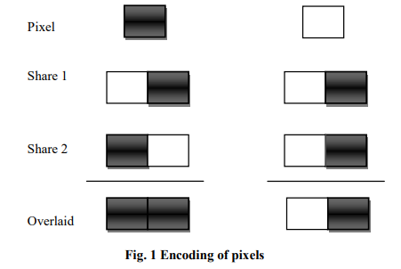
Visual Cryptography
Moni Naor and Adi Shamir were the first to develop the concept of visual cryptography in 1994. They devised an entirely new and secure technique of sharing secrets.
They claim that during the encryption step, a hidden image can be divided into n shares. And, in order to rebuild the secret image, a person must hold all n shares when decrypting.
A secret binary image (SI) is cryptographically encoded into n shares of random binary patterns in a t-out-of-n scheme of VC.
The shares are xeroxed onto transparencies and distributed among the n participants, one per participant. No one knows how much of a participant's share was provided to another.

Slide 6
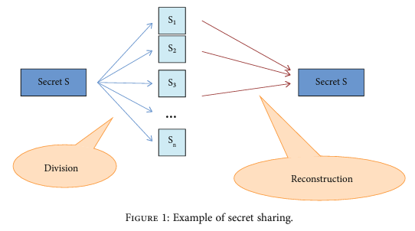
Visual Cryptography
By superimposing any t transparencies together, any t or more participants can visually reveal the secret image.
Even if they had infinite computational capability, none of the
t-1 or fewer people could decode the secret.
The beauty of this strategy was that it couldn't leak the secret image even if there were n-1 shares. The first image would appear when all n shares were superposed.
Binary, Grayscale, and Color images are examples of images that can be used in Visual Cryptography. Naor and Shamir demonstrated how to share a secret binary picture by mistreating their own cryptography table.

Slide 7
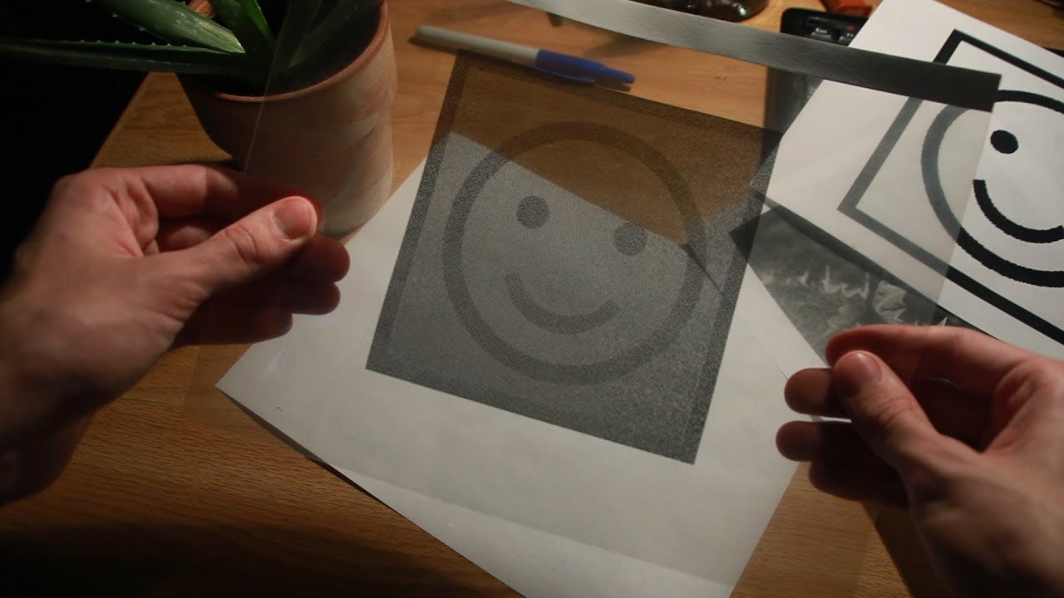

Halftone visual cryptography
To create visual cryptography via halftoning, a unique technique called halftone visual cryptography is suggested.
The suggested method uses the void and cluster algorithm to compress a secret binary image into n halftone shares (images) providing substantial visual information, based on blue-noise dithering principles.
The simulation demonstrates that the visual quality of the produced halftone shares is noticeably better than any other visual cryptography approach currently available.
Few of the main ideas were of course the simulation showing the visual quality of the obtained halftone shares which were observed and attained by the available visual cryptography method known till date by encoding a secret binary image into n shares of random binary patterns.
The hidden image can be visually decrypted by superimposing a qualified subset of transparencies, but the superposition of a banned subset yields no secret information.

Slide 8
Halftone visual cryptography
The goal of this study is to create a general framework for halftone visual cryptography, in which a secret binary image is encrypted into high-quality halftone images, or halftone shares.
The suggested method, in particular, uses the rich theory of blue noise halftoning to the building mechanism utilized in traditional VC to generate halftone shares, while maintaining the security features.
Over the entire decoded image, the same contrast is produced. Landscapes, buildings, and other visual information are conveyed to viewers via halftone sharing.
The novel method produces much superior visual quality than extended VC or any other currently existing VC method.
The following is a breakdown of the paper's structure. Section II explains the essential concepts of visual cryptography, on which halftone visual threshold approaches are proposed for constructing the simplest two-out-of-two scheme as well as a broader access structure scheme.
The proposed method's simulation results are shown in Section III. Finally, in Section IV, conclusions are formed.

Slide 9
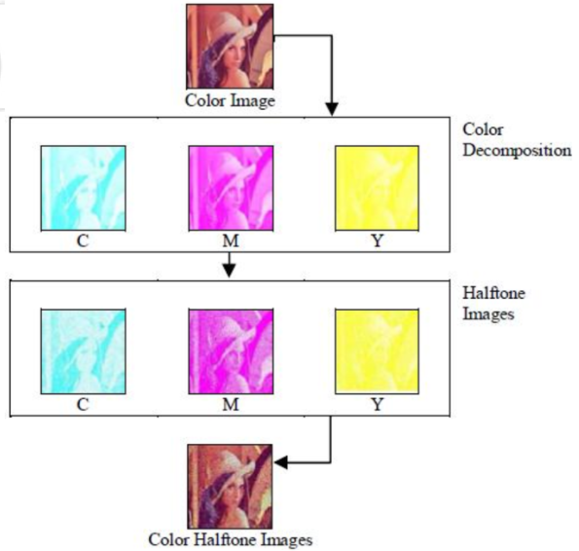
Proposed Scheme
Visual cryptography, an emerging cryptography technology, uses the characteristics of human vision to decrypt the encrypted images.
It does not require the knowledge of cryptography for decryption. For security concerns, it also ensures that hackers cannot perceive any clues about a secret image from individual cover images.
Though it has been developed only for binary images, there have been many papers and research articles about its use in grayscale and colored images.
The report explores one such method where an image is a colour decomposed to Cyan, Magenta, Yellow colors and then the visual cryptography is carried out for the individual decomposition.
Color Decomposition for Color Halftone Image.

Slide 10
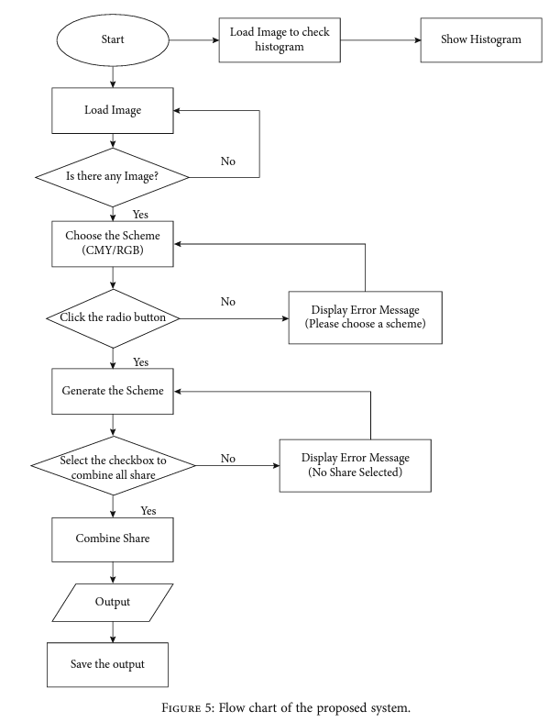

Continued….
The suggested technique determines that the CMY color space secret sharing system is visual cryptography.
Visual cryptography is a technique for encrypting and decrypting images. Image processing is used in visual cryptography, which entails dividing the original image into a few halftone images for encryption and then merging all of the images for decryption.
A method for image processing is applied to the image in order to boost the image's specific operation or to extract useful information. Import an image to perform image analysis and processing.
The picture or image analysis-based reports can be changed as a result of the output.

Slide 11

Fundamental Principles of VC
General access structures were proposed, as well as two strategies for constructing visual cryptography schemes for them. It established lower boundaries for the size of the shares awarded to scheme members.
It introduced a new method for implementing k out of n threshold visual cryptography schemes. The proposed construction for k out of n visual cryptography schemes is better in terms of pixel expansion than the one proposed, and it is the best conceivable for the case of 2 out of n.
On n participants P=1,2,...,n, the model specifies a collection of qualified subsets ΓQual and a set of prohibited subsets Γ Forb. Participants from any qualified subset can decode the secret image together, but those from a forbidden subset are unable to do so. The access structure of the scheme is the pair (Qual,Forb).
As a result, the n-participant access structure can be broken down into a one-participant and a (n1)-participant access structure. We assume that each subgroup in Qua comprises at least two players without sacrificing generality.

Slide 12
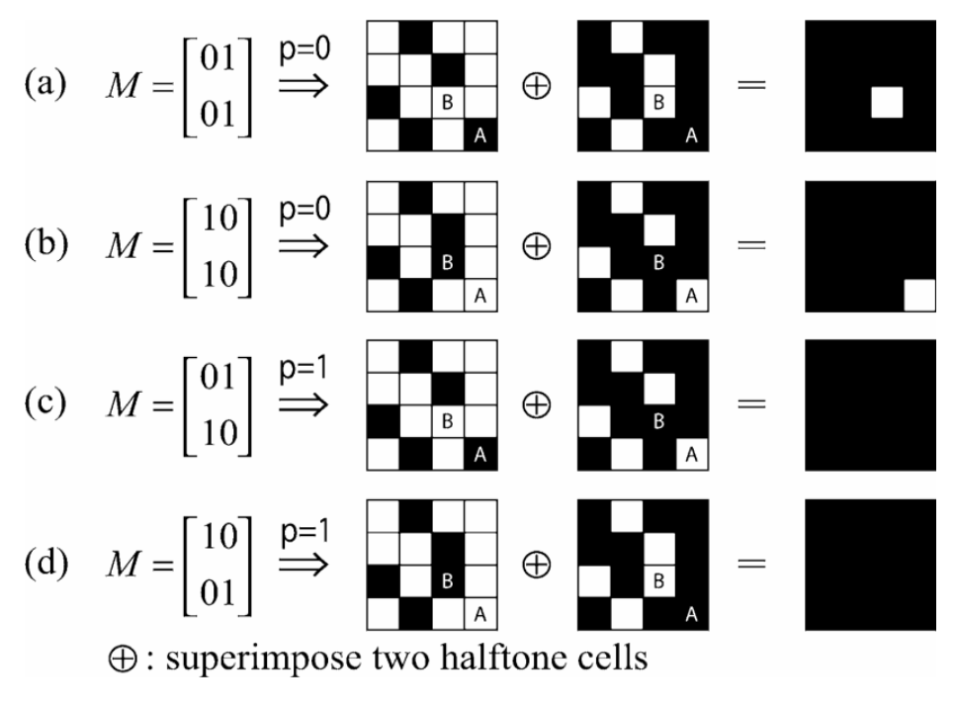
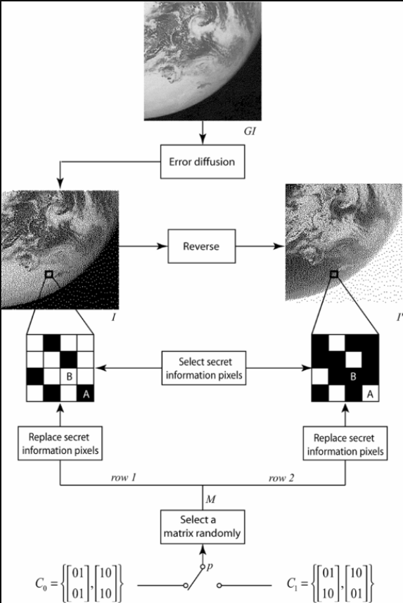
Two-Out-of-Two Halftone VC Method
A specific case of t-out-of-n schemes is the two-out-of-two visual threshold scheme. The hidden image can be recovered by participants in a qualified subset, but not by participants in a banned subset. The qualities of a t-out-of-n scheme, such as the requirements required for good contrast and the smallest possible pixel expansion. Despite the fact that the hidden image is in greyscale, shares are still made up of random binary patterns. In the proposed method, participant 1 is assigned a halftone image I obtained by applying any halftoning method to a grey level image GI, such as the error diffusion algorithm, and participant 2 is assigned its complementary image I, obtained by reversing all black/white pixels of I to white/black pixels.

Slide 13

General Halftone VC
The technique behind the two-out-of-two halftone visual threshold scheme is extended in this section to a scheme for an arbitrary access structure (ΓQual,Γ Forb), in which a secret binary image SI is hidden in n halftone shares.
The scheme is divided into two phases: first, participants are assigned complementary pairs of images so that each qualified subset in ΓQual 1 contains at least one complementary pair of images; second, a secret pixel p is encoded into a Q1xQ2 halftone cell, and m(m VC and halftone VC, respectively, in each of the shares.

Slide 14
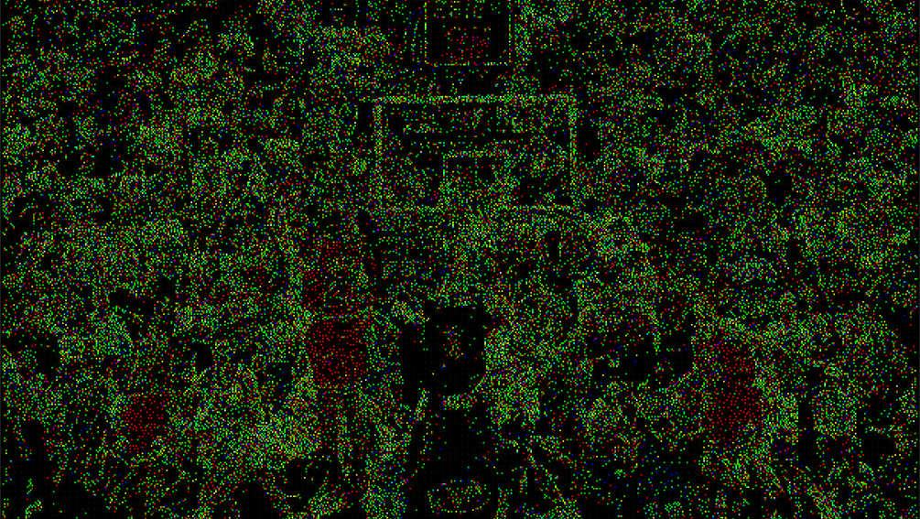
Simulation

Slide 15
What did I learn from this?
Got the opportunity to know and research visual cryptography.
Read about halftone visual cryptography and the various ways in which it operates, namely Blue noise halftoning, digital halftoning, digital watermarking, error diffusion, secret sharing, steganography, visual cryptography.
Read more on CMY color spaced-based visual cryptography scheme for secret sharing of data.
https://ieeexplore.ieee.org/abstract/document/1658106
https://github.com/anushka23g/Half-Tone-Visual-Cryptography

Slide 16
Conclusion
Visual cryptography was originally designed for only binary images, but it has recently been applied to grayscale and color images. One way is to breakdown a color image into Cyan, Magenta, Yellow, and Black.
Halftone conversions were applied for each of the monotone photos using the first three images. To create the three shares, closest neighbor interpolation is used. Finally, to create the output image file, join the three shares.
In contrast to almost all studies and theories of visual cryptography, which focus on binary pictures or images, we used Floyd and Steinberg's halftoning algorithm and color decomposition to key out the framework that can deal with color visual cryptography.
According to color disintegration theories, each individual color on a colored picture can be fragmented into three main colors: Cyan, Magenta, and Yellow. A gray-scale image is metamorphosed into a binary image using halftone technology, which is suitable for visual cryptography.

Slide 17
About the Authors
Zhi Zhou
Department of Electrical and Computer Engineering, University of Delaware, Newark, DE, USA
G.R. Arce
Department of Electrical and Computer Engineering, University of Delaware, Newark, DE, USA
G. Di Crescenzo
Mathematical Sciences Research Center, Telcordia Technologies, Inc., Morristown, NJ, USA

Slide 18

Thank you!

