Slide 1
An Open Grid Services Architecture
Ian Foster
Mathematics and Computer Science Division
Argonne National Laboratory
and
Department of Computer Science
The University of Chicago
http://www.mcs.anl.gov/~foster

Slide 2
Abstract
In both eBusiness and eScience, we often need to integrate services across distributed, heterogeneous, dynamic “virtual organizations” (VOs) formed from the disparate resources within a single enterprise and/or via external resource sharing and service provider relationships. This integration can be technically challenging due to the need to achieve various qualities of service (QoS) when running on top of different native platforms. We present an Open Grid Services Architecture that addresses these challenges. Building on concepts and technologies from the Grid and Web services communities, this architecture defines a uniform exposed service semantics (the Grid service); defines standard mechanisms for creating and discovering transient Grid service instances; provides location transparency and multiple binding protocols for service instances; and supports mapping services for integration with underlying native platform facilities. The Open Grid Services Architecture defines, in terms of Web Services Description Language (WSDL) interfaces, mechanisms required for creating and composing sophisticated distributed systems, including lifetime management, reliable remote invocation, change management, credential management, and notification. Our presentation extends our earlier work on Grid architecture by describing how Grid mechanisms can implement a service oriented architecture, explaining how Grid functionality can be incorporated into a Web services framework, and illustrating how our architecture can be applied within commercial computing as a basis for distributed system integration—within and across organizational domains.

Slide 3


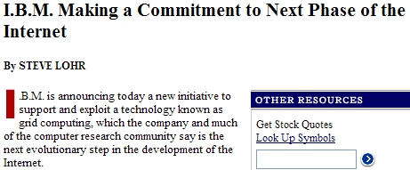
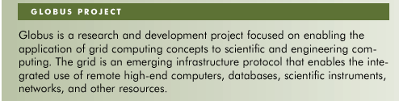



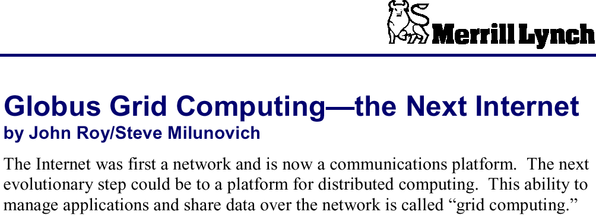
Grid Computing

Slide 4
Overview
The universal nature of the “Grid problem”
A review & assessment of Grid technologies, in particular the Globus Toolkit™
Open Grid Services Architecture as an evolution & integration of Grid technologies and Web services

Slide 5
Partial Acknowledgements
Open Grid Services Architecture design
  Carl Kesselman, Karl Czajkowski @ USC/ISI
  Steve Tuecke @ANL
  Jeff Nick, Steve Graham, Jeff Frey @ IBM
Grid services collaborators at ANL
  Kate Keahey, Gregor von Laszewski
  Thomas Sandholm, Jarek Gawor, John Bresnahan
Globus Toolkit R&D also involves many fine scientists & engineers at ANL, USC/ISI, and elsewhere (see www.globus.org)
Strong links with many EU, UK, US Grid projects
Support from DOE, NASA, NSF, IBM, Microsoft

Slide 6
The Grid Vision
“Resource sharing & coordinated problem solving in dynamic, multi-institutional virtual organizations”
  On-demand, ubiquitous access to computing, data, and services
  New capabilities constructed dynamically and transparently from distributed services
“When the network is as fast as the computer's
internal links, the machine disintegrates across
the net into a set of special purpose appliances”
(George Gilder)

Slide 7
The Grid Opportunity: eScience and eBusiness
Physicists worldwide pool resources for peta-op analyses of petabytes of data
Civil engineers collaborate to design, execute, & analyze shake table experiments
An insurance company mines data from partner hospitals for fraud detection
An application service provider offloads excess load to a compute cycle provider
An enterprise configures internal & external resources to support eBusiness workload

Slide 8

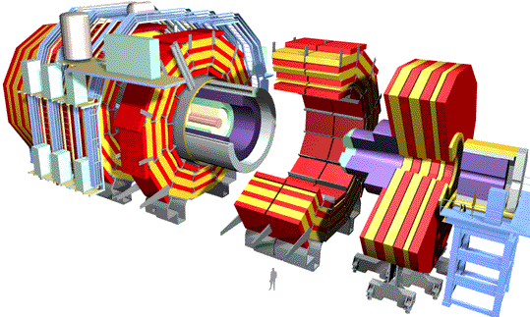
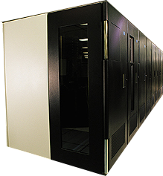
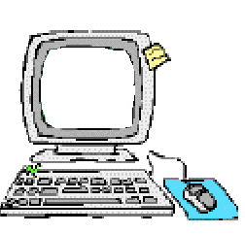
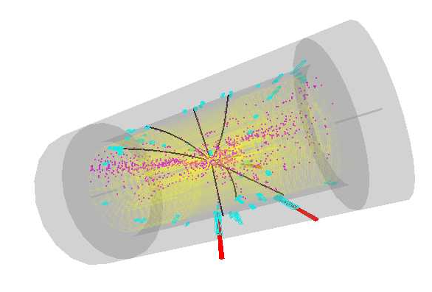
Grid Communities & Applications:
Data Grids for High Energy Physics
~PBytes/sec
Online System
~100 MBytes/sec
1 TIPS is approximately 25,000
SpecInt95 equivalents
There is a “bunch crossing” every 25 nsecs.
There are 100 “triggers” per second
Each triggered event is ~1 MByte in size
Offline Processor Farm
~20 TIPS
~100 MBytes/sec
Tier 0
CERN Computer Centre
HPSS
~622 Mbits/sec or Air Freight (deprecated)
Tier 1
France Regional Centre
HPSS
Germany Regional Centre
HPSS
Italy Regional Centre
HPSS
FermiLab ~4 TIPS
HPSS
~622 Mbits/sec
Tier 2
Caltech ~1 TIPS
Tier2 Centre ~1 TIPS
Tier2 Centre ~1 TIPS
Tier2 Centre ~1 TIPS
Tier2 Centre ~1 TIPS
~622 Mbits/sec
Institute ~0.25TIPS
Institute
Institute
Institute
Physicists work on analysis “channels”.
Each institute will have ~10 physicists working on one or more channels; data for these channels should be cached by the institute server
Physics data cache
~1 MBytes/sec
Tier 4
Pentium II 300 MHz
Pentium II 300 MHz
Physicist workstations
Pentium II 300 MHz
Pentium II 300 MHz
www.griphyn.org www.ppdg.net www.eu-datagrid.org

Slide 9
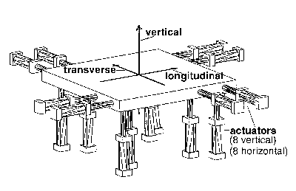
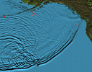
Grid Communities and Applications:
Network for Earthquake Eng. Simulation
NEESgrid: US national infrastructure to couple earthquake engineers with experimental facilities, databases, computers, & each other
On-demand access to experiments, data streams, computing, archives, collaboration
NEESgrid: Argonne, Michigan, NCSA, UIUC, USC www.neesgrid.org

Slide 10
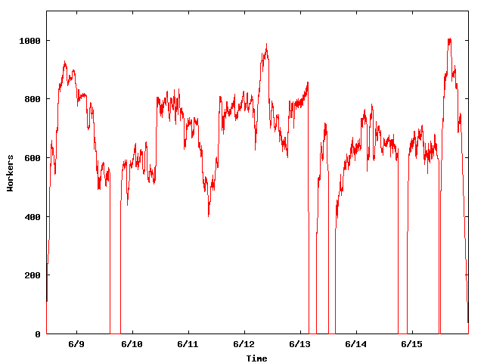
Mathematicians Solve NUG30
Looking for the solution to the NUG30 quadratic assignment problem
An informal collaboration of mathematicians and computer scientists
Condor-G delivered 3.46E8 CPU seconds in 7 days (peak 1009 processors) in U.S. and Italy (8 sites)
  14,5,28,24,1,3,16,15,
  10,9,21,2,4,29,25,22,
  13,26,17,30,6,20,19,
  8,18,7,27,12,11,23
MetaNEOS: Argonne, Iowa, Northwestern, Wisconsin

Slide 11

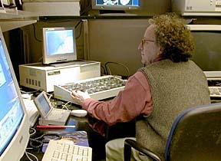


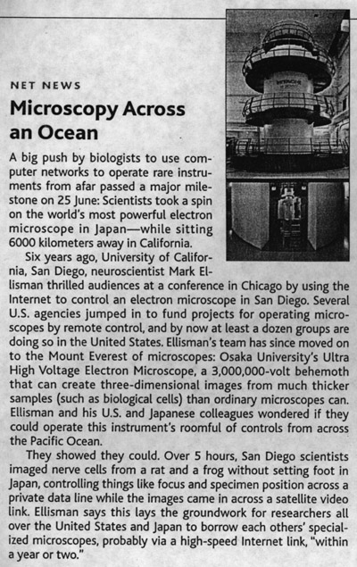


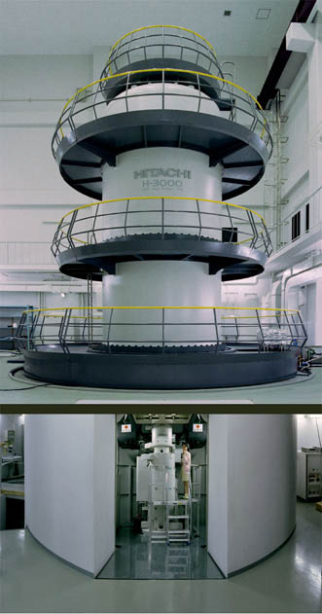
APAN Trans-Pacific Telemicroscopy Collaboration, Osaka-U, UCSD, ISI
(slide courtesy Mark Ellisman@UCSD)
1st
UHVEM
(Osaka, Japan)
NCMIR
(San Diego)
(Chicago)
STAR TAP
(San Diego)
SDSC
Tokyo XP
TransPAC
vBNS
Globus
CRL/MPT
2nd
UCSD
UHVEM
(Osaka, Japan)
NCMIR
(San Diego)

Slide 12

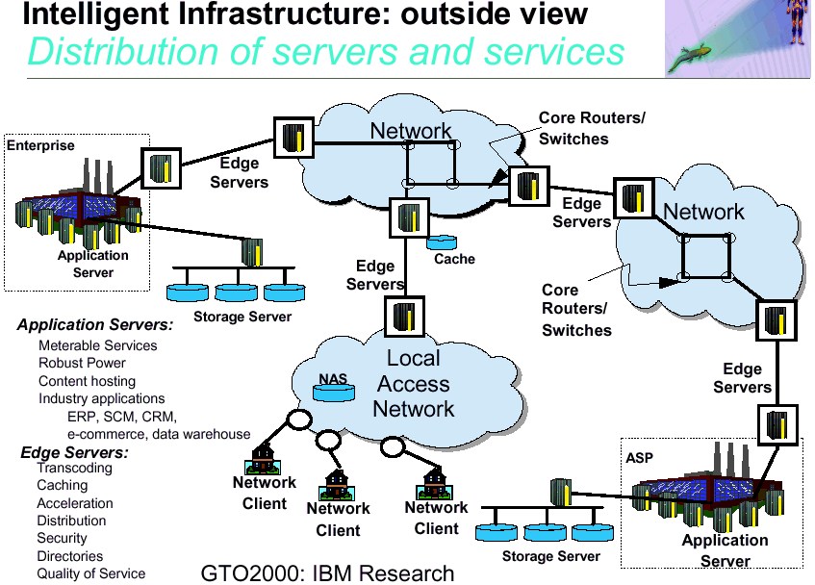
What Makes it Hard
(A Commercial Perspective)

Slide 13
Requirements Include …
Dynamic formation and management of virtual organizations
Online negotiation of access to services: who, what, why, when, how
Establishment of applications and systems able to deliver multiple qualities of service
Autonomic management of infrastructure elements
Open, extensible, evolvable infrastructure

Slide 14
The Grid World: Current Status
Dozens of major Grid projects in scientific & technical computing/research & education
Considerable consensus on key concepts and technologies
  Open source Globus Toolkit™ a de facto standard for major protocols & services
  Far from complete or perfect, but out there, evolving rapidly, and large tool/user base
Industrial interest emerging rapidly
Opportunity: convergence of eScience and eBusiness requirements & technologies

Slide 15
The Globus Toolkit in One Slide
Grid protocols (GSI, GRAM, …) enable resource sharing within virtual orgs; toolkit provides reference implementation ( = Globus Toolkit services)
MDS-2
(Meta Directory Service)
Soft state
registration; enquiry
Reliable remote invocation
GSI
(Grid Security
Infrastruc-ture)
User
Gatekeeper
(factory)
Reporter
(registry +
discovery)
GIIS: Grid
Information
Index Server
(discovery)
Authenticate & create proxy credential
Other GSI-authenticated remote service requests
Create process
Register
User
User
process #1
process #2
Other service
(e.g. GridFTP)
Proxy
Proxy #2
GRAM
(Grid Resource Allocation & Management)
Protocols (and APIs) enable other tools and services for membership, discovery, data mgmt, workflow, …

Slide 16
Globus Toolkit: Evaluation (+)
Good technical solutions for key problems, e.g.
  Authentication and authorization
  Resource discovery and monitoring
  Reliable remote service invocation
  High-performance remote data access
This & good engineering is enabling progress
  Good quality reference implementation, multi-language support, interfaces to many systems, large user base, industrial support
  Growing community code base built on tools

Slide 17
Globus Toolkit: Evaluation (-)
Protocol deficiencies, e.g.
  Heterogeneous basis: HTTP, LDAP, FTP
  No standard means of invocation, notification, error propagation, authorization, termination, …
Significant missing functionality, e.g.
  Databases, sensors, instruments, workflow, …
  Virtualization of end systems (hosting envs.)
Little work on total system properties, e.g.
  Dependability, end-to-end QoS, …
  Reasoning about system properties

Slide 18
Globus Toolkit Structure
Service naming
Soft state
management
Reliable invocation
GRAM
MDS
GridFTP
MDS
???
Notification
GSI
GSI
GSI
Job
manager
Job
manager
Compute
Resource
Data
Resource
Other Service
or Application
Lots of good mechanisms, but (with the exception of GSI) not that easily
incorporated into other systems

Slide 19
Open Grid Services Architecture
Service orientation to virtualize resources
Define fundamental Grid service behaviors
  Core set required, others optional
  A unifying framework for interoperability & establishment of total system properties
Integration with Web services and hosting environment technologies
  Leverage tremendous commercial base
  Standard IDL accelerates community code
Delivery via open source Globus Toolkit 3.0
  Leverage GT experience, code, mindshare

Slide 20
“Web Services”
Increasingly popular standards-based framework for accessing network applications
  W3C standardization; Microsoft, IBM, Sun, others
WSDL: Web Services Description Language
  Interface Definition Language for Web services
SOAP: Simple Object Access Protocol
  XML-based RPC protocol; common WSDL target
WS-Inspection
  Conventions for locating service descriptions
UDDI: Universal Desc., Discovery, & Integration
  Directory for Web services

Slide 21
Web Services Example:
Database Service
WSDL definition for “DBaccess” porttype defines operations and bindings, e.g.:
  Query(QueryLanguage, Query, Result)
  SOAP protocol
Client C, Java, Python, etc., APIs can then be generated
DBaccess

Slide 22
Transient Service Instances
“Web services” address discovery & invocation of persistent services
  Interface to persistent state of entire enterprise
In Grids, must also support transient service instances, created/destroyed dynamically
  Interfaces to the states of distributed activities
  E.g. workflow, video conf., dist. data analysis
Significant implications for how services are managed, named, discovered, and used
  In fact, much of our work is concerned with the management of service instances

Slide 23
The Grid Service =
Interfaces + Service Data
Reliable invocation
Authentication
Service data access
Explicit destruction
Soft-state lifetime
GridService
… other interfaces …
Notification
Authorization
Service creation
Service registry
Manageability
Concurrency
Service
data
element
Service
data
element
Service
data
element
Implementation
Hosting environment/runtime
(“C”, J2EE, .NET, …)

Slide 24
Open Grid Services Architecture:
Fundamental Structure
1) WSDL conventions and extensions for describing and structuring services
  Useful independent of “Grid” computing
2) Standard WSDL interfaces & behaviors for core service activities
  portTypes and operations => protocols

Slide 25
WSDL Conventions & Extensions
portType (standard WSDL)
  Define an interface: a set of related operations
serviceType (extensibility element)
  List of port types: enables aggregation
serviceImplementation (extensibility element)
  Represents actual code
service (standard WSDL)
  instanceOf extension: map descr.->instance
compatibilityAssertion (extensibility element)
  portType, serviceType, serviceImplementation

Slide 26
Structure of a Grid Service
…
…
service
service
service
service
Service
Instantiation
instanceOf
instanceOf
instanceOf
instanceOf
Service
Description
…
serviceImplementation
cA
serviceImplementation
…
serviceType
cA
serviceType
…
PortType
PortType
cA
PortType
=
Standard WSDL
cA
=
compatibilityAssertion

Slide 27
Standard Interfaces & Behaviors:
Four Interrelated Concepts
Naming and bindings
  Every service instance has a unique name, from which can discover supported bindings
Information model
  Service data associated with Grid service instances, operations for accessing this info
Lifecycle
  Service instances created by factories
  Destroyed explicitly or via soft state
Notification
  Interfaces for registering interest and delivering notifications

Slide 28
OGSA Interfaces and Operations
Defined to Date
GridService Required
  FindServiceData
  Destroy
  SetTerminationTime
NotificationSource
  SubscribeToNotificationTopic
  UnsubscribeToNotificationTopic
NotificationSink
  DeliverNotification
Factory
  CreateService
PrimaryKey
  FindByPrimaryKey
  DestroyByPrimaryKey
Registry
  RegisterService
  UnregisterService
HandleMap
  FindByHandle
Authentication, reliability are binding properties
Manageability, concurrency, etc., to be defined

Slide 29
Service Data
A Grid service instance maintains a set of service data elements
  XML fragments encapsulated in standard <name, type, TTL-info> containers
  Includes basic introspection information, interface-specific data, and application data
FindServiceData operation (GridService interface) queries this information
  Extensible query language support
See also notification interfaces
  Allows notification of service existence and changes in service data

Slide 30
Grid Service Example:
Database Service
A DBaccess Grid service will support at least two portTypes
  GridService
  DBaccess
Each has service data
  GridService: basic introspection information, lifetime, …
  DBaccess: database type, query languages supported, current load, …, …
Grid
Service
DBaccess
Name, lifetime, etc.
DB info

Slide 31
Naming and Bindings
Every service instance has a unique and immutable name: Grid Service Handle (GSH)
  Basically just a URL
Handle must be converted to a Grid Service Reference (GSR) to use service
  Includes binding information; may expire
  Separation of name from implementation facilitates service evolution
The HandleMap interface allows a client to map from a GSH to a GSR
  Each service instance has home HandleMap

Slide 32
Registry
The Registry interface may be used to register Grid service instances with a registry
  A set of Grid services can periodically register their GSHs into a registry service, to allow for discovery of services in that set
Registrations maintained in a service data element associated with Registry interface
  Standard discovery mechanisms can then be used to discover registered services
  Returns a WS-Inspection document containing the GSHs of a set of Grid services

Slide 33
Lifetime Management
GS instances created by factory or manually; destroyed explicitly or via soft state
  Negotiation of initial lifetime with a factory (=service supporting Factory interface)
GridService interface supports
  Destroy operation for explicit destruction
  SetTerminationTime operation for keepalive
Soft state lifetime management avoids
  Explicit client teardown of complex state
  Resource “leaks” in hosting environments

Slide 34
Factory
Factory interface’s CreateService operation creates a new Grid service instance
  Reliable creation (once-and-only-once)
CreateService operation can be extended to accept service-specific creation parameters
Returns a Grid Service Handle (GSH)
  A globally unique URL
  Uniquely identifies the instance for all time
  Based on name of a home handleMap service

Slide 35
Transient Database Services
“What services can you create?”
“Create a database service”
Grid
Service
DBaccess
Factory
Grid
Service
DBaccess
Instance name, etc.
Name, lifetime, etc.
“What database services exist?”
Factory info
DB info
Grid
Service
Grid
Service
Registry
DBaccess
Instance name, etc.
Name, lifetime, etc.
Registry info
DB info

Slide 36
Example:
Data Mining for Bioinformatics
Community
Registry
Mining
Factory
Database
Service
BioDB 1
User
Application
Compute Service Provider
.
.
.
.
.
.
“I want to create
a personal database
containing data on
e.coli metabolism”
Database
Service
Database
Factory
BioDB n
Storage Service Provider

Slide 37
Example:
Data Mining for Bioinformatics
“Find me a data mining service, and somewhere to store data”
Community
Registry
Mining
Factory
Database
Service
BioDB 1
User
Application
Compute Service Provider
.
.
.
.
.
.
Database
Service
Database
Factory
BioDB n
Storage Service Provider

Slide 38
Example:
Data Mining for Bioinformatics
Community
Registry
Mining
Factory
GSHs for Mining
and Database
factories
Database
Service
BioDB 1
User
Application
Compute Service Provider
.
.
.
.
.
.
Database
Service
Database
Factory
BioDB n
Storage Service Provider

Slide 39
Example:
Data Mining for Bioinformatics
Community
Registry
Mining
Factory
Database
Service
“Create a data mining service with initial lifetime 10”
BioDB 1
User
Application
Compute Service Provider
.
.
.
.
.
.
“Create a
database with initial lifetime 1000”
Database
Service
Database
Factory
BioDB n
Storage Service Provider

Slide 40
Example:
Data Mining for Bioinformatics
Community
Registry
Mining
Factory
Database
Service
“Create a data mining service with initial lifetime 10”
Miner
BioDB 1
User
Application
Compute Service Provider
.
.
.
.
.
.
“Create a
database with initial lifetime 1000”
Database
Service
Database
Factory
BioDB n
Database
Storage Service Provider

Slide 41
Example:
Data Mining for Bioinformatics
Community
Registry
Mining
Factory
Database
Service
Query
Miner
BioDB 1
User
Application
Compute Service Provider
.
.
.
.
.
.
Query
Database
Service
Database
Factory
BioDB n
Database
Storage Service Provider

Slide 42
Example:
Data Mining for Bioinformatics
Community
Registry
Mining
Factory
Database
Service
Query
Miner
BioDB 1
Keepalive
User
Application
Compute Service Provider
.
.
.
.
.
.
Query
Database
Service
Database
Factory
Keepalive
BioDB n
Database
Storage Service Provider

Slide 43
Example:
Data Mining for Bioinformatics
Community
Registry
Mining
Factory
Database
Service
Miner
BioDB 1
Keepalive
User
Application
Compute Service Provider
.
.
.
.
.
.
Results
Database
Service
Database
Factory
Keepalive
Results
BioDB n
Database
Storage Service Provider

Slide 44
Example:
Data Mining for Bioinformatics
Community
Registry
Mining
Factory
Database
Service
Miner
BioDB 1
User
Application
Compute Service Provider
.
.
.
.
.
.
Database
Service
Database
Factory
Keepalive
BioDB n
Database
Storage Service Provider

Slide 45
Example:
Data Mining for Bioinformatics
Community
Registry
Mining
Factory
Database
Service
BioDB 1
User
Application
Compute Service Provider
.
.
.
.
.
.
Database
Service
Database
Factory
Keepalive
BioDB n
Database
Storage Service Provider

Slide 46
Notification Interfaces
NotificationSource for client subscription
  One or more notification generators
    Generates notification message of a specific type
    Typed interest statements: E.g., Filters, topics, …
    Supports messaging services, 3rd party filter services, …
  Soft state subscription to a generator
NotificationSink for asynchronous delivery of notification messages
A wide variety of uses are possible
  E.g. Dynamic discovery/registry services, monitoring, application error notification, …

Slide 47
Notification Example
Notifications can be associated with any (authorized) service data elements
Grid
Service
Notification
Sink
Grid
Service
DBaccess
Name, lifetime, etc.
Name, lifetime, etc.
DB info
Notification
Source
DB info
Subscribers

Slide 48
Notification Example
Notifications can be associated with any (authorized) service data elements
Grid
Service
Notification
Sink
Grid
Service
“Notify me of
new data about
membrane proteins”
DBaccess
Name, lifetime, etc.
Name, lifetime, etc.
DB info
Notification
Source
DB info
Subscribers

Slide 49
Notification Example
Notifications can be associated with any (authorized) service data elements
Grid
Service
Notification
Sink
Grid
Service
DBaccess
Keepalive
Name, lifetime, etc.
Name, lifetime, etc.
DB info
Notification
Source
DB info
Subscribers

Slide 50
Notification Example
Notifications can be associated with any (authorized) service data elements
Grid
Service
Notification
Sink
Grid
Service
New data
DBaccess
Name, lifetime, etc.
Name, lifetime, etc.
DB info
Notification
Source
DB info
Subscribers

Slide 51
Open Grid Services Architecture:
Summary
Service orientation to virtualize resources
  Everything is a service
From Web services
  Standard interface definition mechanisms: multiple protocol bindings, local/remote transparency
From Grids
  Service semantics, reliability and security models
  Lifecycle management, discovery, other services
Multiple “hosting environments”
  C, J2EE, .NET, …

Slide 52
Recap: The Grid Service
Reliable invocation
Authentication
Service data access
Explicit destruction
Soft-state lifetime
GridService
… other interfaces …
Notification
Authorization
Service creation
Service registry
Manageability
Concurrency
Service
data
element
Service
data
element
Service
data
element
Implementation
Hosting environment/runtime
(“C”, J2EE, .NET, …)

Slide 53
OGSA and the Globus Toolkit
Technically, OGSA enables
  Refactoring of protocols (GRAM, MDS-2, etc.)—while preserving all GT concepts/features!
  Integration with hosting environments: simplifying components, distribution, etc.
  Greatly expanded standard service set
Pragmatically, we are proceeding as follows
  Develop open source OGSA implementation
    Globus Toolkit 3.0; supports Globus Toolkit 2.0 APIs
  Partnerships for service development
  Also expect commercial value-adds

Slide 54
GT3: An Open Source OGSA-Compliant Globus Toolkit
GT3 Core
  Implements Grid service interfaces & behaviors
  Reference impln of evolving standard
  Java first, C soon, C#?
GT3 Base Services
  Evolution of current Globus Toolkit capabilities
  Backward compatible
Many other Grid services
Other Grid
GT3
Services
Data
Services
GT3 Base Services
GT3 Core

Slide 55
Hmm, Isn’t This Just Another Object Model?
Well, yes, in a sense
  Strong encapsulation
  We (can) profit greatly from experiences of previous object-based systems
But
  Focus on encapsulation not inheritance
  Does not require OO implementations
  Value lies in specific behaviors: lifetime, notification, authorization, …, …
  Document-centric not type-centric

Slide 56
Grids and OGSA:
Research Challenges
Grids pose profound problems, e.g.
  Management of virtual organizations
  Delivery of multiple qualities of service
  Autonomic management of infrastructure
  Software and system evolution
OGSA provides foundation for tackling these problems in a rigorous fashion?
  Structured establishment/maintenance of global properties
  Reasoning about total system properties

Slide 57
Why We Will Succeed
Strong and compelling vision with broad support across disciplines and borders
Strong base of technology, experience, success stories, projects
Genuinely open with respect to intellectual and technology contributions
Open Grid community process and organization is gaining commercial support
Strong partnerships, in particular with UK eScience program

Slide 58
Summary
The Grid problem: Resource sharing & coordinated problem solving in dynamic, multi-institutional virtual organizations
Globus Toolkit a source of protocol and API definitions—and reference implementations
  And many projects applying Grid concepts (& Globus technologies) to important problems
Open Grid Services Architecture represents (we hope!) next step in evolution
An enabling framework for investigations of Internet-scale computing systems

Slide 59
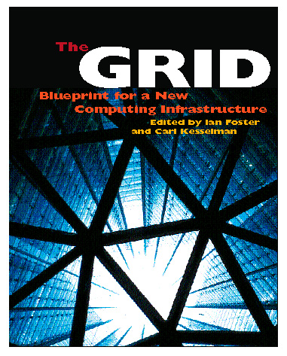
For More Information
The Globus Project™
  www.globus.org
Grid architecture
  www.globus.org/research/papers/anatomy.pdf
Open Grid Services Architecture
  www.globus.org/ogsa
Global Grid Forum
  www.gridforum.org

Slide 60
Extra Slides

Slide 61
Grids: Why Now?
Moore’s law ⇒ highly functional end-systems
Ubiquitous Internet ⇒ universal connectivity
Ubiquitous sensors, cheap storage ⇒ DATA!
Network exponentials produce dramatic changes in geometry and geography
Web created familiarity with network utilities
Middleware is no longer vaporware
Early demonstrators convey benefits
New business models facilitate outsourcing

Slide 62
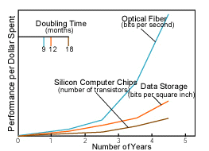
Network Exponentials
Network vs. computer performance
  Computer speed doubles every 18 months
  Network speed doubles every 9 months
  Difference = order of magnitude per 5 years
1986 to 2000
  Computers: x 500
  Networks: x 340,000
2001 to 2010
  Computers: x 60
  Networks: x 4000
Moore’s Law vs. storage improvements vs. optical improvements. Graph from Scientific American (Jan-2001) by Cleo Vilett, source Vined Khoslan, Kleiner, Caufield and Perkins.

Slide 63
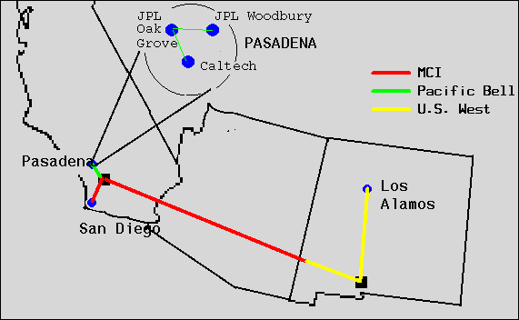
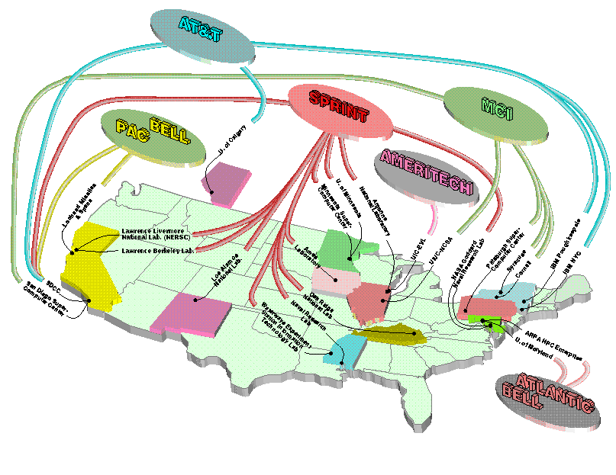
A Brief History
Early 90s
  Gigabit testbeds, metacomputing
Mid to late 90s
  Early experiments (e.g., I-WAY), academic software projects (e.g., Globus, Legion), application experiments
2002
  Major application communities have emerged
  Major infrastructure deployments
  Significant technology base
  Growing industrial interest
  Global Grid Forum: ~500 people, 20+ countries

Slide 64
Evolution
This is not happening all at once
  We have an early prototype of Core (alpha release May)
  Next we will work on Base, others
  Full release by end of 2002 (estimate)
  Partnerships in place for other services
Backward compatibility
  API level seems straightforward
  Protocol level: gateways?
  We need input on best strategies

