Slide 1
Weekly Progress
October 29, 2026
Yuchao Shen
Notes:
Week 3: Sunday A1 migration from Isaac Sim to mjlab. Technical focus: FlexiTac-style distance sampling, hand and foot response mappings, independent ball grasps.

Slide 2
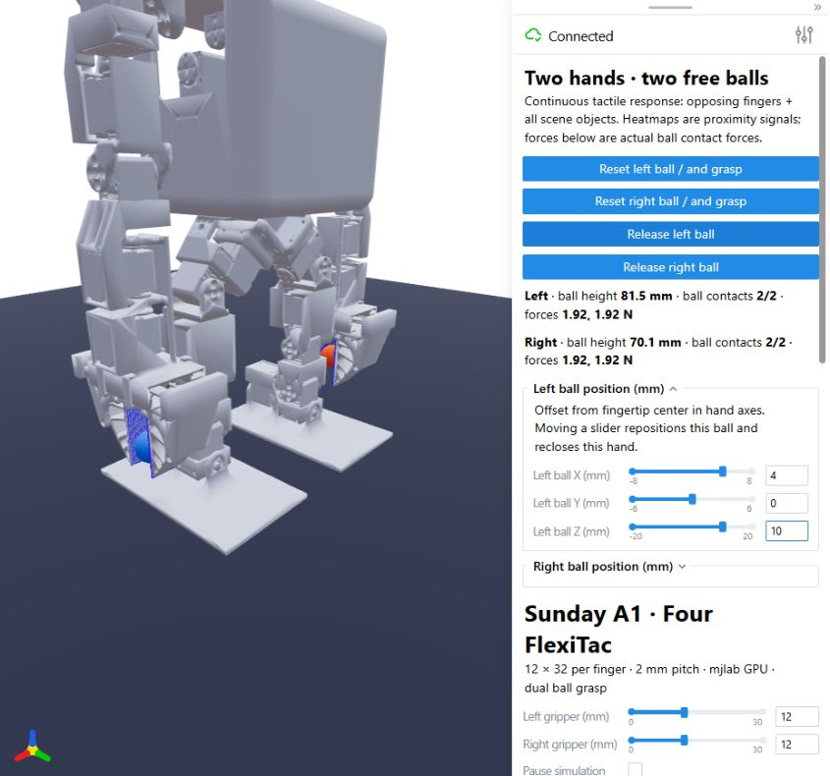
Independent ball grasps in mjlab
The complete Sunday A1 model runs with independent left and right grippers.
Each hand holds a separate 28 mm, 40 g free ball. Contact and friction support the grasp.
Both hands have separate reset, release and XYZ ball offsets. The complete scene has eight tactile arrays.
Development screenshot of the dual-grasp controls, before the foot arrays joined the interface.
Notes:
Sources: C:/Users/Auspring/Desktop/MARS/Progress/Week3/code/src/sunday_a1_mjlab/ball_grasp.py; C:/Users/Auspring/Desktop/MARS/Progress/Week3/code/src/sunday_a1_mjlab/tasks.py; C:/Users/Auspring/Desktop/MARS/Progress/Week3/01_dual_hand_grasp.jpg. Fixed-base task, 27 position actions. No autonomous reaching or locomotion policy. The free balls obey gravity and solver contact. Tactile sampling does not apply its own spring forces. GPU simulation runs in Python through mjlab and MuJoCo Warp. Viser provides browser display and controls.

Slide 3
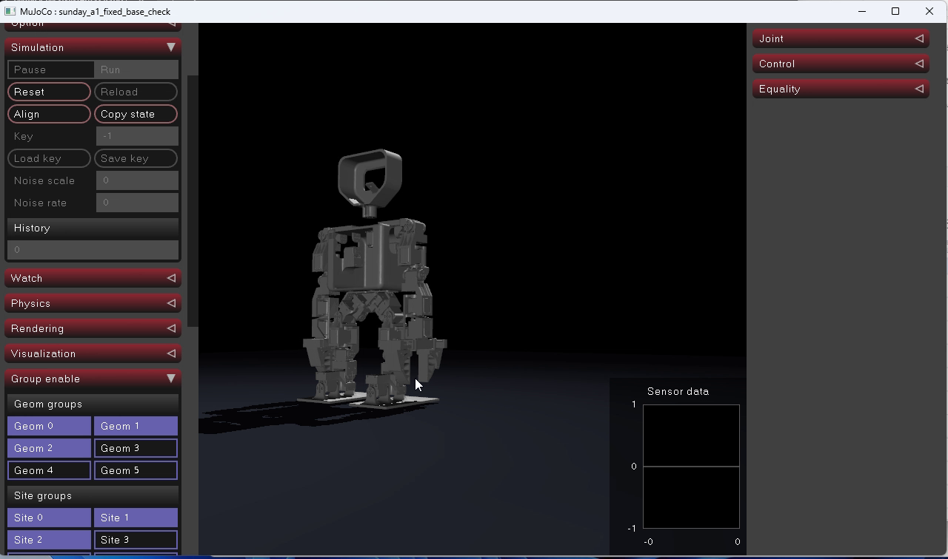
Native MuJoCo model preview
The native viewer provides a direct check of the imported robot model and joint structure.
This recording shows the basic model preview. The complete ball and tactile interface uses a separate scene.
14.5 s recording.
Click the video during the slide show to play.
Notes:
User recording 2026-10-29 022253.mp4, 14.549313 s, H.264/AAC. Original media is embedded in this presentation. The native preview does not include the complete ball/tactile controls. Browser and native viewers are display options. Both can display MuJoCo physics when the application supplies the scene and control loop.

Slide 4
Taxel grids and moving coordinate frames
1. Place a regular grid on each rigid sensor patch
pᵢⱼ = c + (i − (M − 1)/2) Δ e₁ + (j − (N − 1)/2) Δ e₂
c: patch center Δ: taxel pitch e₁, e₂: tangent directions i = 0…M−1, j = 0…N−1
2. Follow the sensor body, then query in the target geometry frame
pᵂ = xᴮ + Rᴮ pᵢⱼ q = (Rᴳ)ᵀ (pᵂ − xᴳ)
xᴮ, Rᴮ: current body pose xᴳ, Rᴳ: current target geometry pose W: world frame
Hands: M × N = 12 × 32, Δ = 2 mm. Feet: 32 × 32, Δ = 2.5 mm.
The same sampling engine updates every patch as its body moves.
Notes:
Exact implementation: C:/Users/Auspring/Desktop/MARS/Progress/Week3/code/src/sunday_a1_mjlab/flexitac.py, local_taxels, initialize_surface_taxels, sample_taxels; C:/Users/Auspring/Desktop/MARS/Progress/Week3/code/src/sunday_a1_mjlab/feet_tactile.py. Equation represents a regular tangent-plane grid. For fingers, signed local Z follows the inward orientation. Geometry vertices and positions use meters after MuJoCo import. Patch coverage M*Delta by N*Delta counts taxel cells, whereas center-to-center span is (M-1)*Delta by (N-1)*Delta. Body and geom pose matrices come from current MuJoCo Warp state. This is the rigid coordinate-transform method used in the FlexiTac Isaac implementation, not an import of its sensor class.

Slide 5
Nearest-surface distance at each taxel
Triangle mesh
q* = arg minₛ∈S ‖q − s‖₂ d = ‖q − q*‖₂
Warp finds the nearest triangle and its barycentric point.
This port uses unsigned mesh distance. Mesh interiors do not get a negative sign.
Analytic scene geometry
Sphere: d = ‖q‖₂ − radius Plane: d = q · (0, 0, 1)
For each taxel: d = min {distance to each eligible target}
Signed analytic distances are negative inside an object. Candidates include supported objects
and opposing fingers, so closing an empty gripper can still generate a response.
Notes:
Sources: C:/Users/Auspring/Desktop/MARS/Progress/Week3/code/src/sunday_a1_mjlab/flexitac.py, sample_taxels and merge_scene_taxels. Mesh query uses wp.Mesh, wp.mesh_query_point and wp.mesh_eval_position, with maximum query distance 0.1 m and a default 0.1 m value for a miss. Target filter excludes the sensor's own body, disabled visual duplicates and unrelated non-finger robot bodies. Supported shapes: plane, sphere, capsule, cylinder, box, approximate ellipsoid and triangle mesh. Six non-plane geometry types have saved probe tests. The original FlexiTac sensor D:/robotics/FlexiTac-IsaacSim-Simulation/source/isaaclab/isaaclab/sensors/warp_sdf_tactile/warp_sdf_tactile_sensor.py supports unsigned, winding signed and normal-based signed modes. Week 2 selected unsigned mode for hands. This port retains unsigned meshes and adds analytic scene-object signed distances. This mixed distance representation is an intentional approximation, not a universal exact SDF.

Slide 6
Finger response: the 1.5 mm shell
r = clip( k max(h − d, 0) / s, 0, 1 )
h = 0.0015 m k = 5000 s = 2.4 d in meters
Example: d = 1.2 mm
δ = 1.5 − 1.2 = 0.3 mm
r = 5000 × 0.0003 / 2.4
= 0.625
The response starts below 1.5 mm
and saturates at d ≤ 1.02 mm.
k and s are inherited response parameters. These values require physical calibration.
Notes:
Exact formula: C:/Users/Auspring/Desktop/MARS/Progress/Week3/code/src/sunday_a1_mjlab/flexitac.py, SHELL_M=0.0015, STIFFNESS=5000, MAX_RESPONSE=2.4 and Warp response assignment. The original D:/robotics/FlexiTac-IsaacSim-Simulation/source/isaaclab/isaaclab/sensors/warp_sdf_tactile/warp_sdf_tactile_sensor.py computes penetration=max(shell-distance,0) for unsigned meshes, clamps k*penetration to max_force, then divides by max_force. Week 2 set shell=1.5 mm, effective world stiffness=5000, max_force=2.4 with normalized output. This port reproduces that numerical mapping. Do not interpret k as a validated skin stiffness or the normalized output as calibrated force. Equivalent normalized gain is 2083.3333 per meter, or a 0.48 mm full-scale shell compression. Hand analytic geometry currently uses the same shell mapping even when its distance is signed. The plotted line is an exact calculation of this function, not measured data. At d=1.02 mm, response=1. At 1.2 mm, response=.625. This readout can activate before solver contact and does not feed an additional force back into the simulation.

Slide 7
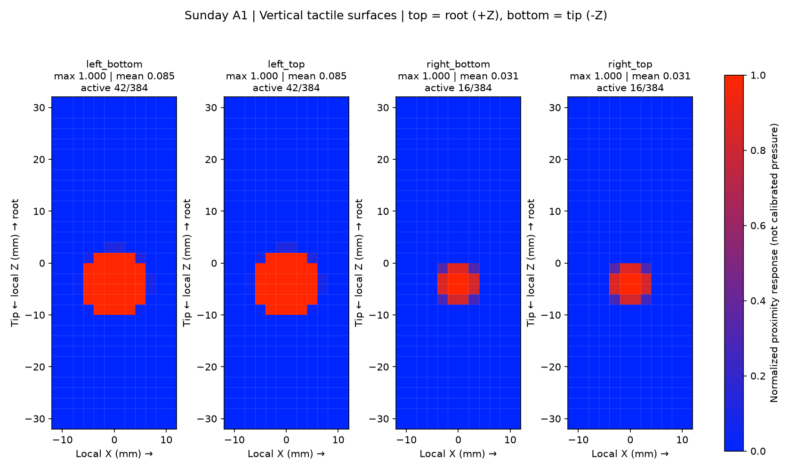
Finger heatmaps during ball contact
Four 12 × 32 arrays provide 1,536 responses. Each grid follows its own finger link.
A local contact produces a local pattern. Opposing-finger proximity also appears after ball release.
All four plots use the same 0–1 response scale. Display transforms place the finger root at the top.
Notes:
Source: C:/Users/Auspring/Desktop/MARS/Progress/Week3/results/ball_grasp/vertical_held_heatmaps.png; C:/Users/Auspring/Desktop/MARS/Progress/Week3/code/src/sunday_a1_mjlab/tactile_display.py; C:/Users/Auspring/Desktop/MARS/Progress/Week3/code/src/sunday_a1_mjlab/flexitac.py. The image shows held-ball patterns. The display transposes storage axes and accounts for opposing finger orientation. It does not rotate physical patches or alter raw observations. Uniform red during empty closure can result from broad opposing-surface proximity and numerical saturation, rather than a measured pressure distribution.

Slide 8
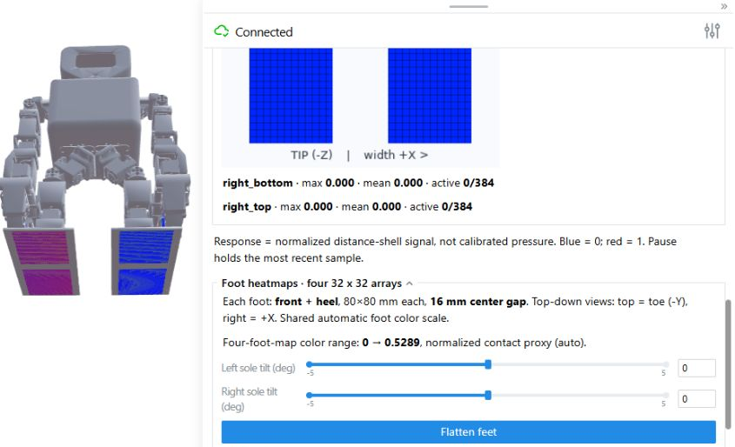
Four foot patches in the same scene
Each foot has a front patch and a heel patch. Every patch contains 32 × 32 taxels.
Each patch covers 80 × 80 mm at 2.5 mm pitch. A 16 mm gap separates the two patches.
The four foot arrays add 4,096 responses and share the hand sensors’ update cycle.
Notes:
Sources: C:/Users/Auspring/Desktop/MARS/Progress/Week3/code/src/sunday_a1_mjlab/feet_tactile.py; C:/Users/Auspring/Desktop/MARS/Progress/Week3/02_hand_and_foot_sensor_view.jpg. Local patch plane z=-30 mm. Front/heel y=-99.175/-3.175 mm. Center spacing 96 mm gives 16 mm gap between 80 mm cell-coverage patches. Local -Y points toward the toe. Left/right patch center x=+5/-5 mm. Same common local-grid and Warp-query engine as the hands. Simulation uses 2 ms physics steps, 10 substeps per 20 ms control step. The tactile observation updates with the control cycle, and Viser refreshes approximately 10 Hz.

Slide 9
Sole response: penetration without a shell
r = clip( max(−d, 0) / d₀, 0, 1 ) d₀ = 0.002 m
For a horizontal ground plane: d = taxel height − ground height
Example: d = −1 mm
δ = max(1, 0) = 1 mm
r = 1 / 2 = 0.5
d ≥ 0: response = 0
d ≤ −2 mm: response = 1
A positive shell can saturate grounded feet. This depth mapping preserves useful changes.
Notes:
Sources: C:/Users/Auspring/Desktop/MARS/Progress/Week3/code/src/sunday_a1_mjlab/feet_tactile.py; C:/Users/Auspring/Desktop/MARS/Progress/Week3/code/src/sunday_a1_mjlab/flexitac.py, response_depth_m causes stiffness=1 and max_response=.002, with shell=0. Signed plane distance produces the shown penetration proxy. This custom foot normalization differs from the hand mapping but uses the same sample/query/output pipeline. The plotted line is the exact mathematical response, not measured data. For unsigned meshes, d cannot be negative, so a zero-shell response cannot detect mesh penetration. Current sole-ground sensing uses an analytic plane. A general uneven triangle-mesh terrain implementation would require signed queries or another penetration/contact method. The response does not deform a skin or add normal force to the physics solver.

Slide 10
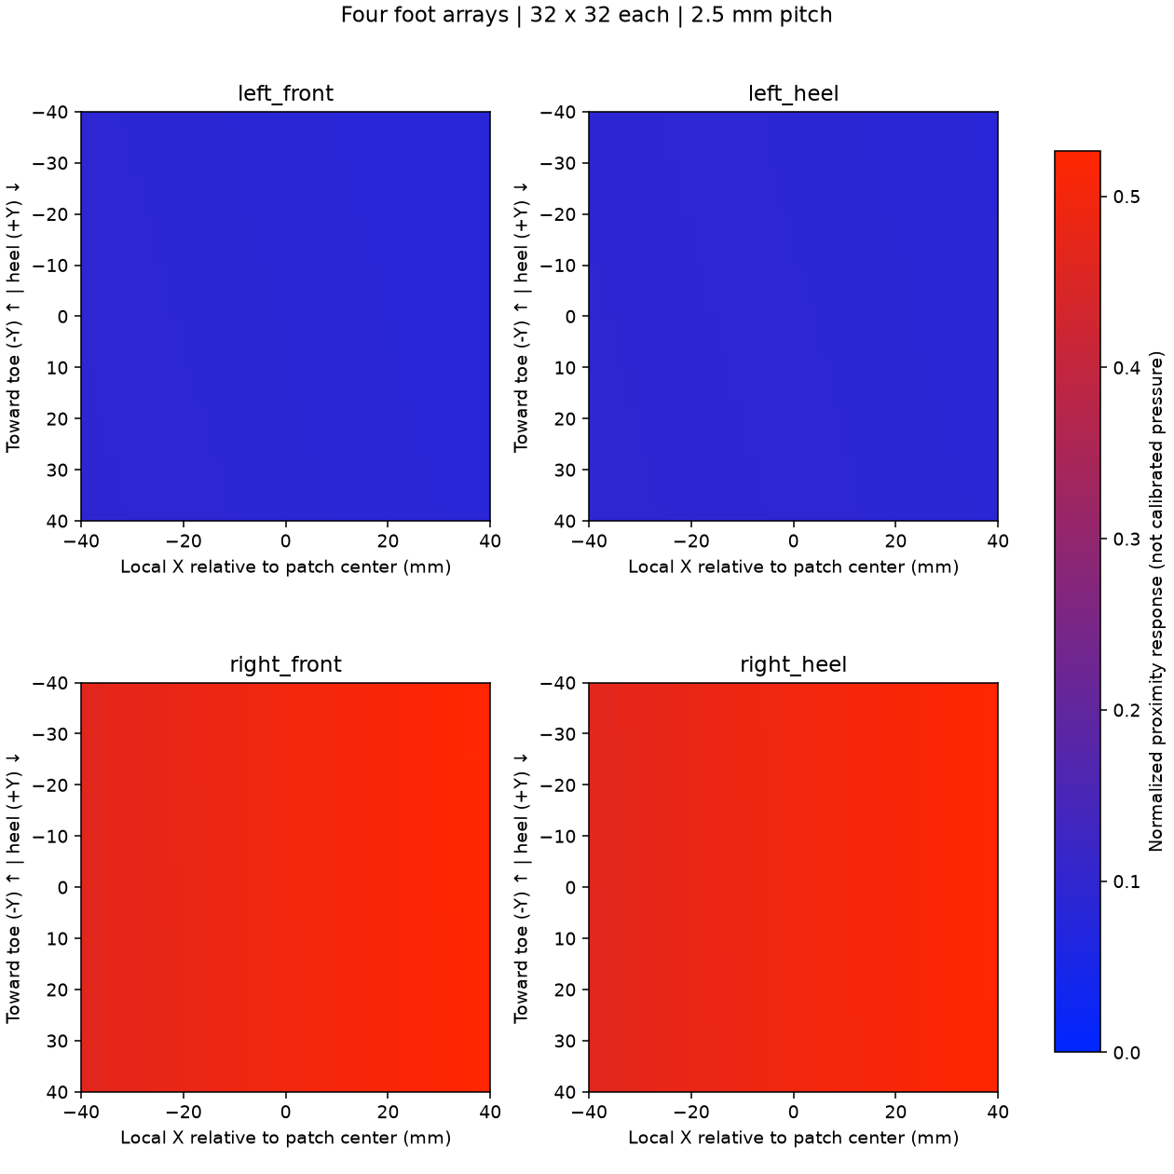
Separate front and heel heatmaps
Four plots report the front and heel regions of the left and right feet separately.
The source model has about 0.82 mm of zero-pose sole height difference, which affects initial readings.
The four foot plots share an automatic color range. Raw responses remain in 0–1 and are saved separately.
Notes:
Sources: C:/Users/Auspring/Desktop/MARS/Progress/Week3/03_foot_heatmaps.png; C:/Users/Auspring/Desktop/MARS/Progress/Week3/results/feet_tactile/check.json; C:/Users/Auspring/Desktop/MARS/Progress/Week3/code/src/sunday_a1_mjlab/tactile_display.py; included source URDF. The original model has approximately .766 mm hip-roll-origin Z asymmetry plus .054 mm ankle-pitch-origin Z asymmetry. The CAD design reason remains unknown. Initial fixed-base root lowers by 6 mm to engage feet. Tilt controls command l_ankle_roll/r_ankle_roll targets, rather than changing installation transforms permanently. Different responses do not alone establish sensor error or different foot forces. The fixed-base support constraint prevents interpreting sole response as total robot weight. Hand fixed scale and foot automatic scale mean their colors cannot be compared as physical pressure.

Slide 11
FlexiTac methods and mjlab adaptations
Component | Isaac / previous setup | Week 3 implementation
Grid and transforms | Rigid surface samples | Same method for hands and feet
Mesh query | Warp nearest surface, optional sign | Warp unsigned mesh distance
Geometry and poses | USD meshes and PhysX state | MuJoCo meshes and Warp state
Sensor lifecycle | Isaac sensor class and callbacks | Custom mjlab Sensor adapter
Response mapping | Shell or signed penetration | Hand shell, sole depth normalization
This is a method port. The demo does not import the Isaac WarpSdfTactileSensor class.
Common output: [environments, patches, taxels, (x, y, z, response)]. Distances remain available.
Notes:
Sources: D:/robotics/FlexiTac-IsaacSim-Simulation/source/isaaclab/isaaclab/sensors/warp_sdf_tactile/warp_sdf_tactile_sensor.py; C:/Users/Auspring/Desktop/MARS/Progress/Week3/code/src/sunday_a1_mjlab/flexitac.py; C:/Users/Auspring/Desktop/MARS/Progress/Week3/code/src/sunday_a1_mjlab/mjlab_flexitac.py; C:/Users/Auspring/Desktop/MARS/Progress/Week3/code/src/sunday_a1_mjlab/feet_tactile.py. See external project and repository links in Week3/README.md. The original sensor offers unsigned, winding signed and normal signed mesh options. Week 2 hands selected unsigned shell mode; Week 1 feet selected signed ground distance. A custom implementation preserves the regular-grid, rigid-frame, Warp-distance and clipped-response methods while replacing platform-specific data access and lifecycle hooks. New eligible scene-object support retains opposing-finger sensing after release. Ellipsoid distances are approximate. New scene geometry requires rebuilding the candidate list. No heightfield or custom SDF geom support yet.

Slide 12
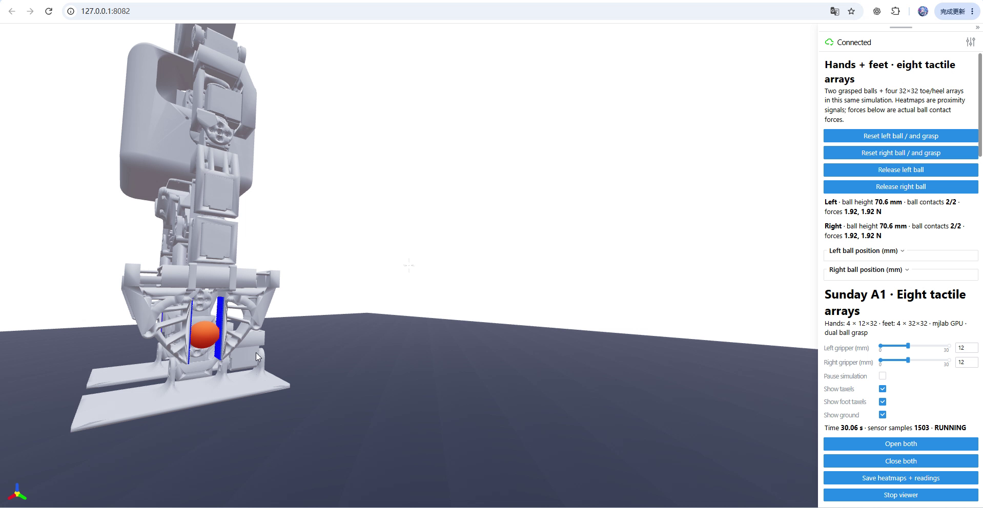
Interactive grasp and tactile demo
One interface controls both grippers and each ball’s position, reset and release.
Eight arrays update with the simulation. Heatmaps change as object and opposing-finger distances change.
50.9 s recording.
Click the video during the slide show to play.
Notes:
User recording 2026-10-29 032143.mp4, 50.943979 s, H.264/AAC, 1918 x 992. The original recording is embedded in the presentation. This recording replaces the earlier 025102 clip and shows the combined eight-array demo after correcting the right-hand tactile sampling planes. It demonstrates independent grasp and release controls. The browser displays the local mjlab simulation through Viser. Heatmap values remain normalized distance responses rather than calibrated pressure. Click the video in PowerPoint slide show mode to play.

Slide 13
Validation results
Check | Saved test condition | Result
Dual grasp | Both balls held for 4 s | 0.477 mm drift per ball
Vertical support | 40 g sphere in each hand | About 0.3924 N per hand
Sole placement | Four parallel environments | 0.055 mm maximum surface error
Object response | Six geometry types, four fingers | Response appears and clears
Force consistency: Σ Fz ≈ mg = 0.040 × 9.81 = 0.3924 N
The force check uses solver contact forces. The tactile heatmaps use the distance formulas.
Notes:
Saved numerical evidence, not a new hardware experiment: C:/Users/Auspring/Desktop/MARS/Progress/Week3/results/ball_grasp/dual_check.json (passed, left/right drift .00047683717044/.00047683716785 m, vertical contact sums approximately .392400056/.392398998 N); C:/Users/Auspring/Desktop/MARS/Progress/Week3/results/feet_tactile/check.json (passed, 4 environments, [4,4,1024,4] output, sole surface error 5.460815737e-05 m, world transform error approx 1.19e-7 m); C:/Users/Auspring/Desktop/MARS/Progress/Week3/results/ball_grasp/object_sensing_check.json. Per-hand release, empty closing, offsets and reset isolation also pass in the dual-grasp record. Objects include sphere, box, capsule, cylinder, ellipsoid and mesh. Ball radius=.014 m, mass=.040 kg. MuJoCo solver contact forces provide Newton units. Summing normalized tactile values is not an alternative force measurement.

Slide 14
Calibration and next steps
Physical pressure needs a calibrated force per taxel
pᵢ = Fᵢ / Aᵢ Aᵢ = Δ²
Hand cell area: 4 mm². Sole cell area: 6.25 mm².
The current response rᵢ alone does not determine Fᵢ or pressure in Pa.
Next: measure loads and fit the response model
Use controlled contacts to identify stiffness, saturation and the sensor’s spatial response.
Compare predicted force and contact distribution with hardware measurements.
Next: extend the physical task
Validate standing with a floating base, add signed terrain queries, and build grasp policies.
The current fixed-base demo supports manual gripper control and repeatable ball resets.
Notes:
Area equation uses nominal square cell coverage, not a claim about measured active hardware electrode area. F_i must come from a validated calibration or contact-distribution model. Neither the hand shell nor the foot depth mapping is currently calibrated to hardware pressure. Fixed-base constraints carry part of the robot load and make sum-of-sole-response weight estimates invalid. The software is a rigid-body sampling approximation with no deformable skin, electrical response or validated material model. Follow-up work should address signed distances on triangle-mesh terrain before claiming general sole penetration sensing. See Week3_Migration_Report.md and README.md for implementation and external reference links. Available launcher remains start_demo.bat.

