Slide 1
Weekly Progress
November 5, 2026
Yuchao Shen
Notes:
Week 4 covers simulated Sunday A1 walking, the PPO rewards, and the planned hardware test.

Slide 2
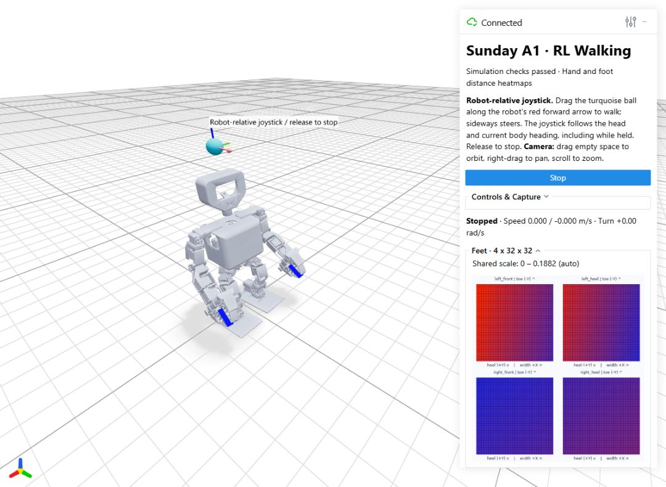
Sunday A1 walking in simulation
Trained an R25 PPO policy in mjlab and MuJoCo for 22 leg, arm and wrist joints.
The browser joystick commands walking speed and turning in the robot’s frame. Release to request a stop.
Week 4 release and demo videos
Notes:
The selected checkpoint is R25-300. The accepted flat-ground tests include forward and reverse, changes in speed, walking and in-place turns, stopping, and restarting.
The batch includes 12 command programs at 100 randomized starts each. The controls and screenshot are from body_follow_v3. Hardware walking validation is pending.
Acceptance report https://github.com/Auspr7ng/mars-weekly-progress/blob/main/Progress/Week4/docs/Acceptance_Report.md
Screenshot https://github.com/Auspr7ng/mars-weekly-progress/blob/main/Progress/Week4/results/web_demo/body_follow_v3.jpg
Repository https://github.com/Auspr7ng/mars-weekly-progress/tree/main/Progress/Week4

Slide 3
PPO rewards for walking and stopping
Objective | Reward and penalty signals
Speed and turning | Reward matching the commanded forward or reverse speed and yaw rate.
Balance | Reward upright posture. Penalize torso oscillation and collisions.
Step quality | Reward foot clearance and step timing. Penalize slip, swing contact and hard landings.
Stopping and smoothness | Reward quiet standing on both feet at zero command. Penalize abrupt changes in policy actions.
The policy sets joint position offsets from a reference pose.
Notes:
Selected final weights include linear velocity tracking +6, yaw tracking +2, upright +3, phase +4, clearance +3, quiet stop +4, planted foot slip −1.2, and peak impact −0.4. Terms use different scaling and gates.
The action rate penalty uses the change in policy actions. The termination checks include sustained excessive tilt, low body height and prohibited contacts.
Frozen reward configuration https://github.com/Auspr7ng/mars-weekly-progress/blob/main/Progress/Week4/policies/joystick_walking_r25_300/source/env_cfg.py#L82
Step quality https://github.com/Auspr7ng/mars-weekly-progress/blob/main/Progress/Week4/policies/joystick_walking_r25_300/source/quality_mdp.py
Stop reward https://github.com/Auspr7ng/mars-weekly-progress/blob/main/Progress/Week4/policies/joystick_walking_r25_300/source/control_mdp.py#L119

Slide 4
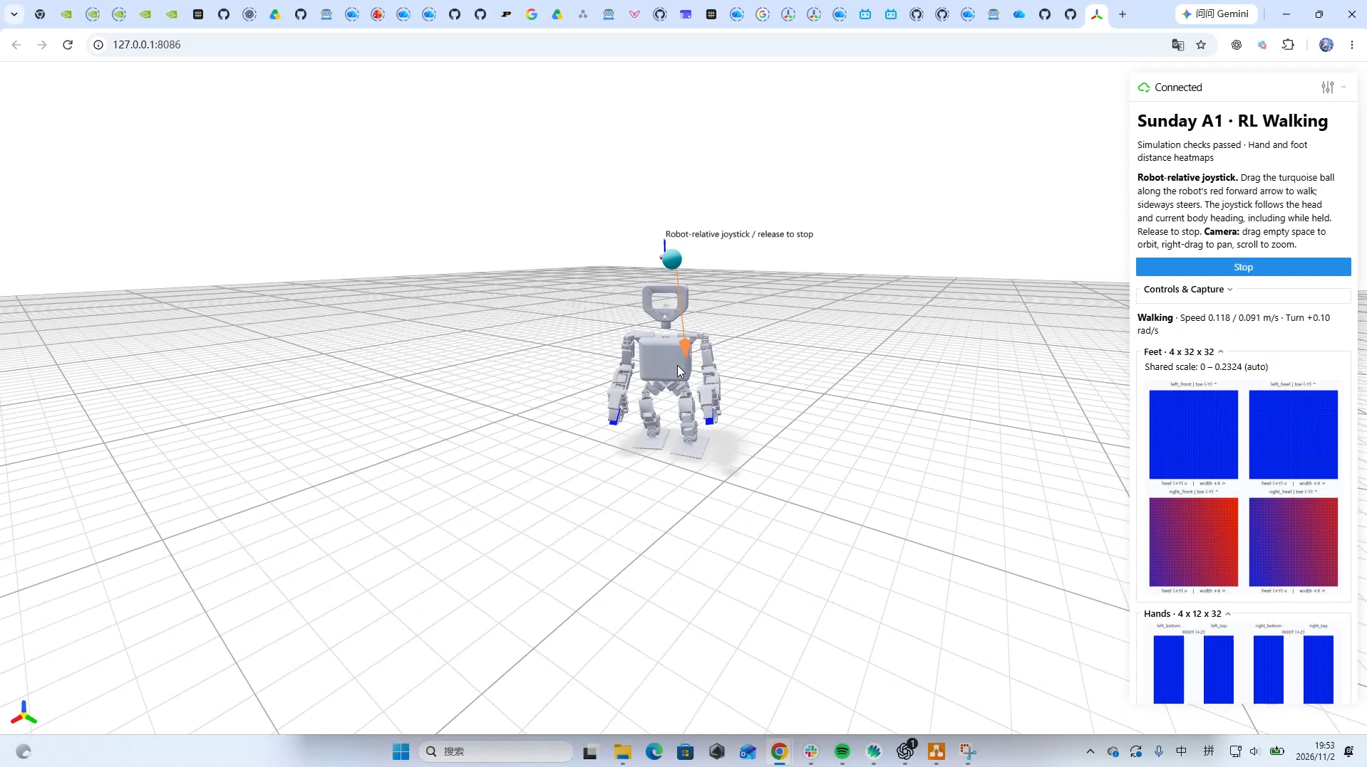

Slide 5
Foot contact in simulation and hardware
System | Signal | How it is used
MuJoCo training | Contact when mean foot force exceeds 3% of body weight | Training only. Rewards and critic observations.
Open Duck Mini | A digital contact switch on each foot | Contact bits enter its walking policy
Sunday A1 hardware | Tactile response across an array of sensing elements | Foot contact detector still needs validation
The viewer displays simulated distance heatmaps.
Notes:
R25 detects contact when the magnitude of the mean foot contact-force vector over 10 samples exceeds 0.03 mg. Rewards and the critic use the signal during training. The actor uses motion and joint observations, command, phase, previous actions, heading and simulated body velocity.
A digital switch yields one bit per foot. An array provides local readings. A well measured heel or toe patch can be evidence of first touch. Treat sustained load-bearing support as a separate condition.
Compare the total baseline-corrected response with the active area and suppress noisy elements. Test separate thresholds for touchdown and lift-off and a short confirmation window. Select thresholds and confirmation time from hardware trials. The current approach is a candidate.
R25 contact function https://github.com/Auspr7ng/mars-weekly-progress/blob/main/Progress/Week4/policies/joystick_walking_r25_300/source/mdp.py#L196
R25 observations https://github.com/Auspr7ng/mars-weekly-progress/blob/main/Progress/Week4/policies/joystick_walking_r25_300/source/env_cfg.py#L59
Open Duck runtime https://github.com/apirrone/Open_Duck_Mini_Runtime/blob/v2/scripts/v2_rl_walk_mujoco.py#L115
LOLA simulated tactile sole, Section 5.3.6 https://mediatum.ub.tum.de/doc/1614716/1614716.pdf
Pressure sum gait event detection https://pubmed.ncbi.nlm.nih.gov/36904942/
FlexiTac baseline and raw data processing https://github.com/FlexiTac/FlexiTac/blob/main/fast_32_16.py

Slide 6
Hardware preparation and next week
Sensor files from Jaeeun
Jaeeun uploaded the IMU Python script. The tactile sensor files are pending.
Ask Jaeeun for raw tactile frames, the sample rate and any existing contact thresholds.
First Xbox walking test
Next follow weeks I plan to use my Xbox controller for a first walking trial on the physical Sunday A1.
Start with supported standing, a few slow forward steps and a controlled stop.
Notes:
Jaeeun confirmed the IMU Python upload and said the tactile files would follow.
Use the initial hardware sessions to check the joint mapping, IMU frame and response timing. Test the contact detector on unloaded feet, toe and heel contact, and full stance. Confirm repeatability and detection delay before using it in feedback.
The first Xbox-controlled walking trial is a plan for next week. The current checkpoint was accepted in simulation.
Hardware review https://github.com/Auspr7ng/mars-weekly-progress/blob/main/Progress/Week4/docs/Model_and_Hardware.md

Slide 7
Week 4 repository guide
File or folder | Purpose
README.md | Setup, demo instructions and recording links
model_300.pt | Selected R25 PPO checkpoint
env_cfg.py and mdp.py | Frozen rewards, observations and contact logic
run_demo.py and native_web_player.py | Launch the demo and run the policy in MuJoCo
docs/Acceptance_Report.md | Simulation checks and results
results/ | Recordings and saved evaluation data
Week 4 on GitHub
Notes:
README https://github.com/Auspr7ng/mars-weekly-progress/blob/main/Progress/Week4/README.md
Selected checkpoint https://github.com/Auspr7ng/mars-weekly-progress/blob/main/Progress/Week4/policies/joystick_walking_r25_300/model_300.pt
Frozen configuration https://github.com/Auspr7ng/mars-weekly-progress/blob/main/Progress/Week4/policies/joystick_walking_r25_300/source/env_cfg.py
Frozen contact and reward code https://github.com/Auspr7ng/mars-weekly-progress/blob/main/Progress/Week4/policies/joystick_walking_r25_300/source/mdp.py
Demo launcher https://github.com/Auspr7ng/mars-weekly-progress/blob/main/Progress/Week4/code/run_demo.py
MuJoCo policy loop https://github.com/Auspr7ng/mars-weekly-progress/blob/main/Progress/Week4/code/src/sunday_locomotion/native_web_player.py
Acceptance report https://github.com/Auspr7ng/mars-weekly-progress/blob/main/Progress/Week4/docs/Acceptance_Report.md
Recordings and validation data https://github.com/Auspr7ng/mars-weekly-progress/tree/main/Progress/Week4/results

