Slide 1
Weekly Progress
October 15, 2026
Yuchao Shen

Slide 2
Assignment from last meeting
• Confirm that the custom robot model loads in Isaac Sim.
• Add one tactile sensor to the top finger of each hand.
This week: setup, model loading, and an intermediate tactile prototype.
Notes:
Jaeeun’s Oct 12 Slack request: confirm custom model loads; add one tactile sensor per hand on the top finger.

Slide 3
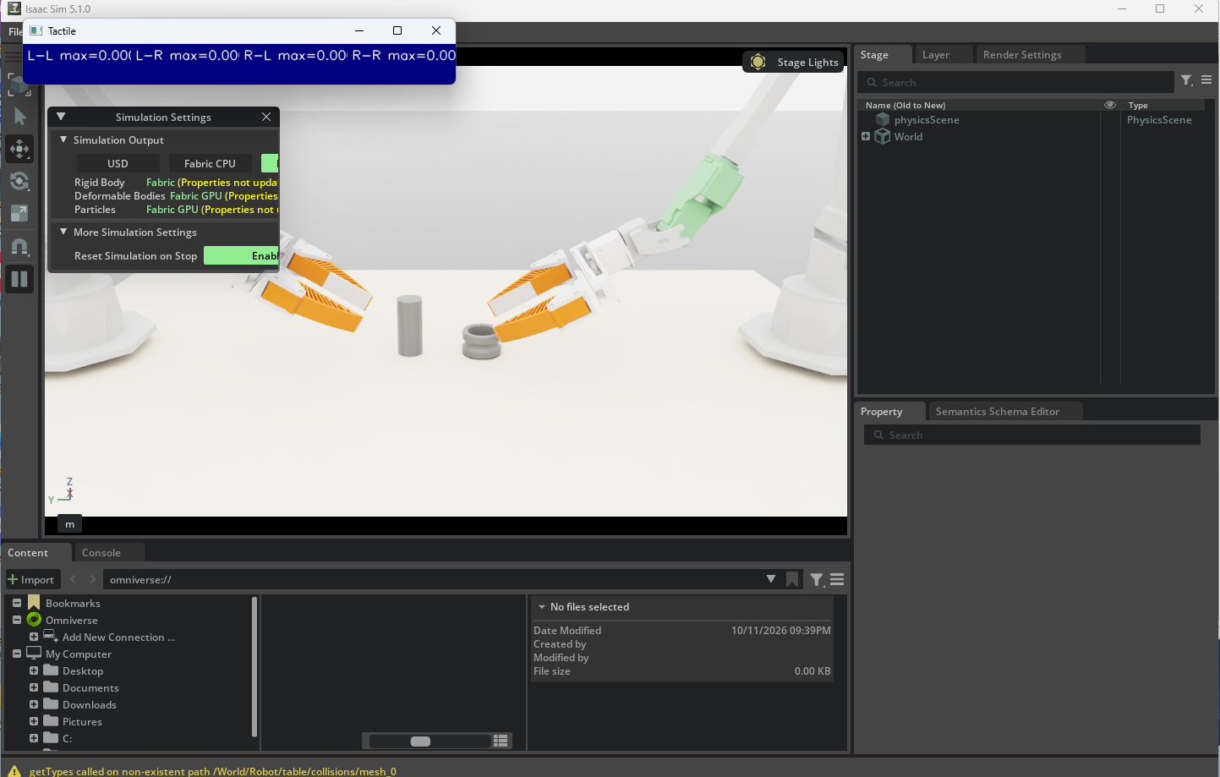
This week: Isaac Sim + FlexiTac baseline
• Isaac Sim 5.1 and FlexiTac running locally on Windows / RTX 4070.
• ALOHA simulation runs with four tactile sensors.
• Trajectory replay produced non-zero tactile heatmap readings.
Image: initial view before trajectory replay.
Notes:
This result was achieved during the same reporting week, before Jaeeun provided the custom model. Source: Oct 11 Slack update and sensor_sim.png.

Slide 4
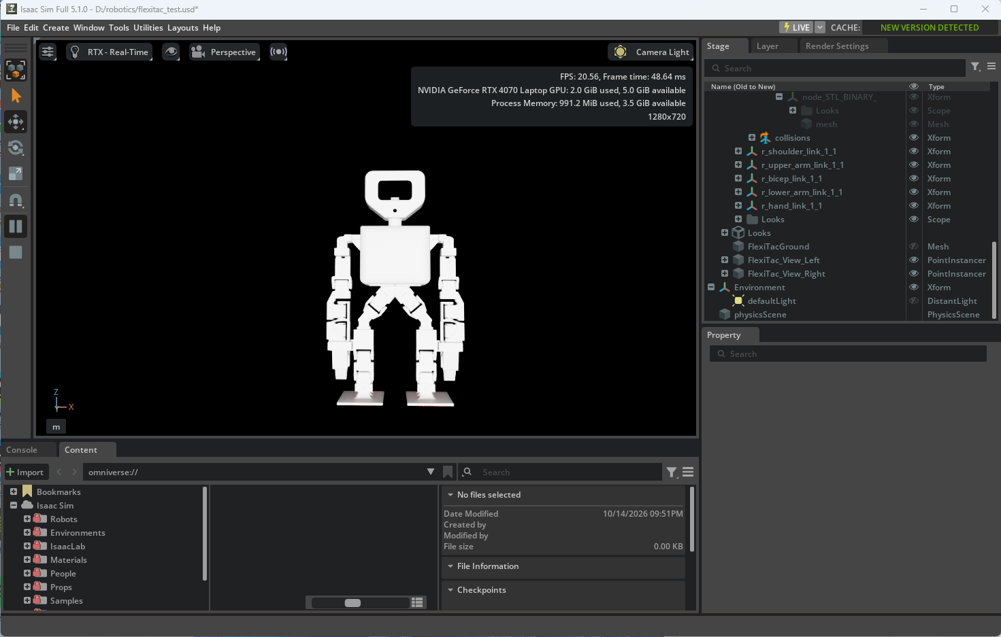
This week: custom robot model loaded
• Confirmed Jaeeun’s custom robot model loads and renders in Isaac Sim 5.1.
Notes:
The custom model was supplied by Jaeeun after the initial ALOHA / SDK progress update. Loading is confirmed; gripper tactile installation is not.

Slide 5
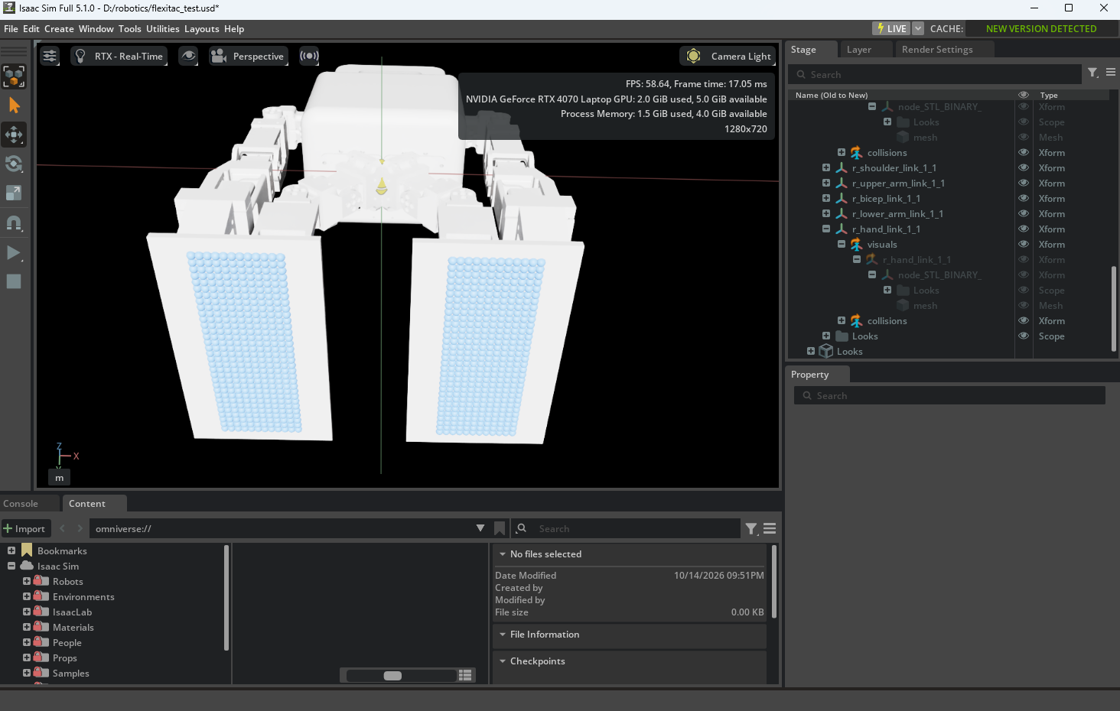
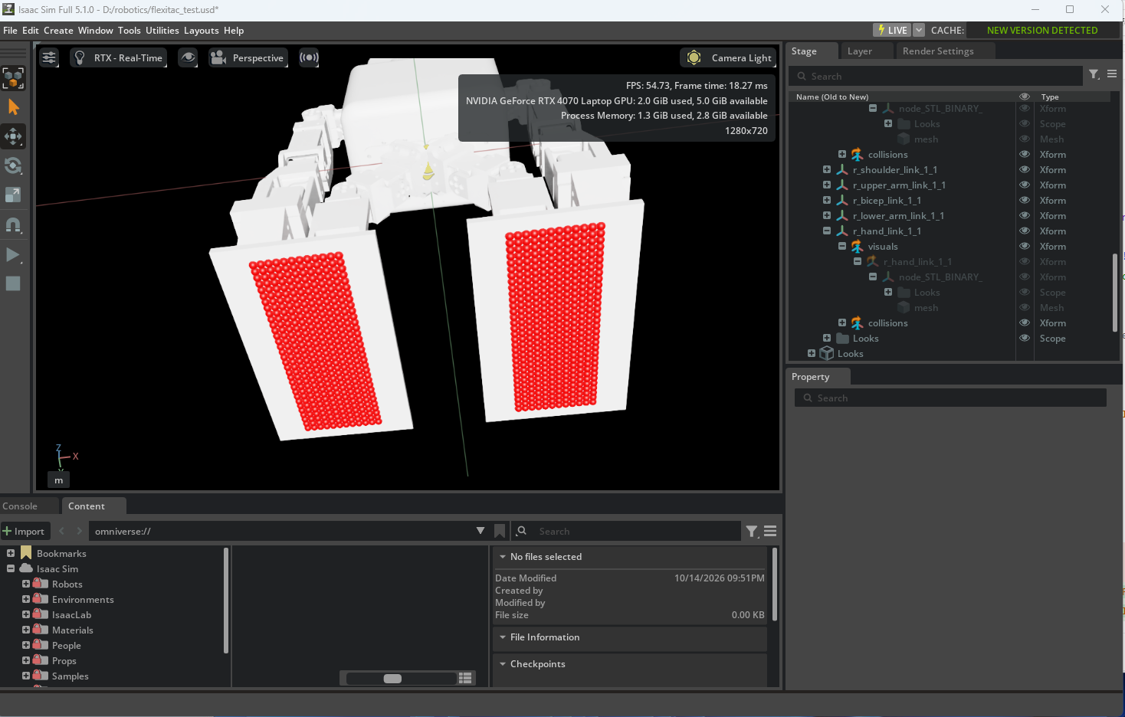
This week: two-foot tactile prototype
12 × 32 sample points per foot
Contact-state visualization
Intermediate validation only — not the requested tactile sensor placement on the grippers
Notes:
The foot grid was built to test the tactile pipeline while the hand mounting surface remains unresolved. Points update on each physics step.

Slide 6
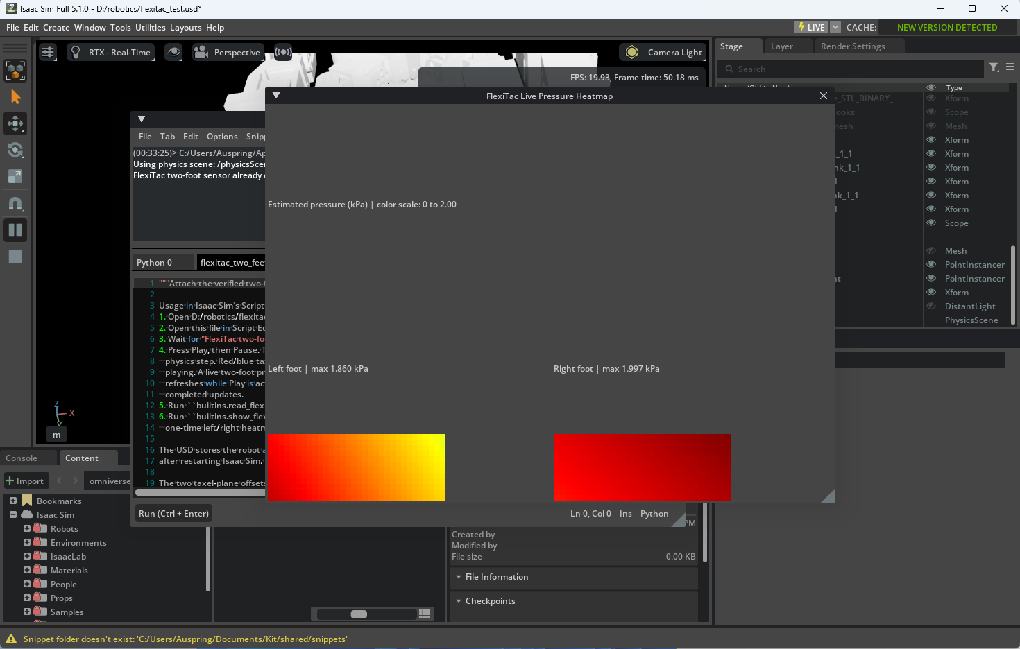
This week: live tactile heatmap
• Both sensors refresh during simulation physics steps.
• Estimated pressure is non-zero under contact.
• Static total force was calibrated against PhysX; spatial pressure is preliminary.
Notes:
One screenshot frame shows L 1.860 kPa and R 1.997 kPa maxima. Earlier static normal force comparison was about 14.4 N left and 17.9 N right. These are model estimates, not physical-sensor validation.

Slide 7
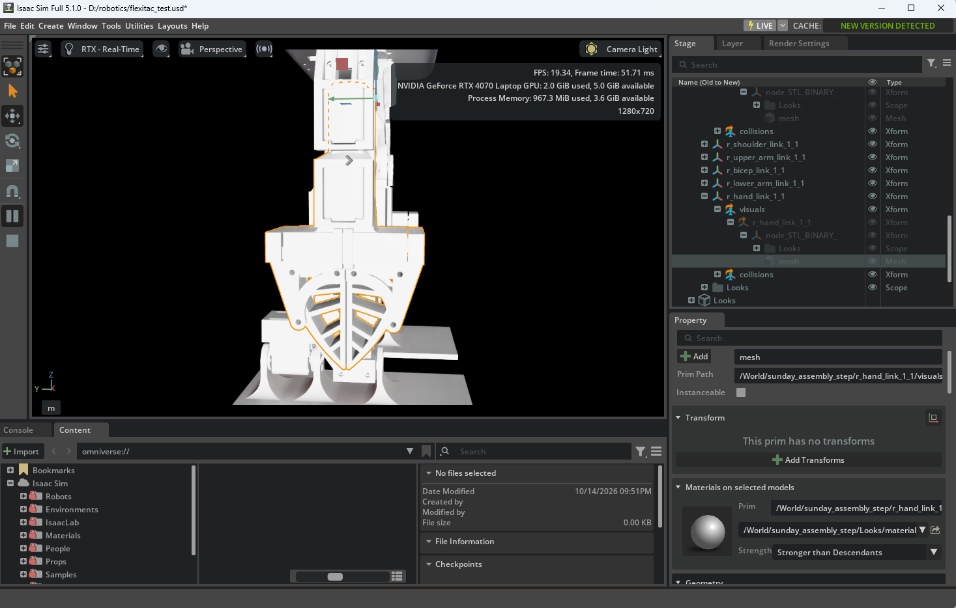
Open issue for discussion
• Each hand appears as one selectable mesh; the top finger is not a separate prim.
• Requested gripper sensors are not installed yet.
• Discuss how to identify and mount sensors on the upper-finger surfaces.
I will bring the setup Python file to the meeting.
Notes:
Do not present a committed next-week plan. Ask Jaeeun for mounting guidance or geometry/coordinates, and decide next steps in the meeting. The setup script is available separately.

