Slide 1
Weekly Progress
October 22, 2026
Yuchao Shen

Slide 2
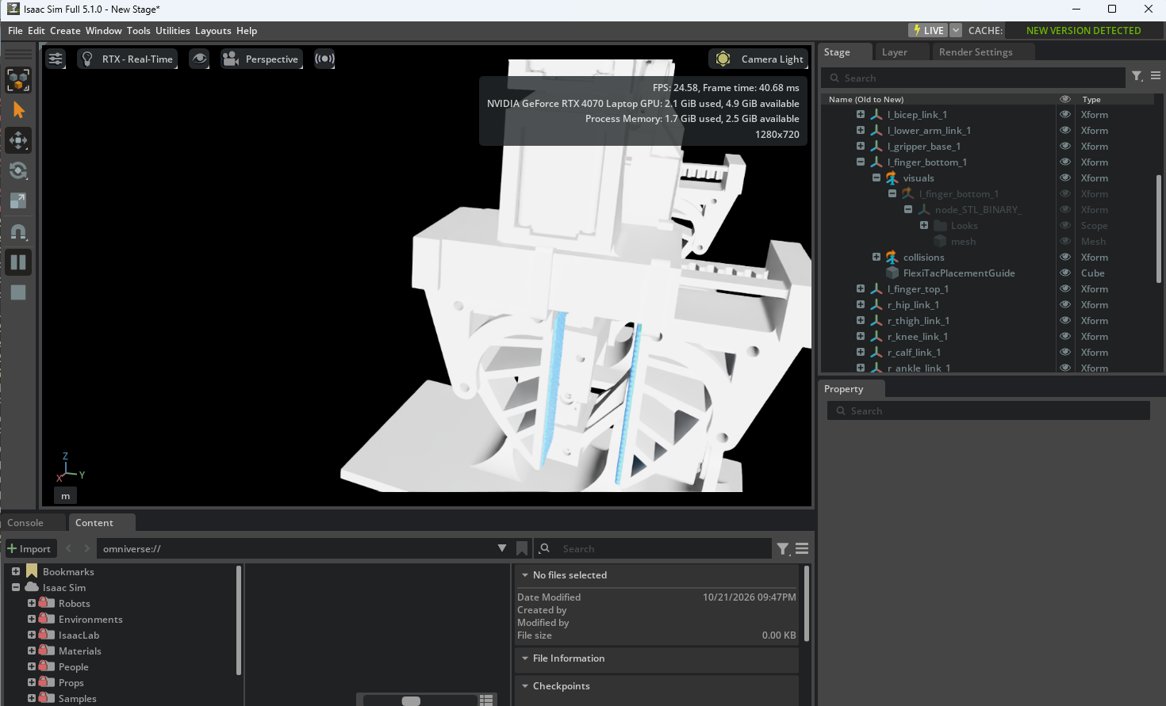
Four virtual finger sensors in Isaac Sim
Separate sensors attach to the upper and lower fingers on both grippers.
Each finger has a 12 × 32 taxel grid, giving 384 readings per sensor.
Blue placement guides show the sensor surfaces in the robot model.

Slide 3
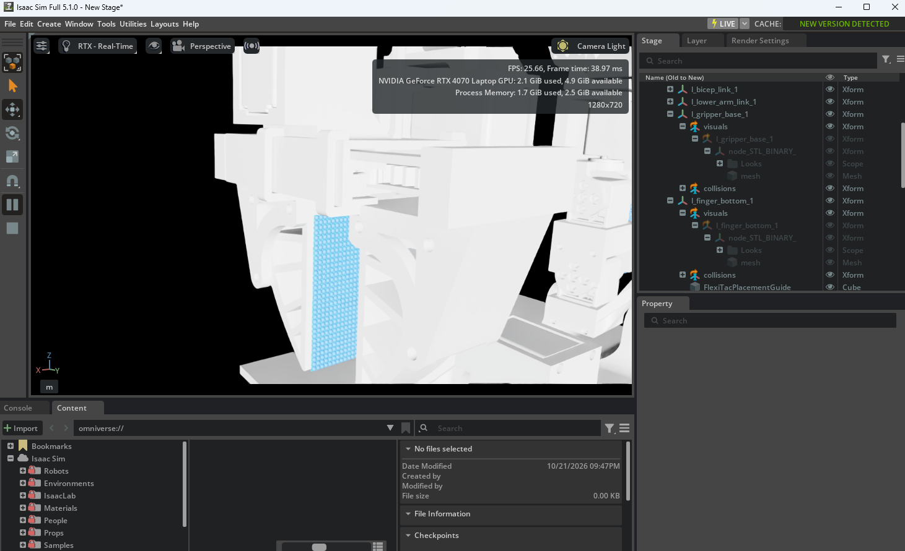
Taxel grid on a moving finger
The grid uses 2 mm taxel pitch and follows its finger link.
The first test queries the opposing finger mesh for each sensor.
The script updates existing sensors when rerun, without duplicating them.

Slide 4
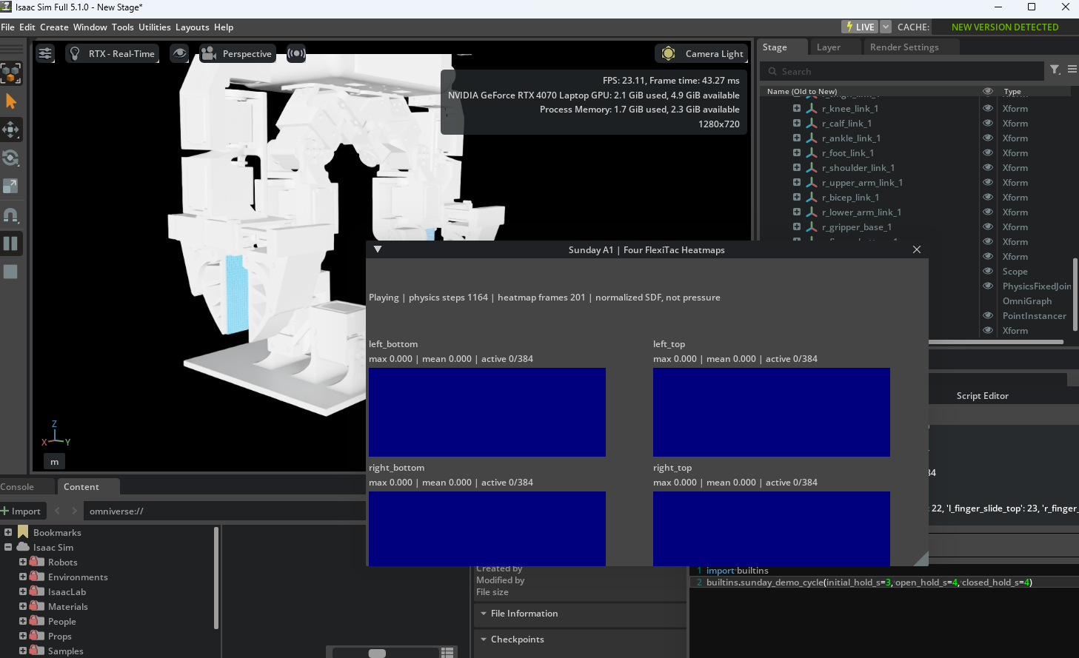
Four live heatmaps with the grippers open
Isaac Sim shows a live 2 × 2 heatmap and a numeric summary for each finger.
In this open frame, all four patches read 0 active taxels out of 384.
The demo holds the initial pose, opens the grippers, then closes them.

Slide 5
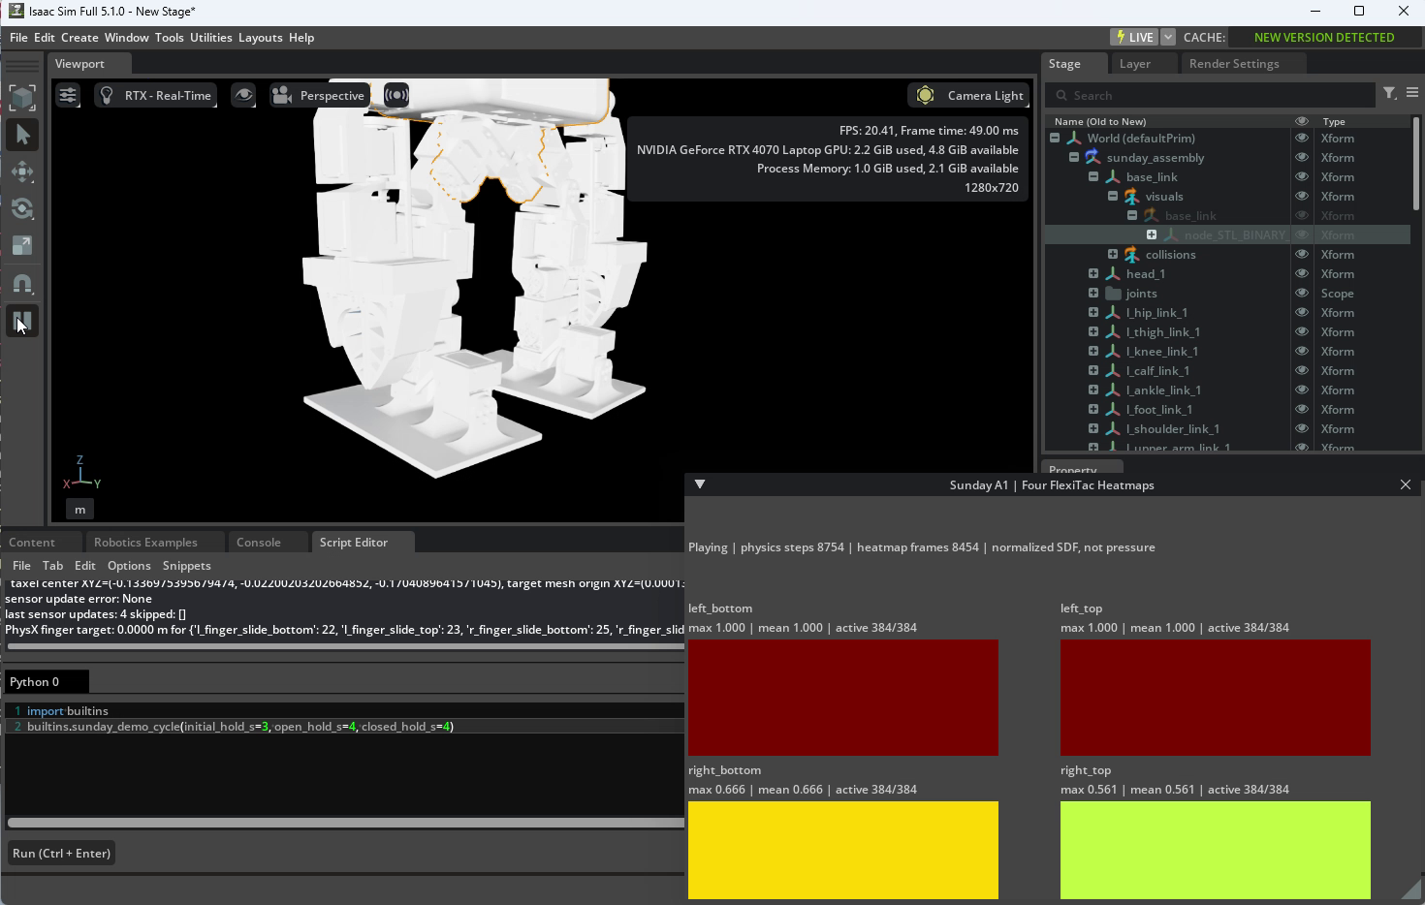
Heatmaps respond when the grippers close
All four panels respond in the closed frame; each shows 384 active taxels.
The displayed maxima are 1.000 and 1.000 on the left, 0.666 and 0.561 on the right.
These are normalized SDF proximity values, not calibrated pressure or force.

