Slide 1
Weekly Progress
November 12, 2026
Yuchao Shen
Notes:
Week 5 has three progress items: Xbox input for the simulated Sunday A1, a foot tactile research plan, and independent cart validation. Hardware walking, tactile-policy results and robot-cart pushing are not claimed.

Slide 2
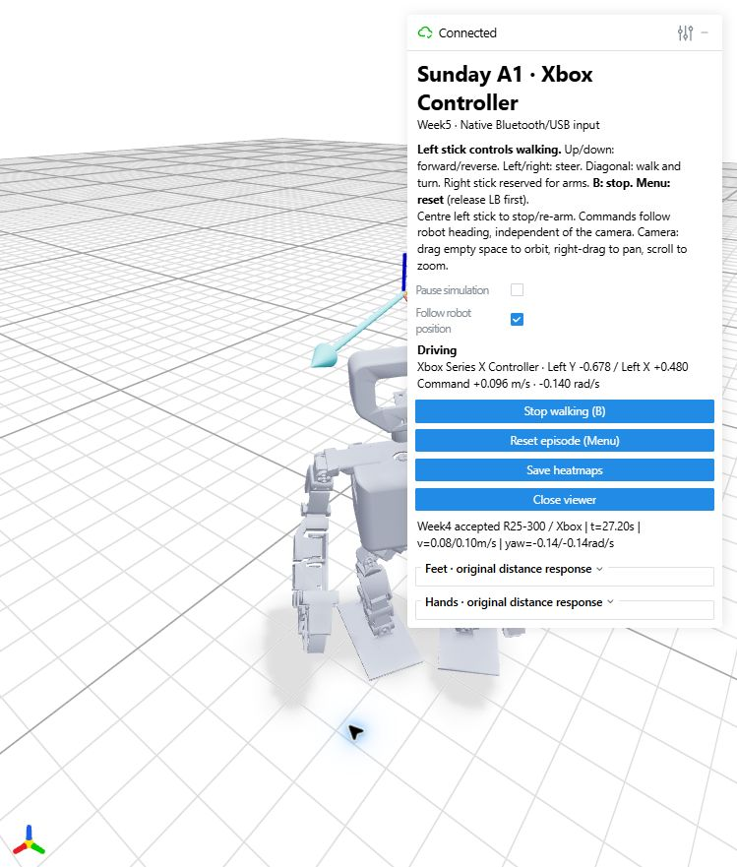
Xbox control of Sunday A1
A Bluetooth Xbox controller drives the local MuJoCo simulation through pygame/SDL.
The left stick uses Week4’s speed and steering mapper in the robot’s frame. Centre it to request a stop.
The right stick remains available for future arm and gripper controls.
Week 5 controller code and evidence
Notes:
Progress 1: actual controller input drives the simulated robot using the frozen Week4 R25-300 checkpoint. No new walking policy was trained.
Left stick Y controls forward/reverse, X controls yaw, and diagonals combine walking and turning. Hardware drift dead zone precedes the original circular joystick mapper.
The screenshot preserves an actual diagonal command from the user session. Measured velocity differs from requested command.
Source: https://github.com/Auspr7ng/mars-weekly-progress/blob/main/Progress/Week5/progress/media/xbox_left_stick.jpg
Code: https://github.com/Auspr7ng/mars-weekly-progress/blob/main/Progress/Week5/code/native_input.py and https://github.com/Auspr7ng/mars-weekly-progress/blob/main/Progress/Week5/code/week4_mapping.py
Policy: https://github.com/Auspr7ng/mars-weekly-progress/blob/main/Progress/Week4/config/accepted_policy.json

Slide 3
Controller checks and current scope
Check | Evidence | Scope
Input mapping | 17 passing command and mapping tests | Includes Week4 parity and diagonal commands
Actual interaction | Forward, reverse, both turns and 138 diagonal samples | Real Bluetooth input, simulated robot response
Walking policy | Frozen R25-300 with 22 active joints | Arm teleoperation remains pending
Further checks | B/Menu and physical unplug/reconnect | Unit coverage exists. Dedicated hardware tests remain
Command limits: forward 0.12 m/s, reverse 0.06 m/s, yaw ±0.25 rad/s.
Current evidence supports simulation control. Physical-robot walking remains untested.
Notes:
The 138 diagonal samples come from the bounded final single-stick snapshot. Counts are sampled trace rows, not independent trials.
No termination occurred in that snapshot. Requested command limits do not cap instantaneous measured velocity.
B and Menu were not observed in the bounded physical-input snapshot. Software tests cover stop/reset gating. A real unplug/reconnect test was not completed.
Source: https://github.com/Auspr7ng/mars-weekly-progress/blob/main/Progress/Week5/results/run_verification.json
Tests: https://github.com/Auspr7ng/mars-weekly-progress/blob/main/Progress/Week5/results/input_contract_tests.json

Slide 4
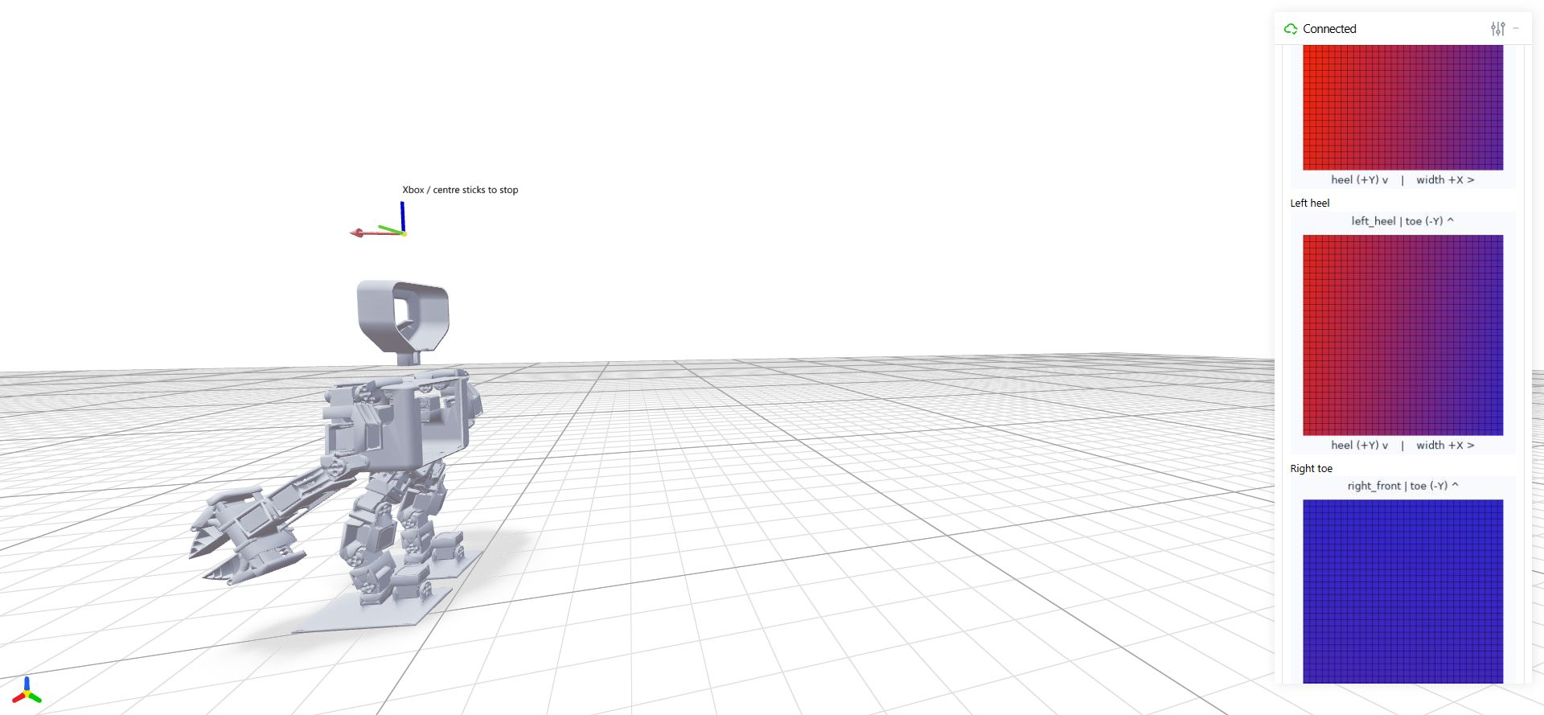
Foot tactile sensing: source review
The viewer’s sole maps encode geometric distance response.
The actor receives no tactile input. Rewards and the critic use separate contact-force signals.
Hardware code reads 32 × 32 ADC frames and applies baseline and threshold filters.
Source review completed. A foot-contact method still needs hardware data and validation.
Notes:
Progress 2 is research planning. The questions originated with this project, not an external lab response. No new contact detector, pressure calibration or tactile-policy result is claimed.
The simulation sole response is clip(max(-d,0)/0.002,0,1). Four 32x32 patches use 2.5 mm pitch and an 80 mm nominal side. These are simulation dimensions, not verified hardware dimensions.
Reviewed lab sources: Code_yuvraj/32_16_fast.ino and fast3.py. Both configure 32x32 data. fast3.py takes a 30-frame baseline, thresholds ADC responses and filters the display. The variable name pressure does not prove calibration.
An idle viewer capture illustrates geometric maps and automatic colour scaling. It is not a hardware contact experiment.
Research: https://github.com/Auspr7ng/mars-weekly-progress/blob/main/Progress/Week5/research/Foot_Tactile_Research_Plan.md
Observation source: https://github.com/Auspr7ng/mars-weekly-progress/blob/main/Progress/Week4/code/src/sunday_locomotion/env_cfg.py
Sole mapping: https://github.com/Auspr7ng/mars-weekly-progress/blob/main/Progress/Week4/code/src/week3_tactile/feet_tactile.py

Slide 5
Foot tactile method and experiment plan
Working hypothesis: a matched foot-contact signal may transfer more reliably than the current distance heatmap.
Stage | Proposed work | Required evidence
Hardware data | Define touch versus loaded support. Capture raw frames and reference labels. | Noise, drift, timing and region mapping
Detector comparison | Compare active area and aggregate response with temporal hysteresis. | Held-out errors and contact delay
Simulation signal | Model the measured threshold, sampling, noise and latency. | Shared feature meaning and validity
Policy study | Compare the existing actor with contact input, then regional features if justified. | Independent walking and stop evaluations
Priority: interface table, labelled bench data and an offline detector comparison.
Method selection and policy changes depend on those measurements.
Notes:
D1 measures effective active area or connected regions after baseline/noise correction. D2 aggregates valid positive responses. Entry/exit thresholds and persistence need data, not borrowed constants.
A reviewed TacVLA manipulation example uses at least three taxels above 0.1 in a 15x8 array. This is a structural reference only. Its thresholds cannot be assumed valid for the feet.
Distinguish geometric touch from load-bearing support before labelling data. Keep invalid/stale data distinct from an airborne foot.
A new actor input changes dimension, history, normalization and weights and needs training/fine-tuning. Privileged critic observations may remain separate.
Source: https://github.com/Auspr7ng/mars-weekly-progress/blob/main/Progress/Week5/research/Foot_Tactile_Research_Plan.md
MuJoCo touch: https://mujoco.readthedocs.io/en/stable/XMLreference.html#sensor-touch

Slide 6
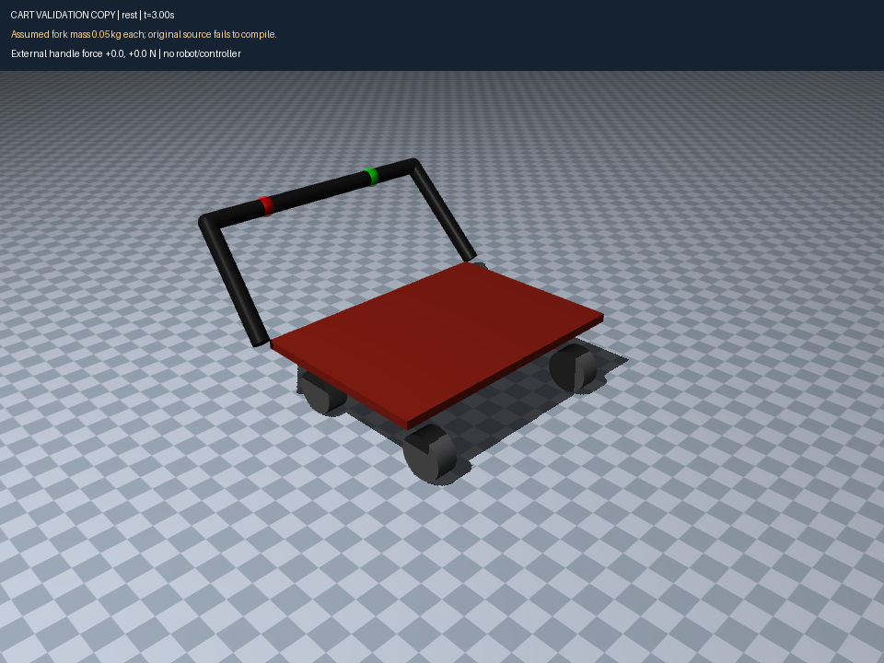
Cart model: load failure and diagnostic copy
Original cart_v2.xml fails to compile: four moving caster bodies lack their own mass and inertia.
The test copy adds 0.05 kg per fork and explicit inertias. Hardware values remain unconfirmed.
13 isolated cases stayed finite with zero warnings and no tipping.
Original model and independent validation report
Notes:
Progress 3 is independent cart validation only. The original is preserved unchanged. MuJoCo 3.8.1 reports moving body mass/inertia below mjMINVAL, first at caster_fl, source line 61. All four swivel bodies share this issue.
Test assumptions per fork: mass .05kg, diagonal inertia (2e-5,2e-5,5e-6)kg*m^2, inertial position (.0075,0,-.0254)m. Added floor, lighting and rendering assets. Original friction and damping remain unchanged.
There are 11 base cases plus two fork-mass sensitivity cases at .01 and .10 kg per fork. Maximum base-case tilt was about .106 degrees. This does not establish real cart dynamics.
Source: https://github.com/Auspr7ng/mars-weekly-progress/blob/main/Progress/Week5/cart_validation/source/cart_v2.xml
Evidence: https://github.com/Auspr7ng/mars-weekly-progress/blob/main/Progress/Week5/cart_validation/results/validation_summary.json

Slide 7
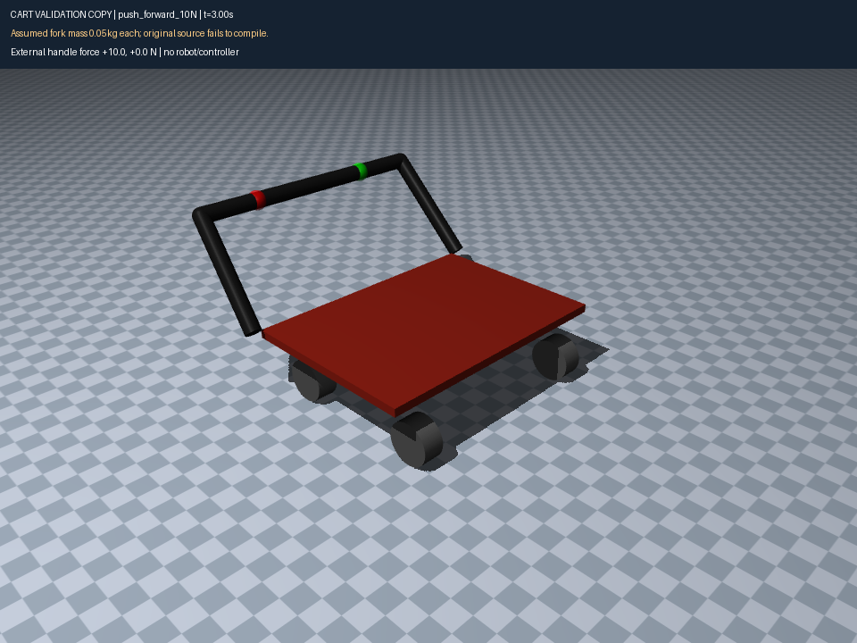
Cart motion validation
36-second recording: rest, straight push, side push and transverse casters.
10 N handle push | Mean forward speed
Wheels aligned | 0.0243 m/s
Casters initially 90° | 0.0031 m/s
Strong resistance and slow caster reorientation need comparison with hardware.
Click the video during the slide show to play.
Notes:
The original H.264 MP4 is embedded without transcoding. Duration 36s, 960x720, 25fps. The video uses the diagnostic fork inertials, not the source model.
Push occurs at the handle midpoint from t=2 to 4s. Mean speed uses t=3 to 4s. Aligned 10N = .024313135m/s. Initial 90-degree caster case = .003086369m/s, ending caster headings about 93.6-94.6 degrees.
Original roll damping=.05Nm*s/rad and frictionloss=.02Nm. Swivel damping/frictionloss=.8/.2. These need intended hardware resistance data before tuning.
Robot-cart pushing remains next week. No robot or learned cart controller appears in this test.
Video: https://github.com/Auspr7ng/mars-weekly-progress/blob/main/Progress/Week5/cart_validation/results/cart_validation.mp4
Report: https://github.com/Auspr7ng/mars-weekly-progress/blob/main/Progress/Week5/cart_validation/Validation_Report.md

Slide 8
Next week and remaining work
Robot-cart pushing
Confirm caster inertials and bearing resistance before integrating the cart with Sunday A1.
Robot pushing remains next week’s task.
Foot tactile measurements
Collect labelled unloaded, light-touch and support data.
Use those measurements to choose and evaluate a contact detector.
Upper-body controls
Keep walking on the left stick. Define a separate arm and gripper interface for the right stick.
Arm teleoperation and physical-robot walking remain pending.
Week 5 code, research plan and validation evidence
Notes:
Future work only. No robot-cart integration, tactile-policy experiment, arm teleoperation or physical walking acceptance is claimed this week. Publication: https://github.com/Auspr7ng/mars-weekly-progress/tree/main/Progress/Week5

