Slide 1

listStudent
Listed all students
1. Alex Yeoh
2. Bernice Yu
3. Charlotte Oliveriro
Details:
Name:
Phone:
Address:
Email:
Role:
Status:
Subject:
Level:
Budget:
English
Secondary
40
NotMatched
Alex Yeoh
91234567
Blk 39 GeylangStreet 29, #06-40
alexyeoh@example.com
Tutor
NotMatched
English
Secondary
$40/hr
Math
Primary
30
NotMatched
Science
Primary
35
NotMatched

Slide 2
match 1
Matching Alex Yeoh
1. Alex Yeoh
91234567
Blk 39 GeylangStreet 29, #06-40
alexyeoh@example.com
Tutor
NotMatched
English
Secondary
$40/hr
1. David Low
2. Eunice Sim
3. Frank Chan
Details:
Name:
Phone:
Address:
Email:
Role:
Status:
Subject:
Level:
Budget:
English
Secondary
40
NotMatched
David Low
92221234
Blk 5 Clementi Ave 2,
#02-08
davidlow@example.com
Student
NotMatched
English
Secondary
$40/hr
English
Secondary
30
NotMatched
Science
Secondary
25
NotMatched

Slide 3
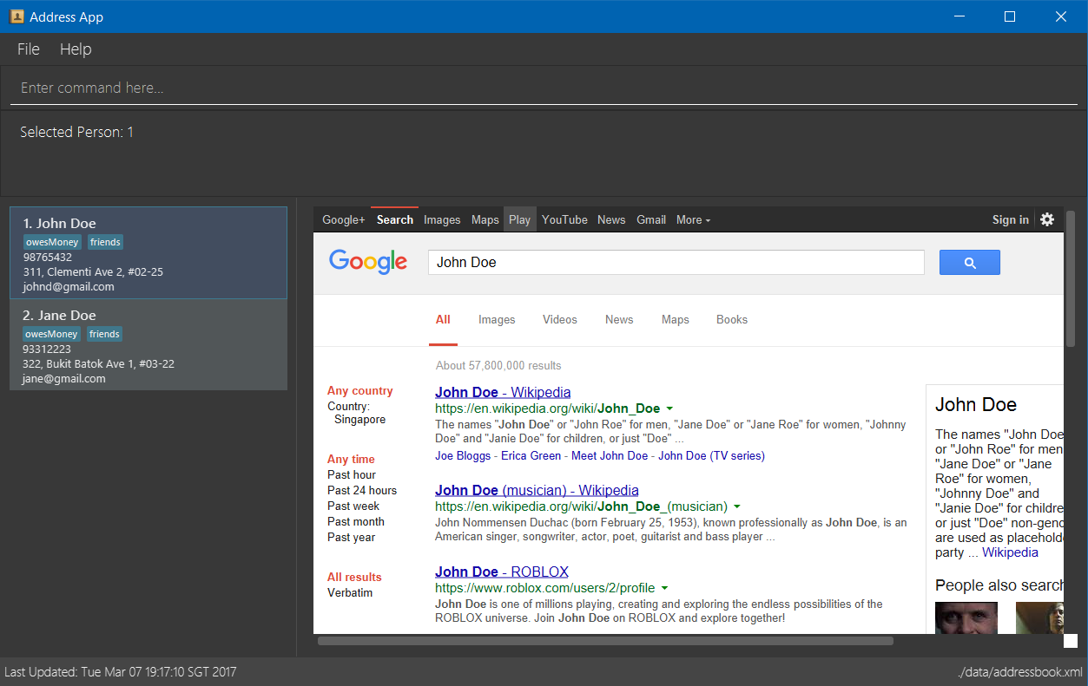
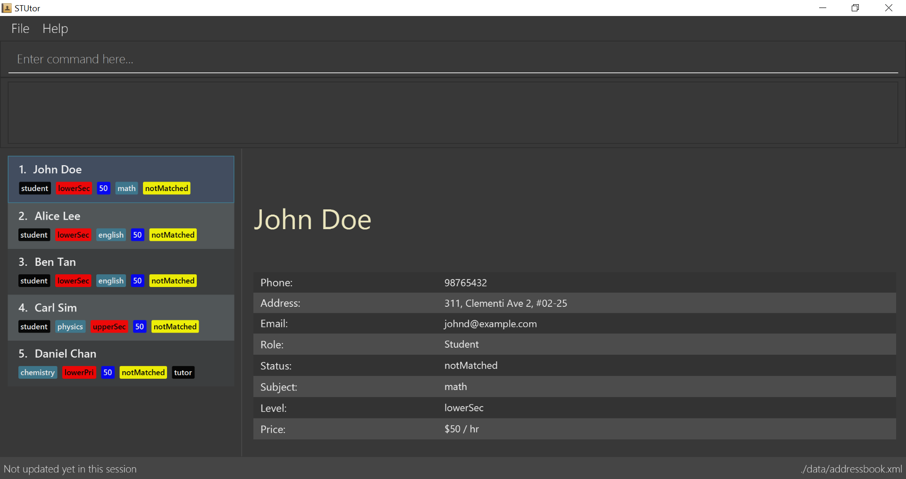
Original Version
Modified Version

Slide 4
Original Version
Improved Version

